Slide 1

The Intergovernmental Coordination Group for the Tsunami and Other Coastal Hazards Warning System for the Caribbean and Adjacent Regions (ICG/CARIBE-EWS)
XIX Session
April 22-24 2026
4.3 WG3: Tsunami Warning Dissemination and Communication Progress Report and Recommendations
Christa von Hillebrandt, Chair Trevor Queeley, Vice Chair

Slide 2
Terms of Reference
Purpose: To examine current and developing capacities and advise the ICG about the definition and composition of early warnings and tsunami products and the methods and best practices for effective end-to-end dissemination and communication.
Tasks:
Explore and document the dissemination capabilities and existing alert guidance in the countries of the region.
Identify the difficulties and challenges
Create communication protocol and standardized information identifying the minimum acceptable levels for communication and dissemination of tsunami early warning in all countries for approval by the ICG.
Provide feedback to the Tsunami Service Providers on its products and communication procedures.
Serve as a reviewing and approving body for proposed changes to TSP products for the CARIBE-EWS, or determine if proposed changes warrant going to the ICG for review and approval.
Present a progress report based on the Key Performance Indicators related to the UN ODTP.
Promote the sharing of experience and expertise, and capacity building essential to effective tsunami warning dissemination and communication.
existing in the region that hinder the impact of
“end to end” dissemination and communication of early warnings.
Establish strategies for the development and implementation of methods and technologies to strengthen the interaction with the media and dissemination of early warnings within the countries of the region.
Evaluate communication tests and tsunami exercises, in order to identify weaknesses and make recommendations to help strengthen these delivery systems
#TSUNAMIREADY

Slide 3
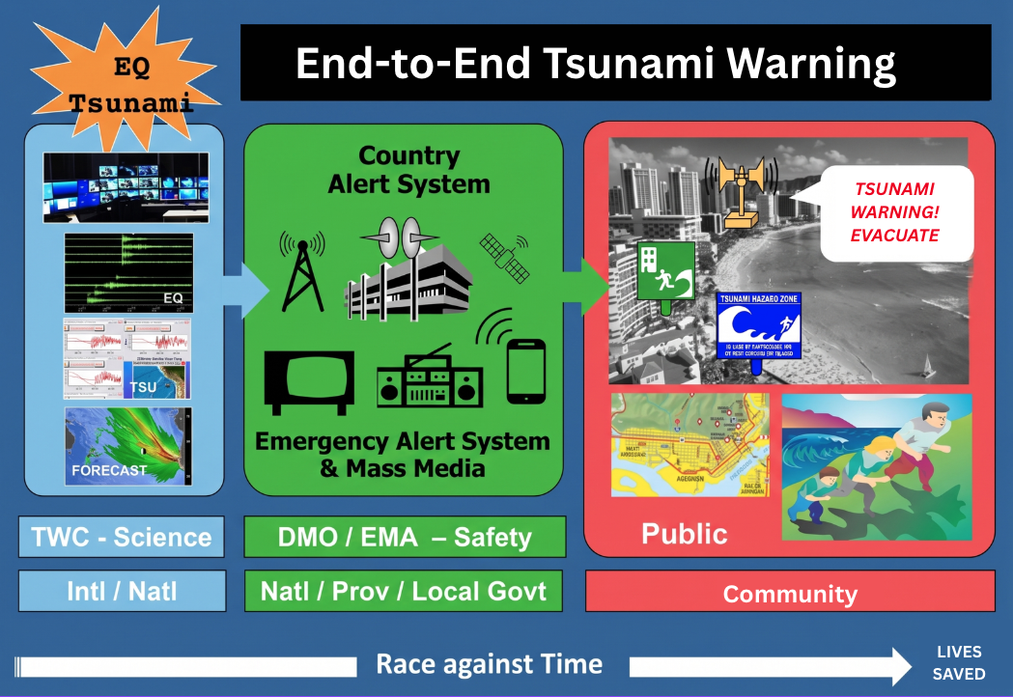
The Focus Area of WG 3

Slide 4
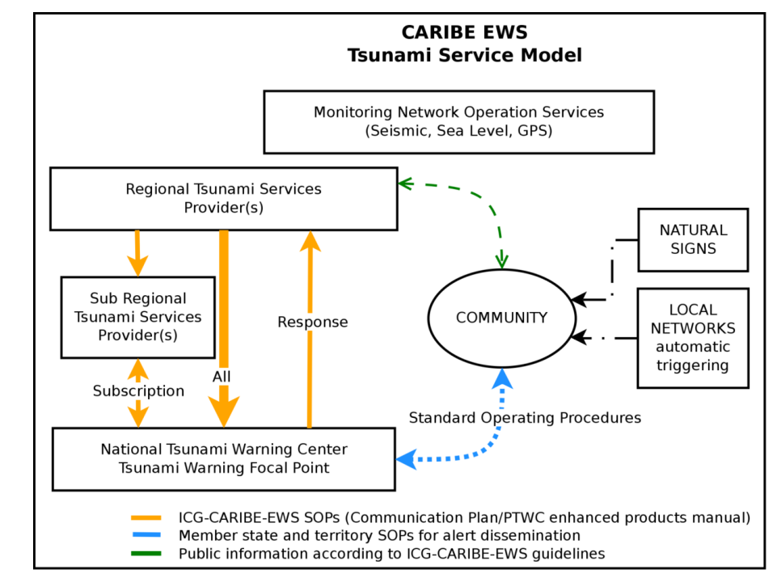
The Focus Area of WG 3
ICG CARIBE-EWS Tsunami Service Model (ICG-X 2015)

Slide 5
Membership
22 members, 18 regular (including TSP’s PTWC and CATAC), 2 Ex Officio (ICG Chair and ICG Executive Secretary)
CARIBE-EWS Member States in WG 3
  Barbados, Colombia, Costa Rica, France, Guatemala, Nicaragua (CATAC), Saint Lucia, UK (Anguilla), USA (PR, USVI, PTWC),
CARIBE-EWS Observers in WG 3
  PRSN

Slide 6
Activities
Status on Implementation of Recommendations from ICG CARIBE EWS XVIII:
Review existing national and local SOPs and provide a report for ICG XIX. IN PROGRESS (CARIBE WAVE 26 survey: 97% national, 70% local SOPs; ITIC-CAR supporting local response plans)
Develop strategic plan to mobilize funding for TW Dissemination, focus on LDCs/SIDS. DELAYED (passing of Dr. Necmioglu and lack of resources)
Coordination with UNDRR, ITU and WMO on CAP. IN PROGRESS (co-coordination in WTAD webinar Nov 5; CAP webinar planned for June 8; ITU joining ICG XIX)

Slide 7
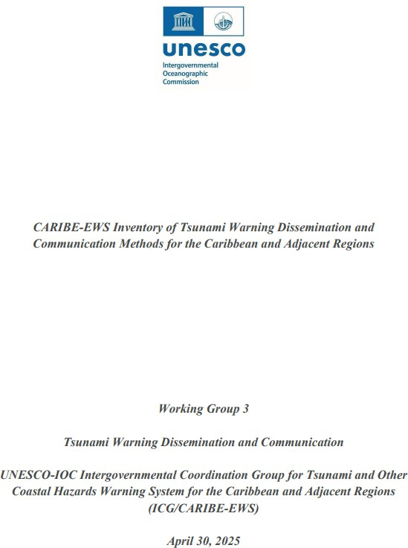
Activities
Post and share CARIBE-EWS Inventory report. Posted as ICG XVIII documents; IN PROGRESS: UWI DRRC publication in peer-reviewed journal; social media / LinkedIn.

Slide 8

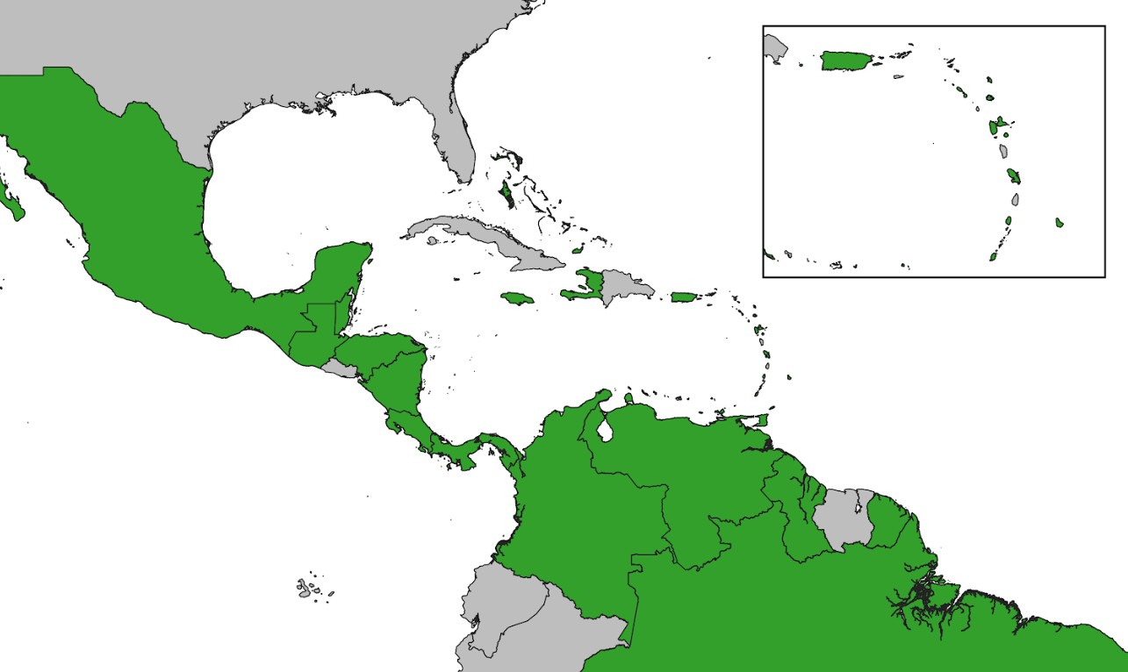
Inventory of Tsunami Warning Dissemination and Communication Methods for the Caribbean and Adjacent Regions
33 responses from 48 Member States
and Territories (69%)

Slide 9
Activities
Status on Implementation of Recommendations from ICG CARIBE EWS XVIII:
Develop training strategy for TW dissemination and communication. IN PROGRESS (CAP training strategy developed, to be implemented in 2026)
PTWC/CATAC coordinate and conduct communication tests. DELAYED (to be pursued next intersessional period)
CATAC to submit updated User's Guide by end of 2025. RECEIVED (April 10, 2026) ; meeting held April 15; provided initial feedback, more comprehensive review recommended)

Slide 10
Activities
Other Activities 2025-2026
The working group had three virtual meetings and two regional virtual events during the 2025-2026 intersessional period.
Supported the planning, conduct and evaluation of CARIBE WAVE 2026 (March 19)
Conducted GNC-A webinar in preparation for CARIBE WAVE 26 (March 12, 2026)
Shared revised PTWC User’s Guide (May 2025) for CARIBE-EWS with members
ITIC-CAR developing program to ingest PTWC messages and produce national products

Slide 11
Recommendations for ICG/CARIBE EWS XIX
Recognizes the actions of the Working Group 3 towards the advancement of tsunami warning dissemination and communication.
Welcomes the participation of Member State nominees, WMO and UNDRR in the Working Group 3.
Encourages active participation of all its members.
Requests Member States to communicate to the Secretariat changes in designations.

Slide 12
Cont. (Inventory)
Noting the advances in the implementation plan for the Ocean Decade Tsunami Programme and its recommended actions for advancing Tsunami Warning, Dissemination and Communication,
Additionally noting the findings and recommendations of the UN Early Warnings for All Initiative (EW4ALL),
Acknowledging the status of publication and dissemination efforts for the CARIBE-EWS Inventory and Member State Needs report.
Recommends the Working Group 3 to continue working on the publication and dissemination of the results of the CARIBE-EWS Inventory and MS Needs of Tsunami Warning Dissemination and Communication Methods for the Caribbean and Adjacent Regions report and findings and revise as needed.

Slide 13
Cont. (CAP Coordination)
Acknowledging the WG3 efforts on communication methods and training needs,
Noting the coordination with UNDRR, ITU (EW4ALL pillar lead), WMO and Alert Hub on CAP,
Additionally Noting the ITU plans for enhancing warning dissemination, including Cell Broadcast and SMART Seas Project,
Further Noting that a CAP training strategy has been developed for implementation in 2026,
Recommends the Working Group 3 to continue coordination with UNDRR, ITU, WMO, Alert Hub and other relevant organizations on strategic planning and training on CAP and other methods for enhanced tsunami warning dissemination and communication.

Slide 14
Cont. (SOP)
Noting the WG3 task to create a communication protocol and standardized information identifying minimum acceptable levels for communication and dissemination of tsunami early warning in all countries,
Acknowledging the results from the CARIBE WAVE 26 evaluation survey: 97% national-level (30 of 31) and 70% local-level (21 of 30) respondents reported SOPs in place,
Noting that the gap between national and local SOPs highlights an area where continued capacity building is needed, particularly through the UNESCO/IOC Tsunami Ready Programme,
Recommends the Working Group 3 to continue the review of existing national and local SOPs and provide a report for the ICG XX.

Slide 15
Cont. (Comm Tests, PTWC, CATAC/EEW)
Recalls that PTWC and CATAC were to coordinate and conduct communication tests following notification to Member States, and report results to WG3 and ICG,
Further recalls the WG3 task to evaluate communication tests and tsunami exercises, to identify weaknesses and make recommendations to strengthen delivery systems,
Notes that the Revised User’s Guide for the PTWC Procedures and Products for CARIBE-EWS was published in May 2025 and that the new products will be implemented by PTWC in August 2026.
Notes further advances by CATAC, including in Earthquake Early Warning, and potential applications for Tsunami warning and communication,
Recommends CATAC to continue to share, explore and integrate EQEW applications into its tsunami services and products for its TWFP and NTWCs, and report to ICG XX.

Slide 16
Cont. (CATAC Users Guide)
Notes the User’s Guide for the Central American Tsunami Advisory Center (CATAC), English, version 2026,
Recalls that CATAC is serving as an interim sub-regional Tsunami Service Provider for Central America for both the PTWS and CARIBE-EWS.
Recommends that the Secretariat coordinate between CATAC and the CARIBE-EWS and PTWS Steering Committees for the publication of the Users Guide by IOC.

Slide 17
Cont. (AI)
Notes that AI is having a greater relevance in the warning enterprise for tsunami warning dissemination and communication and its potential impact on the protection of life and property,
Further Notes the need for more coherence across the emergency management community and warning enterprise on the role of AI, given the nature of tsunami warnings.
Recommends WG3 to explore with stakeholders the role of AI on tsunami warning dissemination and communication.
Appreciates the support that the International Tsunami Information Centre Caribbean Office has provided to Working Group 3 with as the contributions of other stakeholders;

Slide 18
Thank You!
#TSUNAMIREADY

Slide 19
Cont. (Training)
Acknowledging the WG 3 report on the survey conducted among Member States on communication methods used and training required,
Noting that some of the training priorities can best be done locally (telecoms) and others regionally (online or in person),
Further Noting TOWS recommendation and the results of the CARIBE EWS survey for the need of Common Alerting Protocol (CAP) training and the efforts underway through EW4ALL,
Requests UNESCO/IOC Tsunami Resilience Sector to enhance coordination, including training, with UNDRR, International Telecommunications Union and WMO on CAP.
Recommends WG3 to develop a training strategy for tsunami warning dissemination and communication taking into consideration international, regional and national resources and activities.

Slide 20
Cont (PTWC Users Guide, EEW)
Noting the updates to the PTWC Users Guide for the CARIBE EWS, and the integration of the 2006 PTWC Communications Plan for the CARBE EWS,
Recommends the adoption of the 2025 PTWC Users Guide for the CARIBE EWS,
Further recommends the implementation of the new products by PTWC following notification to Member States with three months in advance.
Noting further advances by CATAC in Earthquake Early Warning, and potential applications for Tsunami warning and communication,
Recommends CATAC to continue to share, explore and integrate EQEW applications into its tsunami services and products for its TWFP and NTWCs.

Slide 21
Cont. (GSDD, Supplement)
Acknowledging that the Global Service Definition Document updated and approved by TOWS in 2025 is based on agreed concepts and guidelines and describes global tsunami warning services that are provided by regional tsunami warning systems operating in different ocean basins as a global system of systems and coordinated by the Intergovernmental Oceanographic Commission,
Noting that there are some items of the CARIBE EWS Tsunami Service Provider that are not included or are inconsistent with the Global Service Definition Document,
Further noting the duplications between the TOWS Global Service Definition Document and the CARIBE EWS Technical, Logistical and Administrative Requirements of a Regional Tsunami Service Provider for CARIBE-EWS.
Recommends the ICG CARIBE EWS Steering Group to prepare a CARIBE EWS supplement to the GSDD.
Further recommends that both the GSDD and the CARIBE EWS supplement guide the operations of the CARIBE EWS Tsunami Service Providers.

Slide 22
Cont. (SOPs)
Noting the task of the WG 3 to create a communication protocol and standardized information identifying the minimum acceptable levels for communication and dissemination of tsunami early warning in all countries for approval by the ICG,
Requests the Working Group 3 to review existing national and local SOPs and provide a report for the ICG XIX.
Appreciates the support that the International Tsunami Information Centre Caribbean Office has provided to Working Group 3 with as the contributions of other stakeholders;

Slide 23
Cont. (SOPs)
Noting the task of the WG 3 to create a communication protocol and standardized information identifying the minimum acceptable levels for communication and dissemination of tsunami early warning in all countries for approval by the ICG,
Requests the Working Group 3 to review existing national and local SOPs and provide a report for the ICG XIX.
Appreciates the support that the International Tsunami Information Centre Caribbean Office has provided to Working Group 3 with as the contributions of other stakeholders;

Slide 24
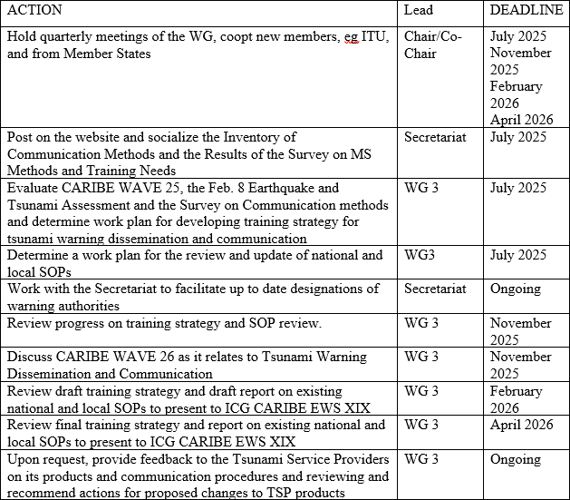
Internal Work Plan/Key Proposed Activities

