Slide 1
3.2 ICG/CARIBE-EWS Secretariat Report
ICG/CARIBE-EWS XIX
22-24 April 2026
Bernardo Aliaga Rossel
Head
Tsunami Resilience Section

Slide 2

Secretariat support to the ICG/CARIBE-EWS
during the intersessional period (I)
Continued to support IOC ICG/CARIBE-EWS and its TSP through the continuous update of TNCs/NTWCs/TWFPs, Working Groups and Task Teams contact databases in direct contact with the Member States
Published the report of the Expert Meeting on Seismic Sources in the Northwest Caribbean and on Non-Seismic Sources of Tsunamis for the Caribbean and Adjacent Regions in Heredia, Costa Rica, 2-6 December 2024. The report of the Expert Meeting is available in UNESDOC.
Provided active support to CARIBE WAVE 26 (CL-3065) and published TS-198 CARIBEWAVE26 Participant Handbook).
Assisted the implementation of the TRRP.

Slide 3
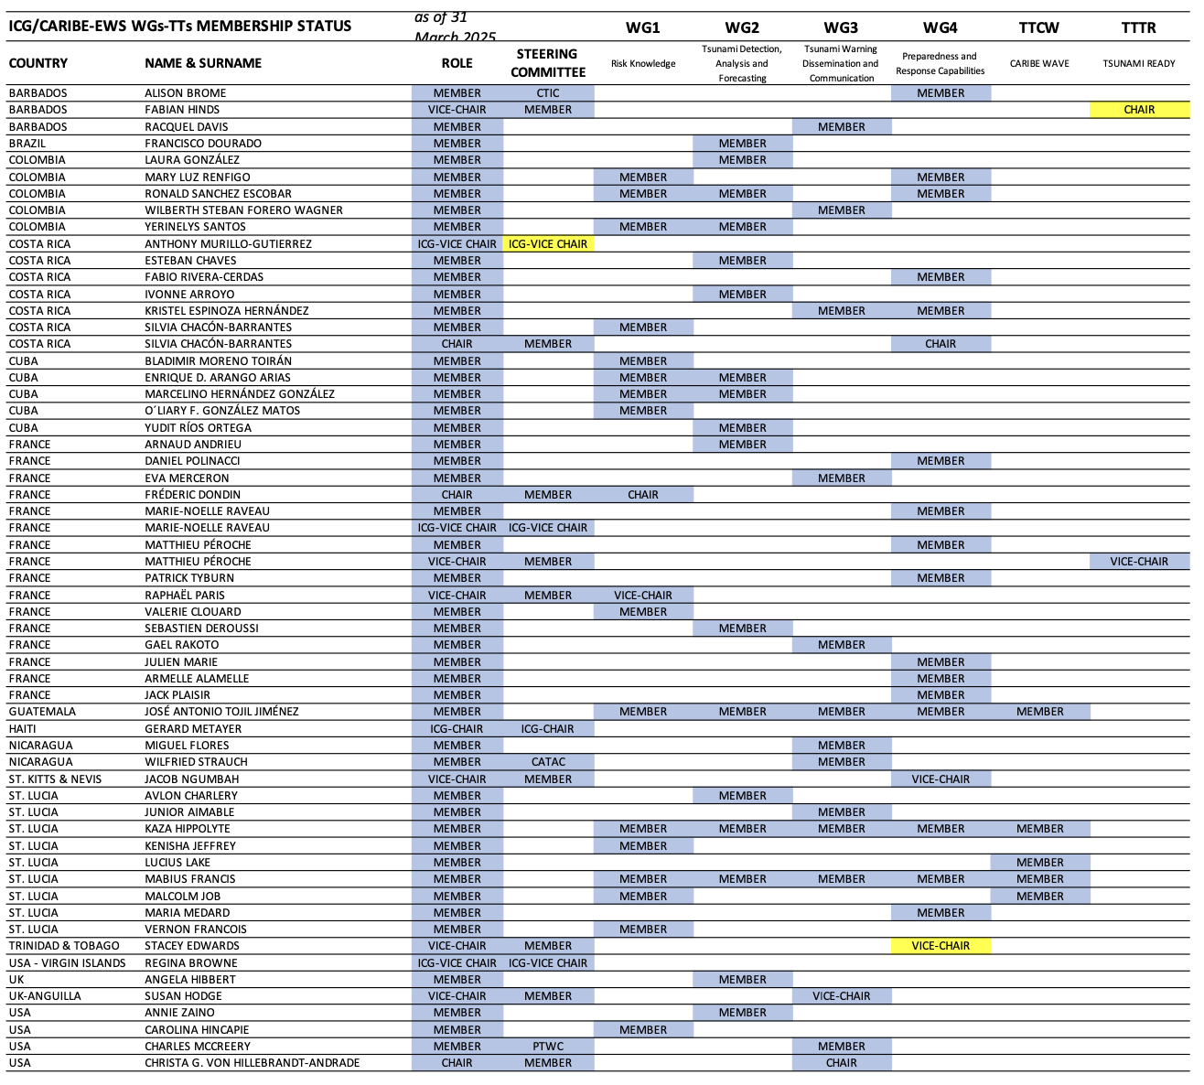
ICG/CARIBE-EWS WGs/TTs Membership Status
Member States were invited on 9 October 2023 through CL-2965 to nominate experts to the ICG/CARIBE-EWS Working Groups and Task Team.
As of 31 March 2025, there are 76 experts from 17 Member States/Territories, with the following distribution:
BARBADOS 3
BRAZIL 1
COLOMBIA 5
COSTA RICA 6
CUBA 5
FRANCE 14
GUATEMALA 1
HAITI 1
NICARAGUA 2
ST. LUCIA 9
TRINIDAD AND TOBAGO 1
UK 1
UK-ANGUILLA 1
USA 12
USA–PUERTO RICO 7
US VIRGIN ISLANDS 5
VENEZUELA 2
Delegations are invited to inform the Technical Secretary in case of any updates to the ICG/CARIBE-EWS Working Groups and Task Team Membership status.
Registration to OceanExpert is essential!

Slide 4
Status of CARIBE-EWS Action Monitor
Completed / Failed-Delayed / In Progress / Not Started / Canceled
Maintained by the Secretariat as a tool to monitor the execution of the Decisions and Recommendations of the ICG/CARIBE-EWS and relevant Ocean Decade Tsunami Program Research and Development Implementation Plan (ODTP-RDIP) milestones,
Updated at ICG/CARIBE-EWS Sessions and Steering Committee Meetings.
File available under ICG/CARIBE-EWS XIX Documentation.

Slide 5
TNC/TWFP/NTWC Contact List
TOWS-WG-XVIII Recommendations
TOWS-WG-XVIII
The Group recommended the IOC Assembly at its 33rd session in 2025 to request the IOC Secretariat to prepare a standard and improved methodology of collecting TNC/TWFP/NTWC contact information, in close collaboration with the TT-TWO and TT-DMP and present its work at the next Joint TT-DMP and TT-TWO Meeting.

