Slide 1






ICG CARIBE-EWS XIX Session
CARIBE WAVE 2027
Gisela Báez-Sánchez
CARIBE WAVE Chair, Puerto Rico Seismic Network, USA
Antonio Aguilar
CARIBE WAVE Vice Chair, FUNVISIS, Venezuela
Supported by:
Christa G. von Hillebrandt-Andrade
Manager, ITIC Caribbean Office
ICG CARIBE EWS WG III Chair
Kimberly Maisonet Gonzalez
Student Contractor
ITIC Caribbean Office
April 23, 2026

Slide 2
Goals for ICG XIX
Decide on the Date and Time CARIBE WAVE 27
Confirm Scenarios for CARIBE WAVE 27
Suggestions for Scenarios Beyond 2027
Review Recommendation and Decisions for CW

Slide 3
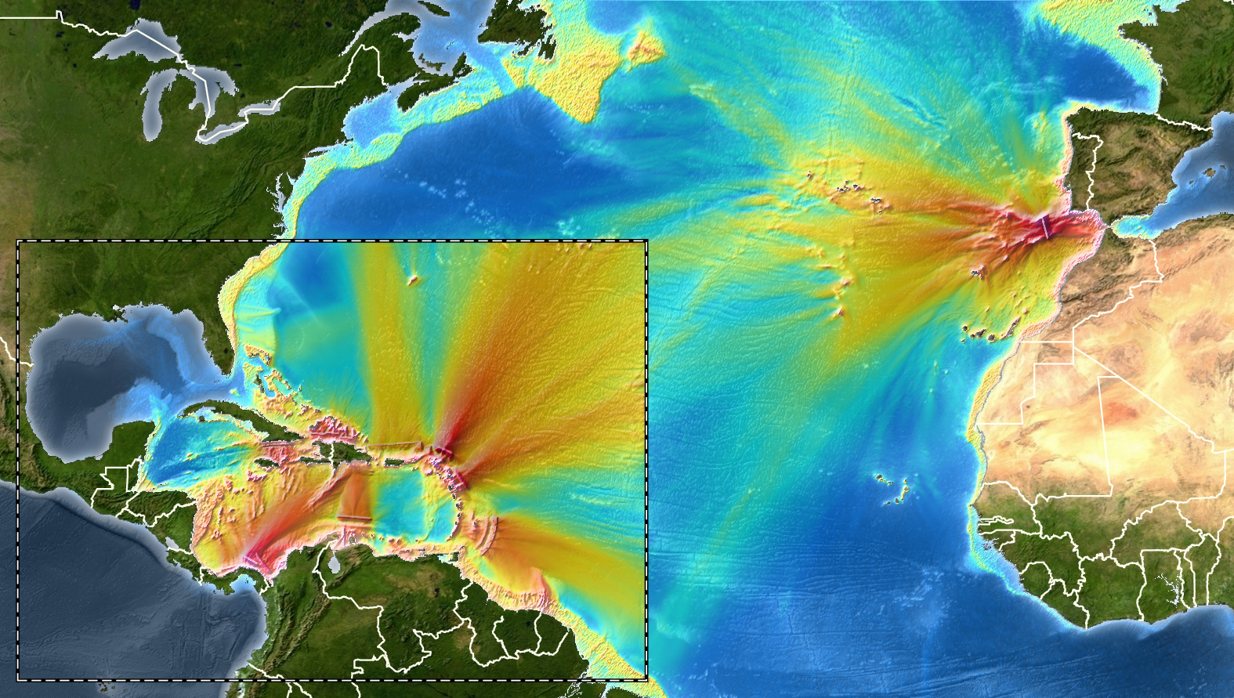
Coverage of Past Exercises

Slide 4
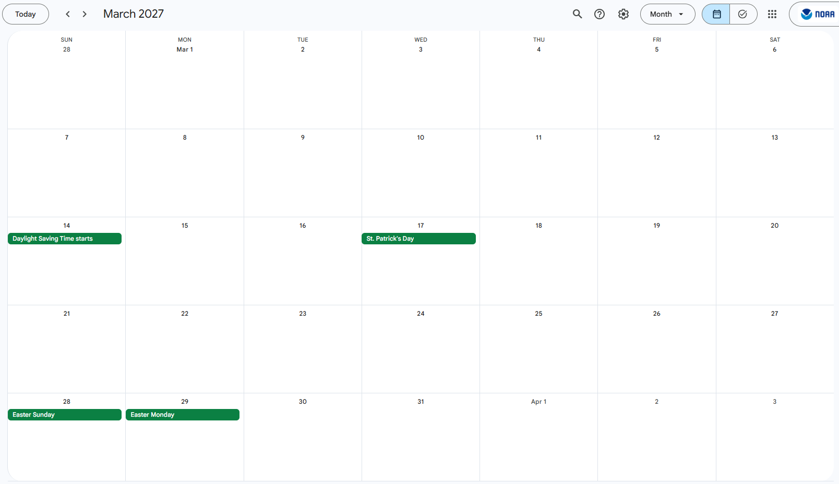
Date and Time of the Scenario
Possible Date
in March:
Thursday
March 18, 2027
CW 27
– *Easter Week –
Hotwash

Slide 5
CARIBE WAVE 27 Scenarios
Previous ICG/CARIBE-EWS-XVIII recommendations for CW 27 proposals:
Southern Caribbean (earthquake)
Distant tsunami
Notes:
‹#›

Slide 6
CARIBE WAVE 27 Scenarios
Initial WG1 recommended scenarios for CW 27:
Cariaco (Earthquake+Landslide)
Barbados (Earthquake)
Notes:
‹#›

Slide 7
Member State/ Territory | Suggestion
Barbados | Fault zone just east of Barbados.
France | Regional seismic scénario (1 to 3 hours before ETA and a couple of hours of inundation) with significant coastal impact
Haiti | sources generating tsunami with inundation
Honduras | A fault closer to the Islas de la Bahía
Mexico | Honduras 8/9/1856 Ms 7.5 Earthquake
Panama | North Panama Deformed Belt (Oriental segment, close to Panama-Colombia border)
CARIBE WAVE
2027
CW 26
Survey Results

Slide 8
CARIBE WAVE
2027
CW 26
Survey Results
Member State/ Territory | Suggestion
Puerto Rico | A local scenario for PR and VI.
Saint Lucia | seismic trigger originating along the Caribbean tectonic plates.
SVG | The eastern Caribbean plate or seismically active zone around Antigua and Martinique
UK Cayman Islands | Cayman 7.8M earthquake from January 2020
Venezuela | I would like to suggest the scenario of the 1900 earthquake on the coasts of Venezuela.

Slide 9
Decision and Recommendations ICG/CARIBE-EWS-XIX:
The Intergovernmental Coordination Group for the Tsunami and Other Coastal Hazards Warning System for the Caribbean and Adjacent Regions (ICG/CARIBE-EWS),
Instructs the CARIBE EWS Working Groups and the CARIBE WAVE Task Team to identify actions arising from CARIBE WAVE 26 and past CARIBE WAVE Exercises and identify follow up actions in coordination with CTIC and the CARIBE-EWS Secretariat,
Reconfirms that CARIBE WAVE 27 will have the following scenarios 1) Southern Caribbean earthquake and tsunami, and 2) the Distant earthquake and tsunami (pending furher discussion of the Task Team, WG and TSP),
Decides that the CARIBE WAVE 27 exercise will take place on Thursday, March 18, 2027, commencing at 15:00 UTC with one dummy message for the communication test from PTWC and CATAC to the TWFPs and NTWCs, and the 1st message for the scenarios coming shortly after according to PTWC and CATAC simulated procedures for the respective scenarios they are supporting. Member States are encouraged to execute activities at times deemed convenient based on national procedures and circumstance,
Reminds again Member States to consider alternative dates and times for running of CARIBE WAVE 27, if the agreed date is not feasible, and that information on conducting the exercise on alternative dates be shared in the Handbook,
Notes:
‹#›

Slide 10
Recommendation ICG/CARIBE-EWS-XIX. (CONT)
Requests again that Member States consider conducting all or part of their exercise response activities during non-working hours, particularly at night, to be better prepared for tsunami events that are more likely to occur during non-working hours,
Recommends following a coordination process, timetable, and benchmarks for CARIBE WAVE 27, similar to what has been used in prior CARIBE WAVE exercises, and that this includes a series of preparatory webinars,
Further recommends that the registration process remains at www.tsunamizone.org and that Member States promote registration and participation among their stakeholders,
Notes the limited registration of people with disabilities in CARIBE WAVE 26.
Recommends that Member States proactively engage people with disabilities, including the visually impaired, deaf people, and support their inclusion in tsunami safety initiatives by utilizing materials in Braille, sign language and other accessible formats, thereby promoting early warnings for all.
Recommends continuation of the Task Team for CARIBE WAVE,
Recommends the Secretariat to inform the UNDRR on the date of CARIBE WAVE 27 and request the theme of the WTAD 27 in advance of the exercise,
Notes:
‹#›

Slide 11
Recommendation ICG/CARIBE-EWS-XIX. (CONT)
Further recommends that Task Team CARIBE WAVE and Member States consider the theme of WTAD 2027 in the conduct and reporting of the exercise,
Noting again that CATSAM is a tool for identifying tsunami sources and their associated threat for exercise planning purposes,
Reminds again Task Team CARIBE WAVE to assist Working Group 1 in prioritizing scenarios to be included in CATSAM,
Additionally reminds Member States to consider including their selected CARIBE WAVE 27 scenario within a multi-hazard framework wherever possible,
Suggests again that Task Team CARIBE WAVE explores opportunities to further involve tourists and tourism organizations such as the Caribbean Tourism Organization (CTO), in CARIBE WAVE exercises, with the aim to develop multi-lingual guidelines/resources for the involvement of tourists in CARIBE WAVE Exercises,
Notes:
‹#›

Slide 12
Recommendation ICG/CARIBE-EWS-XIX. (CONT)
Further suggests that Task Team CARIBE WAVE explores opportunities to further involve national and regional maritime and port authorities so they may exercise their plans and procedures,
Recommends that Member States consider UN agencies operating in their countries for receipt of products and relevant information and further notes the IOCARIBE agreement to support UN Country Teams by encouraging them to engage with emergency management practitioners in their countries of operation,
Acknowledges the consistent support of ITIC-CAR to the work of the TT CARIBE WAVE and looks forward to its continued support to TT CARIBE WAVE,
Suggests the CARIBE WAVE 28 exercise scenarios selection based on the Task Team experts recommendations.
Recommends the enhancement of the caribewave.org with the addition of information and materials that serves a wider range of stakeholders beyond the current target of government authorities.
Financial Implications: None
Notes:
‹#›

