Slide 1


Pacific Tsunami Preparedness Capacity Assessment
Short update at ICG/PTWS Online Steering Committee Meeting,
March 2026
Lara Bland (NEMA, NZ), Laura Kong (ITIC), Bernardo Aliaga (UNESCO IOC)

Slide 2



A quick refresher – TPCA objectives
1. To evaluate the existing technical capacity of the Pacific Tsunami Warning & Mitigation System (PTWS)
2. To identify specific gaps and capacity development requirements at regional and national levels for strengthening the technical and policy aspects of the tsunami warning and mitigation systems in the region
3. To reinvigorate political commitment and provide recommendations for investments in tsunami preparedness, aiming to address the identified gaps in the PTWS area through regional and subregional cooperation

Slide 3

A quick refresher
Followed TPCA done in IOWMS in 2024, the 20 year anniversary of the Boxing Day tsunami. Track progress since 2005.
Conducted in Pacific through 2025 - the 60yr anniversary of ITSU (PTWS predecessor). The TPCA was the first for the Pacific and sets a baseline for monitoring future progress.
Huge support from the Economic and Social Commission for Asia and Pacific (ESCAP) and their partners, and the UNESCO IOC.
One year project, co-led by Dr. Laura Kong (ITIC) and Lara Bland (NEMA, NZ), with significant support from Öcal Necmioglu (IOC), Nishimae san (PTWS Chair), Temily Baker (ESCAP), Celine Barre, David Coetzee, PHIVOLCS

Slide 4
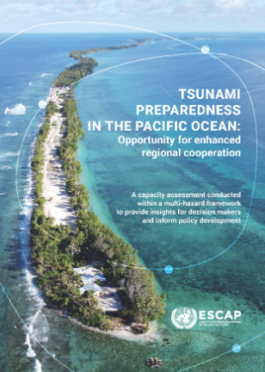
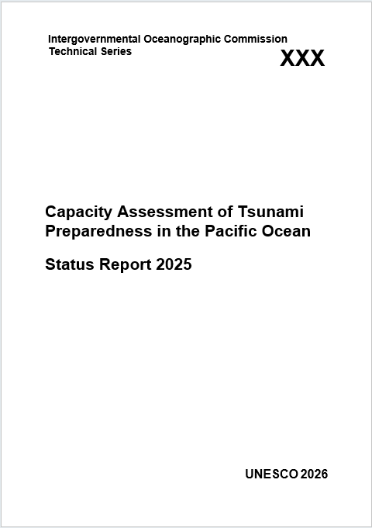
Key milestones and products
Survey
1 Feb – 14 Mar 2025
Preliminary results at ICG
7-11 April 2025
Evaluation Workshop
14 -16 May 2025
Progress reported at IOC/UNESCO 33rd Assembly
June 2025
Policy Document launched at ODTP First conference
Nov 2025
IOC Technical Report
Imminent
Qns spanned upstream and down
42 of 46 MSs
100% of PICT
English and Spanish
Initial trends and feedback
Workshop planning
PHIVOLCS
Discuss results, trends and draft recommendations
Membership across TWGs and RWGs
Approval by SC in Sep 2024 to project end Sep 2025 – huge pace!!

Slide 5
Recommendations (priority)
Forty four recommendations, some with several sub-recs, were identified from analysis and the Evaluation Workshop.
Nine were noted as top priority:
Build understanding of hazard and risk and how they differ, with a specific focus on risk and its components (risk = hazard x exposure x vulnerability/capacity), to improve planning and decision making.
Ensure, with urgency, that 100% of countries have hazard assessments for earthquake-generated tsunamis, noting that 19% of the respondent countries had no tsunami hazard assessment and 24% had no risk assessment.

Slide 6
Recommendations (priority)
Ensure, with urgency, that 100% of the countries have tsunami evacuation maps for tsunami vulnerable communities based on hazard assessments, noting that no evacuation maps are available in 24% of the countries.
Build capacity to perform hazard and risk assessments, noting that 27% of countries indicated they have poor or very poor capacity to undertake tsunami hazard or risk assessments.
Create inundation maps – including those for worst cases used for defining evacuation zones and ones reflecting the more likely inundation …for insurance purposes or land use planning.

Slide 7
Recommendations (priority)
NTWC must be able to assess tsunami threat based on sea level data.
Ensure 100% of countries have the capability to receive potential tsunami threat information and issue timely warnings to their coastal communities, noting that at least 2 PTWS countries do not currently have the capability.
Ensure that 100% of Member States have SOPs that cover both upstream and downstream processes.
Strongly encourage a drastic increase in investment and effort to better support the implementation of these (TRRP) initiatives as described by the Banda Aceh Statement.

Slide 8
Next steps?
Additional comments from colleagues?
Mechanisms to share findings and close capability gaps
Future tracking and surveys

