Slide 1
Tsunami Ready Coalition
update
Dr. Laura Kong, Chair, TRC
Director, ITIC
TOWS-WG-XIX, 30-31 March 2026
Online

Slide 2
Establish Tsunami Ready & Coalition (2022)
IOC Decision EC-55/3.5.1 (June 2022) Warning and Mitigation Systems of Ocean Hazards. Part IV: Working Group on Tsunamis and Other Hazards related to Sea Level Warning and Mitigation Systems (TOWS-WG)
Approves the establishment of the UNESCO/IOC Tsunami Ready Recognition Programme (TRRP) as described in the working document “Tsunami Ready Programme – Proposal for endorsement by IOC” dated 21 February 2022;
Approves also
(ii) the Terms of Reference for the Tsunami Ready Coalition, as included under Annex 2 to this decision;
Annex 1. Revised Terms of Reference of the Working Group on Tsunamis and Other Hazards Related to Sea-Level Warning and Mitigation Systems (TOWS-WG)
The membership of the TOWS-WG will be constituted by:
a) The Chairpersons of the four ICG-TWSs, the Scientific Committee of the UN Ocean Decade Tsunami programme, the special Tsunami Ready Coalition, and representatives of the GOOS Steering Committee and IODE,
b) …

Slide 3
Annex 2. Terms of Reference (TRC, 2022)
Goal: Contribute to increasing the number of Tsunami Ready recognized
communities as part of the UN Ocean Decade.
Objectives:
The goal should be achieved through the following objectives:
Raise the profile of Tsunami Ready in collaboration with critical stakeholders across the UN system, interested regional organizations, national disaster management agencies and the public,
Increase funding resources for the implementation of Tsunami Ready,
Advise the TOWS-WG, TTDMP, and TTTWO on the implementation of Tsunami Ready, including on measures related to:
flexibility with regards to accomplishing the indicators to allow for circumstances where formal bureaucratic frameworks/requirements may pose barriers,
consideration of unique regional and/or local circumstances,
recognition of similar standards already in place in some countries
Appoint Chair, Jan 2023
Develop Implementation Plan, July 2024

Slide 4
TRC Implementation Plan 1 (IOC A-33/3.4.1, 2025)
IOC Decision A-33/3.4.1 (June 2025) Warning and Mitigation Systems of Ocean Hazards. Working Group on Tsunamis and Other Hazards related to Sea Level Warning and Mitigation Systems (TOWS-WG)
The Assembly,
Approves the Tsunami Ready Coalition Implementation Plan as reviewed by the UN Ocean Decade Tsunami Programme Scientific Committee (ODTP-SC) and the Task Teams on Tsunami Disaster Management and Preparedness, and Tsunami Watch Operations (TT-DMP and TT-TWO respectively) including:
The Coalition mandate and terms of reference,
The Coalition structure, and
The identified key Coalition Partners;
…
Encourages Member States to provide voluntary financial contributions to the IOC special account and in-kind contributions to support the Ocean Decade Tsunami Programme, the IOC Tsunami Ready Recognition Programme and the Tsunami Ready Coalition;

Slide 5
TRC Implementation Plan 2 (IOC A-33/3.4.1, 2025)
Requests the IOC Secretariat to:
inform Member States of the availability of the Tsunami Ready Toolkit through an IOC circular letter addressed to the Tsunami National Contacts, National Tsunami Ready Boards, and more widely by the attaching it as an appendix to the UNESCO-IOC Standard Guidelines for the Tsunami Ready Recognition Programme (IOC Manuals and guides, 74);
disseminate the final version of the basic tsunami warning product/template for use by the radio amateurs, as a guidance;
finalize the Tsunami Ready Coalition Implementation Plan in consultation with the Tsunami Ready Coalition Chair the Coalition Partners, 'Ambassadors' or similar namesake, and Coalition Co-Chair;
extend invitations to the proposed Coalition Partners and 'Ambassadors' or similar namesake, and a Coalition Co-chair, and urgently address needed resources;

Slide 6
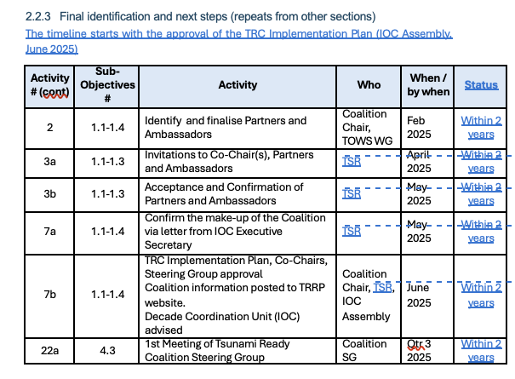
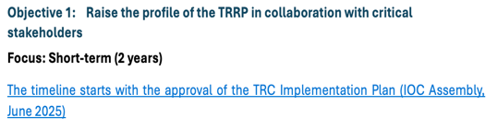
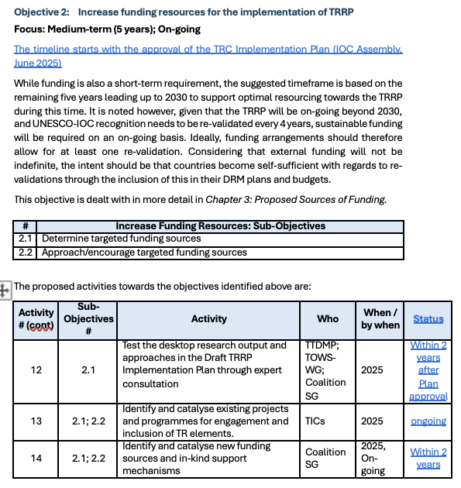
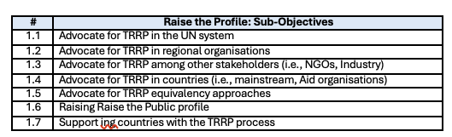
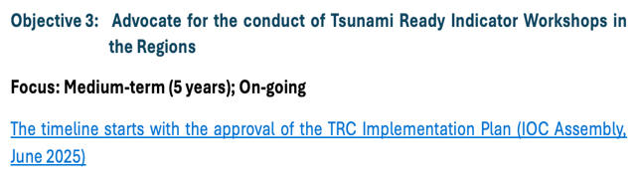
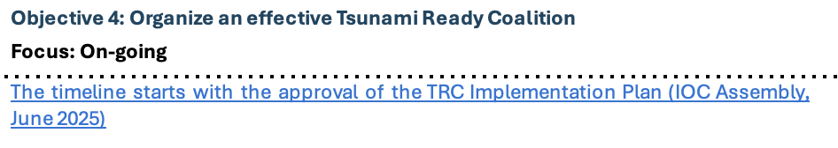
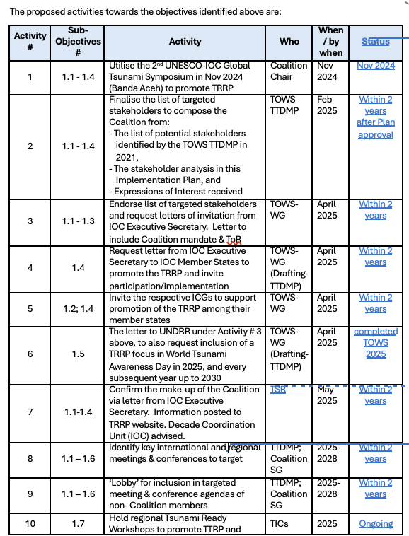
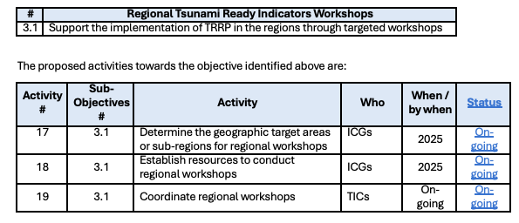
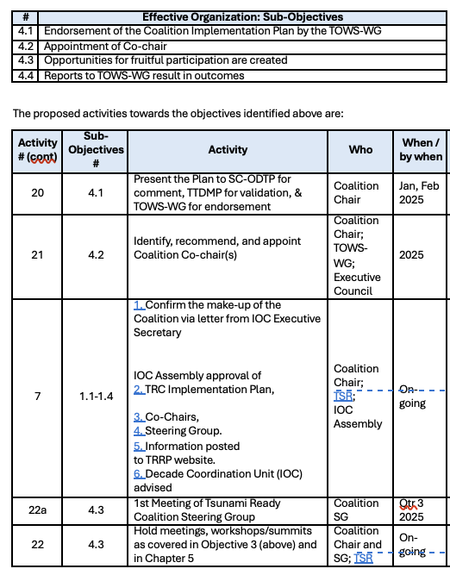
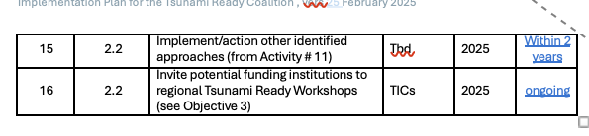

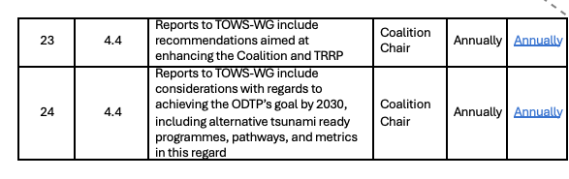
2025 - 2026 (iii) Finalize TRC Implementation Plan
Incorporate feedback from TOWS WG 2025
Considering TRC could not be fully constituted due to TSR Secretariat reduced resources, relax time lines to (‘within 2 years’)

Slide 7
Nonetheless, activities continue: TRC Chair, TICs, TSR
Strong efforts for Objectives 1 and 3 (short-term 2 years)
WTAD: 2025 Be Tsunami Ready: Invest in Tsunami Preparedness 2026 #GetToHighGround
Encourage equivalency development - PTWS equivalency approved for piloting in 2025
Advocate for reporting by % prepared and resilient, not number of communities => more meaningful and consistent with PTWS Equivalency.
Organize, Conduct Regional Summits (Caribbean 2026), Regional Workshops (NEAMTWS Inundation/Evacuation 2025, PTWS – PICT, LAC, SE Asia 2026, IOTWMS – Makran 2026), National Workshops (numerous)
TSR seeking resources from ODCU for dedicated person for TRRP
Objective 1. Raise the profile of the TRRP in collaboration with critical stakeholders
Advocate for TRRP in the UN system
Advocate for TRRP in regional organisations
Advocate for TRRP among other stakeholders (i.e. NGOs, Industry)
Advocate for TRRP in countries (i.e. mainstream, Aid Organisations)
Advocate for TRRP equivalency approaches
Raise the Public profile
Support countries with the TRRP process
Objective 3. Regional Tsunami Ready Indicator Workshops
Support the implementation of TRRP in the regions through targeted workshops

Slide 8
TOWS WG TT Recommendation (2026)
Notes the approval of the TRC Implementation Plan in June 2025, including its mandate, terms of reference, structure, and key Coalition Partners,
Welcomes the ﬁnalization of the Plan by the TSR and TRC Chair, and its publication as an IOC Technical Series XX (in press, 2026), that establishes a strategic roadmap to achieve 100% tsunami readiness,
Appreciates the work of the TRC Chair, TICs, and the TSR toward progressing the Implementation Plan, especially regarding:
Objective 1: Raise proﬁle of the TRRP in collaboration with critical stakeholders through advocacy at meetings and workshops, support of TRRP equivalency approaches to build 100% resiliency, inclusion within tsunami disaster reduction or tsunami resilience projects, to the public around the world. Through the facilitation of the TICs, and generous support of Aid organizations to countries, there are now 110 recognized communities in 33 countries around the world, with about 70 additional communities in progress in the coming year.
Objective 3: Advocate for the conduct Tsunami Ready Indicator Workshops in the Regions though regional workshops in the Paciﬁc Islands held in 2023 and the Caribbean Summit I in 2010, the upcoming Caribbean Summit II in 2026, in the NEAMTWS in 2025, upcoming regional workshops in 2026 for the Pacific Islands, Latin American and Southeast Asian countries, and the Makran region of the NW Indian Ocean, and national workshops that have brought tsunami agencies, with non-government organizations, industry, and Aid organizations to work collaboratively to recognize Tsunami Ready communities, UN system.
Recalls that the Plan is intended to be a dynamic document to allow for updates, as reﬂected in the Coalition’s annual reports to the TOWS-WG,
Acknowledges the reduced resource and capacity of the TSR secretariat has prevented it from extending invitations to the proposed Coalition Partners and 'Ambassadors' or similar namesake, and a Coalition Co-chair that together will serve as the catalyst and leadership for the TRRP and noting also that the UNESCO Expenditure Plan implies additional budgetary restrictions for IOC in the biennium 2026-2027.
Recommends the relaxation of the Plan’s timelines of actions and activities concerning Objective 2: Increase funding resources for implementation of TRRP, and Objective 4: Organize an eﬀective Tsunami Ready Coalition, until such time that the full Coalition can be constituted
Requests the IOC Executive Secretary to urgently seek extra budgetary resources to resume progress of the TRC Coalition Implementation Plan.

Slide 9
Tsunami Ready Coalition
update
Dr. Laura Kong, Chair, TRC
Director, ITIC
TOWS-WG-XIX, 30-31 March 2026
Online

