Slide 1

World Organisation of Volcano Observatories
N Fournier (NZ), L Sandri (IT), J Lowenstern (US), B Taisne (SG), C Widiwijayanti (SG), S Barsotti (IC), A Amigo (CH), A Bonforte (IT), N Geshi (JP), S Hidalgo (EC)
TTTWO meeting
Online 5 Mar 2026

Slide 2
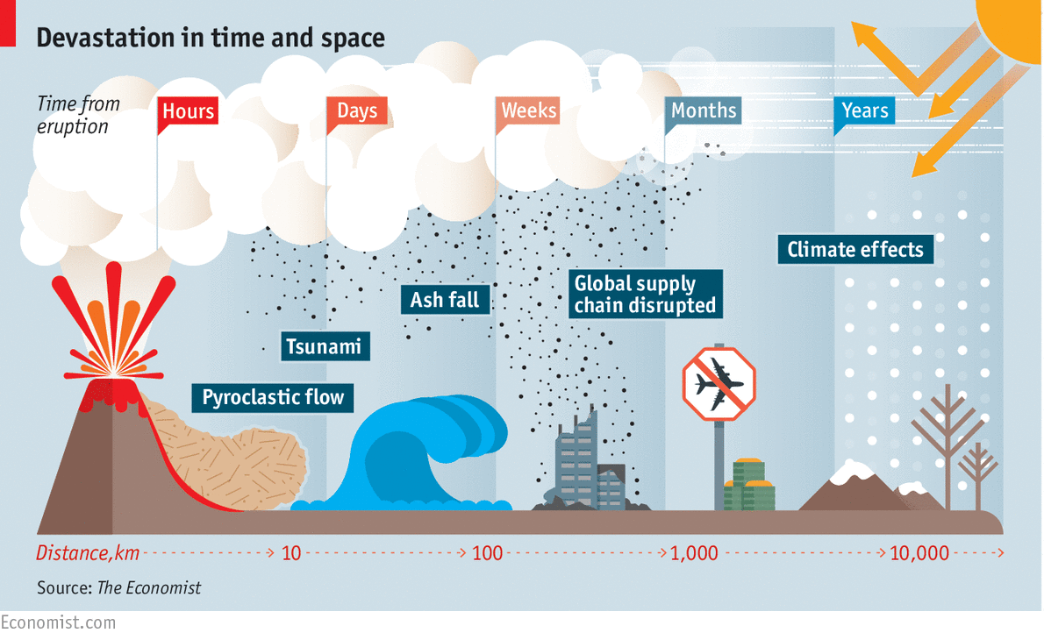







Who benefits from Volcano Monitoring?
Communities
Local
Regional
Global

Slide 3






Duty to our communities, government and global partners
Central Government
EW4ALL initiative
Emergency management
Neighbouring countries
Aviation
Local authorities
VAAC
CAA
Communities
ICAO
Volcano Observatories

Slide 4
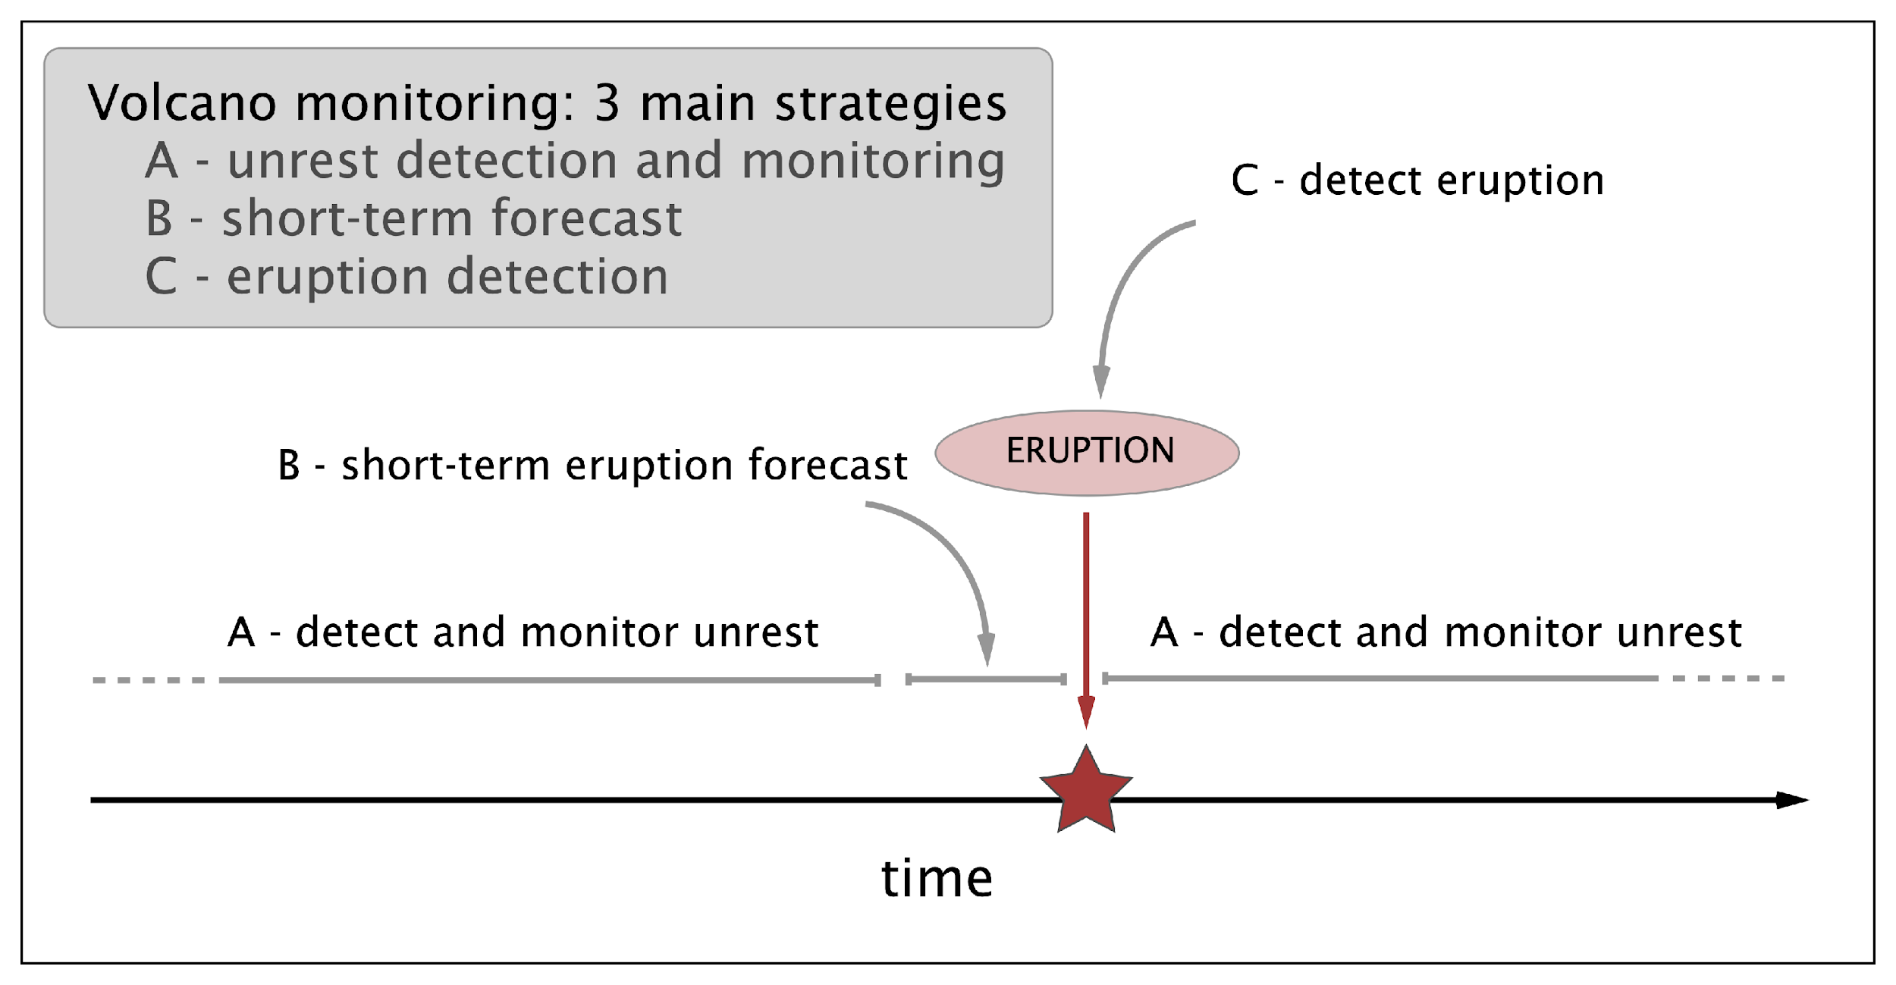
What is Volcano Monitoring?

Slide 5
Focus on early unrest notification & rapid eruption detection and impact forecasting
Notes:
Eruptions at some volcanoes are just incredibly difficult to forecast (see Whakaari on Wed)

Slide 6
Volcano vs tsunami: tsunamigenic volcanic processes can be totally subaerial
Detection and early notification of tsunamigenic volcanic processes cannot solely rely on aviation partners (e.g. VAAC). Instead, leverage volcano observatories monitoring capability and science advisory processes

Slide 7
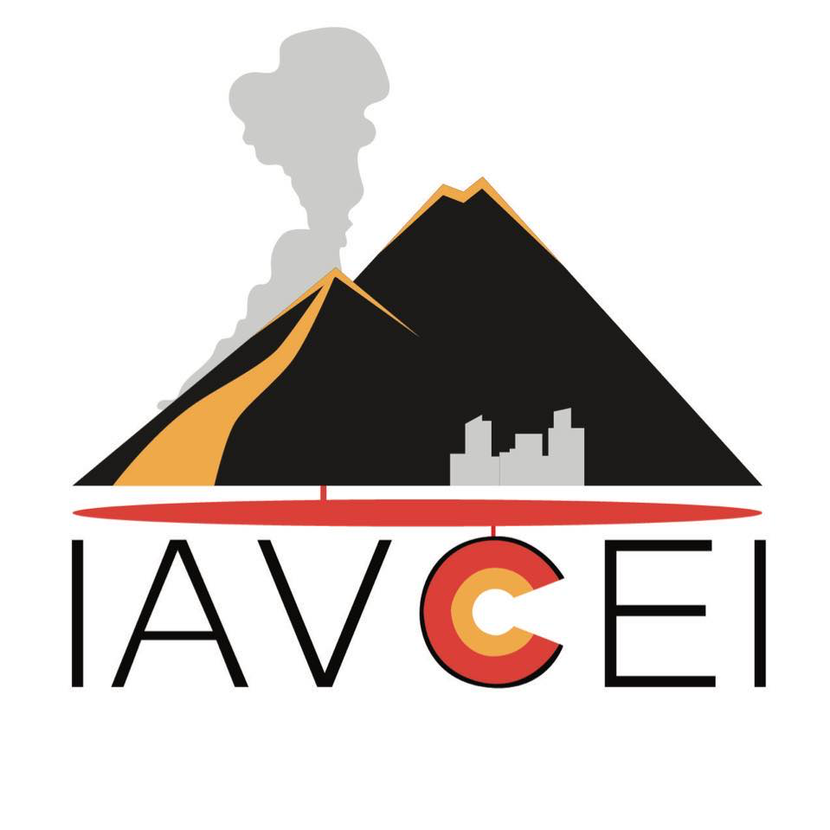
What is WOVO?
WOVO is a IAVCEI network of – and for – volcano observatories worldwide
The objectives of WOVO are to connect, support, and advocate for its members, through three core programs:
1. The Volcano Observatory Best Practices (VOBP) workshops to exchange experiences and propose recommendations for optimising operational efficiency and responding effectively to volcanic eruptions and unrest.
2. WOVOdat, a comprehensive global database on volcanic unrest
3. VAAH and Early Warning initiatives where WOVO provides representation and advocacy for volcano observatories

Slide 8



1. VOBP: Volcano Observatory Best Practice workshop series
VOBP workshops were first conceived to provide an international forum to VOLCANO OBSERVATORIES, to discuss their practical issues and identify internationally shared BEST PRACTICES.
BEST PRACTICES are neither rules nor prescriptions; VOBP workshops recognise as a value the diversity in culture, education, societal background, access to resources, that characterise volcano observatories throughout the world.
Rather, BEST PRACTICES represent a reference
RISK GOVERNANCE AND
PARTNERSHIP
MONITORING CAPABILITY

Slide 9
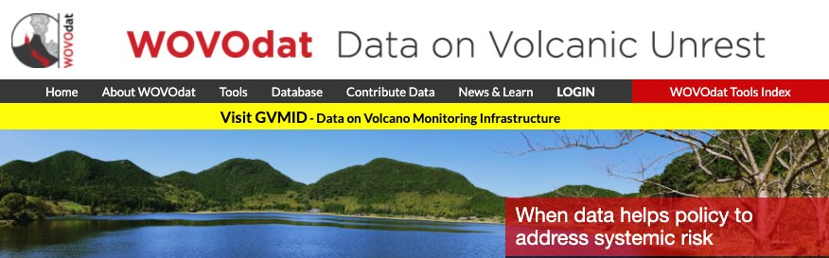
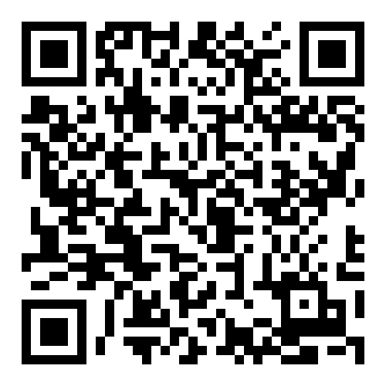
2. WOVOdat: Access to Global monitoring data
WOVOdat is an open-access, growing global database of volcano monitoring data, developed by the World Organization of Volcano Observatories (WOVO) under IAVCEI and currently hosted by the Earth Observatory of Singapore. ​It improves understanding of eruptive processes, enhances eruption forecasting, and supports risk reduction through comparative analysis of unrest patterns within and across volcanoes. ​WOVOdat promotes global collaboration, data sharing, and capacity building to enable transparent, timely, and evidence-based decision-making.

Slide 10
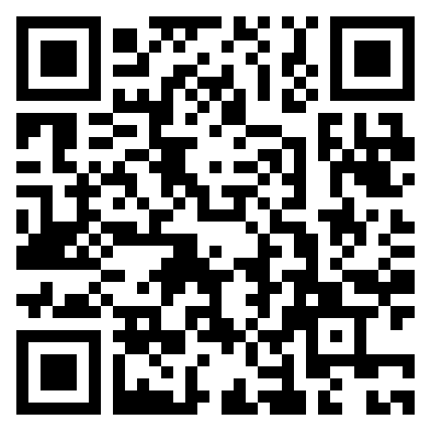
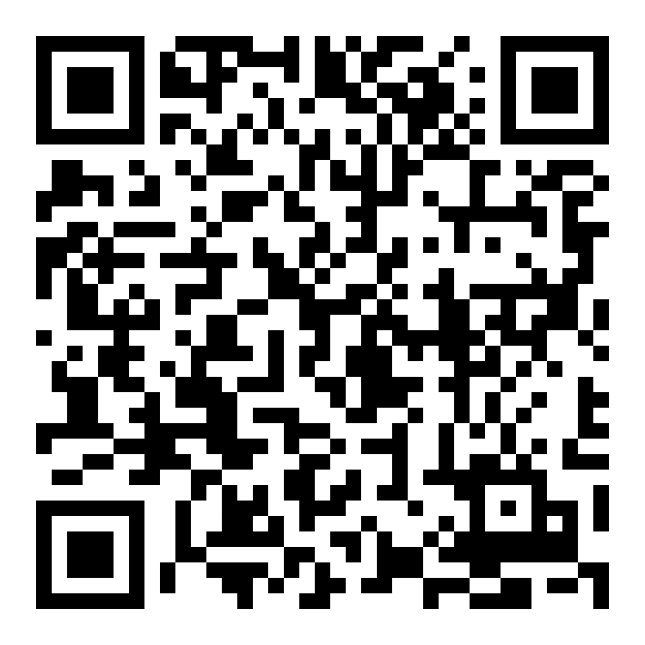
2. WOVOdat: Volcano Monitoring Infrastructure
The Global Volcano Monitoring Infrastructure Database (GVMID), part of WOVOdat, documents and advances ground- and space-based volcano monitoring capabilities. ​It provides insights into monitoring techniques, helping observatories strengthen networks and address gaps with remote sensing and new technologies. ​GVMID supports improved network design for better eruption anticipation and detection.
Example of global assessment on magma migration capability:
About GVMID:

Slide 11
3. VAAH: Volcanic Ash and Aviation Hazards and cross-disciplinary initiatives
The Volcanic Ash and Aviation Hazards (VAAH)
Represents and advocates for observatories within the aviation and meteorological communities
Intended to facilitate and make accessible information from (to) the aviation community (ICAO)
Strong connection with the WMO and the VAACs

Slide 12
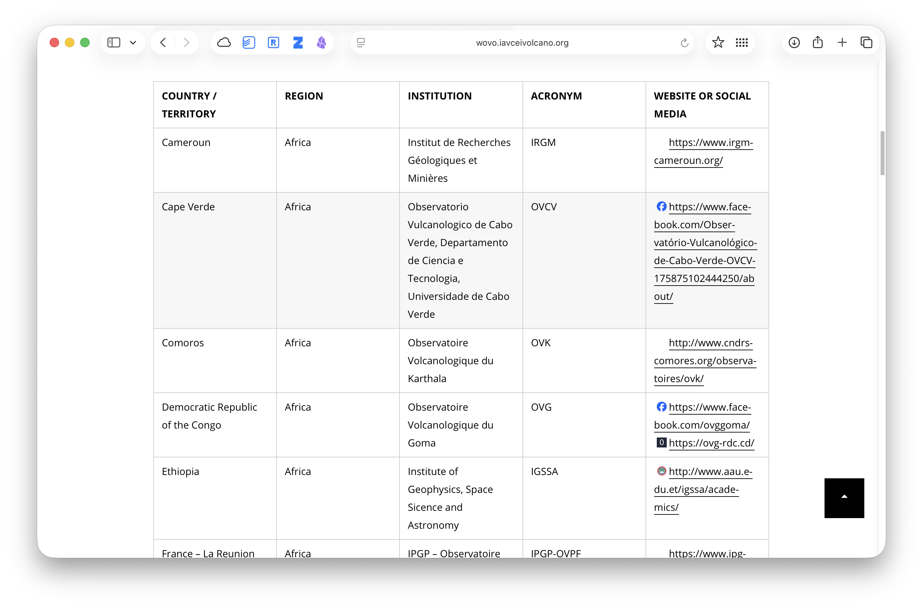
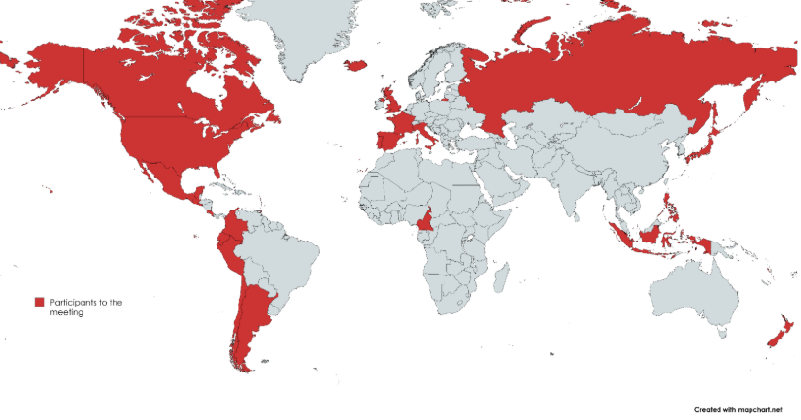
Connect, support, and advocate for obs

Slide 13
WOVO can help by
Being a touch-point and connector for and with volcano observatories
For TTTWO, be a sounding board and offer guidelines on capability, efficiency and effectiveness for cross-disciplinary early warnings efforts
Nico Fournier – Earth Sciences New Zealand
wovo@iavceivolcano.org (WOVO chair) or nico.fournier@earthsciences.nz

