Slide 1
Agenda Item 2.2.2 - Reports from Non-IOC Bodies: WMO
Nineteenth Meeting of the Working Group on Tsunamis and Other Hazards related to Sea Level Warning and Mitigation Systems (TOWS-WG-XIX)
31 March – 1 April 2026
Dr Enrico Fucile, Chief, WMO Information System (WIS) Section, efucile@wmo.int
Dr Muhibuddin Usamah, Scientific Officer, Early Warning Services Section, musamah@wmo.int

Slide 2







WMO Information System (WIS 2.0)
1963 World Weather Watch
1970s Global Telecommunication System
2007 WMO Information System (WIS)
2019 WMO Reform (Earth System Approach)
2021 WMO Unified Data Policy / GBON
WIS 2.0
… system of systems using Web-architecture and open standards to provide simple, timely and seamless sharing of trusted data and information …
Open Standards (OGC, W3C, IETF, …)
Open Source (use off the shelf tools)
Data sharing through Web and publication/subscription (pub/sub) protocols
Cloud ready (turn-key solutions)
Web APIs (Application Programming Interface)
Notes:
A little history to start …
The WMO Global Telecommunications System (GTS), established in the 1970s was designed to enable WMO Members to share data and products with each other in support of operational weather forecasting. Over the last 40 years or so, the GTS has successfully moved indispensable, time-critical data between NMHSs day-in, day-out.
But weather and climate data is important to everyone. So WMO Congress commissioned the WMO Information System (WIS) in 2007.
WIS builds on and incorporates the GTS, adding a data catalogue, data discovery portal and additional mechanisms for users to subscribe to and download data shared on the GTS. It is comprised of hundreds of data providing centres from across the globe (Data Collection and Production Centres, and National Centres), plus 15 Global Information System Centres (or GISCs) that are regional hubs for search, discovery, and access to data.
The original WIS is a child of its time – designed circa 2005. It’s based on service-oriented architecture principles, uses complex ISO 19115/19139-based XML for metadata, and is not well integrated into the Web. Since 2005, we’ve seen a move towards “webby” applications, with good practice characterised in the W3C Data on the Web and W3C Spatial Data on the Web Best Practices. In summary: Resource-oriented architecture, RESTful Web services, and JSON and HTML as core formats.
This is a journey that OGC has been on for some time now, and many of the OGC API standards appear ripe for inclusion in WIS2.
Our aim for WIS2 is to increase data provider participation by lowering the technical barriers to entry, and from the data consumer perspective, make weather and climate data Findable, Accessible, Interoperable, and Reusable (FAIR).

Slide 3

WIS2 Implementation Timeline
Pilot Phase
Pre-operational
Operational
Transition
2025
Pilot Global Broker
Pre-oper Global Brokers
Global Brokers operational
2030
2033
2026 …
Pilot Global Cache
Pre-oper Global Caches
Global Caches operational
2024
2023
Pilot Global Discovery Catalogue
Pre-oper Global Discovery Catalogue
Global Discovery Catalogue operational
90% of Members migrated
Stop gateways and GTS
Q1
Q2
Q3
Q1
Q2
Q3
Workshops and training
WIS 2.0 Tech- Reg approved
Guidelines for WIS 2.0 implementation published
Technical guidance in Guide to WIS
Report on WIS2 progress
NCs/DCPCs may stop GTS functions if migrated to WIS2
GISCs contributing to Global Services may stop WIS1

Slide 4





WIS2 Global Service instances
China Brazil
France
USA
Global Discovery Catalogue
Canada
China
Global Broker
China
Germany
Japan
Korea
USA/UK
Global Cache
Global Monitoring
China
Morocco

Slide 5
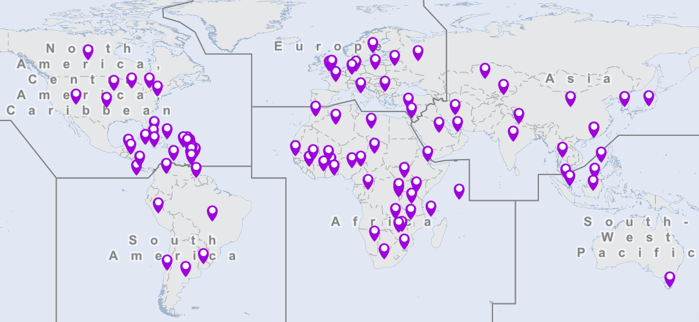
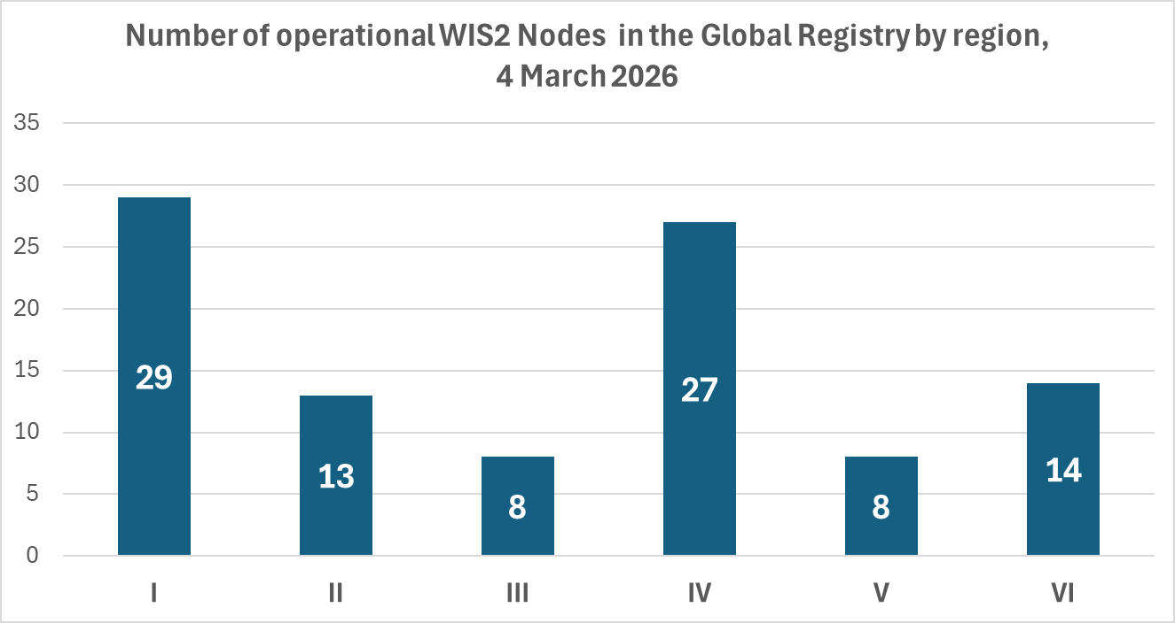
Registered WIS2 Nodes on 4 March 2026
WIS
Number of operational WIS2 Nodes in the WIS2 Global Registry: 99 (8 DCPCs and 91 NCs)
- using wis2box software: 79 →~80% of active WIS2 Nodes use wis2box implementation
- using another software: 20 →~20% of active WIS2 Nodes use another implementation
To see the latest status please check:
Operational WIS2 Nodes on the WMO Knowledge Hub
automatically updated when a new Operational WIS2 Node is recorded in the WIS2 Global Registry

Slide 6
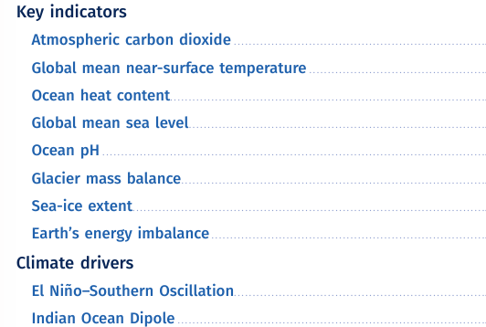

State of the Global Climate 2025

Slide 7
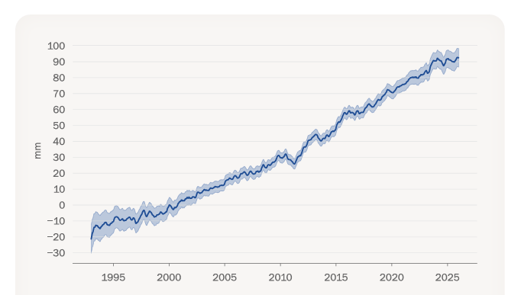
State of the Global Climate 2025: Global mean sea level
In 2025, global mean sea level was comparable to the record-high levels observed in 2024 in the satellite altimetry record
Satellite altimetry records showed a rapid increase in global mean sea level of about 5 mm over 2023 and 2024 (see figure) associated with a strong El Niño that ended in early 2024.
Global mean sea level change (change from January 1993 in mm) shown for 1993–2025. The seasonal cycle has been removed from the data. The shaded area indicates the uncertainty. Source: Data from Aviso, Centre national d’études spatiales (CNES).

Slide 8

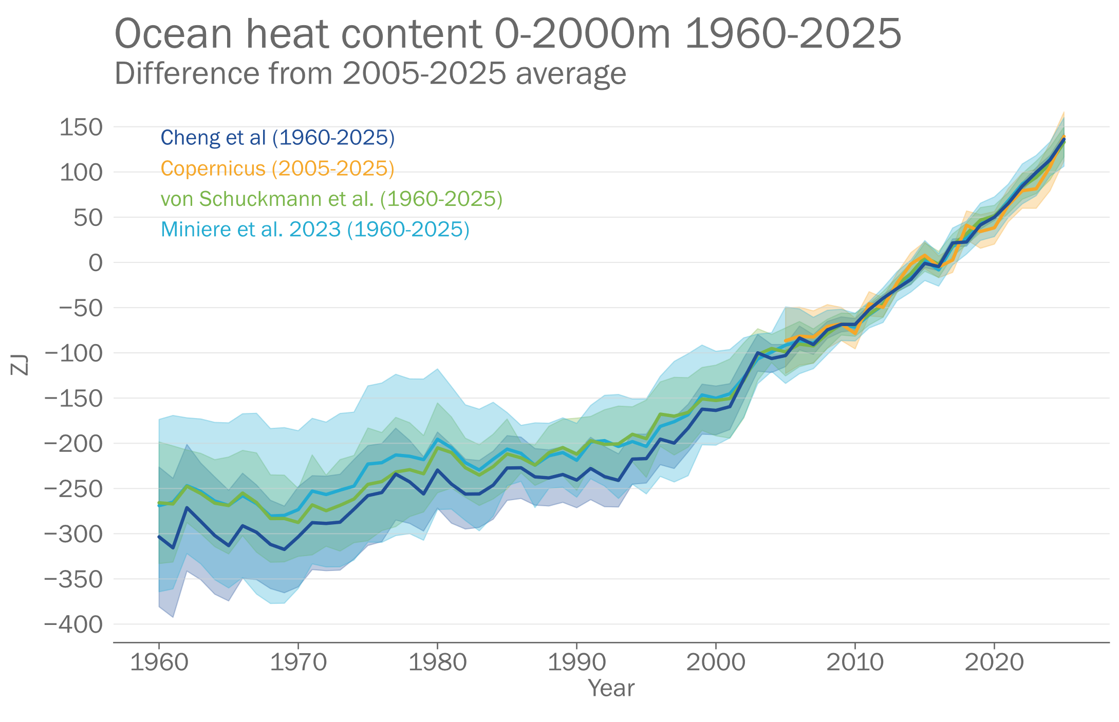
State of the Climate | Oceans
2025
Ocean heat content in 2025 was the highest on record.
11.0–12.2 ZJ/year
2005
3.05–3.91 ZJ/year
2005
The rate of ocean warming over the past two decades, 2005–2025, is more than twice that observed over the period 1960–2005.
1960

Slide 9
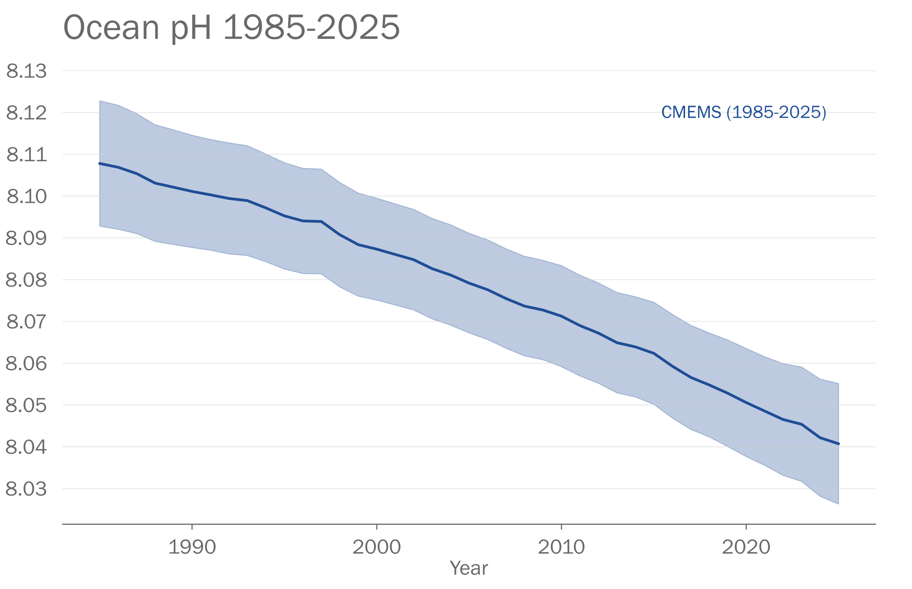
State of the Climate | Oceans
Surface ocean pH continues to decline
Ocean surface pH has changed at a rate of –0.017 ± 0.001 pH units
per decade over the period 1985–2025.

Slide 10
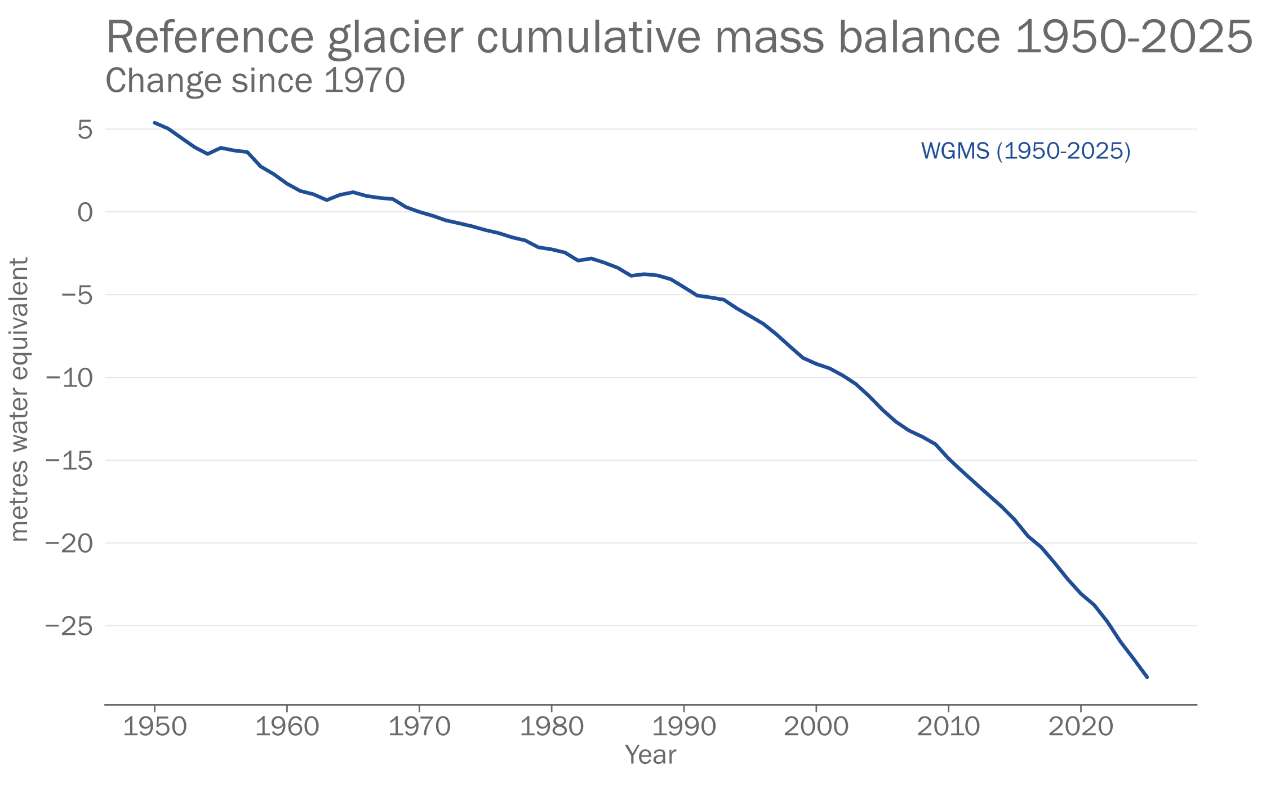
State of the Climate | Cryosphere
In 2024/2025, glacier mass loss was in the top 5.
Eight of the ten most negative annual glacier mass balances since 1950 have occurred since 2016.

Slide 11
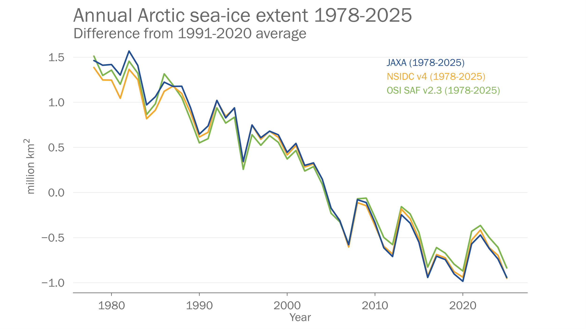
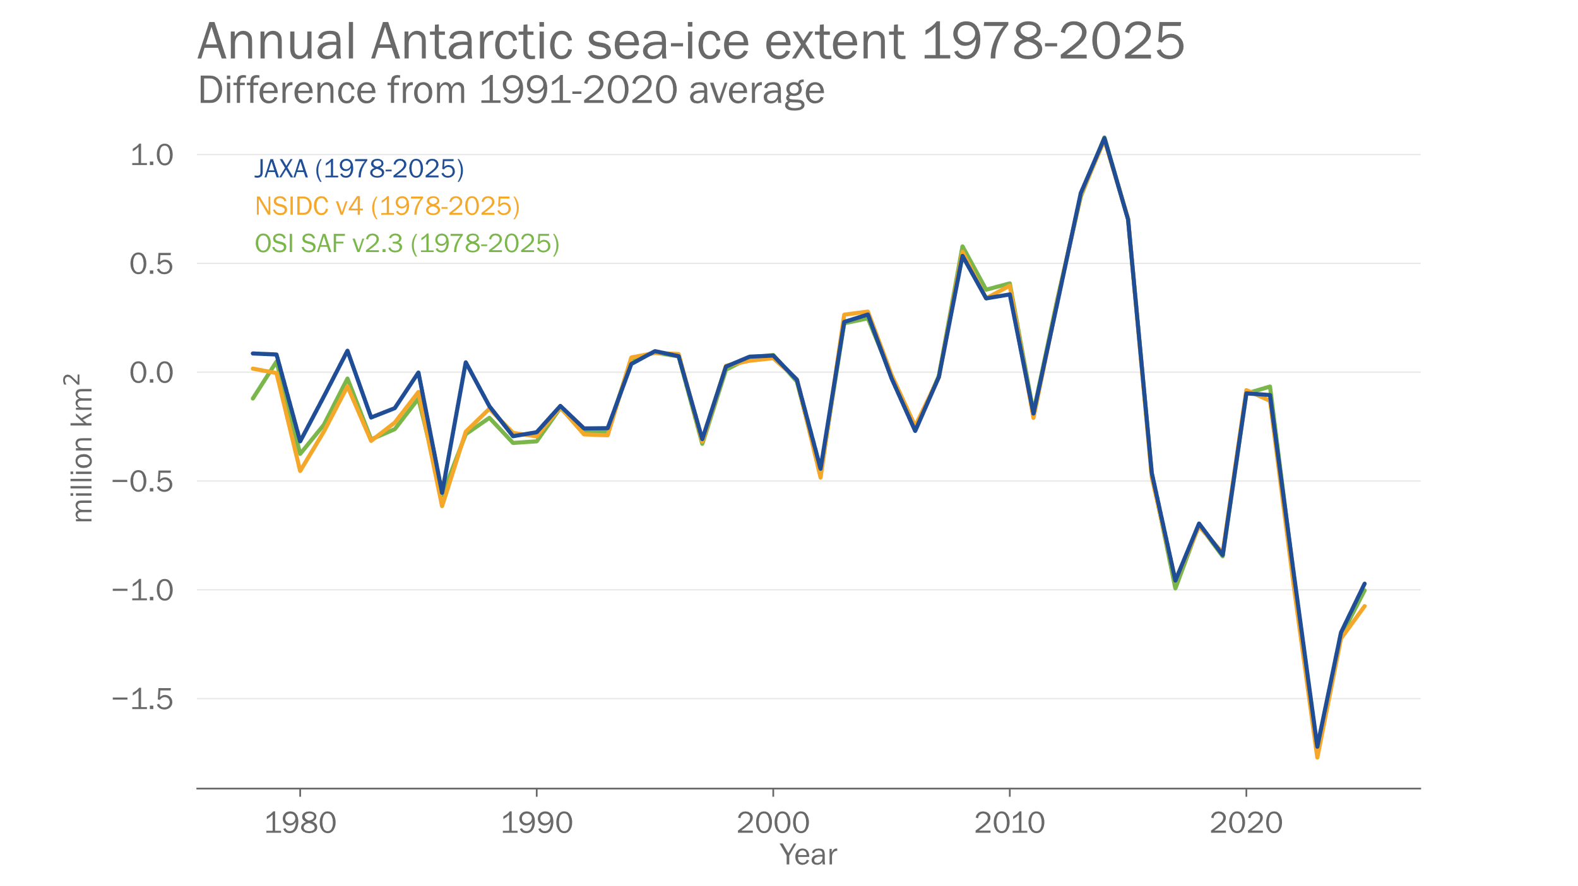
State of the Climate | Cryosphere
The annual Arctic sea-ice extent was the lowest or second lowest on record in the satellite era.
The average Antarctic sea ice extent for 2025 was the third lowest after 2023 and 2024.

Slide 12
New Technical Regulations for Early Warnings
6.3 Information and derived products
Designation of official providers, unambiguous and supported by institutional arrangements
Captured in WMO Register of Alerting Authorities
Supported by business continuity arrangements and quality management
Supported by guidance, practice, training and competencies
Specific information and products that consider the national and local contexts, covering all phases of events, including impact-based information, including multi-hazard interoperability, compounding and cascading events
Archived and continuously improved
6.2 Institutional Arrangements
6.1 General
Members operate the necessary early warning services for meteorological, hydrological, climatological, and related environmental hazards
Provide to national and local governments, disaster risk management, general public and any other stakeholders
Provide minimum viable level of service where there are gaps.
Using WIPPS and SWFP regional and global support

Slide 13
New Technical Regulations for Early Warnings
6.4 Dissemination and communication
6.5 Recording and cataloguing
Suitable and multiple communication channels, including traditional and indigenous channels
Information exchanged using WMO Unified Data Policy
Routine use of Common Alerting Protocol (CAP)
Systematic recording of meteorological, climatological, hydrological and related environmental hazardous events, using WMO-CHE methodology (NB: CHE supports UNDRR DELTA Resilience (Disaster & Hazardous Events, Losses and Damages Tracking & Analysis) system)
Collection and sharing of supplementary data.

Slide 14
Marine related services - update
MetOcean Rolling Review of Requirements (RRR)
Completed RRR on Oceanic Earth System Application Category alongside Atmosphere and cryosphere.
Agreed Rolling Review of Requirements approach for investigating the met-ocean services to the Blue Economy.
Wave, Coastal Hazards and Marine Emergency Response
Finalizing WMO Storm Surge forecasting Guide with support of ETOOFS.
Reviewing candidates for RSMC on marine emergency response, including oil spill & search and rescue
Compliance review on wave forecasting RSMCs
Maritime Safety services in support of E-Navigation
Consideration on expansion of S-41X for synoptic features and forecast conditions (including oceanographic variables)
Collaboration with Members and industries for testing the preapproval S-411 and S-412 Product Specification (Note S-124 for navigation warnings responsible for Tsunamis warnings)
Engagement in IHO HSSC18 (May), S-100 WG11 (Sept.)
Coordination on implementation plan with exploring S-100 costing model
Competencies and Capacity Development
Marine forecasters competencies published in WMO No. 1209, 2026
Marine Services Course implementation in WMO RA I (Africa) Phase II, and RA II & V (SE Asia) Phase I
Code:
ETOOFS: Expert Team on Operational Ocean Forecasting Systems RSMC: Regional Specialized Meteorological Centre
IHO: International Hydrographic Organization
HSSC: Hydrographic Services and Standards Committee
S-100 WG: S-100 Working Group

Slide 15
Thank you

