Slide 1

World Tsunami Awareness Day
Louise Xi LI
Head of Campaigns and Community, UNDRR
xi.li@un.org
March 2026

Slide 2
World Tsunami Awareness Day 2025
Be Tsunami Ready: Invest in Tsunami Preparedness
Observed on 5 November under the theme Be Tsunami Ready: Invest in Tsunami Preparedness, WTAD 2025 advanced global tsunami preparedness, early warning, and community resilience.
With the support of the Government of Japan, UNDRR implemented a year-long programme marking the Day’s 10th anniversary, combining global advocacy, policy engagement, public awareness, and community-based action, reinforcing the priorities of the Sendai Framework and the Early Warnings for All agenda.
Global Reach
Events across Europe, Asia-Pacific, Americas, Pacific, and Middle East
Multi-Stakeholder
Governments, UNESCO-IOC, academia, private sector, youth
686.6 Million Media reach
36 media articles
1.05 Million Social impressions

Slide 3
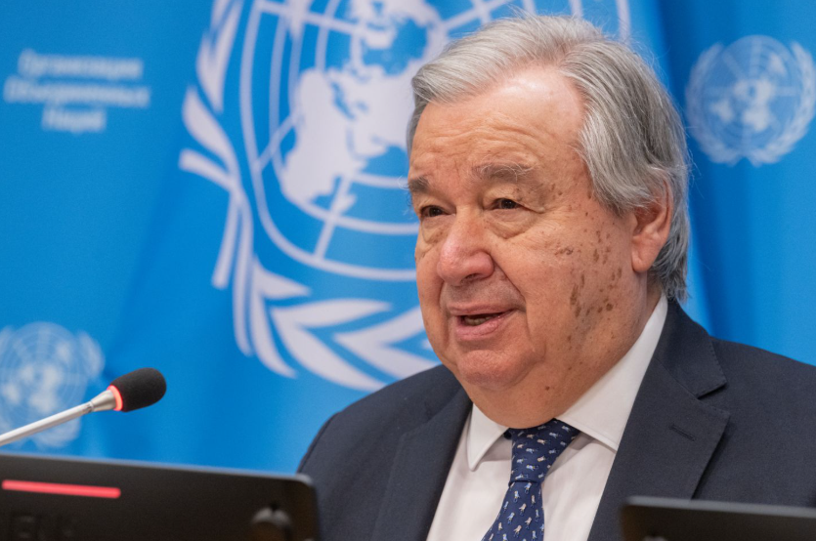
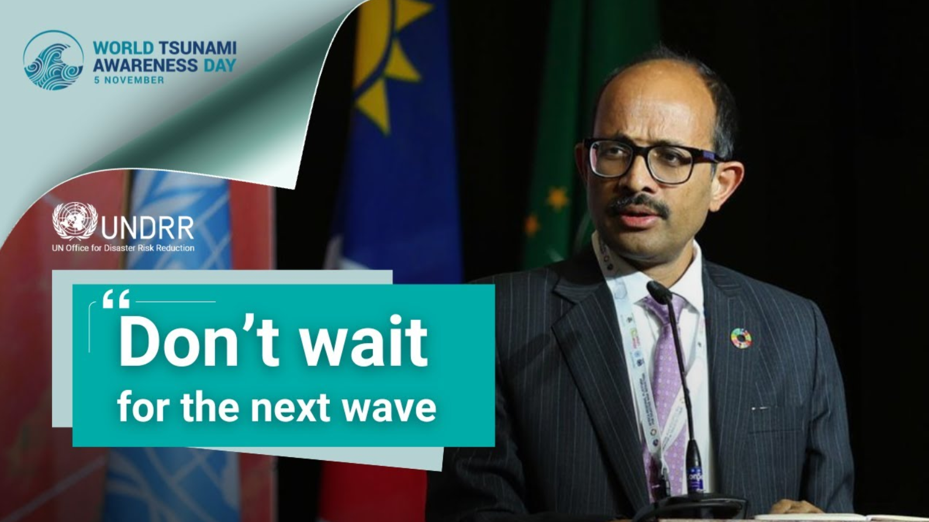
High-Level UN Messaging
Special Representative of the Secretary-General for Disaster Risk Reduction, Kamal Kishore, amplified the campaign through a video address.
UN Secretary-General António Guterres issued a dedicated message urging sustained investment in preparedness.

Slide 4
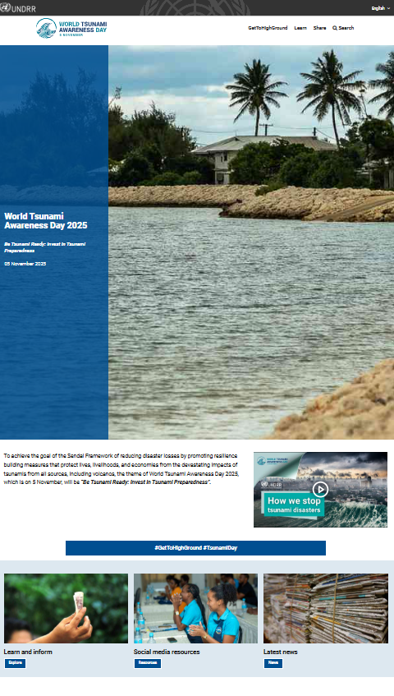
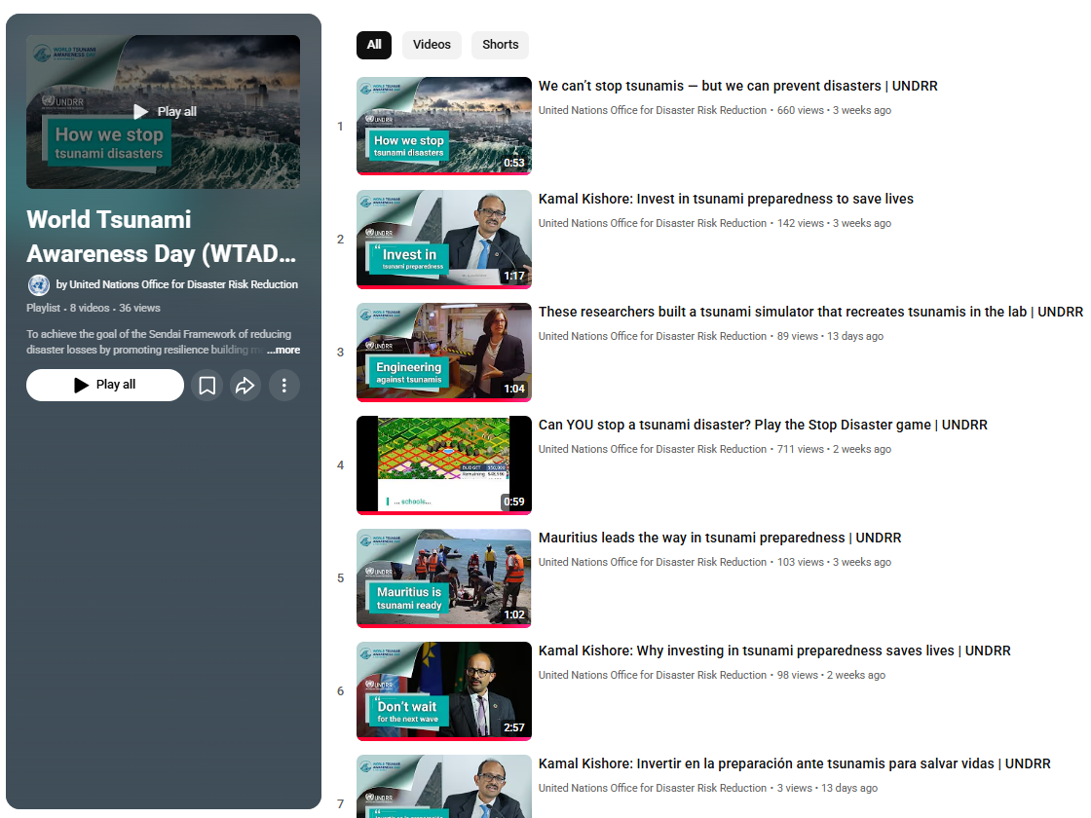
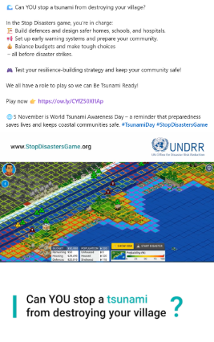
Digital Campaign: Reach and Engagement
Social Media (LinkedIn, X, Facebook): total impressions 1.05 million; cumulative follower base of participating partner accounts: 30.5 million
Website (UNDRR.org, PreventionWeb, WTAD Microsite): comparing to 2024, total views soared by 71% to 19,817; engaged sessions jumped 82% to 6,339
Stop Disasters Game, Tsunami Scenario: approx. total users – 40,000, total plays – 56,208

Slide 5
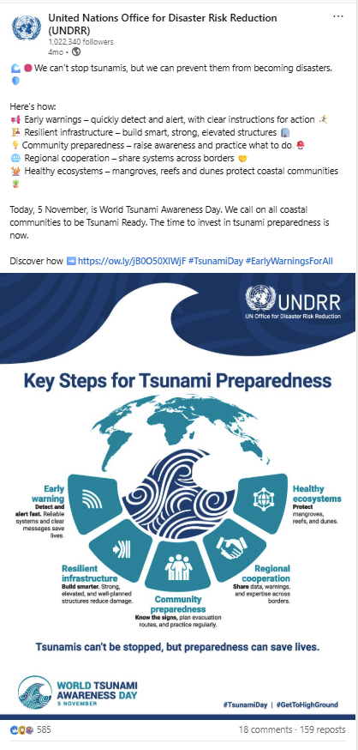
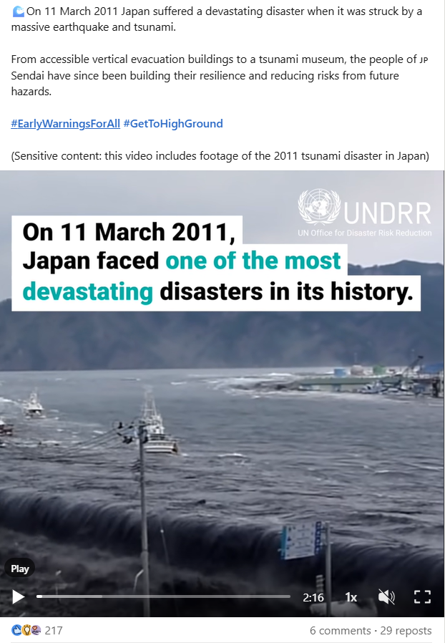
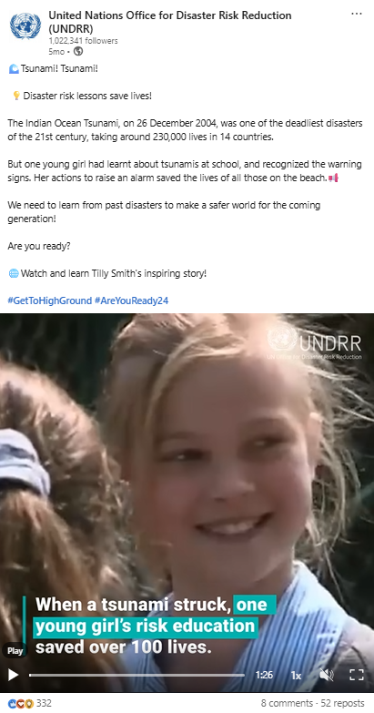
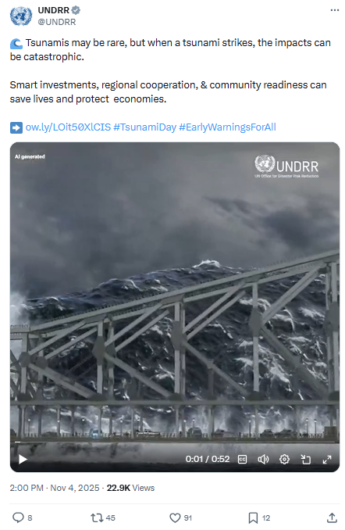
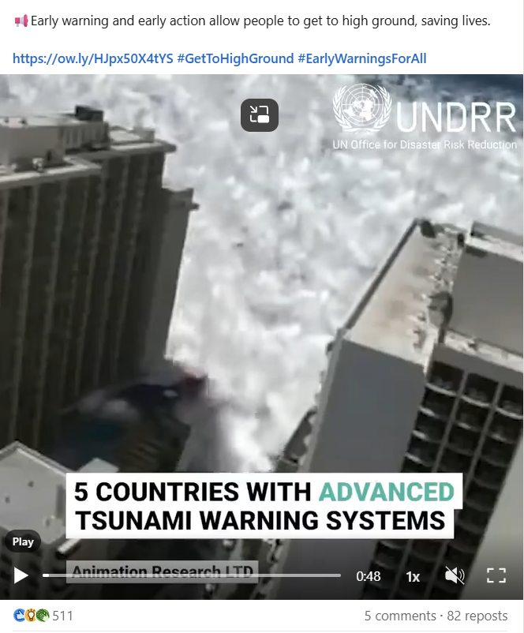
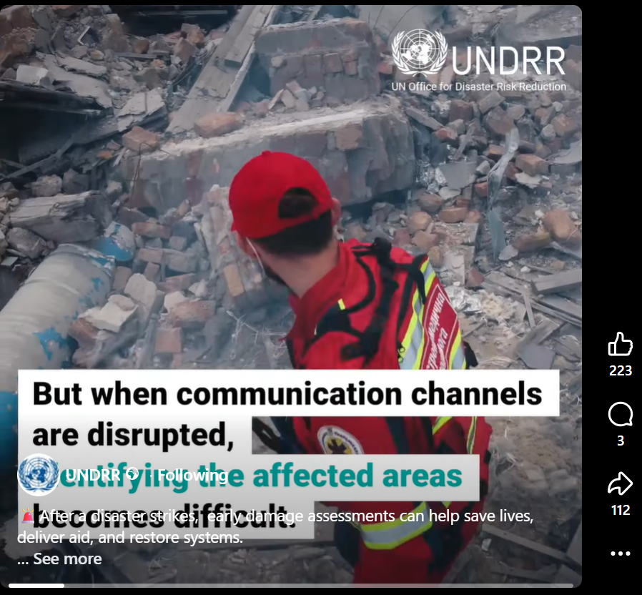
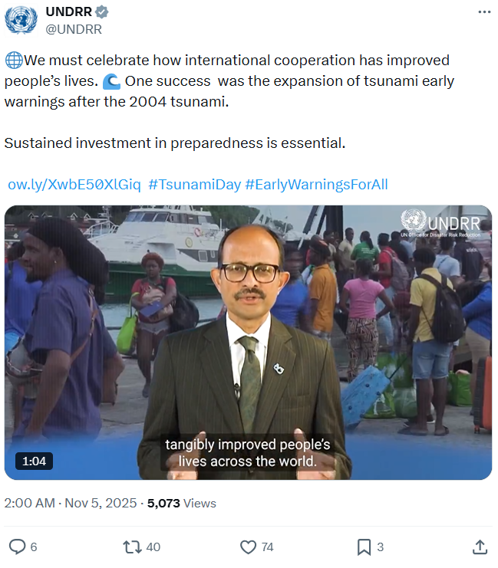
Best Performing Posts on Linkedin, Facebook, X
Linkedin
Facebook
X

Slide 6
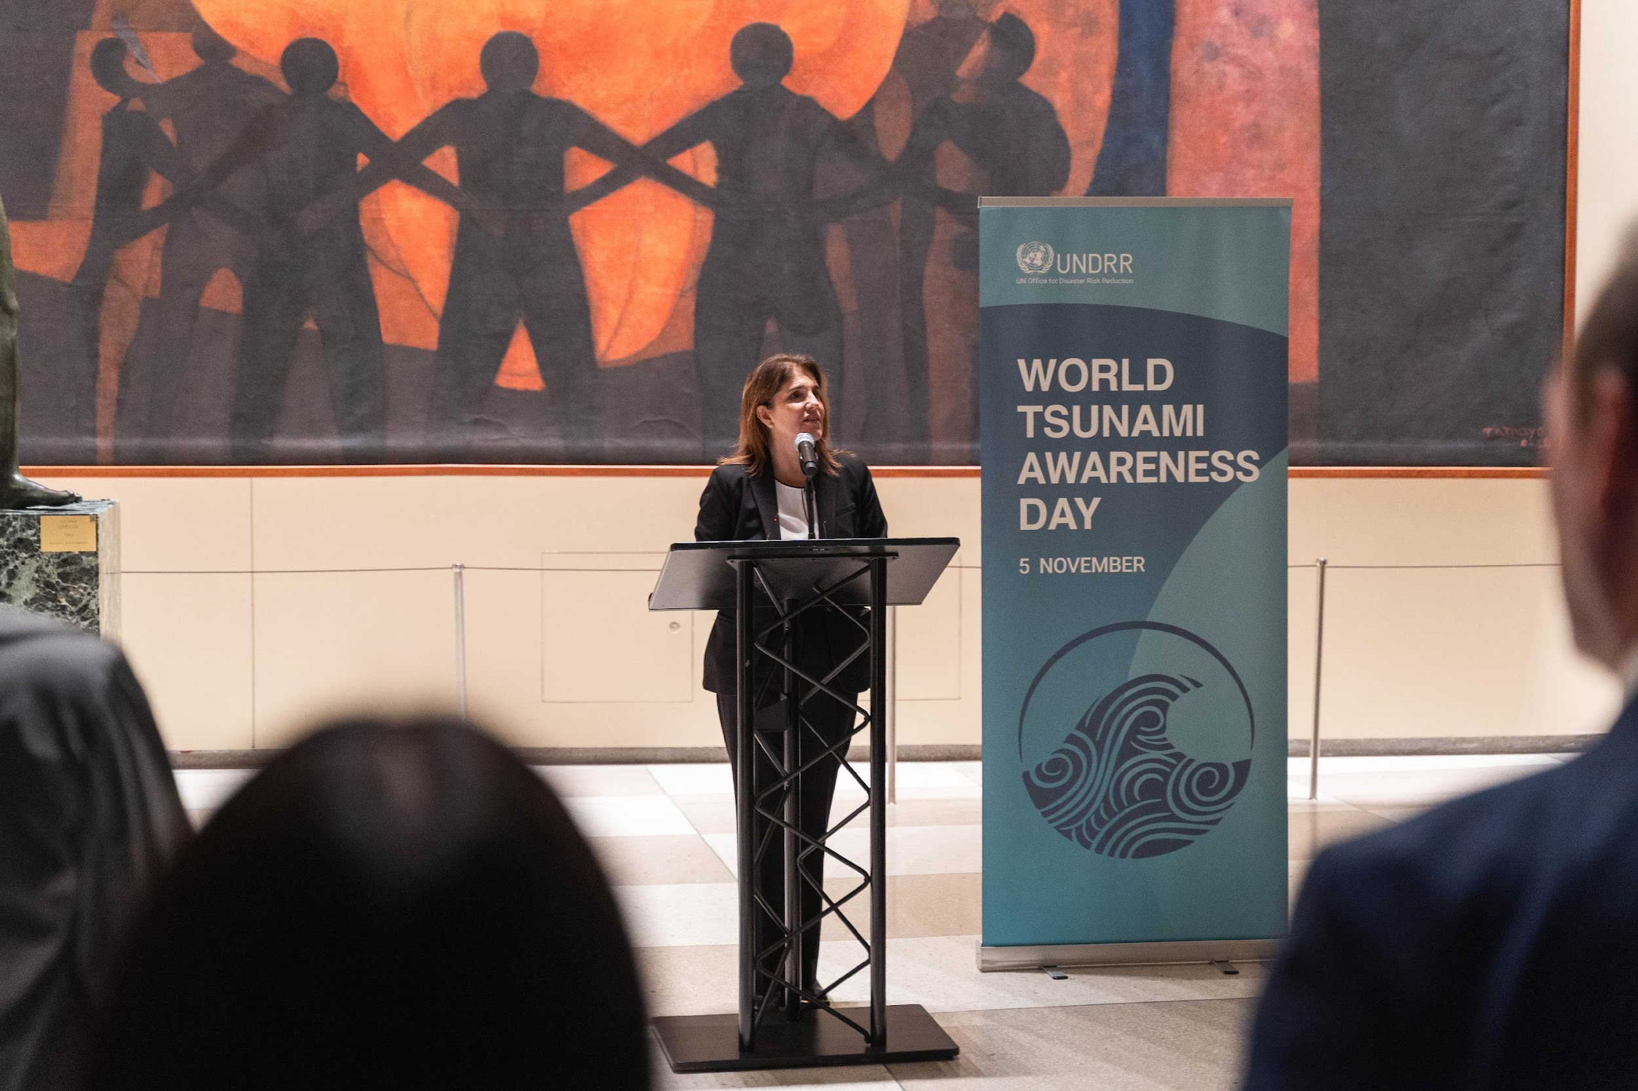
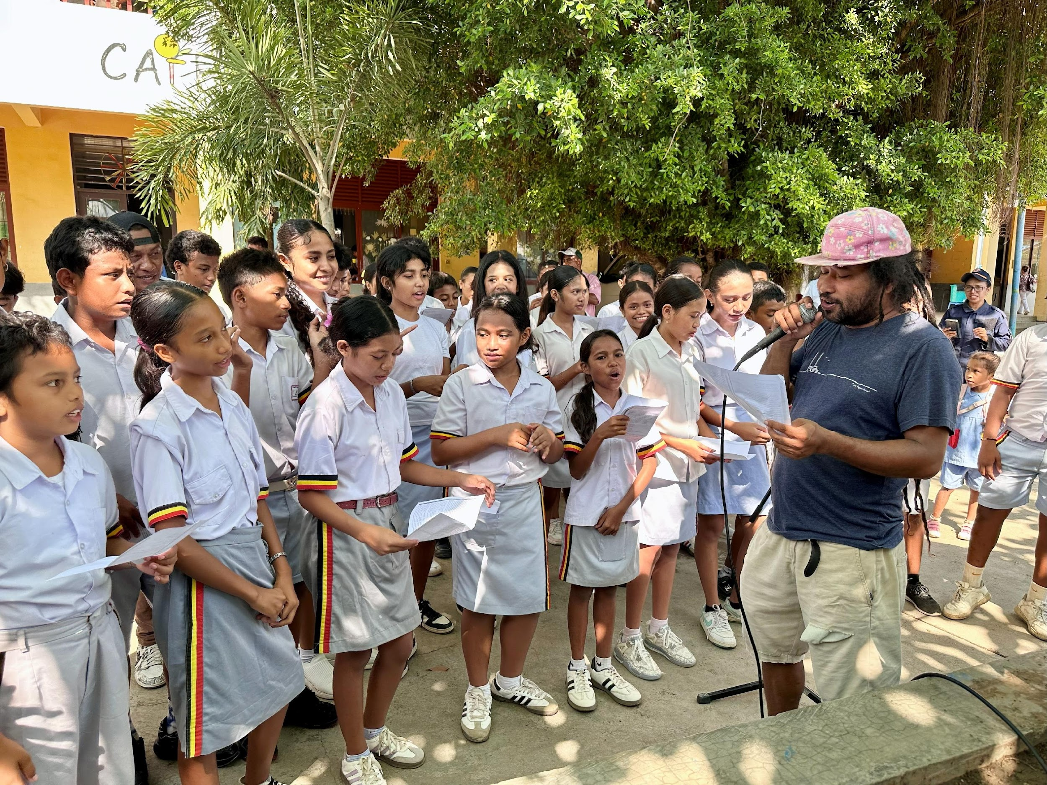
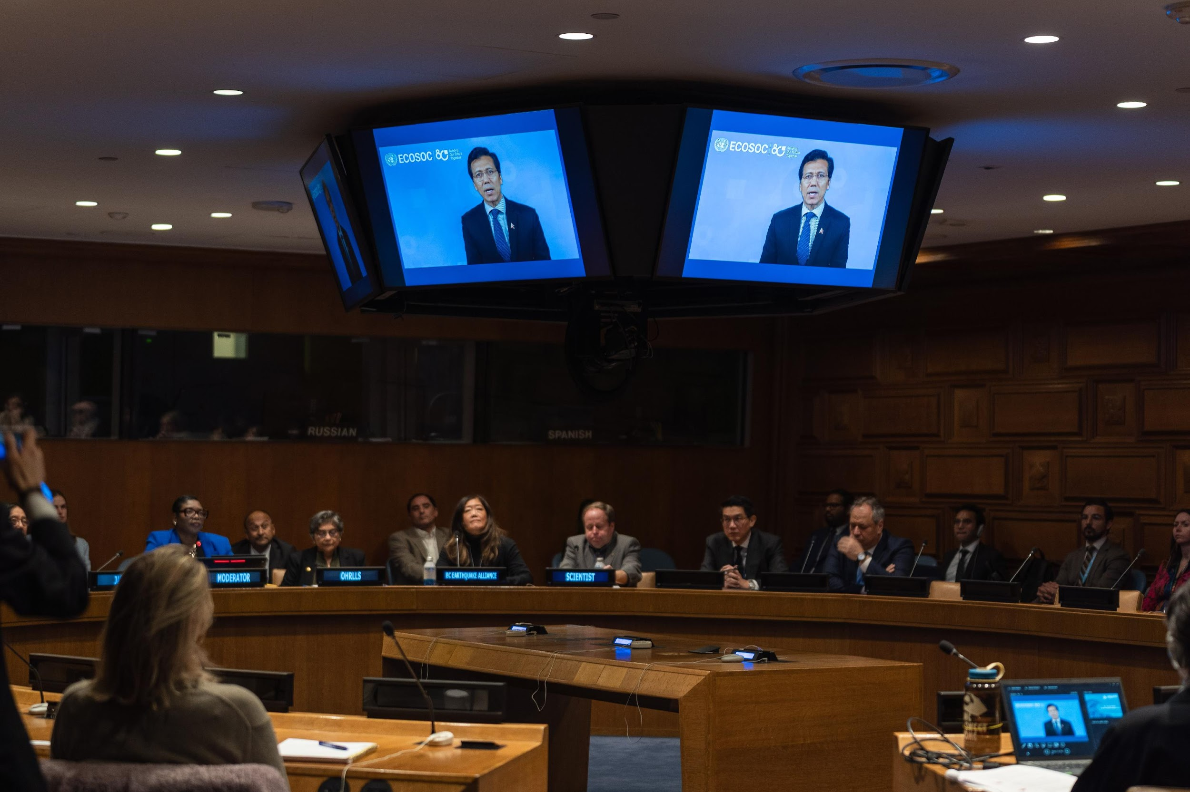
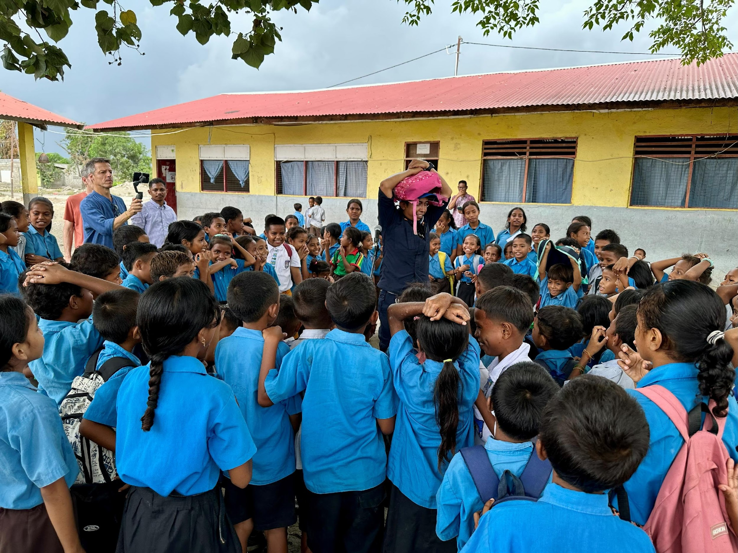
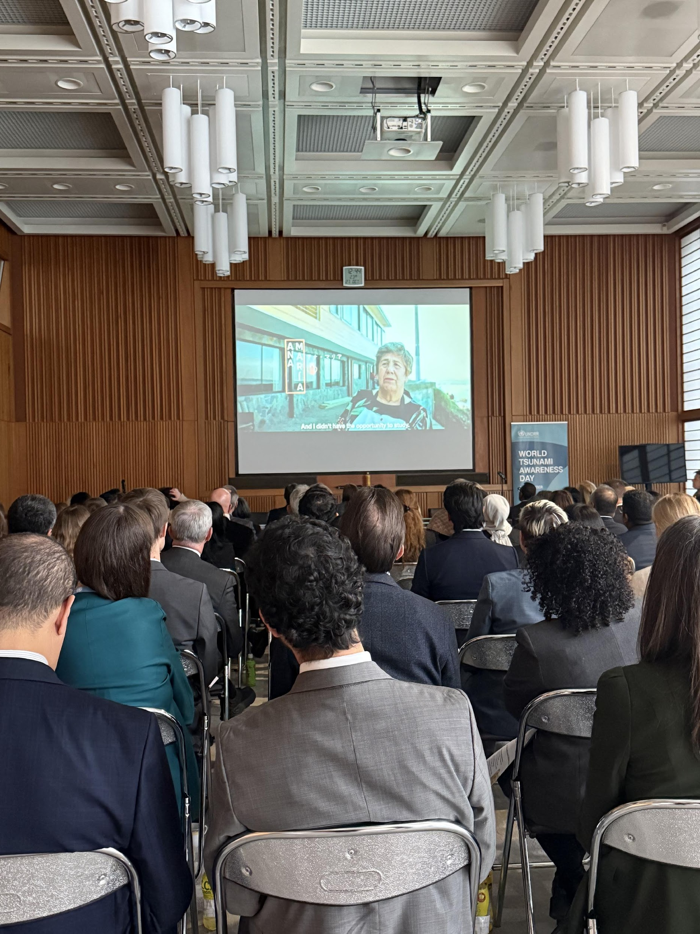
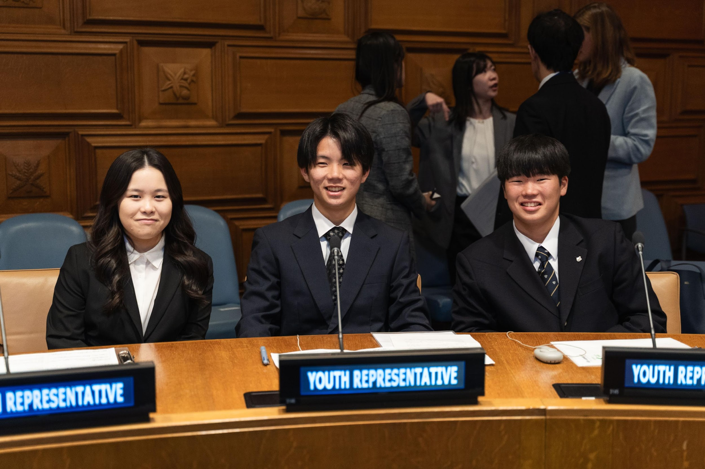

Hero Initiatives and Events
Geneva Film Screening & High-Level Panel, 27 October: Screening of Tsunami Ladies, panel with Japan, Chile, UNESCO IOC, and private sector.
New York High-Level Event, 5 November: Focus on financing preparedness; panel with Japan, Sri Lanka, Maldives, ECOSOC, OHRLLS, youth and academia
270th Commemoration in Portugal, Cascais, 1 November: High-visibility event elevated public awareness and local resilience through Tsunami Ready Programme
Timor-Leste, Dili Activation, 5-7 November: Music-based behavior change initiative with youth, #GetToHighGround community evacuation drill
IOWave Exercise in Mauritius, 25 October: Media coverage of the UNESCO IOC lead tsunami evacuation drill and cross-border simulation testing interoperability

Slide 7
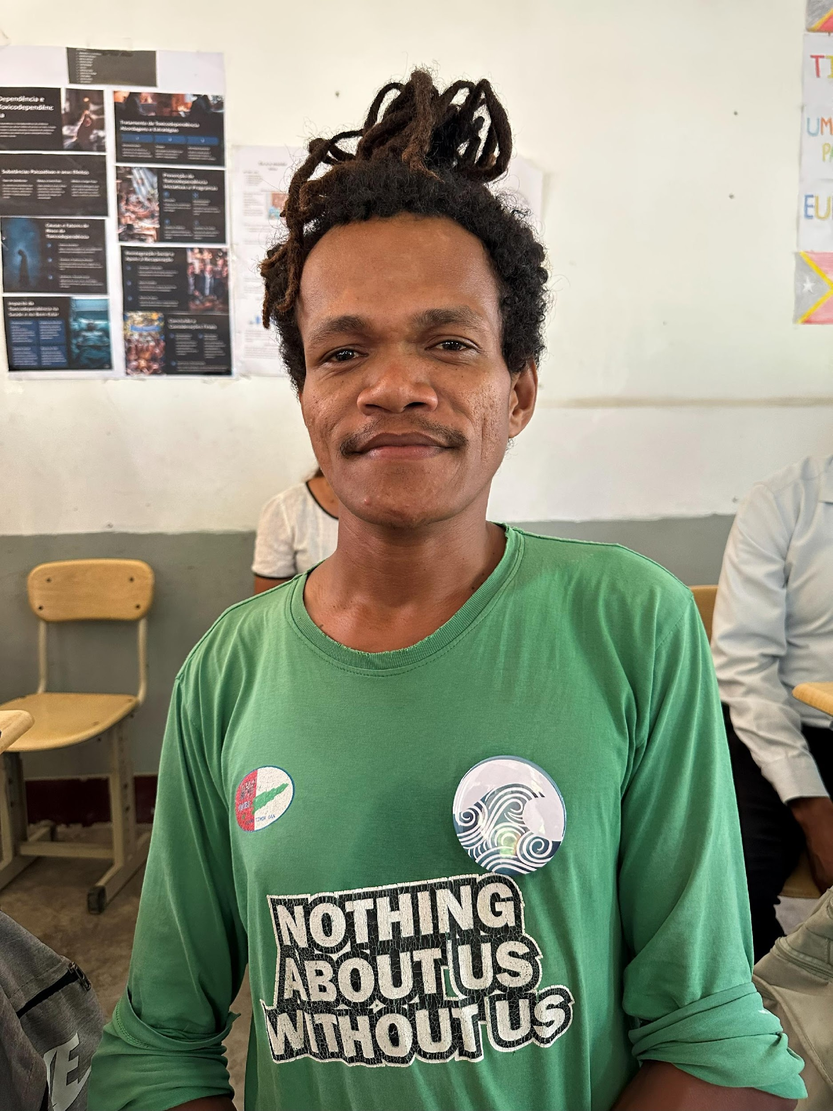
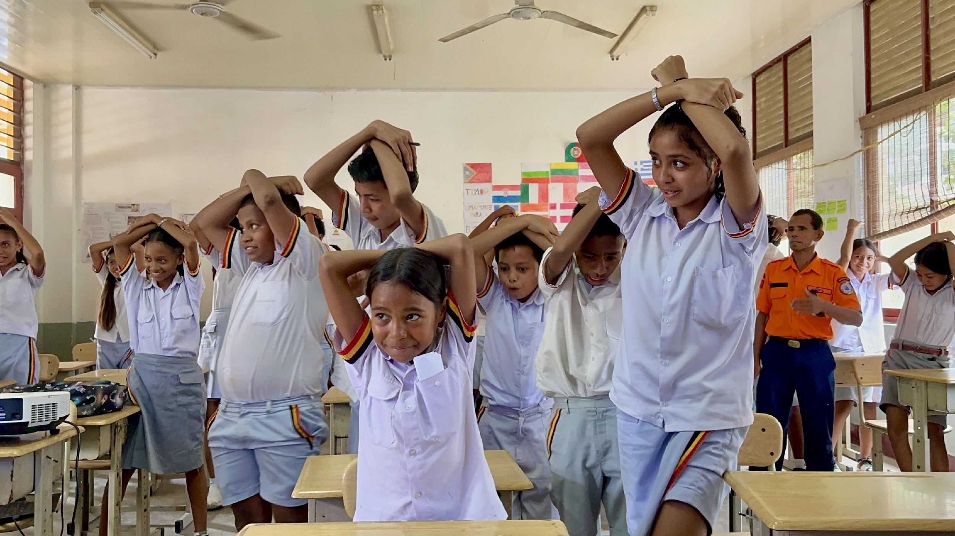
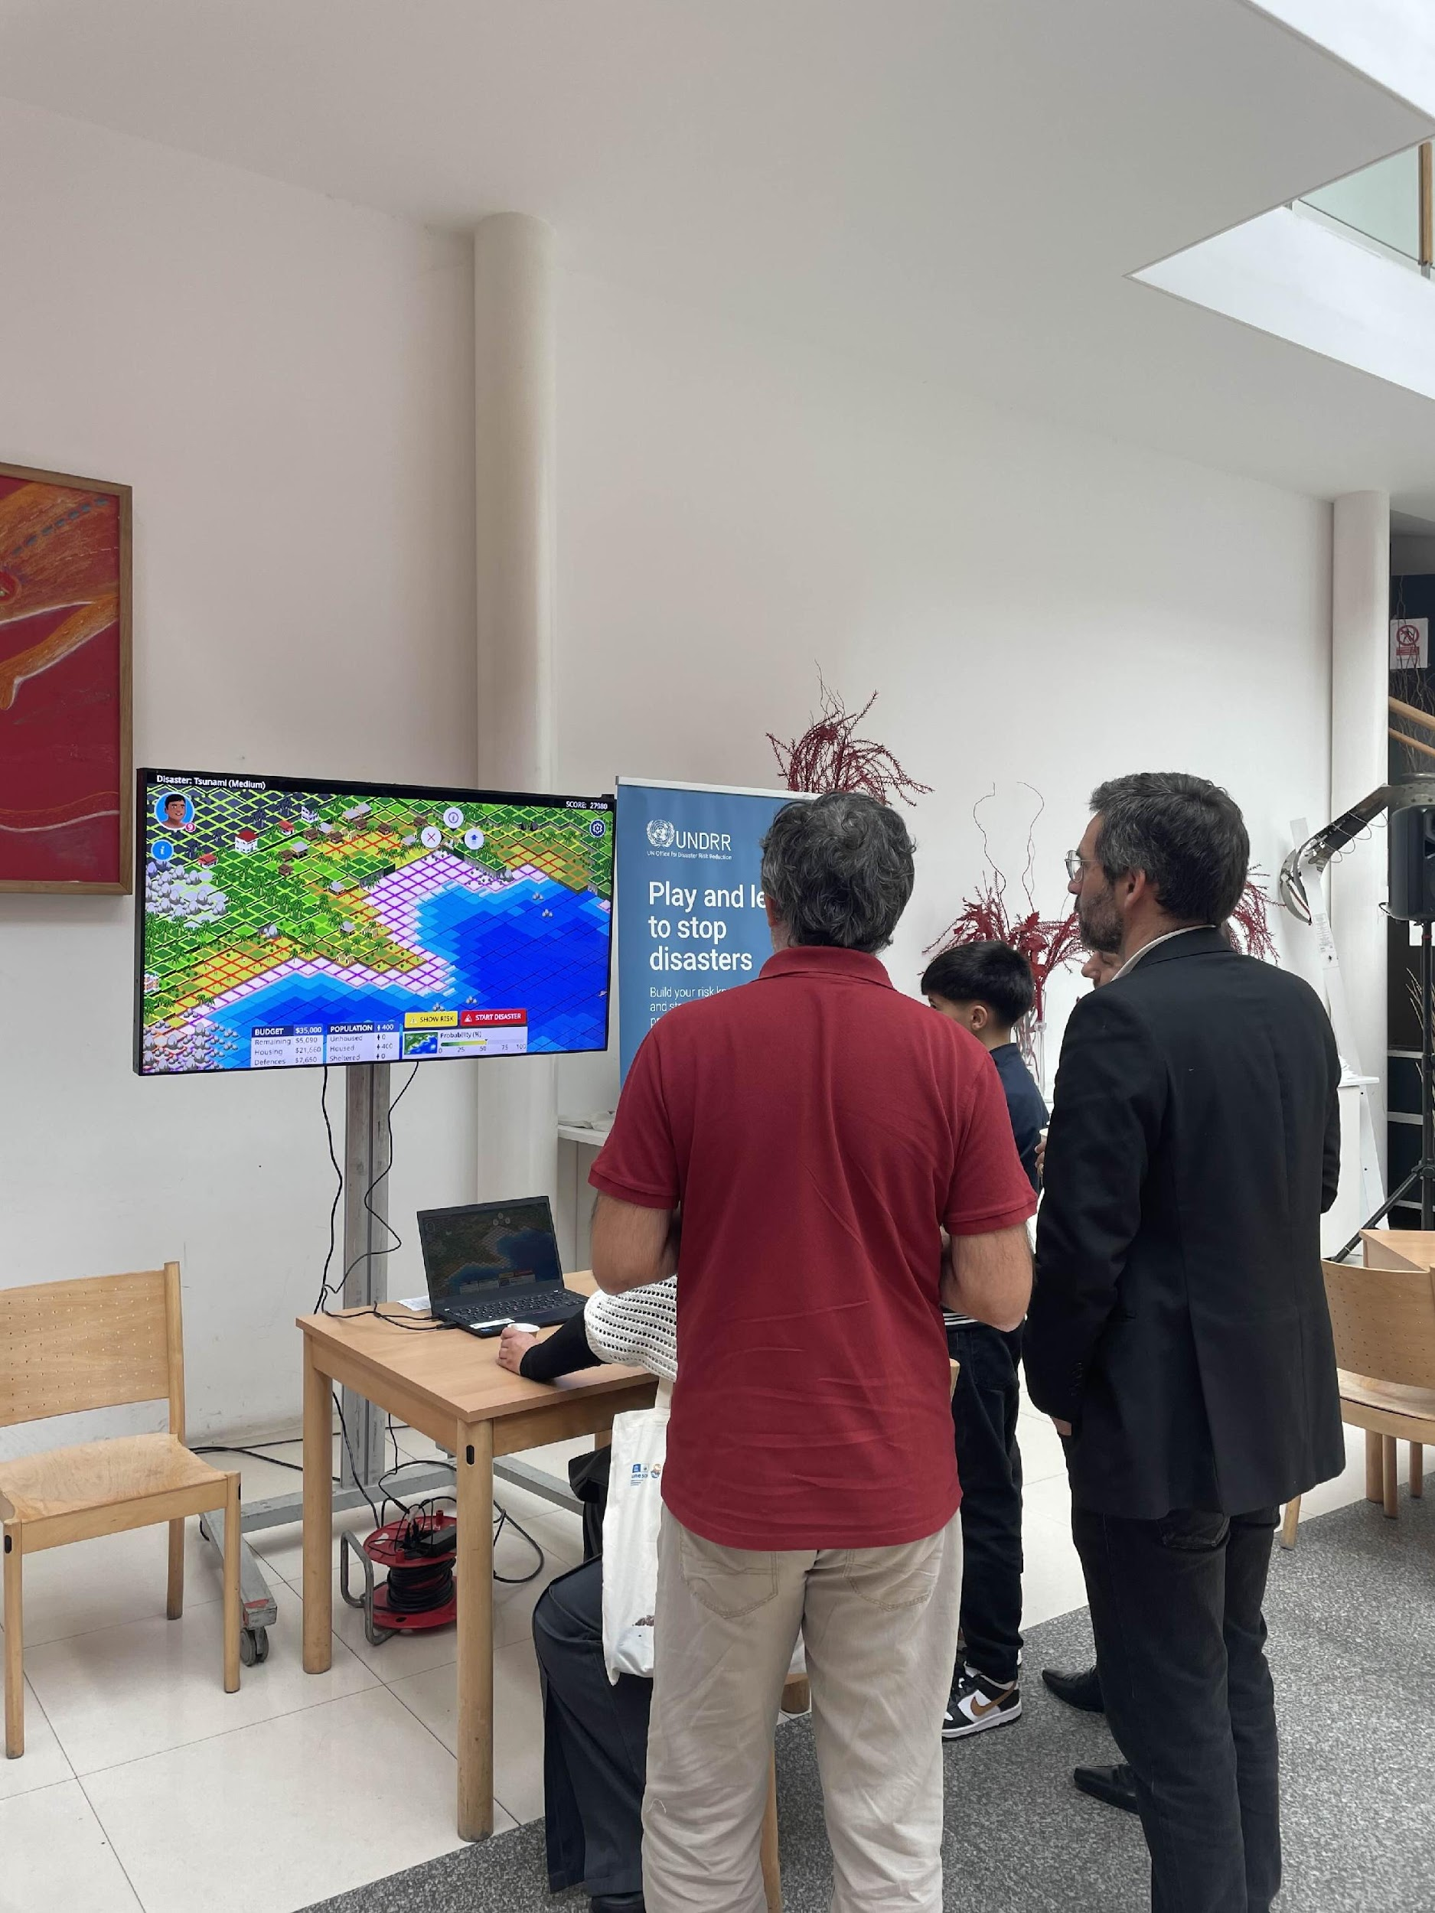
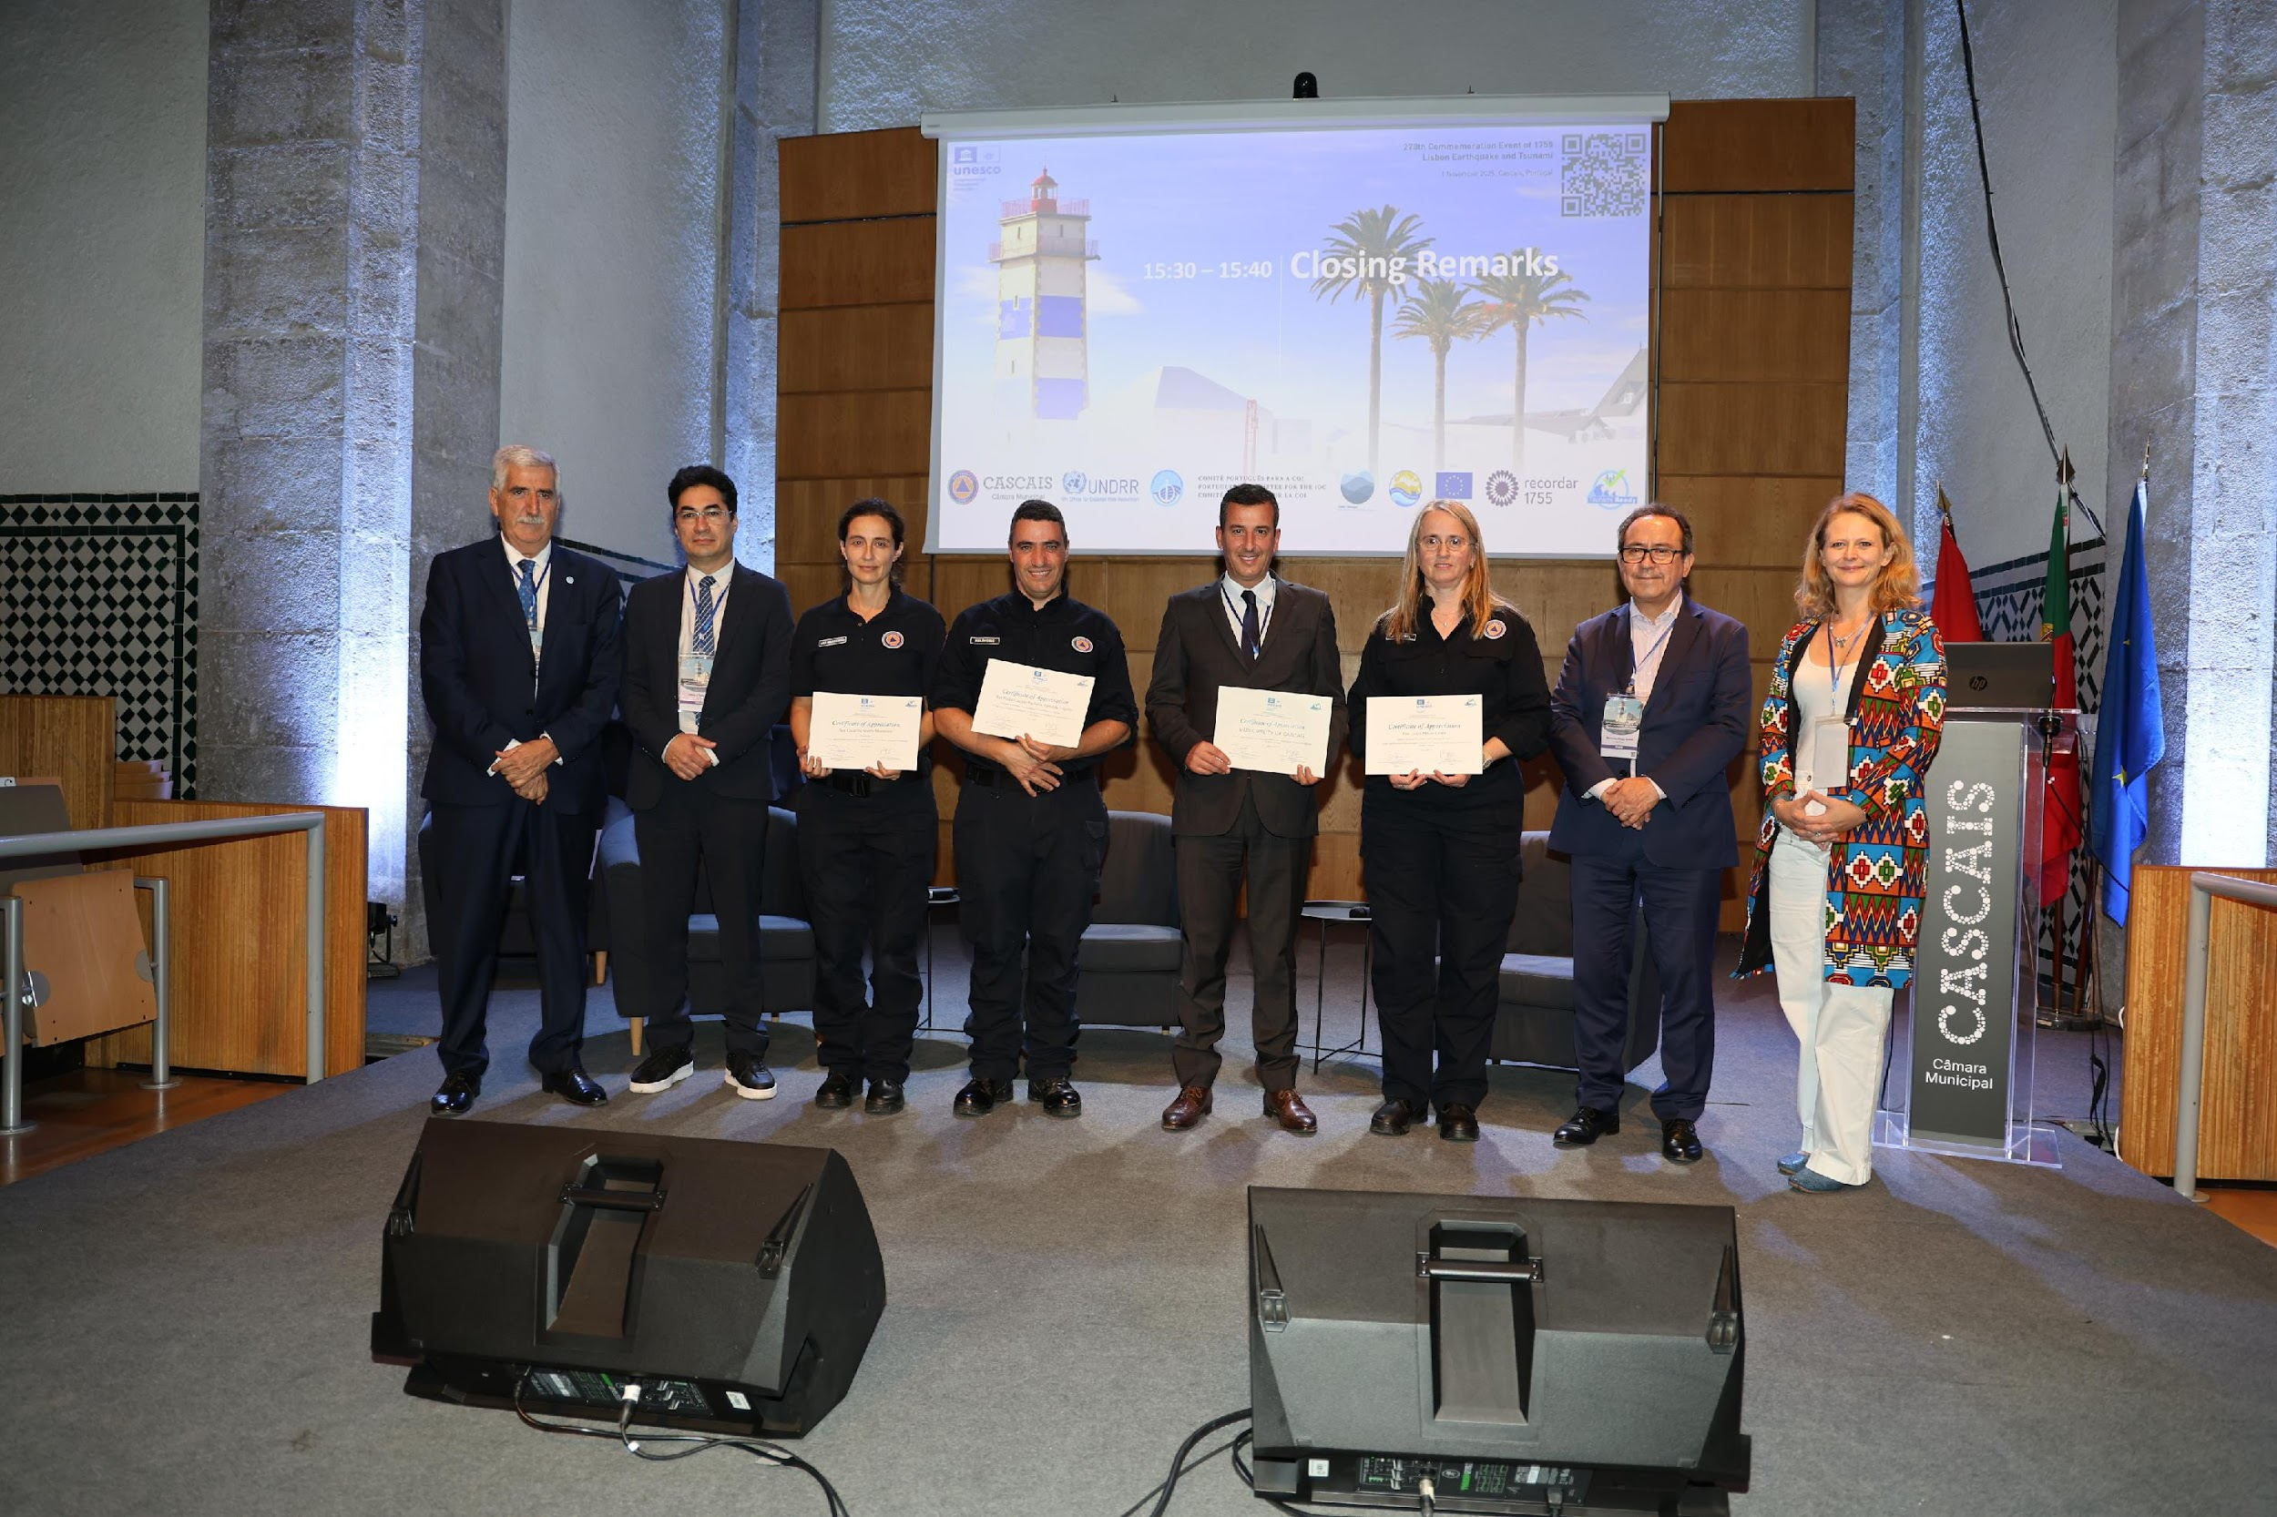
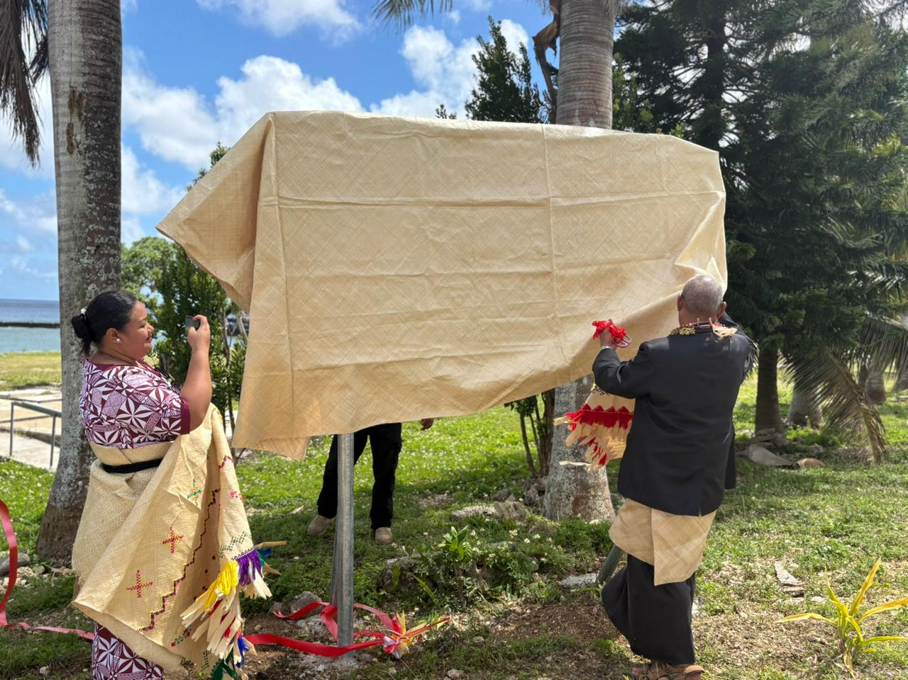
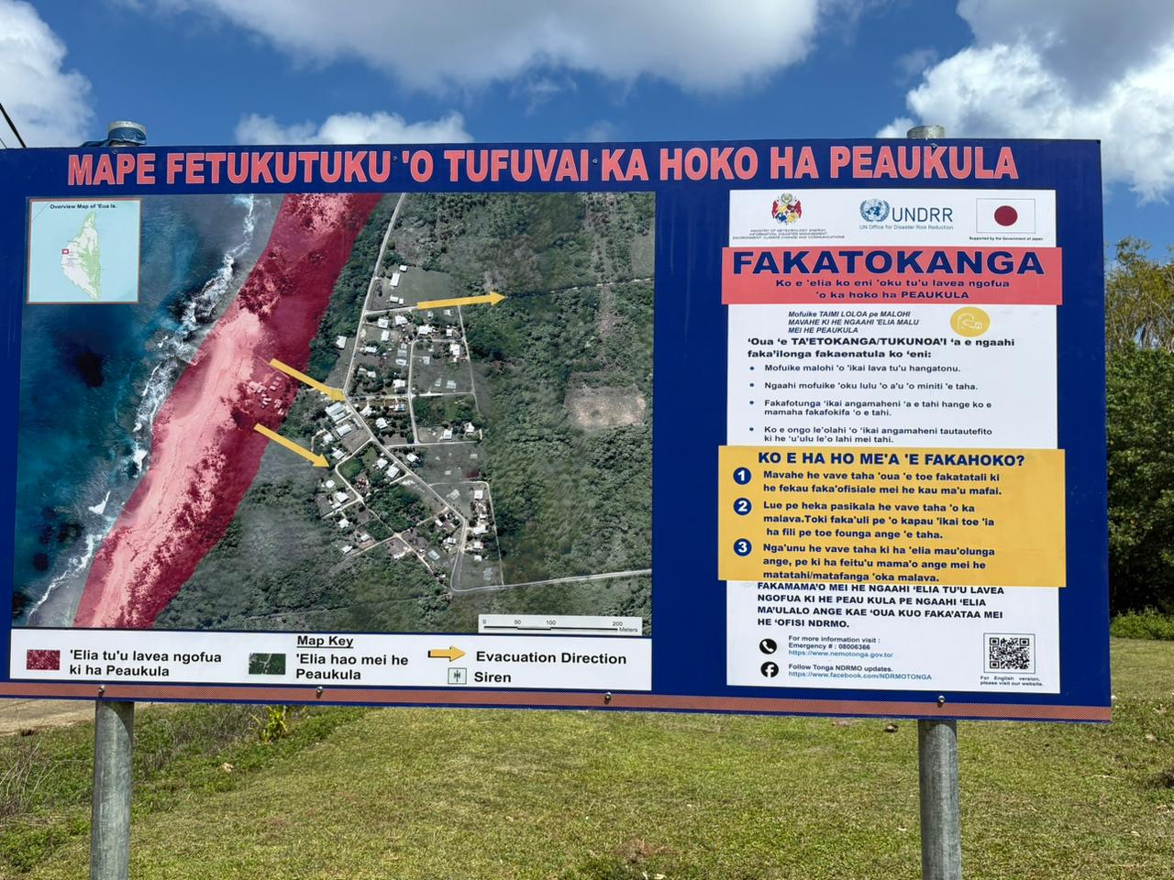
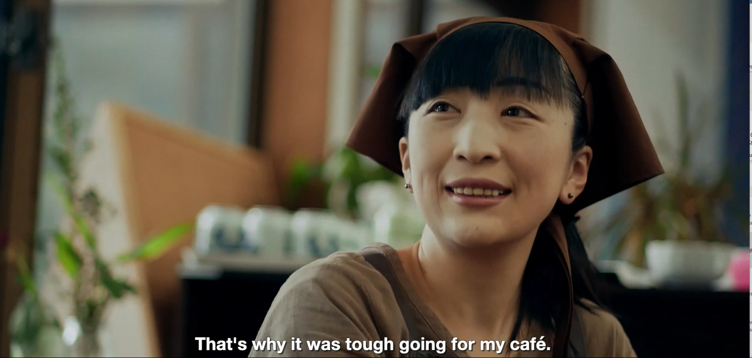
Hero Initiatives and Events
Tonga Sign Installation: Installation of 5 tsunami evacuation signboards in ʻEua
Regional Dialogue, 6 November: Session on tsunami warning communication and dissemination in the Americas and the Caribbean; shared lessons on data, risk assessment and inclusive early warning
Cairo Commemoration & Multi-Hazard Resilience Forum, 9 November: Event strengthened multi-hazard early warning, risk-informed education, and coordinated action to protect coastal communities in Egypt and the wider Arab region
Youth Summit in Japan, Sendai (27-28 November): Student-led international exchange on preparedness, innovation challenges and school evacuation drills
Online Game Stop Disasters: Interactive game to improve public preparedness by turning key tsunami-safety actions into quick, practical learning moments

Slide 8
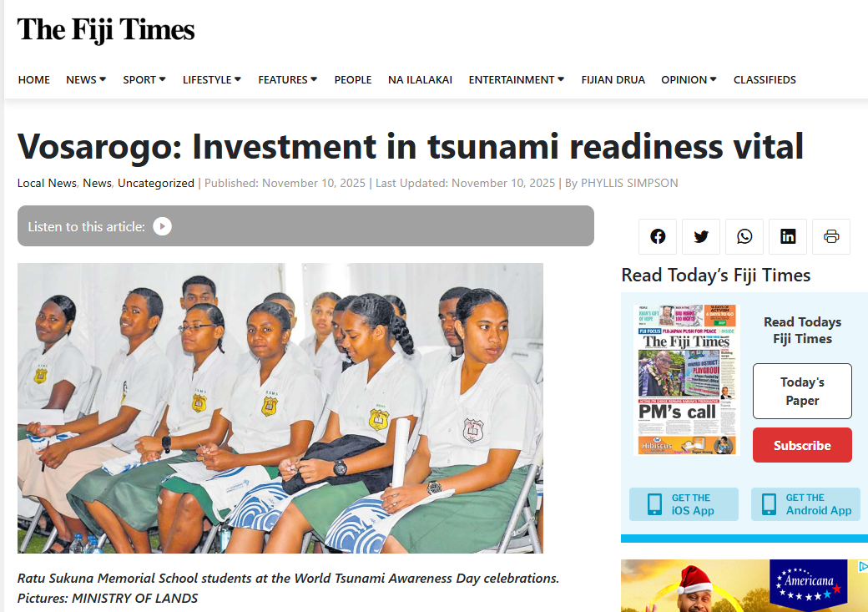
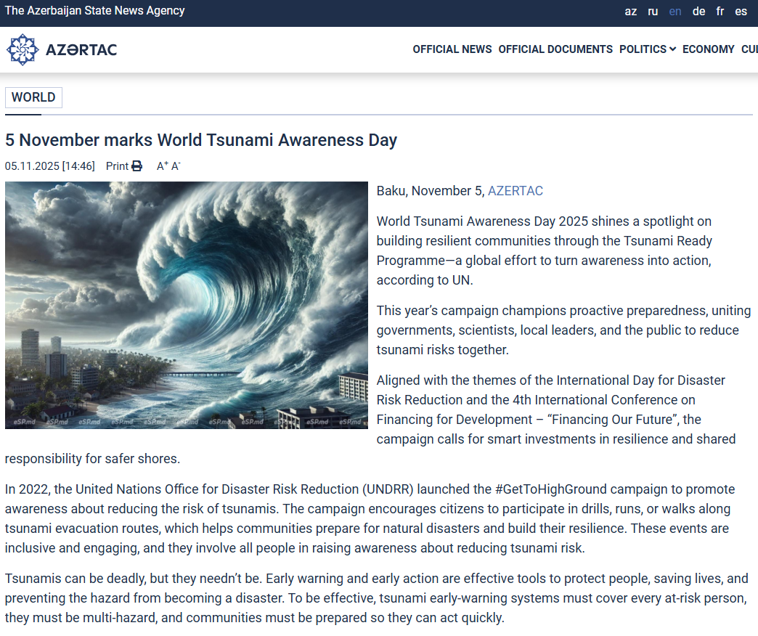
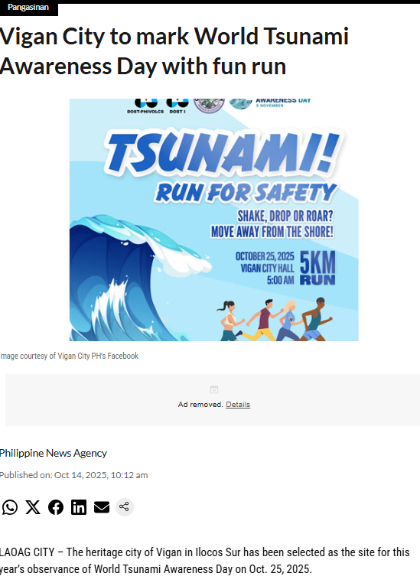
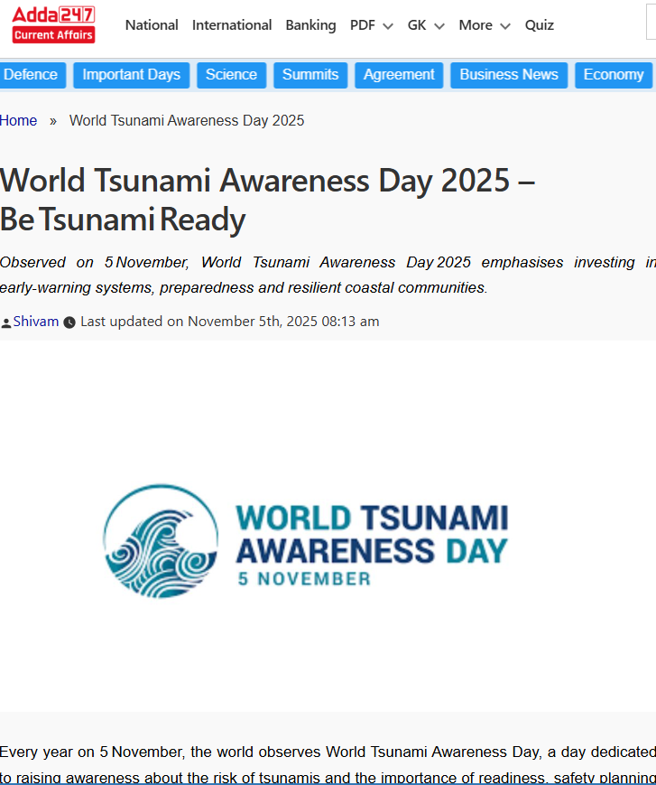
Coverage by Media Outlets
Total Articles Published: 36
Top Outlets: ReliefWeb, EIN News, Fiji Times, Barbados Today, Azertag
Total Reach: 686,6 million, Total Views: 1,2 million, Total Engagement: 256,200
Sentiment: overwhelmingly positive with focus on preparedness and early warning

Slide 9
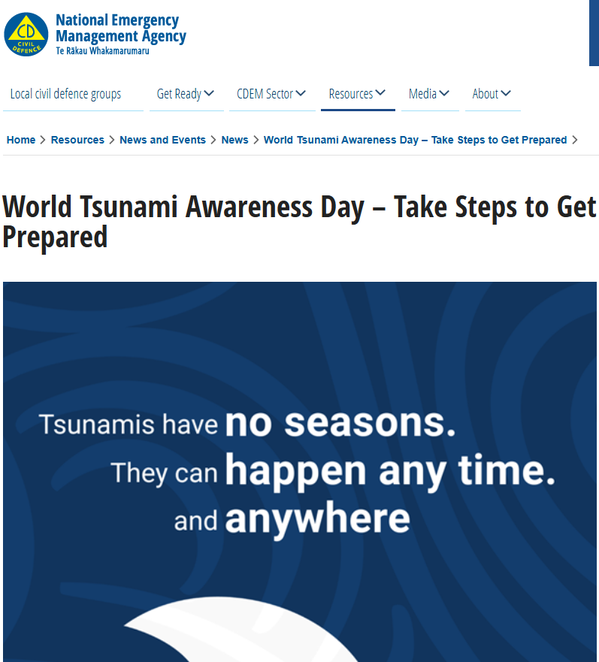
Policy Traction
New Zealand’s National Emergency Management Agency (NEMA) issued a public statement on 5 November 2025 reinforcing message on community readiness.
The President of Palau, Surangel S. Whipps Jr., declared September 2025 as “National Preparedness Month” and urged all citizens to adopt proactive preparedness measures.
Trinidad & Tobago’s Office of Disaster Preparedness and Management (ODPM) issued a public message on 5 November 2025 on the of smart investments in preparedness.
On 5th November, Australian Institute for Disaster Resilience (AIDR) launched a newly revised Tsunami Emergency Planning in Australia Handbook.

Slide 10
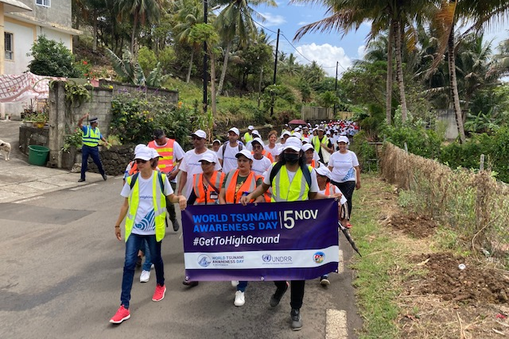
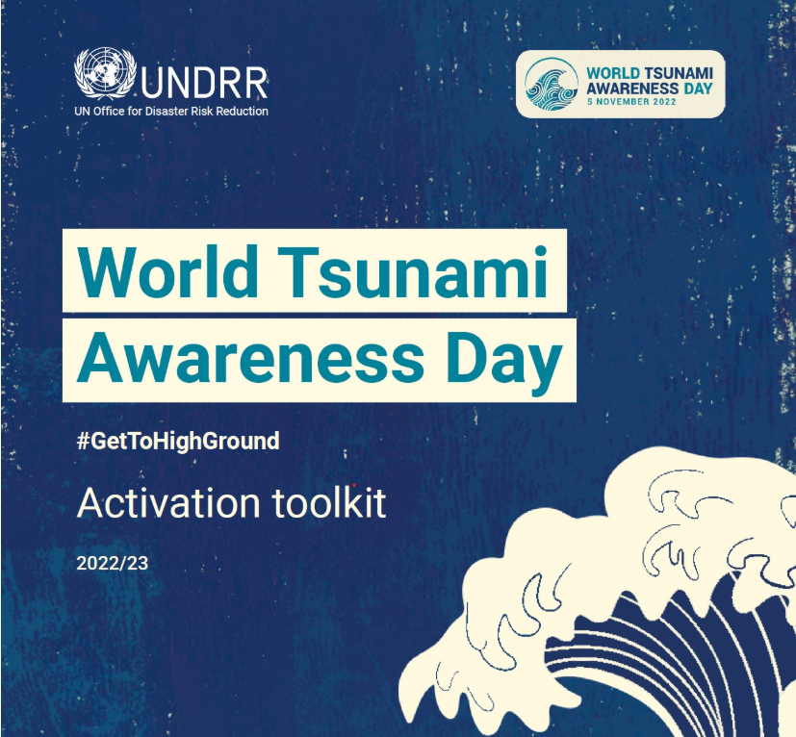
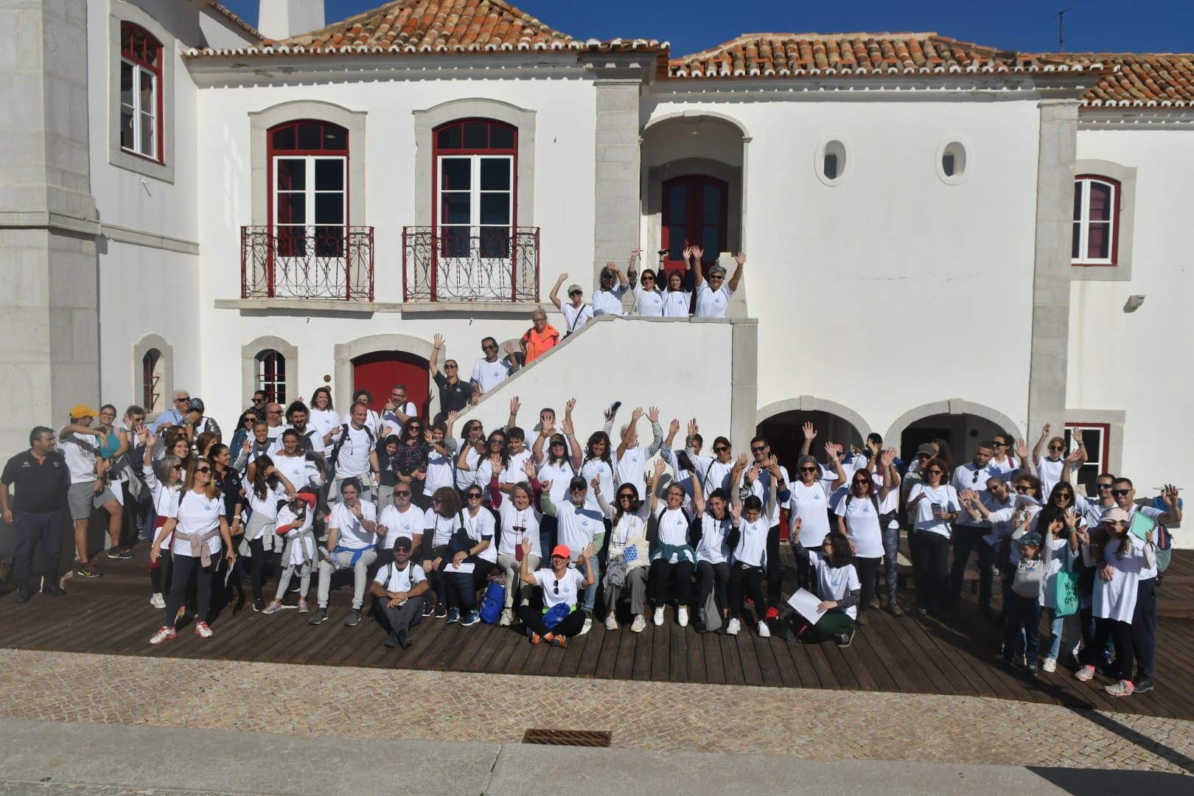
Looking Ahead:
WTAD 2026: #GetToHighGround Campaign
Citizen Engagement: Building a culture of tsunami and other coastal hazards awareness for all people at risk
Engaging citizens in symbolic walks along the tsunami evacuation routes
Country examples:
    Mauritius: 250+ participants with a military marching band, training session after
    Portugal: 100+ participants, Secretary of State for Home Affairs Patricia Gaspard

Slide 11
Reach out to collaborate
Louise Xi LI
Head of Campaigns and Community, UNDRR
xi.li@un.org

