Slide 1
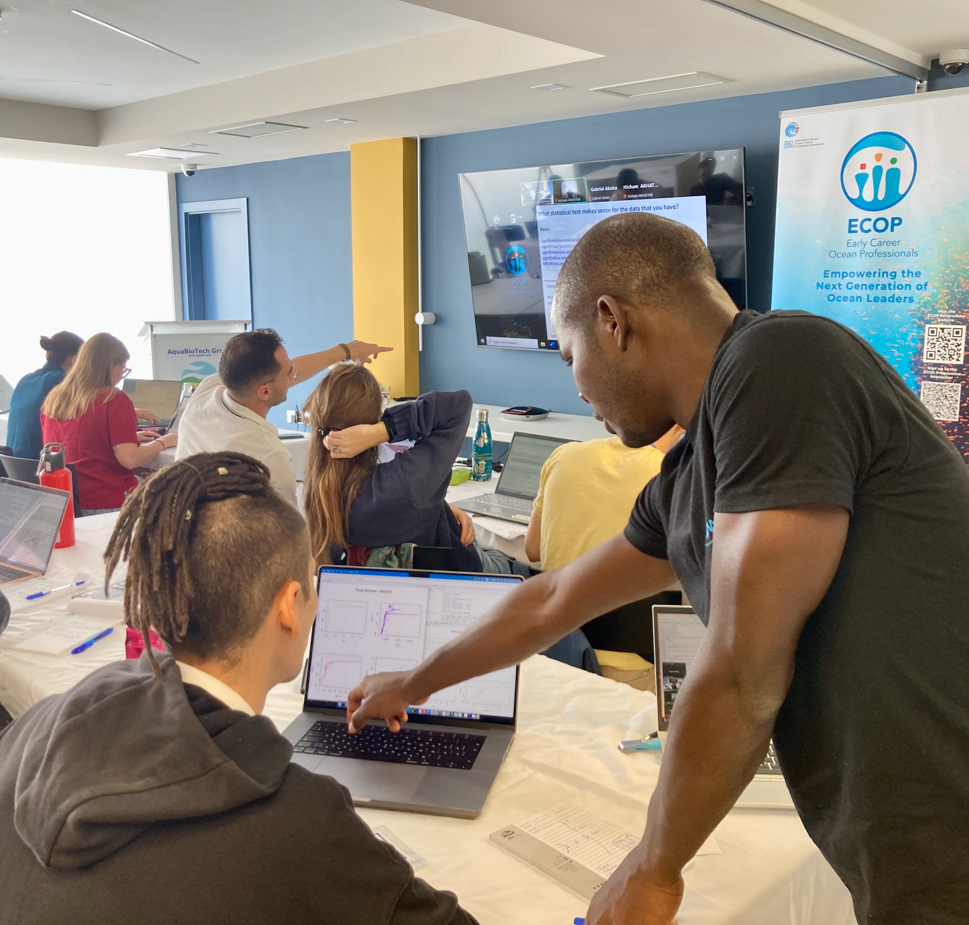
Empowering the global community with the blue skills of the future

Slide 2

The OceanTeacher Global Academy is IOC’s training platform and learning management system, enabled by a global network of Regional and Specialised Training Centres, and affiliated partners, aiming to build equitable capacity in ocean science, observations, and services worldwide through knowledge sharing and coordinated training.
OTGA is a flagship component of IOC Capacity Development action, ross-cutting, supporting the implementation of its strategic framework.

Slide 3
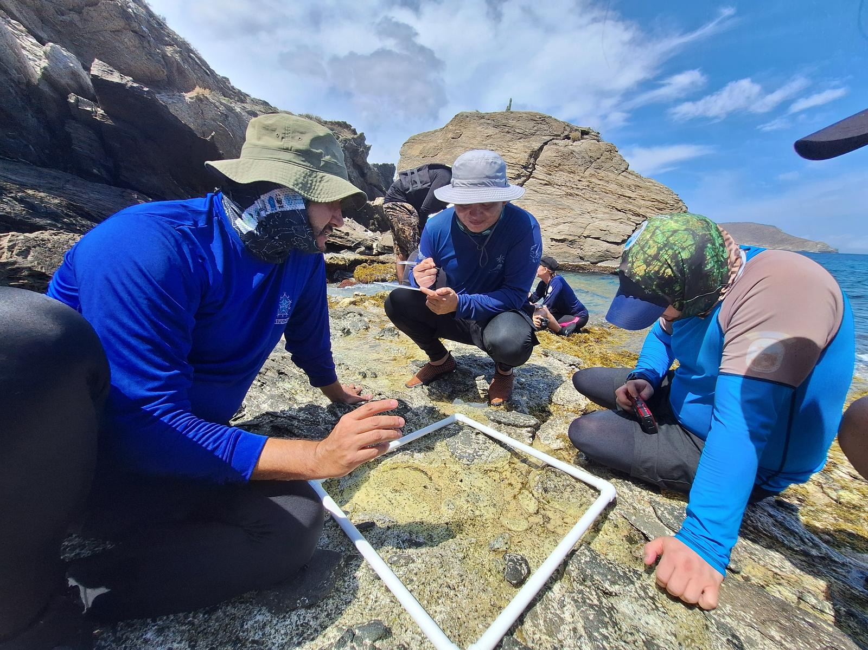
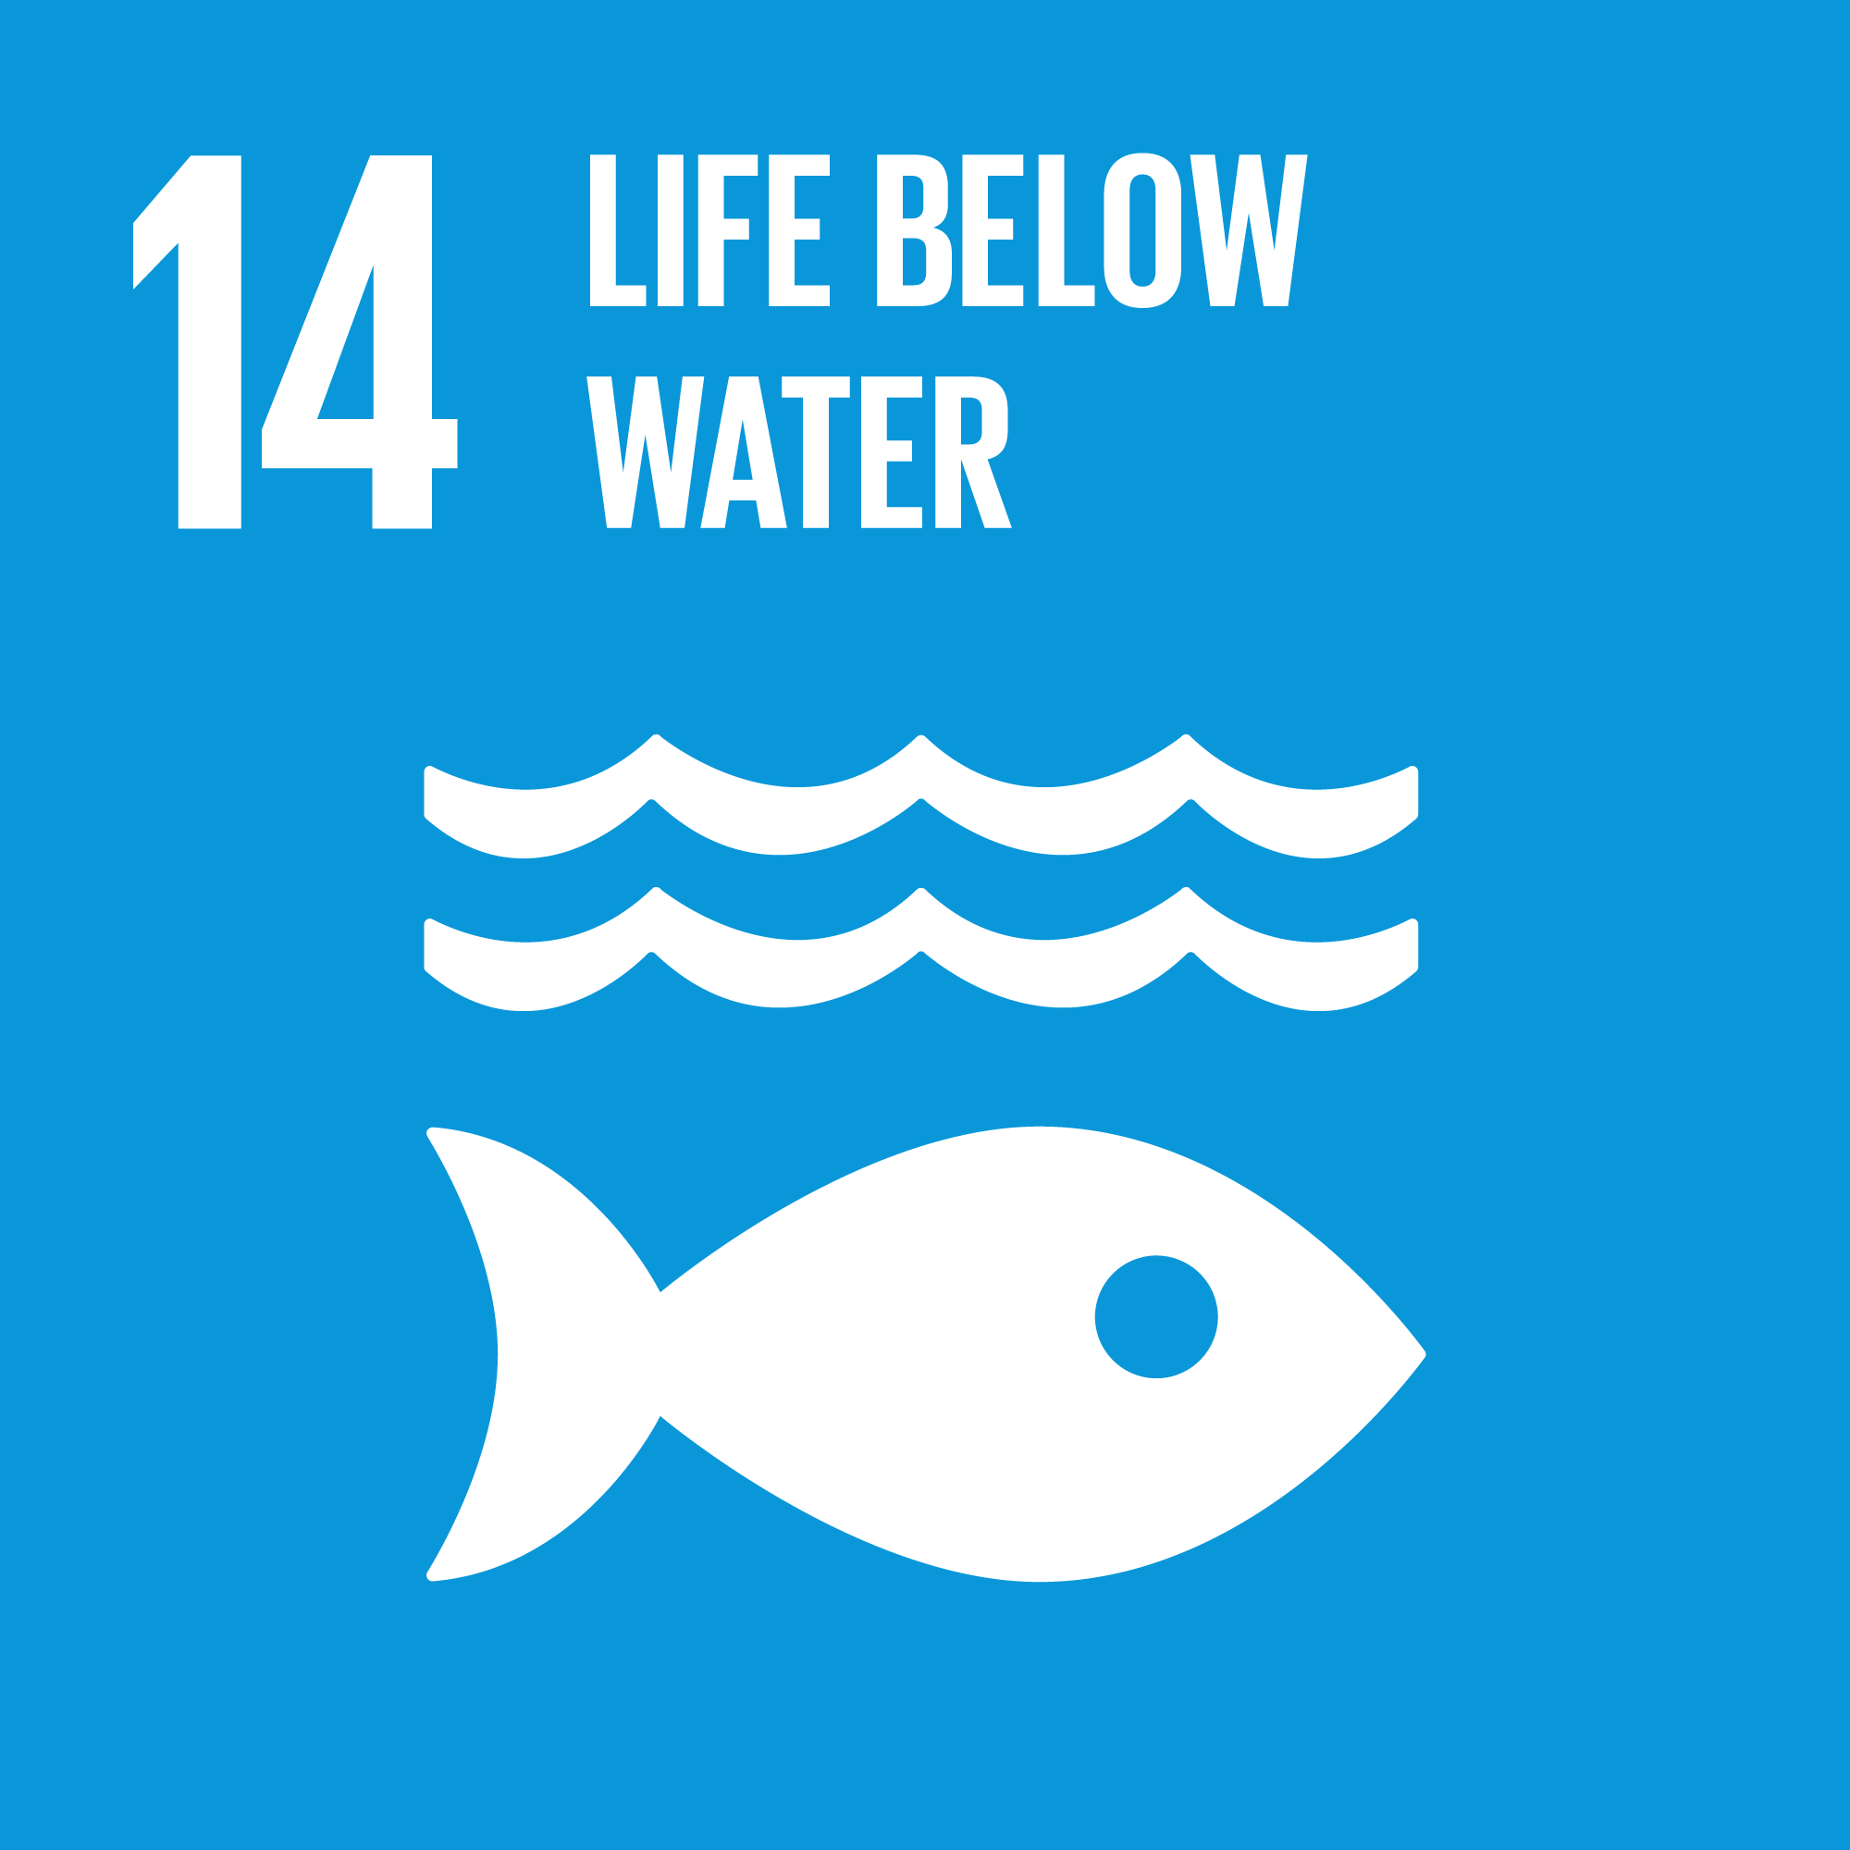

OceanTeacher Global Academy
OTGA provides a complete set of learning services and products, standardized, accredited, openly and freely available to the ocean community.
OTGA equips communities and countries with the skills needed to make impactful ocean decisions and policies, building on a legacy of decades of training initiatives led or facilitated by IOC Programmes, Regional Sub-Commissions, and Member States.
17 RTC/STC
+100 partners
1000 facilitators
4 languages
2K hours/y
ISO certified
1800 learners
187 countries

Slide 4


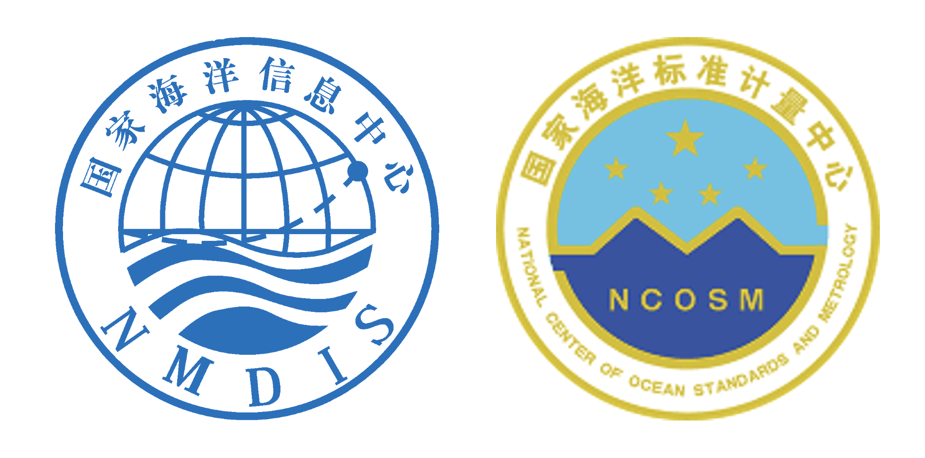

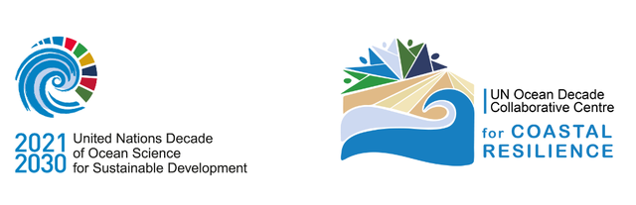
OceanTeacher Global Academy
STC
International Tsunami Information Centre
RTC
India
RTC
China
STC
Indonesia
DCC
Coastal Resilience

Slide 5
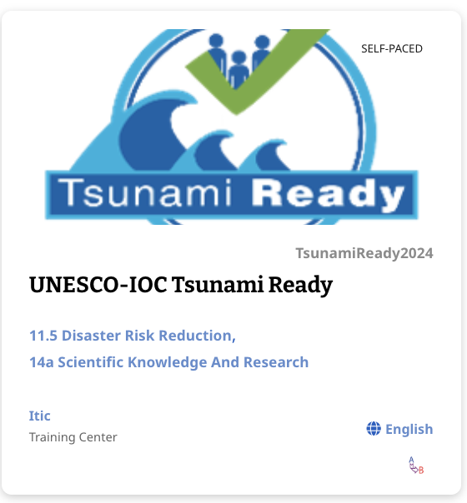
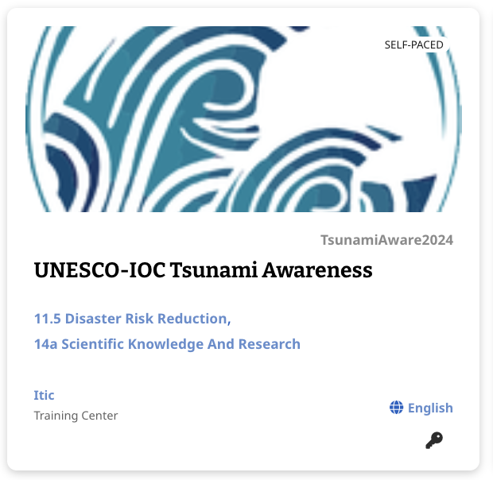
OceanTeacher Global Academy
5 years results and impact - TSUNAMI
Since 2024
Online self-paced
486 participants
6h training
102 Countries (17 in Africa, 30 SIDs)
Since 2025
Online self-paced
244 participants
6h training
74 Countries (6 in Africa, 21 SIDs)

Slide 6
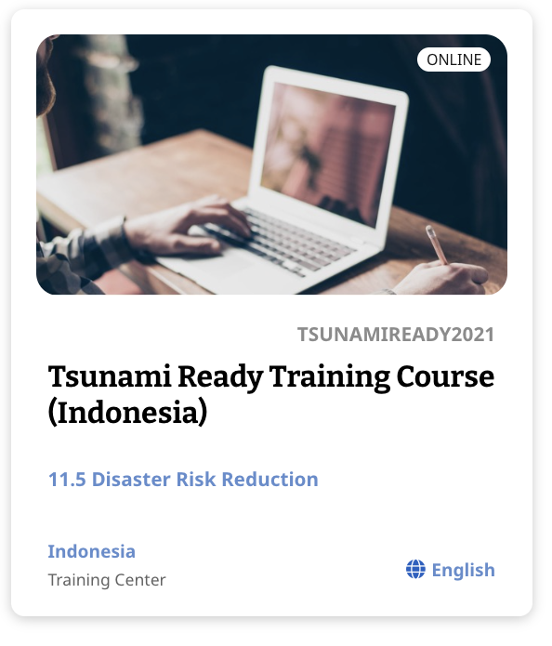
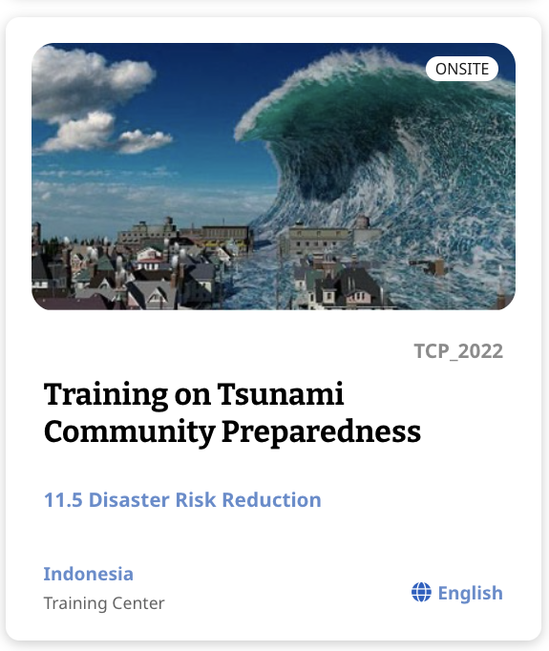
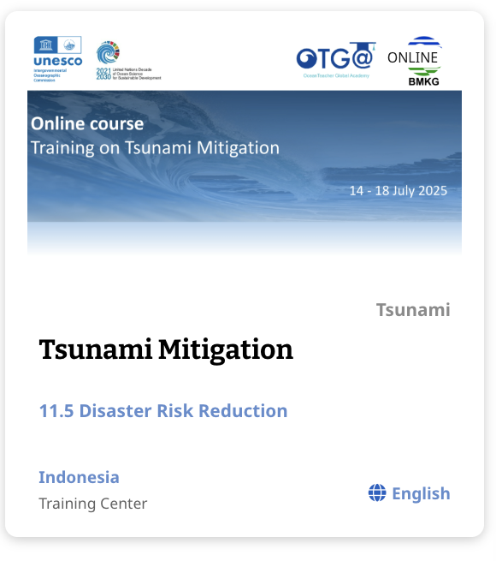
OceanTeacher Global Academy
5 years results and impact - TSUNAMI
2021
online
81 participants
30h training
15 Countries (2 SIDs)
2022
Face-to-face
30 participants
45h training
6 Countries (1 in Africa, 1 SIDs)
2025
online
22 participants
42h training
14 Countries (1 in Africa, 3 SIDs)

Slide 7
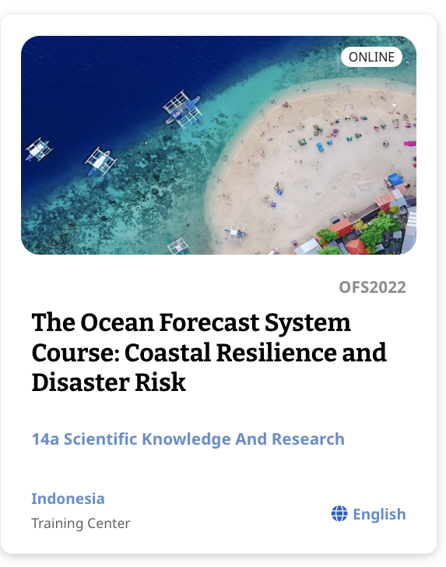
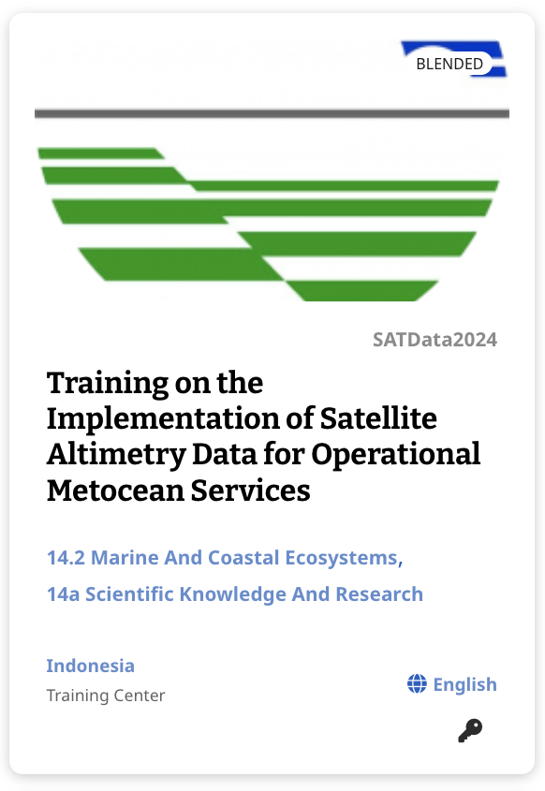
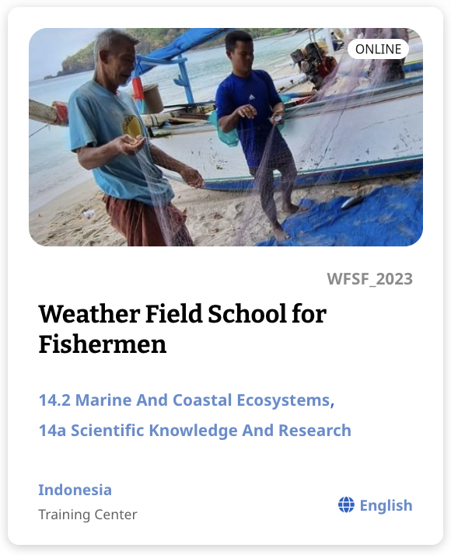
OceanTeacher Global Academy
5 years results and impact – Other hazards
2021, 2022, 2023, 2024
online
216 participants
+200h training
30 Countries (8 in Africa, 3 SIDs)
2024
online
32 participants
41h training
24 Countries (2 in Africa, 7 SIDs)
2023
online
22 participants
60h training
14 Countries (5 in Africa, 2 SIDs)

Slide 8
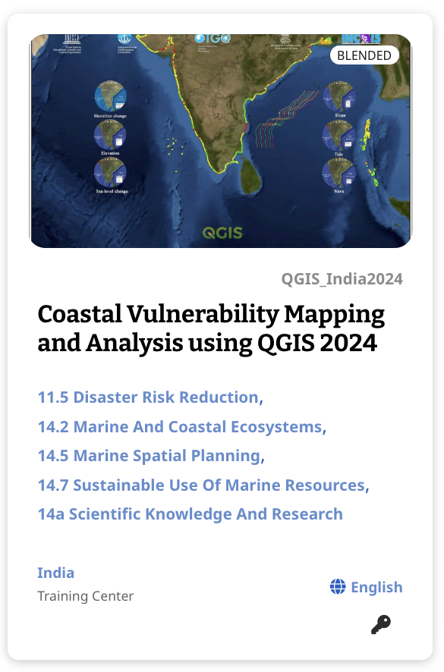
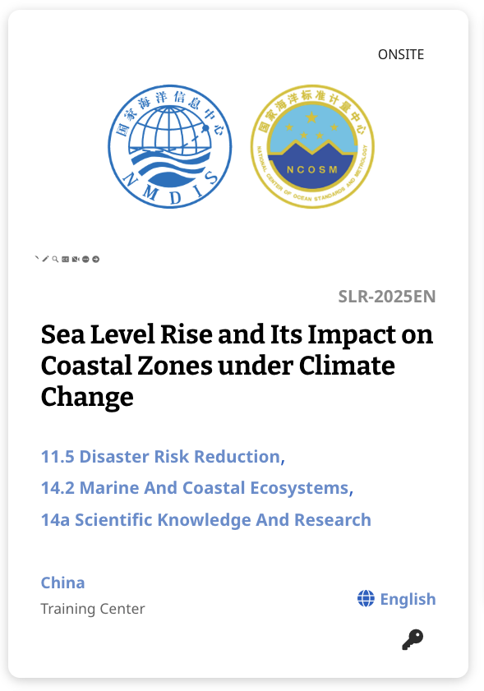
OceanTeacher Global Academy
2023
blended
35 participants
80h training
11 Countries (6 in Africa, 3 SIDs)
2025
Face-to-face
16 participants
36h training
7 Countries (1 in Africa)
2024
blended
25 participants
80h training
6 Countries

Slide 9
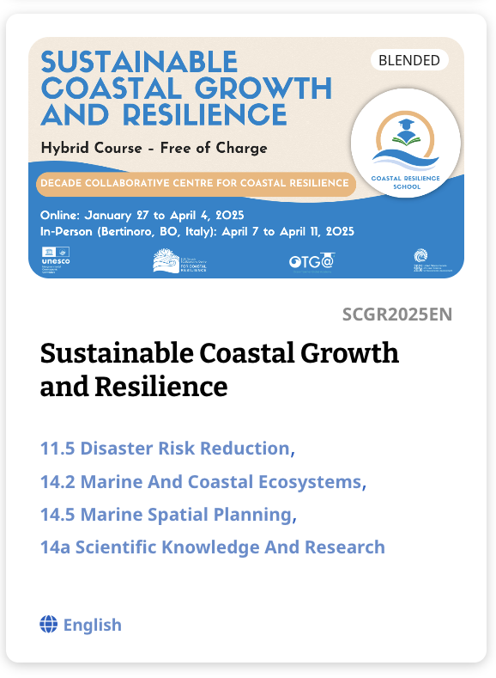
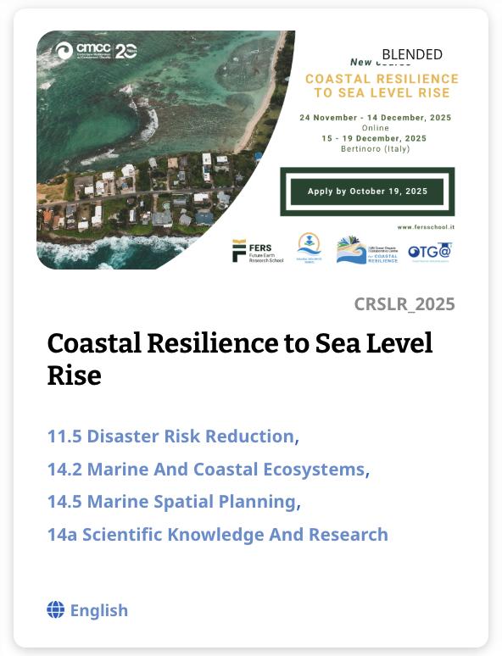
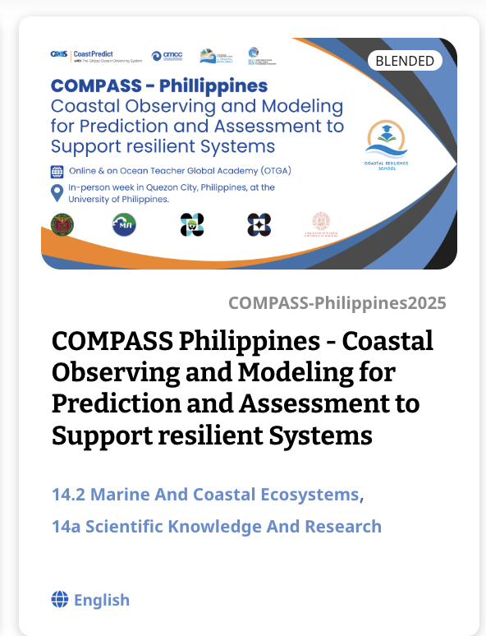
OceanTeacher Global Academy
5 years results and impact
2025
blended
25 participants
100h training
23 Countries (7 in Africa, 4 SIDs)
2025
blended
20 participants
94h training
13 Countries (5 in Africa, 2 SIDs)
2025
online
16 participants
50h training
1 countries

Slide 10
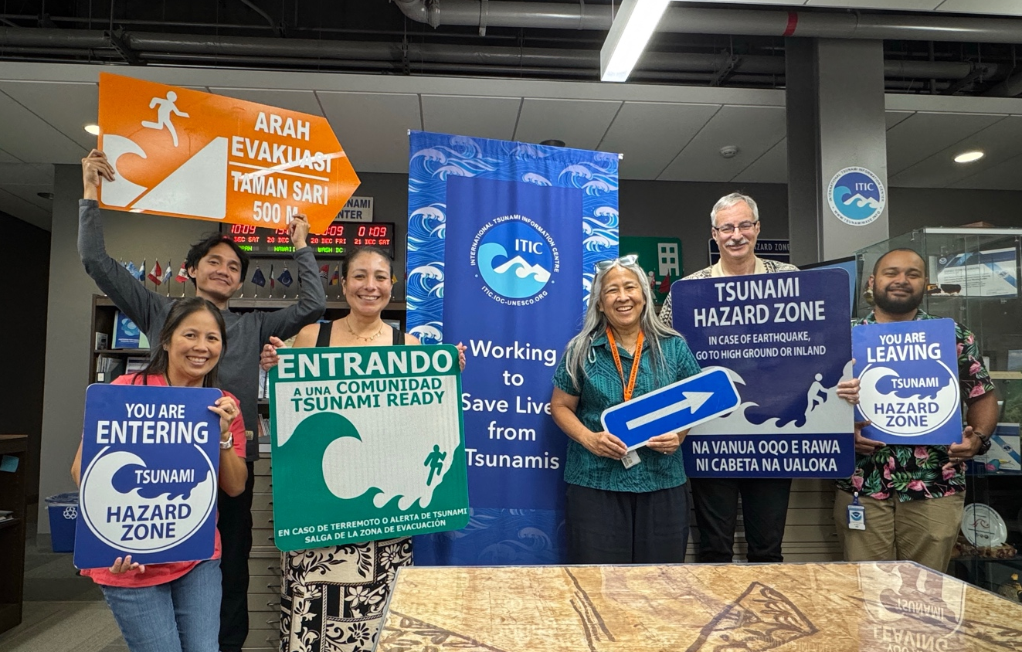
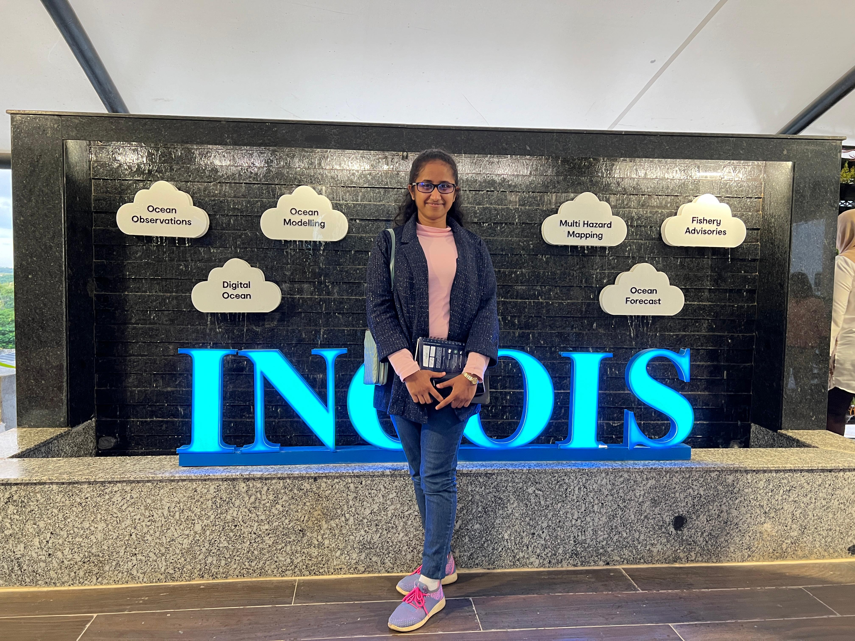
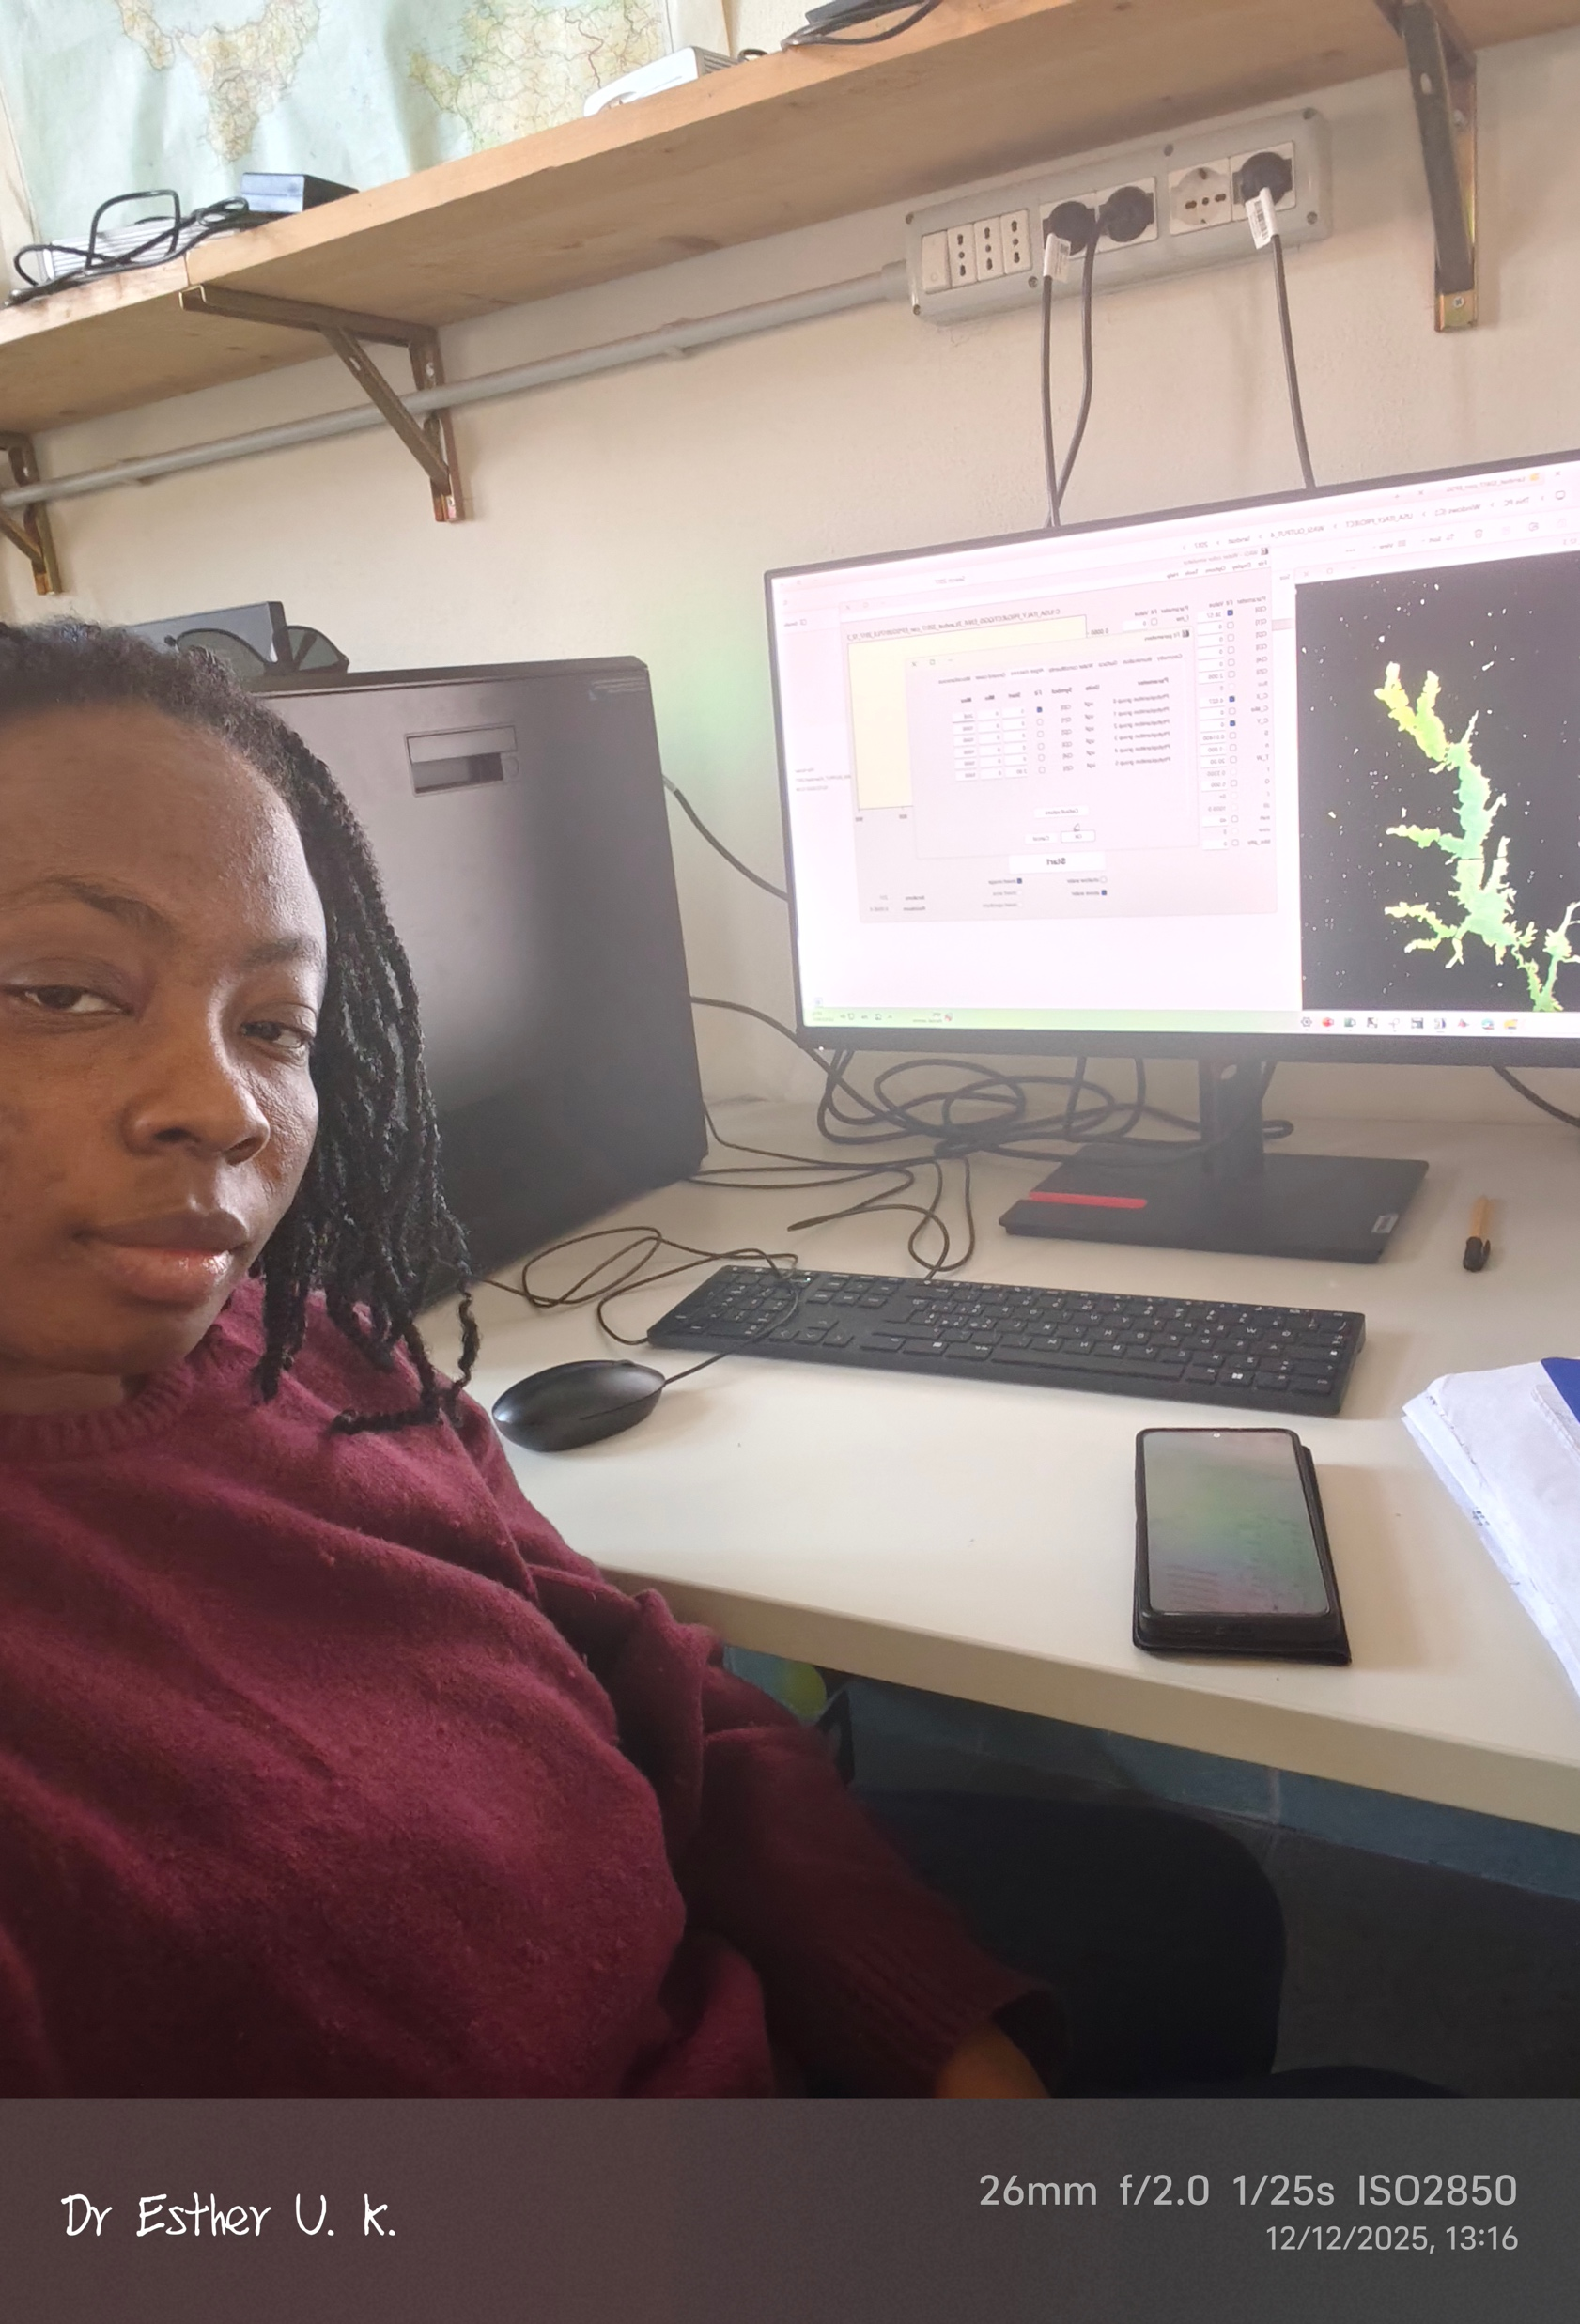
Ocean Traineeships
ITIC participated in the 2024 cohort
2024: Trainee from Indonesia (Taniela Takeifanga)
2024: Trainee from Tonga (Taniela Takeifanga)
INCOIS participated in the 2024 and 2025 cohorts
2024: Trainee from Sri Lanka ( Peshala Thilakrathna)
2025 Trainee from Côte d’Ivoire (Yago Amemou)
DCC-CR participated in the 2025 cohort
2025: Trainee from Nigeria (Esther Kadiene)

Slide 11
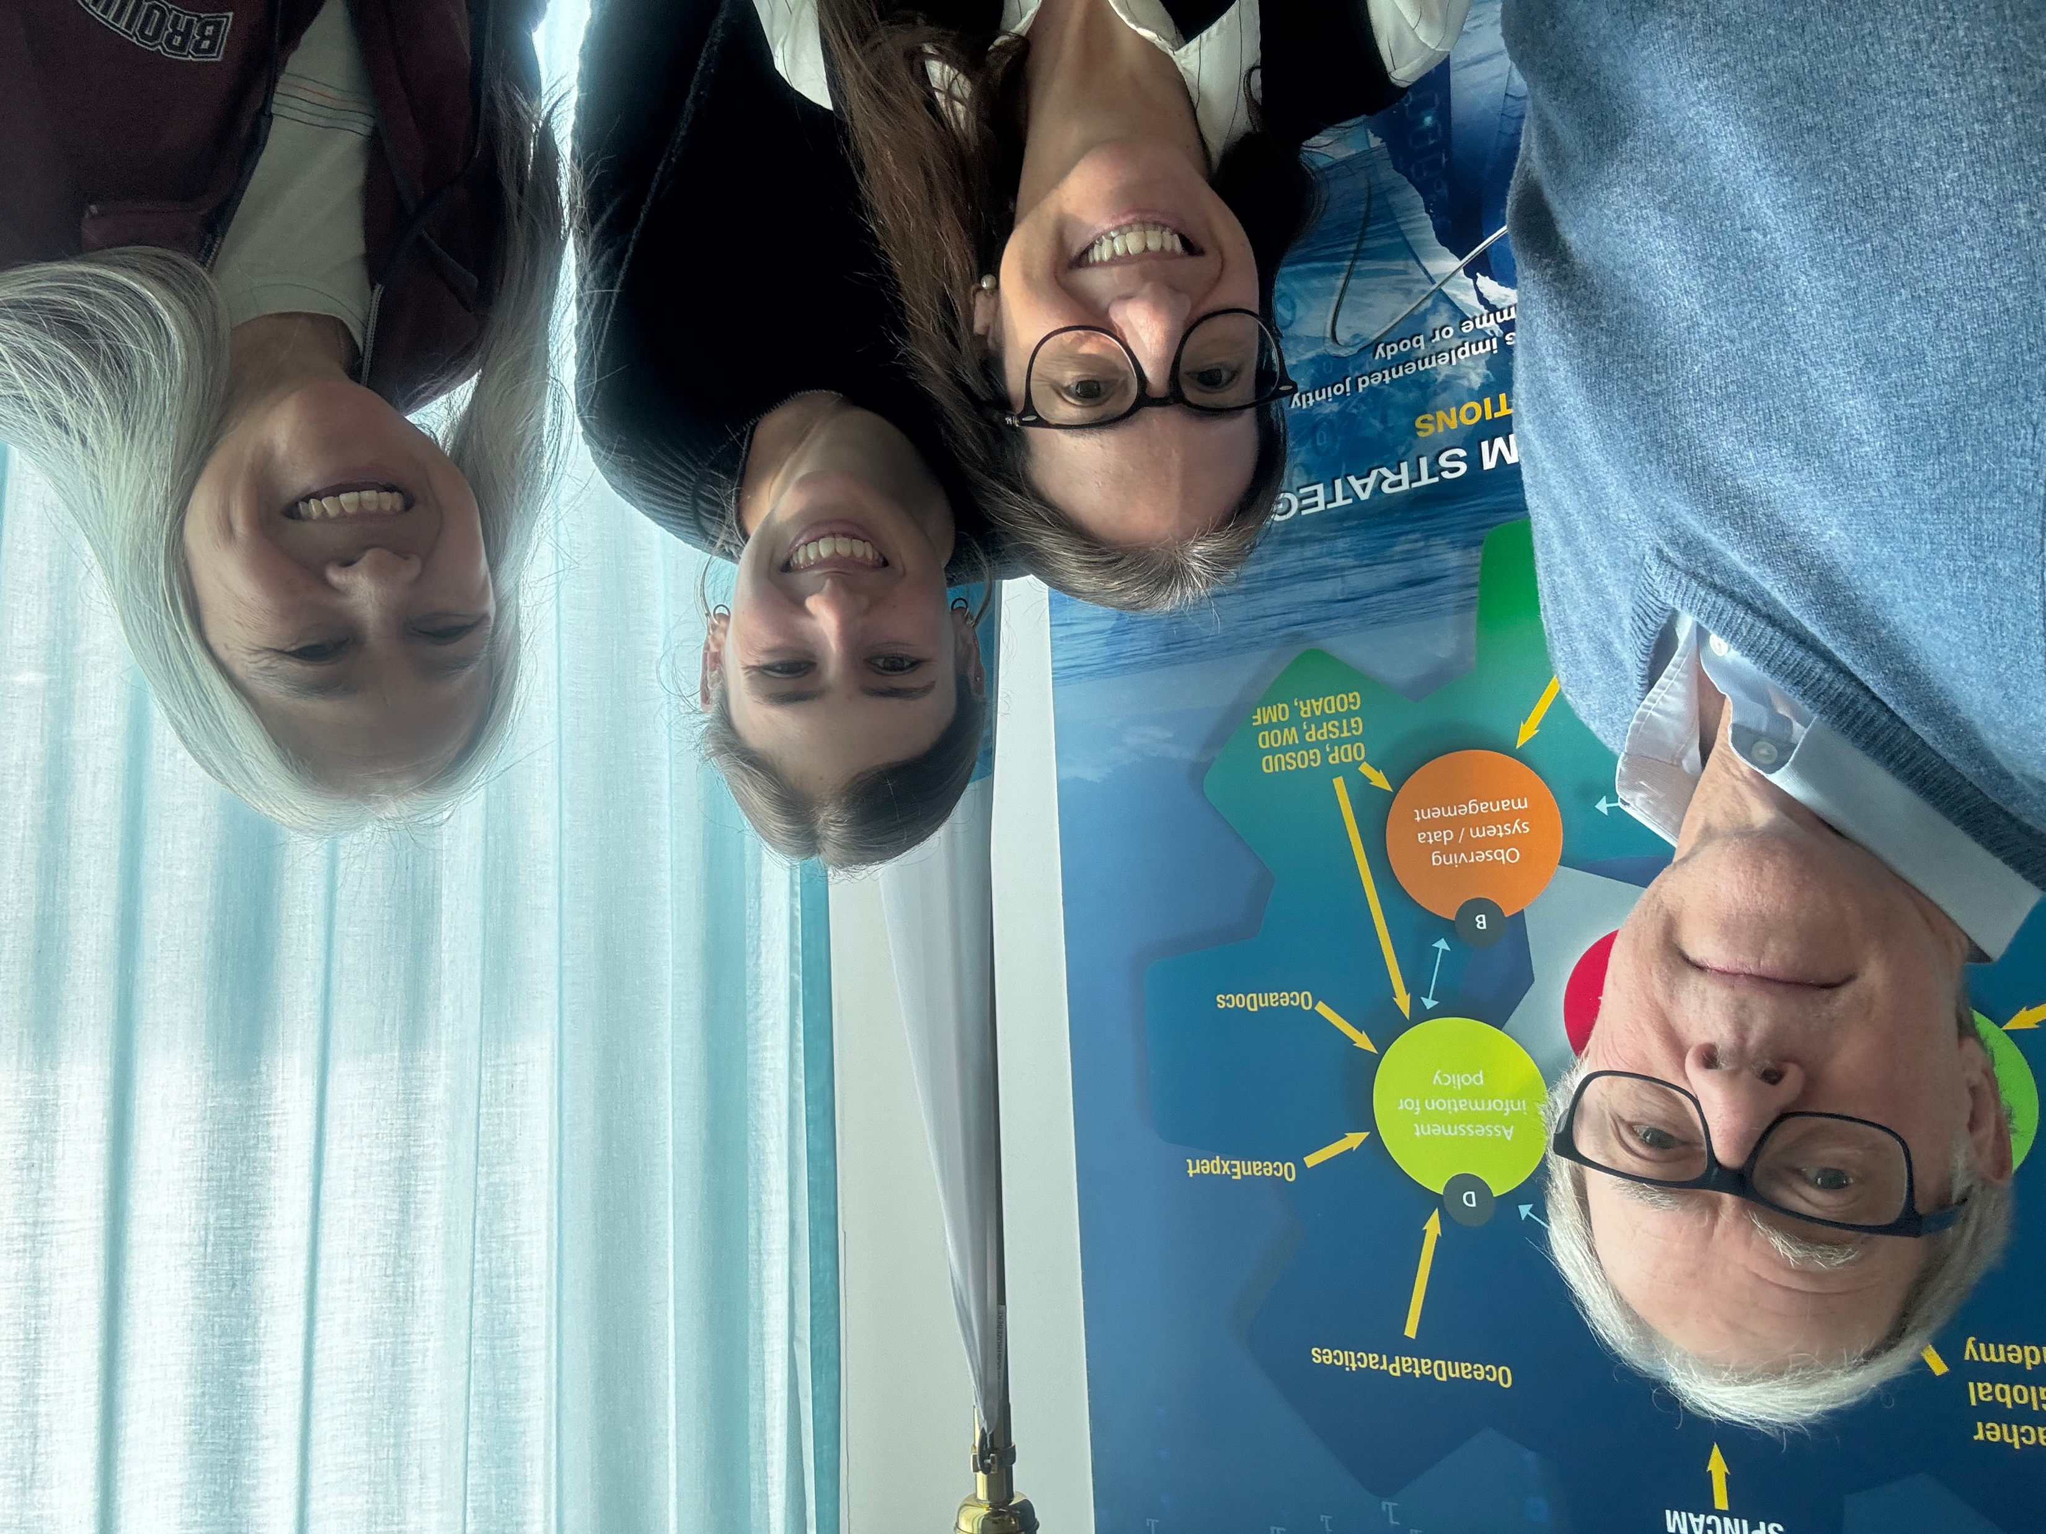
OceanTeacher Global Academy
NEW COURSES TO BE LAUNCHED
2026
IOC Tsunami Warning Centre Minimum Staff Competency Trainings
  STC ITIC
  Core Science, Earthquake and Forecasting
  Online & blended cycles
Sustainable Coastal Growth and Resilience (Asia Pacific)
  RTC China, DCC-CR, SIO, Decade Capacity Development Facility
  Early and Mid Career Ocean Professionals
  Online & blended
NEEDS, PRIORITIES, OPPORTUNITIES
Optimization of training resources (re-use, replication, update)
Regional approaches
Face-to-face opportunities
Cyclic and/or continuous training frameworks

Slide 12


THANK YOU
Ana Carolina Mazzuco
IOC Training Coordinator / OTGA Coordinator
ac.mazzuco@unesco.org
ioc.training@unesco.org
‹#›

