Slide 1
TOWS-WG-XIX (online)
31 March-1 April 2026
Report from ICG/PTWS
Dakui WANG, Chair of ICG/PTWS
31 March 2026

Slide 2
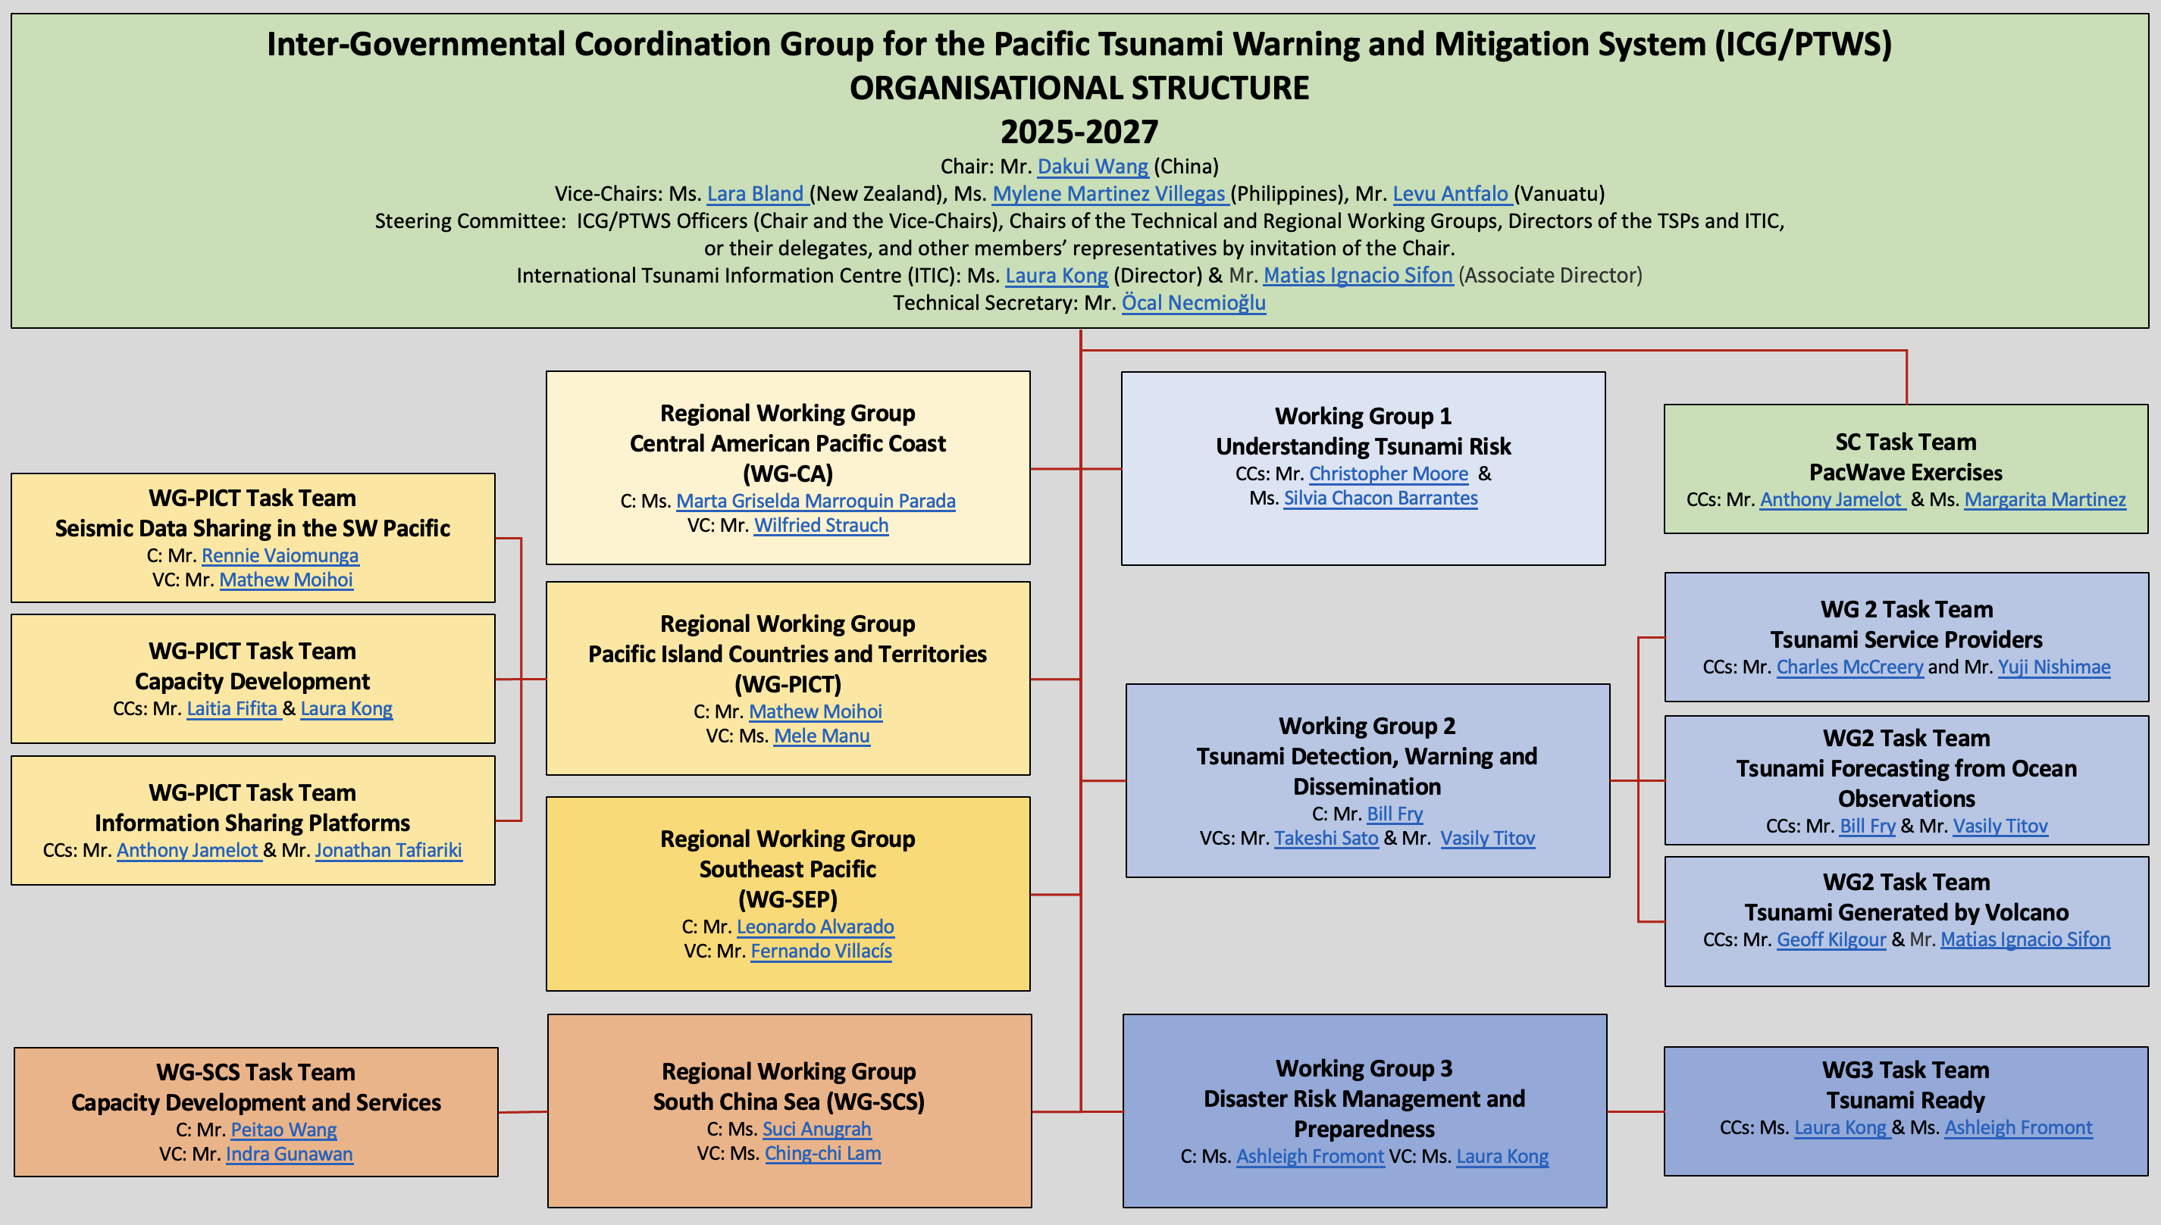
The ICG/PTWS was established in 1965 as a response to the 1960 Valdivia earthquake and tsunami. It manages tsunami-risk-related affairs across 46 Member States with access to the Pacific Ocean basin, and convened for the first time in 1968.

Slide 3
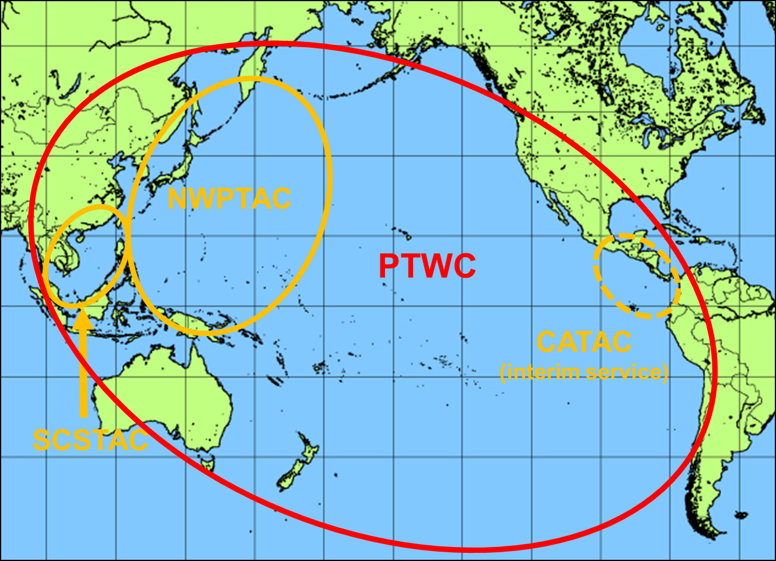
Tsunami Service Provides (TSP) in the Pacific
Three Tsunami Service Providers
Pacific Tsunami Warning Center (PTWC) operated by USA
Northwest Pacific Tsunami Advisory Center (NWPTAC) operated by Japan
South China Sea Tsunami Advisory Center (SCSTAC) operated by China
One interim TSP
Central America Tsunami Warning Center (CATAC) operated by Nicaragua, with full functionality in an interim manner
ICG/CARIBE-EWS Further recommends the consideration of CATAC as a TSP in its XIX Session in 2026 to enable the IOC Executive Council to consider the final admission of CATAC as TSP in June 2026. (Recommendation ICG/CARIBE-EWS-XVIII.8)

Slide 4
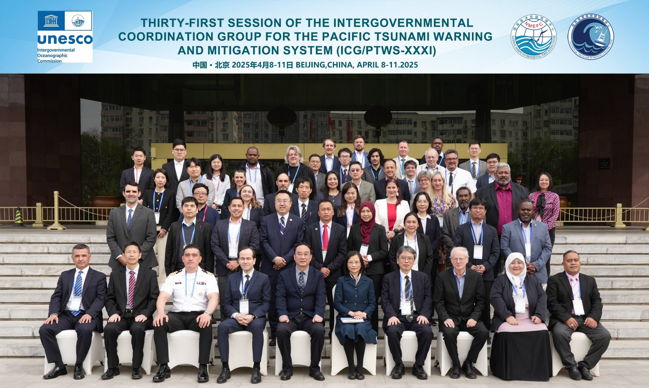
ICG/PTWS XXXI, Beijing, China, 7-11 April 2025
62 Delegates
from 24 Member States
32 Observers from 14 countries

Slide 5
9th ICG/PTWS – IUGG JTC Joint Tsunami Workshop
60th Anniversary of the ICG/PTWS - Past and Future
1 April 2025 (Online)
Aims
7 April 2025 (Hybrid)
Aims
Guide 5-year research and development strategy for detection, monitoring and forecasting through:
1) Investigating challenges to achieving Decade forecasting goals
2) Exploring emergent data technologies to achieve Decade forecasting goals
3) Exploring emergent forecasting technologies to achieve Decade forecasting goals
4) Exploring impact-based forecasting including challenges faced when forecasting inundation and time-dependence
1) Recognition of contributions of 60 years of PTWS
2) Prospective of the future of PTWS
3) Tsunami DRR within the context of the IODTP – lessons from 60 years

Slide 6
Joint Workshop Outcomes
Need for interaction between forecast users and forecast creators (EM – TSP)
Challenges with forecasting uncertainties and conservative approaches
Challenges of equity in tsunami resilience across all member states
Local events create a forecasting challenge
Need for direct ocean observations to forecast non-earthquake sources

Slide 7
ICG/PTWS XXXI Summaries (1)
The ICG acknowledged the conduct of PacWave24 and first-time testing of the dissemination of maritime safety products to NAVAREA Coordinators in the Pacific and in the Southwest Atlantic (e.g. NAVAREAs VI, X, XI, XII, XIII, XIV, XV, and XVI).
The ICG endorsed the conduct of the first-ever UNESCO-IOC Pacific Tsunami Preparedness Capacity Assessment, which constitutes the first system wide measurement of the existing capacities to guide future efforts to improve the PTWS, with the kind support of ESCAP, and requested that the PTWS Steering Committee play a leading role during the intersessional period for implementation, reporting and follow-up.
Recalling that IOC Assembly Decision A-32/3.4.1 instructed all regional Tsunami Service providers, in collaboration with NAVAREA operators of IHO, to test the tsunami maritime safety products in 2023/24, with a view to operationally implementing them in 2024–2025, and considering that the PTWC as a TSP that covers all coasts of the Pacific Tsunami Warning System has agreed to provide this service for the PTWS and has designed such products, conducted a communication test with Pacific NAVAREA Coordinators, and produced a draft guide to those products, the ICG requested PTWC to implement the products in 2025 following the next meeting of the World-Wide Navigational Warning Service in September 2025.

Slide 8
ICG/PTWS XXXI Summaries (2)
The ICG recommended provisional approval of the ‘Tsunami Ready Equivalency Guidance’,
as described in the Draft Document (Agenda 4.2) of the ICG/PTWS-XXXI session, for trial use in order to finalize the Guidance for approval at the ICG/PTWS-XXXII session. It also recommended that the ICG/PTWS WG3 Task Team on Tsunami Ready conduct a pilot test of the PTWS ‘Tsunami Ready Equivalency Guidance’.
Recalling the importance of the UNESCO-IOC Tsunami Ready Recognition Programme as a key mechanism toward achieving the UN Ocean Decade Goal of ‘100% of communities at risk of tsunami prepared for and resilient to tsunamis by 2030‘, the ICG requested WG3 Task Team on Tsunami Ready to continue to investigate further actions to recognize, support and celebrate the benefits of formal UNESCO-IOC Tsunami Ready Recognition,
The ICG recalled its recommendation made at its last session to authorize the commencement of full functional operations of the Central America Tsunami Advisory Centre (CATAC), effective after the IOC governing body session in June 2024, with the exact date to be decided after coordination with the ICG/CARIBE-EWS (Recommendation ICG/PTWS-XXX-6), and took note of the recommendation of ICG/CARIBE-EWS at its 17th session regarding the review of CATAC as a Tsunami Service Provide at its 18th Session in May 2025 to enable the IOC Assembly to consider the final admission of CATAC as a TSP in June 2025 (Recommendation ICG/CARIBE-EWS-XVII.8).

Slide 9
ICG/PTWS XXXI Summaries (3)
The ICG decided to carry out a 12th Pacific Wave Exercise in 2026 (PacWave 26) through September to November 2026 to support the International Disaster Risk Reduction Day (13 October) and the World Tsunami Awareness Day (5 November).
The ICG accepted with appreciation the kind offer of Ecuador to host the 32nd Session of the ICG/PTWS in Ecuador in 2027, for which specific dates will be determined at a later stage.
The ICG decided to continue the PTWS Steering Committee with revised Terms of Reference to establish a permanent structure comprising three Vice-Chairs.
Congratulates Chair Mr Dakui Wang (China) and Vice Chairs Ms Lara Bland (New Zealand), Ms Mylene Villegas (Philippines), and Mr Levu Antfalo (Vanuatu) on their election to leadership of the PTWS.

Slide 10
TOWS-WG-XVIII/3 Recommendation
the TOWS-WG-XVIII/3 Recommendation:
  Establishing arrangements among Tsunami Service Providers (TSP) within each ICG to ensure that service provision is ensured at all times for full Area of Service of the ICG;
WG2 Task Team on Tsunami Service Providers (TT-TSP) reviewed the current status of service through a virtual meeting held in August 2025 and recognized that:
  USNTWC plays the role of the back-up center for the PTWC. From the point of this view, either the PTWC or the USNTWC can continue the tsunami services in the whole Pacific.
  Additionally, the CATAC (trial operation), the NWPTAC and the SCSTAC cover their Area of Service. The Hong Kong Observatory cover the South China Sea as the back-up center of the SCSTAC.

Slide 11
TSP User’s Guide Revision
ICG/PTWS-XXVIII.2 Recommendation;
Decided The existing and emerging TSPs create or revise their current individual TSP user guides with a similar structure and content
According to a standard structure of TSP User’s Guides provided by WG2 (Appendix 2 ICG/PTWS-XXX.8 Recommendation), TSPs are still revising User’s Guides
ICG/PTWS-XXXI reviewed NWPTAC and PTWC revised User’s Guides
ICG/PTWS-XXXI.4 requested that PTWC eliminates that section naming coasts with less than 0.3 meter amplitude forecast and include clarifying language about the application of key text product statements - that they are advice only and only for PTWS coasts
SCSTAC revised User’s Guide was reviewed in the WG-SCS-XIII Novermber 2025

Slide 12
Hazard Assessment and Early Warning for TGV
ICG/PTWS-XXVIII.2 Recommendation;
Decided The existing and emerging TSPs create or revise their current individual TSP user guides with a similar structure and content
According to a standard structure of TSP User’s Guides provided by WG2 (Appendix 2 ICG/PTWS-XXX.8 Recommendation), TSPs are still revising User’s Guides
ICG/PTWS-XXXI reviewed NWPTAC and PTWC revised User’s Guides
ICG/PTWS-XXXI.4 requested that PTWC eliminates that section naming coasts with less than 0.3 meter amplitude forecast and include clarifying language about the application of key text product statements - that they are advice only and only for PTWS coasts
SCSTAC revised User’s Guide was reviewed in the WG-SCS-XIII Novermber 2025

Slide 13
M>7 Earthquakes from Feb.2025 to Feb.2026
 | date | time (UTC) | latitude | longitude | depth | mag | magType | place | Max. tsunami height (m)
1 | 2025/03/30 | 12:18:50.362Z | -20.30 | -174.07 | 29 | 7 | mww | 61 km SSE of Pangai, Tonga | 0.05
2 | 2025/05/02 | 12:58:26.014Z | -56.81 | -68.10 | 10 | 7.4 | mww | 2025 Drake Passage Earthquake | 0.14
3 | 2025/07/16 | 20:37:41.667Z | 54.57 | -160.47 | 38 | 7.3 | mww | 2025 Sand Point, Alaska Earthquake | 0.1
4 | 2025/07/20 | 06:49:04.327Z | 52.83 | 160.68 | 34 | 7.4 | mww | 2025 Eastern Kamchatka, Russia Earthquake | 1.53
5 | 2025/07/28 | 22:10:35.109Z | -57.61 | 157.04 | 31 | 7 | mww | Macquarie Island region | No Tsunami
6 | 2025/07/29 | 23:24:52.483Z | 52.49 | 160.24 | 35 | 8.8 | mww | 2025 Kamchatka Peninsula, Russia Earthquake | 17
7 | 2025/08/22 | 02:16:18.246Z | -60.32 | -61.92 | 10 | 7.5 | mww | 2025 Southern Drake Passage Earthquake | 0.17
8 | 2025/09/13 | 02:37:56.761Z | 53.20 | 160.19 | 58 | 7.4 | mww | 105 km E of Petropavlovsk-Kamchatsky, Russia | 0.1
9 | 2025/09/18 | 18:58:14.939Z | 53.14 | 160.72 | 27 | 7.8 | mww | 140 km E of Petropavlovsk-Kamchatsky, Russia | 0.31
10 | 2025/10/10 | 01:43:59.585Z | 7.29 | 126.69 | 59.425 | 7.4 | mww | 12 km E of Santiago, Philippines | 0.3
11 | 2025/10/10 | 20:29:20.075Z | -60.19 | -61.82 | 5.639 | 7.6 | mww | Drake Passage | No Tsunami
12* | 2025/12/08 | 14:15:10.1Z | 40.97 | 142.29 | 54 | 7.4 | mww | East Hokkaido, Japan | 0.64*
13 | 2026/02/22 | 16:57:46.240Z | 6.83 | 116.26 | 619.849 | 7.1 | mww | 55 km NNW of Kota Belud, Malaysia | No Tsunami
Earthquake source parameters by USGS, except for * by Japan Meteorological Agency (JMA)
Max tsunami height by NGDC/WDS Global Historical Tsunami Database, except for * by JMA

Slide 14
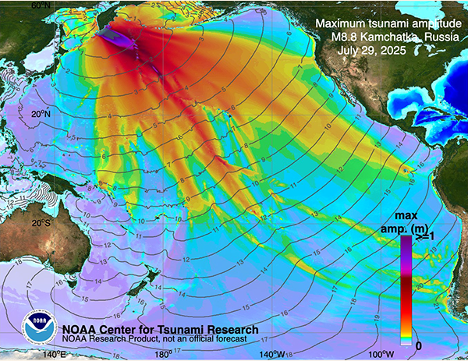
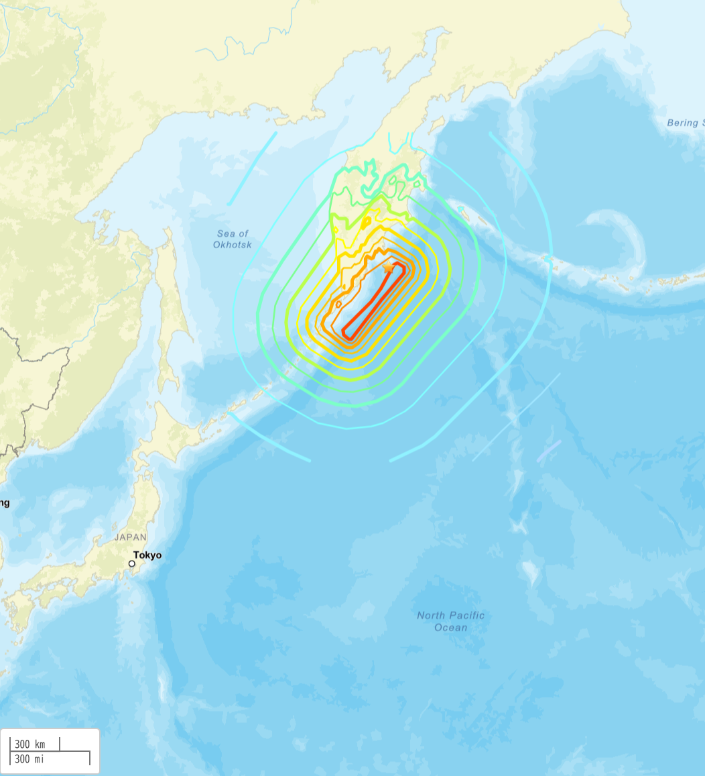
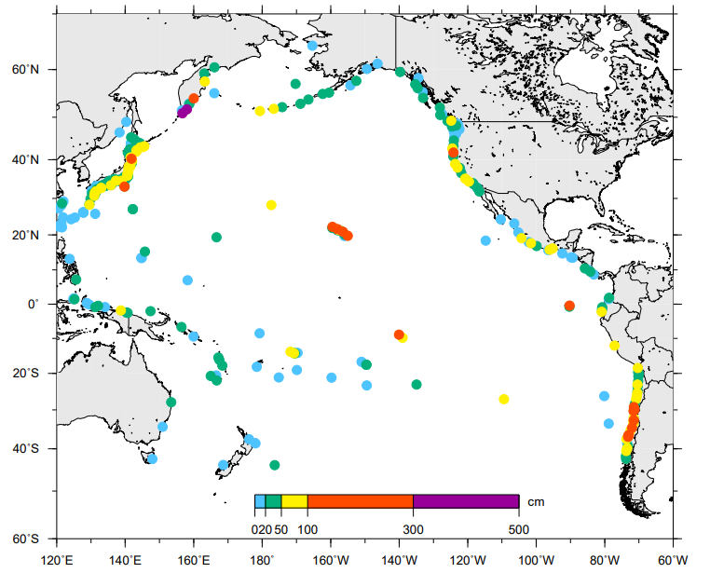
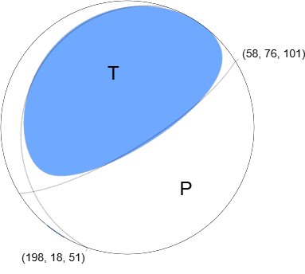
29 July 2025 M8.8 Kamchatka Earthquake and Tsunami
2025-07-29 23:24:52 (UTC)
52.495°N 160.240°E 35.0 km depth
Mw8.8, the strongest Earthquakes since the 2011 Tohoku earthquake in Japan.
Significant tsunami amplitudes were recorded across the Pacific, including 1.74m in Kahakui, Maui (Hawaii), 1.13m in Crescent City (California), 1.04m in Baltra (Galapagos Islands, Ecuador), and 1.12m in Coliumo (Chile).
(draft) 29 July 2025 M8.8 Kamchatka Earthquake and Tsunami Post Event Assessment of PTWS Performance
(draft) 29 July 2025 M8.8 Kamchatka Earthquake and Tsunami Post Event Assessment of PTWS Performance
https://earthquake.usgs.gov/earthquakes/eventpage/us6000qw60/map
W-phase Moment Tensor (Mww8.83)
Observed maximum height, data by NOAA tsunami database https://www.ncei.noaa.gov/access/metadata/landing-page/bin/iso?id=gov.noaa.ngdc.mgg.hazards:G02151
https://earthquake.usgs.gov/earthquakes/eventpage/us6000qw60/moment-tensor

Slide 15
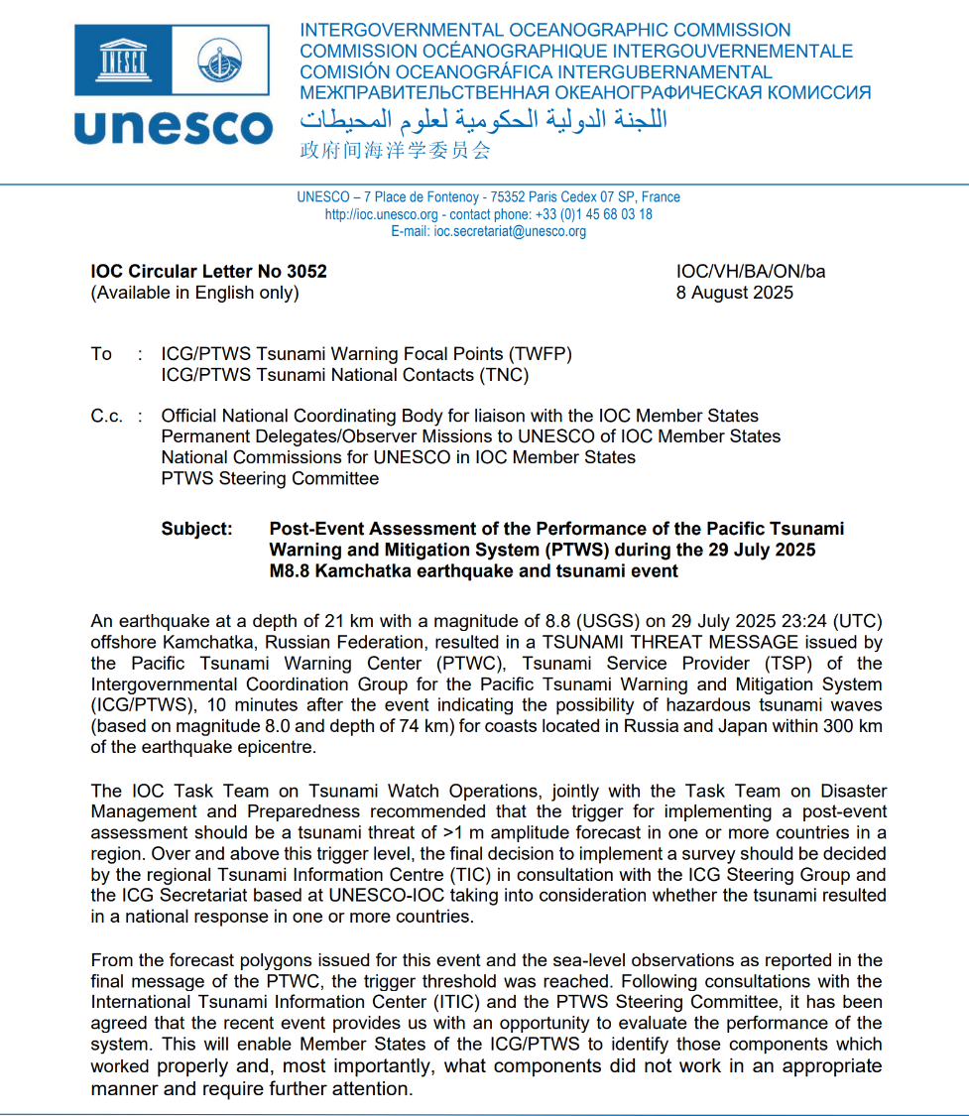

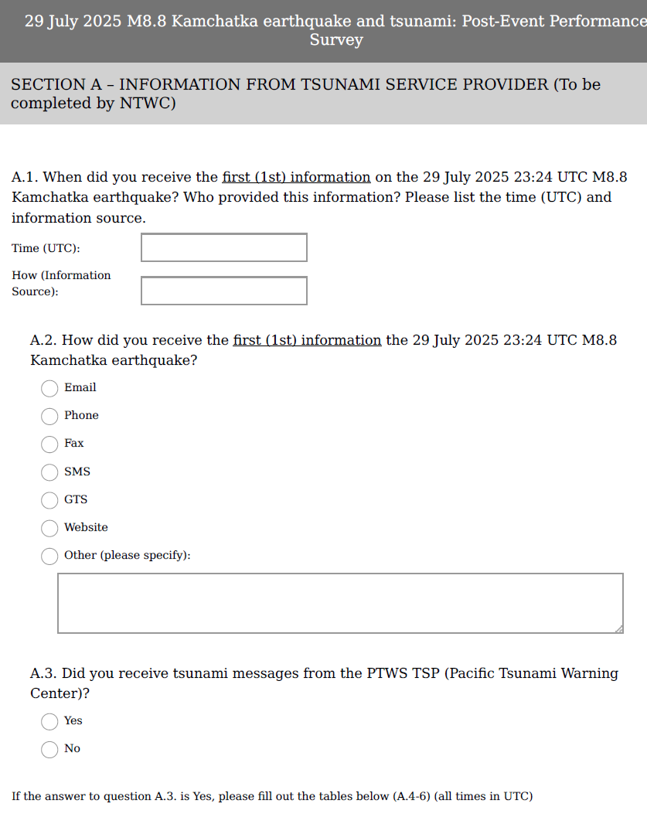
Post-Event Assessment of the Performance of the PTWS during the event
IOC Secretariat and ITIC organized the survey.
It is expected to provides us with an opportunity to evaluate the performance of the system.
  8 Aus. 2025 A questionnaire distributed to Member States, to be responded before 5 Sep. 2025.
  Out of 46 PTWS Member States, 30 responded to the survey,
  Summary report to be published.
According to the draft report;
  Almost all respondent countries received messages from the covering TSP(s),
  93% of respondent countries issued warnings or related information,
  52% acted before receiving the TSP PTWC messages,
CL-3052
(draft)
29 July 2025 M8.8 Kamchatka Earthquake and Tsunami
Post-Event Assessment of PTWS Performance

Slide 16
Kamchatka Post-Event Assessment
On 29 July 2025, a powerful magnitude 8.8 earthquake struck off the eastern coast of the Kamchatka Peninsula, Russian Federation, at a depth of 35 km. This earthquake was among the ten largest globally since 1900, but also the strongest since the devastating 2011 Tohoku event in Japan. The Kamchatka earthquake triggered a Pacific-wide tsunami.
The 2025 Kamchatka event demonstrated the effectiveness of PTWS in providing timely, actionable warnings across the Pacific and effective coordination among international, national, and local agencies. However, it also highlighted areas for improvement, including:
Enhancing early warning systems,
Promoting redundant communication technologies,
Strengthening community education and preparedness,
Addressing technical gaps,
Broadening multi-sectoral engagement.
In conclusion, the 2025 Kamchatka earthquake and tsunami event reaffirmed the Pacific Tsunami Warning System’s ability to deliver timely and actionable warnings. At the same time, it revealed key areas for improvement in communication, technical capacity, and community engagement. Addressing these gaps will be essential to further strengthen tsunami resilience across the Pacific.

Slide 17
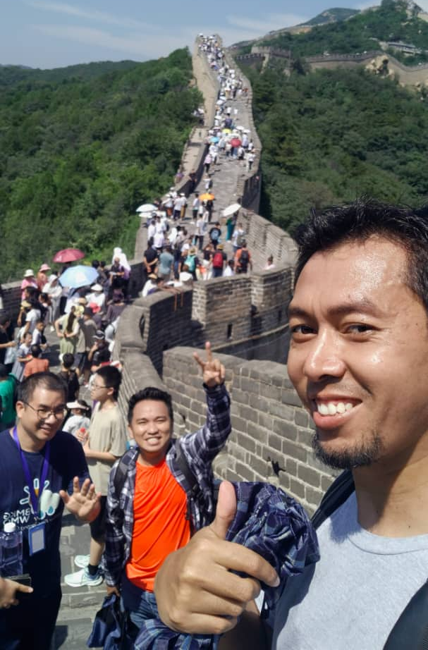
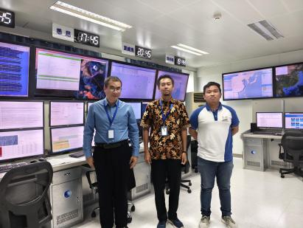
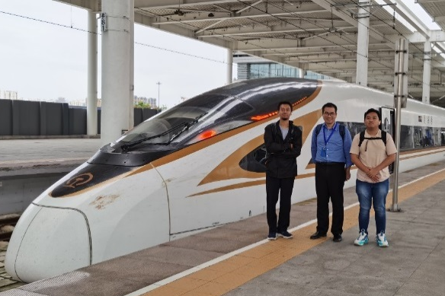
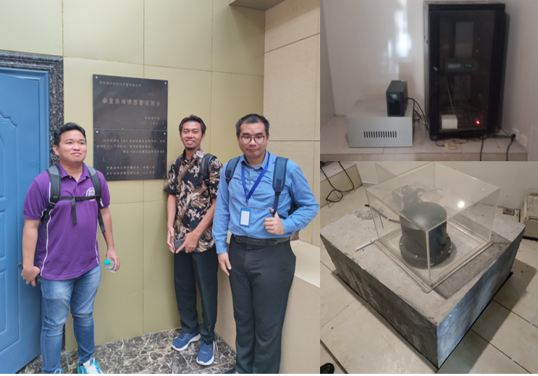
SCSTAC International Staff Programme
.
2023—
Ms. Nadira BintiJanius (Malaysia)
Mr.Tom Carlo E. Simborio (Philippines)
Mr. Fakhry Dwi Sulistio (Indonesia)
Mr. Muhammad Hafizh Ghifari (Indonesia)
2024—
Mr. Mohammad Obie Restianto (Indonesia)
Mr. Bhenz Rodriguez (Philippines)
Mr. Yip Weng Sang (Malaysia)

Slide 18
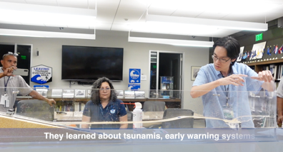
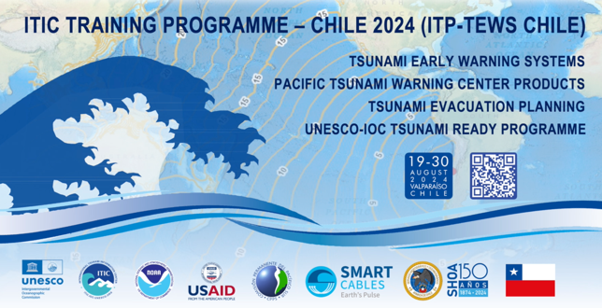
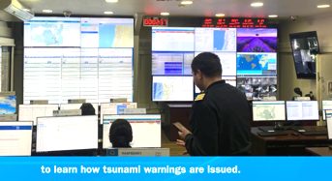
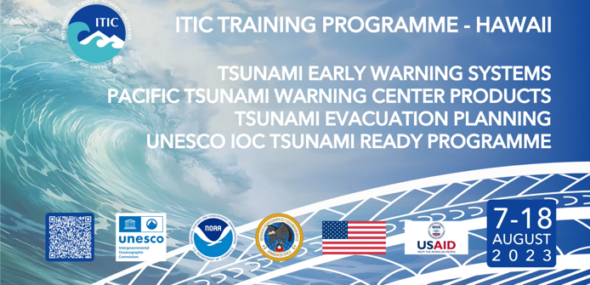
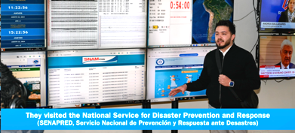
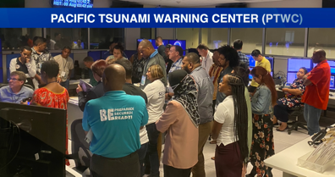
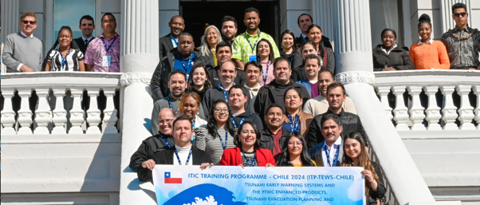
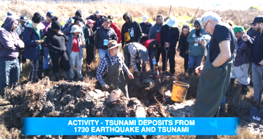
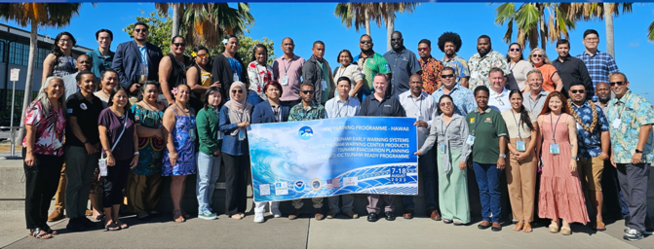
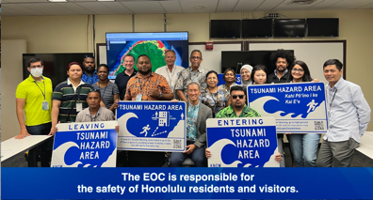

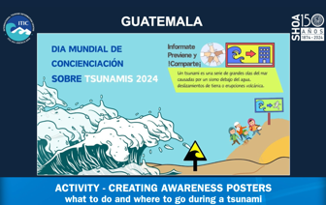
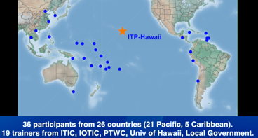
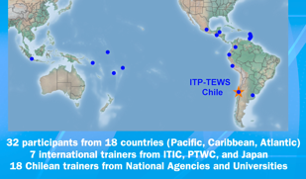

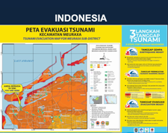
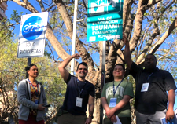
ITIC Training Programme
ITIC - SHOA organized (68 participants from 26/18 countries)
2023 Hawaii system
2024 Chile system
English, 508-compliant
Video
English, 508-compliant, Spanish

Slide 19
PTWS Tsunami Preparedness Capacity Assessment (TPCA)
ICG/PTWS-XXXI endorsed the conduct of the PTWS-TPCA as the first system wide measurement of the existing capacities to inform next efforts to improve the PTWS under the kind support of ESCAP and requested the PTWS Steering Committee to provide the leadership role in the intersessional period for the execution, reporting and follow-up.
TPCA Objectives
To evaluate the existing technical capacity of the Pacific Tsunami Warning & Mitigation System (PTWS)
To identify specific gaps and capacity development requirements at regional and national levels for strengthening the technical and policy aspects of the tsunami warning and mitigation system in the Pacific
To reinvigorate political commitment and provide recommendations for investments in tsunami preparedness, aiming to address the identified gaps in the PTWS area through regional and subregional cooperation

Slide 20
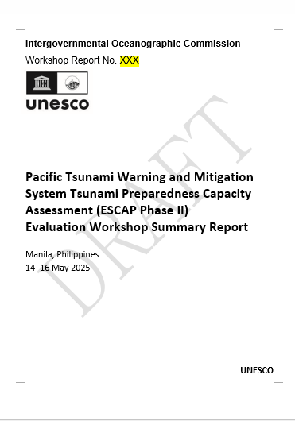
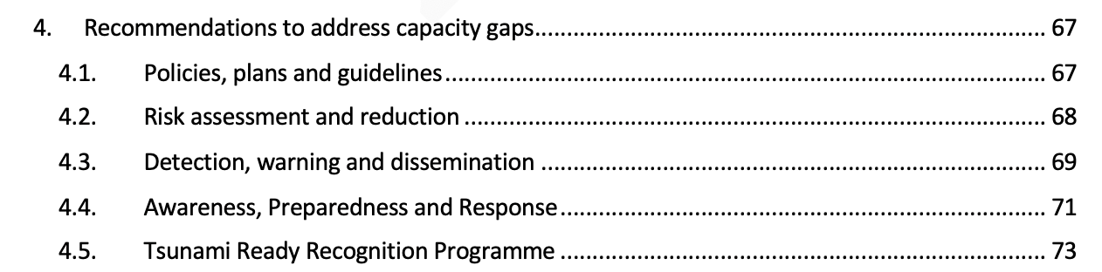
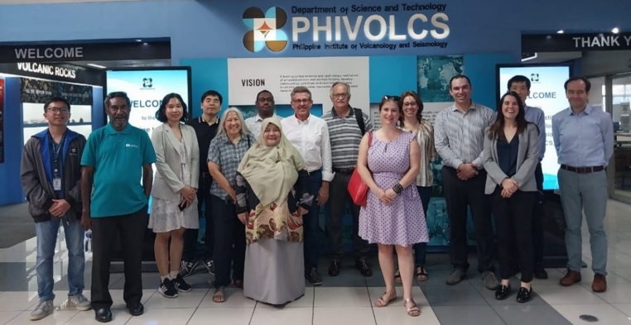
TPCA Draft Technical Report, June 2025
ICG/PTWS Evaluation and Recommendations Workshop, 14–16 May 2025, Manila, Philippines, hosted by PHIVOLCS
Based on the responses received from 91% of the ICG/PTWS Member States (42 out of 46)

Slide 21
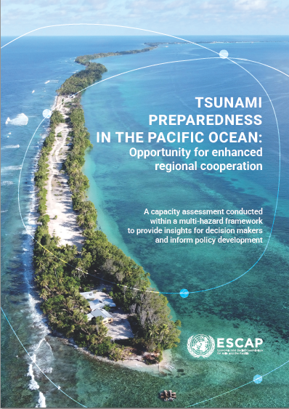
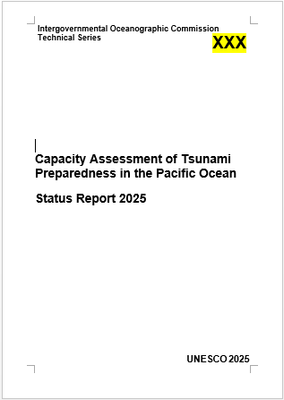

Slide 22
Recommendation-Tsunami Policies, Plans and Guidelines (TPPG)
TPPG.1 | Invite 100% of Member States at risk of tsunami to have at least a national policy, plan, or guideline pertaining to tsunami, noting that at least 6 countries in the PTWS do not have tsunami policies of any kind, at least 7 countries do not have any kind of DRR plan that includes or relates to tsunami, and at least 12 countries do not have any kind of tsunami guidelines [S/R].
TPPG.2 | Note that tsunami risk assessments can inform all phases of the disaster risk management cycle, including the recovery phase (for instance, impact-based forecasting products can inform post-disaster needs assessments) [W].
TPPG.3 | Promote deeper involvement from, and cooperation with, the emergency management sector, including through exercises, noting that an effective system requires multi-stakeholder collaboration [W]. Highlight the need for collaboration between the NTWC, NDMO, and recovery financers, including the provision of scientific advice in the recovery/reconstruction phase. Increase NDMO involvement in PTWS to bring recovery perspectives. Increase understanding of tsunami impacts to assist NDMOs and decision makers in response and recovery. Encourage development of National Post-Tsunami Field Survey Guide.

Slide 23
TPPG.4 | Consider how tsunami risk assessments and other tsunami information can inform the development of risk financing products [W].
TPPG.5 | Build synergies with relevant sectors (such as government, private sector, civil society organisations, NGOs) so that their specific considerations for tsunami readiness are addressed [W].
TPPG.6 | Advocate through the global Sendai/SDG/Ocean Decade frameworks and other global initiatives for the inclusion of tsunami DRR into national and sectoral policies [W].
TPPG.7 | Encourage Member States directly to include tsunami in all DRR policies, including sectoral [W].
TPPG.8 | Enhance international cooperation and partnership to strengthen Member States’ capacity to effectively deliver Tsunami and Geohazards DRR programmes [W].

