Slide 1
TOWS-WG-XIX
March 31– April 1, 2026
Report of the ICG/NEAMTWS
2025-2026
Alessandro Amato
Chair
Ignacio Aguirre Ayerbe and Amr Hamouda
(vice Chair)
Denis Chang Seng
Technical Secretary

Slide 2

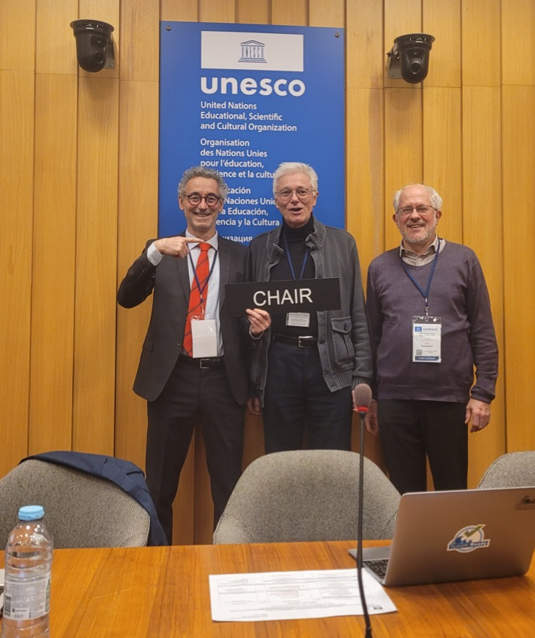
ICG/NEAMTWS D&R (December 2025)
Appreciated the organization of the side event on 20 Years of ICG/NEAMTWS: Achievements and New Horizons at the ICG/NEAMTWS-XX session since its establishment in 2005 and the presentation of Certificates of Appreciation to individuals whose contributions shaped NEAMTWS over the past 20 years;
Welcomed Mr Alessandro Amato, Italy, as the re-elected ICG/NEAMTWS Chairperson, Mr Amr Hamouda (Egypt) and Mr Ignacio Aguirre Ayerbe (Spain) as vice Chairpersons for a second term for the period 2026–2027.

Slide 3
The structure of the ICG/NEAMTWS reorganized
WG1 revised from Hazard Assessment and Modelling to WG 1: Hazard and Risk Assessment;
WG2 & WG3 revised from Seismic, Geophysical and Sea Level Measurements and Sea Level Data Collection and Exchange, including Offshore Tsunami Detection and Instruments to WG2: Detection, Warning and Dissemination;
WG4 revised from Public Awareness, Preparedness and Mitigation to WG3: Awareness and Response.
Task Teams remained, including the new (2024) TT on Non-Seismic Tsunamis. One new TT on Governance was established

Slide 4
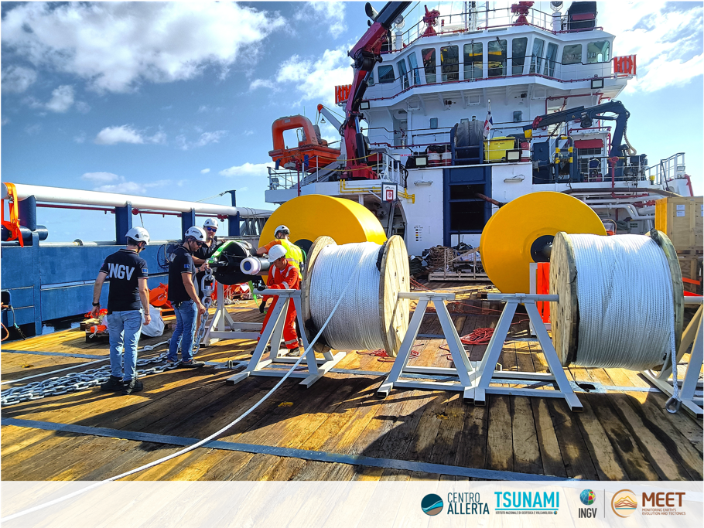
ICG/NEAMTWS D&R (December 2025)
Further welcomed Fatih Turhan (Türkiye) as a new co-chair for WG1, Selda Altuncu Poyraz (Türkiye) as a new co-chair for WG2 & 3 and Tuğçe Ergün (Türkiye) as a new co-chair for WG4 for the period 2026-2027.
Appreciated the deployment (9–17 September 2025) of the first two deep-sea buoys in the Ionian Sea by the Tsunami Alert Centre (CAT) of the National Institute of Geophysics and Volcanology (INGV, Italy) to enable real-time detection of tsunamis.
Welcomed the progress made to conduct NEAMWave26 exercise between 3-24 March 2026 (*).

Slide 5
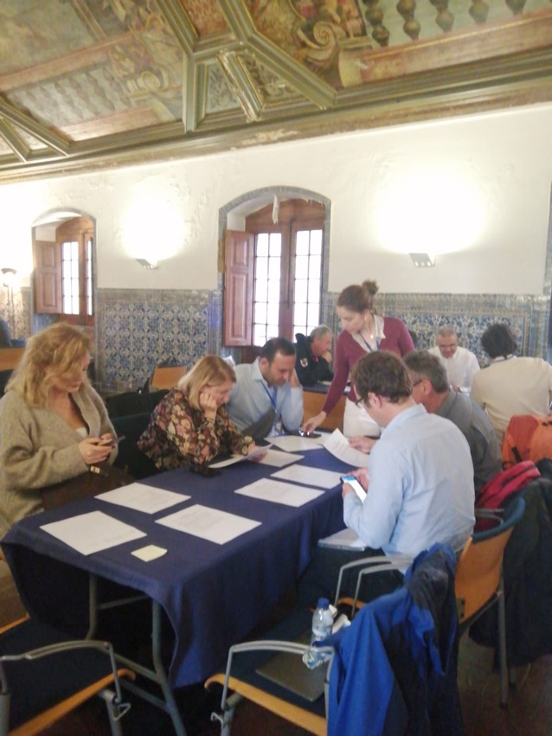
ICG/NEAMTWS main meetings (December 2025)
First Ocean Decade Tsunami Programme Conference, 10 - 11 November 2025, and the Joint International Symposium, Hyderabad, India, 12–14 November 2025;
Secretariat contribution and participation in the Early Warning For All Stakeholder Forum, 2-3 June 2025, and Eighth Global Platform for Disaster Risk Reduction (GP2025), 4-6 June 2025, Geneva;
ICG-NEAMTWS Steering Committee Meeting, Istanbul, Türkiye, by the Kandilli Observatory and Earthquake Research Institute (KOERI), 15 - 16 May 2025;
Participation in the TOWS Joint Task Team on DMP and TWO and the 18th session of the TOWS-WG, Paris, France, 24 - 25 February 2025
National to Local Levels SOP Workshop, Oct. 2025 and the Event for the 1755 Lisbon Earthquake in collaboration with the Civil Protection Dep. of Cascais and Loulé, Portugal, 5 November 2025 (CoastWave2.0);

Slide 6
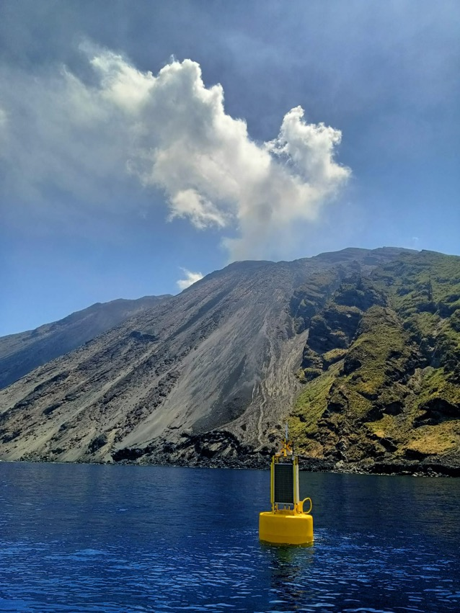
ICG/NEAMTWS main meetings (December 2025)
Evacuation Mapping Workshop to Strengthen Tsunami Preparedness in the MEAM Region by the Univ. of Montpellier Paul-Valéry, through its LAGAM,30 June - 4 July 2025 (CoastWave2.0);
The technical capacity-building workshop, held at ISPRA headquarters in Rome organized by ISPRA and INGV, focused on the methodologies and GIS tools for tsunami inundation map processing (NEAM-COMMITMENT)
Tsunami Hazard Workshop to support decision-making on the tsunami hazard zone to be used for emergency and evacuation planning in the municipality of Cádiz, based on a probabilistic analysis (S-PTHA), 26 June 2025;
Multi-Hazard Stakeholders Workshop organized by INGV in Stromboli Island, Italy with contributions from the Municipality of Lipari and the Italian Department of Civil Protection, 6–9 October 2025 (NEAM-COMMITMENT);
Tsunami Evacuation Workshop for validation and co-design of the tsunami evacuation maps in Cádiz, 3–4 November 2025.

Slide 7
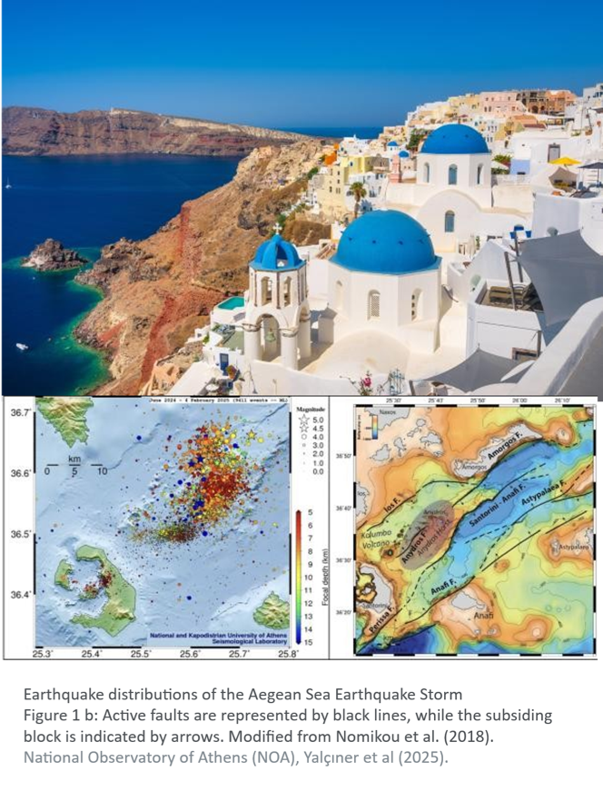
Inter-sessional activity Dec. 2024 – Dec. 2025
NEAM Steering Committee and TSP meetings:
Santorini meetings (Jan-Feb 25)
  TSP meeting
  Expert meeting
SC: Istanbul, May 2025
SC: Online, 1 Dec. 2025
TSP meetings on PTF, EMSC issue, etc.
ICG Dec. 3-5, 2025

Slide 8
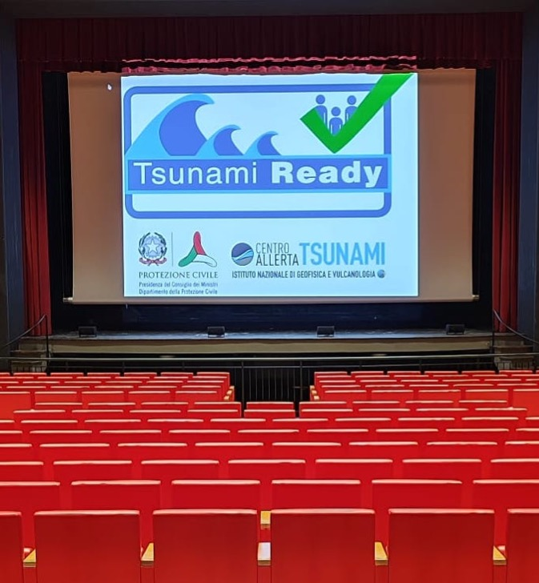
NEAM Regional Tsunami Ready Board est.
Established in response to Israel request for TRR
Chair: NEAMTWS Chair
Components: WG 1,2-3,4 co-Chairs, TT-TR co-Chairs, TIC Director
Meetings in January-May 2025
Report on June 2025
Discussion at ICG Dec. 2025
Recommends: TOWS-WG and the Task Team on Disaster Management and Preparedness (TT-DMP) to provide guidance on how to address Tsunami Ready applications submitted for situations including: i) the entire national coastline and ii) unique emergency management policies or strategies that are not covered by the UNESCO/IOC (2022) Standard Guidelines for the Tsunami Ready Recognition Programme, IOC Manuals and Guides No. 74.
Notes:
TIC Director / ICG Technical Secretary: Denis Chang Seng
Working Group 1 - Hazard Assessment and Modelling - Co-Chairs: Jorge Macías (University of Malaga, Spain) and Audrey Gailler (Commissariat à l’Energie Atomique et aux Énergies Alternatives, France)
Working Group 2 and 3 - Seismic, Geophysical and Sea Level Measurements and Sea Level Data Collection and Exchange, Including Offshore Tsunami Detection and Instruments – Co-Chairs: Anna von Gyldenfeldt (Federal Maritime and Hydrographic Agency, Germany) and Didem Cambaz (Bogazici University Kandilli Observatory and Earthquake Research Institute, Türkiye)
Working Group 4 - Public Awareness, Preparedness and Mitigation – Chair: Cecilia Valbonesi (Università Degli Studi di Firenze, Italy) and Raluca Partheniu (National Institute for Earth Physics, Romania).
Task Team on Tsunami Ready – Co-Chairs: Maria Ana Baptista (Instituto Superior de Engenharia de Lisboa, Instituto Politécnico de Lisboa, Portugal) and Elena Daskalaki (National Observatory of Athens, Greece).
Other guests at the discretion of the RTRB Chair?

Slide 9
Projects / actions for Ocean Decade Tsunami Programme
Appreciated two new project actions have been endorsed by Ocean Decade Tsunami Programme with reference to Challenge 6 “Increase Community Resilience to Ocean Hazards”:
Global Tsunami Model Association (GTM)
NEAM-COMMITMENT (Ocean Decade Call 8)
Noted: The official ending of CoastWAVE Project Phase II (CoastWAVE 2.0) Scaling-Up and Strengthening the Resilience of Coastal Communities in the North-Eastern Atlantic and Mediterranean Regions to the Impact of Tsunamis and Other Sea Level-Related Coastal Hazards’ is 30th of June 2026;

Slide 10
... Noted
The continued awareness-raising efforts nationally on tsunami hazards and preparedness by Member States during the inter-sessional period in line with, and as a contribution to the World Tsunami Awareness Day, 5 November 2025;
Progress achieved in implementing Tsunami Ready Recognition for communities in: Ras El-Bar (Egypt); Marseille and Nice (France); Palmi, Stromboli (Italy); Larache (Morocco); Cascais and Loulé (Portugal); Cádiz (Spain); and Tuzla, Kartal, and Seferihisar (Türkiye);
The new Terms of Reference of the ICG/NEAMTWS Task Team on Governance (Appendix 7);

Slide 11
Further noted the following UNESCO-IOC Publications:
Community Perceptions of Coastal Sea-Level Related Hazard Risks: A Survey Implemented by the UNESCO-IOC DG/ECHO CoastWAVE Project Partners in the North-Eastern Atlantic, Mediterranean and Connected Seas (NEAM) Region, IOC/2025/TS/192;
UNESCO-IOC EU DG ECHO CoastWAVE Project: evaluation of Inexpensive Devices for Sea Level (IDSL) IOC. Technical series, 210 [214];
Strengthening the resilience of coastal communities in the Northeast Atlantic, Mediterranean Region to the impact of tsunamis and other sea level related coastal hazards (CoastWAVE): external evaluation of the DG ECHO CoastWAVE project IOC. Information document series, 1549 [27].
(Several papers were also published on many scientific journals)
Cookbook see next slide - - - >

Slide 12
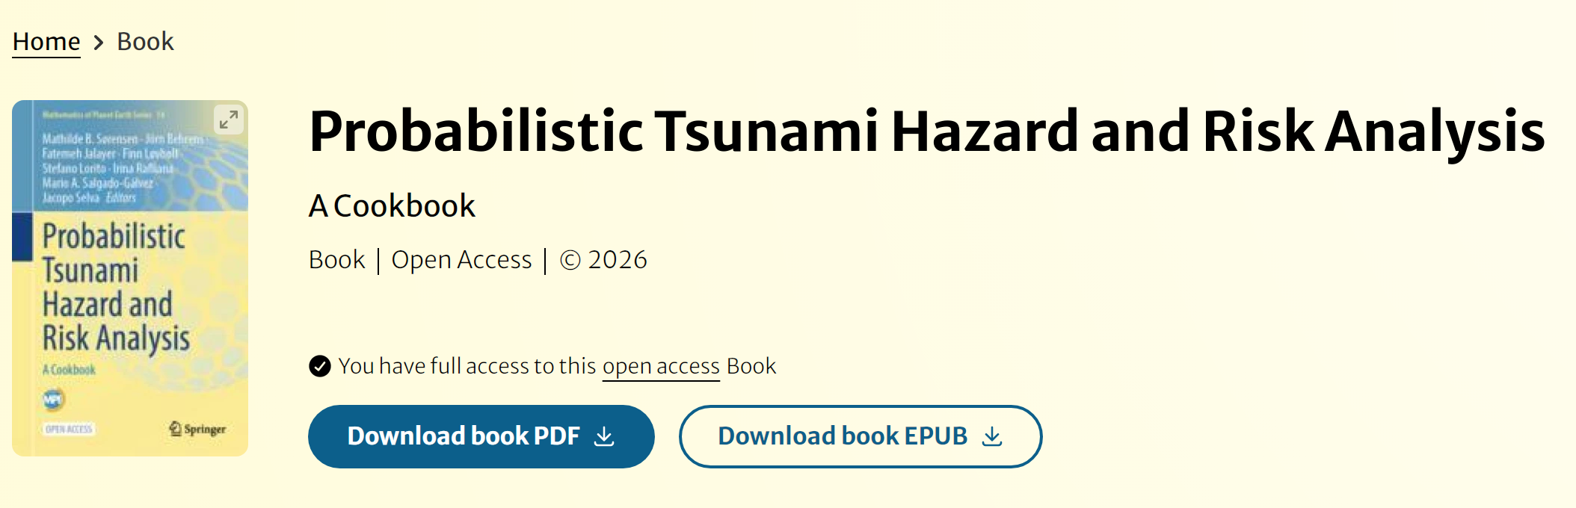
A Cookbook for Probabilistic Tsunami Hazard and Risk Analysis (2026)
9 Chapters, 25 Recipes, 601 pages, more than 50 Authors
https://doi.org/10.1007/978-3-031-98115-9
Notes:
Editors:Mathilde B. Sørensen,
Jörn Behrens,
Fatemeh Jalayer,
Finn Løvholt,
Stefano Lorito,
Irina Rafliana,
Mario A. Salgado-Gálvez,
Jacopo Selva
- This book is open access, which means that you have free and unlimited access
- Intends to forward the scientific basis for probabilistic tsunami hazard and risk analysis
- Presents an overview of existing methods, to unify the description of named workflows
- Gives enough freedom to build on the knowledge to further develop the field

Slide 13
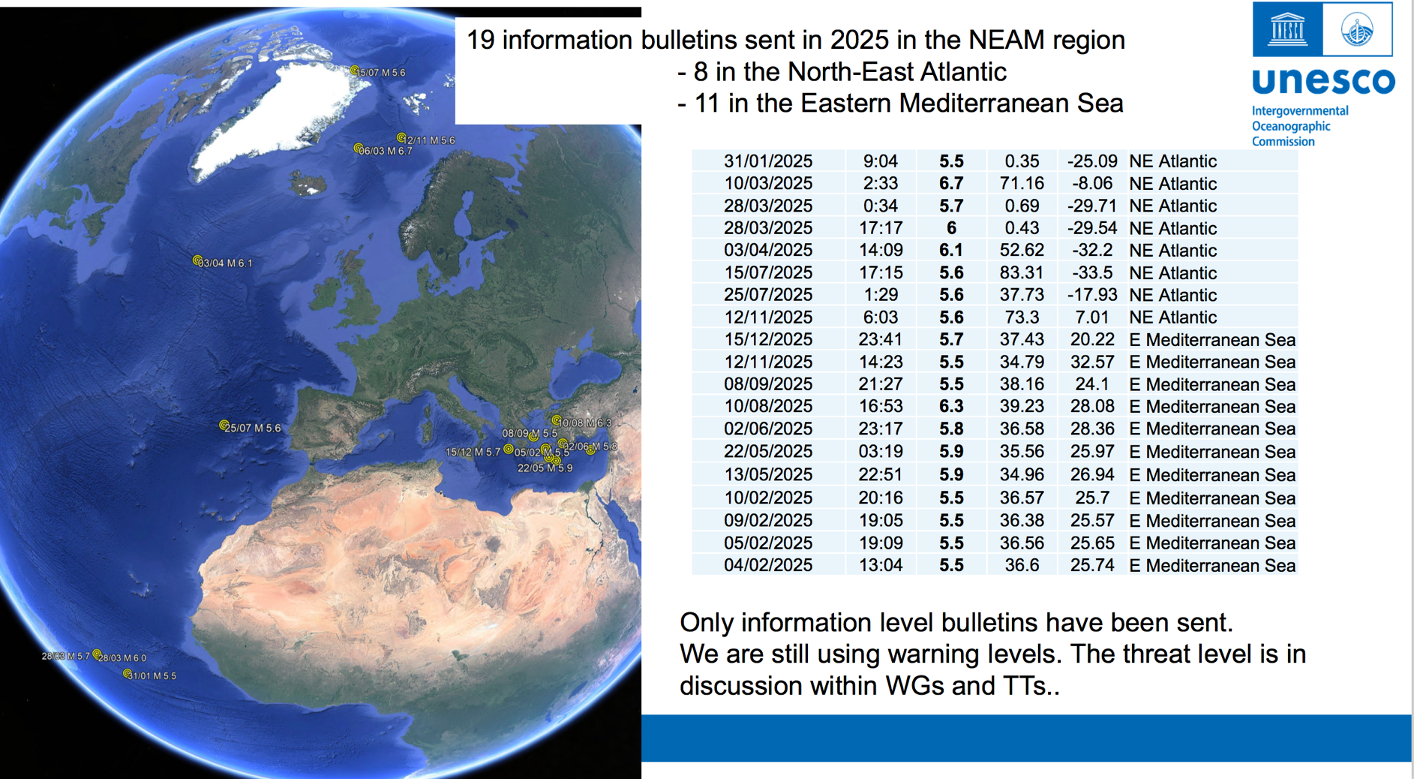
Recent events in the NEAM region

Slide 14
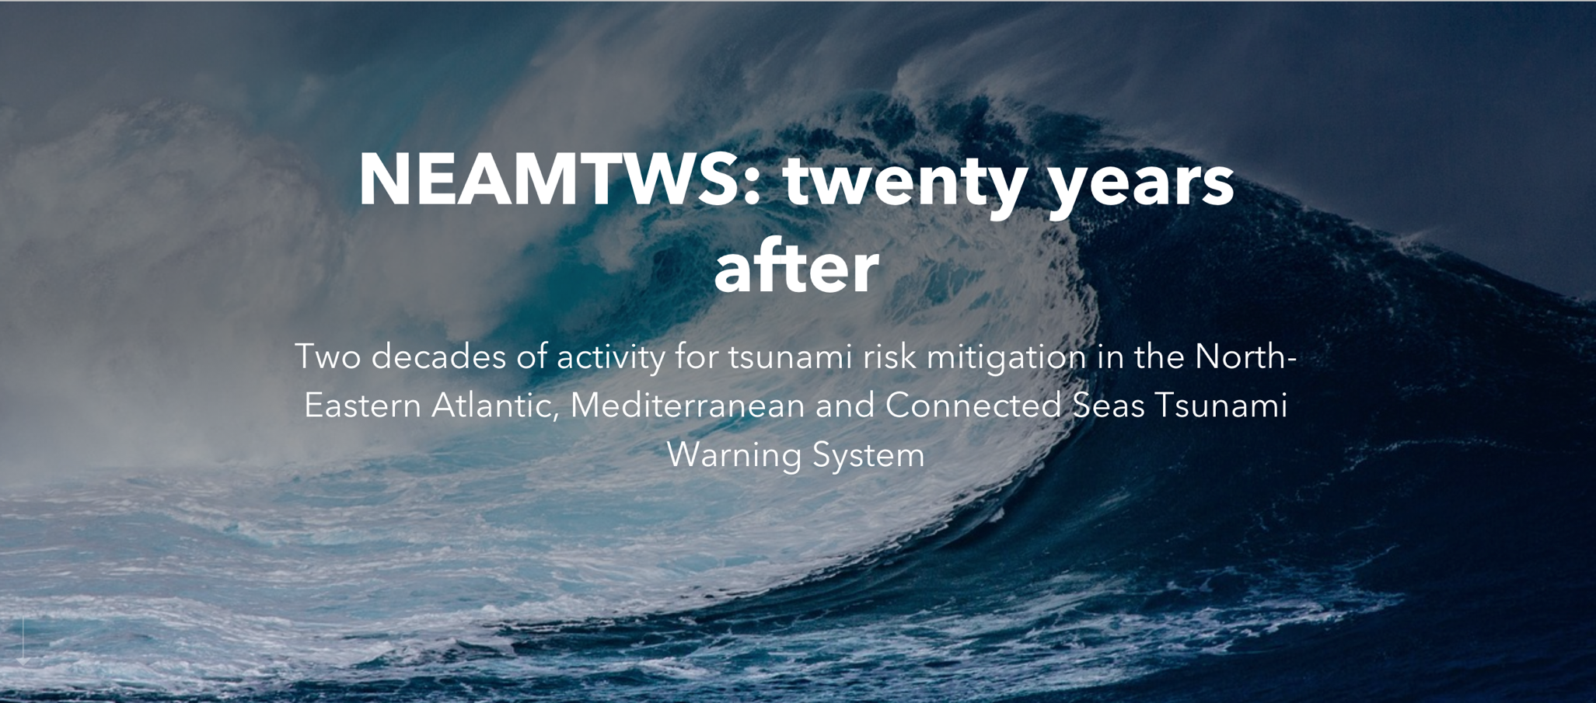
A Story Map
https://storymaps.arcgis.com/stories/47cd88ad5d7e4ca199498fec509b0506

Slide 15
Thank you

