Slide 1
TOWS-WG-XIX
31 March – 1 April 2026
Item: 2.1
Intergovernmental Coordination Group for the Indian Ocean Tsunami Warning and Mitigation System (ICG/IOTWMS)
Eluri Pattabhi Rama Rao
Chair, ICG/IOTWMS
Acknowledgements:
Yuelong Miao, Harkunti Rahayu
Srinivasa Kumar, Ardito Kodijat, Nora Gale
31 March 2026

Slide 2
Implementation of Previous Recommendations
TOWS-WG Meetings
TWO-2024-02-03: Organise online webinars for each ICG involving relevant Volcano Observatories and Volcanic Ash Advisory Centers (VAACs). Global webinar conducted on 16 & 23 April 2025.
TWO-2024-02-05: Organise in 2024 webinars in coordination with IHO for the NAVAREA operators and back-up METAREA operators to introduce the new service and products for the maritime community, and obtain and advise TSPs of the contact information for their respective NAVAREA and METAREA operators to disseminate the new maritime bulletins. Pre-IOWave25 webinar for NAVAREA coordinators held on 21 October 2025
TWO-2025-02-03: Dissemination of the specialized TSP bulletins for the maritime community is tested in CARIBE-EWS, IOTWMS and NEAMTWS by at least one TSP either through the planned communication tests or planned tsunami exercises. NAVAREA bulletins tested during Exercise IOWave25 on 5 Nov 2025.
TWO-2025-02-04: Each ICG to develop SOPs for volcanoes with a tsunamigenic potential within their Earthquake Source Zone (ESZ). SOPs for volcano (and non-seismic) sources developed through IOTWMS WG2, included in IOTWMS Tsunami Service Providers Standard Service Definition Document (Version 5), and tested during Exercise IOWave25.
33rd Session of the Assembly
Recommends the regional ICGs:
to create relationships between National Meteorological and Hydrological Services (NMHS) and TSPs/NTWCs in order to ensure that tsunami-specific instrumentation including Tsunameters/DART® and ocean cable systems are correctly monitored and utilized for detection of meteotsunami; Initial discussion commenced.
continuation of the investigation and the possibility to adopt tsunami forecasting methods, including probabilistic methodologies, toward impact-based forecasting, that could also assist post-disaster response, recovery and needs assessment processes; Ongoing.
to prioritize regional Tsunami Ready workshops or summits in 2025 and conduct further workshops or summits before 2030; Regional Tsunami Ready training conducted in Hyderabad, India during 15-23 April 2025. Targeted training for Madagascar, Maldives, Seychelles, Sri Lanka conducted in Hyderabad, India during 16-21 March 2026.

Slide 3
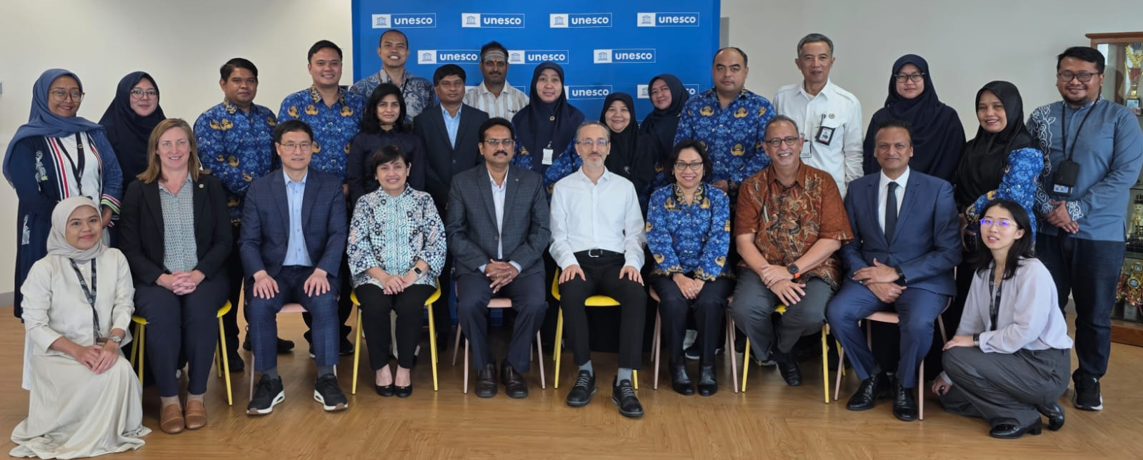
Intersessional Meetings & Projects
Conferences
ITS-2025, 12-14 Nov 2025, Hyderabad, India
ODTP Conference, 10-11 Nov 2025, Hyderabad, India
PCTWIN, 08-11 April 2025, Kochi, India
Intersessional Meetings
Working Group 1 on Tsunami Risk Community Awareness & Preparedness, 23 July 2025
19th Meeting of the Steering Group, Jakarta, Indonesia, 17-19 June 2025
Working Group 2 on Tsunami Detection, Warning and Dissemination, 25 Aug 2025
Working Group 3 on Tsunami Ready Implementation, 15 Oct 2025
Subregional Working Group for the North- West Indian Ocean, 8 Oct 2025
Task Team on Exercise IOWave25, 30 April 2025
Funded Projects
Flanders UNESCO Science Trust Fund (FUST) project on Strengthening Community Resilience to ocean hazards through implementation of TRRP in SIDS and Africa (Madagascar & Seychelles)
Phase 3 UNESCAP Project on Strengthening Tsunami Warning in the North-West Indian Ocean through Regional Cooperation (India, Iran, Maldives, Pakistan, Sri Lanka + Oman, UAE)
Project Proposals
FUST Phase 2 project on Integrated Sea-Level Warning and Resilience Network (ISL‑WARN)
ESCAP w/ GMT project on Building Capacities for Next‑Generation Tsunami and Coastal Multi‑Hazard Warning Systems in the Pacific and Indian Oceans.
Upcoming Meetings
Intersessional Meetings of the Working Groups & Task Teams (to be confirmed)
20th Meeting of the Steering Group, Perth, Australia, 9-11 June 2025
15th Session of the ICG/IOTWMS, Muscat, Oman, 15-19 Nov 2026
Participants at the 19th Meeting of the Steering Group, Jakarta, Indonesia, 17-19 June 2025

Slide 4
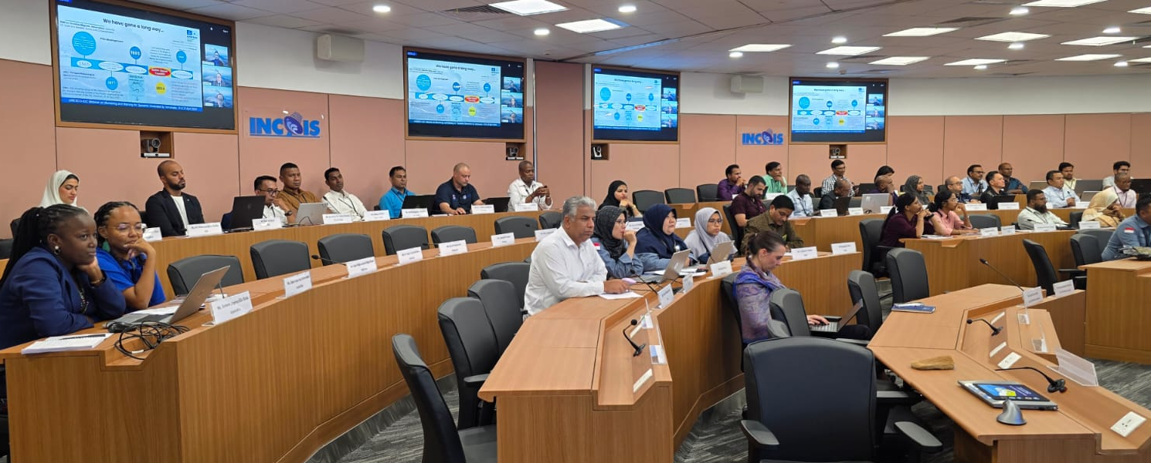
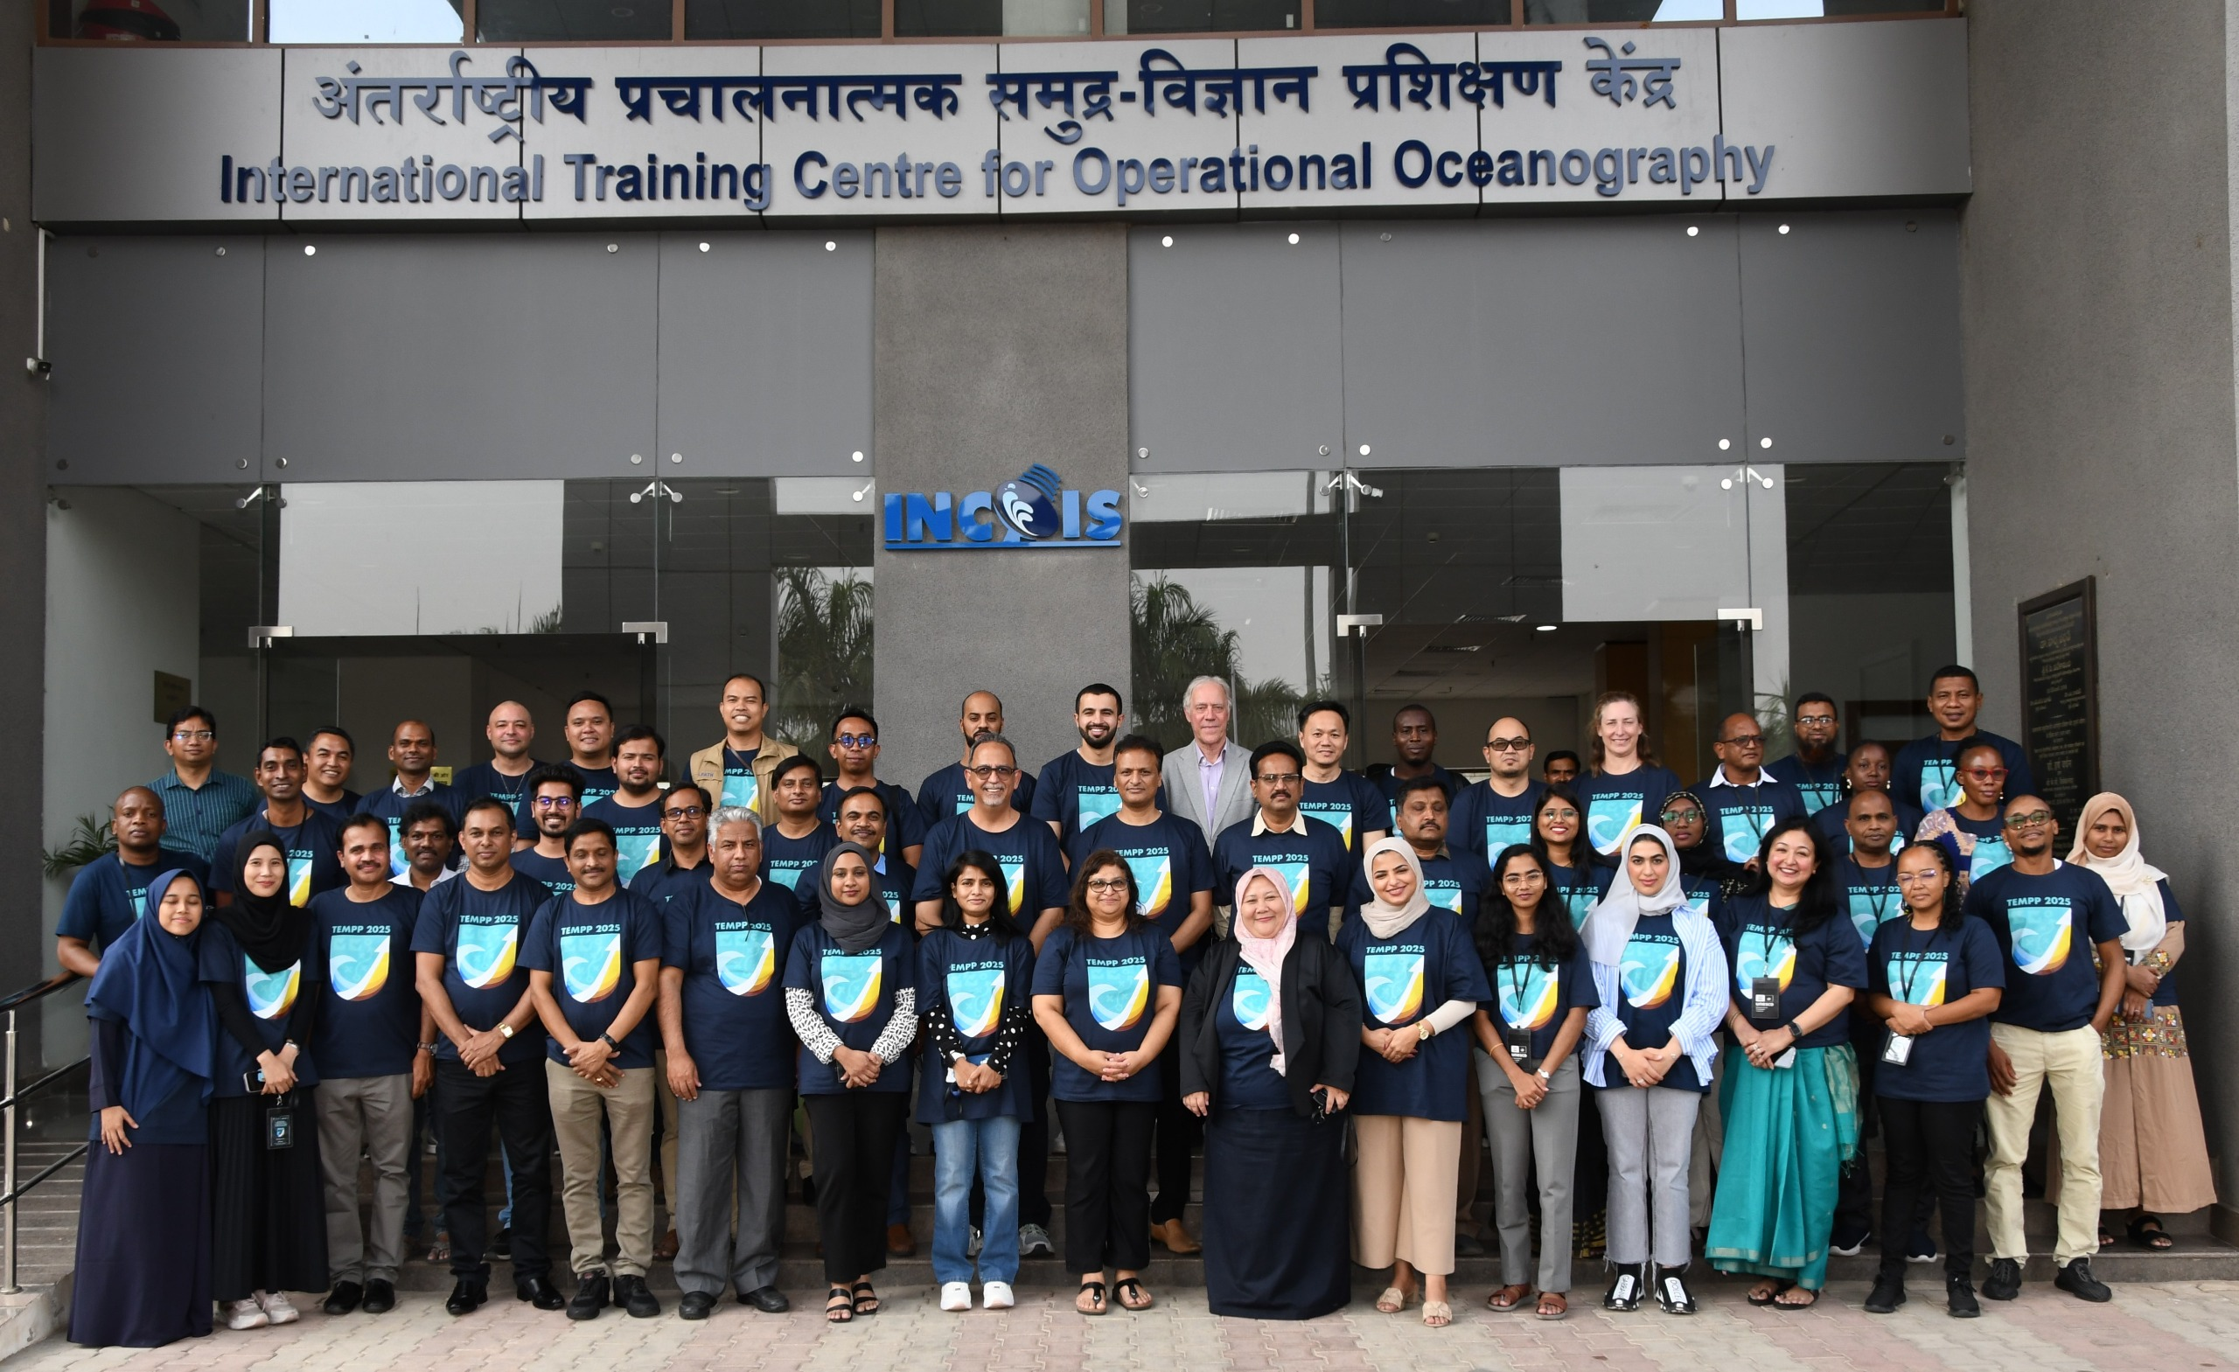
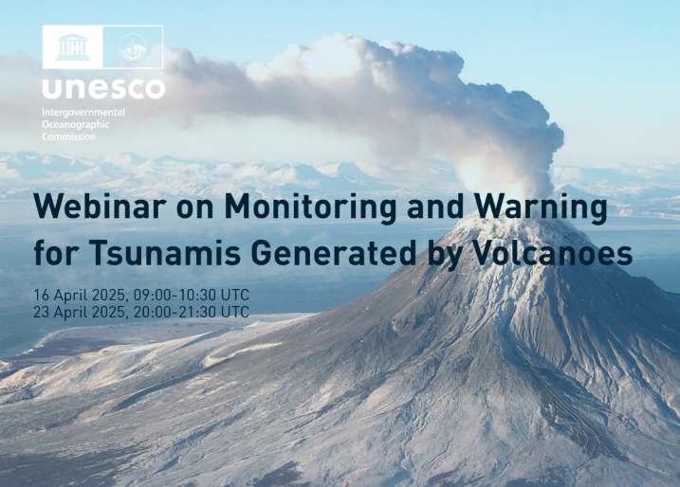
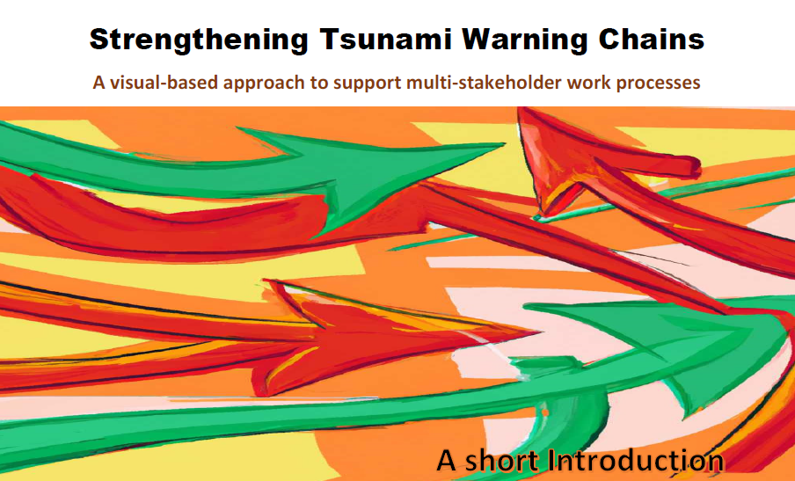
Capacity Development Activities
The 2024 Capacity Assessment of Tsunami Preparedness in the Indian Ocean (IOC Technical Series 193) guides capacity development initiatives & training.
Early Warning Chains and SOPs
Pre-IOWave 2025 Workshops on Standard Operating Procedures for National Tsunami Warning Centres and Disaster Management Organisations
      Eastern Indian Ocean Member States, 04-06 Aug 2025
      Western Indian Ocean Member States, 11-13 Aug 2025
      Online regional workshops and in-person national workshops.
      Draft booklet on Strengthening Tsunami Warning Chains
      Tsunami Messages for NAVAREA Coordinators
      Pre-IOWave25 Webinar for NAVAREA Coordinators on Strengthening Maritime Tsunami Alerting Mechanism.
      Post-IOWave25 Webinar
      Webinar on Lessons Learnt during Exercise Indian Ocean Wave 2025, 16-17 Dec 2025
      Tsunami Generated by Volcanoes
      Webinar on Monitoring and Warning for Tsunamis Generated by Volcanos, 16 & 23 April 2025
      Tsunami United Sessions
      Tsunami United Sessions for high school students including interactive online session, coaching and campaigns to raise awareness and build resilience against tsunami threats, 14 Aug – 19 Sep 2025
Tsunami Evacuation Maps, Plans and Procedures
TEMPP Training focused on a) Tsunami Inundation Modelling, b) Tsunami Evacuation Maps, Plans and Procedures & c) the UNESCO-IOC Tsunami Ready Recognition Programme ( 15-23 April 2025, Hyderabad, India)
TIMM Training focused on Tsunami Ready implementation in Madagascar, Seychelles and Sri Lanka (16-21 March 2026, Hyderabad, India)

Slide 5
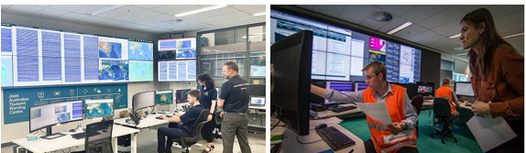
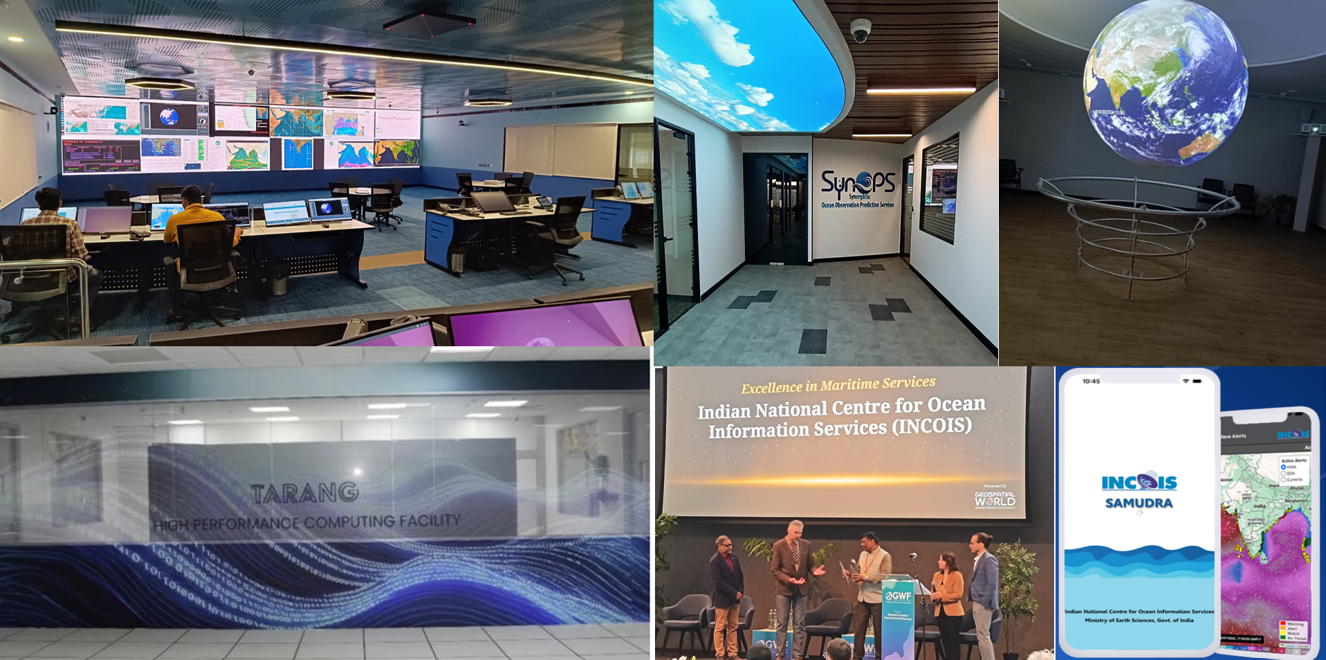
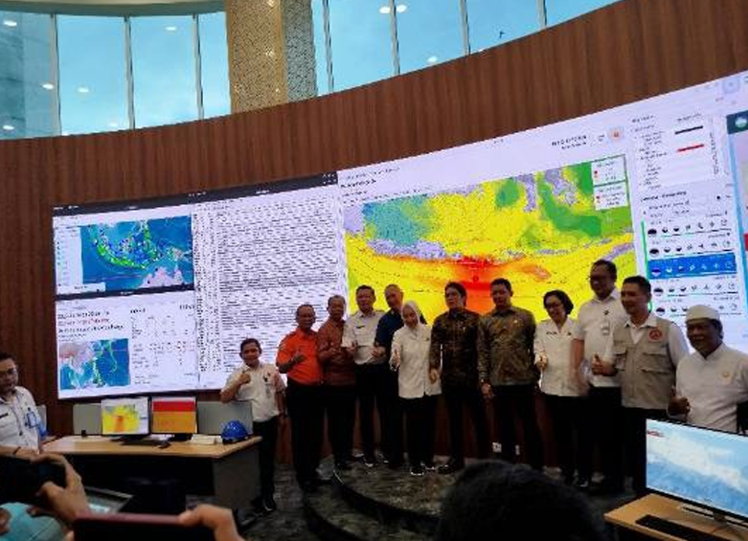
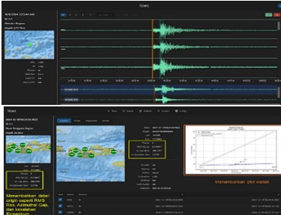
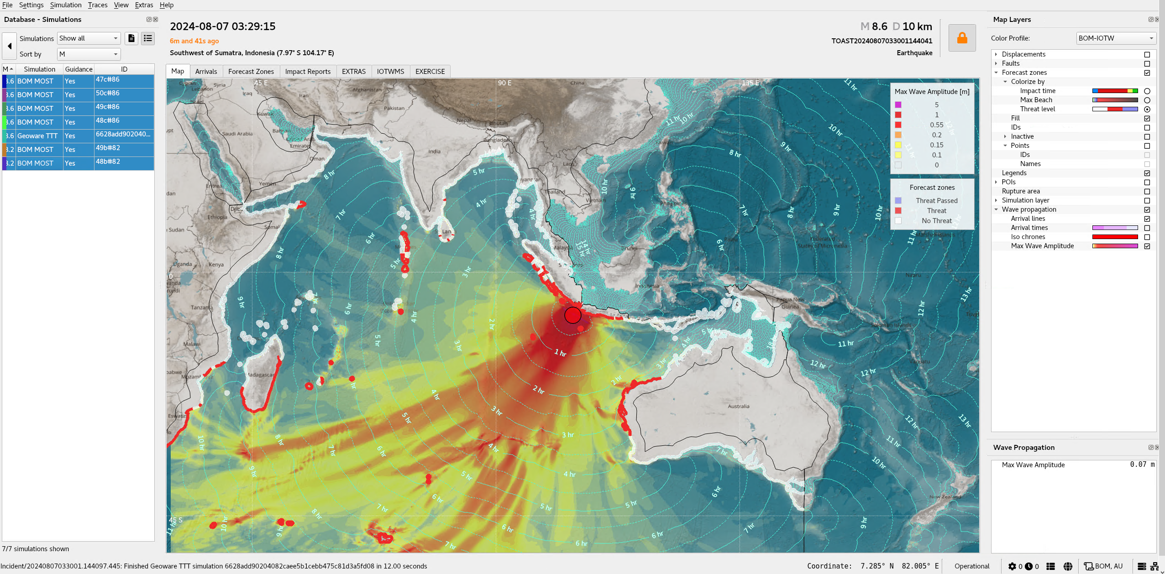

During the reporting period, the Indian Ocean experienced three earthquake events of magnitude ≥ 6.5, all of which were assessed as posing no tsunami threat by TSPs.​
TSPs Progress
TSP Australia TSP India
TSP Indonesia
NAVAREA & TGV Products: Implemented
BOM‑JATWC ISO 9001: Accredited 2020; re-accredited 2023 → valid to 2026
Audits: Annual surveillance 2024; next July 2025
Bureau-JATWC has implemented 2 minor updates to TOAST system. These updates contain bug fixes and ease of use features.
DART Stations: Two Tasman Sea DARTs restored; 5 of 6 are online.
GA‑JATWC ISO 9001: Work underway toward ISO 9001:2015
Upgraded to SeisComP6 & currently in testing
Seismic Array: Real-time processor tested in parallel; performance assessment ongoing
NAVAREA & TGV Products: Implemented
Maintaining CFZs Layers for IOTWMS
Established 15 new tide gauges with co-located GPS along Indian coast.
Upgraded SeisComP7 and operational.
HPC facility “TARANG” at INCOIS - Dedicated to real-time tsunami inundation modeling, operational oceanography, and advanced simulations.
INCOIS (TSP India) is contributing to the ODTP goals through various projects like PCTWIN, SMART Cables, Tsunami Ready at Odisha, etc.
INCOIS is also contributing for the ESCAP Phase-3 project of NWIO region.
India hosted TEMPP, and UNESCO-TRRP training workshop during 15-23 April 2025;
Tested NAVAREA & TGV Products
Backup Operational Center of InaTEWS at Bali launched on 14 June 2025 by BMKG equipped with Base Isolator Technology to ensure earthquake resilience and operational continuity;
Experimenting AI-based earthquake processing and ~10,000 tsunami scenarios for faster, more comprehensive warnings.
Develop a New Magnitude Formula Mbmkg
Expanded Sunda Zone tsunami database with 1,800 new pre-calculated scenarios (Mw 7.1–7.3), including ‘odd’ magnitudes from West Sumatra to Sumbawa
3

Slide 6

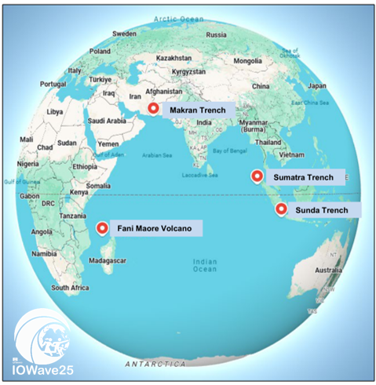
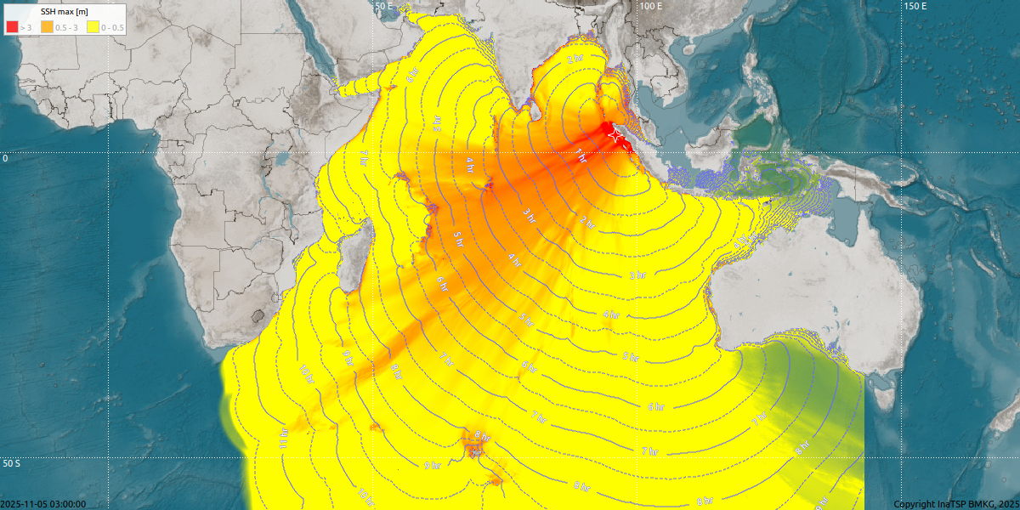

Indian Ocean Wave 2025
Overview
25 September to 05 November 2025
4 Scenarios including1 Non-seismic event and outside of working hours
Included non-seismic and NAVAREA products
Encourage the Member States to ensure the participation of TR recognised communities
Pre-IOWave SOP & Post-IOWave25 Lessons Learnt Workshops
Participation
At least 20 countries participated in IOWave25 through simulations, drills, tests and evacuations.
Community evacuations involved ~330,000 people overall across the region
Seven countries carried out community-level evacuations: India (112,000), Indonesia (207,000), Sri Lanka (3,000) , Timor Leste (200), United Arab Emirates (108)
NAVAREA messages: Trial dissemination of was conducted during IOWave25 with all Indian Ocean NAVAREA coordinators (VII-XI) participating.

Slide 7

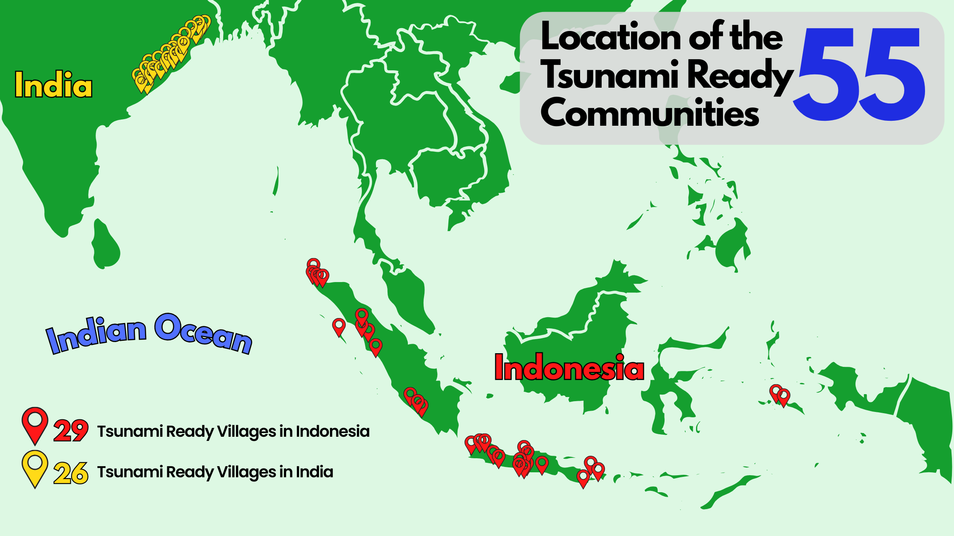
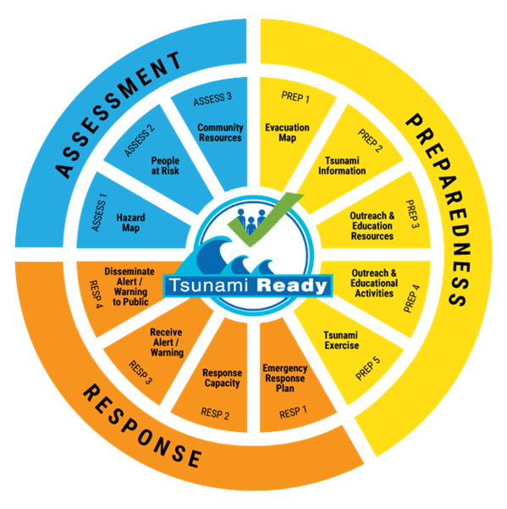
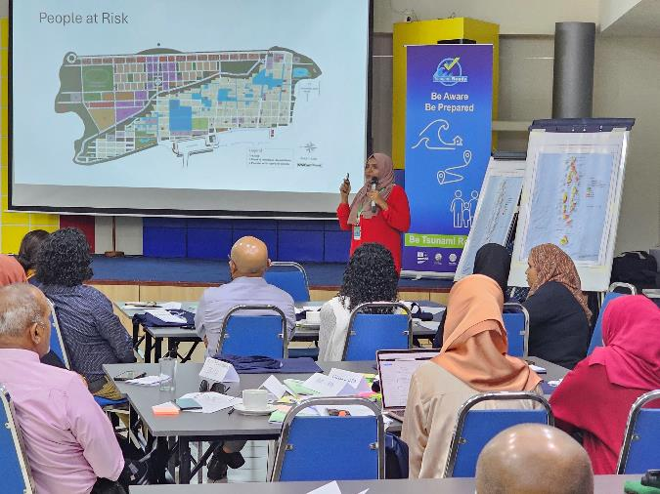
Tsunami Ready Recognition Programme
Community performance-based recognition programme that facilitates tsunami preparedness as an active collaboration of the community, community leaders, and national and local emergency management agencies.
Structured and systematic approach for community preparedness.
12 Indicators of Assessment, Preparedness, and Response
TEMPP & TRRP Trainings
19 National Tsunami Ready Focal Points
3 National Tsunami Ready Boards - India, Indonesia and Seychelles
55 IOTWMS Communities - 26 in India and 29 in Indonesia

Slide 8
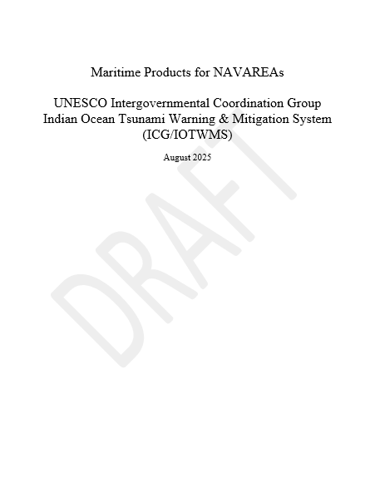
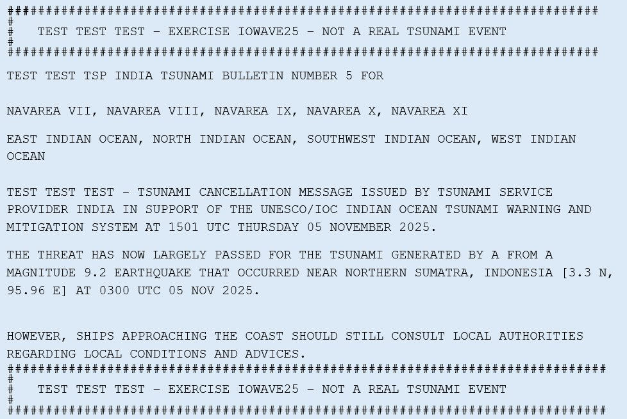
NAVAREA Tsunami Messages
Conducted Webinar on Maritime Tsunami Products for the Indian Ocean Region on 21 October 2025 for the NAVAREA coordinators in the Indian Ocean
Trial dissemination during IOWave25
Commencement of NAVAREA messages from TSPs (SOP)
Maritime Safety (NAVAREA) messages are issued from Type‑II onwards and continue until Final/Cancellation. Countries are listed under threat based on wave amplitudes ≥0.5 m at their coasts (per TSP assessments) and threat status reported by NTWCs, in line with IOTWMS TOWS-WG recommendations and public bulletin policy.
NAVAREA User guide
Participation & Summary – IOWave25 Scenario 4
05 November 2025
All five Indian Ocean NAVAREA Coordinators (VII–XI) participated.
100% found TSP products easy to access and useful for preparing NAVAREA messages (Australia, India, Japan, Pakistan, South Africa).
40% reported interaction with their NTWC (India, Pakistan).
Feedback:
  Preferred formatting observed in TSP-India’s messages;
  coordinates should follow Joint IMO/IHO/WMO Manual format:
  Latitude DD‑MM.mmN/S, Longitude DDD‑MM.mmE/W
  (e.g., 32‑18.65S 165‑02.81E).

Slide 9
Common Alert Protocol Status – ICG/IOTWMS
National Focus
  CAP implementation rests with NTWCs, in line with their sovereign authority to issue official warnings.
  Integration of tsunami warnings into national CAP systems is encouraged.
Regional Role
  TSPs generate regional forecasts and stage them on password-protected websites.
  TSPs provide forecast guidance only; TSP-level CAP is not appropriate due to legal and multi-layered architecture.
Guidelines Development
  Priority is on developing Guidelines for CAP Implementation at the National Level for Tsunami Early Warnings (IOTWMS WG‑2).
  ITU to provide guidance on optimal CAP-based tsunami warning dissemination architecture for NTWCs.
Collaboration & Pilot Initiatives
UNESCO-IOC ICG/IOTWMS is engaging with ITU and WMO .
30 EW4All countries supported for CAP national implementation.
Jointly identifying a small set of ICG Member States to pilot CAP for tsunami warnings and strengthen end-to-end early warning chains (SOPs, TSPs, NTWCs, NDMOs, LDMOs, communities).

Slide 10
