Slide 1
ICG/CARIBE-EWS-XVIII
REPORT
Gérard Métayer
ICG/CARIBE-EWS Chair
Mars 31, 2026
TOWS-WG-XIX

Slide 2
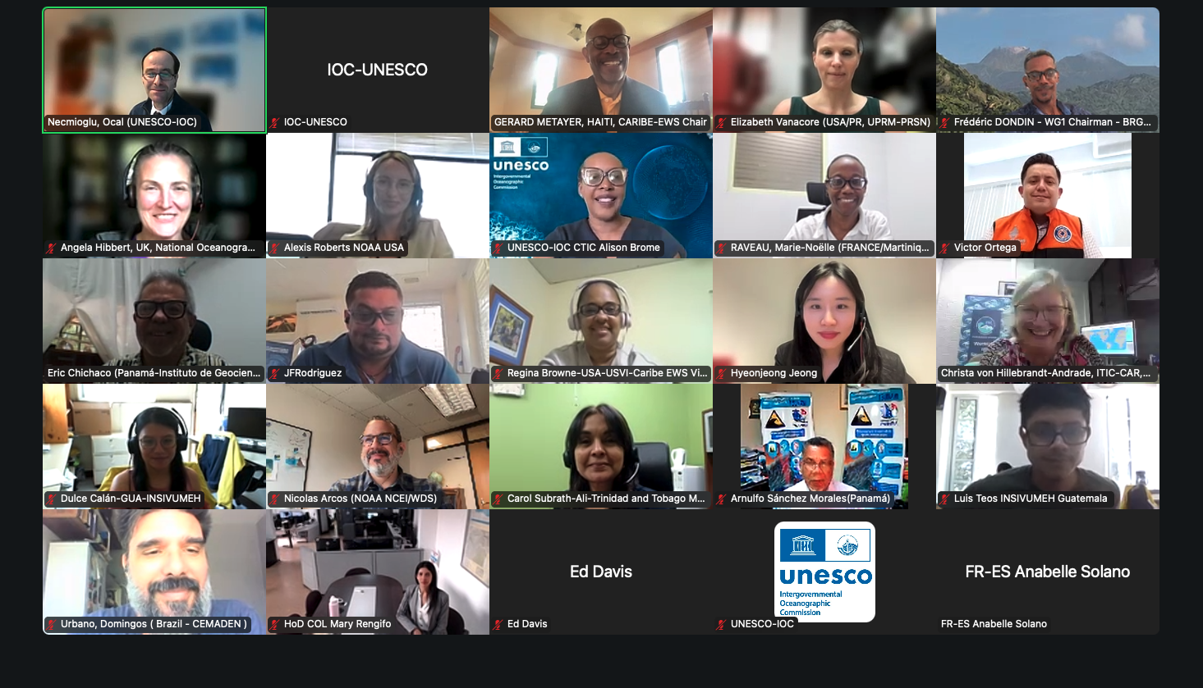
ICG/CARIBE-EWS-XVIII meeting
Online, 5-7 and 9 May, 2025
59 virtual participants
19/48 MS and Territories
21 Observers with Argentina and Uruguay as new
Anniversary event and Next meeting Curacao, April 20-24, 2026,

Slide 3




Officers elected in 2025
Gérard Métayer, Haiti
Chair re-elected
Marie-Noelle Raveau,
France, Martinique
Vicechair re-elected
Silvia Chacon Barrantes,
Costa Rica
Vicechair elected
Regina Browne, USVI
Vicechair re-elected

Slide 4
Reports and Recommendations
Reports from UN and Non UN Organizations, Status of other ICGs
Reports from Ocean Decade Tsunami Program, Tsunami Ready Recognition Program
Reports from Technical Secretariat, CTIC, ITIC-CAR, PTWC, CATAC
Reports from some Member States and Territories
British Virgin Islands, Colombia, Costa Rica, Cuba, France, Guatemala, Mexico, USA.
Reports from Caribe Wave exercise, Policy matters, Program and budget.
Recommendations to IOC on Governance, Working Groups & Task Teams, CITIC, CATAC

Slide 6
XXth Anniversaries of ICG/CARIBE-EWS
ICG/CARIBE-EWS participated at the 2nd Global Tsunami Symposium to celebrate the Two Decades Post 2004 Indian Ocean Tsunami in Banda Aceh on november 2024
ICG/CARIBE-EWS notes that 2025 is the 20th anniversary of the establishment of the ICG/CARIBE-EWS, 2026 will be the 20th anniversary of the first ICG/CARIBE-EWS and 2027 will be the 20th Session of the ICG/CARIBE-EWS
The ICG further noted that these anniversaries had already been noted as an important opportunity for raising awareness, ensuring tsunami resilience in the Caribbean and its Adjacent regions. A Tsunami Ready Summit will be organized in Curacao during 2026 for these circumstances.
CARIBE-EWS Steering Committee will organize events and other actions and activities associated with the occasion of the 20th anniversaries of the ICG/CARIBE-EWS

Slide 7
Recommendations to TSP Operations Document
Noting that there are some items of the CARIBE EWS Tsunami Service Provider that are not included or are inconsistent with the Global Service Definition Document (GSDD)
Further noting the duplications between the TOWS Global Service Definition Document and the CARIBE EWS Technical, Logistical and Administrative Requirements of a Regional Tsunami Service Provider for CARIBE-EWS the importance of developing performance indicators also for communication and dissemination of TSP products,
Recommends the ICG/CARIBE-EWS Steering Group to prepare by 30 September 2025 a CARIBE EWS supplement to the GSDD, and share with CATAC and PTWC,
Additionally recommends the ICG/CARIBE-EWS Steering Group to define the reporting mechanism for its TSPs, including performance KPIs that include communication and dissemination and inform PTWC and CATAC by 30 September 2025
Further recommends that both the GSDD and the CARIBE EWS supplement guide the operations of the CARIBE EWS Tsunami Service Providers.
The ICG/CARIBE-EWS

Slide 8
The ICG/CARIBE-EWS
Appreciated greatly the report and technical and administrative advances performed by CATAC during the intersessional period and its continuous efforts
Noted the challenges of CATAC during the February 8, 2025 Western Caribbean M7.6 event
Recommends that CATAC continues full functionality in an interim manner to be able to support the National Tsunami Warning Centers (NTWCs), Tsunami Warning Focal Points and Emergency Management Authorities in Central America
Recommended the Steering Committee to work with CATAC and Member States towards the consideration of CATAC as a TSP at its XIX session in 2026, with the aim of consideration of CATAC as a TSP in its XIX Session in 2026 to enable the IOC Executive Council to consider the final admission of CATAC as TSP in June 2026.
Central America Tsunami Advisory (CATAC)

Slide 9
Specialized TSP Bulletins for maritime community
The ICG-CARIBE-EWS noted that the TOWS-WG-XVIII recommended that the full operational implementation of TSP bulletins for the maritime communities by at least one TSP in each ICG takes place in 2025
The ICG-CARIBE-EWS approved the PTWC implementation of maritime products for WWNWS NAVAREA IV and V Coordinators
The ICG-CARIBE-EWS requested PTWC to create an annex to the User's Guide with a description of the Maritime Products
The ICG-CARIBE-EWS recommended PTWC to coordinate a start date for the implementation of the Maritime Products with the NAVAREAs by the end of 2025 and also test in CARIBE WAVE 26
The ICG-CARIBE-EWS requested the Secretariat to inform the concerned NAVAREA IV and V Coordinators accordingly.
Need to expand support for Tsunami Ready Recognition Program
Requests the Member States to provide greater support through financial
and human resources

Slide 10
Caribbean Tsunami Information Center (CITIC)
The ICG/CARIBE-EWS
Appreciates the continued support of ITIC and its Caribbean Office as requested by CTIC
Notes the renewal and signature of the memorandum of understanding between the Government of Barbados and UNESCO-IOC regarding CTIC on 29 May 2024 and its strengthening by the extension of the duration from 3 to 5 years
Recommends convening a dedicated session of the CARIBE-EWS Steering Committee to
strategically review the CTIC Governance structure in identifying and supporting the implementation of
resource mobilization, staff, partnerships, and other frameworks to enhance the ownership and
sustainability of the CTIC,
Recommends that CTIC continues to work with the IOC Secretariat, CARIBE-EWS Member States and partners to develop a strategic plan to guide the resource mobilization and staffing efforts of the CTIC
Need to expand support for Tsunami Ready Recognition Program
Requests the Member States to provide greater support through financial
and human resources

Slide 11
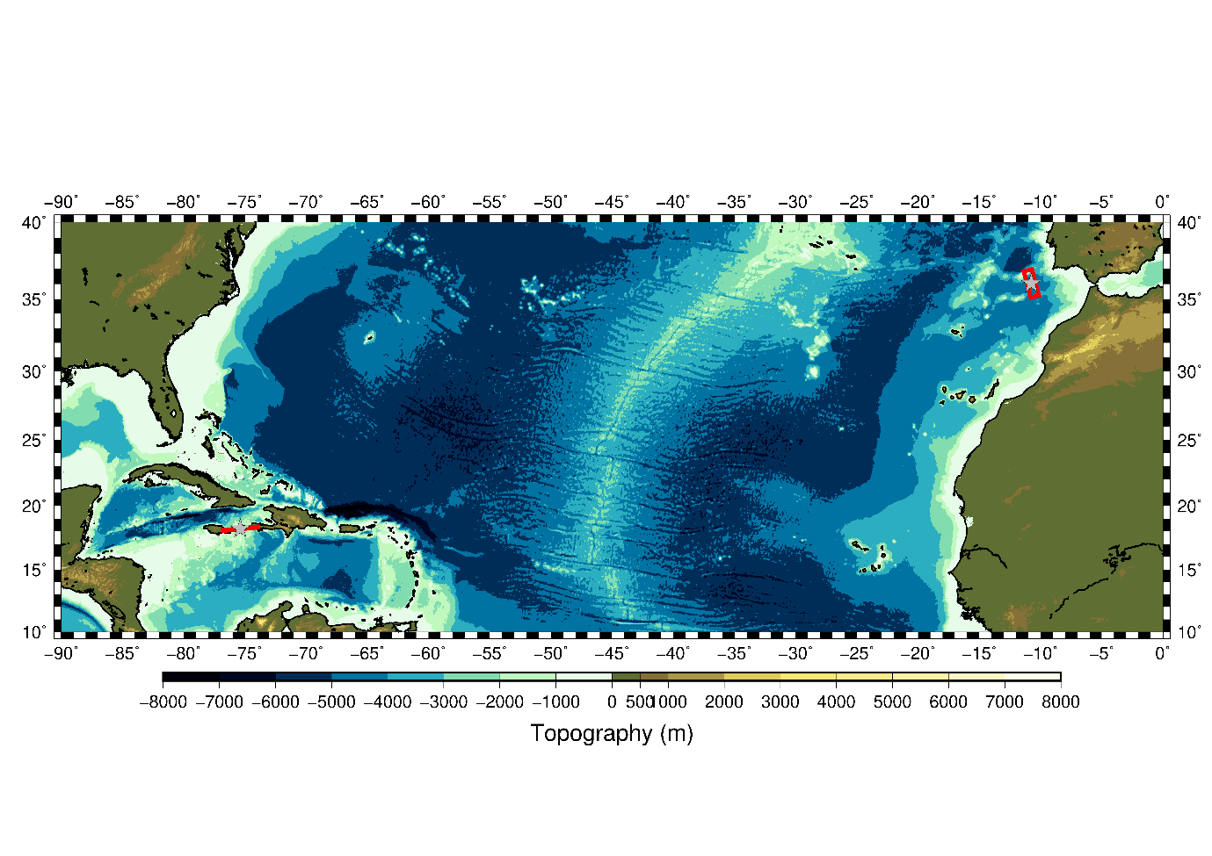
CARIBE WAVE 25
March 20, 2025 15:00 UTC
2 scenarios
  Jamaica Scenario
  Portugal Scenario
500,000+ people registered
Kick’em Jenny
NPDB

Slide 12
CARIBE WAVE 26
CARIBE WAVE 27
March 19, 2026, 15:00 UTC
2 scenarios
  Cayman Island EQ and Tsunami
  Kick’em Jenny Volcano
2 Possible Scenarios
Southern Caribbean EQ
Distant Tsunami

Slide 13
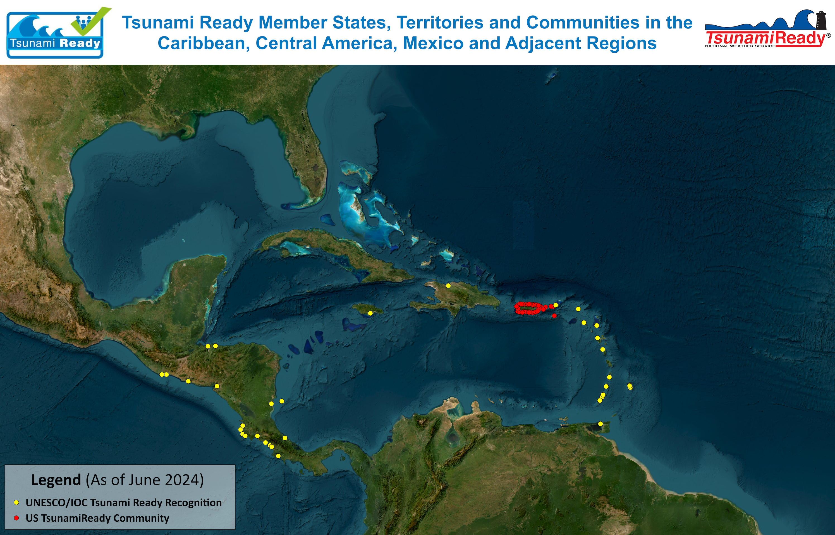
25+ countries and territories have/implementing Tsunami Ready
21 UNESCO/IOC Tsunami Ready Communities/Countries/Territories
3 Renewal
49 US TsunamiReady communities in Puerto Rico and USVI

Slide 14

OCEAN DECADE TSUNAMI PROGRAMME:
THE MAIN SOCIAL OUTCOME
BY
2030
TO MAKE
100%
OF COMMUNITIES AT RISK OF TSUNAMI PREPARED FOR AND RESILIENT TO TSUNAMIS

