Slide 1
Tsunami Ready Recognition Program (TRRP) Indian Ocean
Suci Dewi Anugrah
Chair of WG3 Tsunami Ready Implementation ICG/IOTWMS
suci.anugrah@bmkg.go.id
TOWS-WG Inter ICG Task Team on Disaster Management and Preparedness (TTDMP2), 5-6 March 2026

Slide 2
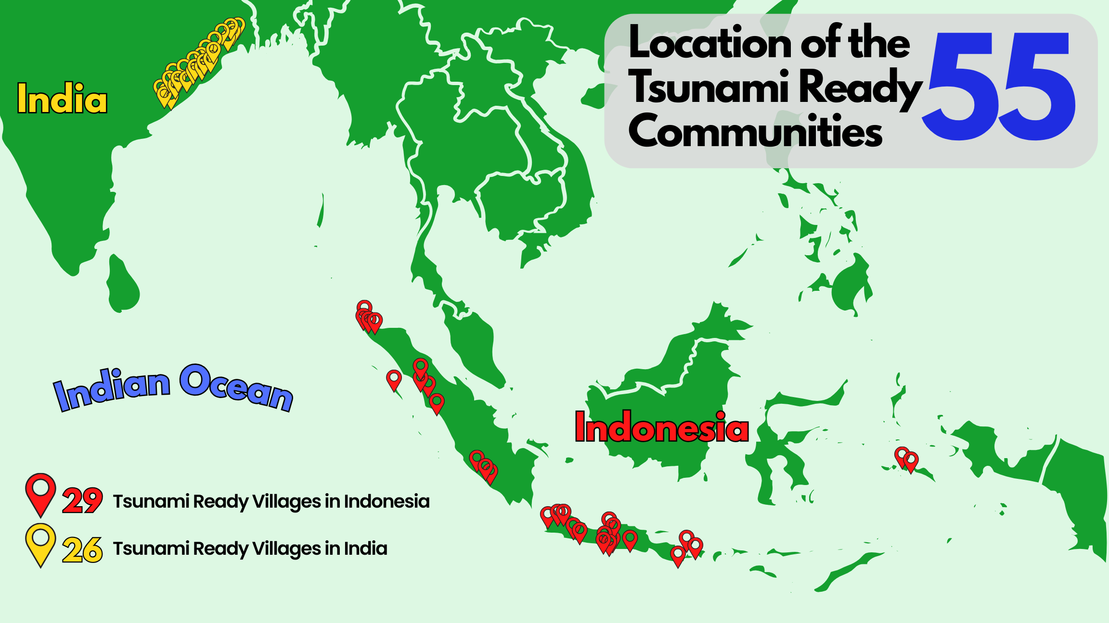
CURRENT STATUS OF THE INDIAN OCEAN TSUNAMI READY COMMUNITIES
INDIA
1 Provinsi, 6 Kecamatan, 26 Desa
Balasore District
Jayadevkasaba Pahi Village,
Jagannathpur Village,
Kanyanagari Village,
Sahapur Village,
Bhadrak District
Mohanpur Village,
Sanakrushnapur Village,
Adhuan Village,
Badahabelisahi Village,
Ganjam District
Kantiagada Village,
Markandi Village,
Prayagi Village,
Uppalaputi Village,
Venkatraipur Village,
Jagatsinghpur District
Bahgeipur Village,
Bhuyanpala Village,
Dhanaharbelari Village,
Noliasahi Village,
Shadabedi Village,
Kendrapada District
Chinchiri Village,
Kaitha Village,
Kantilo Village,
Tantiapala_Sasan Village,
Puri District
Chhotipada Village,
Keutajanga Village,
Khalakatapatana Village,
Narasinghpatana
INDONESIA
11 Province, 18 District, 26 Villages
Sumatera Barat
Purus-Kota Padang
Lolong Belanti-Kota Padang
Tapakih-Kota Padang
Tua Pejat-Kepulauan Mentawai
Amping Parak-Pesisir Selatan
Yogyakarta
Glagah-Kulon Progo
Kemadang-Gunung Kidul
Parangtritis-Bantul
Gading Sari- Bantul
Tirto Hargo- Bantul
Poncosari- Bantul
Bali
Tanjung Benoa-Badung
Pangastulan-Buleleng
Aceh
Deah Glumpang-Banda Aceh
Gampong Jawa-Banda Aceh
Mon Ikeun-Aceh Besar
Lamkruet-Aceh Besar
Nusa Tenggara Barat
Kuta Mandhalika-Lombok Tengah
Jawa Barat
Pangandaran-Pangandaran
Cikakak-Sukabumi
Citepus-Sukabumi
10-11 November 2025
INCOIS, Hyderabad, India
Jawa Timur
Tambakrejo-Malang
Maluku
Galala-Ambon
Hative-Ambon
Bengkulu
Lempuing-Bengkulu
Penurunan-Bengkulu
Teluk Sepang-Bengkulu
Banten
Panggarangan-Lebak
Jawa Tengah
Sidaurip-Cilacap
TOWS-WG Inter ICG Task Team on Disaster Management and Preparedness (TTDMP2), 5-6 March 2026

Slide 3
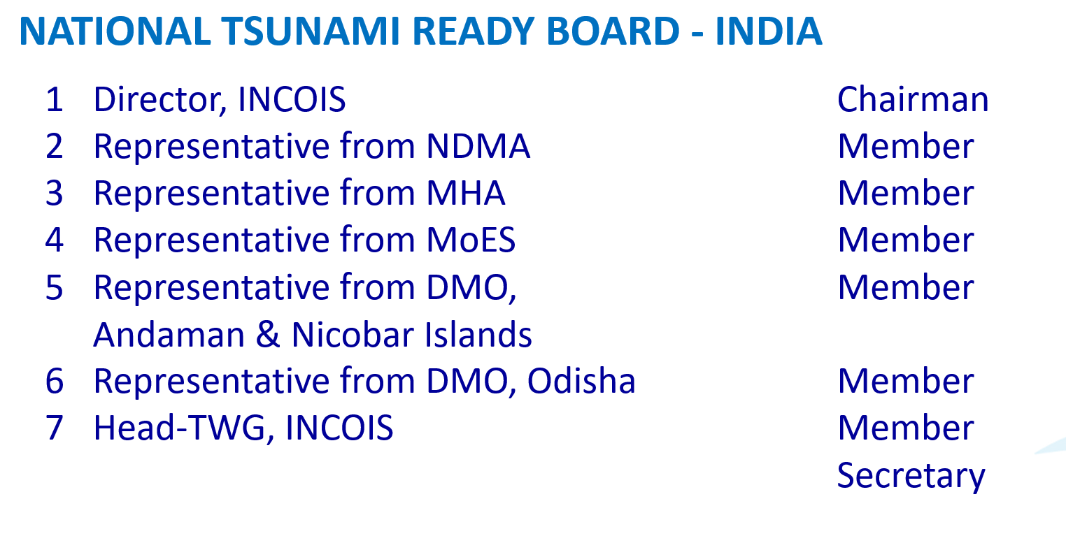
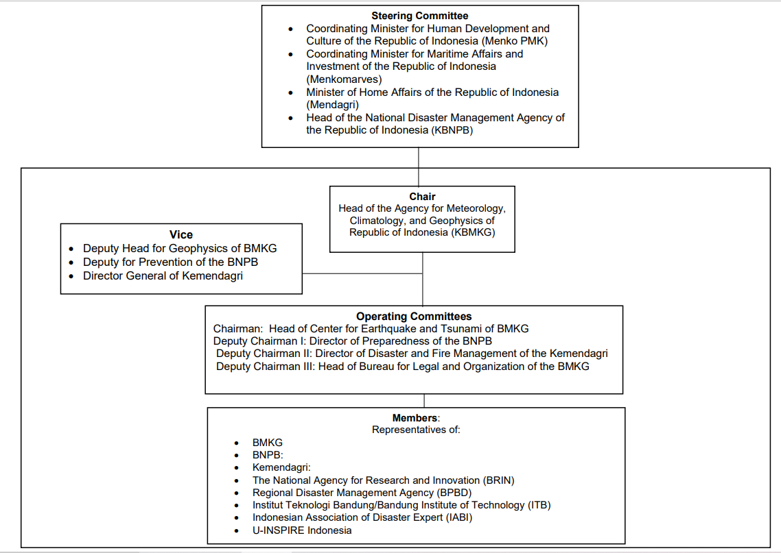
National TsunamI Ready Board (NTRB)
New NTRB in Seychelles and Maldives has been established in 2025
Role of NTRB: Coordinating, advocacy, promotion,and socialization TRC, Recommend the Tsunami Ready Community to gain UNESCO-IOC Tsunami Ready Recognition,
Meet regularly to plan activities and review progress
Prepare a list of all entities that can support the Tsunami Ready programme
Appoint representatives to oversee the implementation and maintenance of the Tsunami Ready indicators
Develop a fully costed and resourced work plan
Monitor implementation and review status of Tsunami Ready indicators
Complete and submit Tsunami Ready recognition Application to the NTRB
TOWS-WG Inter ICG Task Team on Disaster Management and Preparedness (TTDMP2), 5-6 March 2026

Slide 4
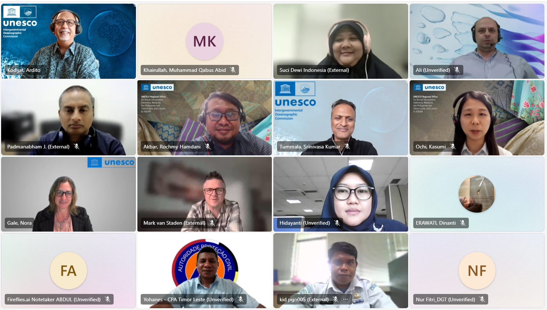
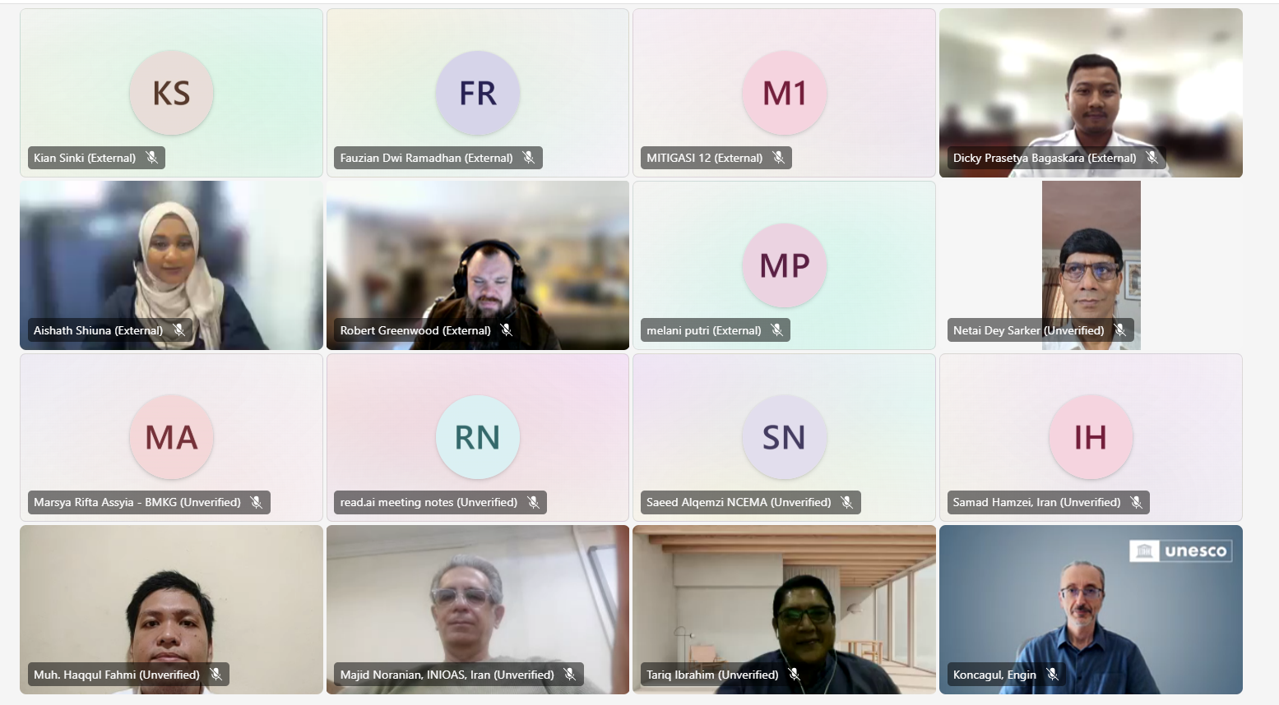
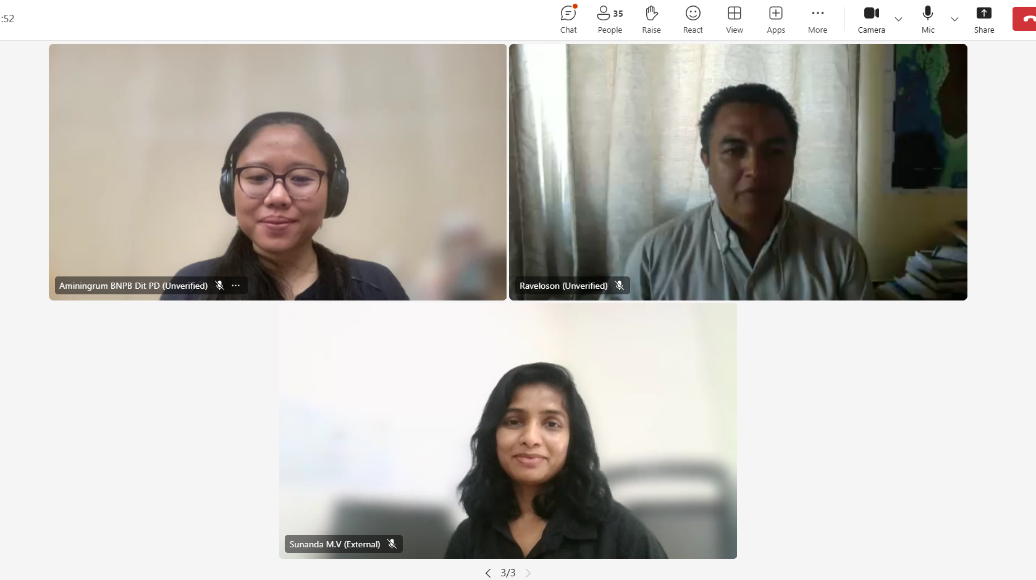
National Tsunami Ready Focal Points (NTRFP)
(TRFP) is a contact (person) officially to liaise with ICG/IOTWMS on the implementation of Recognition Programme (TRRP), or a recognized similar national initiative,
NTRFPs from:
Australia
Bangladesh
Comoros
India
Indonesia
Iran
Kenya
Madagascar
Malaysia
Maldives
Mauritius
Mozambique
Myanmar
Pakistan
Seychelles
South Africa
Sri Lanka
Timor Leste
UEA
NTRFP Coordination Meeting, 14 October 2025
TOWS-WG Inter ICG Task Team on Disaster Management and Preparedness (TTDMP2), 5-6 March 2026

Slide 5
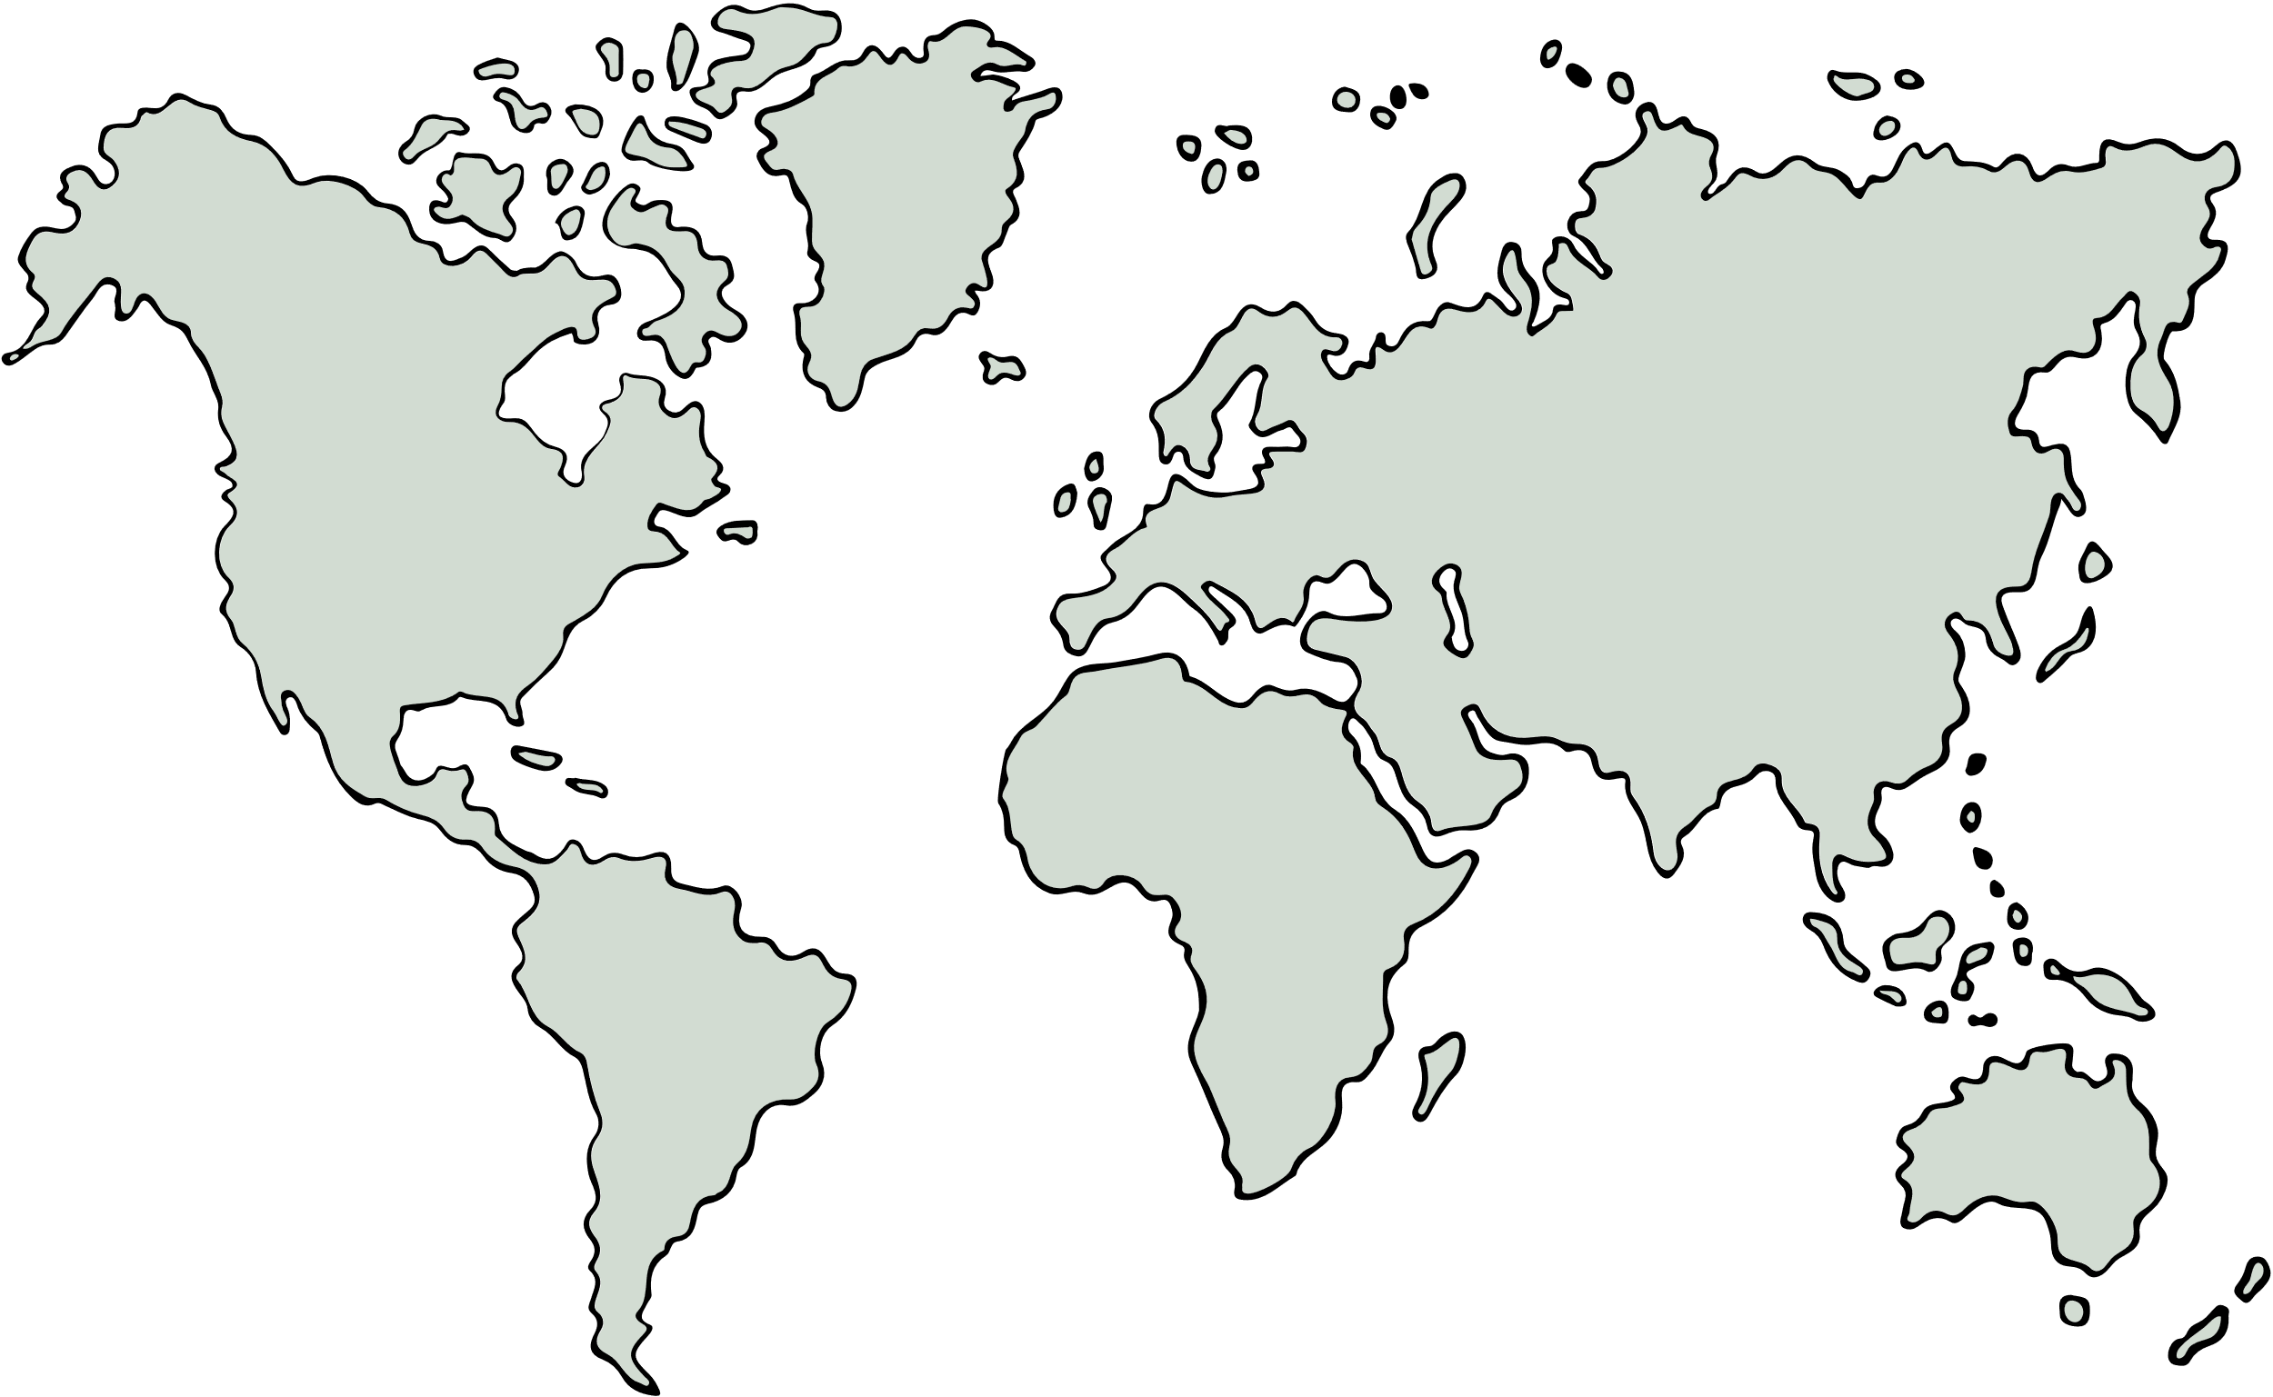
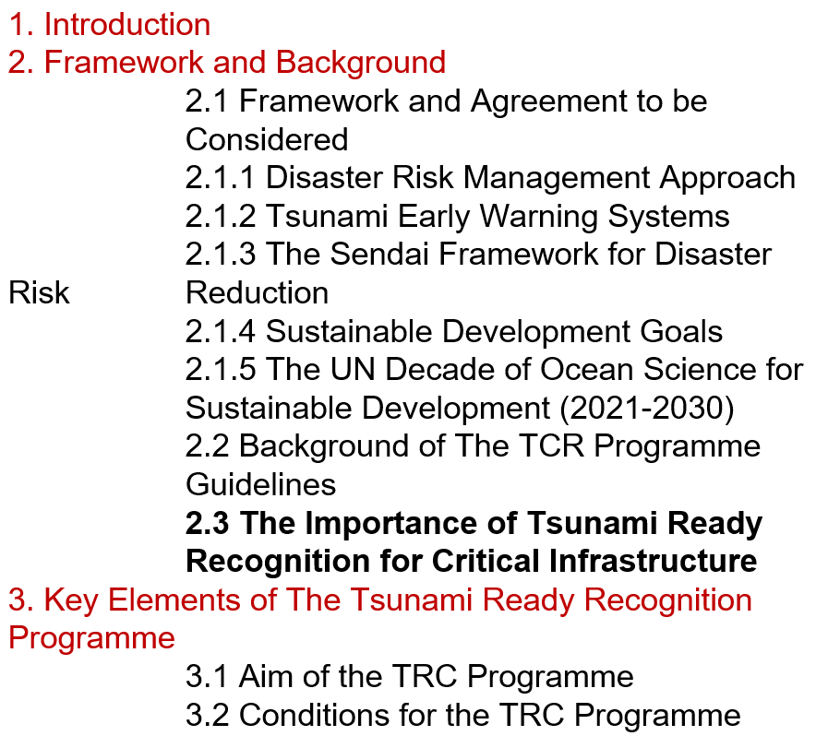

TSUNAMI PREPAREDNESS FOR CRITICAL INFRASTRUCTURE
Critical infrastructure also forms an integral part of coastal communities.
With operations running continuously 24 hours a day, seven days a week, these facilities have a distinct advantage in maintaining tsunami preparedness.
There are currently no standardized guidelines specifically developed for recognizing Tsunami Ready for critical infrastructure community.
Many of critical infrastructure are constructed along coastal areas directly facing the sea
TRC aims to:
Ensuring Human Safety
Anticipating Cascading Hazards
Accelerating Recovery and Business Continuity
Maximizing the Role of Critical Infrastructure in Strengthening Community Preparedness
Al Rayyan
International Airport
Thandwe Airport
Colombo
International Airport
Seychelles
International Airport
Yogyakarta
International Airport
I Gusti Ngurah Rai
International Airport
Indian Ocean
Sainte Marie Airport
Port Hedland Airport
King Shaka
International Airport
TSUNAMI READY FOR CRITICAL INFRASTRUCTURE GUIDELINE
Same Foundation, The approach adopts the 12 UNESCO-IOC Tsunami Ready indicators, adjusts them based on the type and function of each critical infrastructure (e.g., airport, port, industrial zone).
There are currently no standardized guidelines specifically developed for recognizing Tsunami Ready for critical infrastructure and private sector community.
The concept of TRRP Implementation for Critical Infrastructure and the Drafted Guidelines has been proposed during the online meeting of WG 3 for the ICG/IOTWMS.
The guidelines is currently under review.
TOWS-WG Inter ICG Task Team on Disaster Management and Preparedness (TTDMP2), 5-6 March 2026

Slide 6
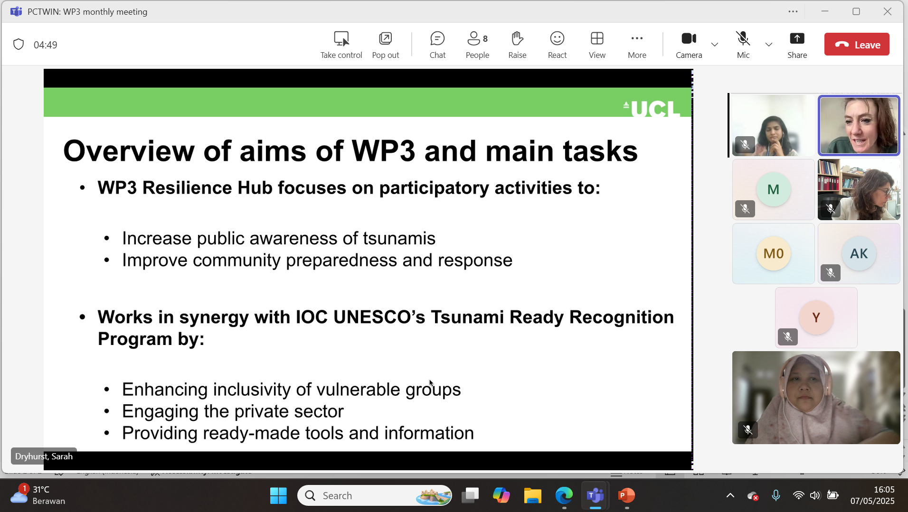
PROJECT COLLABORATION ON PEOPLE CENTRE TSUNAMI EARLY WARNING FOR THE INDIAN COASTLINE (PCTWIN)
The WG 3 is involved to the PCTWIN (initiated by UK Natural Environment Research Council (NERC) and the Indian Ministry of Earth Sciences (MoES) for the WP3 Resilience Hub, focus on:
Increase public awareness of tsunami
Improve community preparedness and response
Work in Synergy with WG3 by
Enhancing inclusivity of Vulnerable Groups
Engaging the Private Sectors
Providing ready-made tools and Information: Develop a clear and practical guideline based on the exercise to effectively measure inclusivity and engagement within Tsunami Ready
TOWS-WG Inter ICG Task Team on Disaster Management and Preparedness (TTDMP2), 5-6 March 2026

Slide 7
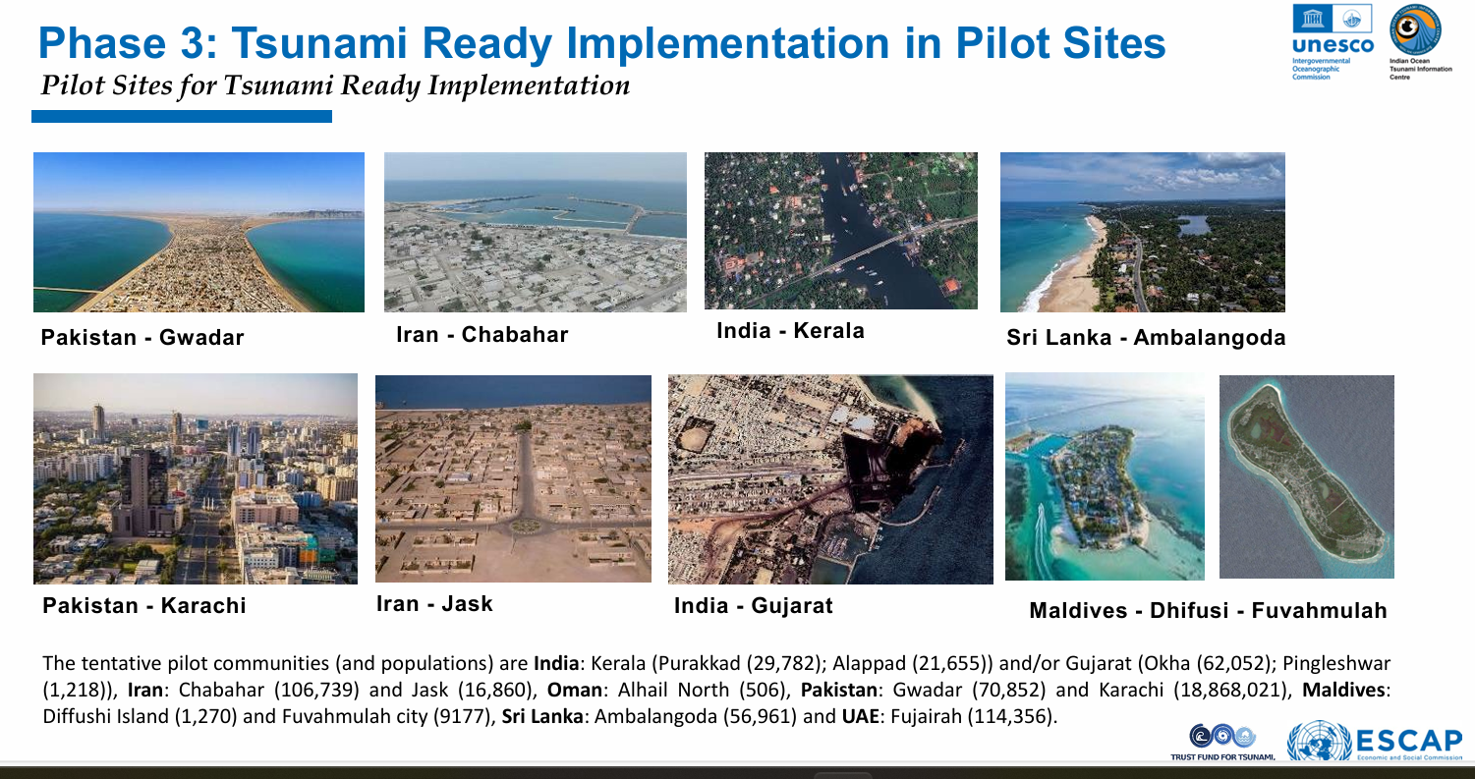
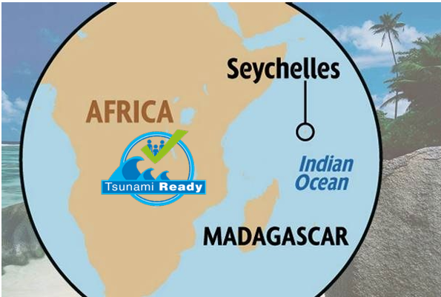
PROJECT COLLABORATION ON UNESCAP & FUST
UNESCAP:
In Strengthening tsunami warning in the North-West Indian Ocean through regional cooperation: Independent Evaluation Assessment
Phase 3: Tsunami Ready Implementation in Pilot Site: Improved community capacities for tsunami preparedness and response that are in line with the set of indicators of the UNESCO Tsunami Ready Recognition Programme (TRRP) in the 5 participating countries
Target on Tsunami Ready: 10 TRCs from 5 countries
FUST Tsunami Ready in Indian Ocean SIDs and Africa:
Objective: To implement the UNESCO-IOC Tsunami Ready Recognition Programme in selected pilot communities within Madagascar and Seychelles
Target on Tsunami Ready: 2-4 TRCs from 2 countries
TOWS-WG Inter ICG Task Team on Disaster Management and Preparedness (TTDMP2), 5-6 March 2026

Slide 8
CHALLENGES
Less participation on the Implementation of Tsunami Ready:
Result from the capacity assessment: 13 countries (59%) confirmed that they are already participating in TRRP
Limited resources to process the recognition including to verify and giving advocacy the TRC
Less awareness of tsunami due to the rare event, based on our observation during the tsunami ready in Seychelles, because of they do not have the local source of tsunami, the issue on the tsunami preparedness is not considered to be prioritized

Slide 9
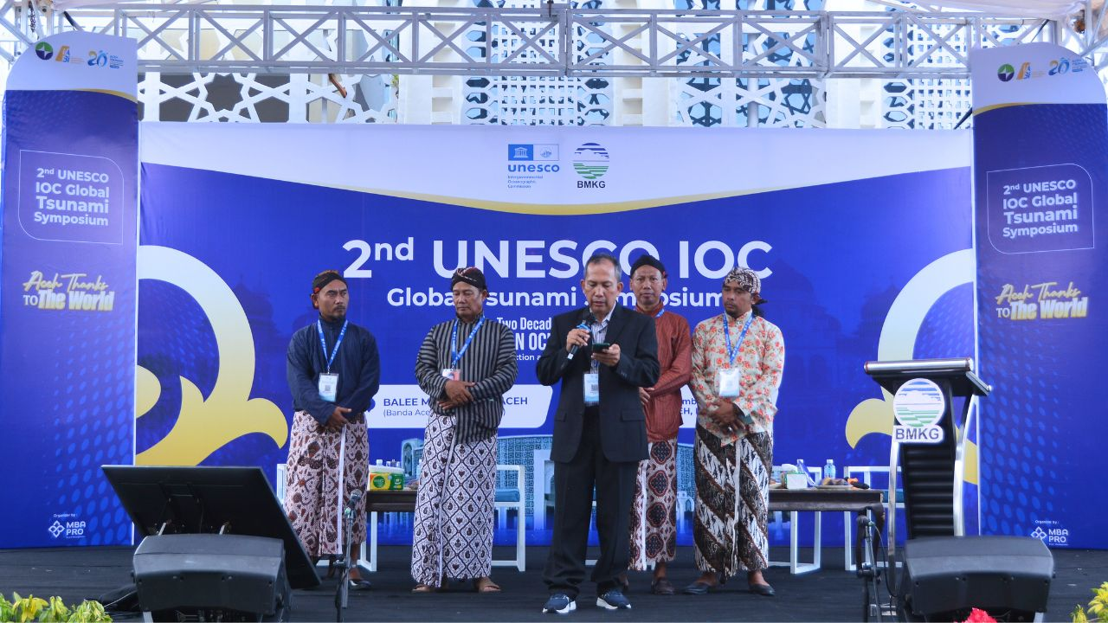
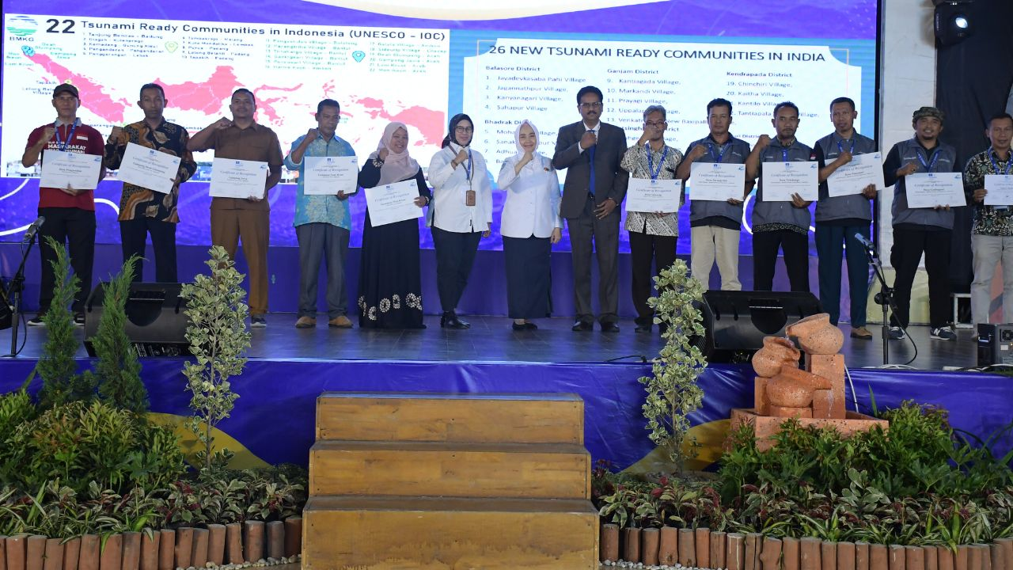
TSUNAMI READY FOR GLOBAL TSUNAMI SYMPOSIUM 2024
36 communities: 12 from Indonesia and 24 from India were recognized as Tsunami ready Community
Banda Aceh Statement:
Global Tsunami Warning and Mitigation System: Building Sustainability for the next decade through Transformation and Innovation.
UNESCO and its partners call on States and civil society to drastically step up their investments and efforts to achieve 100% Tsunami Ready Communities worldwide by 2030.
TOWS-WG Inter ICG Task Team on Disaster Management and Preparedness (TTDMP2), 5-6 March 2026

Slide 10
THANK YOU
suci.anugrah@bmkg.go.id
TOWS-WG Inter ICG Task Team on Disaster Management and Preparedness (TTDMP2), 5-6 March 2026

