Slide 1
International Tsunami
Information Center (ITIC)
Training Videos
Dr. Laura Kong
Director, ITIC
Dr. Dailin Wang
Senior Oceanographer, PTWC

Slide 2
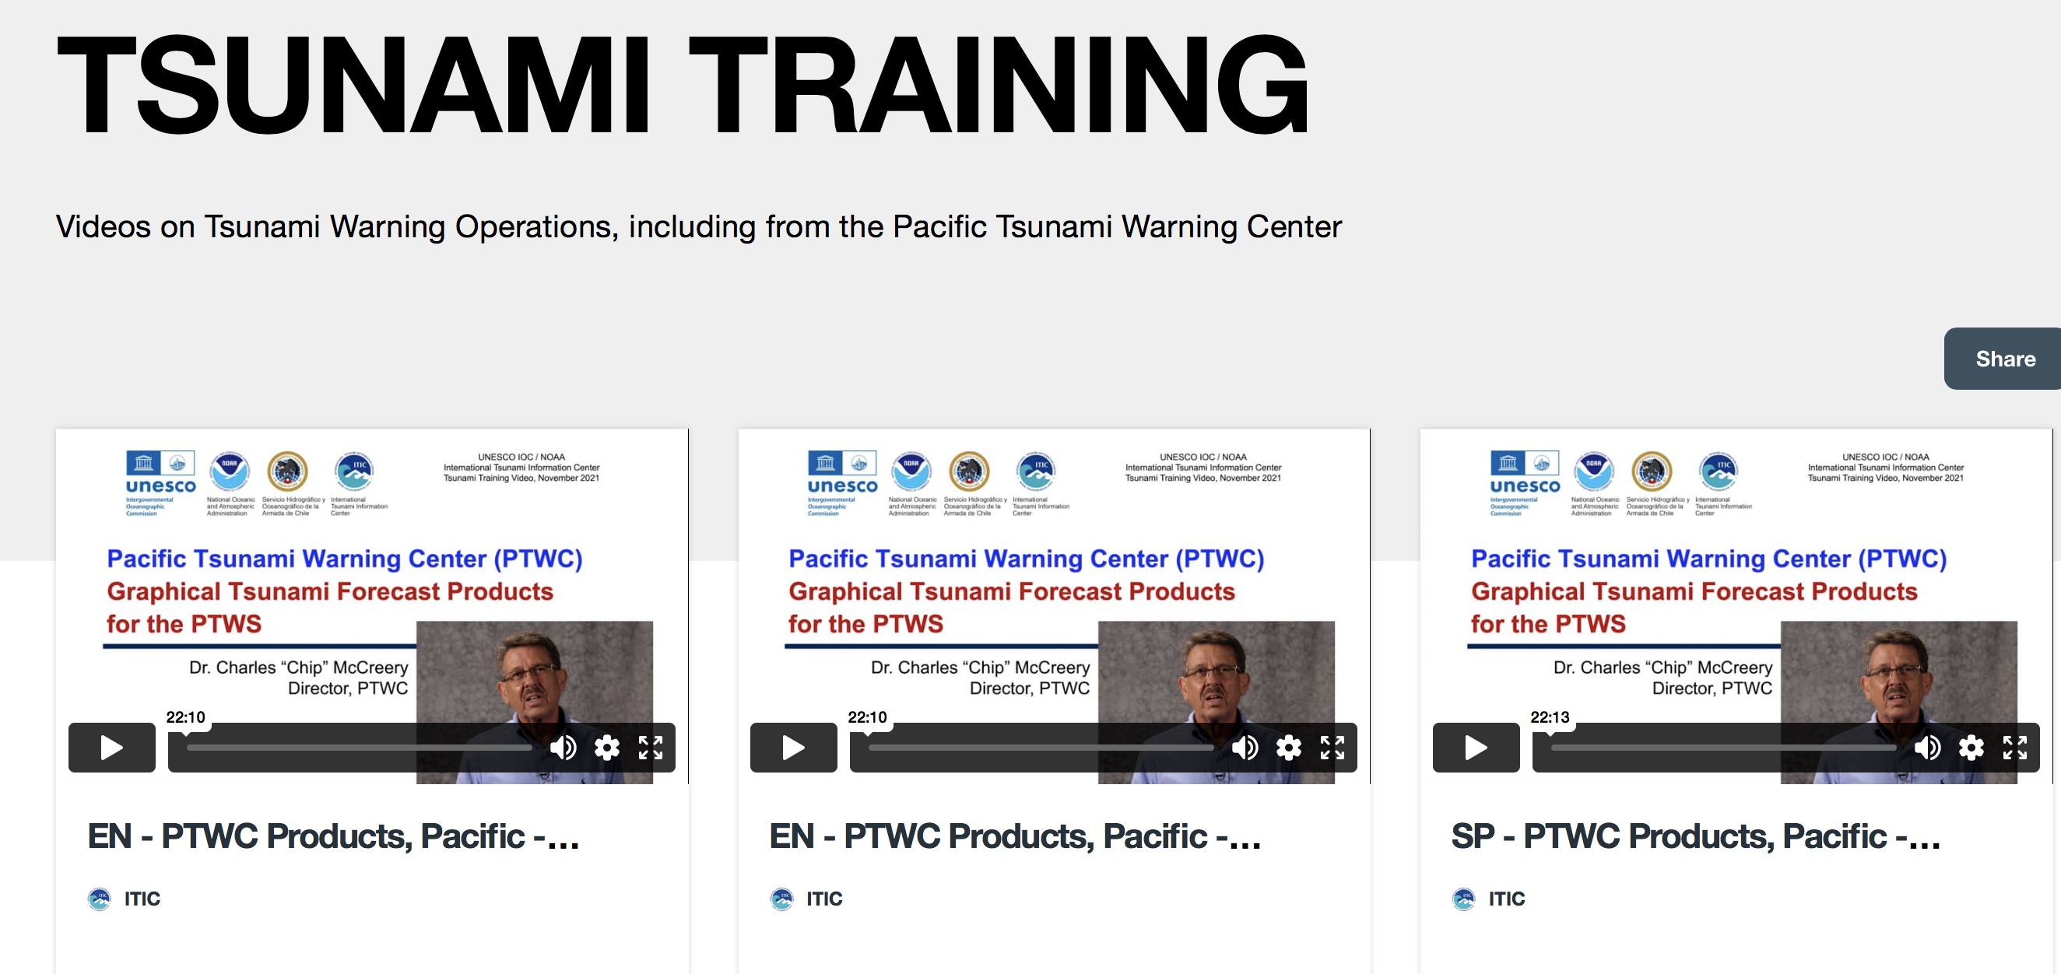
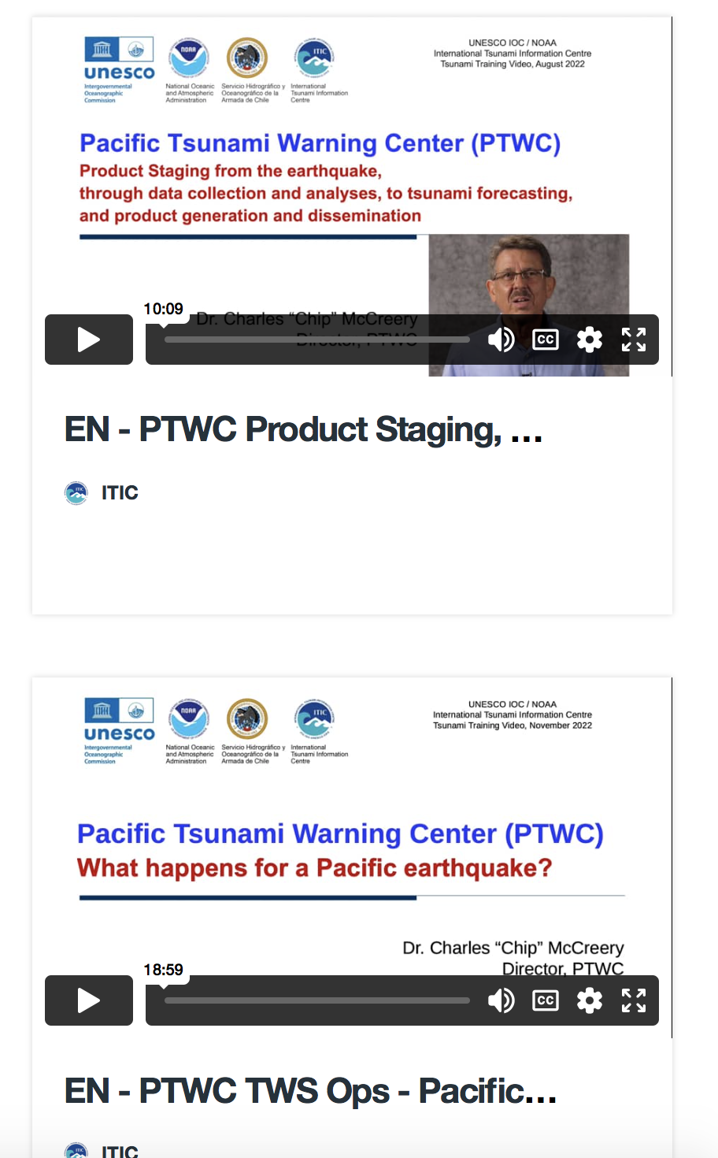
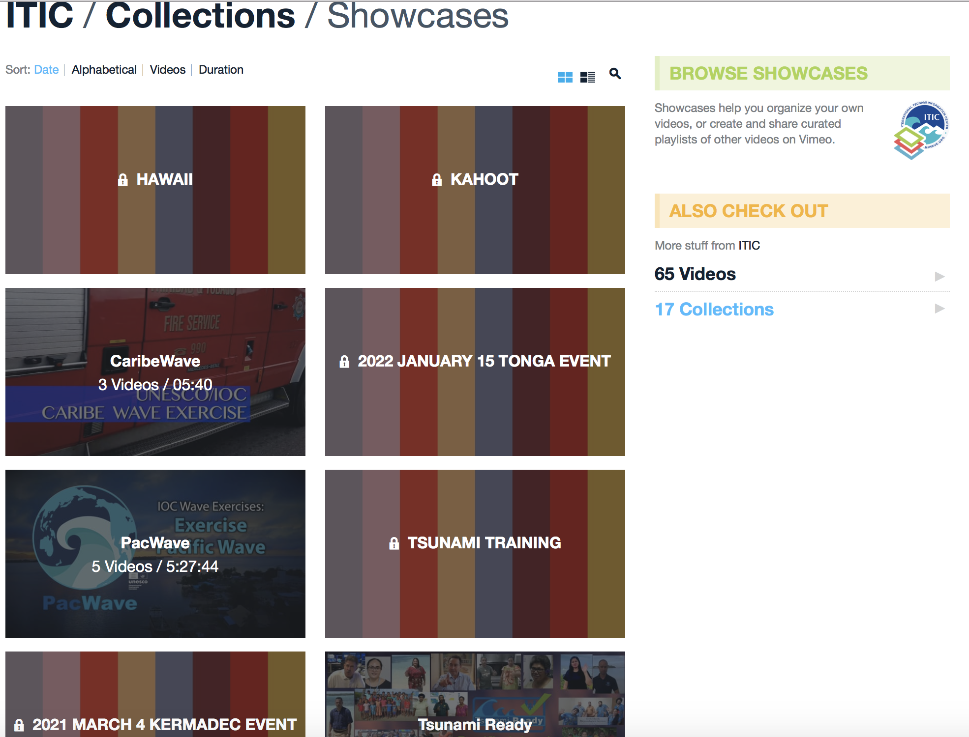
ITIC training videos – PTWC SOPs (support OTGA)
  2021-22: PTWC Enhanced Products and Staging (Pacific, Caribbean) (EN-SP-FR) 10-22 min
  2022: TWC Operations – What happens at PTWC during Pacific earthquake? (EN) 18 min
  Planned: Tsunami Forecasting (EN) (req fr PTWS 4 Mar 2021 debrief) – 20 min
PTWC Enhanced Products - explanation and product staging
https://www.youtube.com/playlist?list=PLVuF658wCrzVD52LkAcr1JNWQLfAX3kPu
https://vimeo.com/showcase/8956022
Password: training

Slide 3
PTWC Enhanced Products
Why, What, Criteria, Staging

Slide 4
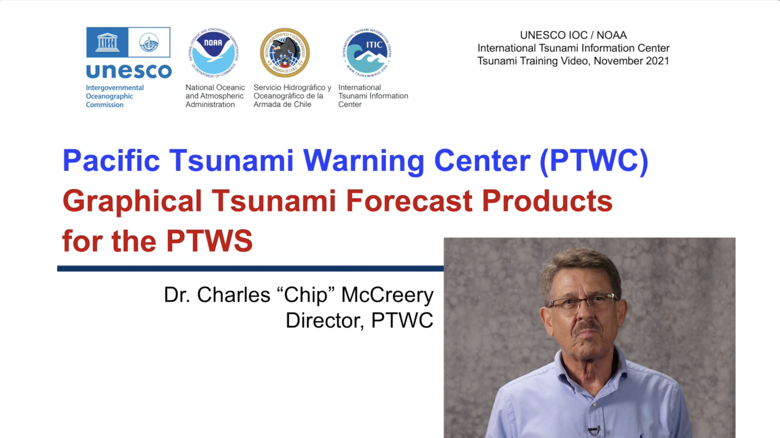
PTWC Product Explanation
PACIFIC:
https://youtu.be/oK5SZvbF8us
CARIBE:
https://youtu.be/plg9H8WW30U

Slide 5
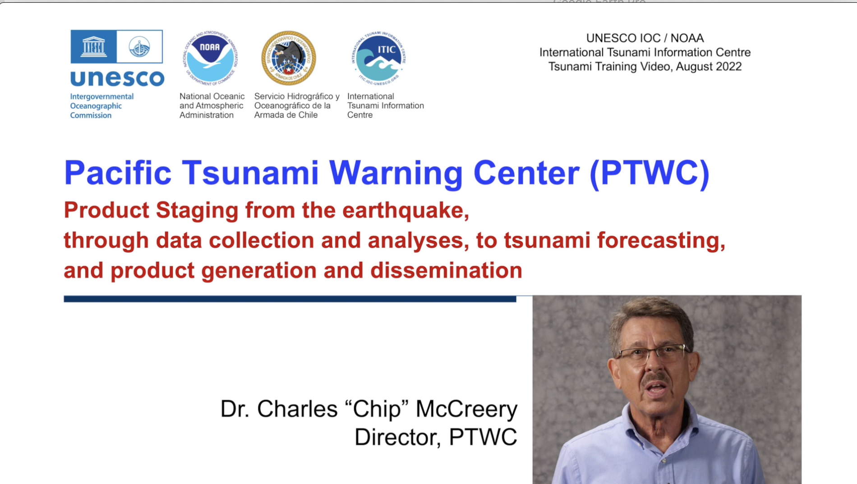
PTWC Product Staging
PACIFIC:
https://youtu.be/oK5SZvbF8us
CARIBE:
https://youtu.be/plg9H8WW30U

Slide 6

PTWC operations
PACIFIC:
https://youtu.be/oK5SZvbF8us
CARIBE:
https://youtu.be/plg9H8WW30U

Slide 7
Available resources - YouTube
TWC Tsunami Trainings - all are on one playlist.
  PTWC Products – Products, Staging https://www.youtube.com/playlist?list=PLVuF658wCrzVD52LkAcr1JNWQLfAX3kPu
CARIBE-EWS English
  https://www.youtube.com/playlist?list=PLVuF658wCrzWkFxGU6Rx4K7cIfNRSovDK
CARIBE-EWS Spanish https://www.youtube.com/playlist?list=PLVuF658wCrzXPxa7zdfnnN2fY2Kg34q_n
CARIBE-EWS French https://www.youtube.com/playlist?list=PLVuF658wCrzXqhaLsR_QtBuCIVNZI_qyL
PTWS English
  https://www.youtube.com/playlist?list=PLVuF658wCrzXZYkfNCaW-8gBciLyVVDMC
PTWS Spanish
https://www.youtube.com/playlist?list=PLVuF658wCrzW1CmYuQvi8US8ZLjRz3NyL
Playlists / videos unlisted URLs. Only people with links can view.
PTWC Operations - Pacific EQ tsunami processing
https://youtu.be/AGno0Vim9g0

Slide 8
Thank You
Muchas Gracias
Dr. Laura Kong
Director, ITIC
Dr. Dailin Wang
Senior Oceanographer, PTWC

