Slide 1


2. OTGA Status
2.2. Review of RTC/STC Activities
2.2.2 RTC Belgium
Ana Carolina Mazzuco
IODE Training Coordinator – OTGA Coordinator
SG-OTGA V, November 2025

Slide 2

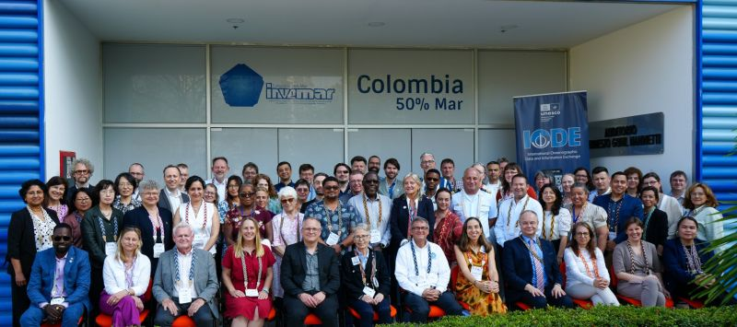
2. OTGA Status
2.2 Review of RTC/STC Activities
2.2.2 RTC Belgium
UNESCO/IOC Project Office for IODE
Oostende, Belgium
SCOPE & PRIORITY:
Ocean Data and Information Exchange
European region
Secretariat – Central Coordination

Slide 3
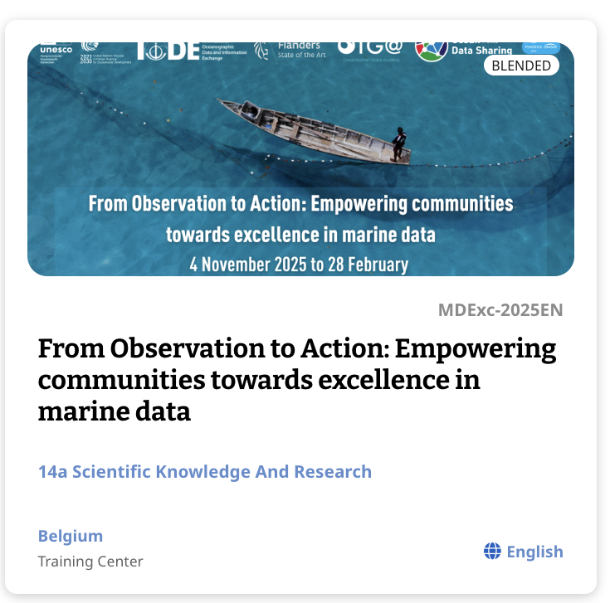
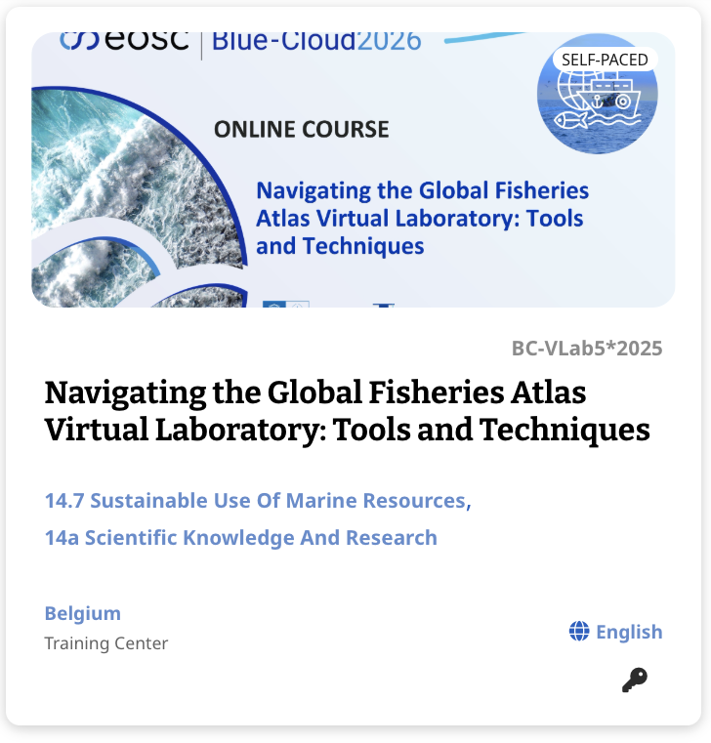
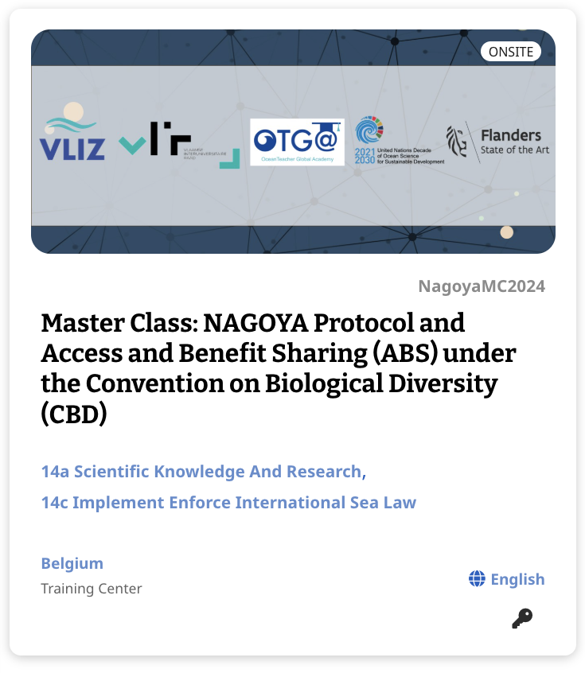
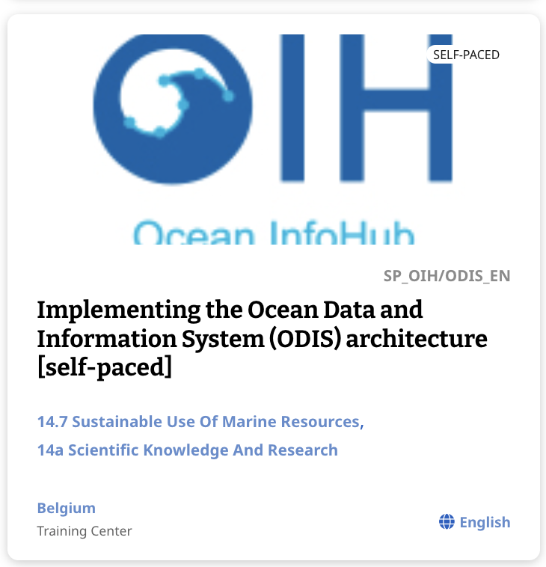
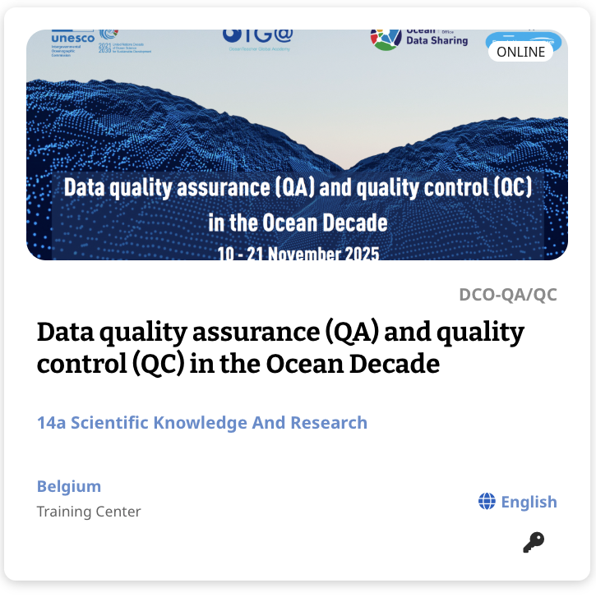
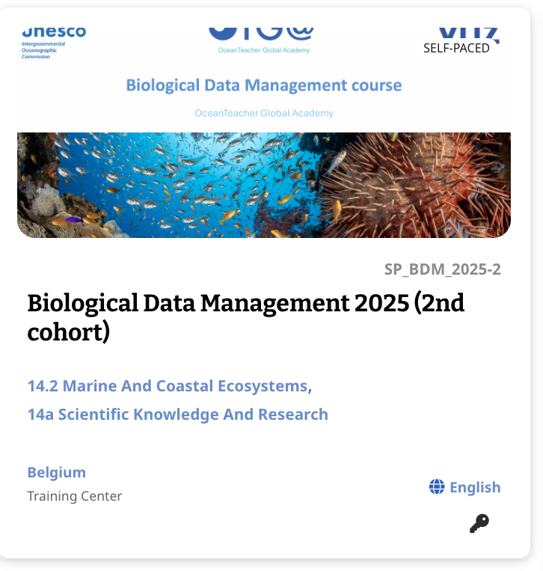
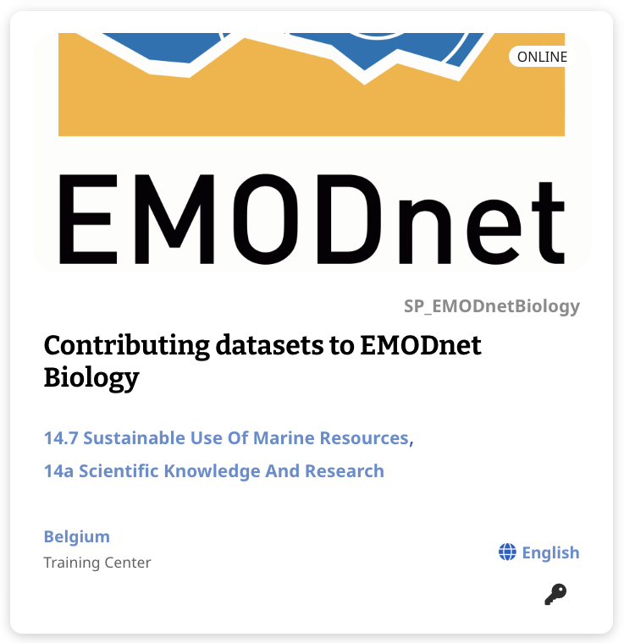
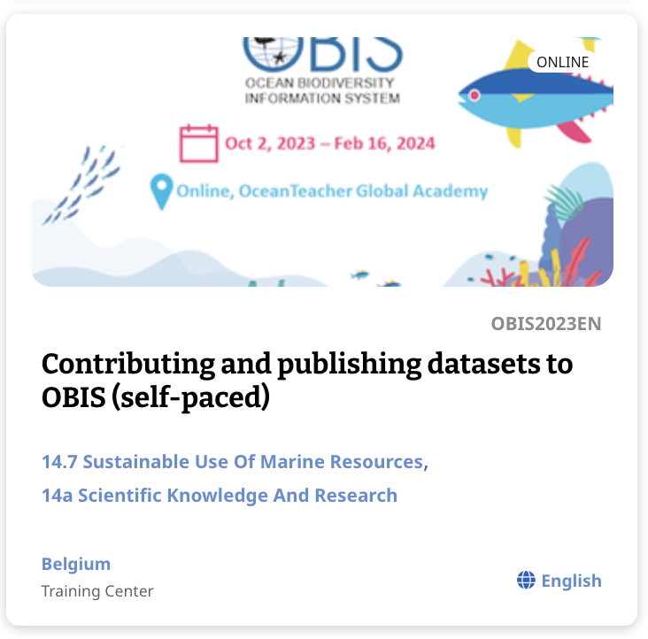
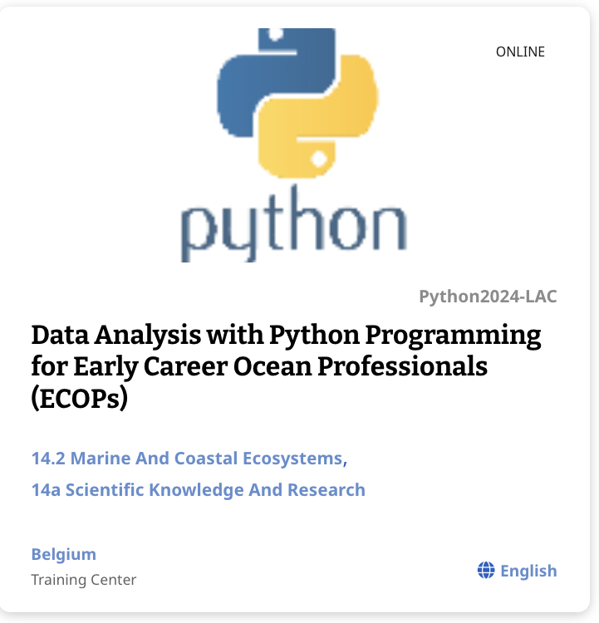
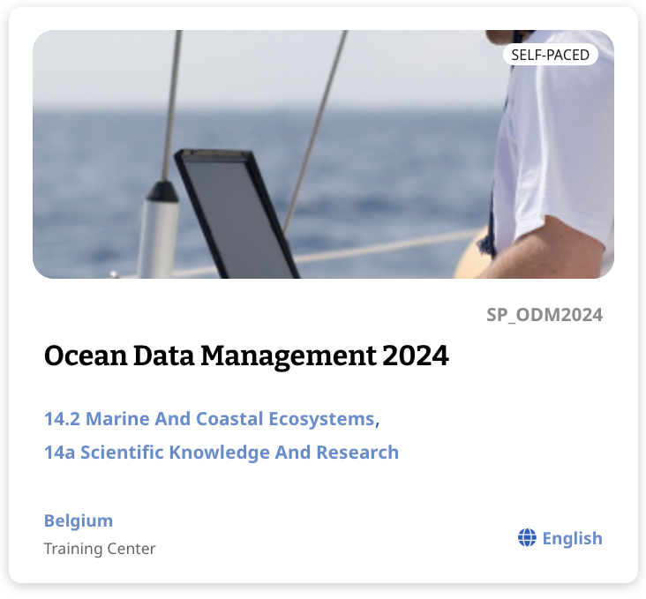
2. OTGA Status
2.2 Review of RTC/STC Activities
2.2.2 RTC Belgium
Training activities in 2024/2025:
24 training courses
2000 learners
Joint collaboration with:
IOC Ocean Biodiversity Information System (OBIS)
IOC Ocean Best Practices System (OBPS)
IOC Ocean Data and Information System (ODIS)
IOC Decade Coordination Office (DCO) for Ocean Data Sharing (ODS)
EU European Marine Observation and Data Network (EMODnet),
Ocean Decade Early Career Ocean Professional Programme Data Centre of Flanders Marine Institute (VLIZ)

Slide 4
2. OTGA Status
2.2 Review of RTC/STC Activities
2.2.2 RTC Belgium
Challenges:
New trainings:
Combining the activities of OTGA Secretariat and its expansion of training centre.
It envisions to enhance its activities onsite, in support of the European ocean-related priorities in the next years.
New courses are planned to be launched in 2026, including a BBNJ-Agreement and Indigenous and Local Knowledge (jointly with Ocean Decade Unit/Capacity Development Facility), Emerging topics in Ocean Data, and expanded online course on Nagoya Protocol/ABS (jointly with VLIZ).
Update of existing courses.
New projects approved and submitted.

