Slide 1


2.2. RTC Mombasa Activities 2024-2025
Harrison Ongánda
RTC/STC scope and priorities
Achievements of trainings in 2024/2025 with OTGA
Training activities planned for 2026 with OTGA
SG-OTGA V, November 2025

Slide 2
RTC scope and priorities
RTC Mombasa is hosted by Kenya Marine and Fisheries Research Institute
A key priority for Kenya at the moment is Marine Spatial Planning (MSP)
  Key Result Areas for Strategic Objectives of KMFRI - Knowledge Management and Dissemination: There is an increasing need for data and information for the different facets of the Blue Economy. Transfer of knowledge and information is the backbone for key decision-making to support policy development and uptake of research, innovation, and development
The RTC is working within the priorities of IOCAFRICA Sub-commission
  Ocean observation and monitoring
  Ocean sciences and assessments
  Ocean governance and legislation
  ‘Training and research opportunities
RTC primarily provides support for English speaking countries but we have involved

Slide 3
Achievements of trainings in 2024/2025 with OTGA
Course Title | Implementation of FAIR Principles to African Marine and Coastal Data
Dates | 23-26 Sep. 2024
Learning outcomes | Gain insights into data governance principles; Acquire knowledge of data citation and attribution Gain knowledge on how to access and contribute to global datasets Build and strengthen skills in data management, standardization, and documentation Learn to publish high quality (meta)data
Collaborations | International Coastal Atlas Network, SeaBed 2030 project, Regional office for the Committee on Open Data (CODATA), Ocean InfoHUB , Flanders Marine Institute (VLIZ).
Participants | Benin(1), Comoros(1), Egypt(1), Ghana(2), Kenya(2), Madagascar(1), Mozamnbique(2), Somalia(1), South Africa(1), Nigeria(2), Mauritius(1), Seycheles(1), DRC(1), Cameroon(1), Morocco(1),
Comments | Participants were issued with certificates of participation. Need to organize an ACMA data processing to update the portals through the NODCS

Slide 4
Satellite-Derived Bathymetry (SDB) Training for the Western Indian Ocean using Optimal Satellite Imagery
  Seabed 2030 project
Date: 17-21 November 2025
Venue: Mombasa, Kenya

Slide 5
Training activities planned for 2026 with OTGA
Course Title | System Dynamics for Sustainable Marine Spatial Planning and Management
Dates | TBD
Learning outcomes | Apply systems thinking to ecosystem-based governance, particularly in the context of MSP and SBE practices Use system dynamics modelling techniques to represent and analyse marine ecosystems, uses and governance systems Critically assess and design/contribute to strategies ensuring environmental, social-cultural and economic aspects are integrated in MSP and SBE develop skills in using participatory methods for co-developing and inclusive systems dynamic modelling Develop skills to use system dynamic modelling for scenario planning Develop the ability to understand and communicate models and outputs to diverse audiences
Collaborations | Nelson Mandela University (NMU); Scottish Association for Marine Science (SAMS); Kenya Marine Fisheries Research Institute (KMFRI)
Participants | Open applications
Comments | This course will support NODCs who are actively providing support to MSP processes

Slide 6
Training activities planned for 2026 with OTGA
Other activities to be considered for 2026 include:
Fundamentals of oceanographic data management
Inter-calibration of common data sets (Coastal observations, ship-based observations etc) – as part of implementation of Objective 4.2.8 of the IIOE-II Implementation Strategy
Operational remote sensing satellite oceanography – based on any of the products such as Copernicus, Ocean color etc – in support of ocean observation and monitoring programs

Slide 7
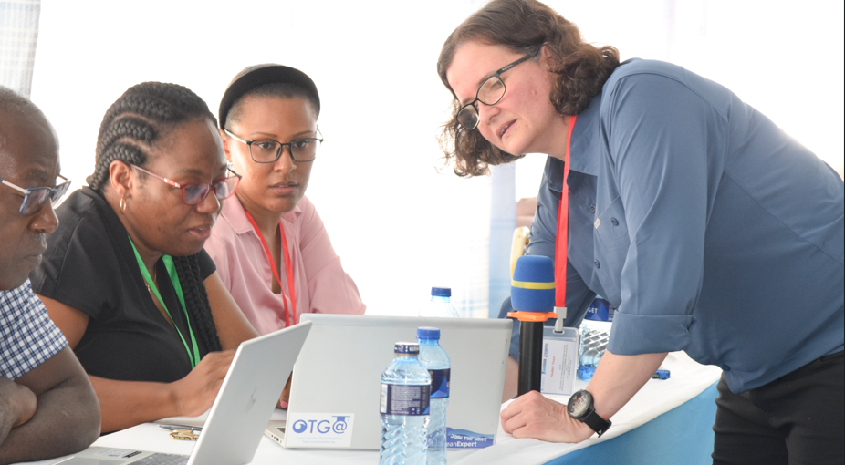
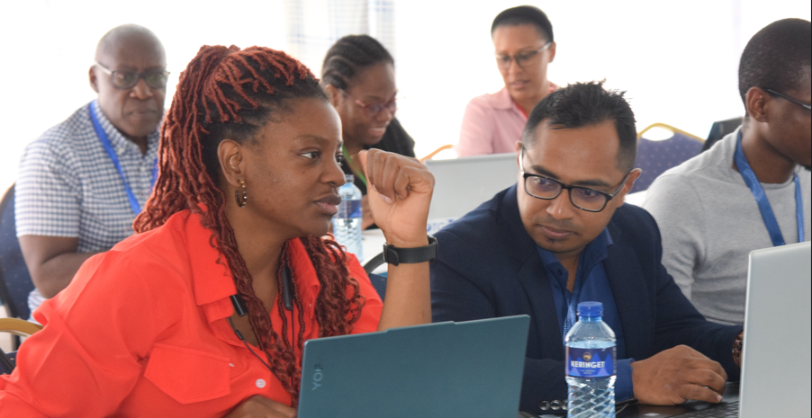
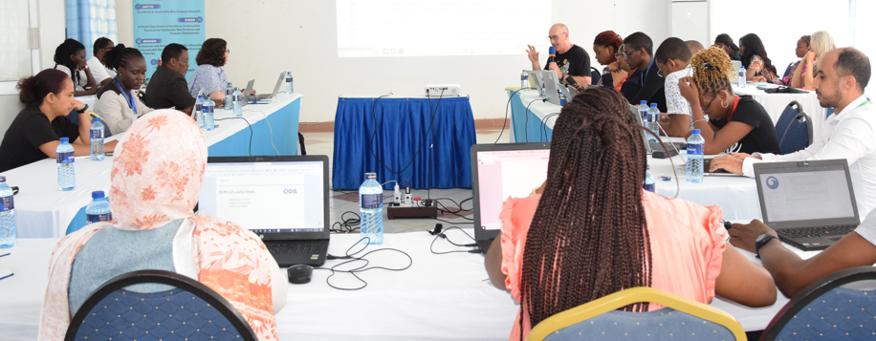

Slide 8
ASANTE SANA – THANK YOU

