Slide 1


RTC MALAYSIA Activities
AIDY M MUSLIM
RTC/STC scope and priorities
Achievements of trainings in 2024/2025 with OTGA
Training activities planned for 2026 with OTGA
SG-OTGA V, November 2025

Slide 2


Recent Focus
Key focus areas include Marine Science, Aquatic Resources, Fisheries, and the Oil & Gas sector.
INOS UMT has prioritized delivering specialized courses for national agencies, aligning with their operational needs.
Most training programs are funded by respective agencies and conducted primarily through face-to-face sessions.
We are exploring opportunities to adapt these courses for delivery through OTGA (OceanTeacher Global Academy).

Slide 3
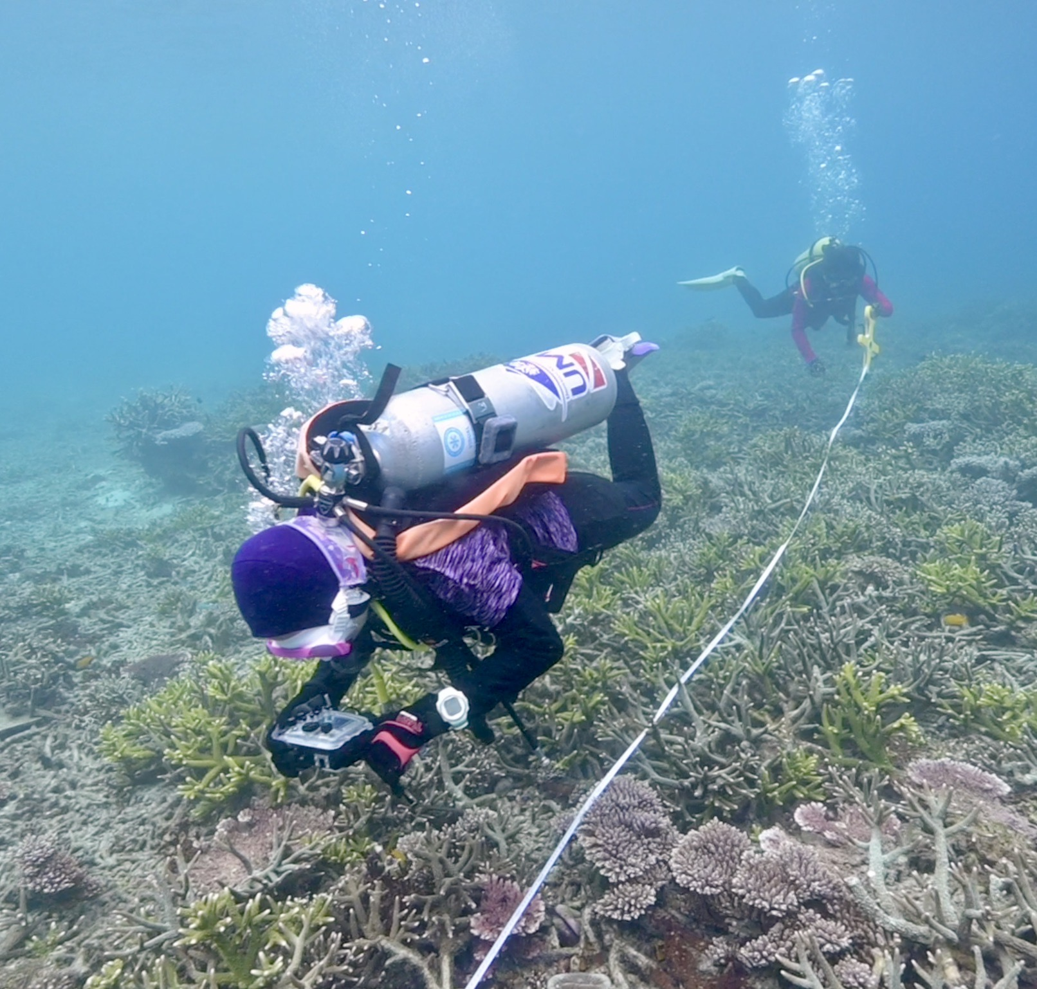
Achievements of trainings in 2025 with OTGA
One course was planned for 2025
Coral Reef Health and Monitoring (Deferred till 2026)
Assisted NMDIS on Training courses.

Slide 4
Training activities planned for 2026 with OTGA
Coral Reef Health and Monitoring (June 2026)
Mohd Safuan Che Din (chedinmohdsafuan@umt.edu.my)
2. Marine GIS (August 2026)
Idham Khalil (Idham@umt.edu.my)
Adapted From Open distance learning course developed for University Credit.

Slide 5
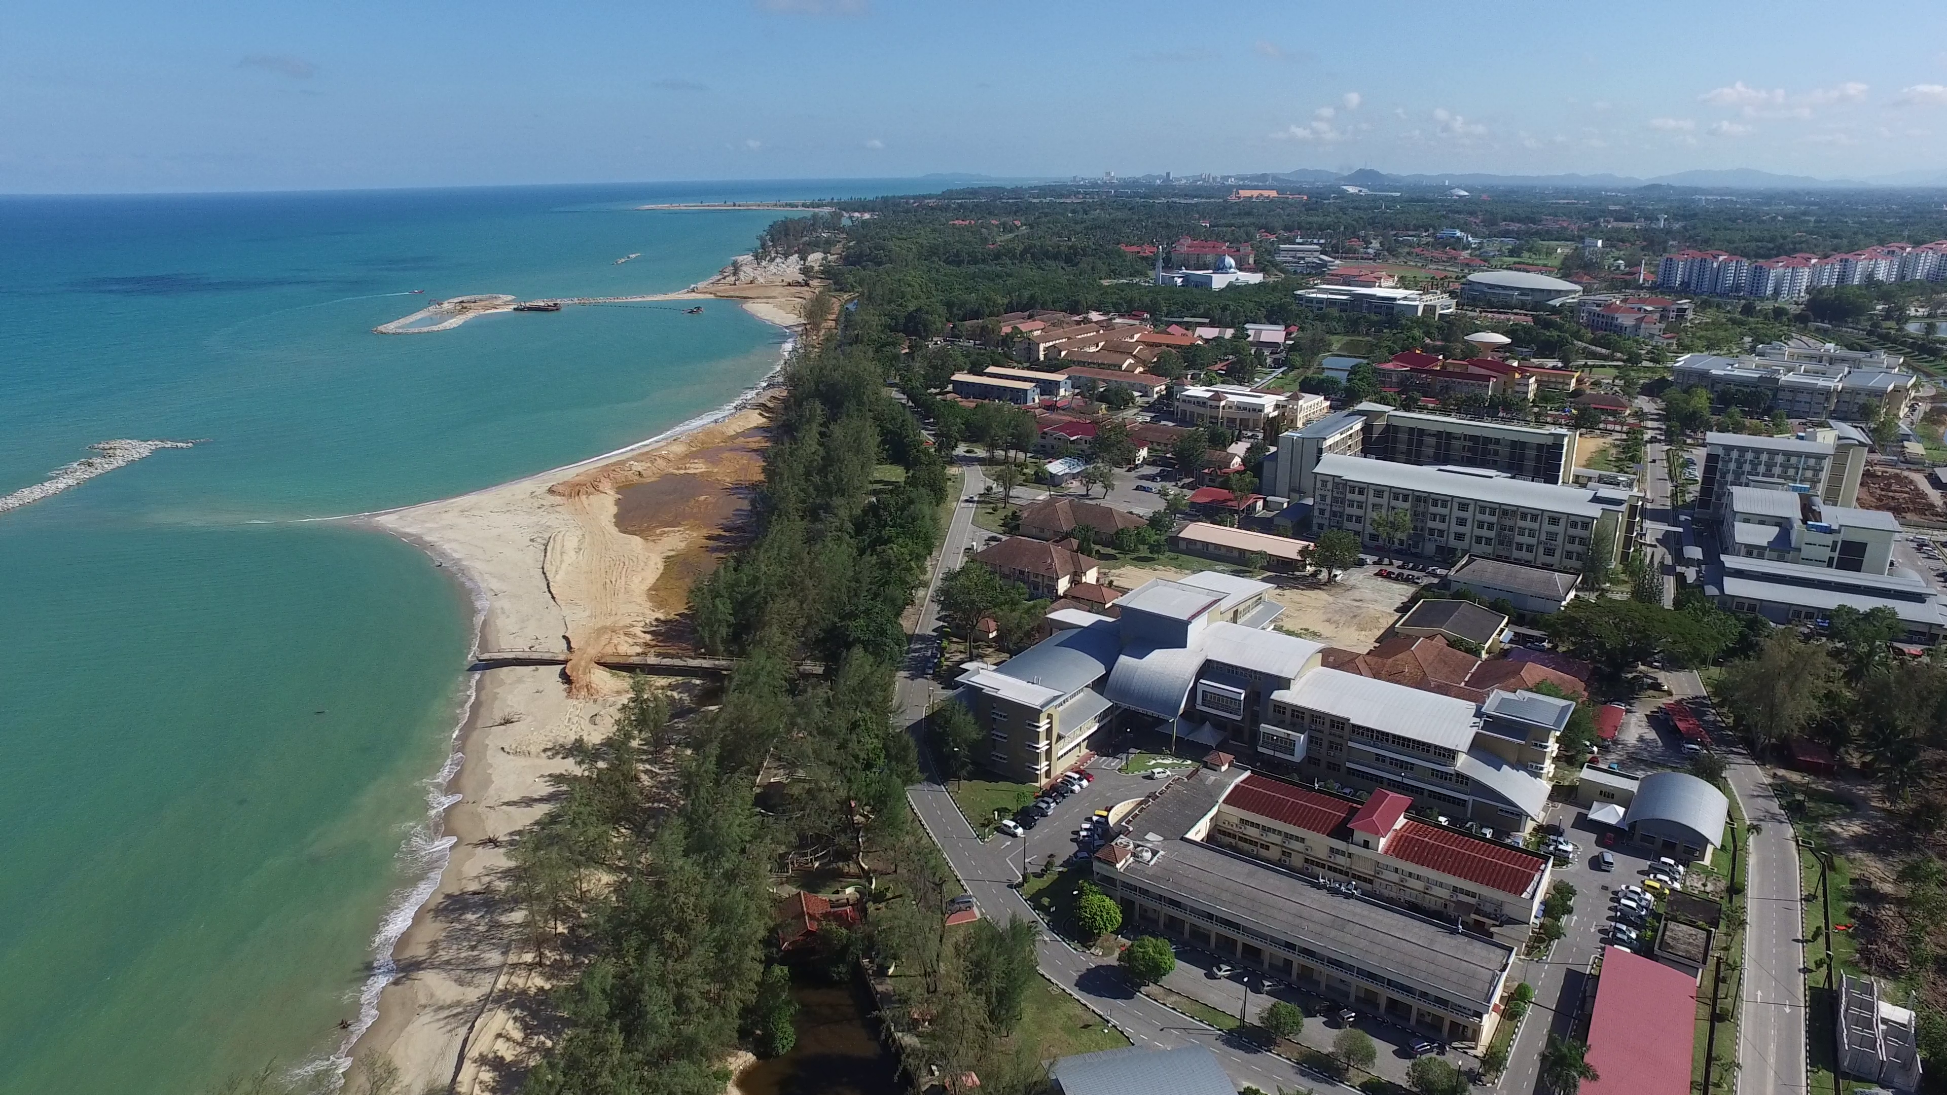

THANK YOU

