Slide 1
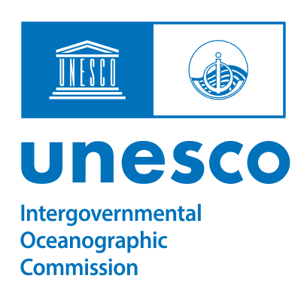
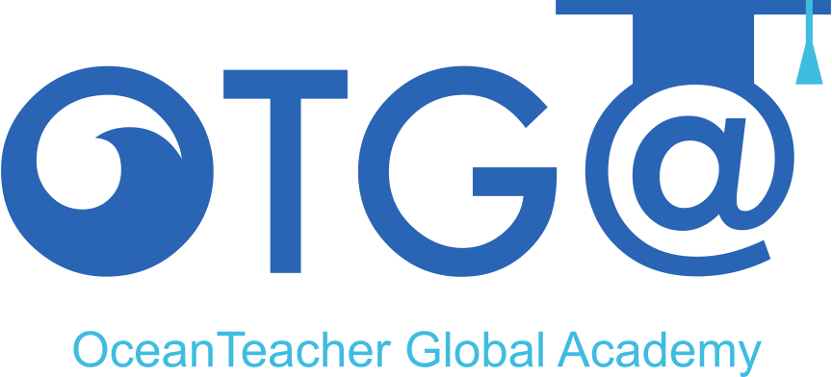

2.2. RTC, CePTMAR-UEM, Mozambique Activities 2024-2025
Clousa Sarmento Maueua
SG-OTGA V, November 2025

Slide 2
RTC scope and priorities
Scope- Marine research, innovation, Ocean Literacy and extension work
Center affiliated to the Eduardo Mondlane University
Priorities: research on coastal zone management, ecosystems management, physical processes of the ocean

Slide 3
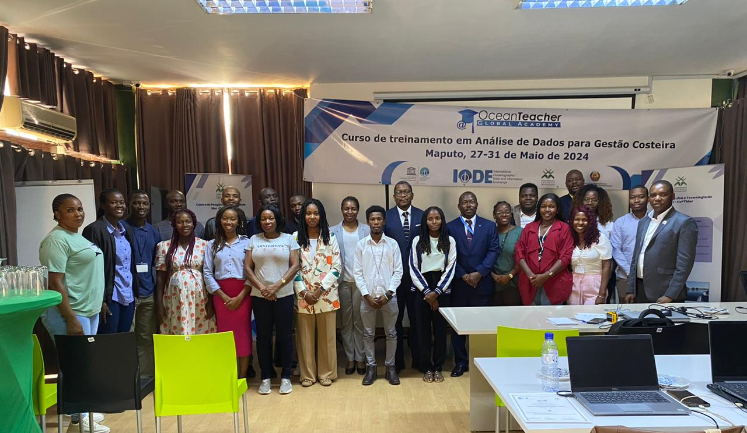
Achievements of trainings in 2024/2025 with OTGA
Data analysis for coastal management
Financed by OTGA (IOC-UNESCO)
on-site
20 participants (Angola and Mozambique)
27- 31 may 2024
2. Ocean Observations Technologies
Online- OTGA platform
30 participants (Angola, Brasil,
Cape Verde, Portugal, Timor-Leste, Mozambique)
7- 15 November 2024
OTGA course, May 2024

Slide 4
Achievements of trainings in 2024/2025 with OTGA
A join course among Kenya and Mozambique RTC’s
Organizers- IOC Africa
Course name: Sustainable Coastal Growth
Planned for 13-17 October 2025, onsite-Mombasa
Not realised, no availability of funds

Slide 5
Lessons Learnt and Challenges
Lessons Learnt
Challenges
Early preparation, tree months before, facilitates administrative arrangements (UNESCO-Mozambique, CePTMAR);
Participants prefer to learn not more than two (2) tools/programs for data analysis
Selection of participants-among many applications
Funds to help participants with data (mobile airtime) for online courses

Slide 6
Training activities planned for 2026 with OTGA
Onsite course: Sustainable Coastal Growth, 8-12 June 2026
Online course: Ocean Observations Technologies

Slide 7
Thank you
Obrigada

