Slide 1
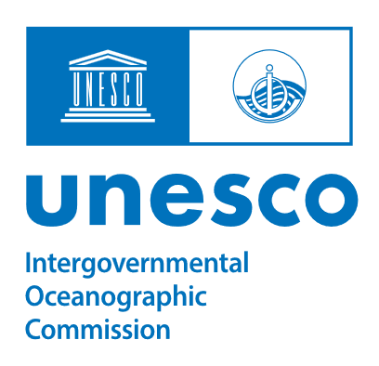
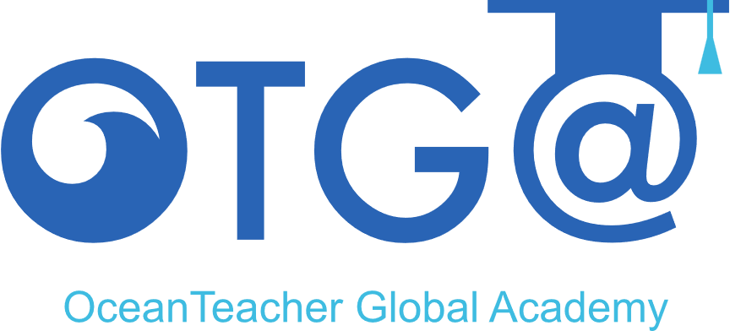
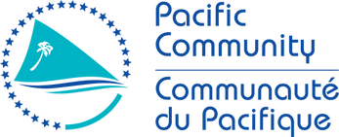
REVIEW OF OTGA ACTIVITIES
Pacific Community
Maeva Tesan
RTC/STC scope and priorities
Achievements of trainings in 2024/2025 with OTGA
Training activities planned for 2026 with OTGA
SG-OTGA V, November 2025

Slide 2



1.ACHIEVEMENTS
OF TRAININGS IN 2025

Slide 3
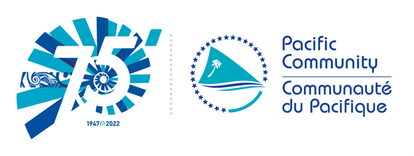
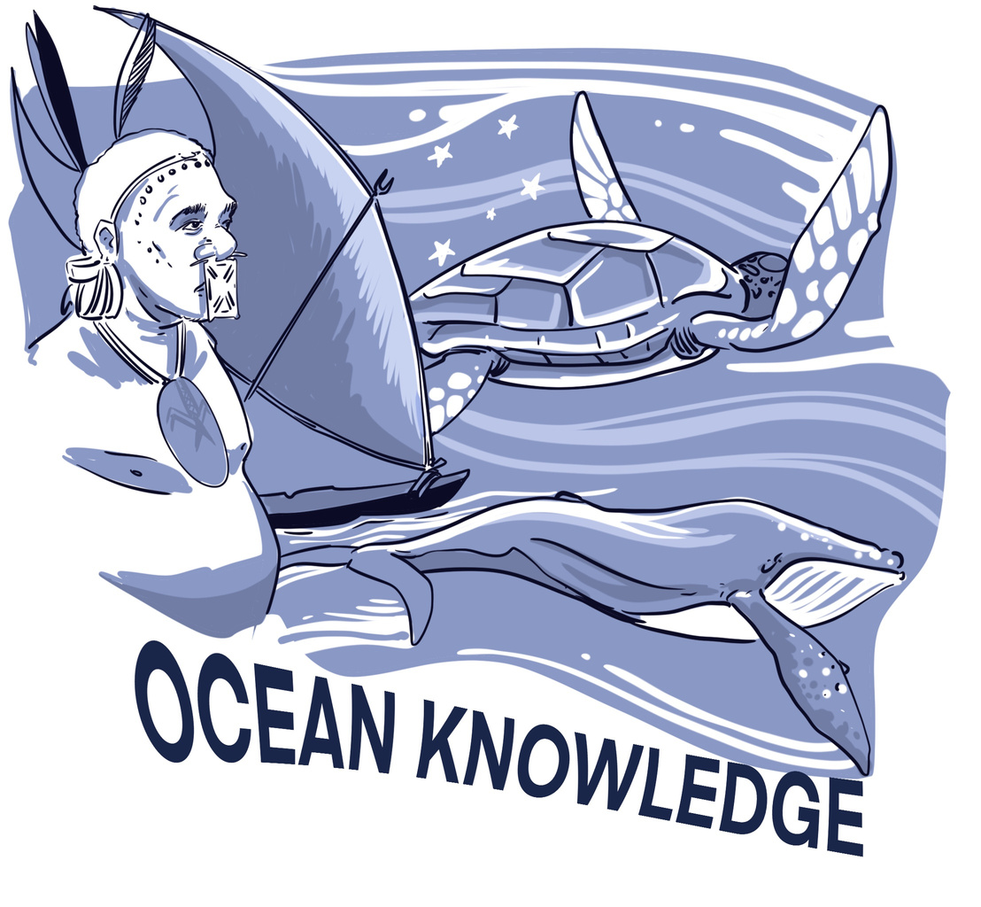
Discussions with the Global ECOP Network
We have engaged in discussions with the Global ECOP Network to promote a course on ocean governance.
Exchanges with PIF and OPOC
In the region, ocean governance is a shared mandate among several agencies. As a result, our process has experienced some delays due to the multiple levels of approval and coordination required among the different organisations.

Slide 4
2.TRAINING ACTIVITIES PLANNED
FOR 2026 WITH OTGA

Slide 5
2.2. Regional ocean governance
(focus on maritime boundaries)

Slide 6
1. Pacific Ocean Governance course
The Maritime Boundaries Programme is a cornerstone of Pacific regional ocean governance, supporting Pacific Island countries and territories in securing their maritime zones and upholding their sovereign rights under the United Nations Convention on the Law of the Sea (UNCLOS).
Led by the Pacific Community (SPC), in close collaboration with national governments, regional organisations, and partners such as Australia, New Zealand, and the Pacific Islands Forum Secretariat (PIFS), the programme provides legal, technical, and geospatial expertise to define and formalise maritime boundaries across the region.
The initiative aims to ensure that all Pacific Island countries have clearly defined, internationally recognised maritime zones. This clarity strengthens national jurisdiction over marine resources, supports sustainable ocean management, and
For teachers, this knowledge strengthens their ability to explain how international law (UNCLOS) shapes ocean governance, and how Pacific Island countries play a leading role in securing their rights and responsibilities over vast ocean spaces.

Slide 7
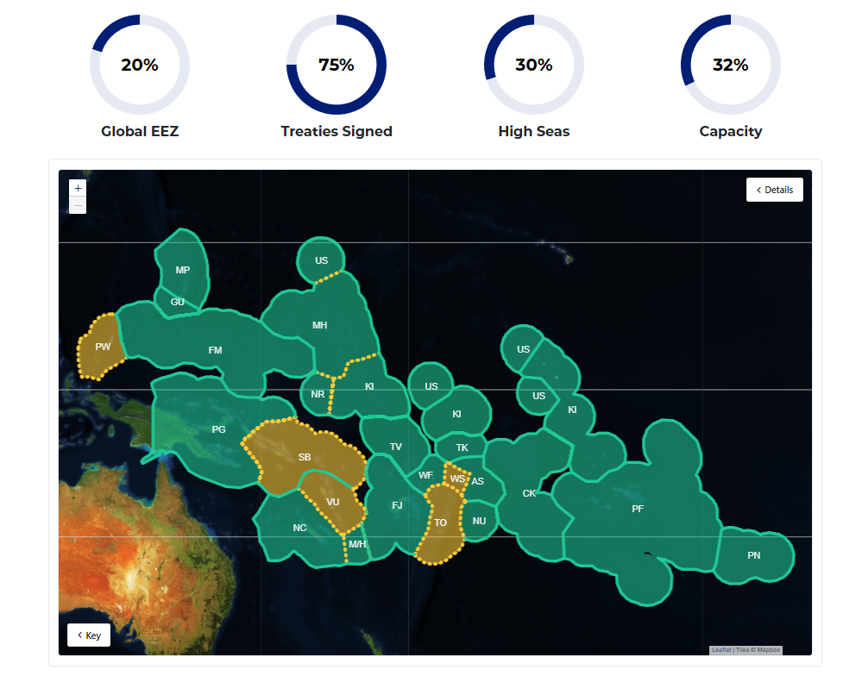
1. Pacific Ocean Governance course
https://pacificdata.org/dashboard/maritime-boundaries

Slide 8
1. Pacific Ocean Governance course
The following structure can be adopted and promoted for the course:
Module 2:
the Council of Regional Organisations in the Pacific (CROP)
Module 3:
maritime boundaries
Module 1:
regional frameworks
Module 4:
Extended Continental Shelf (ECS)
Learning outcomes
Understand the legal and institutional frameworks for ocean governance
Identify how regional cooperation supports the Blue Pacific Continent
Learning outcomes
Recognise how CROP agencies collaborate under the “One CROP” approach
Understand the link between CROP work and sustainable ocean management
Learning outcomes
Understand UNCLOS principles on boundary delimitation
Analyse the regional progress and challenges in boundary finalisation
Learning outcomes
Understand the ECS submission and review process

Slide 9
2.2. Marine Spatial Planning
in the Pacific region

Slide 10
2. An SPC project: the Marine Spatial Planning (MSP) micro-qualification
The Marine Spatial Planning (MSP) Micro-Qualification is part of a Pacific-led effort to build the skills needed for sustainable ocean management.
It focuses on training government officers, community representatives, and early-career professionals to plan and manage how marine spaces are used, balancing biodiversity, cultural values, livelihoods, and economic development.
Development of the qualification has been guided by an Industry Advisory Committee (IAC) made up of technical experts from the Pacific Community (SPC), regional universities, and partners (Waitt Foundation, IUCN, and Conservation International).
The IAC provides advice, technical review, and validation throughout the process to ensure the training is practical, regionally relevant, and aligned with the Pacific Qualifications Framework. Its members represent expertise from SPC’s Oceans, Fisheries, and Education programmes, regional training institutions, and government stakeholders from Fiji, Solomon Islands, Kiribati, and the Cook Islands.
The design of the micro-qualification is complete but is going through the accreditation process.
Course content is being developed.

Slide 11
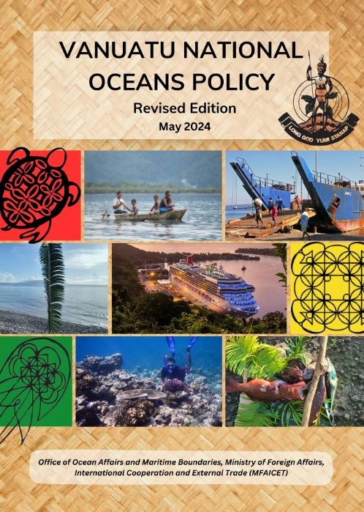
2. An SPC project: the Marine Spatial Planning (MSP) micro-qualification
1. Micro qualification 1: what is MSP?
2. Micro qualification 2: GIS (oceanic and costal)
Examples of case studies: Vanuatu
The National Ocean Policy (NOP) of Vanuatu is deeply rooted in the Nakamal, a traditional institution central to national decision-making. Developed through extensive consultations with provincial councils and local chiefs, the policy involved participation from even the most remote islands and districts. The NOP formally recognises traditional marine jurisdictions, extending from the high-water mark to 100 metres beyond the reef, reflecting a strong integration of traditional governance with modern ocean management principles.

Slide 12
FOCUS:
Production of key contents and workplan

Slide 13
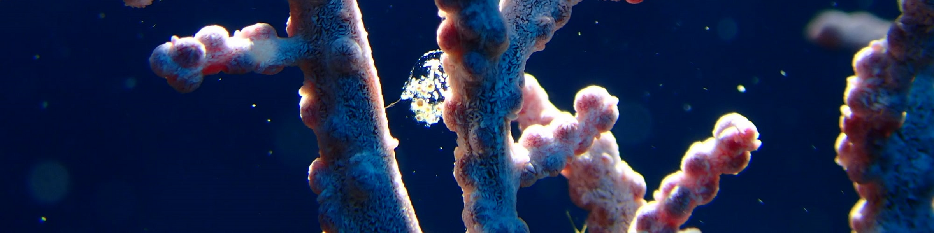
1. Approval of final contents
It should be acknowledged that some of the content to be shared relates to ongoing projects that require review by CROP agencies, as ocean governance is a shared responsibility among multiple organisations in the Pacific region.

Slide 14
2. Workplan (TBC)
Training Title | Focus Area | Preparation Period | Delivery Date
Regional Ocean Governance | Maritime Boundaries | Jan–July 2026 | August2026 (TBC)
Marine Spatial Planning in the Pacific Region | Marine Spatial Planning (MSP) | Jan–September 2026 | October 2026 (TBC)

Slide 15
THANK YOU

