Slide 1



Draft Toolkit for Folder and File Name in UNESCO-IOC Tsunami Ready Application

Slide 2

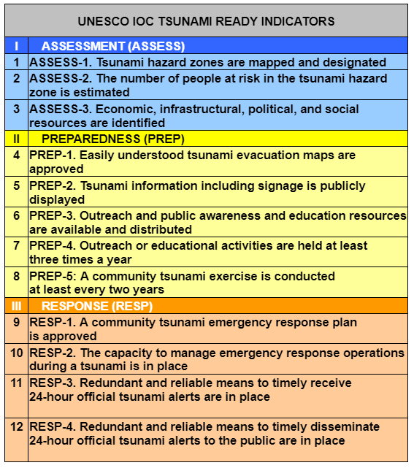
Introduction
A formal recognition process follows standard guidelines (UNESCO-IOC Manual and Guide 74).
Checklist for TR application is available in MG74
This toolkit is to help to name the folders to store the documents and naming the files of the 12 UNESCO-IOC Tsunami Ready indicators application evidences: Assessment, Preparedness and Response.

Slide 3
Steps in Completing the Application
Fill in the application form (MG 74).
Compile all supporting evidence of the Indicators (Documents, Maps, Photos, Images, Videos, etc.)
Create cloud space to share the documents, i.e. Google Drive, One Drive, etc.
Create folders using the suggested folder names.
Re-name all the supporting evident file name in accordance with the suggested file naming.
Place the files in the assigned folder.
Fill in the application form indicating the evident file name and location in the cloud space folder.

Slide 4

Overall Structure of the Folder Name
TR RECOGNITION
A-1
A-2
A-3
ASSESS
Main Folder
CC_NS_Community Name
PREP
P-1
P-2
P-3
P-4
P-5
CC: Country code
NS: Name of State/Provinces
Example:
For main folder write the full name of the community
ID_SB_Purus
ID: Indonesia (CC)
SB: Sumatera Barat (NS)
Purus: Community name
RESP
R-1
R-2
R-3
R-4
EVALUATION

Slide 5
Overall Structure of the File Name
CC: Country code
https://www.unece.org/cefact/locode/service/location
NS: Name of State / Province
Use the country agreement of the state/province abbreviation, if none, use the first letter(s) of the state/province's name, and can be a 2-3 letter abbreviation.
CN: Community Name
Use the country agreement of the community’s abbreviation, if none, use the first letter(s) of the community's name, and can be a 2-3 letter abbreviation
File Name
Based on the indicator file names
Example:
File name: evacuation map
ID: Indonesia, SB: Sumatra Barat, Purus: name of village
Complete file name: ID_SB_Purus_Evacmap

Slide 6
Folder Content and File Name
File content | File name | File type | Example
Application forms | CC_NS_CN_applic | PDF | ID_SB_Purus_applic
Recognition and Appreciation Certificate | CC_NS_CN_cert_rec CC_NS_CN_cert_app_X | PDF | ID_SB_Purus_cert_rec ID_SB_Purus_cert_app_1
Tsunami Ready Sign | CC_NS_CN_TRSign | JPG/PNG/PDF | ID_SB_Purus_TRsign
Media News | CC_NS_CN_news_X | PDF | ID_SB_Purus_news1
TR RECOGNITION
Should there are several files of the same name please put number (X)
CC: ID (Indonesia)
NS: SB (Sumatra Barat)
CN: Purus (Purus village)
File content | File name | File type | Example
Field Verification Visit * | CC_NS_CN_vervisit | PDF | ID_SB_Purus_vervisit
Evaluation report * | CC_NS_CN_evalrep_X | PDF | ID_SB_Purus_evalrep_1
Annual report * | CC_NS_CN_annrep_year | PDF | ID_SB_Purus_annrep_2024
EVALUATION
* If available of once it is made available
CC: ID (Indonesia)
NS: SB (Sumatra Barat)
CN: Purus (Purus village)
Should there are several files of the same name please put number (#)

Slide 7
Folder Content and File Name
File content | File name | File type | Example
Hazard Map | CC_NS_CN_hazard_map | JPG/PNG/PDF | ID_SB_Purus_hazard_map
A-1
File content | File name | File type | Example
People at Risk | CC_NS_CN_peopleatrisk_X | PDF | ID_SB_Purus_peopleatrisk_1
ASSESS
A-2
Should there are several files of the same name please put number (#)
File content | File name | File type | Example
Community Resources | CC_NS_CN_resource_X | PDF | ID_SB_Purus_resource_1
A-3
Should there are several files of the same name please put number (#)

Slide 8
Folder Content and File Name
File content | File name | File type | Example
Evacuation Map | CC_NS_CN_evacmap | JPG/PNG/PDF | ID_SB_Purus_evacmap
P-1
File content | File name | File type | Example
Tsunami Information | CC_NS_CN_tsuinfo_# | JPG/PNG/PDF | ID_SB_Purus_tsuinfo_1
P-2
File content | File name | File type | Example
Outreach and Education Resource | CC_NS_CN_OEres_# | JPG/PNG/PDF or links | ID_SB_Purus_OEres_1 ID_SB_Purus_OEres_2
PREP
P-3
File content | File name | File type | Example
Outreach and Education activity | CC_NS_CN_OEact | JPG/PNG/PDF /MP4 or links | ID_SB_Purus_OEact_1 ID_SB_Purus_OEact_2
P-4
File content | File name | File type | Example
Tsunami Exercise | CC_NS_CN_exercise | JPG/PNG/MP4 or links | ID_SB_Purus_exercise_1
P-5

Slide 9
Folder Content and File Name
File content | File name | File type | Example
Emergency Response Plan | CC_NS_CN_respplan_# | PDF | ID_SB_Purus_respplan_1
R-1
File content | File name | File type | Example
Response Capacity | CC_NS_CN_respcap_# | JPG/PNG/PDF or MP4 | ID_SB_Purus_respcap_1 ID_SB_Purus_respcap_2
R-2
RESP
File content | File name | File type | Example
Receive Alert / Warning | CC_NS_CN_rec_alert_# | JPG/PNG/PDF or MP4 | ID_SB_Purus_rec_alert_1 ID_SB_Purus_rec_alert_2
R-3
File content | File name | File type | Example
Receive Alert / Warning to public | CC_NS_CN_diss_alert_# | JPG/PNG/PDF or links | ID_SB_Purus_diss_alert_1 ID_SB_Purus_diss_alert_2
R-4

Slide 10
Notes
Photos:
  Limit photos of evidence of each indicator to max. 5 photos.
    Make sure the photos are of high quality but not too big size.
    Avoid similar photos of the same object or evidence.
Videos:
  If the video file is less than 50 MB, the video can be included in the submission, for a bigger file size, upload the video to YouTube, Vimeo, or other social media and provide the link to the video.

