Slide 1
The GLOSS Programme and Data Portals Angela Hibbert Caribbean Training Course Barbados 17th-21st November

Slide 2

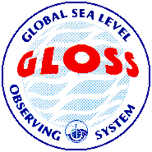
GLOSS and GOOS
The Global Ocean Observing System (GOOS) is a permanent global system for observations, modelling and analysis of marine and ocean variables to support operational ocean services worldwide.
Responsible to the Intergovernmental Oceanographic Commission Assembly
The Global Sea Level Observing System (GLOSS) is a component of GOOS and aims to:
Establish high quality global and regional sea level networks for application to climate, oceanographic and coastal sea level research
Maintain sea level stations around the world for long term climate change and oceanographic sea level monitoring

Slide 3
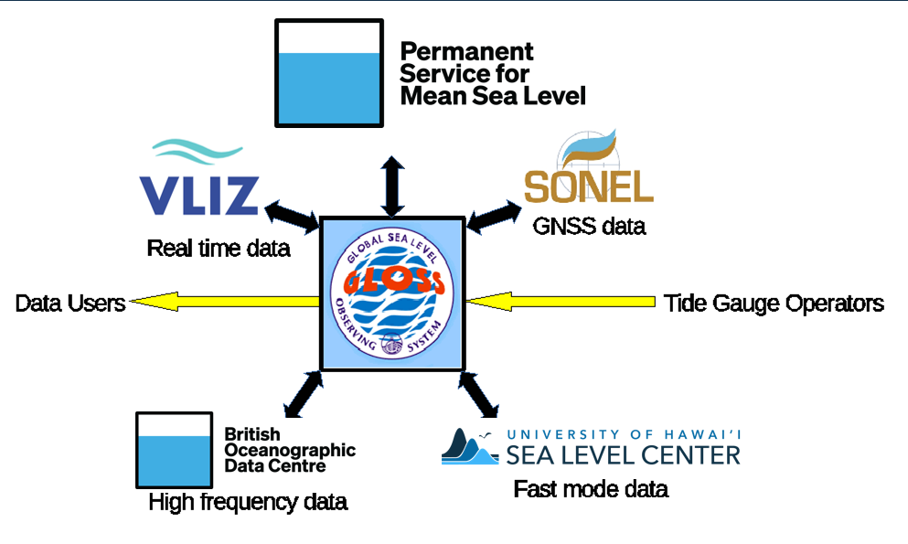
The GLOSS Sea Level Community
Notes:
Global Navigation Satellite Systems reflectometry

Slide 4


Slide 5
The PSMSL
Founded in 1933 "For the study of tides and tidal currents, of other movements of the sea surface and of currents of different origins..."
This was about ocean dynamics and land movement, not monitoring sea level rise!
1936 – decided to produce a volume of globally collected monthly and annual sea level with updates every 5 years.
Primary data source for studies of longer term sea level variability including the reports of the Intergovernmental Panel on Climate Change (IPCC)

Slide 6
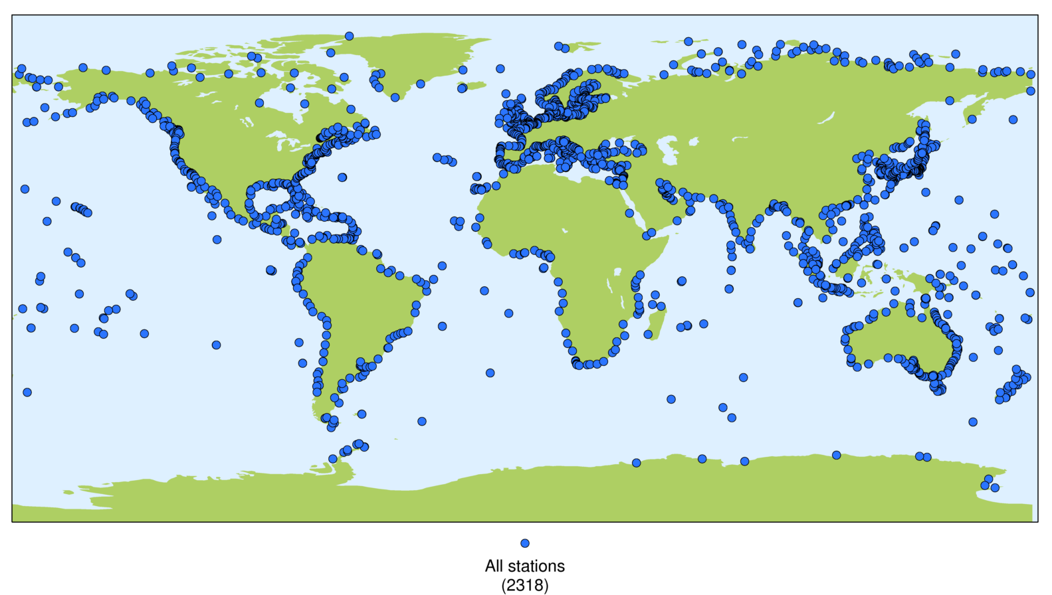
The PSMSL Dataset Today
Contains 54000 station years from >2000 different sites in 200 different countries
All data are freely available for use without restriction from www.psmsl.org, which is updated every Wednesday.

Slide 7
PSMSL Datasets
Where possible, all data for a station are related through time to a consistent set of locally defined benchmarks.
Two main datasets:
(1) Revised Local Reference (RLR): with datum control
(2) Metric: no datum control
Notes:
See Phil Woodworth’s talk about this on Friday, but essentially, there are a set of fixed points on land (benchmarks) to which the measuring point and observations of the tide gauge instrument can be related. So, if the technology changes through time, the records from the different technologies can be connected to form one continuous record.

Slide 8
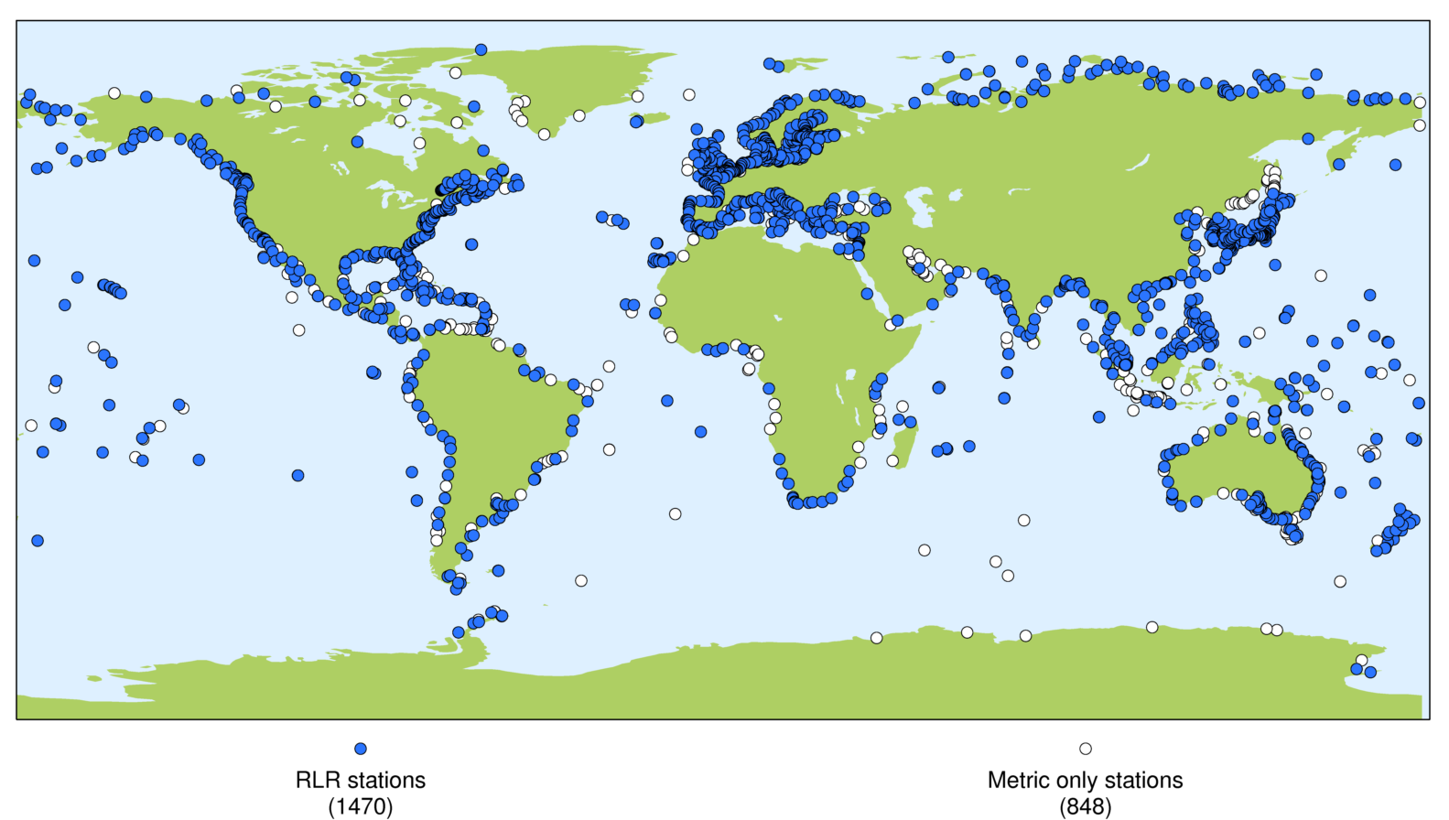
RLR (Datum Controlled) Dataset

Slide 9
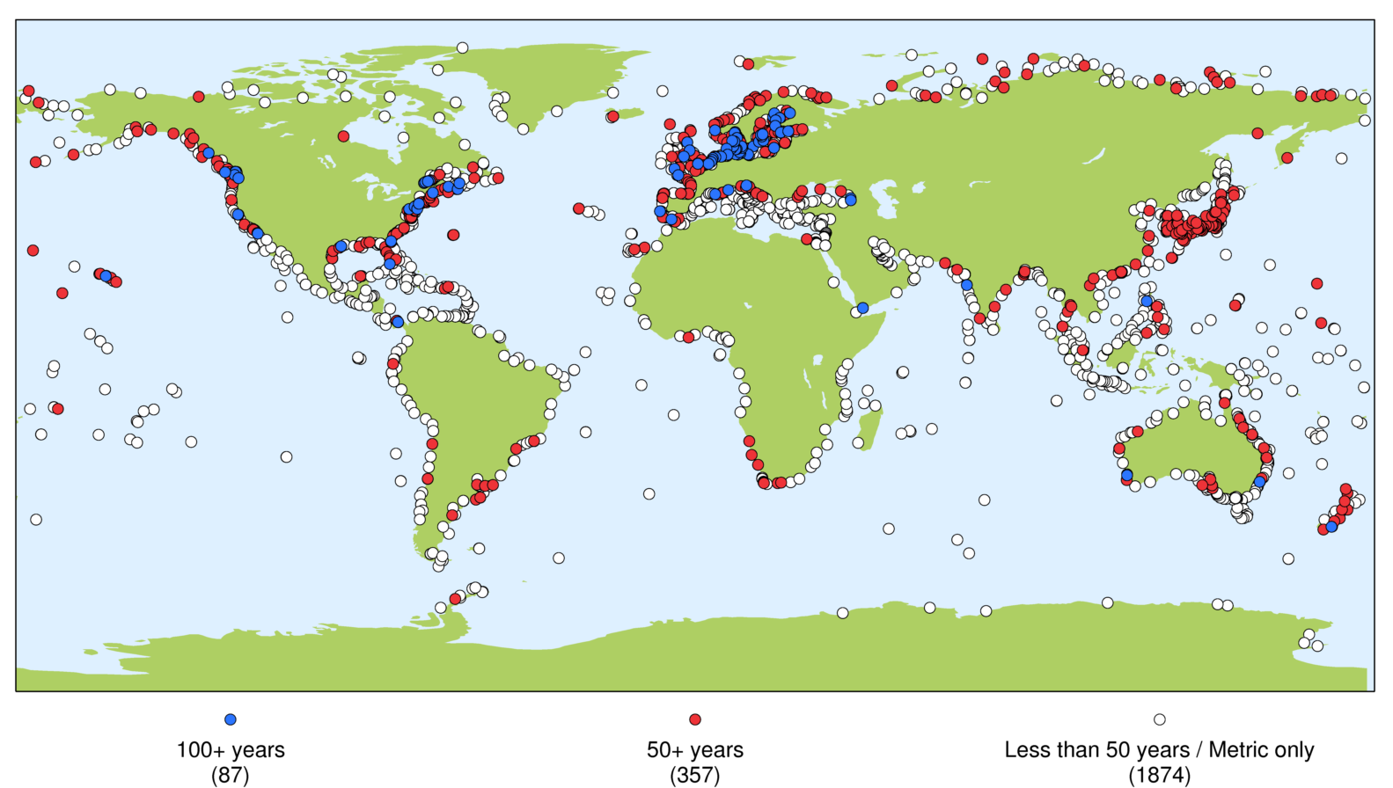
Longer RLR Records
Notes:
Historically, there has been a bias in availability of measurements towards the Northern Hemisphere.

Slide 10
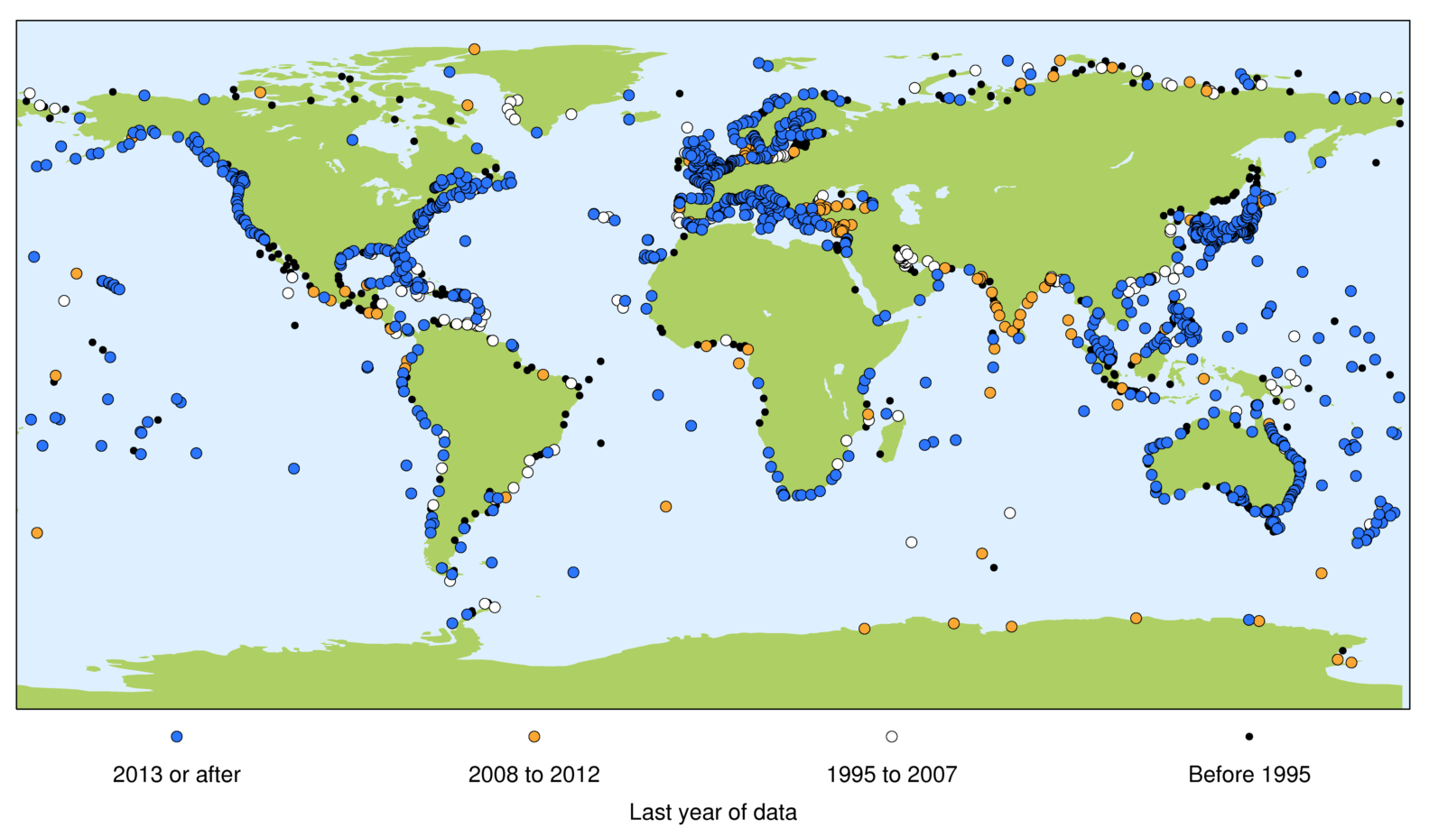
Latest Available Data
Notes:
Some gauges have fallen into disrepair (black and white dots), which is the issue we are currently trying to address in the Caribbean e.g. by installing the St Lucia gauge

Slide 11
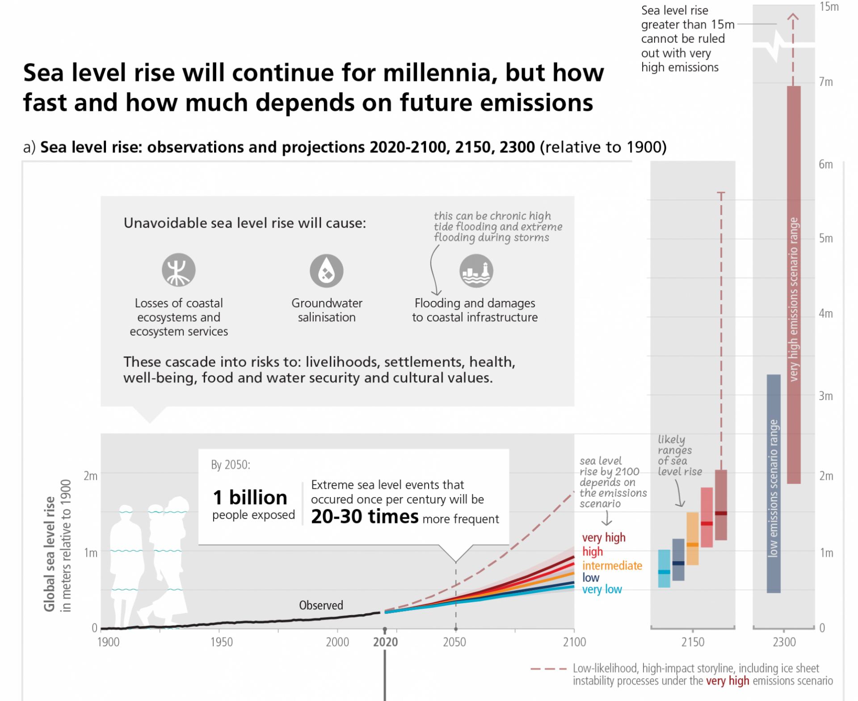
Use of PSMSL data
Global Mean Sea Level reconstruction: from IPCC AR6

Slide 12
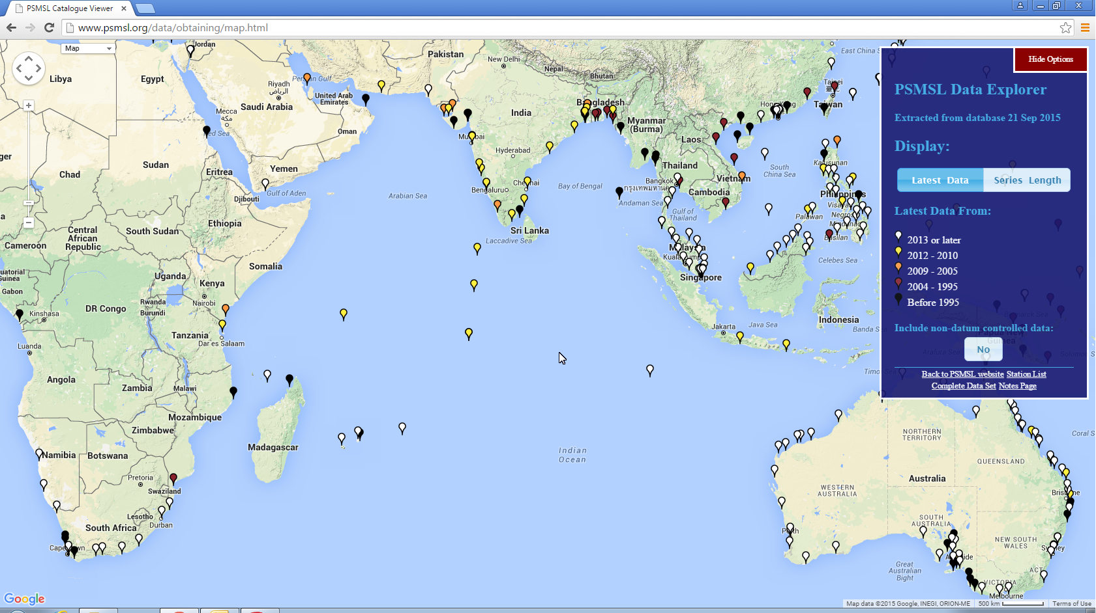
Data Explorer www.psmsl.org/data/obtaining/map.html

Slide 13
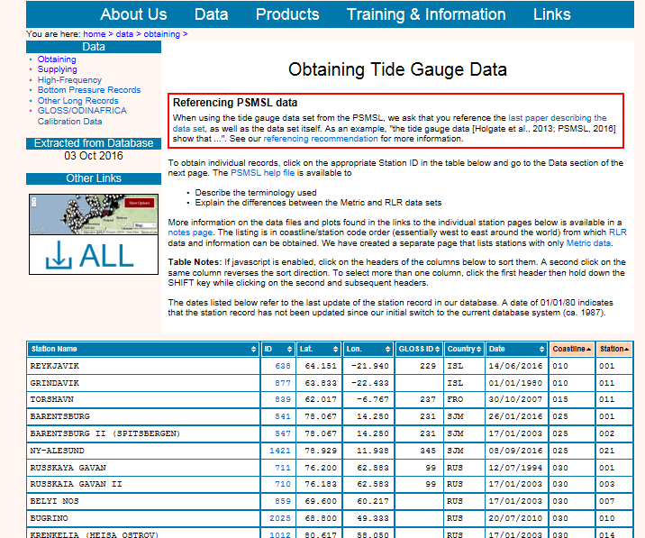

Slide 14
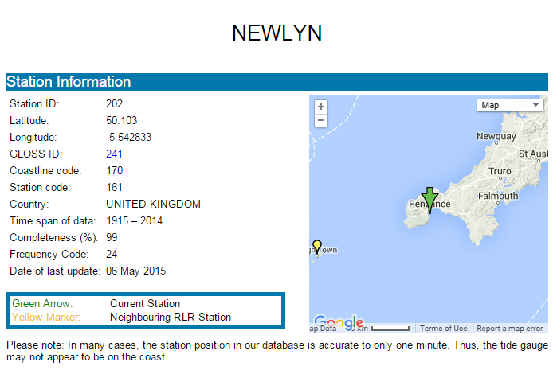
Station Metadata (1) www.psmsl.org/data/obtaining/stations/202.php

Slide 15
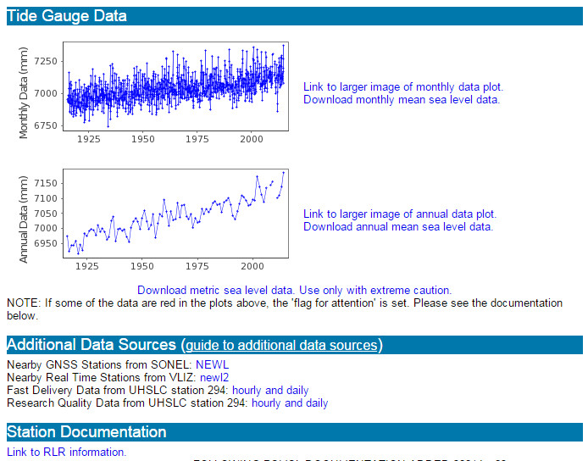
Station Metadata (2) www.psmsl.org/data/obtaining/stations/202.php

Slide 16
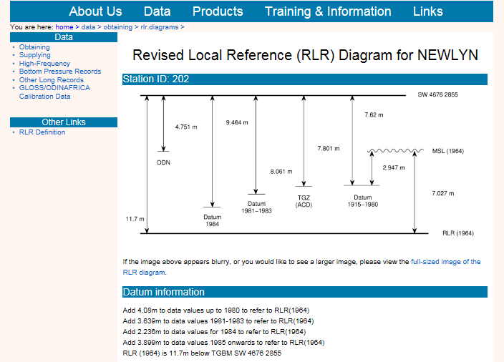
Station Metadata (3) www.psmsl.org/data/obtaining/rlr.diagrams/202.php

Slide 17
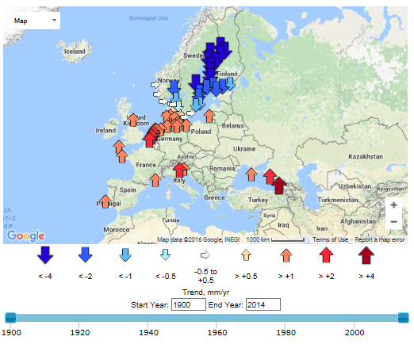
Trend Explorer www.psmsl.org/products/trends/

Slide 18
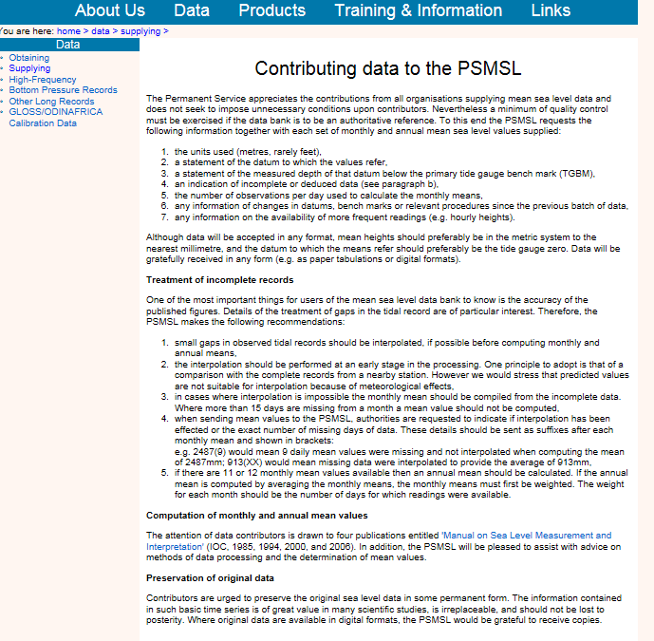
www.psmsl.org/data/supplying/

Slide 19
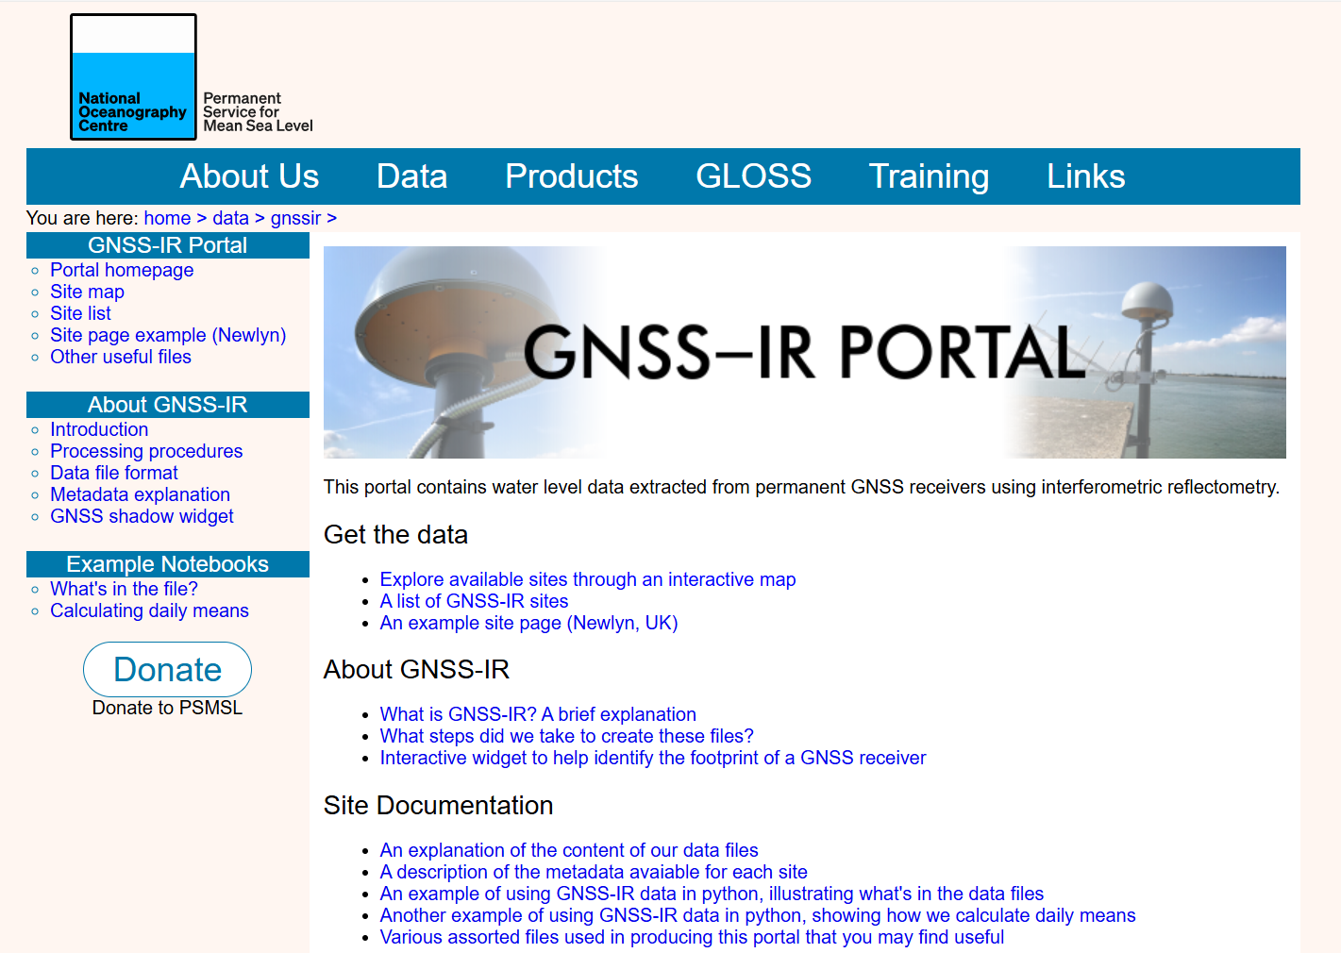
GNSS-IR Data Portal
https://psmsl.org/data/gnssir/
Global archive for sea level data from GNSS-IR
Contains data from almost 400 GNSS stations globally
Some records extend back 15 years

Slide 20
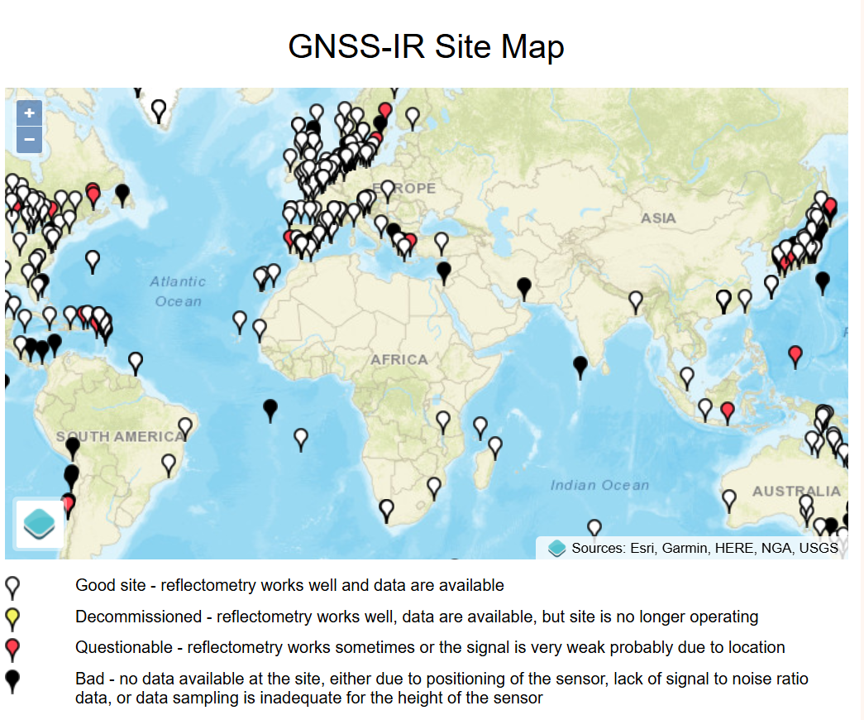
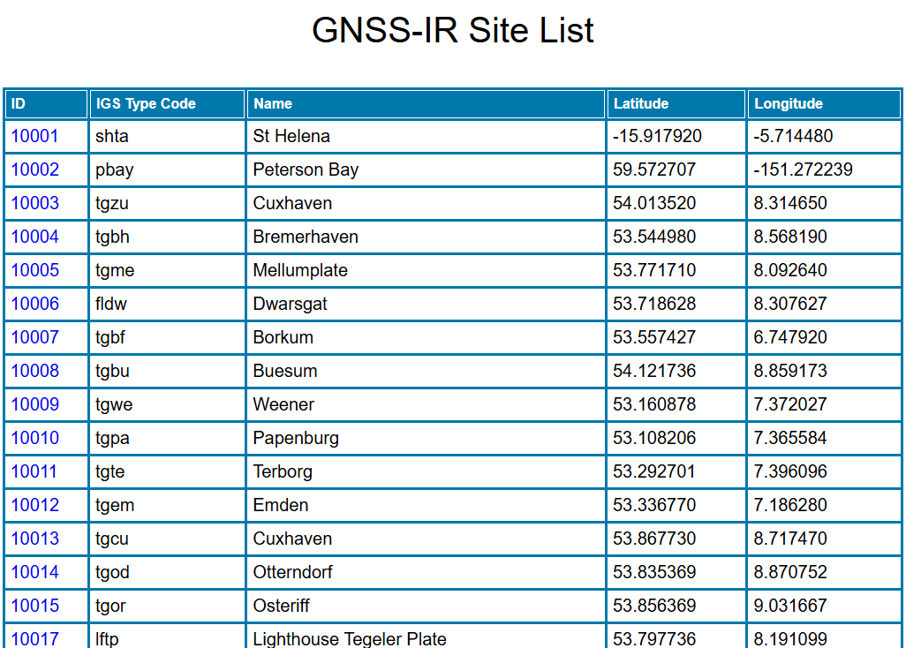
GNSS-IR Data Portal

Slide 21
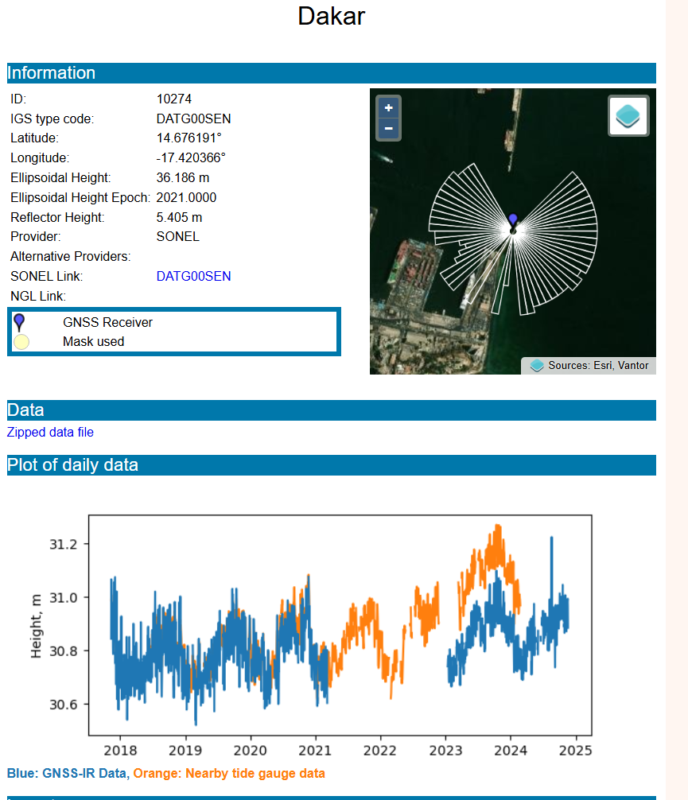
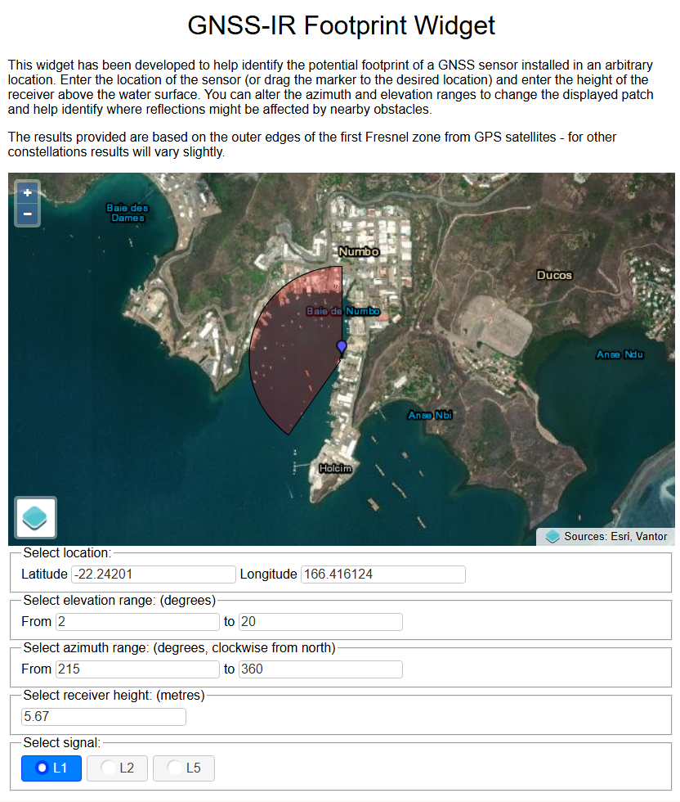
GNSS-IR Data Portal

Slide 22
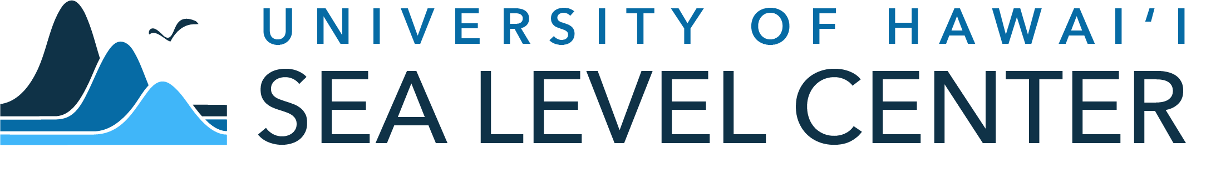

Slide 23
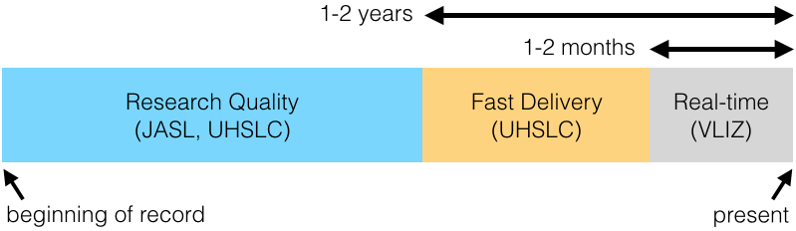
University of Hawaii Sea Level Center
GLOSS Fast and Real-Time Centre
Hourly means of sea level
Fast mode data - ‘light’ QC, released with 1-2 months
Research Quality Data Set (RQDS) produced within 1-2 years
Web site: http://uhslc.soest.hawaii.edu/

Slide 24
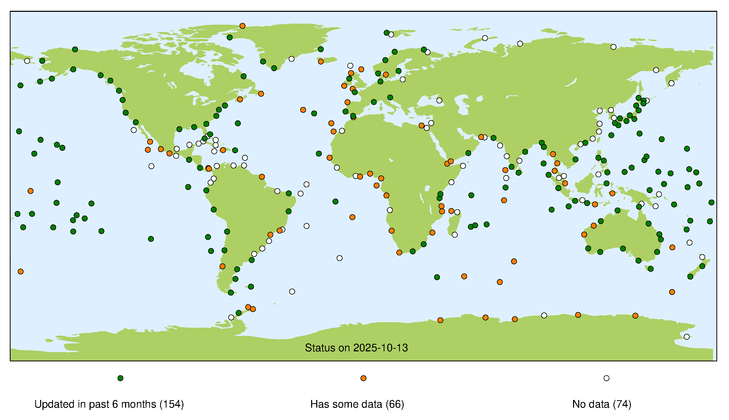
Fast Mode Data

Slide 25
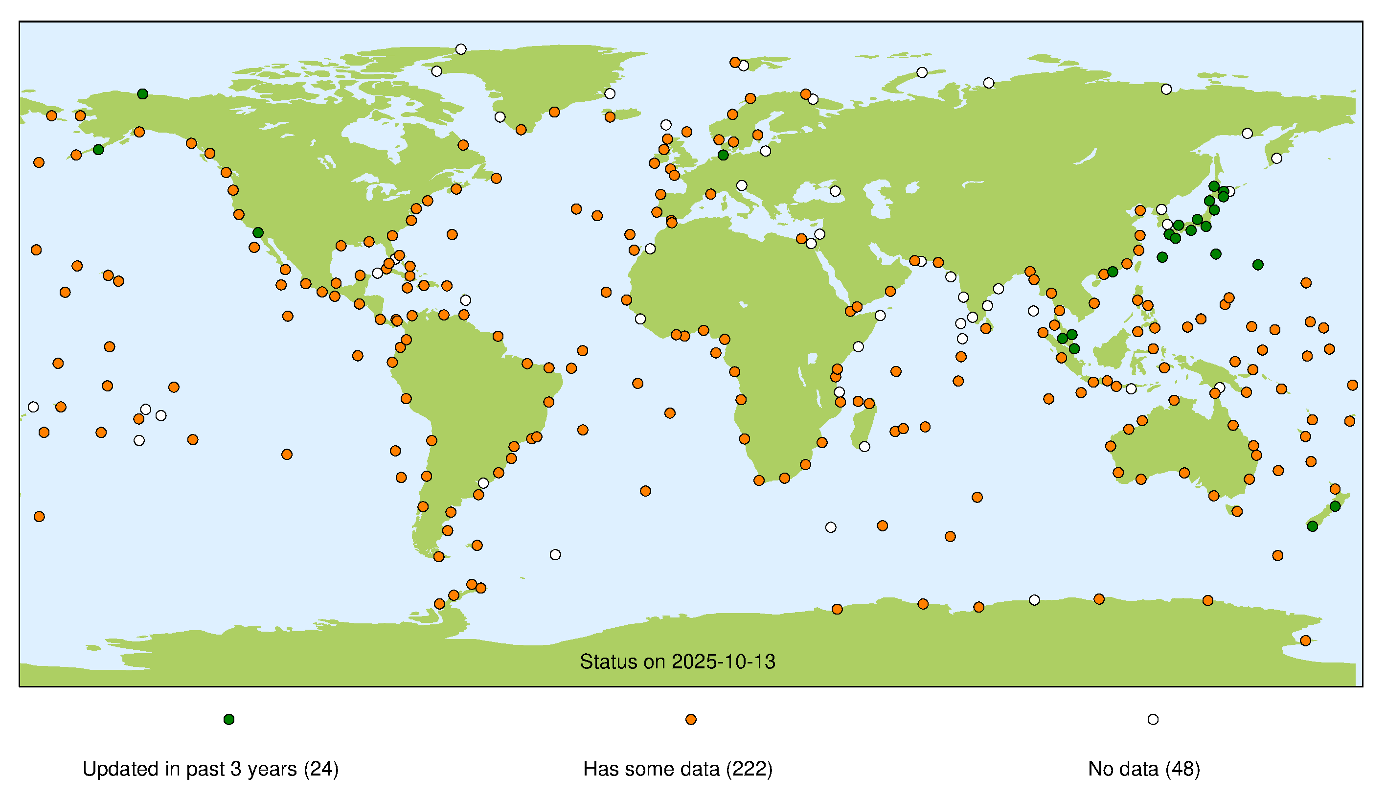
Research Quality Data Set (RQDS)

Slide 26
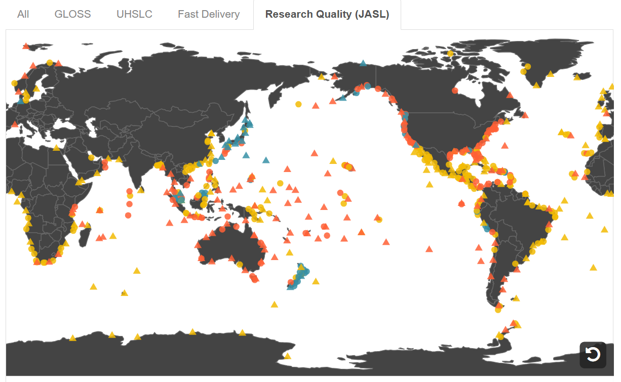
Data Explorer

Slide 27
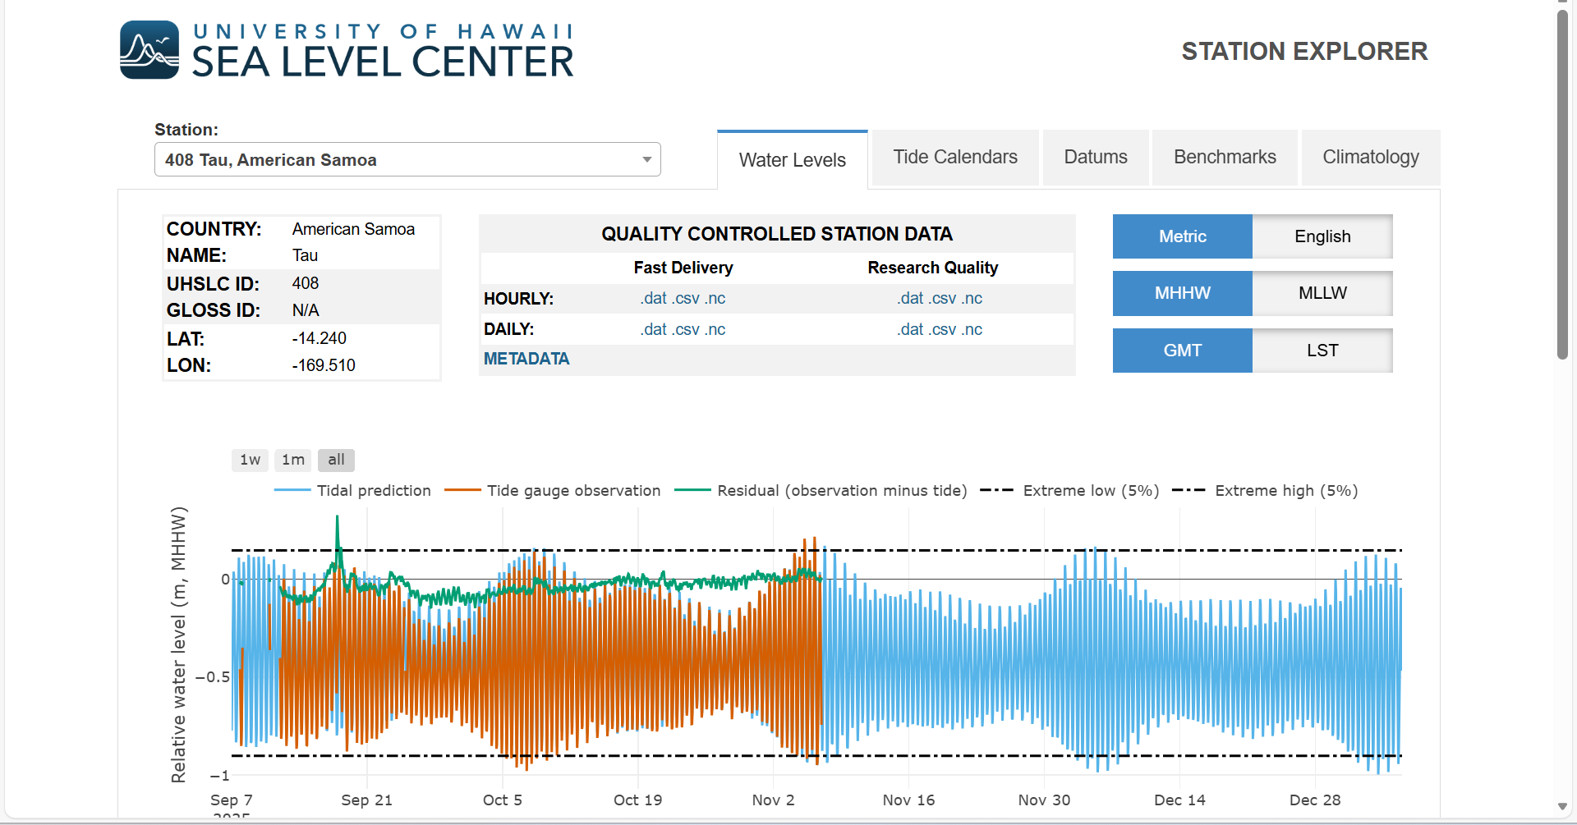
Data Explorer

Slide 28
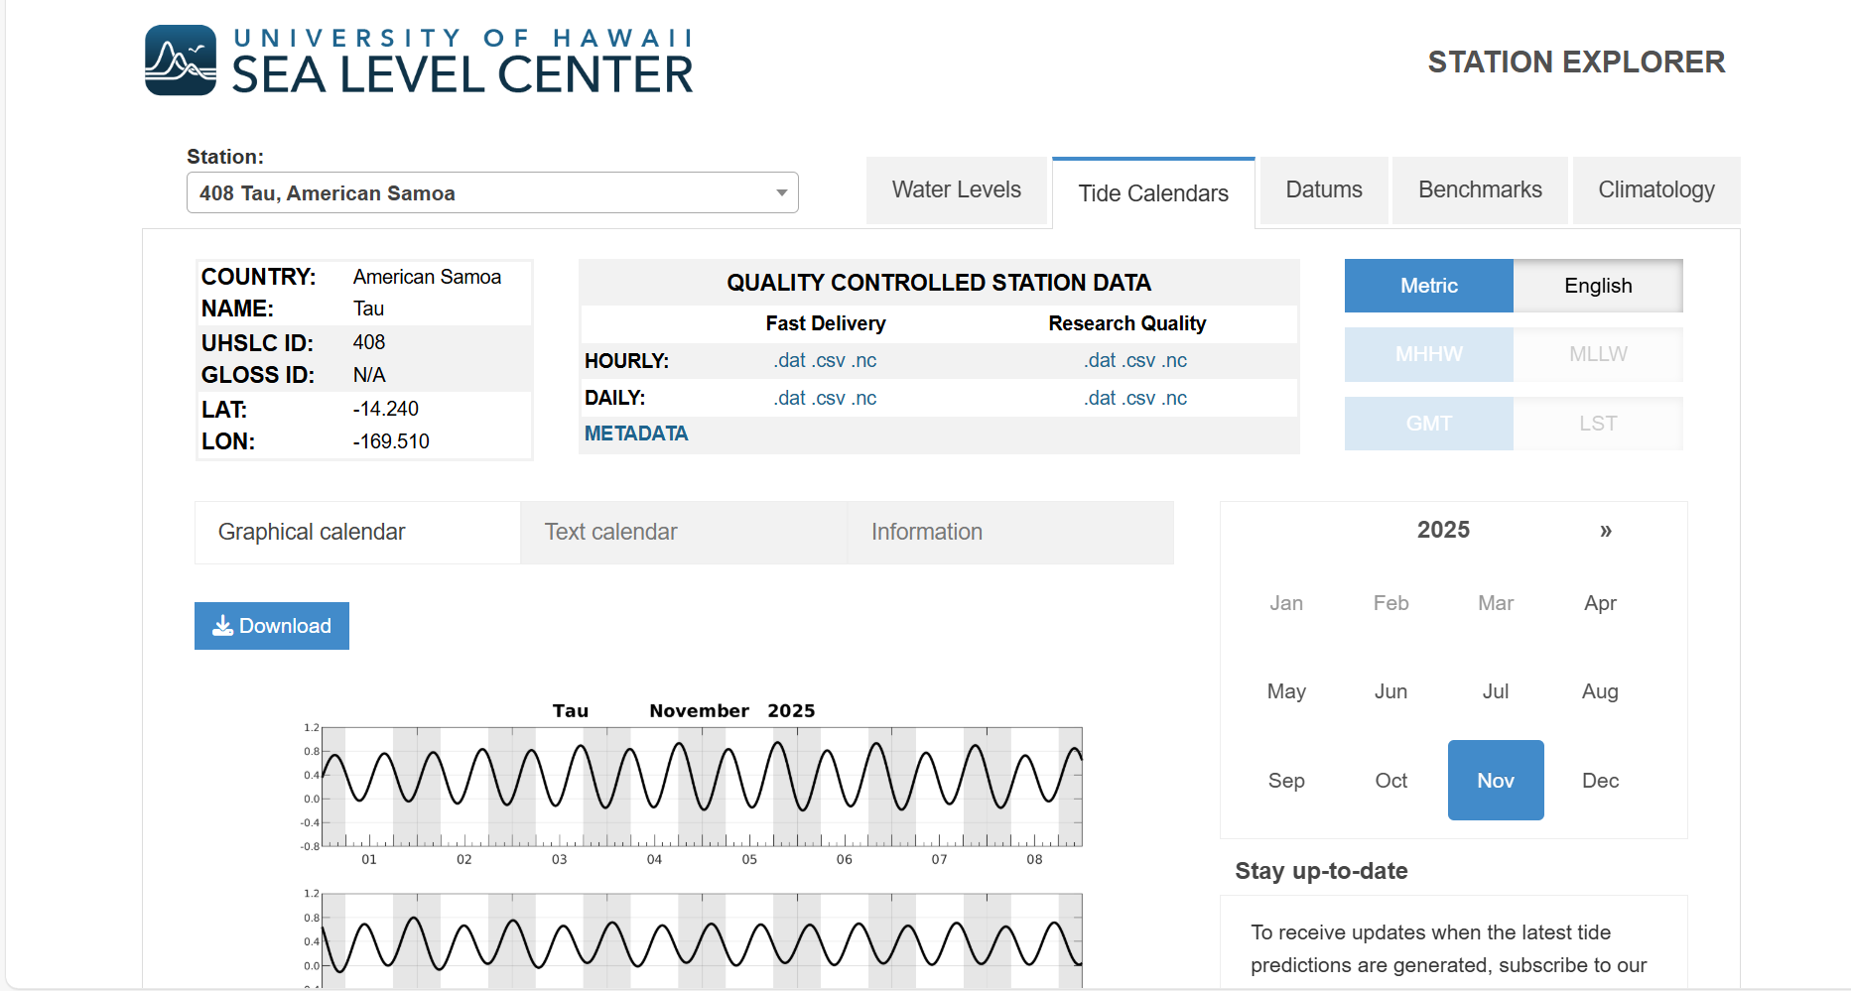
Data Explorer

Slide 29
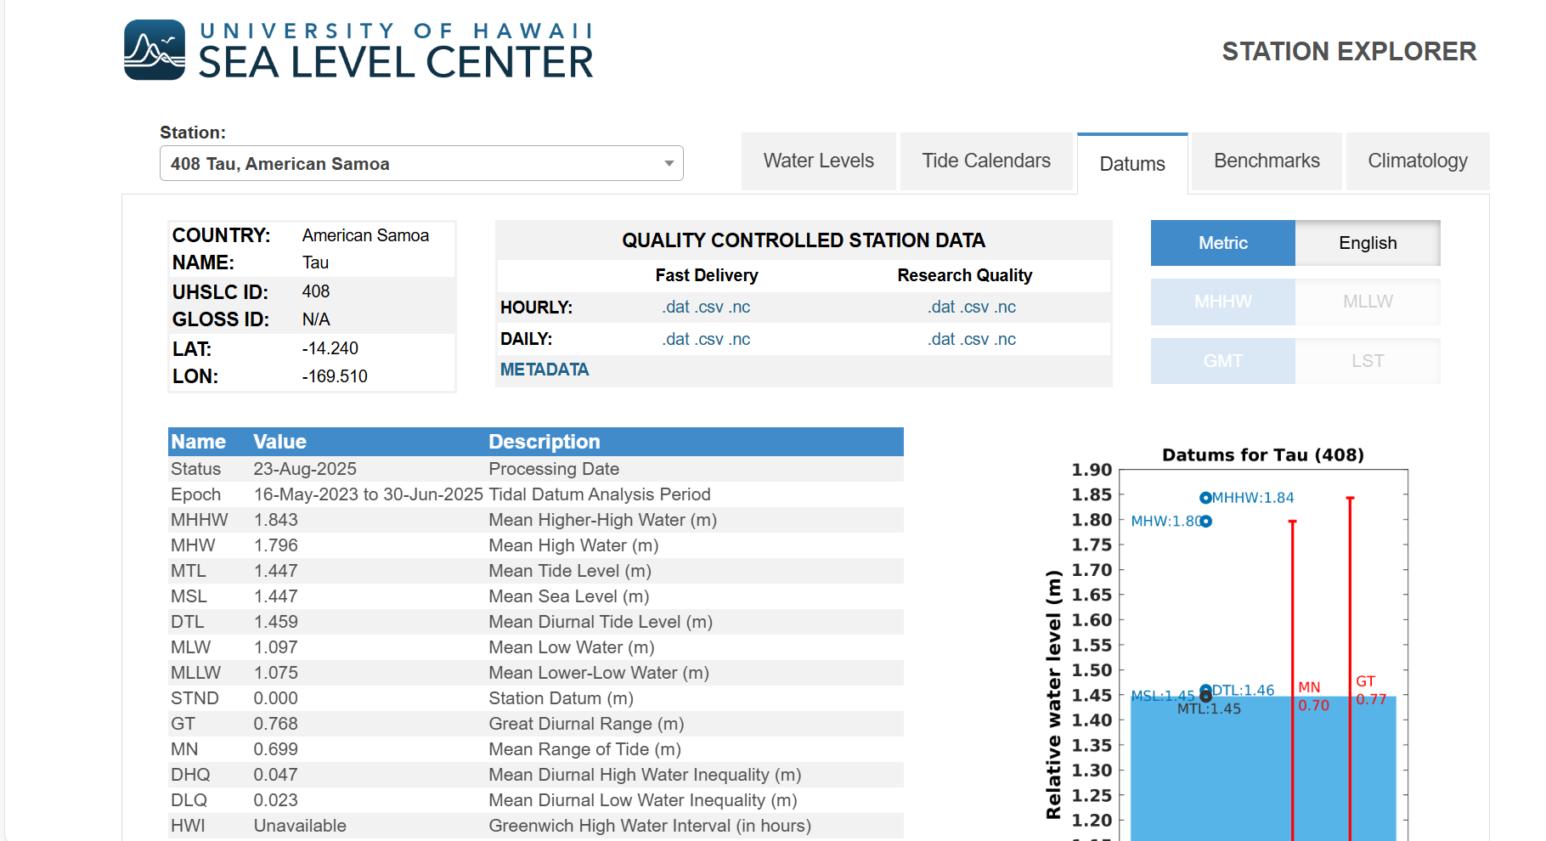
Data Explorer

Slide 30
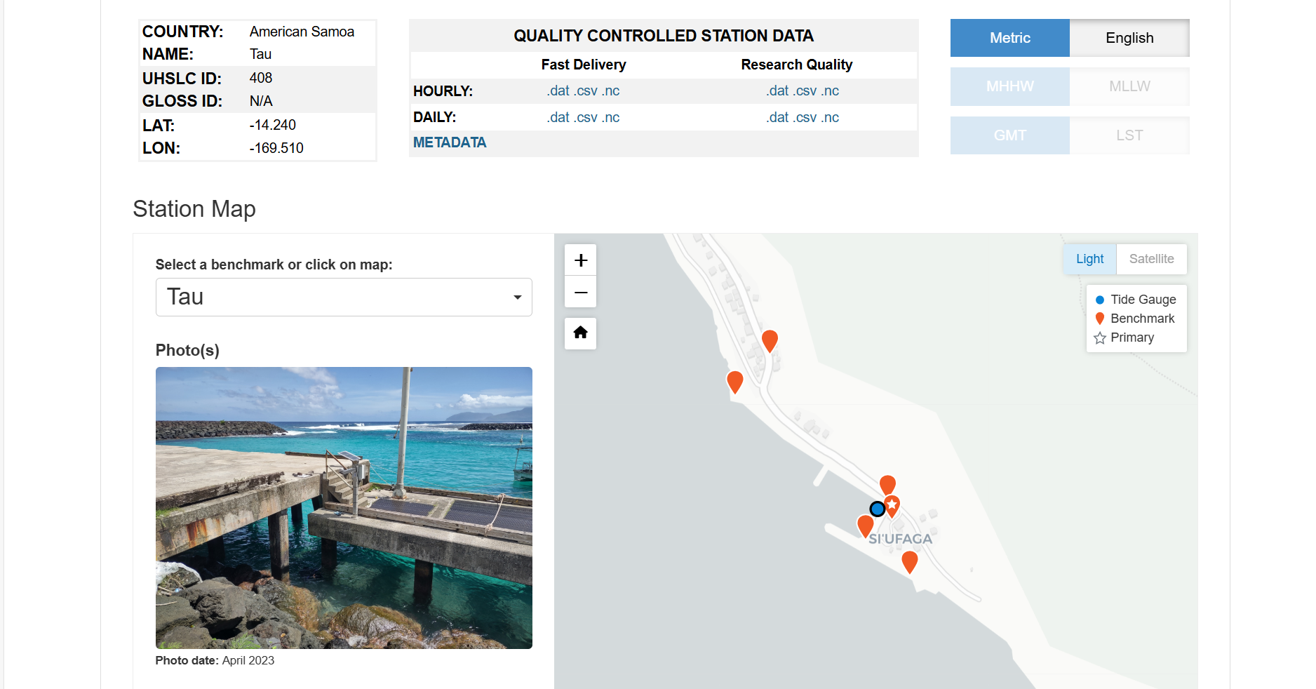
Data Explorer
Notes:
Benchmarks

Slide 31
Data Explorer
Notes:
Benchmarks

Slide 32
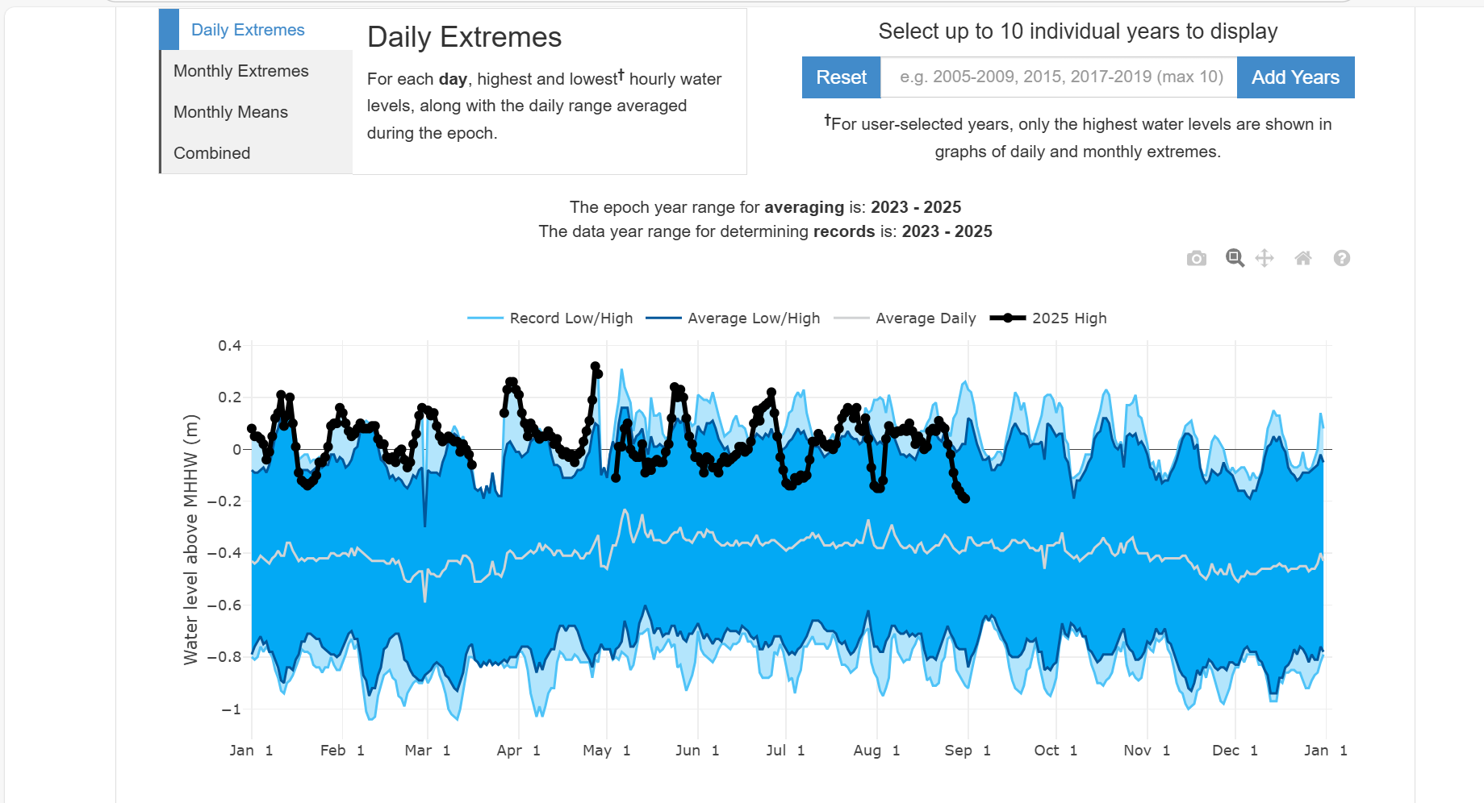
Data Explorer
Notes:
Climatology

Slide 33
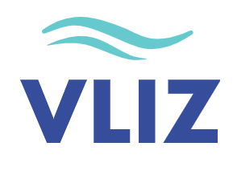
IOC SLSMF

Slide 34
IOC Sea Level Monitoring Station Facility (SLSMF)
IOC Sea Level Monitoring Facility (IOC SLMF)
Hosted at the Flander Marine Institite (VLIZ)
GLOSS Real-Time Data Centre
High Frequency observations
Not quality-controlled
For operational, early warning purposes
Web site: http://www.ioc-sealevelmonitoring.org
Ideal for daily checks on data availability and quality to support tide gauge technicians

Slide 35
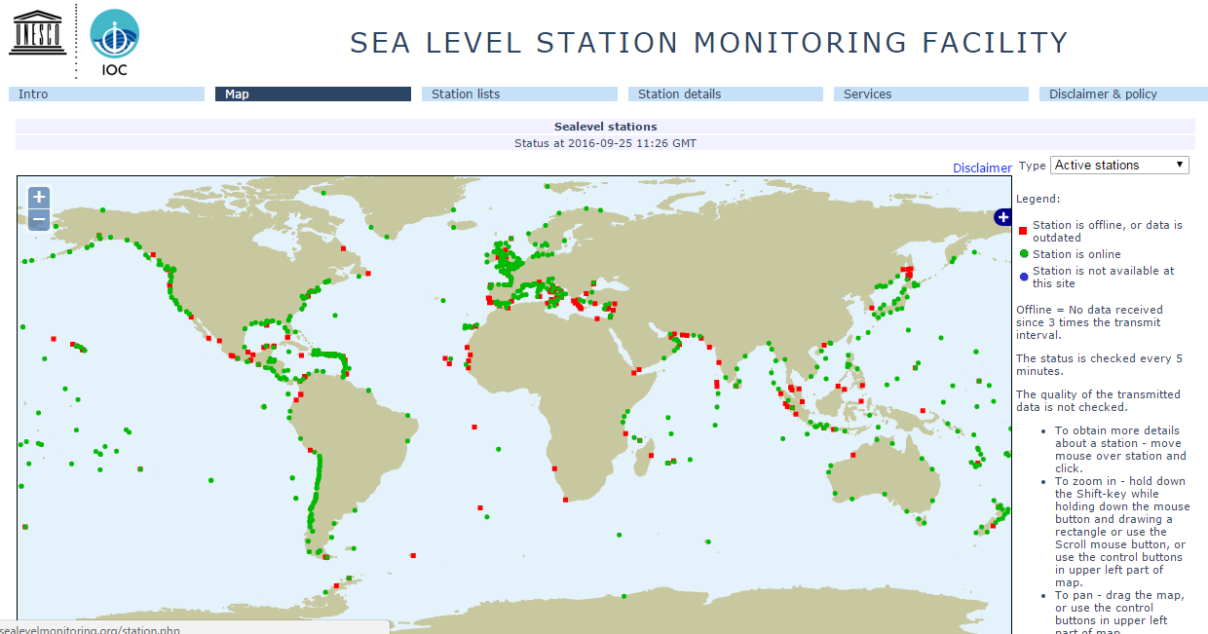
IOC SLSMF
IOC Sea Level Monitoring Facility (IOC SLMF)
http://www.ioc-sealevelmonitoring.org

Slide 36
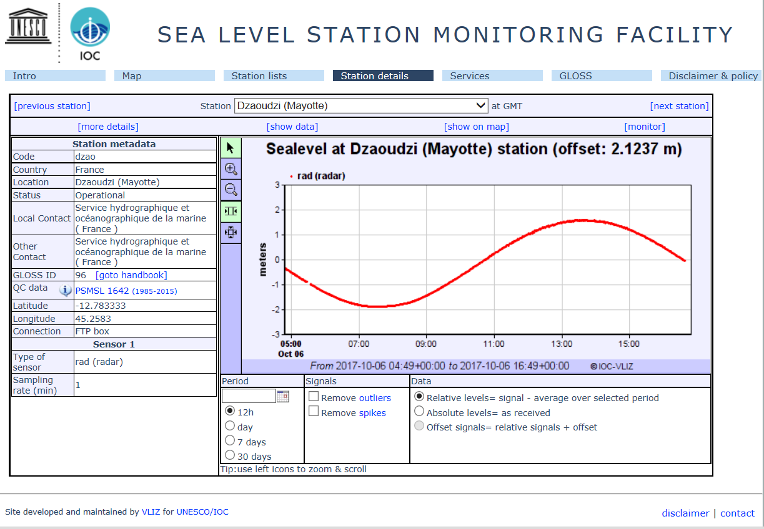
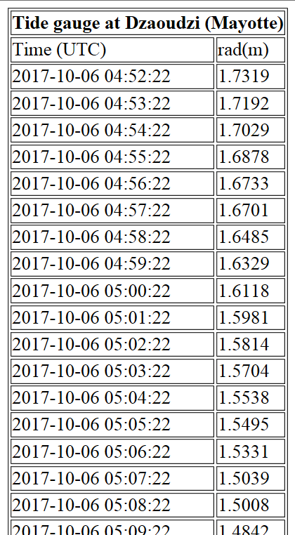
IOC SLSMF
IOC Sea Level Monitoring Facility (IOC SLMF)
http://www.ioc-sealevelmonitoring.org

Slide 37
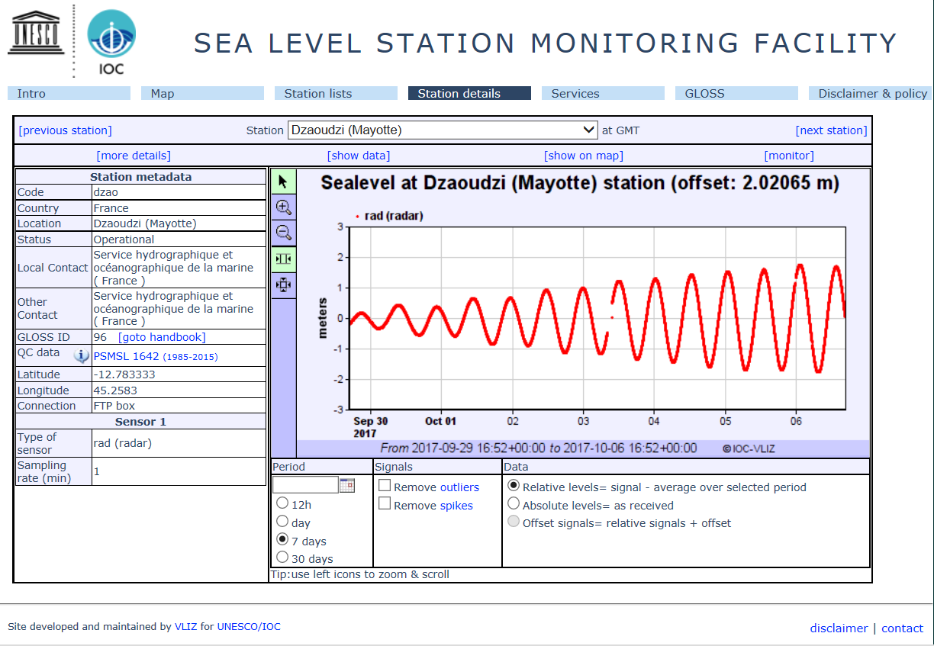
IOC SLSMF
IOC Sea Level Monitoring Facility (IOC SLMF)
Switch radio button to absolute levels

Slide 38
IOC SLSMF
IOC Sea Level Monitoring Facility (IOC SLMF)

Slide 39
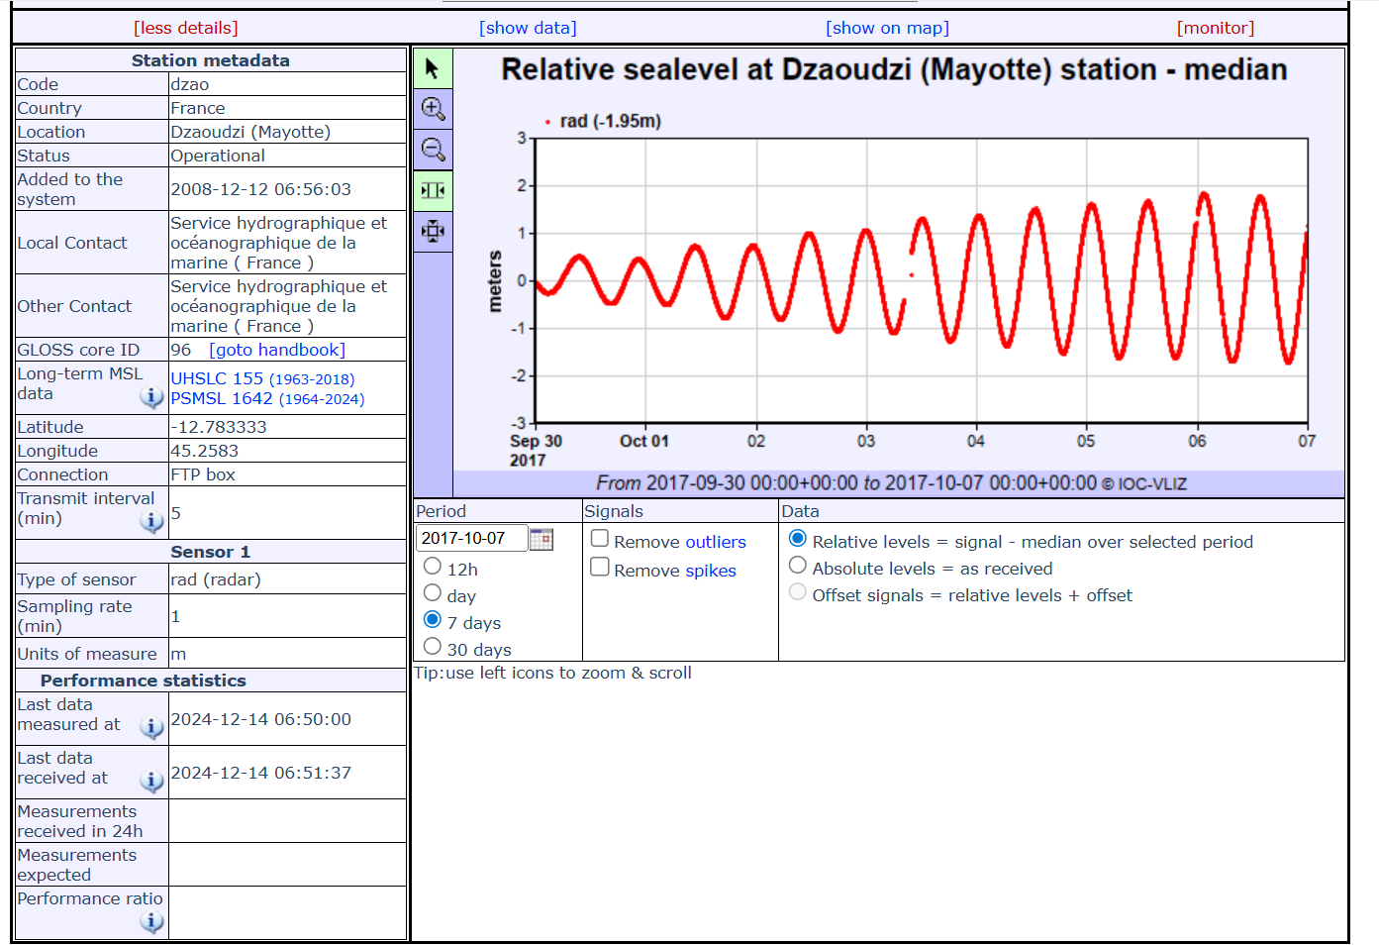
IOC SLSMF
IOC Sea Level Monitoring Facility (IOC SLMF)

Slide 40


Slide 41
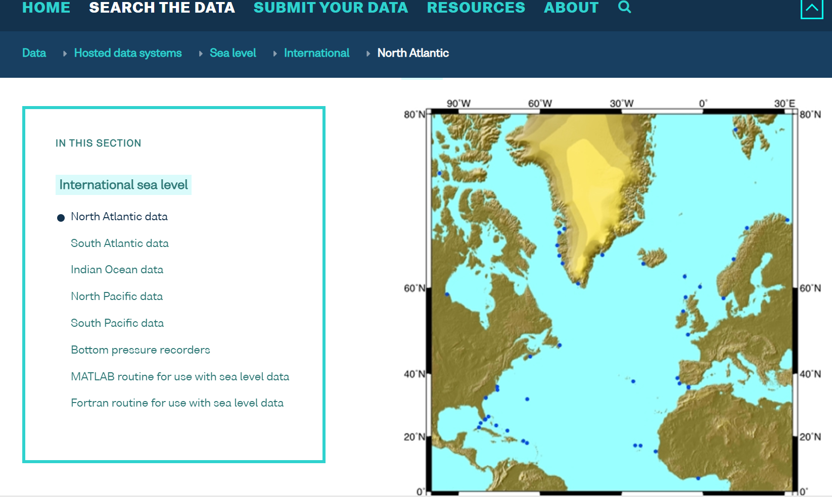
BODC
UK’s National Marine Data Centre
International GLOSS data centre for high frequency delayed-mode data

Slide 42
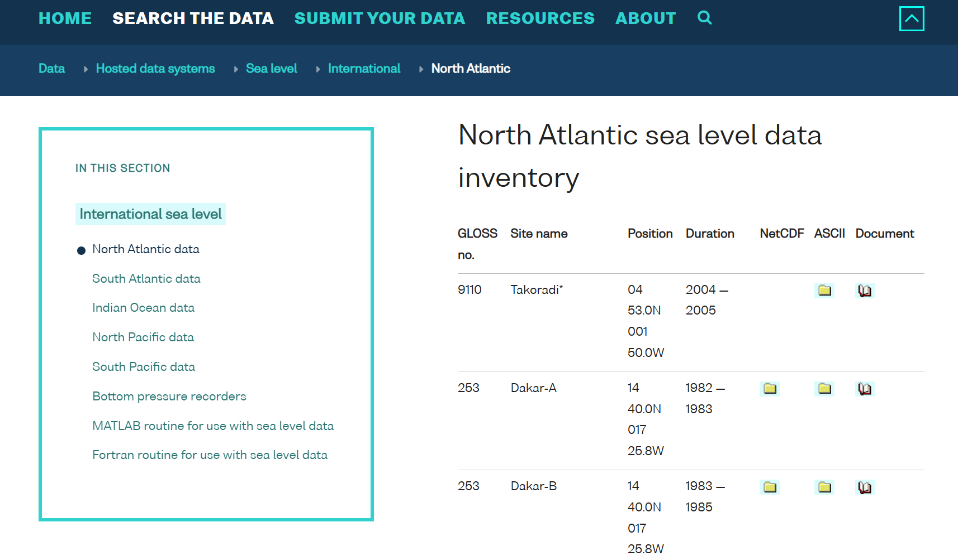
BODC

Slide 43


Slide 44
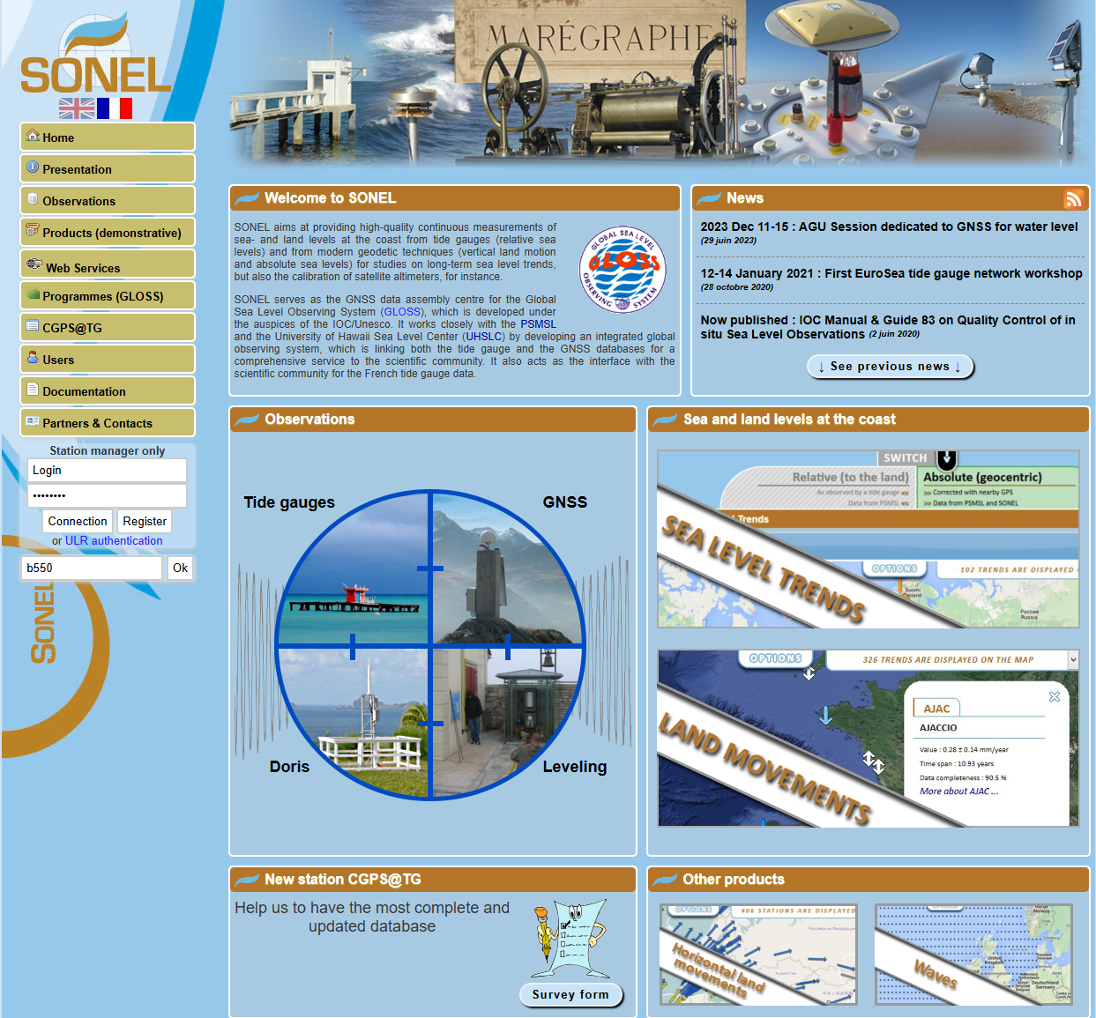
SONEL
Provides high-quality continuous measurements of sea and land levels at the coast from tide gauges and modern geodetic techniques
SONEL serves as the GNSS data assembly centre for the Global Sea Level Observing System (GLOSS), which is developed under the auspices of the IOC/Unesco.
Provides:
Vertical Land Movement Time Series
GNSS Data Archive for GPS @ Tidegauges

Slide 45
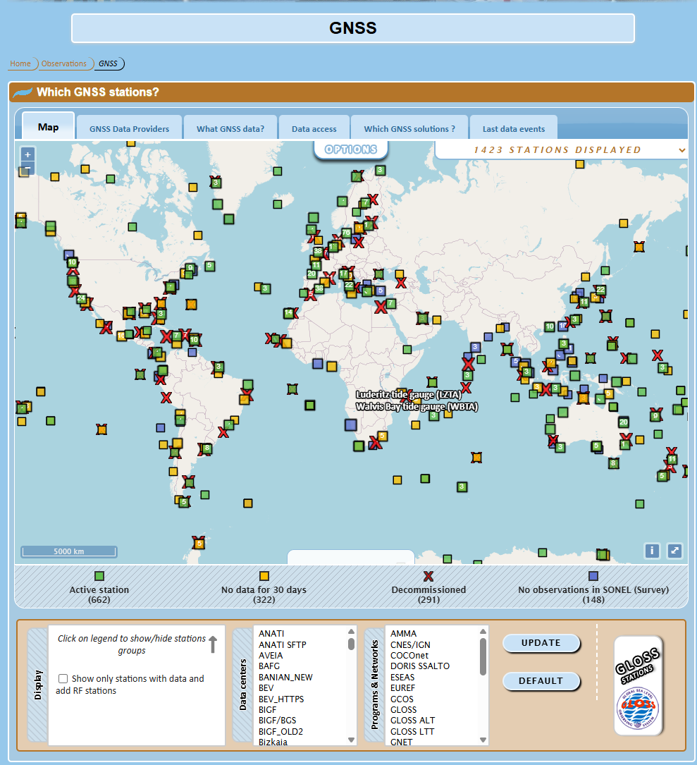
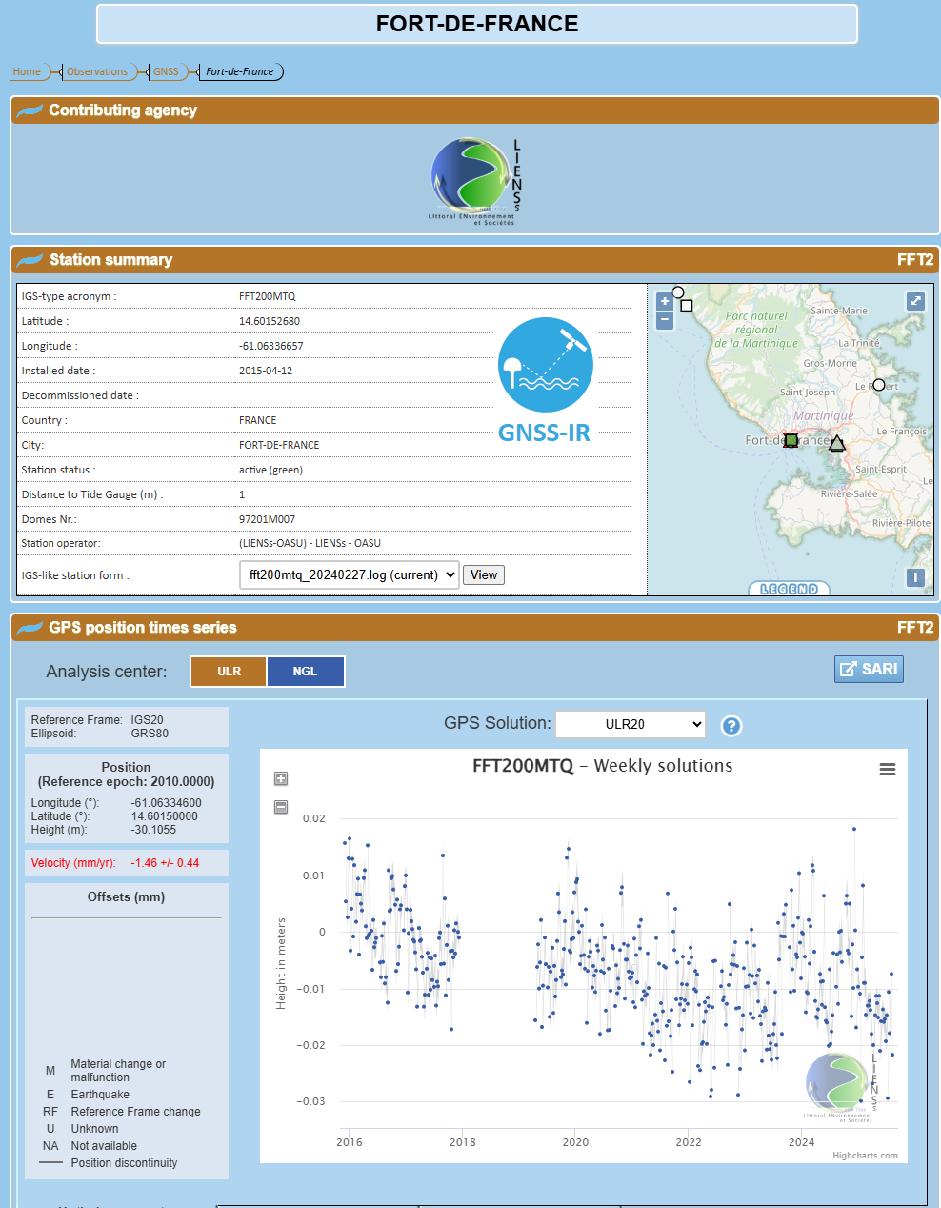
SONEL

Slide 46
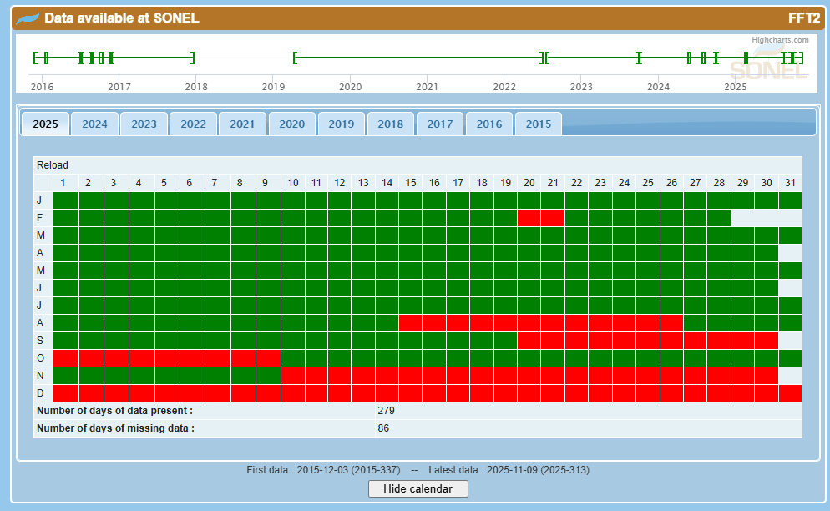
SONEL

Slide 47

Nevada Geodetic Laboratory

Slide 48
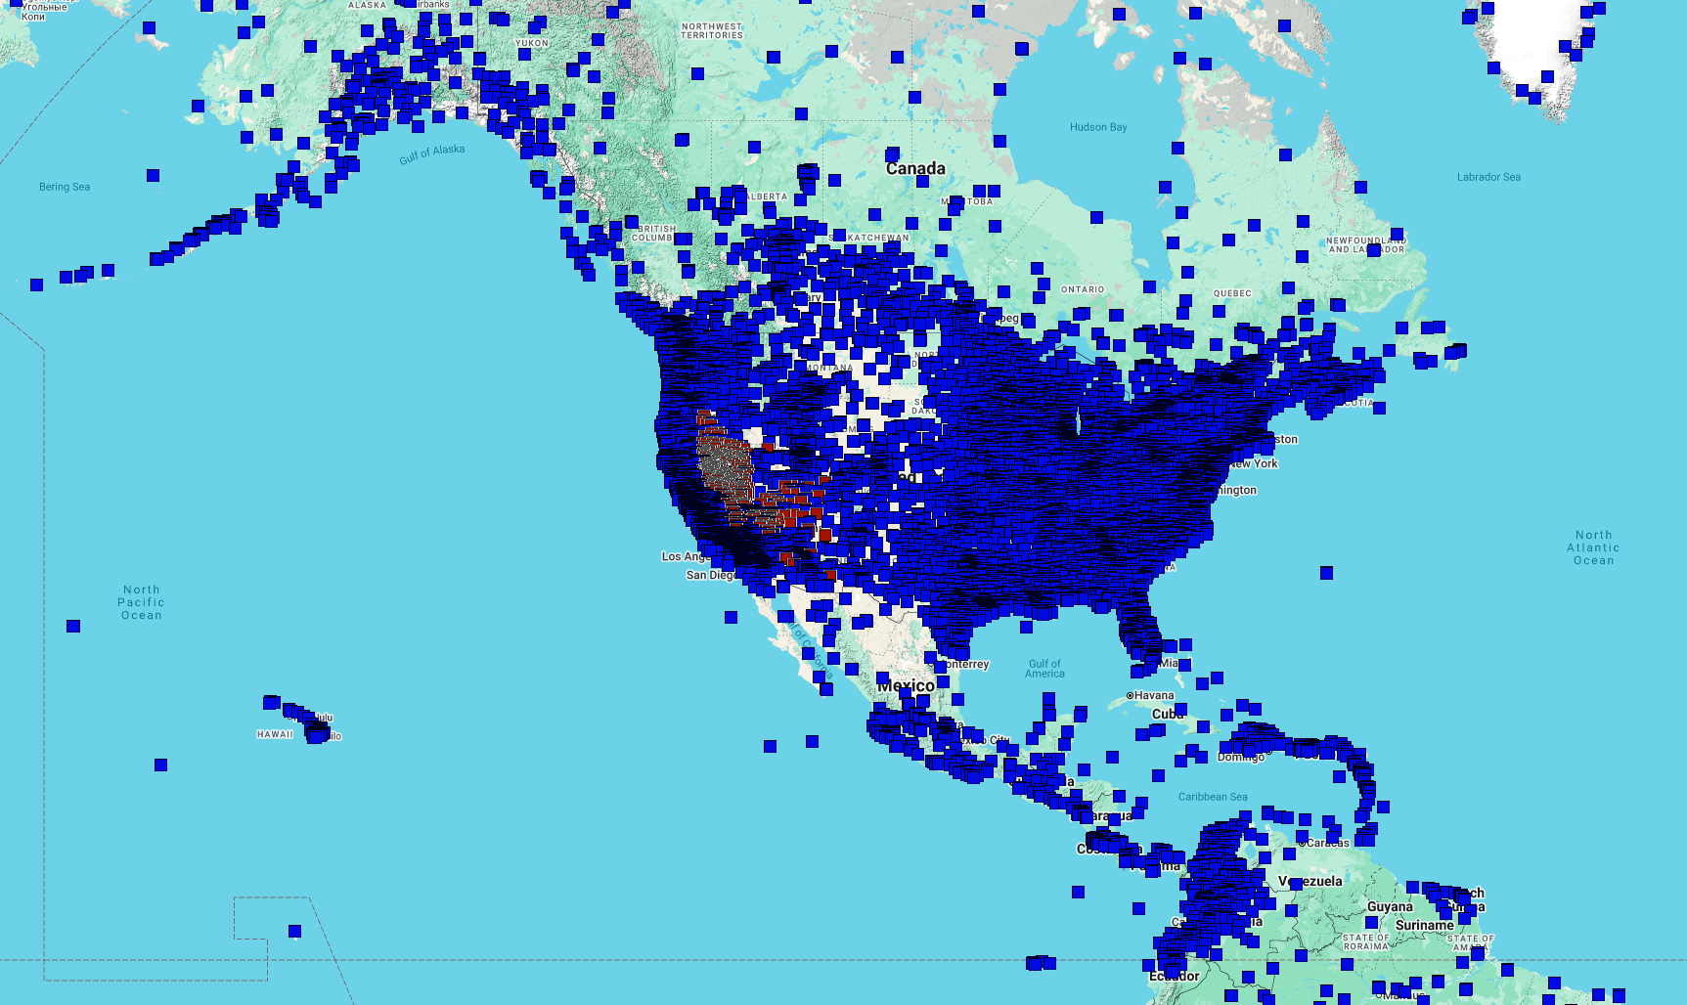
Nevada Geodetic Laboratory
Not affiliated with any International Body
Process GNSS data from over 23000 sites around the world
By far the biggest provider of position time series and velocities in the world

Slide 49
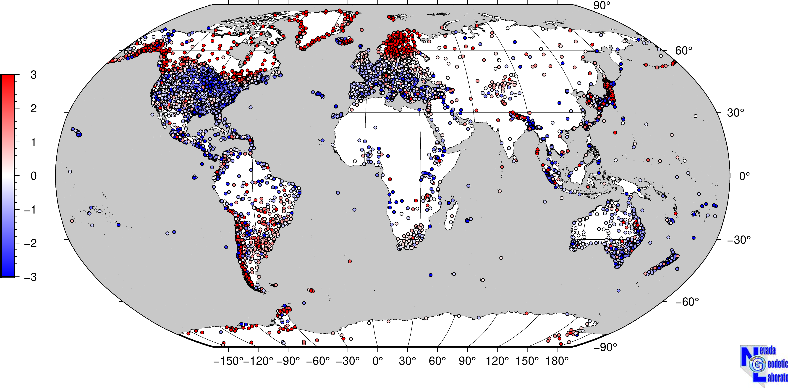
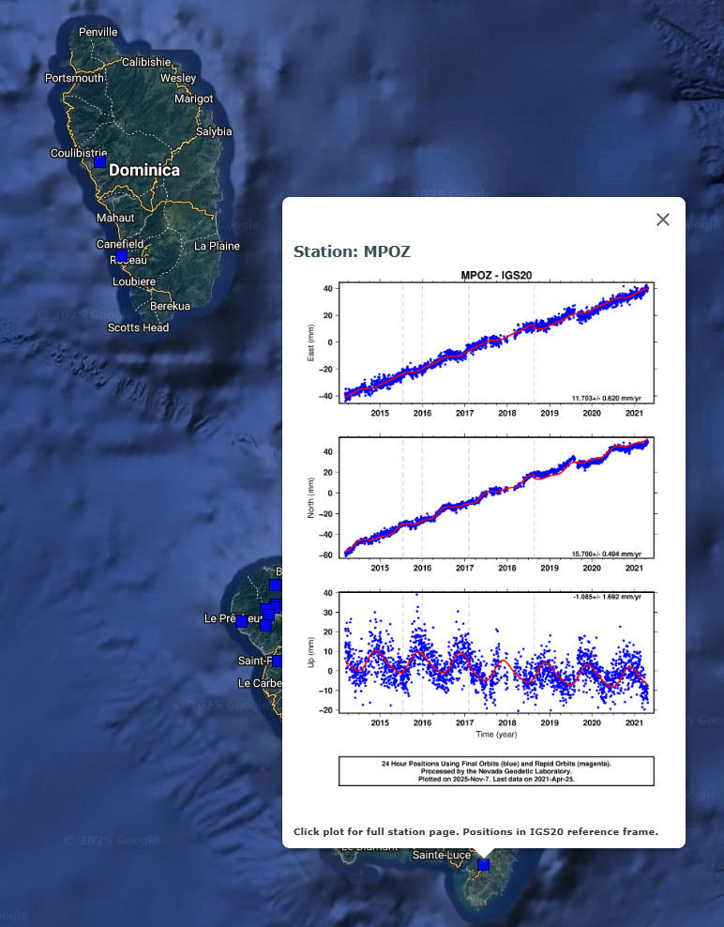
Nevada Geodetic Laboratory
Also provide global estimates of vertical land movement at GPS sites and PSMSL gauge locations
https://geodesy.unr.edu/vlm.php

