Slide 1

Barbados workshop
Water level datum definition
Silvia costa
Notes:
Se puede agregar una imagen encima. Se recomienda formato panorámico

Slide 2
CONTENS
VERTICAL DATUM DEFINITION
DATUM EN HIDROGRAFÍA
CRITERIA OF THE IHO
CHART DATUM ALL OVER THE WORLD.
HYDROGRAFIC REFERENCE MODEL

Slide 3
a) VERTICAL DATUM DEFINITION
Always we have to know where our feet are

Slide 4
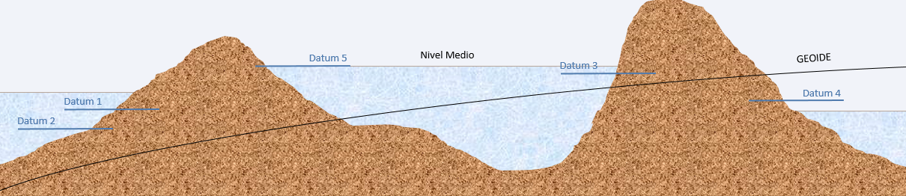
A vertical datum is a reference system used to measure altitudes, elevations, or depths on the Earth's surface or in bodies of water.
While a geodetic datum focuses on describing the shape and horizontal location of the Earth, a vertical datum is used to define the altitude or relative elevation of points on the Earth's surface or subsurface.
The water level datum is a local elevation plane applied only within the specific area where water level measurements have been conducted.
In Spain, the vertical geodetic datum used as a reference is the so-called MEAN SEA LEVEL AT ALICANTE.

Slide 5
B) Types of datums
Marie Kondo, organizing data sets

Slide 6
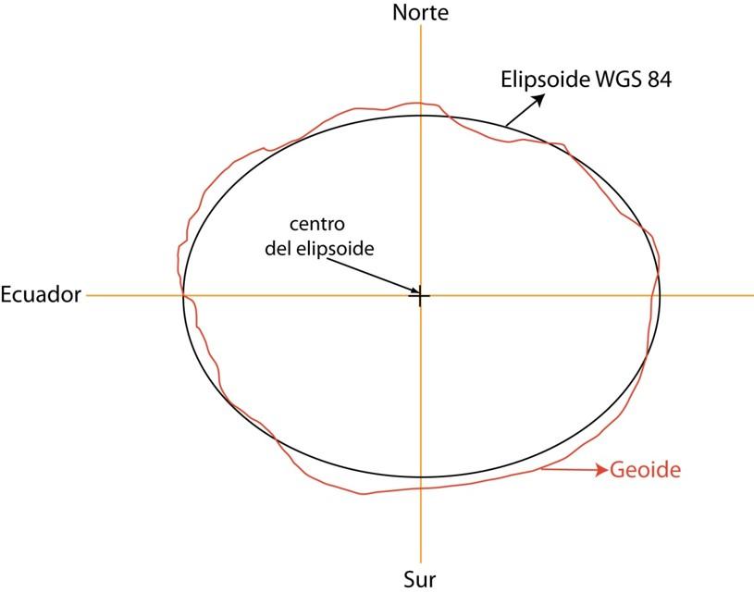
GEOID vs ELLIPSOID
THE GEOID IS THE THEORETICAL SURFACE OF THE EARTH THAT COINCIDES WITH THE MEAN SEA LEVEL AT REST AND EXTENDS CONTINUOUSLY BELOW THE CONTINENTS. IT REPRESENTS THE ACTUAL SHAPE OF THE EARTH CONSIDERING THE VARIATIONS IN THE EARTH'S GRAVITATIONAL FIELD.
THE ELLIPSOID IS A MATHEMATICAL SURFACE GENERATED BY ROTATING AN ELLIPSE AROUND ONE OF ITS AXES, USED TO APPROXIMATE THE SHAPE OF THE EARTH. UNLIKE THE GEOID, IT IS A REGULAR AND SMOOTH FIGURE THAT FACILITATES GEODETIC AND CARTOGRAPHIC CALCULATIONS.

Slide 7
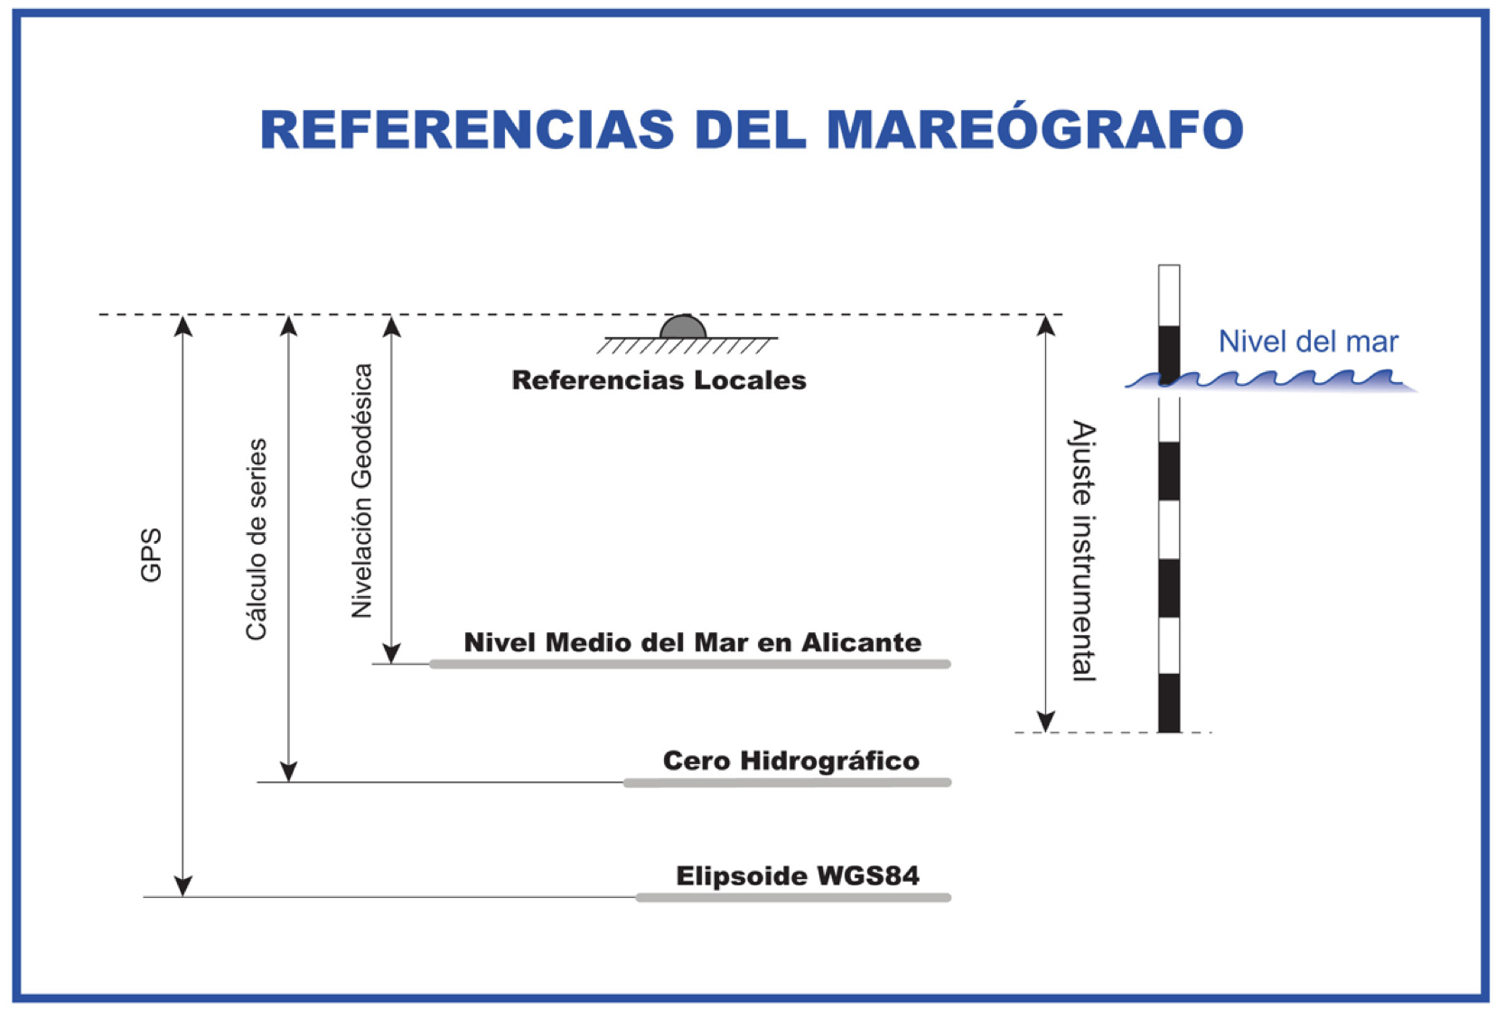
VERTICAL TOPOGRAPHIC DATUM vs NAUTICAL CHART
 | TOPOGRAPIC DATUM | NAUTICAL CHART DATUM
MAIN USES | GEODESY AND TOPOGRAPHIC CARTOGRAPHY | NAVIGATION AND HYDROGRAPHY
SIGN OF THE MEASURES | POSITIVE - UPWARDS | POSITIVE – DOWNWARDS
REFERENCE SURFACE | MEAN SEA LEVEL O GEOID | LAT OR SURFACE
VALUE | POSITIVES HEIGTH | POSITIVE DEPTH
OBJETIVES | REPRESENTAR RELIEVE TERRESRE | NAVIGATION SAFETY

Slide 8

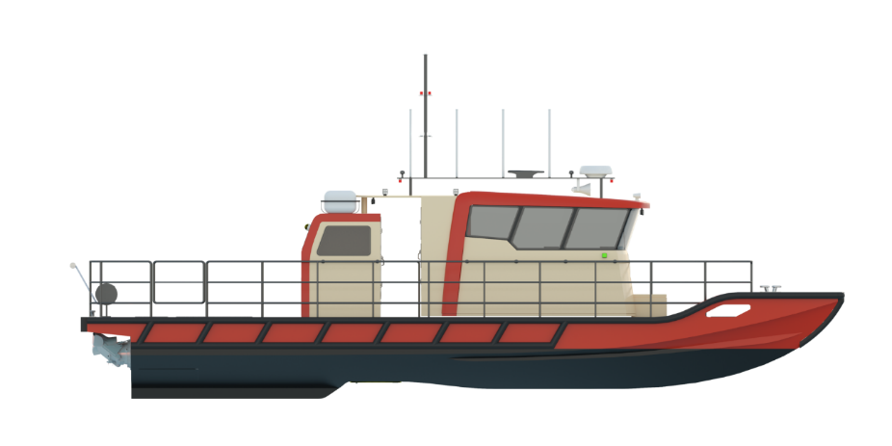

CHART DATUM – REFERENCE NAUTICALS CHARTS
Sonda obtenida 1
Sonda obtenida 2
Fondo

Slide 9
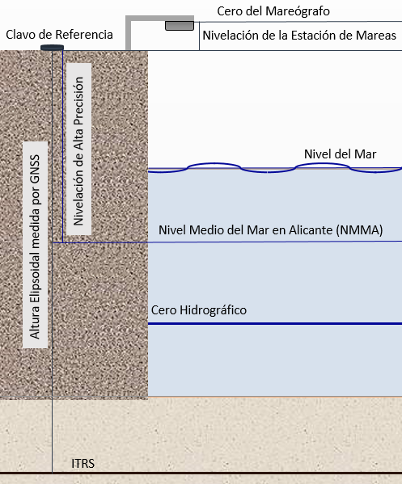
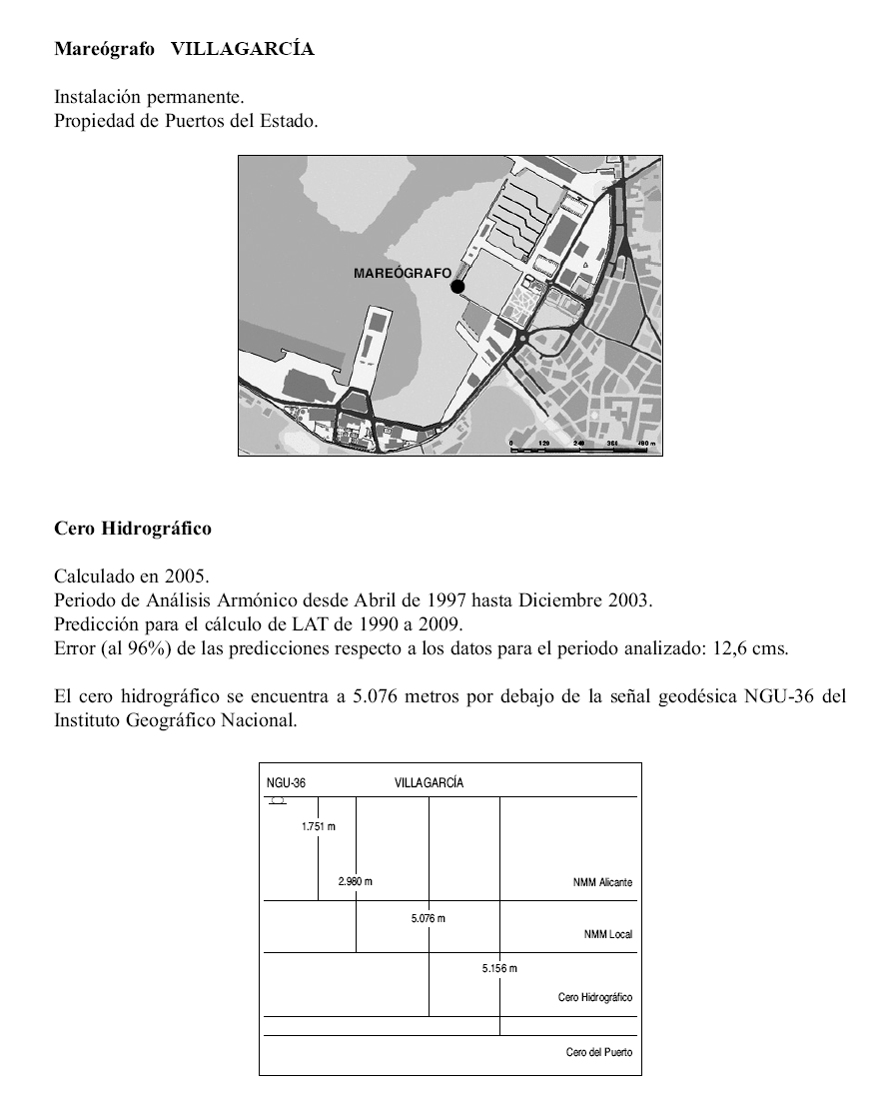
ZERO TIGE GAUGE
LOCAL MEAN SEA LEVEL
ZERO PORT
The datums are local datums and should not be extended to areas with different hydrographic characteristics without measures confirming that such extrapolation is valid.
​
The reference datum is permanently fixed to a local leveling network (3 benchmarks). These benchmarks may also be referred to as vertices or reference pins, and they are leveled relative to each other. This allows for the physical recovery of the datum to reinstall a tide gauge or verify it.

Slide 10
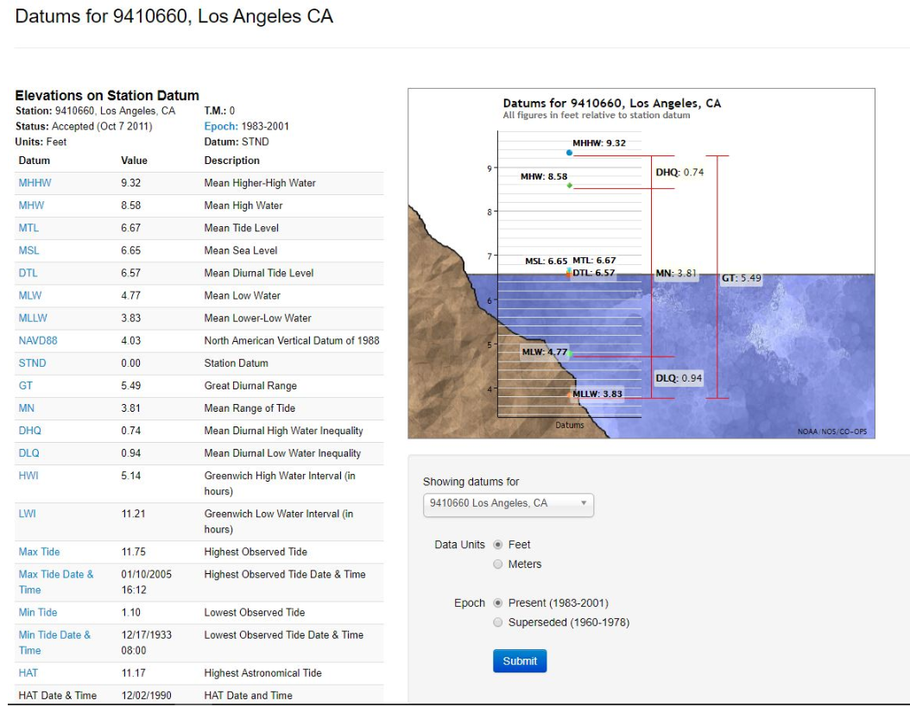

Slide 11
HAT Highest Astronomical Tide | The elevation of the highest predicted astronomical tide expected to occur at a specific tide station over the time period of 40 years. The 40 years period will include 2 National Tidal Datum Epoch periods. This time period will be updated every 20 years. The present values are based on the time period of 2000-2040.
MHHW* Mean Higher High Water | The average of the higher high water height of each tidal day observed over the National Tidal Datum Epoch. For stations with shorter series, comparison of simultaneous observations with a control tide station is made in order to derive the equivalent datum of the National Tidal Datum Epoch.
MHW Mean High Water | The average of all the high water heights observed over the National Tidal Datum Epoch. For stations with shorter series, comparison of simultaneous observations with a control tide station is made in order to derive the equivalent datum of the National Tidal Datum Epoch.
DTL Diurnal Tide Level | The arithmetic mean of mean higher high water and mean lower low water.
MTL Mean Tide Level | The arithmetic mean of mean high water and mean low water.
MSL Mean Sea Level | The arithmetic mean of hourly heights observed over the National Tidal Datum Epoch. Shorter series are specified in the name; e.g. monthly mean sea level and yearly mean sea level.
MLW Mean Low Water | The average of all the low water heights observed over the National Tidal Datum Epoch. For stations with shorter series, comparison of simultaneous observations with a control tide station is made in order to derive the equivalent datum of the National Tidal Datum Epoch.
MLLW* Mean Lower Low Water | The average of the lower low water height of each tidal day observed over the National Tidal Datum Epoch. For stations with shorter series, comparison of simultaneous observations with a control tide station is made in order to derive the equivalent datum of the National Tidal Datum Epoch.
LAT Lowest Astronomical Tide | The elevation of the lowest predicted astronomical tide expected to occur at a specific tide station over the time period of 40 years. The 40 years period will include 2 National Tidal Datum Epoch periods. This time period will be updated every 20 years. The present values are based on the time period of 2000-2040.

Slide 12
GT Great Diurnal Range | The difference in height between mean higher high water and mean lower low water.
MN Mean Range of Tide | The difference in height between mean high water and mean low water.
DHQ Mean Diurnal High Water Inequality | One-half the average difference between the two high waters of each tidal day observed over the National Tidal Datum Epoch. It is obtained by subtracting the mean of all the high waters from the mean of the higher high waters.
DLQ Mean Diurnal Low Water Inequality | One-half the average difference between the two low waters of each tidal day observed over the National Tidal Datum Epoch. It is obtained by subtracting the mean of the lower low waters from the mean of all the low waters.
HWI Greenwich High Water Interval | The average interval (in hours) between the moon's transit over the Greenwich meridian and the following high water at a location.
LWI Greenwich Low Water Interval | The average interval (in hours) between the moon's transit over the Greenwich meridian and the following low water at a location.
Max Tide Highest Observed Tide | The maximum height reached by a rising tide. The high water is due to the periodic tidal forces and the effects of meteorological, hydrologic, and/or oceanographic conditions.
Min Tide Lowest Observed Tide | The minimum height reached by a falling tide. The low water is due to the periodic tidal forces and the effects of meteorological, hydrologic, and/or oceanographic conditions.
Station Datum | A fixed base elevation at a tide station to which all water level measurements are referred. The datum is unique to each station and is established at a lower elevation than the water is ever expected to reach. It is referenced to the primary bench mark at the station and is held constant regardless of changes to the water level gauge or tide staff. The datum of tabulation is most often at the zero of the first tide staff installed.
National Tidal Datum Epoch | The specific 19-year period adopted by the National Ocean Service as the official time segment over which tide observations are taken and reduced to obtain mean values (e.g., mean lower low water, etc.) for tidal datums. It is necessary for standardization because of periodic and apparent secular trends in sea level. The present NTDE is 1983 through 2001 and is actively considered for revision every 20-25 years. Tidal datums in certain regions with anomalous sea level changes (Alaska, Gulf of Mexico) are calculated on a Modified 5-Year Epoch.

Slide 13
C) CRITERIA OF THE IHO
IHO’S LAW

Slide 14
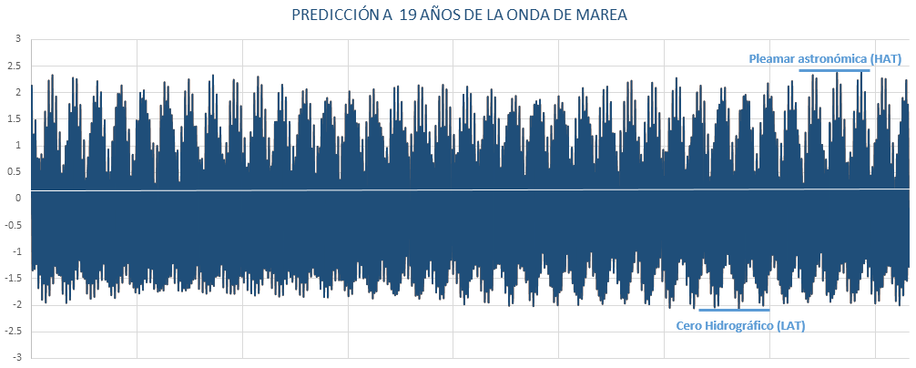
​
IHO nautical charts currently use a chart datum known as the "Lowest Astronomical Tide" (LAT). This datum is based on the lowest tide predicted over a 19-year period.
The LAT is determined for a specific location by first conducting a harmonic analysis of tidal observations. The harmonic components obtained are then used to predict tides over a 19-year period. The LAT corresponds to the lowest low water level predicted during that timeframe. The International Hydrographic Organization (IHO) has recommended its members adopt the LAT as the standard chart datum.
​

Slide 15
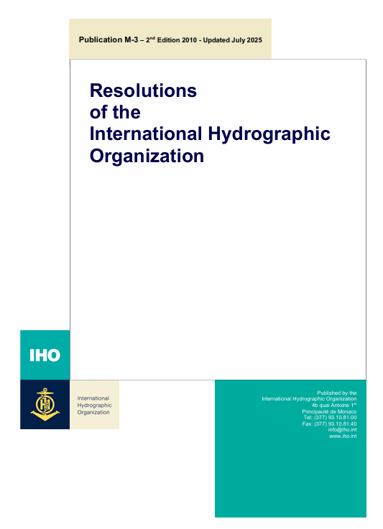
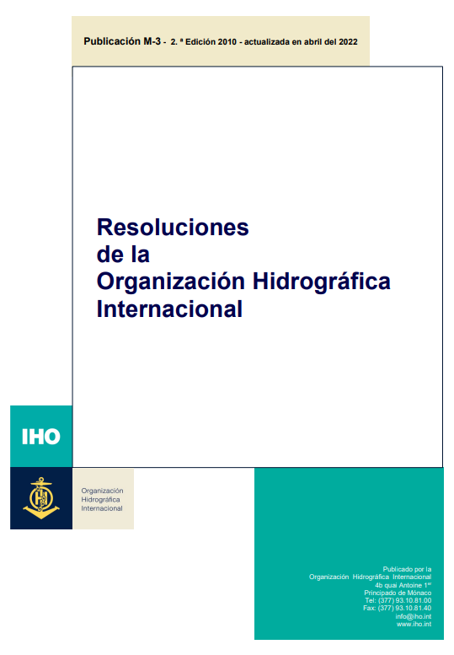

Slide 16
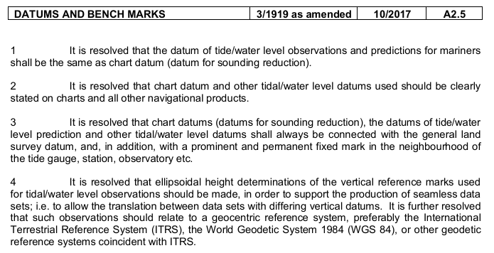




Slide 17
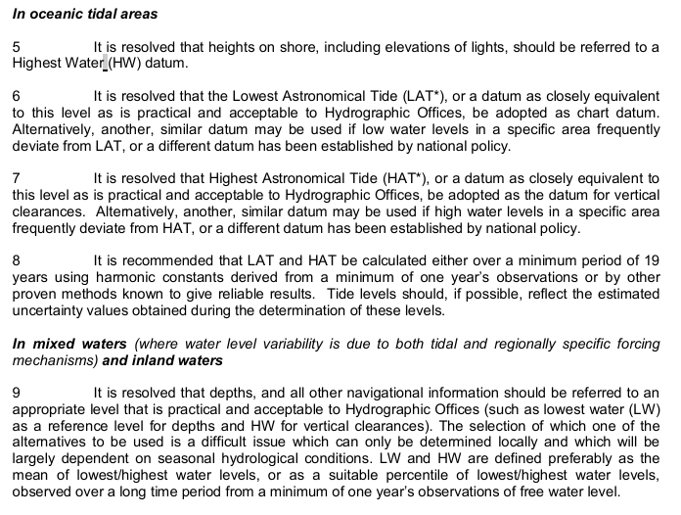
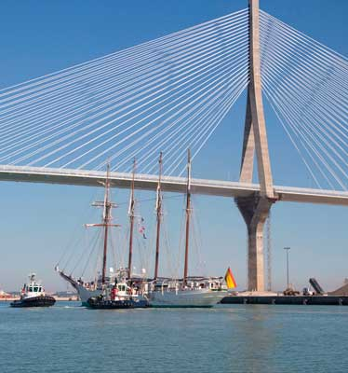












Slide 18
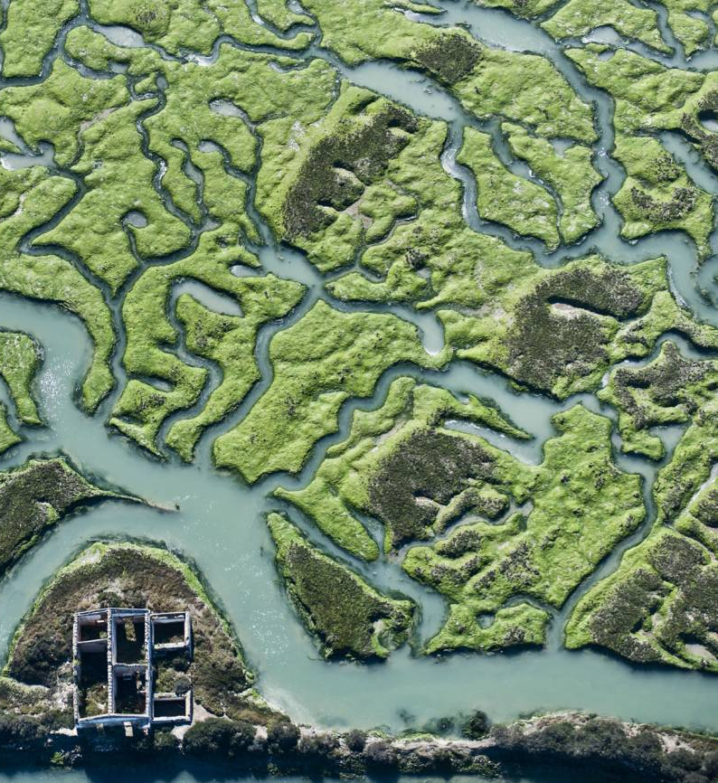
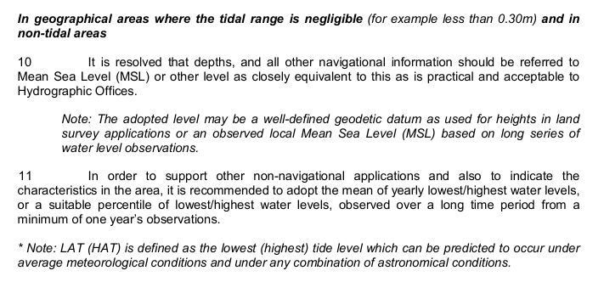



Slide 19
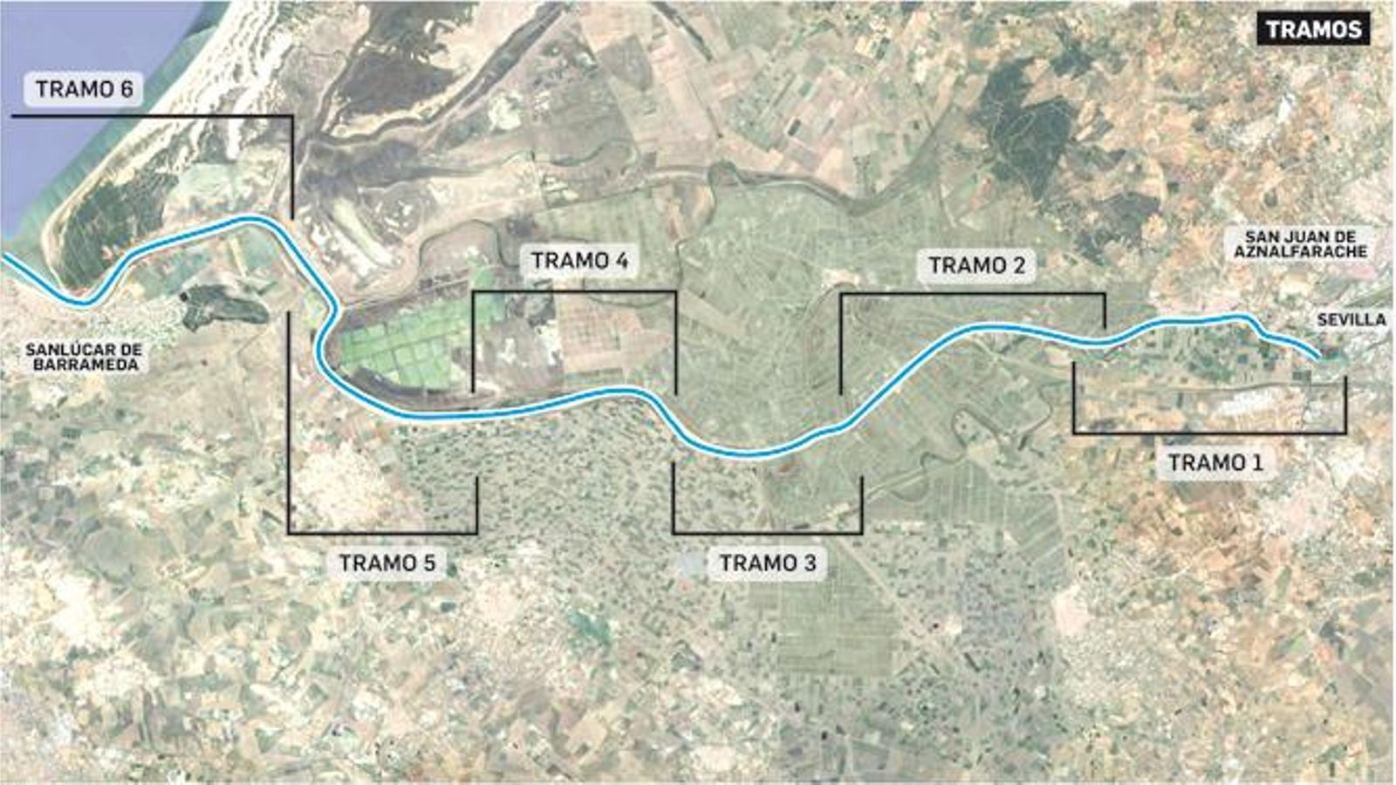
The relationship between the chart datum and the terrestrial survey datums is usually not mentioned on the charts, but should appear in national tide tables for reference by surveyors and engineers. (IHO, S-4 Regulations of the IHO for International (INT) Charts and Cartographic Specifications of the IHO, 2021). Paragraph B-405.6
In rivers and estuaries, on larger scales, it may sometimes be desirable to include a diagram indicating, by sections, the changes in the chart datum. (IHO, S-4 Regulations of the IHO for International (INT) Charts and Cartographic Specifications of the IHO, 2021) Paragraph B-405.7.
The zero tide gauge and sounding reduction (if applied) are part of the minimum metadata for an ocean sounding. (IHO, Resolutions of the International Hydrographic Organization, 2022). Ref. 4/1932 – Metadata for ocean soundings.
The chart datums (datums for sounding reductions), the datums for tide/sea level prediction, and other tide/sea level datums will always be linked to the general terrestrial survey datum and, furthermore, to a fixed, permanent, and prominent mark near the tide gauge, station, observatory, etc. (IHO, Resolutions of the International Hydrographic Organization, 2022). Ref. 3/1919. Datums and leveling marks.

Slide 20
It is resolved that the vertical datum used in nautical charts, the Hydrographic Zero (HZ), shall be unambiguously defined to enable subsequent bathymetric data comparisons to be conducted efficiently and reliably, as well as to allow the accurate merging of data sets utilizing different vertical datums. (IHO, Resolutions of the International Hydrographic Organization, 2022). Ref. 1/2008. Appeal Convention for the vertical datum of charts.
​
It is recommended to use a designated epoch, for example CD (2006) or LAT-UK (2000). The decision regarding the epoch at which a change of Hydrographic Zero (HZ) is necessary for a given area, as well as the name assigned to that specific definition of HZ, remains the responsibility of each Member State according to their national requirements. (IHO, Resolutions of the International Hydrographic Organization, 2022). Ref. 1/2008. Appeal Convention for the vertical datum of charts.
​
It has been resolved that, when unaltered soundings are accepted from original foreign charts, a note indicating the sounding reduction level used for each part of the area shall be included in the chart title; alternatively, this information may be included in the tide information panel of the chart. (IHO, Resolutions of the International Hydrographic Organization, 2022). Ref. 3/1947. Soundings taken from foreign charts.

Slide 21
C) CHART Datum all over the world
LET`S SEE FARAWAY OUR PORTS AND BEACHES.

Slide 22
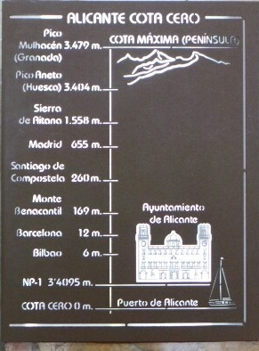
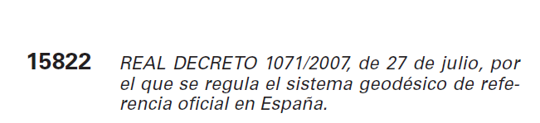
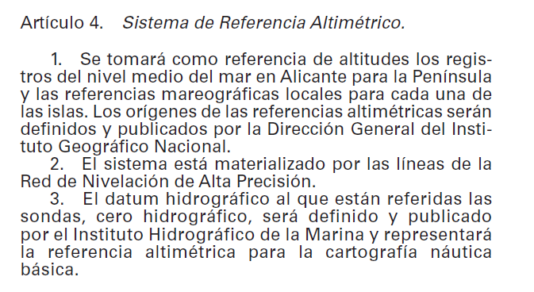
The first tide gauge was installed in Alicante in 1870 by the National Geographic Institute, with the mean sea level at this location serving as the origin of the National Geodetic Leveling Network.

Slide 23
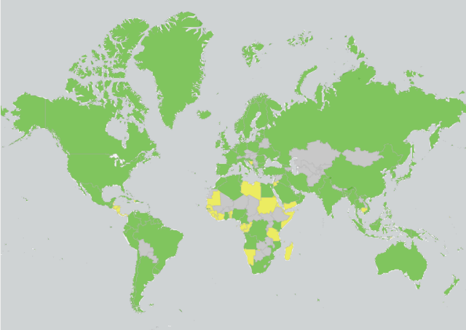
Some members of the OHI, such as the United Kingdom, France, and Spain, Tunisie adhere to its guidelines = LAT

Slide 24
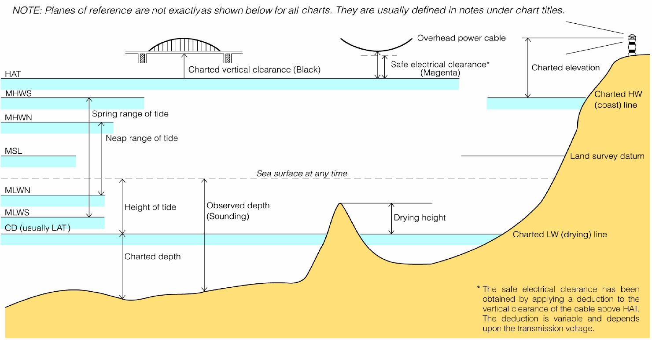
For example, in the coastal waters of the United States, bathymetric data and chart datums use the Mean Lower Low Water (MLLW).

Slide 25
Tide-less lagoons and bays along the US coast, where the area transitions from tidal to non-tidal, utilize a LWD obtained by subtracting 0.2 m from the local Mean Sea Level derived from observations and adjusted over a 19-year period.
The datum used in Canadian charts is the surface known as “Lower Low Water, Large Tide” or LLWLT, which represents the mean of the annual lowest tide for each year based on a 19-year prediction.
In the Great Lakes of Canada and the US, the standard requires referencing fixed low water datums (LWD) for each lake, based on the analysis of monthly averages during low water states.
The chart datums used in some British Admiralty Charts were the Mean Low Water Springs (MLWS) and Indian Spring Low Water (ISLW). The ISLW values are derived from summations of amplitudes of several major harmonic components below the local Mean Sea Level.
In the Black Sea, the Average Water Level is employed.

Slide 26
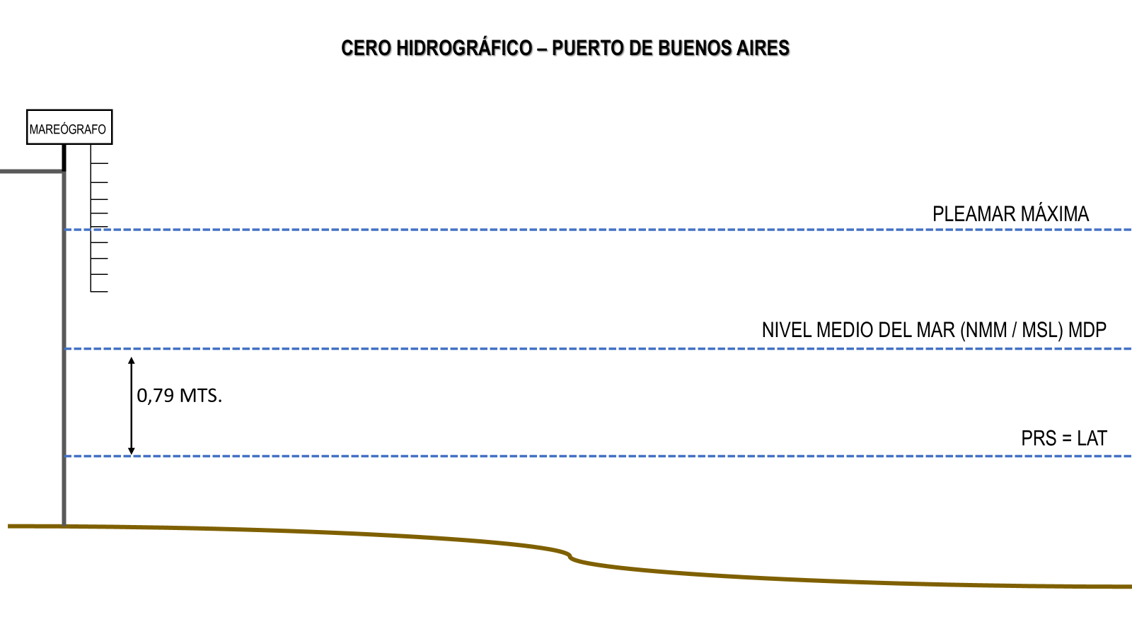
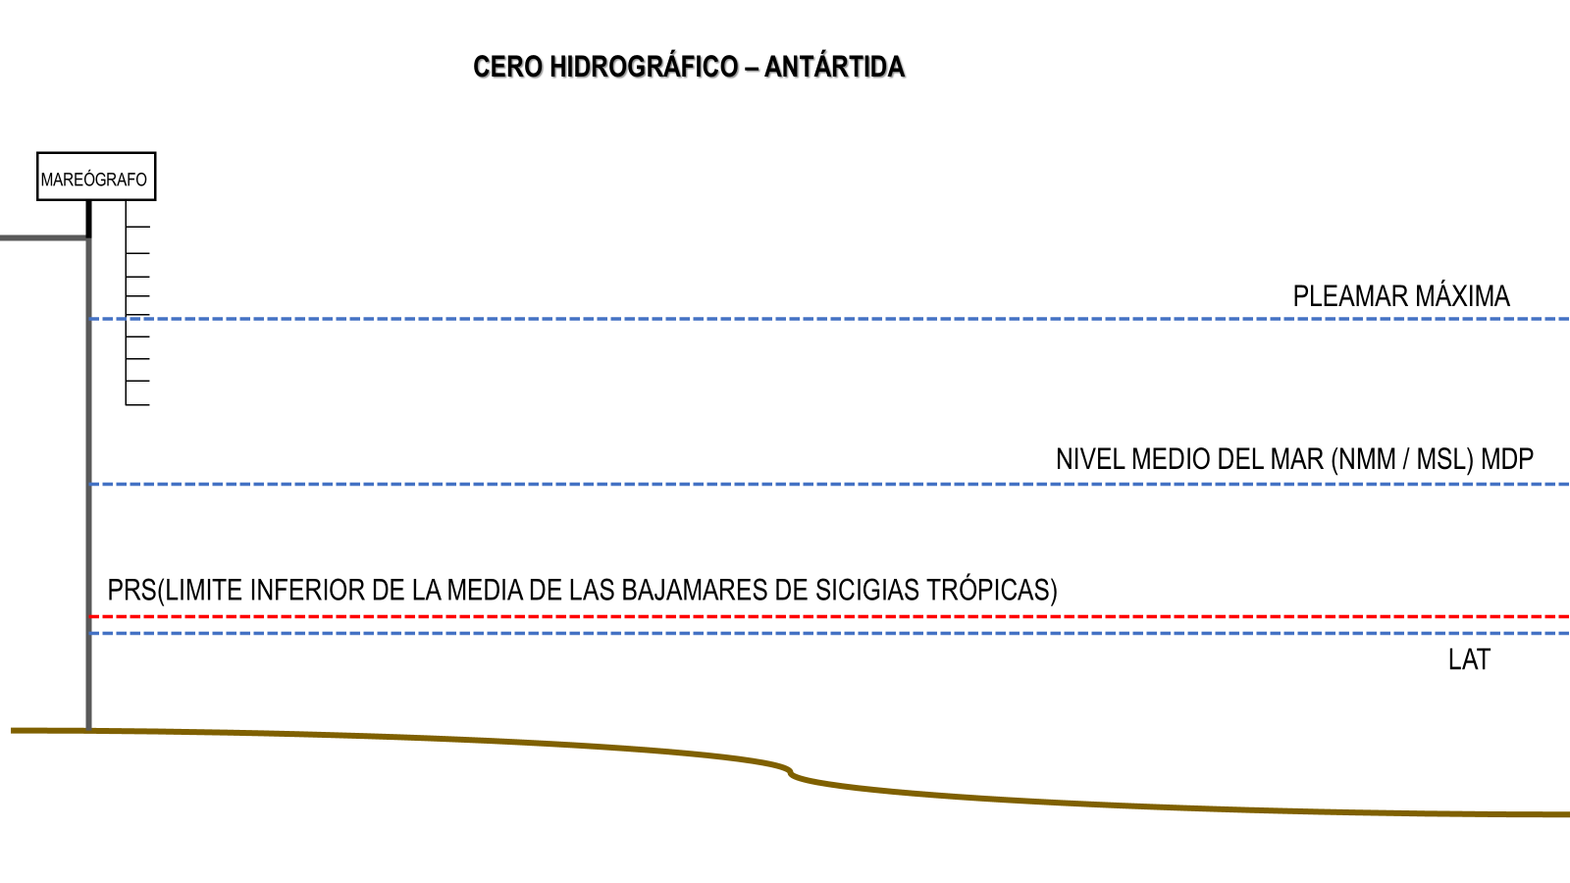
ARGENTINA ADOPTS THE LAT (LOWEST ASTRONOMICAL TIDE) FOLLOWING THE RECOMMENDATIONS OF THE IHO.
​
IN ANTARCTICA, THE LOWER LIMIT OF THE MEAN OF TROPICAL SPRING TIDES IS USED.

Slide 27

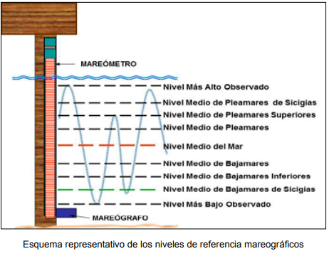
PERU
ESTABLISHES AS THE VERTICAL REFERENCE DATUM FOR CHARTS THE MEAN LOW WATER SPRING TIDE LEVEL (MLWSTL), WHICH ALSO SERVES AS THE HYDROGRAPHIC ZERO.

Slide 28
e) HYDROGRAPHIC REFERENCE MODELS
FROM ONE POINT TO A SURFACE

Slide 29
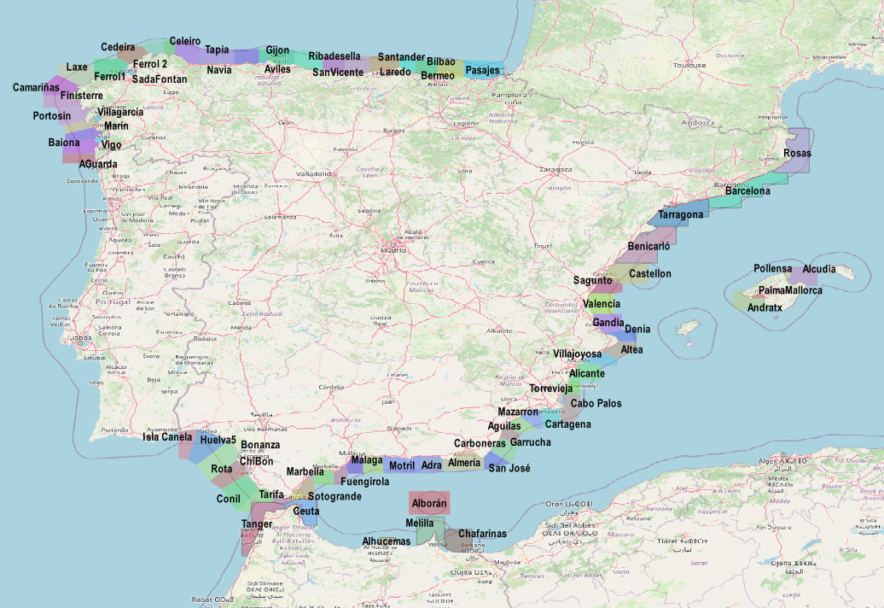
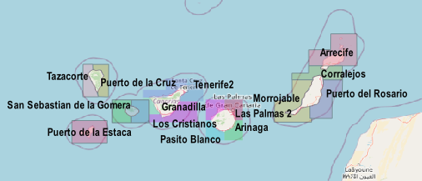

Slide 30
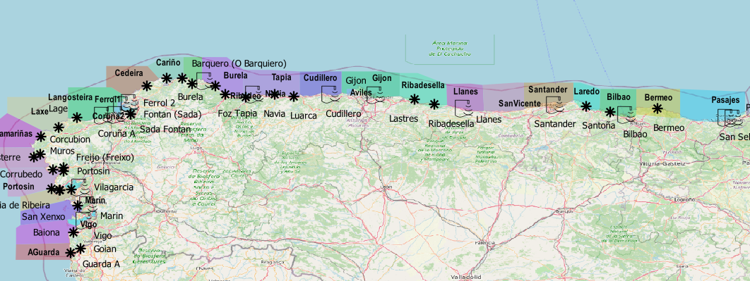
 | GIJÓN | CUDILLERO | ≠
1/08/2023 | 02:48 | 02:47 | +1’
8/08/2023 | 08:19 | 08:20 | -1’
16/08/2023 | 03:31 | 03:31 | +1’
24/08/2023 | 08:04 | 08:04 | 0’
 | GIJÓN | CUDILLERO | ≠ (m)
1/08/2023 | 3.92 | 3.79 | 0.13
8/08/2023 | 3.48 | 3.34 | 0.14
16/08/2023 | 3.67 | 3.56 | 0.11
24/08/2023 | 3.3 | 3.19 | 0.11

Slide 31
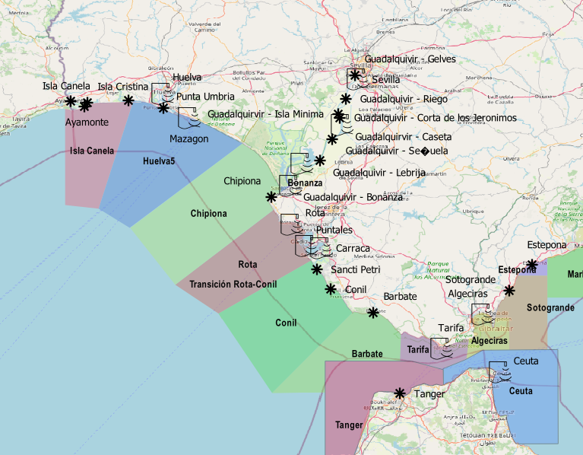
Isla Canela | ≠ | Huelva | ≠ | Chipiona
3.05 | -0.2 | 3.25 | +0.01 | 3.24
2.72 | -0.15 | 2.87 | +0.02 | 2.85
2.85 | -0.21 | 3.06 | +0.02 | 3.04
2.56 | -0.15 | 2.71 | +0.03 | 2.68
 | Isla Canela | ≠ | Huelva | ≠ | Chipiona
1/08/2023 | 01:44 | +6’ | 01:38 | +9’ | 01:29
8/08/2023 | 07:21 | +6’ | 07:15 | +7’ | 07:08
16/08/2023 | 02:23 | +4’ | 02:19 | +6’ | 02:13
24/08/2023 | 07:00 | -1’ | 07:01 | +9’ | 06:52

Slide 32
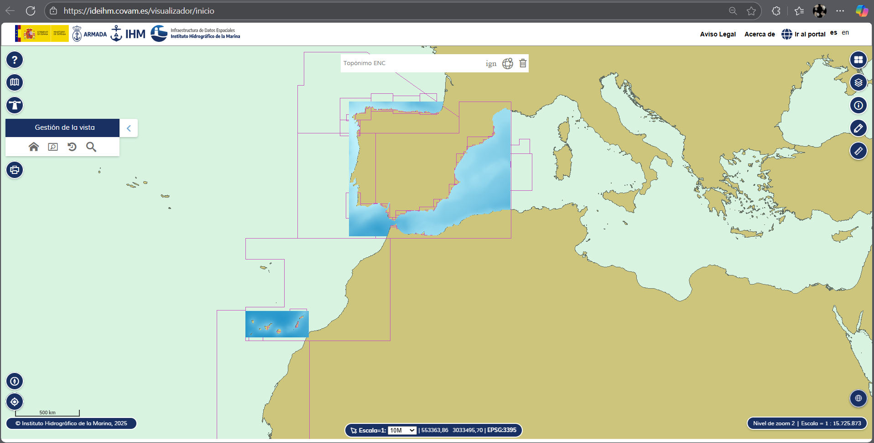

Slide 33
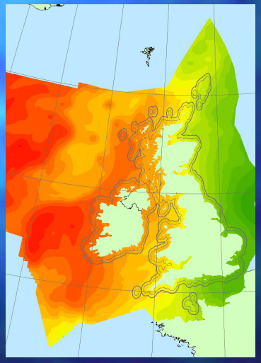
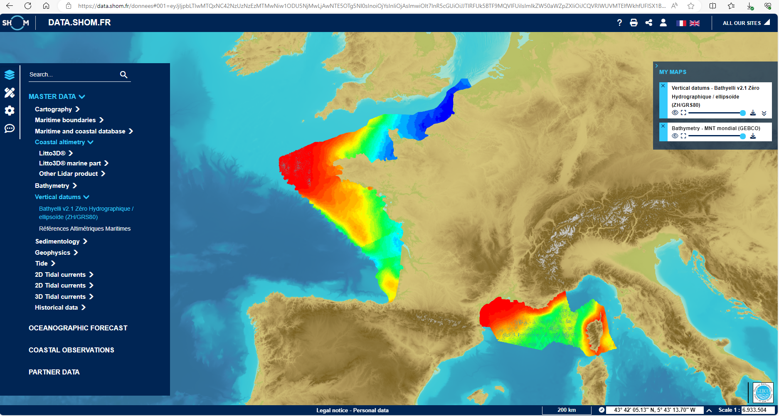

Slide 34
Notes:
Esta diapositiva no se debe de modificar ya que es la que permite el cierre con el efecto del escudo reduciéndose

