Slide 1
Sea level data quality control and processing
Angela Hibbert
Caribbean Training Course Barbados 17th-21st November

Slide 2
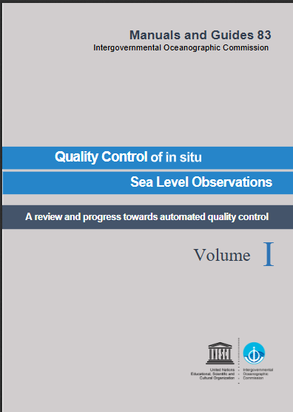
Principles of Quality Control
“To ensure the data consistency within a single data set and within a collection of data sets and to ensure that the quality and errors of the data are apparent to the user who has sufficient information to assess its suitability for a task.” (Unesco, 1993)

Slide 3
Benefits of Quality Control
By maintaining common standards and a minimum level to which all sea level data should be quality-controlled, consistency can be achieved between data centres
This ensures data reliability and strengthens the reputation of research that draws on sea level data
Helps to align tide gauge data with 'FAIR' Guiding Principles for scientific data management. These aim to ensure that data are ‘Findable, Accessible, Interoperable, and Re-useable’

Slide 4
The Importance of Tide Gauge Maintenance Logs
Quality control starts with: Good maintenance Good record keeping
So, keep thorough maintenance records and ensure that they are to hand when quality controlling a time series.
This helps to identify whether errors are random (e.g. malfunctions or bad readings)
or systematic: a change in practice (e.g. a change from spot readings to averages)
a change in instrumentation (e.g. a sensor change)
a change in environment (e.g. construction nearby, dredging etc)
A summary of such changes should form part of the metadata for a time series

Slide 5
The Importance of Tide Gauge Maintenance Logs
Metadata should include:
Time zone and timestamping of the data
Sampling rates and averaging periods
Instrumentation, manufacturer, model, serial number
Installation and maintenance dates
Details of any calibrations, dates and offsets from those
Geographic location (latitude, longitude, coordinate system) and any pertinent environmental information (e.g. sited in an estuary or within a stilling well)
Datum information (chart datum, national datum)
Levelling information (regularity of levelling, benchmark heights etc)
The IOC Quality Control Manual contains a template for recording comprehensive metadata

Slide 6
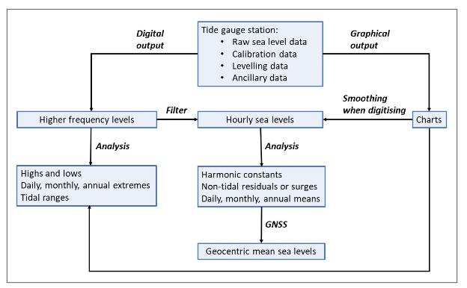
Principles Of Quality Control
Some problems will be obvious when examining a time series e.g. gaps and outliers, but others won’t become clear until the tide is removed, so we follow a clear process:

Slide 7
Removal of Tides for Quality Control
Tides often dominate a sea level record, masking some true features (e.g. tsunamis, seiches) as well as errors, so separation of tidal and non-tidal components is important and facilitates data quality control
Observed
An example from Port Stanley Nov-Dec 2004
Tidal prediction

Slide 8
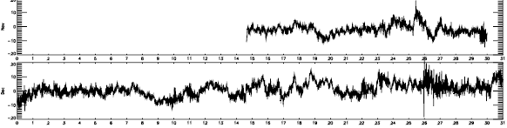
Non-tidal record
Non-tidal record shows:
1. No big storm surges (Southern Hemisphere summer)
2. A lot of high-frequency noise of a few cm due to harbour seiches
3. On 27 December arrival of the Sumatra tsunami
➔ None of this is evident from looking at the total observed record

Slide 9
Benefits of Tidal Analysis
The separation of the sea level record into tidal and non-tidal components is needed to produce tide tables or tidal predictions
The non-tidal signals (seiches, tsunamis) become clearly identified
Tidal analysis facilitates quality control, allowing errors in the sea level time series to be identified
Some errors in a time series might be obvious before performing tidal analysis, but it is an essential precautionary step.
We will learn more about tidal analysis tomorrow. For now, lets look at some common errors in tide gauge records…….

Slide 10
Common errors in tide gauge records
Spikes, jumps or ‘stuck’ data due to instrumental faults
Some spikes or jumps might be real features of a record (e.g a tsunami) so they can be evaluated by ‘buddy checking’ with data from a neighbouring location and flagged, if appropriate
Missing data
Reference level changes
Timing errors
Drift
These errors can be fixed in the final data set - the Quality Controlled Delayed-Mode data set.

Slide 11
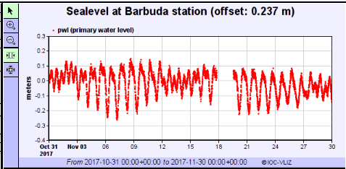
Obvious errors in a raw time series - Gaps
Small gaps of up to an hour can be interpolated but longer gaps like this cannot be corrected
Is this a telemetry failure? Check other nearby sites
Can the missing data be recovered from the data logger?

Slide 12
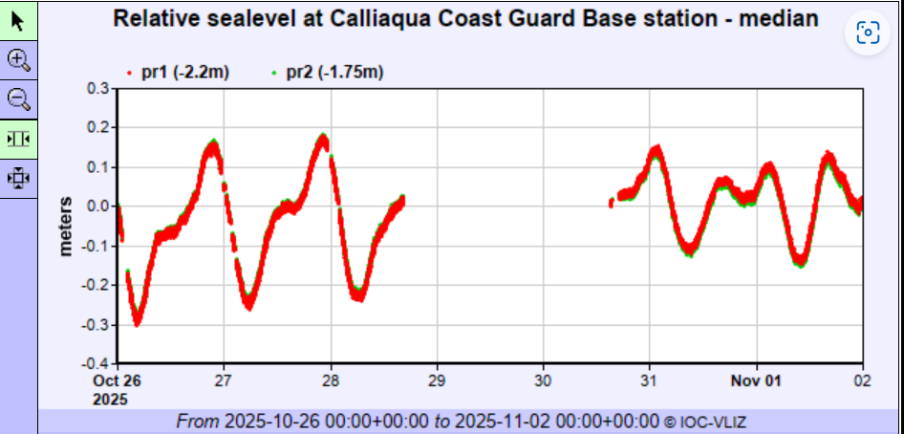
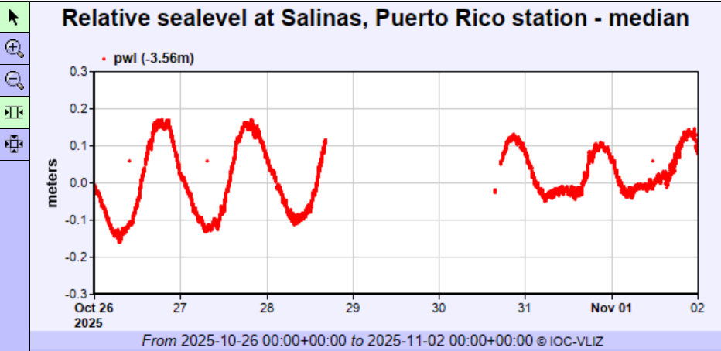
Obvious errors in a raw time series - Gaps
This was a regional telemetry failure seen at various locations including Puerto Rico and St Vincent and the Grenadines

Slide 13
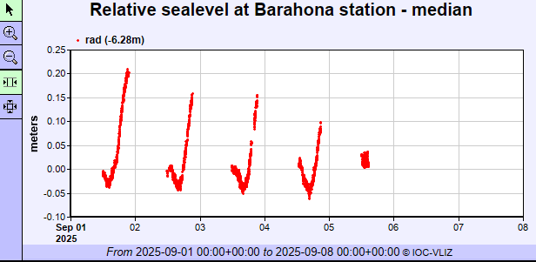
Obvious errors in a raw time series - Gaps
Do the gaps appear at a neighbouring station?
Notes:
Dominican republic

Slide 14
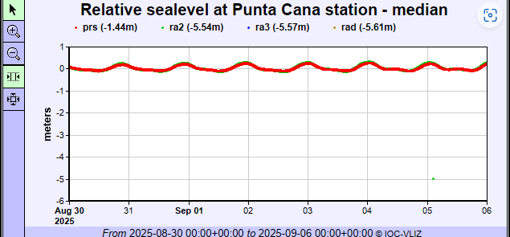
Obvious errors in a raw time series - Gaps
Do the gaps appear at a neighbouring station?
No
Notes:
Dominican Republic

Slide 15
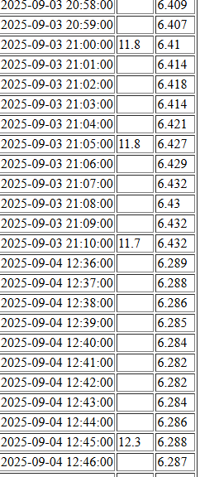
Obvious errors in a raw time series - Gaps
This appears to be a recurring problem during hours of darkness. Is it a solar powered tide gauge with a battery that isn’t retaining a charge?
Advise tide gauge technician to check/change the battery?
Notes:
Dominican republic

Slide 16
Obvious errors in a raw time series – Spikes or outliers
This looks like a recurring error with the instrumentation
This could be corrected by interpolation, but you should advise the tide gauge technician to investigate and eliminate the problem at the next site visit

Slide 17
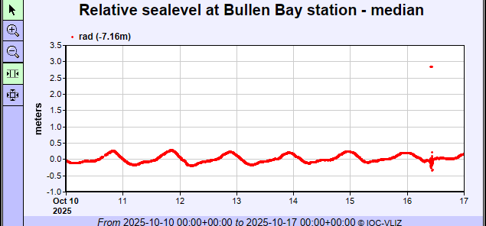
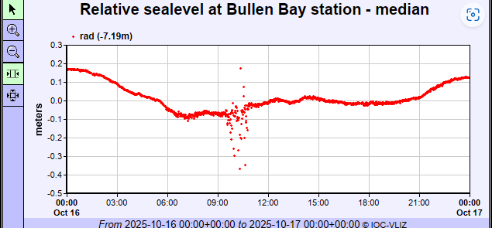
Obvious errors in a raw time series – Spikes or outliers
No neighbouring gauge to compare
Lots of noise
What were the local conditions?
Needs further investigation
Notes:
Curacao

Slide 18
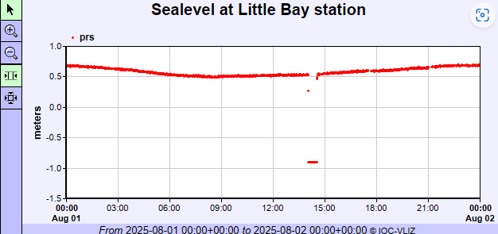
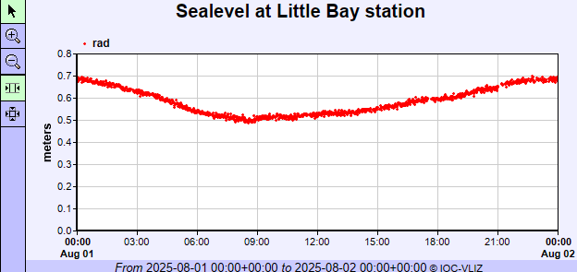
Obvious errors in a raw time series – Spikes or outliers
In this case, the pressure sensor is affected but the radar sensor is fine. The gap is less than one hour so can be interpolated.
Notes:
Montserrat

Slide 19
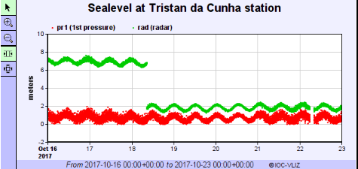
Obvious errors in a raw time series – Datum shifts
In this case, the radar sensor exhibits a datum shift (i.e. a sudden change in the mean level), but the pressure sensor is fine.
In fact, the radar had just been installed and was being programmed with an offset to report relative to a local datum
This was verified by consulting maintenance records
Notes:
Montserrat

Slide 20
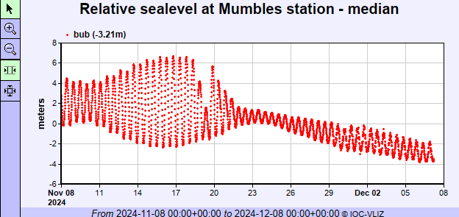
Obvious errors in a raw time series – Drift
The mean level gradually shifts up or downwards.
In this case, the downward drift is accompanied by reduced amplitude in the tidal cycle
This looks like a compressor failure in a bubbler system
Everything following the failure is suspect data and should be flagged

Slide 21
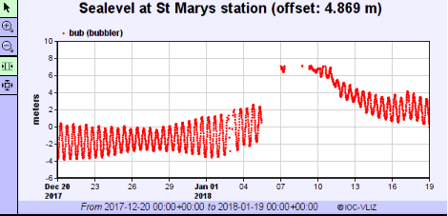
Obvious errors in a raw time series – Multiple problems!
In this case, there are some small gaps, upward drift, larger gaps and downward drift
This tide gauge suffered a few power failures during a storm surge (hence the data gaps) and came away from its fixings to the harbour wall, producing drift in the time series.

Slide 22
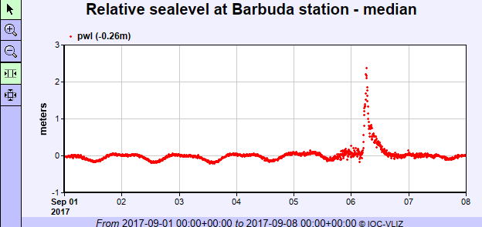
A word of caution…..
Some true features of a sea level record can look erroneous!
Hurricane Irma

Slide 23
Subtle errors in a raw time series, identifiable after tidal analysis
Timing Errors
Green – observation
Blue – tidal prediction
Pink – non-tidal residual

Slide 24
Quality Control Software
Quality control checks are automated in some software packages, but others rely on visual inspection of a time series.
Automatic QC software may detect:
constant values
near-constant values
out of range values
isolated spikes or clustered spikes
It is less capable of detecting datums shifts, drift and timing errors
Important! Even automatically quality controlled time series will require some final visual checks to be performed before a Quality Controlled Delayed-Mode data set is produced.

Slide 25
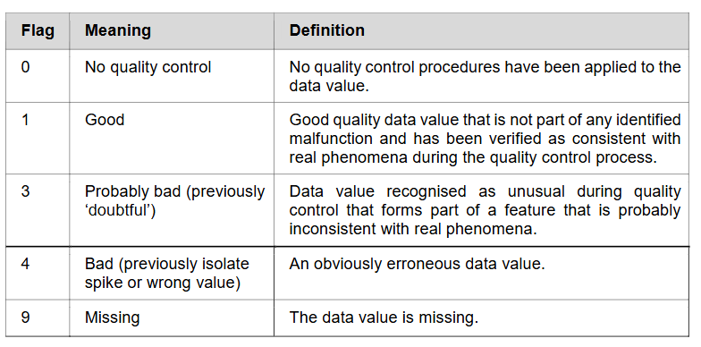
Quality Control Software
QC software allows data to be corrected or flagged. GLOSS recommended flags are shown below:

Slide 26
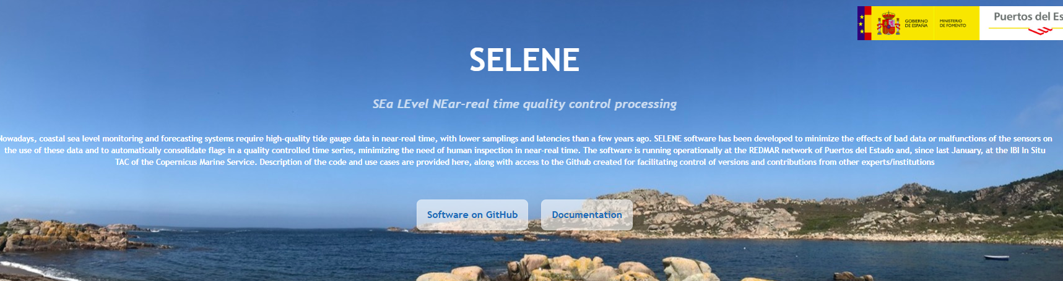
Quality Control Software
Sources of automated quality control software:
https://puertos-del-estado-medio-fisico.github.io/SELENE/
Open source software

Slide 27
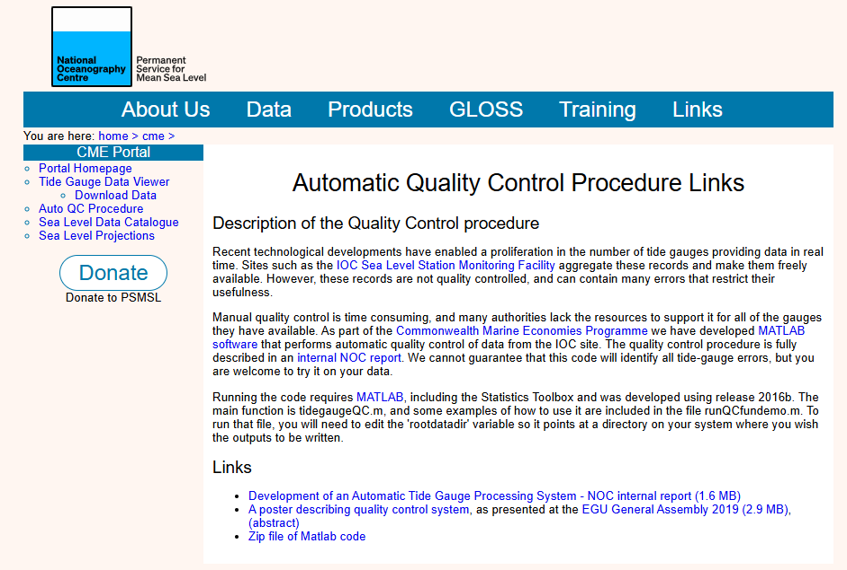
Quality Control Software
Sources of automated quality control software:
https://psmsl.org/cme/autoqc.php
Matlab-based software

Slide 28
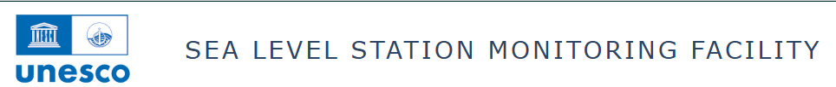
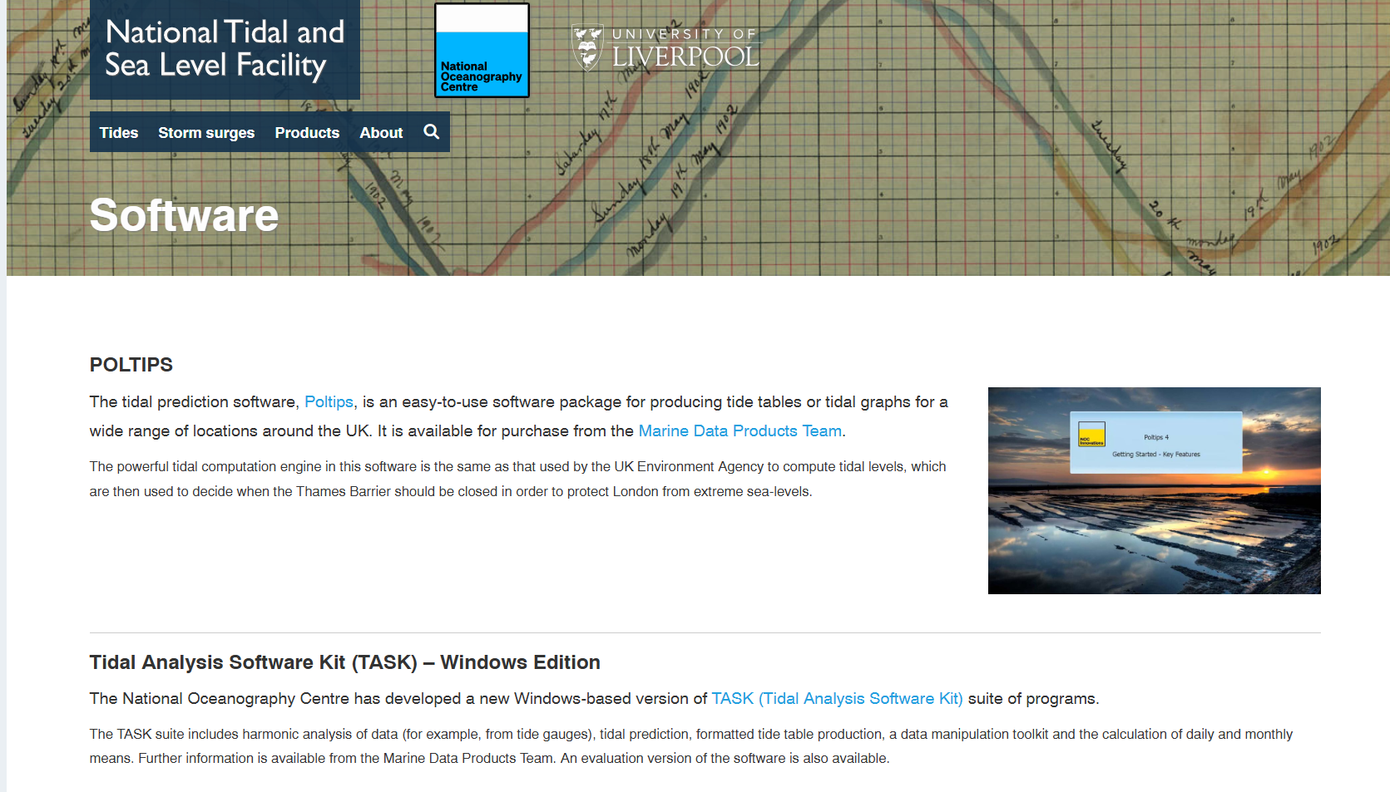
Quality Control Software
Sources of automated quality control software:
Coming soon….
Open source, with training courses TBD
Sources of delayed mode quality control software:
TASK and POLTIPS (https://ntslf.org)

Slide 30
Sea level data quality control Quiz
Angela Hibbert
Caribbean Training Course Barbados 17th-21st November

Slide 31
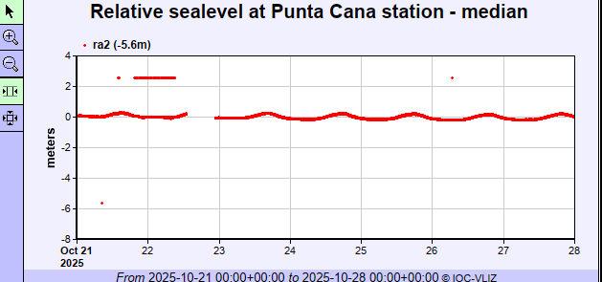
What’s the problem? What action do we take?

Slide 32
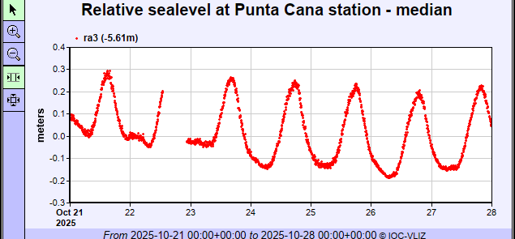
What’s the problem? What action do we take?
There are obvious outliers and a gap in this record
There are some constant or near-constant values requiring investigation
Compare with other channels
Advise the tide gauge technician
Interpolate outliers for up to 1 hr. Flag others as suspect

Slide 33
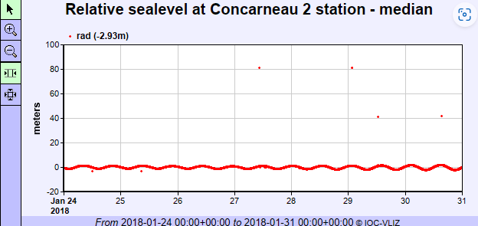
What’s the problem? What action do we take?

Slide 34
What’s the problem? What action do we take?
Check second sensor (none exists)
Interpolate the outliers and small spikes

Slide 35
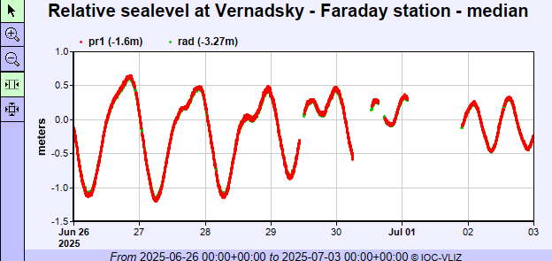
What’s the problem? What action do we take?

Slide 36
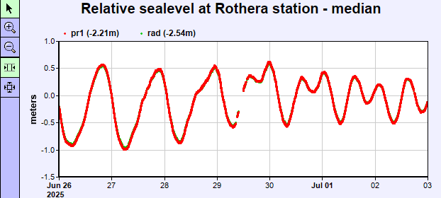
What’s the problem? What action do we take?
Interpolate small gaps
Check neighbouring gauges
Possible telemetry outage affecting both stations, but Vernadsky is worse-affected.
Contact tide gauge technician to investigate

Slide 37
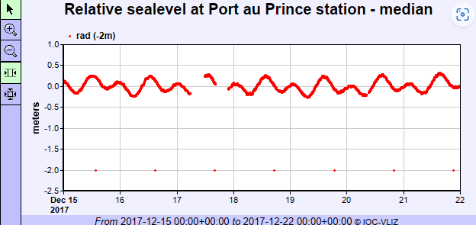
What’s the problem? What action do we take?

Slide 38
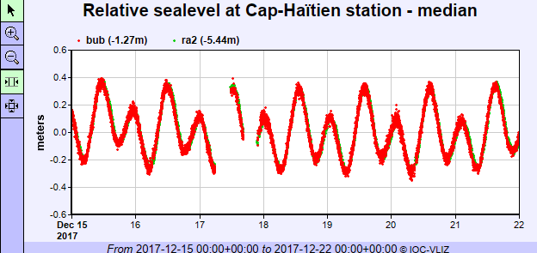
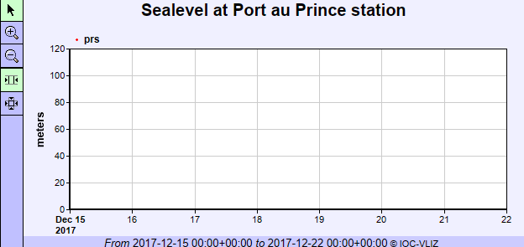
What’s the problem? What action do we take?
A recurring outlier - interpolate the outliers and ask the tide gauge technician to investigate
Large gaps - Check for other sensor(s) and neighbouring gauges. Second sensor is not operational, but nearby gauge shows similar gaps – likely to be a telemetry issue

Slide 39
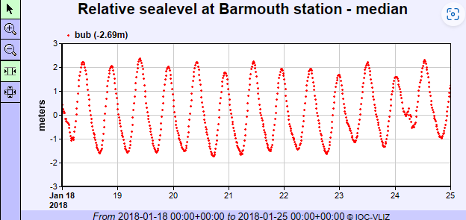
What’s the problem? What action do we take?

Slide 40
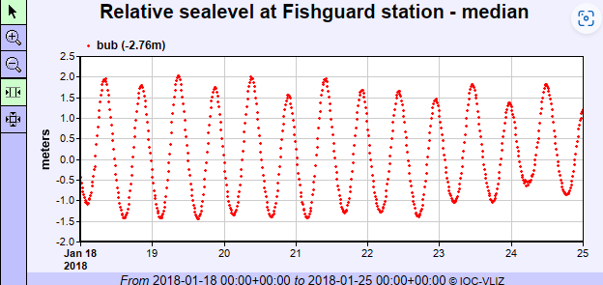
What’s the problem? What action do we take?
Fluctuations at Low Water on the 18th and 24th Jan
Check for second sensor (none)
Check neighbouring gauge (no similar patterns)
Contact tide gauge technician
The bubbler system is attached to the leg of a road bridge with small eddies forming around the pillars of the bridge, moving sediment near the bubbler outlet. The pneumatic lines to the bubbler were becoming blocked by sediment, so the system was purged by blasting compressed gas through the system.

Slide 41
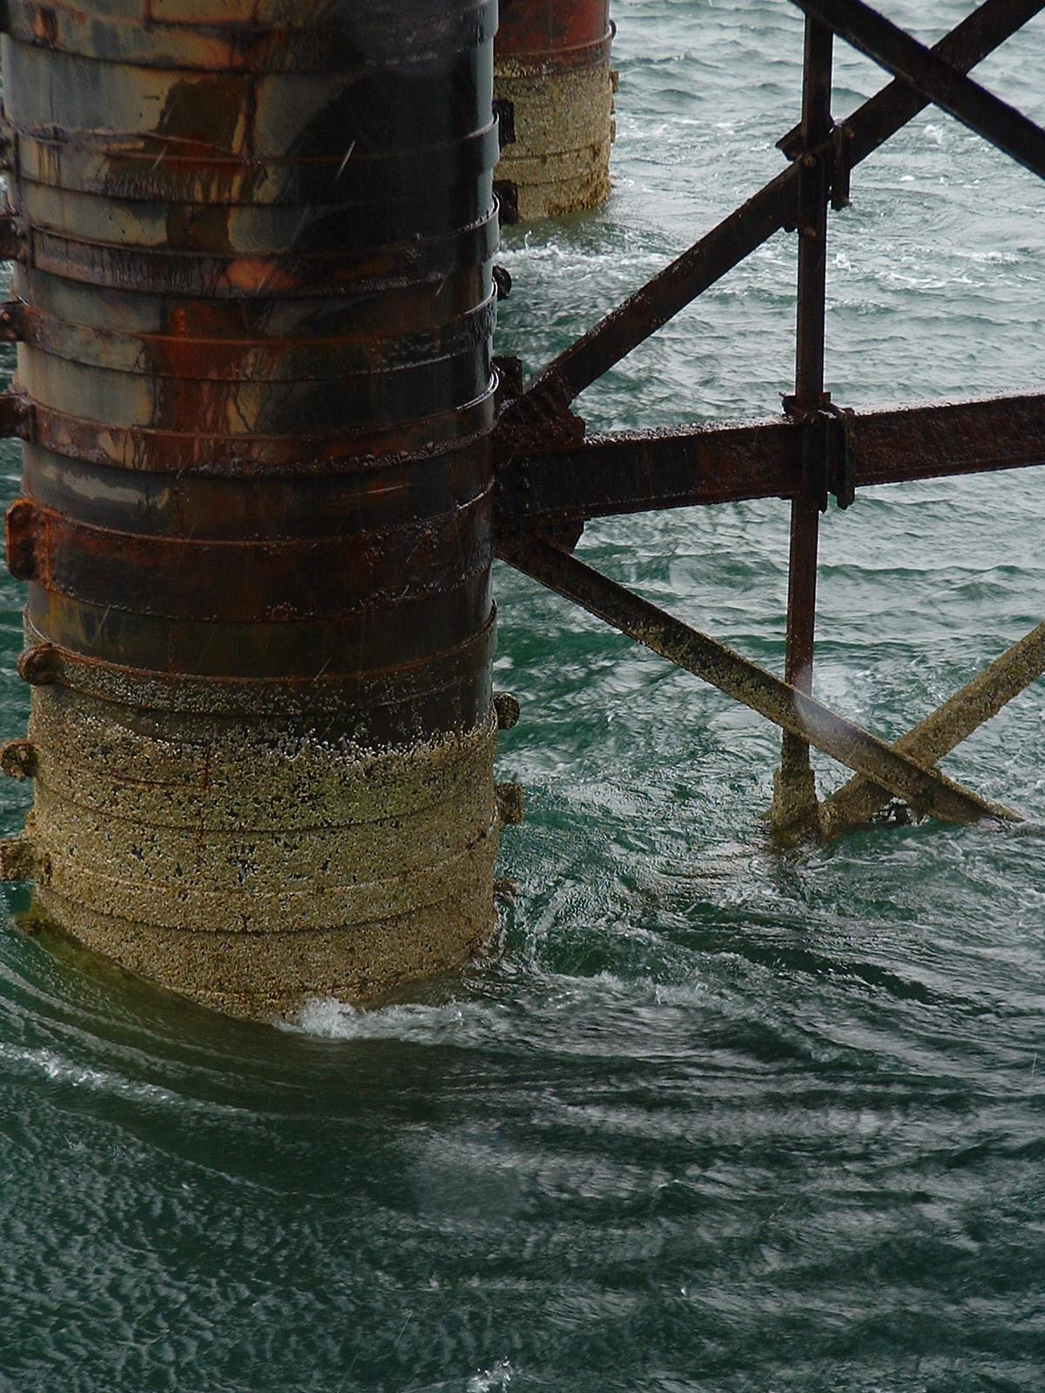
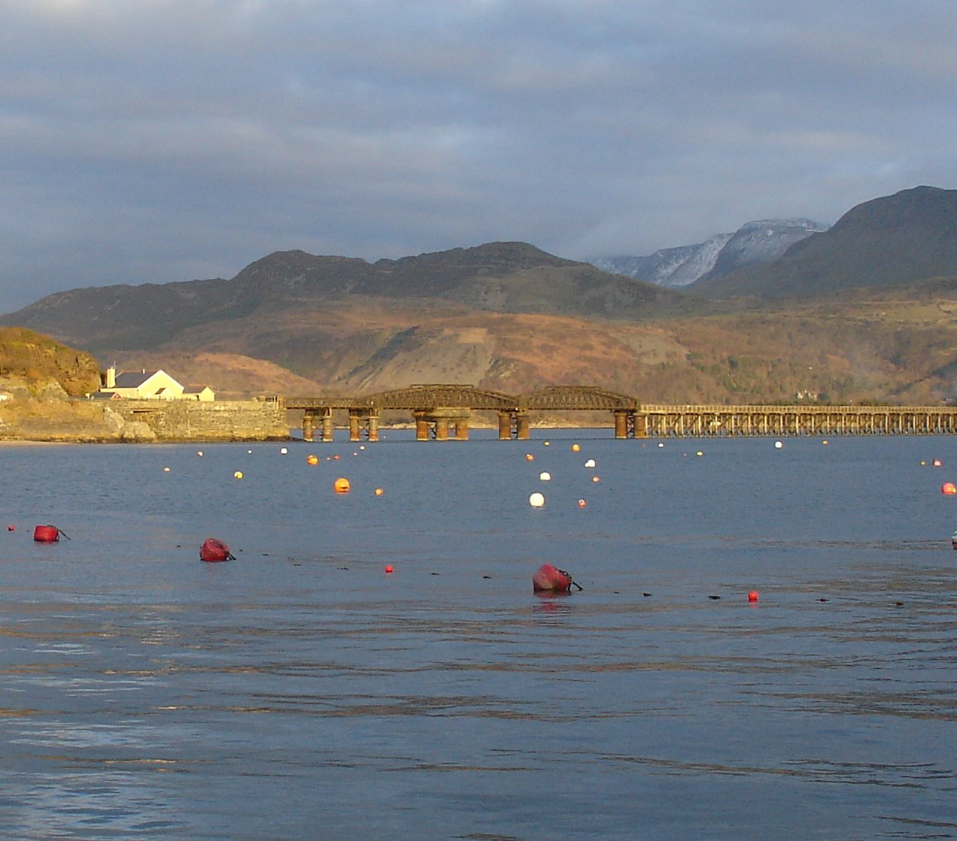
What’s the problem? What action do we take?
The bubbler system is attached to the leg of a road bridge with small eddies forming around the pillars of the bridge, moving sediment near the bubbler outlet. The pneumatic lines to the bubbler were becoming blocked by sediment, so the system was purged by blasting compressed gas through the system.

Slide 42
What’s the problem? What action do we take?

Slide 43
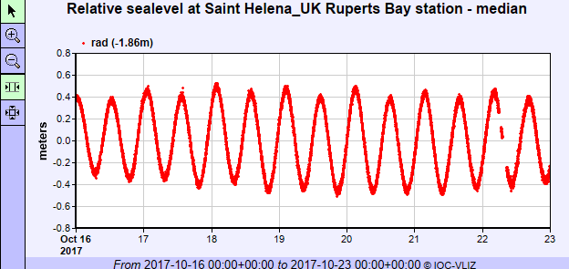
What’s the problem? What action do we take?
Datum shift – contact tide gauge technician and check maintenance log. This related to the application of an offsets in the radar during setup
Data gaps – check neighbouring gauge. One of the gaps appears to match, therefore may be a telemetry outage

