Slide 1
Ioc tides training course 17 – 21 November 2025 Bridgetown, barbados

Slide 2
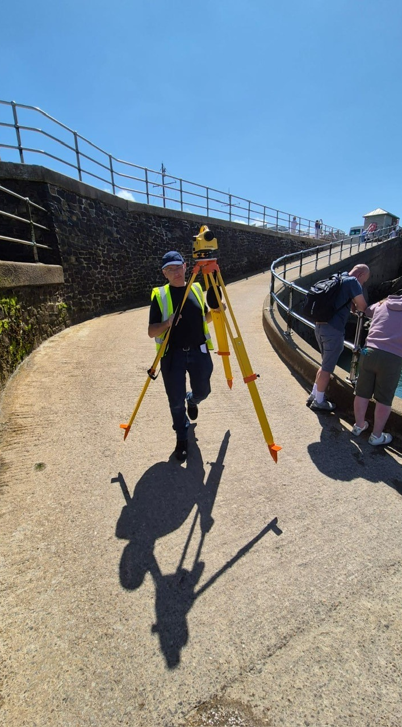
Classroom theory on geodetic levelling (optical method)
Geoff Hargreaves and simon Williams (NOC)

Slide 3
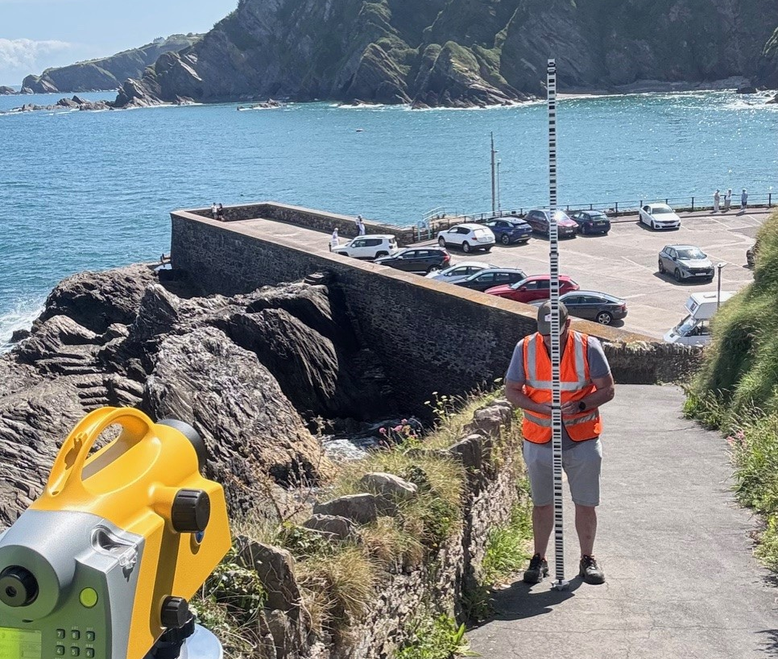
What is levelling?
Levelling is the method of determining height differences using a horizontal line of sight.
In hydrographic surveying, levelling is used to connect tide poles and tide gauge Contact Points to benchmarks on the nearby land.

Slide 4
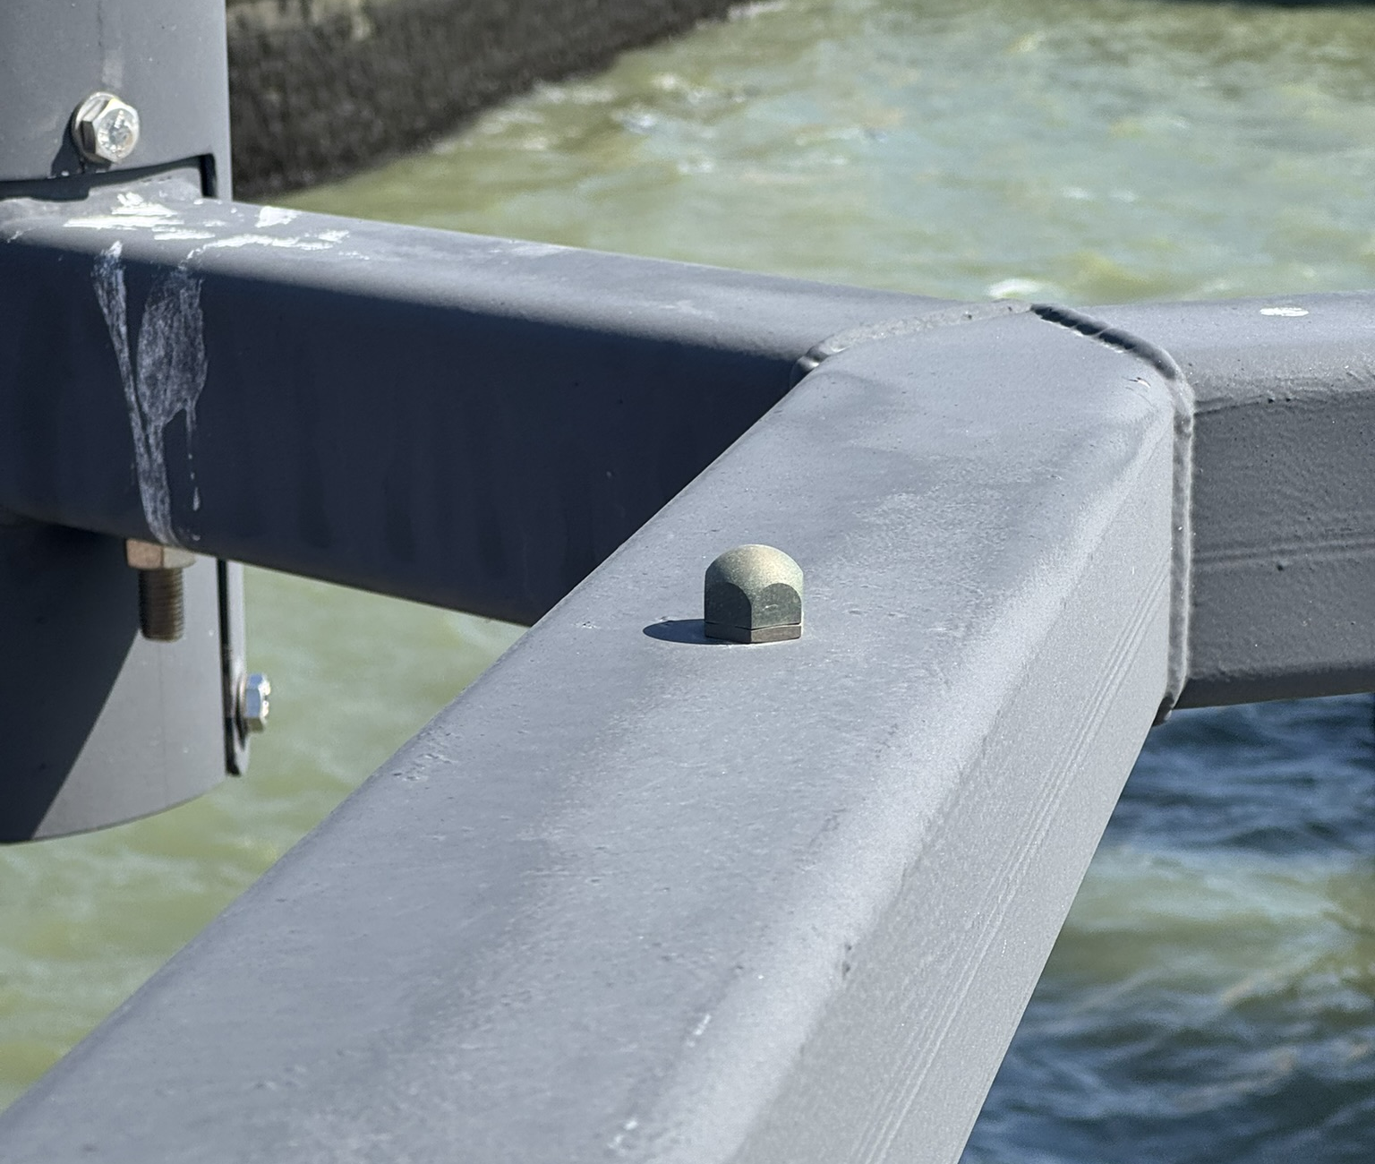
Why do we undertake levelling?
We want to relate the heights of various marks, such as a tide gauge Contact Point (CP) or Tide Gauge Benchmark (TGBM) and ancillary marks to each other, to check the stability of the local height relationships.
We may also need to relate tide gauge heights to national levelling systems.
Relating heights over short distances (i.e. metres to 100s metres) is performed by conventional levelling.

Slide 5
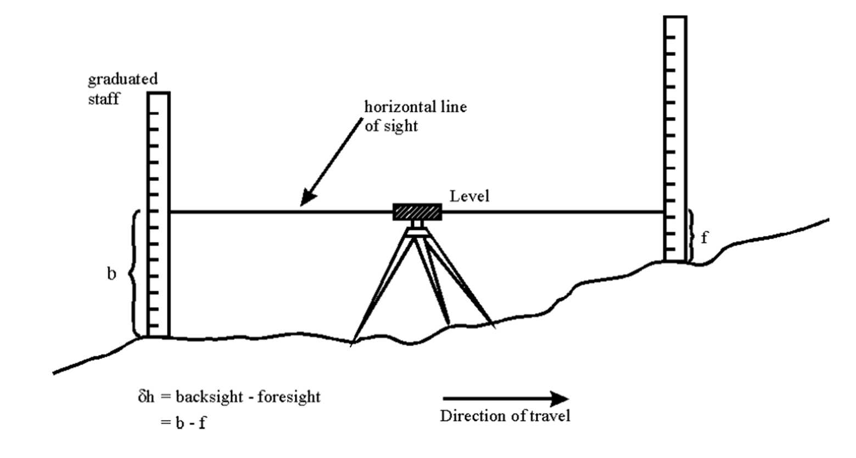
How is levelling done?
Start at a benchmark with a known value – Point A.
Set up the level on a tripod midway between Point A and Point B.
Place the staff on Point A benchmark and note the staff reading – this is the backsight value.
Move the staff to Point B (do not move the tripod) and place it on the reference point we want to measure, note the staff reading – this is the foresight value.
Point A
Point B

Slide 6
Calculating the new height value
Height difference between Point A and Point B is determined by:
δh = backsight value – foresight value
If A_{h} = height value of Point A then
B_{h} = A_{h} + δh
Where B_{h} is the height value of Point B
Height values are called Reduced Level
Point A
Point B

Slide 7
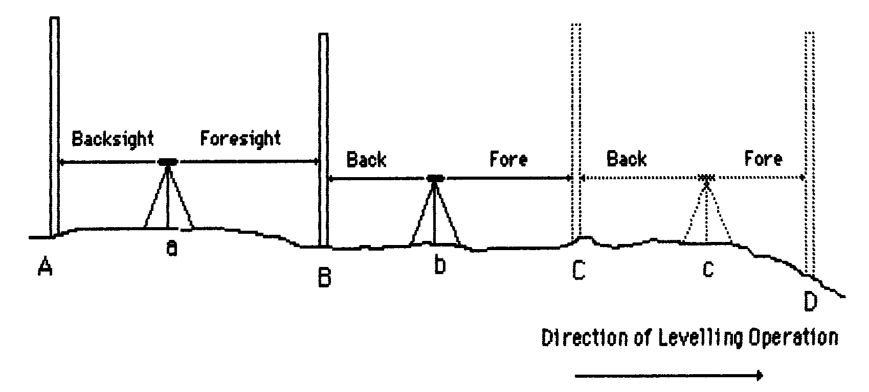
What if there’s a large distance between the two points
The previous example is nice and simple since Point A and Point B are close together.
If the points to be levelled are further apart (Point A to Point D), multiple stages and staff readings are needed to travel the distance between the two points.
At each stage, the reduced level obtained from the previous setup is carried forward.
Each place where the staff undergoes a backsight and foresight reading is called a Change Point.
Point A
Point D

Slide 8
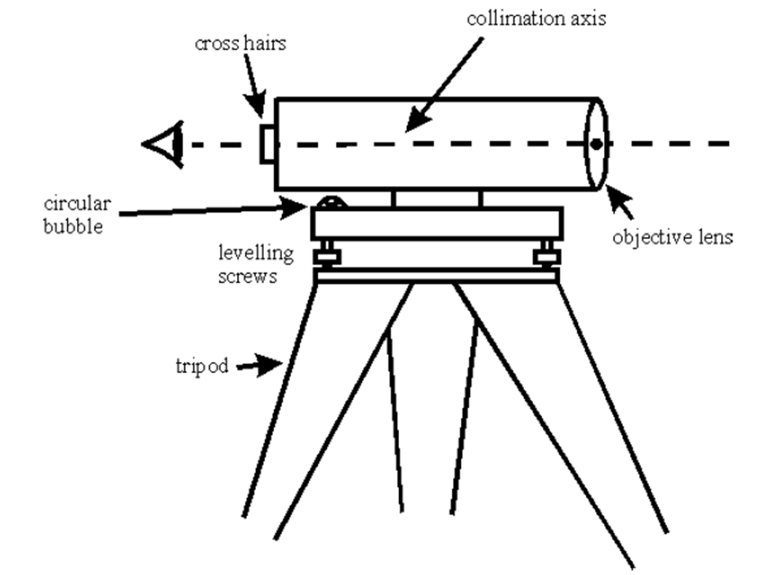
Setting up the level
Extend the tripod legs and set them to an angle of about 60 degrees, so that the level is at a comfortable height to operate.
Adjust the legs so that the tripod mounting plate is approximately level.
Use the three levelling screws to centre the bubble such that the level is exactly level (for our purposes).
Once set, THE TRIPOD MUST NOT MOVE.

Slide 9
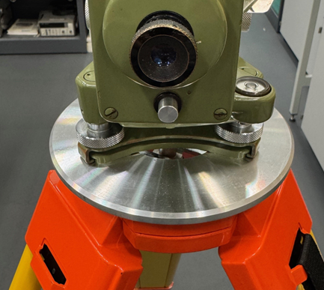
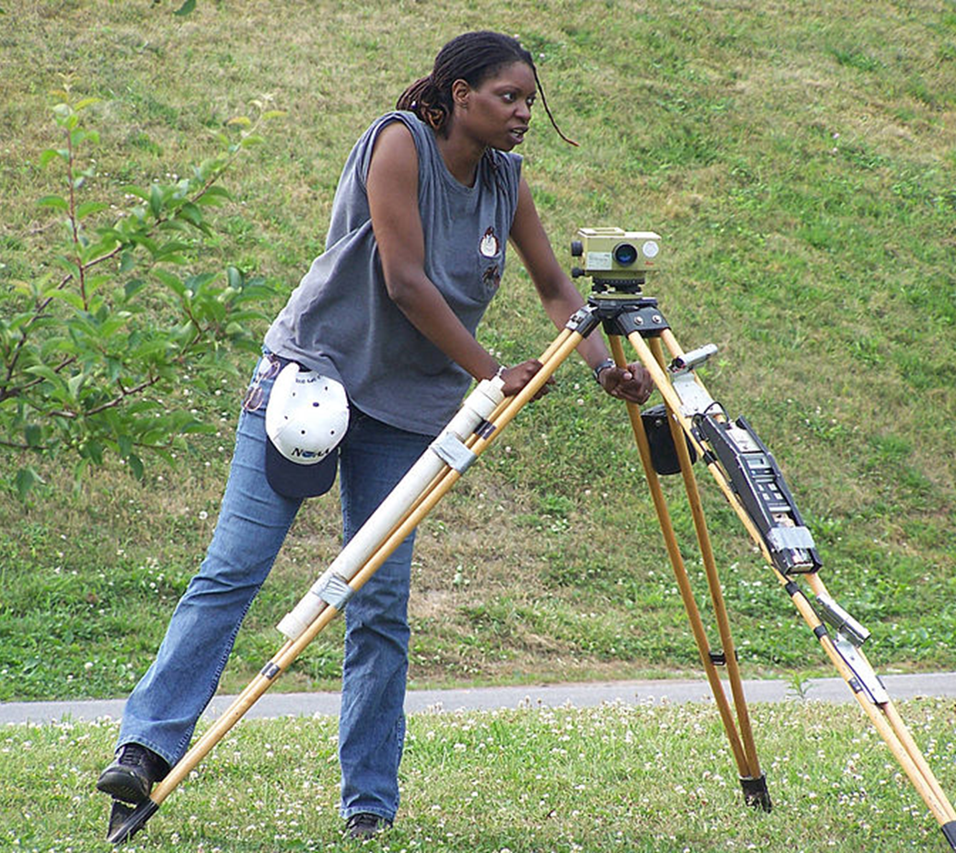
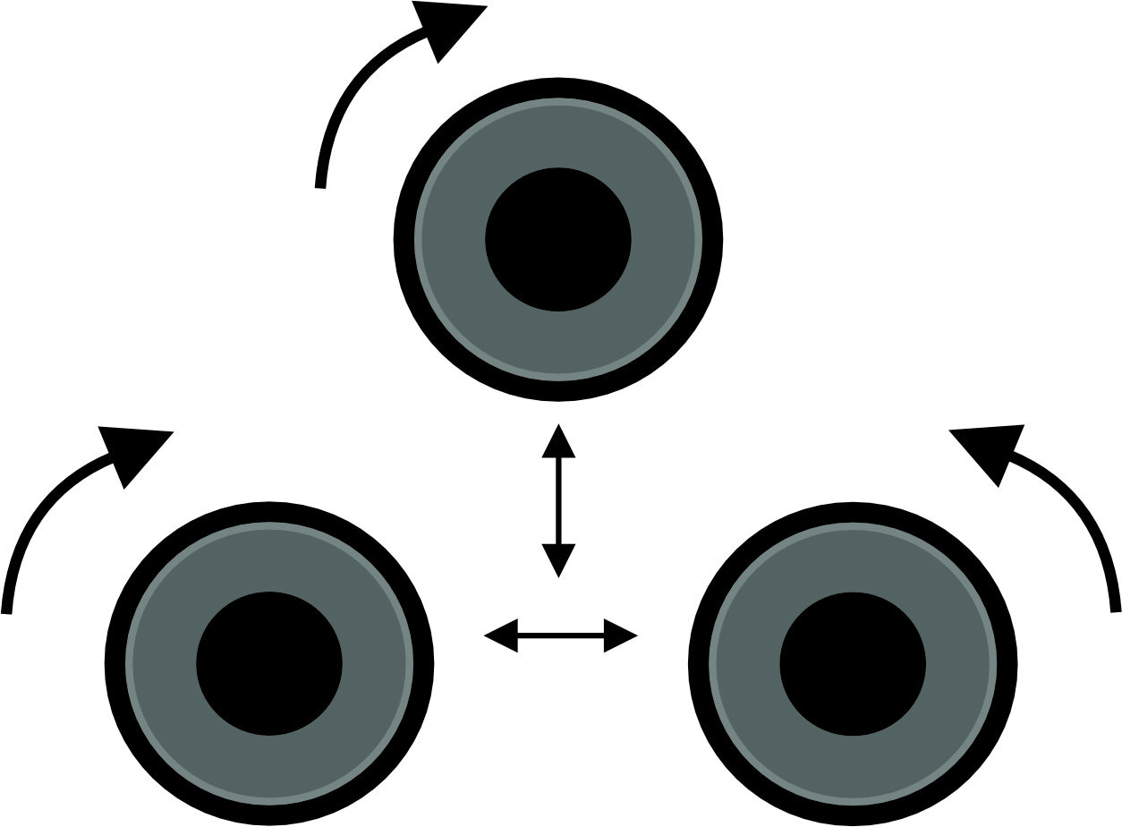
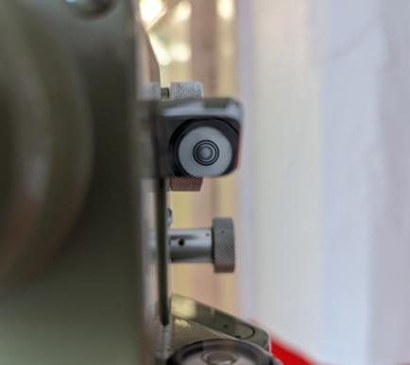
Tips when Setting up the level
When attaching the level to the tripod, align the adjustment knobs with the tripod legs.
If the tripod legs are placed upon soft ground, make sure the feet are pressed firmly into the ground.
Adjust the level by rotating two knobs in opposing directions to get left/right bubble position set and then use the remaining knob to adjust the bubble in the forwards/backwards direction.
Make sure the bubble on the level is in the centre, rotate the level to make sure it stays in the centre.
NOAA COOPS

Slide 10
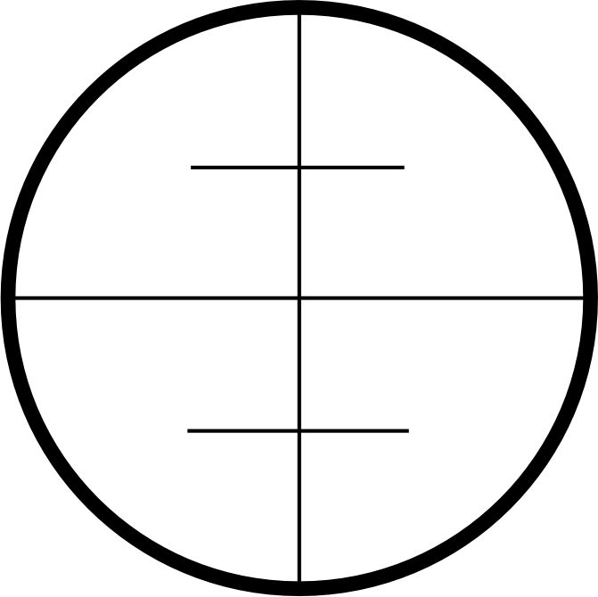
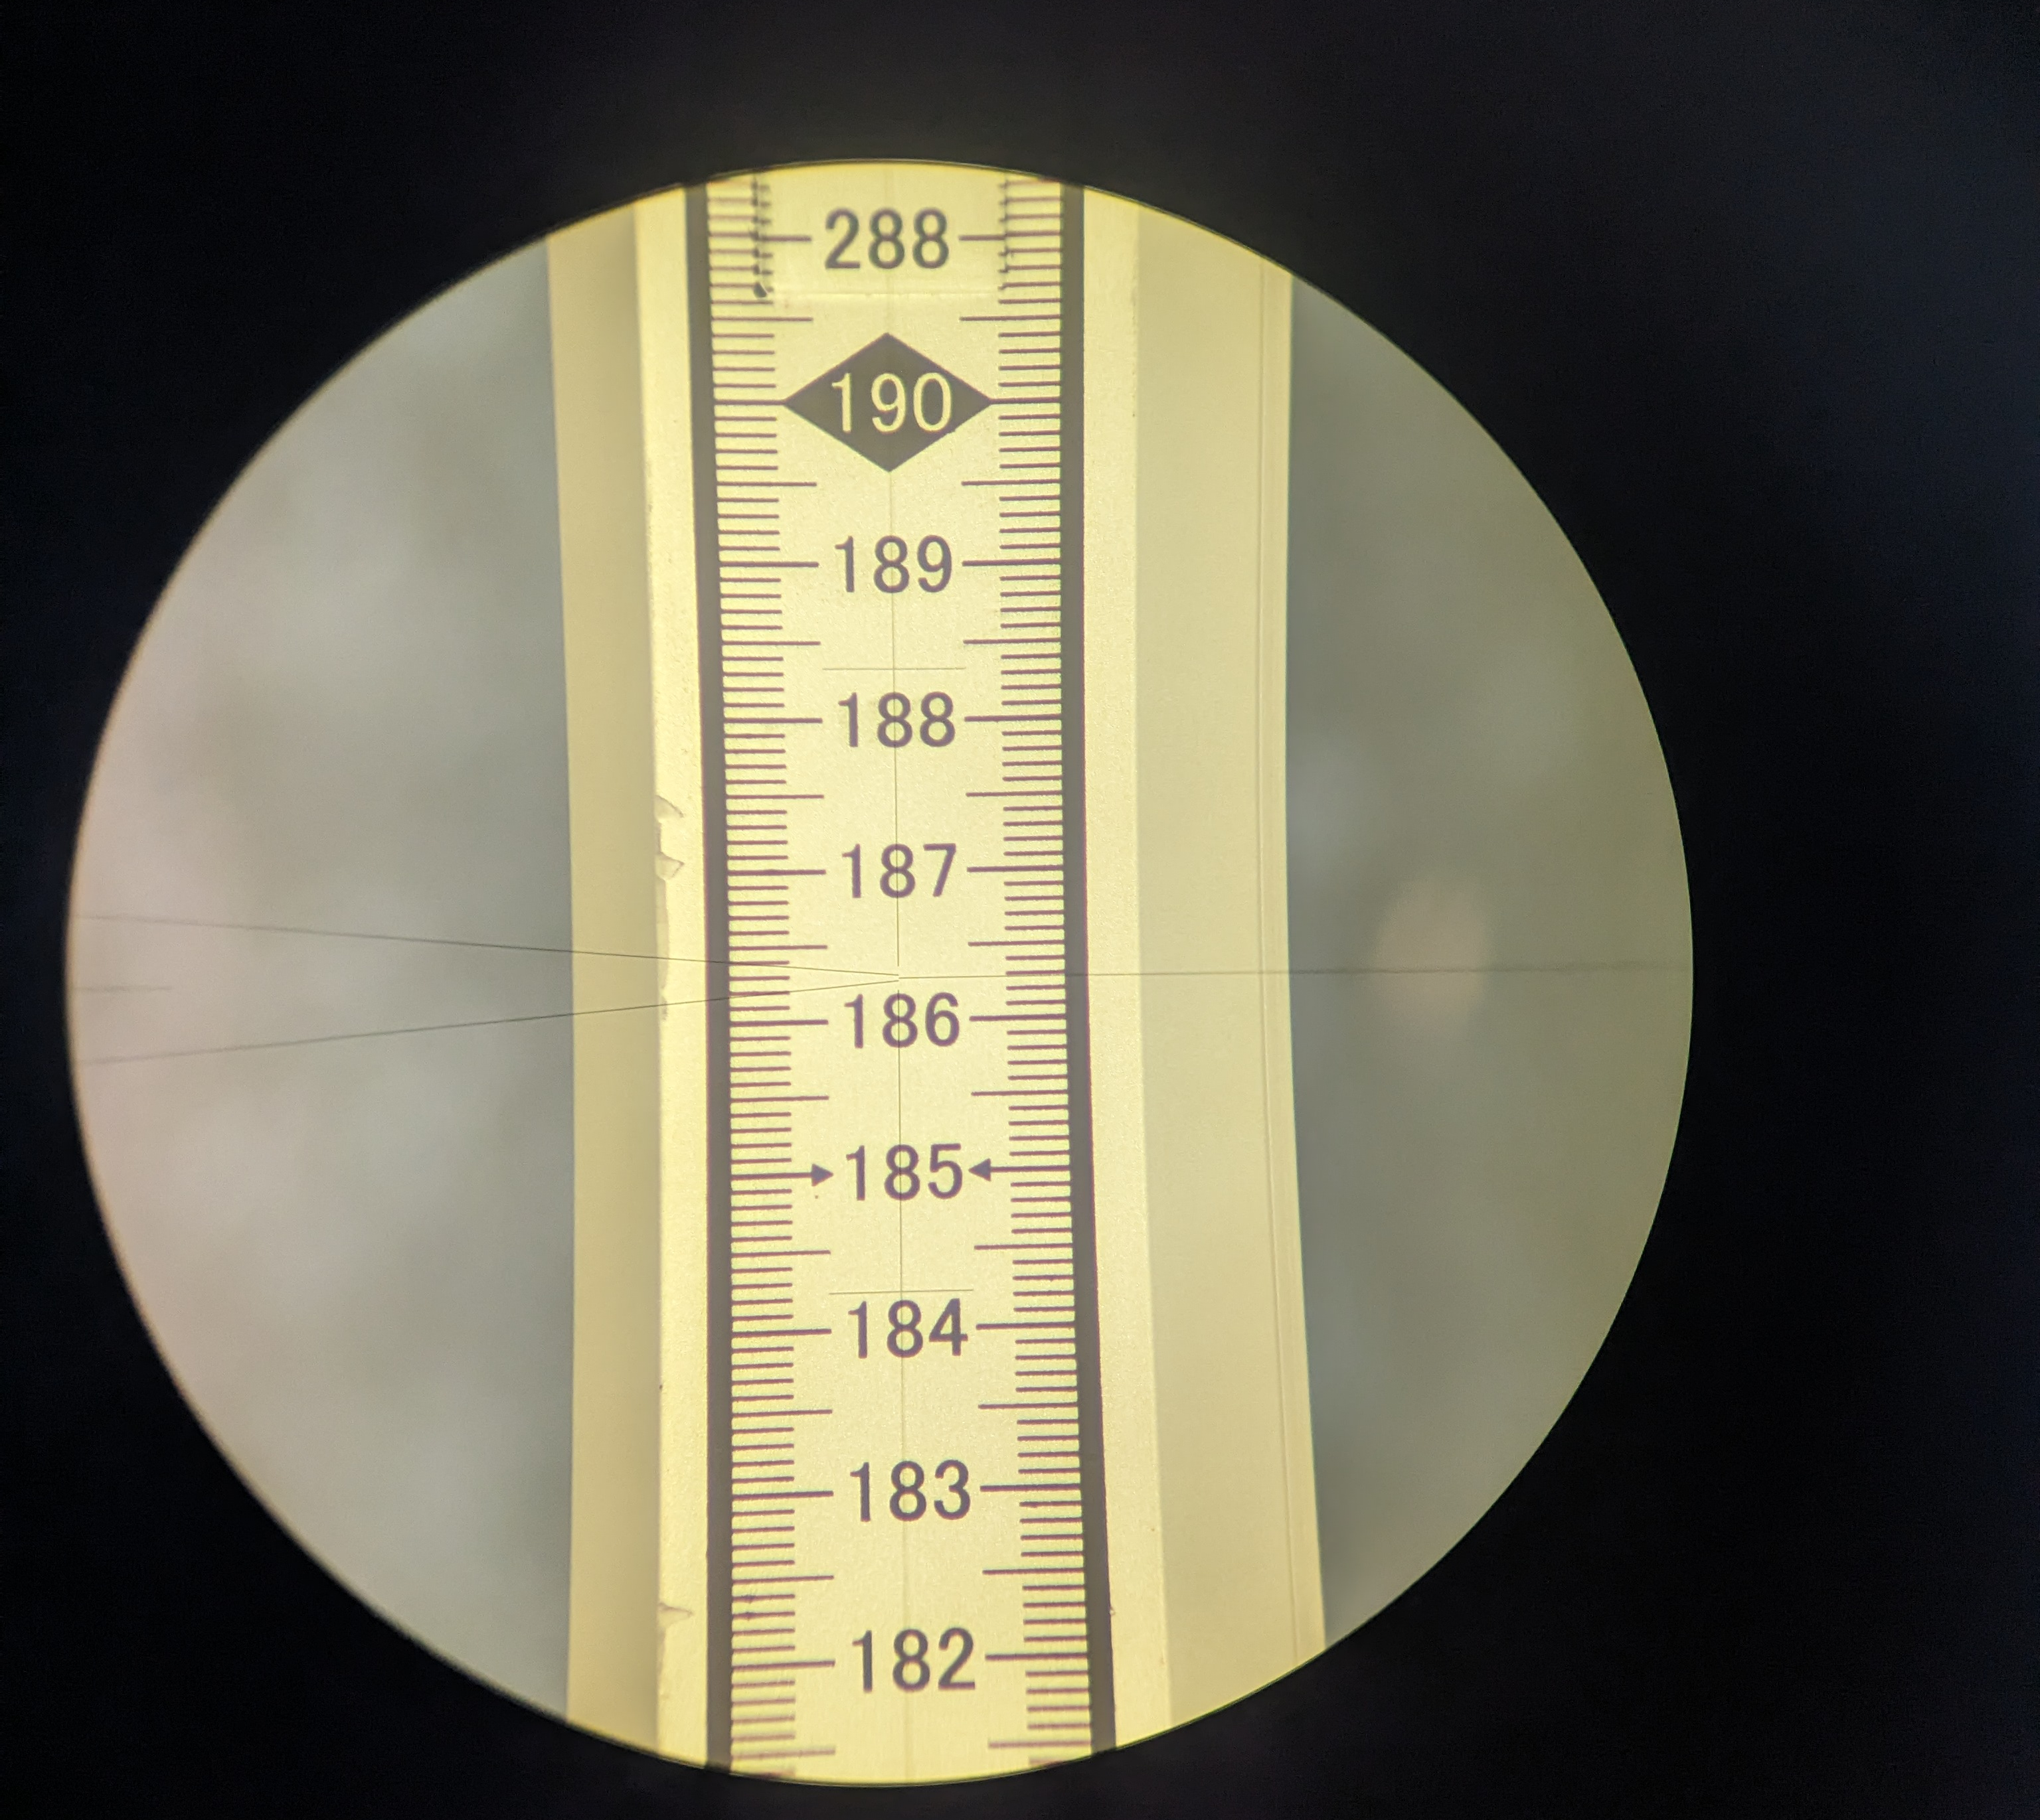
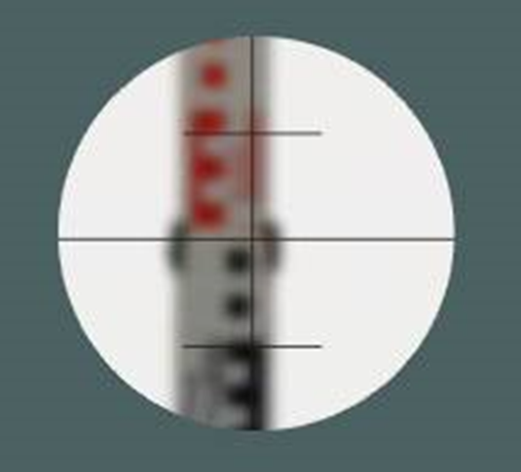
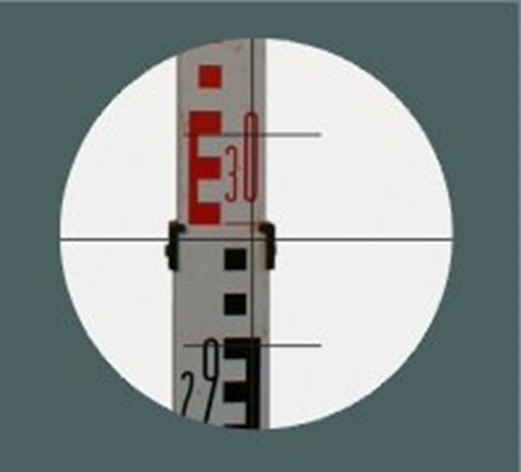
Adjusting the level
Before taking readings, the level must be adjusted for use by the operator.
The level has crosshairs that must be in focus, this is achieved by rotating the eyepiece.
The level has an objective lens that focuses on the staff. When it is correctly focussed, the operator will see a sharp image of the staff and the crosshairs will be in focus.
Another dial provides left/right micro-adjustment to centre the crosshairs on the staff.

Slide 11
Taking readings
The person holding the staff must ensure that it is vertical using its own attached bubble. The staff must be held firmly to avoid swaying in the wind and not be extended more than necessary.
Using an E face staff, the value marked refers to the bottom of the ‘E’.
Each block or space equals 10mm. The top of the E is 50mm.
A reading is the value of the central crosshair.

Slide 12
what distance to measure over?
The backsight distance and foresight distance should be roughly the same.
Do not be tempted to set the distance from staff to level too far, as this can affect reading accuracy.
Setting the distance too short requires more stages to cover the distance and more time spent setting up the level.
A sighting distance of between 20m and 25m from the level to the staff is a good compromise.

Slide 13
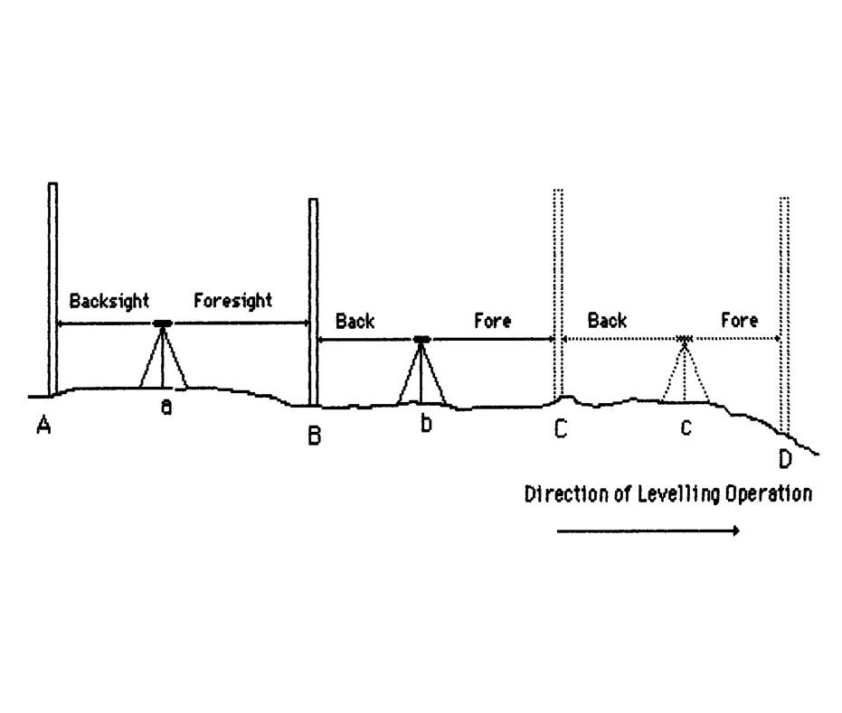
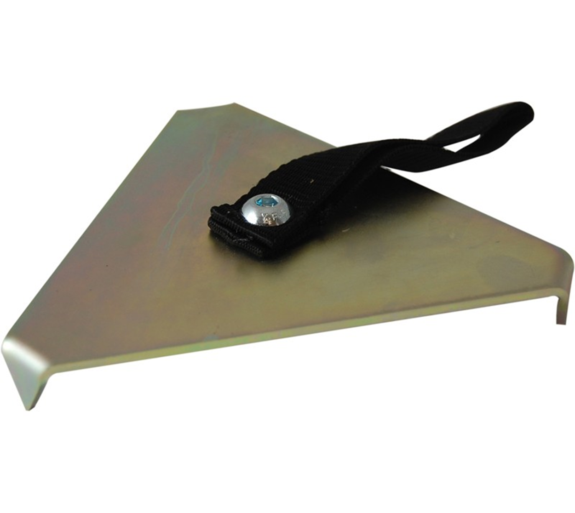
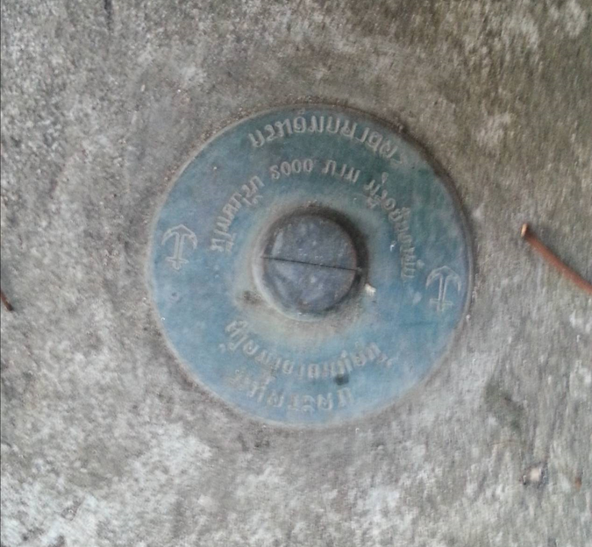
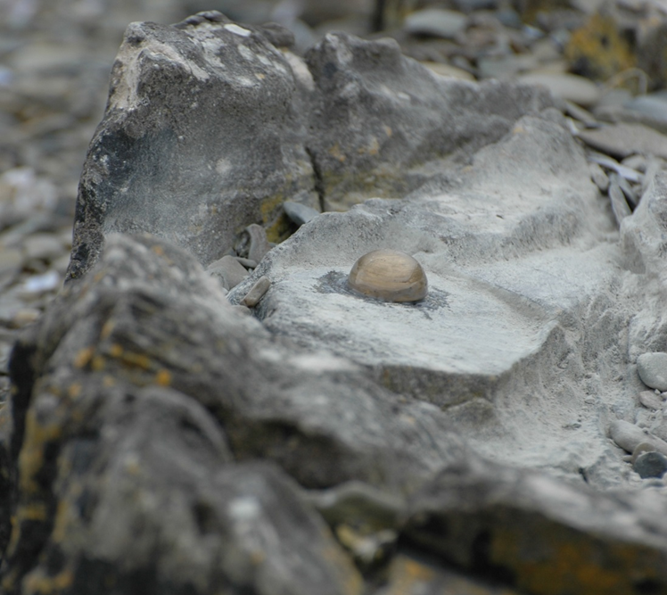
Levelling runs
When traversing a long distance between benchmarks, a change plate or foot plate can be used.
This is placed on the ground and provides the staff with a stable base to rest on between foresight and backsight readings.
The change plate must not move between readings.
During a levelling run, if the tripod or change plate moves between readings, the section must be restarted.

Slide 14
Completing the levelling run – closing error
Once the levelling run has travelled from the start at A to the destination at D, note the value for D.
Repeat the levelling run in reverse, starting at D and ending at A.
Use the value for D just obtained as the starting height for the reverse run.
At the end of the run, note the value for A.
The closing error is the difference between starting value for A and ending value for A.

Slide 15
Errors in levelling
Errors can and do occur in levelling. We need to try and minimise these errors.
Errors may be caused by:
Misreading the staff – if the staff is not held completely vertical or is affected by weather.
Not setting the bubble in the centre to level the instrument.
Disturbing the instrument or change plate between readings.
Instrument errors – collimation error.

Slide 16
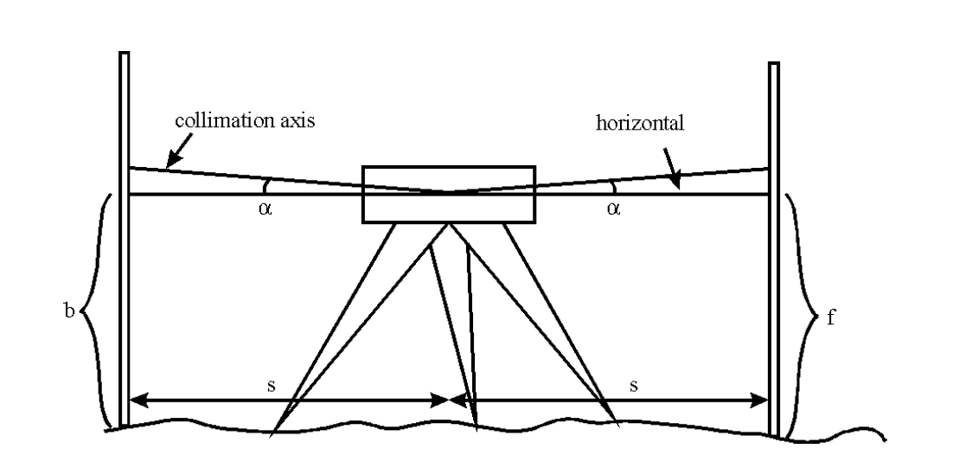
Collimation error
Collimation error is when the collimation axis is not truly level.
In the diagram the collimation axis is tilted relative to horizontal.
This is causing the level to read high on the staff.
The effect of the collimation error is eliminated if sight lengths are kept equal.

Slide 17
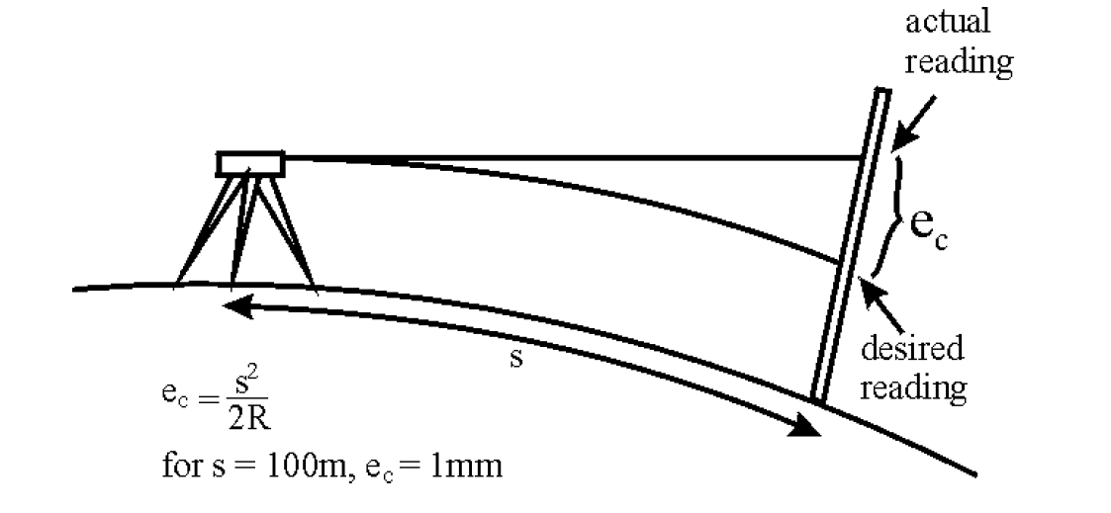
Curvature of the earth
Due to the curvature of the Earth, the line of sight at the instrument will deviate from a horizontal line as one moves away from the level.
For a sight length of 100m the effect is 1mm.
The effect is eliminated if sight lengths are kept equal for fore and back sights.

Slide 18
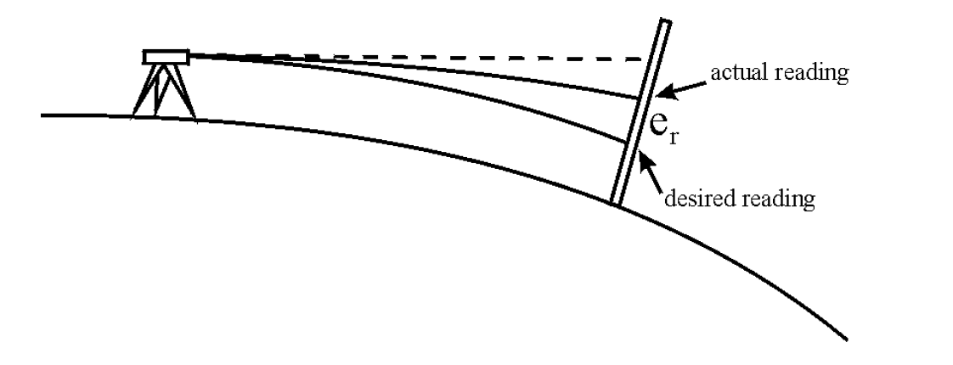
refraction
The variable density of the Earth's atmosphere causes a bending of the ray from the staff to the level. The effect is illustrated in the sketch.
The effect of refraction is almost eliminated by using equal foresight and backsights.

Slide 19
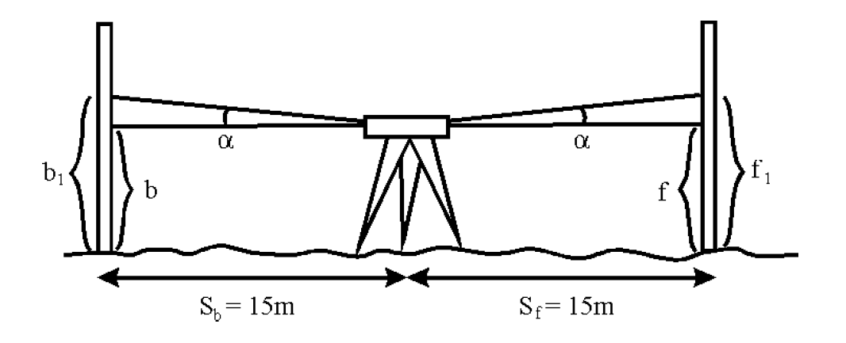
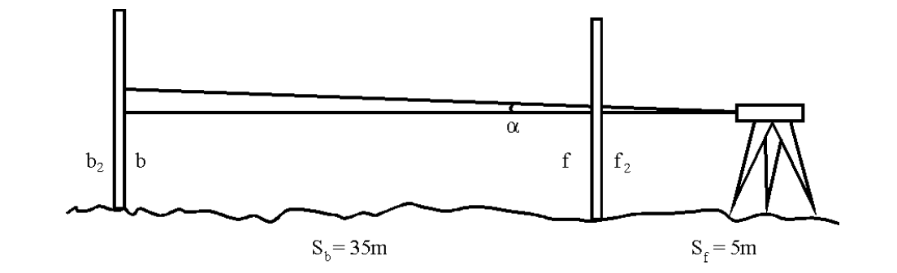
Two peg test – check the accuracy of the level
Identify or set out two pegs 30m apart.
Set up the level at the midpoint and take staff readings on both pegs.
Move the level 5m from one of the pegs and repeat the staff readings.
Δh₁ = b₁ - f₁
Δh₂ = b₂ – f₂
If Δh₁ - Δh₂ is not zero, there is a collimation error with the level.

Slide 20
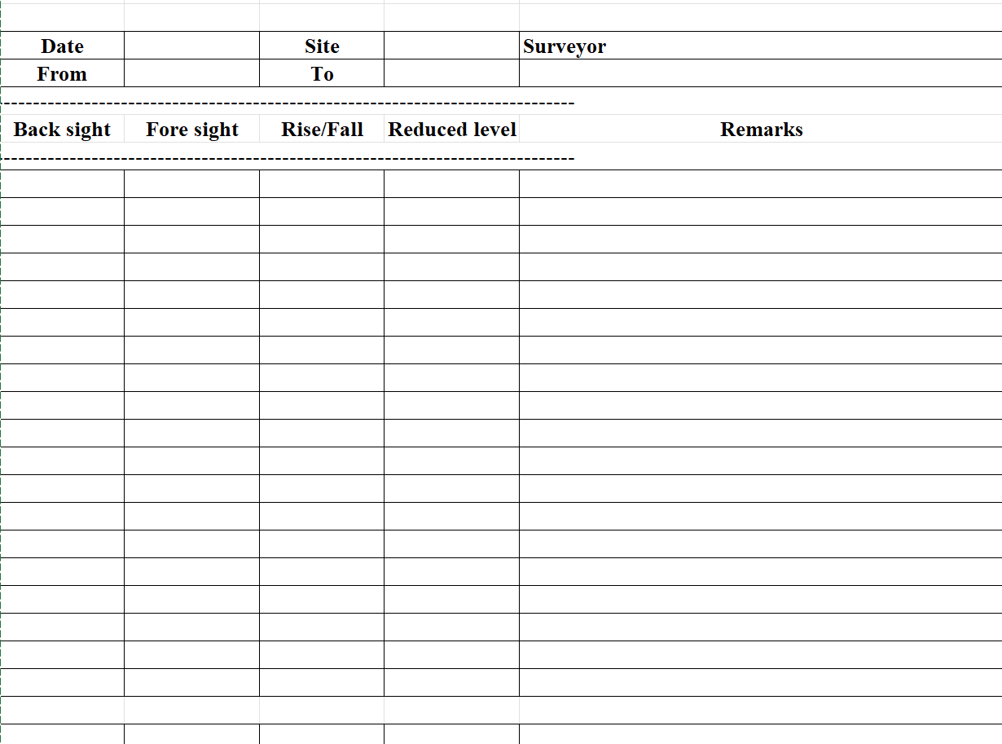
Recording your results
Record all your readings and calculations for each levelling run.
At the start of levelling, the reduced level is the known height value of the benchmark.
Record backsight and foresight values.
Rise/fall value is backsight – foresight.
New reduced level value is previous reduced level value plus rise/fall value.

Slide 21
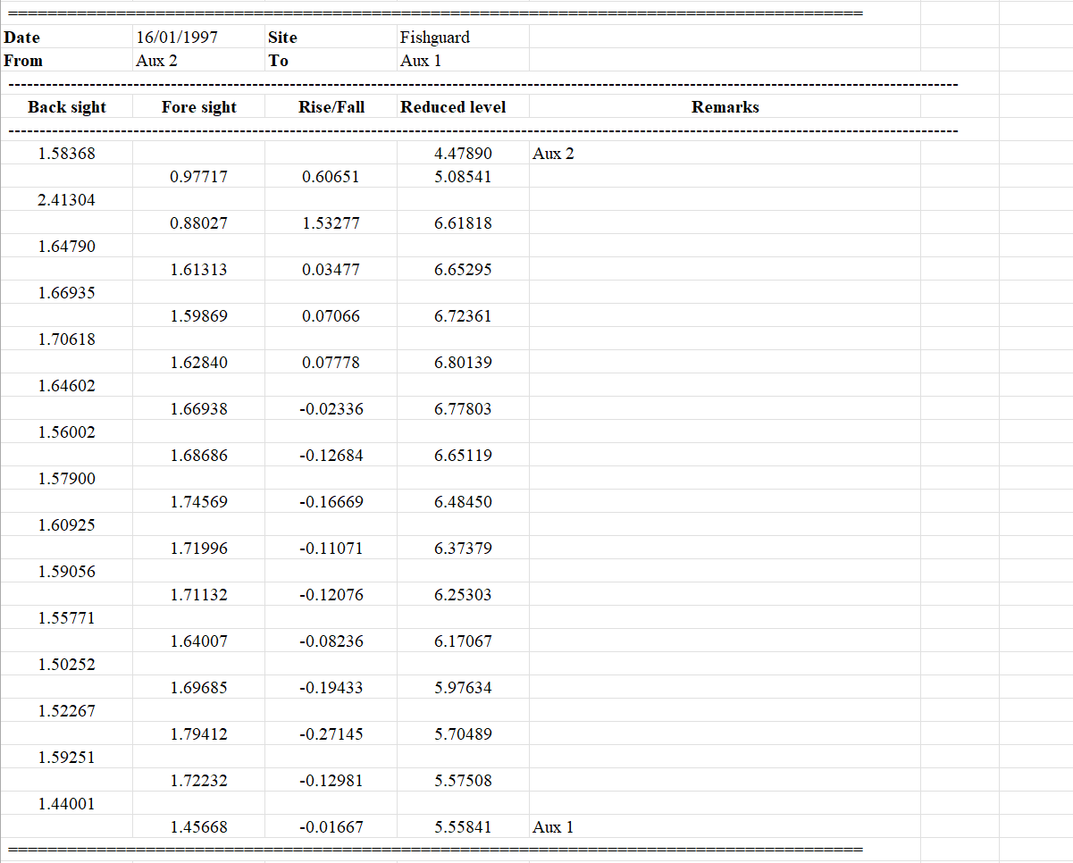
Example of a levelling exercise

Slide 22
recognition
The information contained in this presentation is based primarily on the short note written for PSMSL/GLOSS by Prof. Charles Merry (Univ. Cape Town).
Available from www.psmsl.org.
https://psmsl.org/train_and_info/training/reading/levelling.pdf

Slide 23
Thank you

