Slide 1
Ioc tides training course 17 – 21 November 2025 Bridgetown, barbados

Slide 2
Anatomy, maintenance and installation of a tide gauge
Geoff Hargreaves (NOC) and Sylvia costa gonzÁles (IHM)

Slide 3
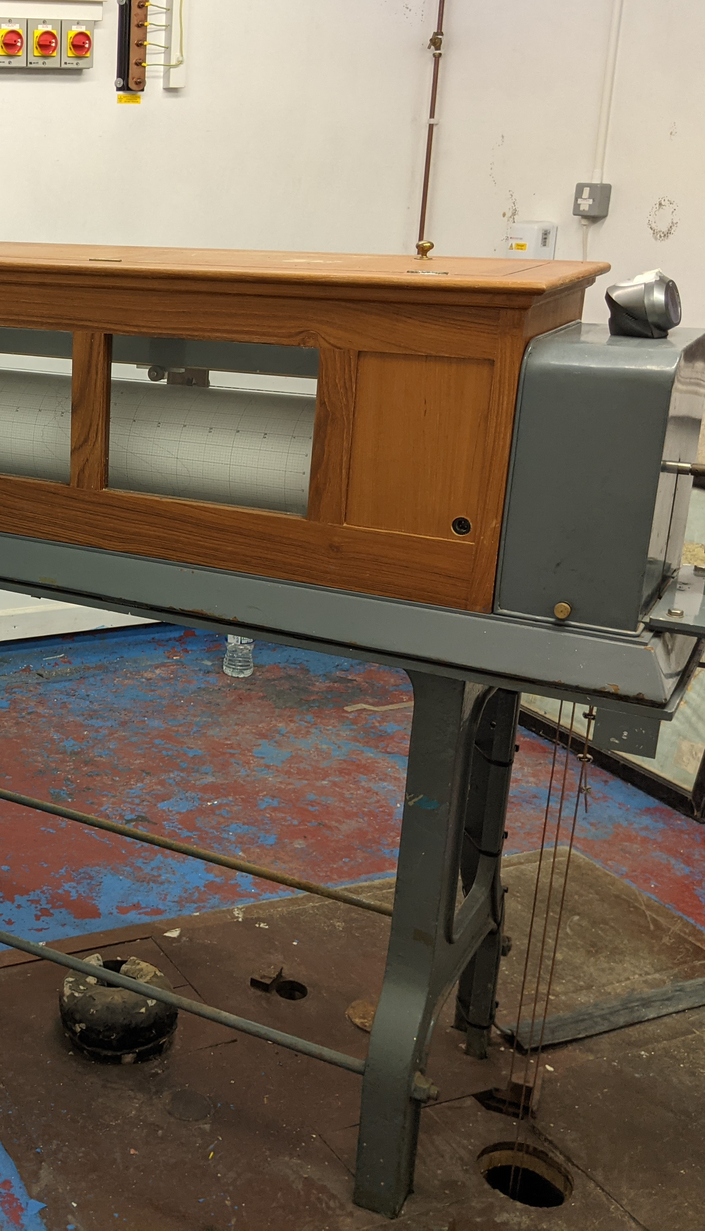
Anatomy of a tide gauge

Slide 4
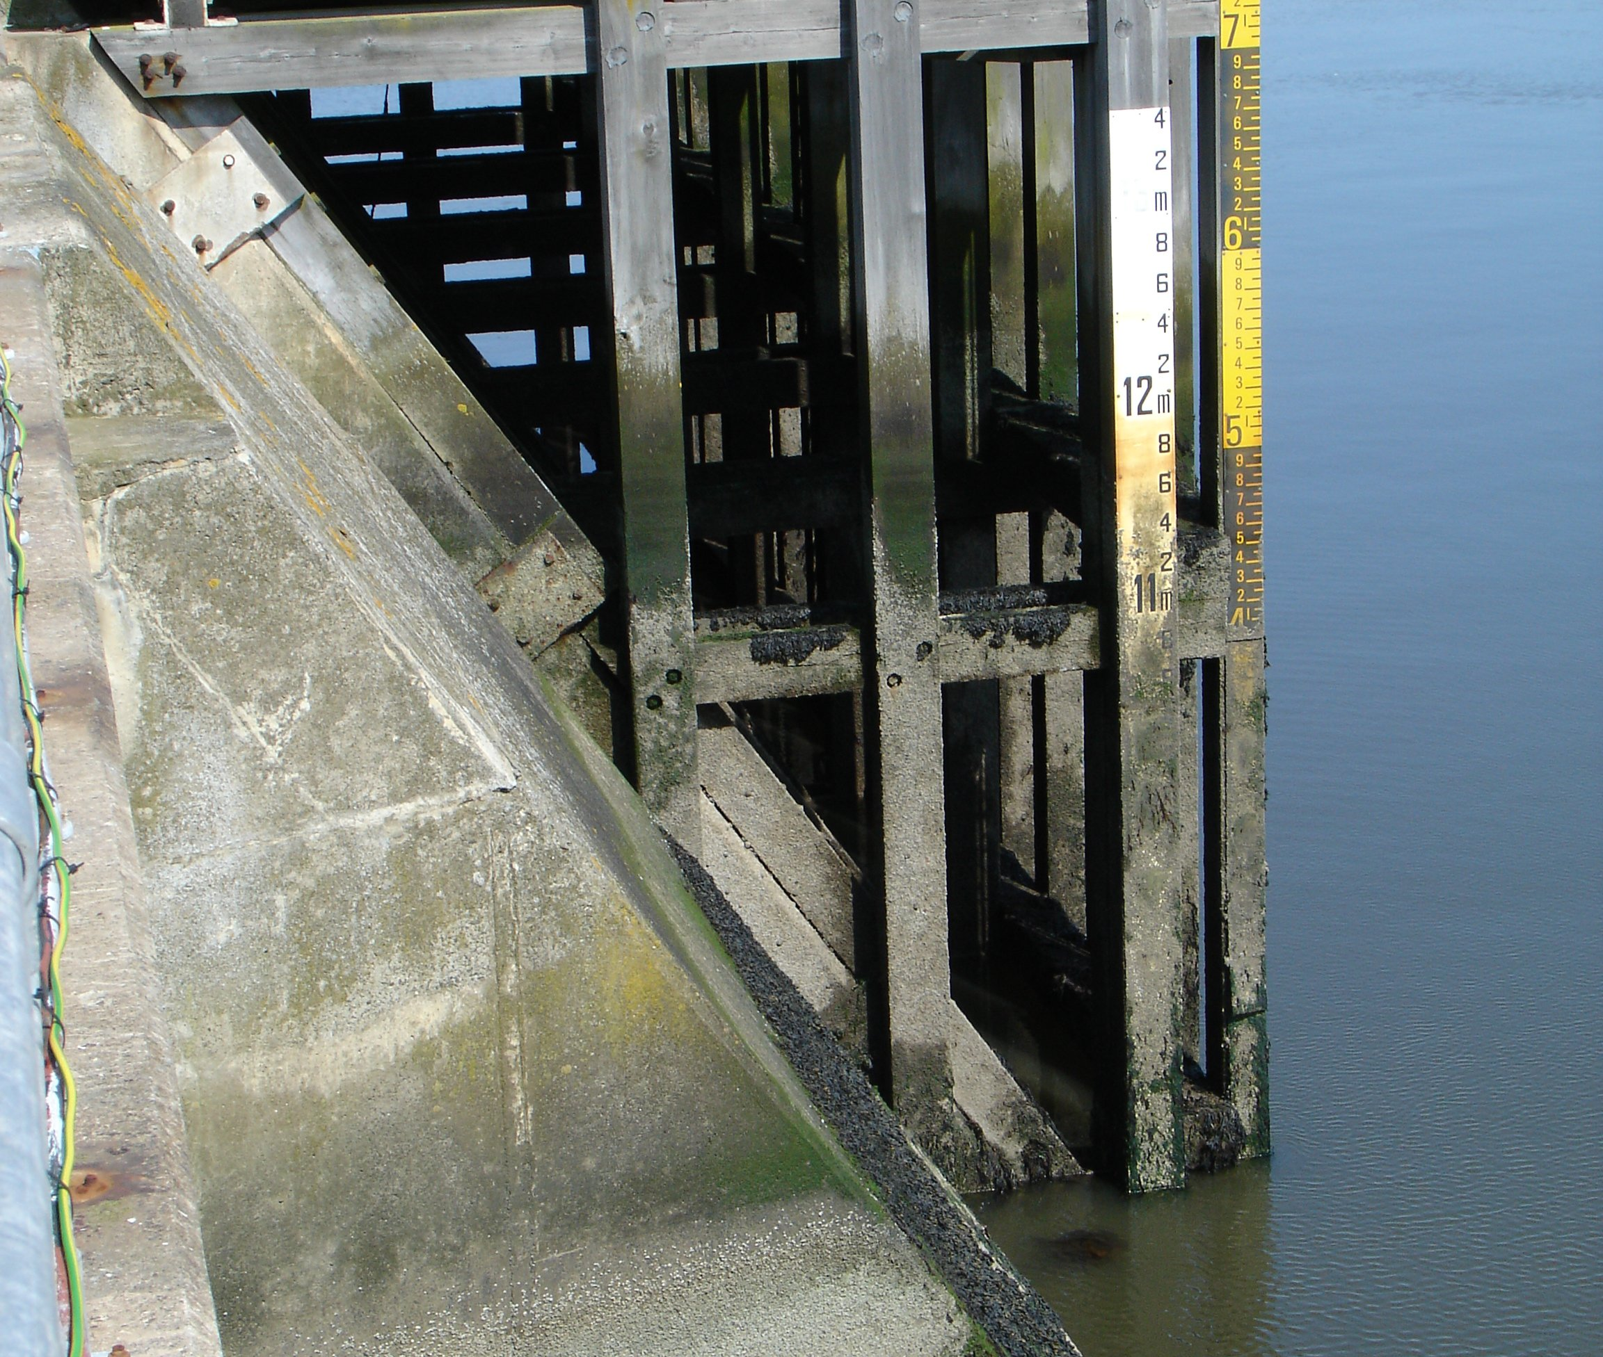
What is required from a tide gauge
A tide gauge is required to do certain things.
Measure the height of the sea level.
Record the measurements at regular intervals.
Send the recorded data somewhere for further analysis.
Can complete steps 1 and 2 automatically and ideally step 3 as well.

Slide 5
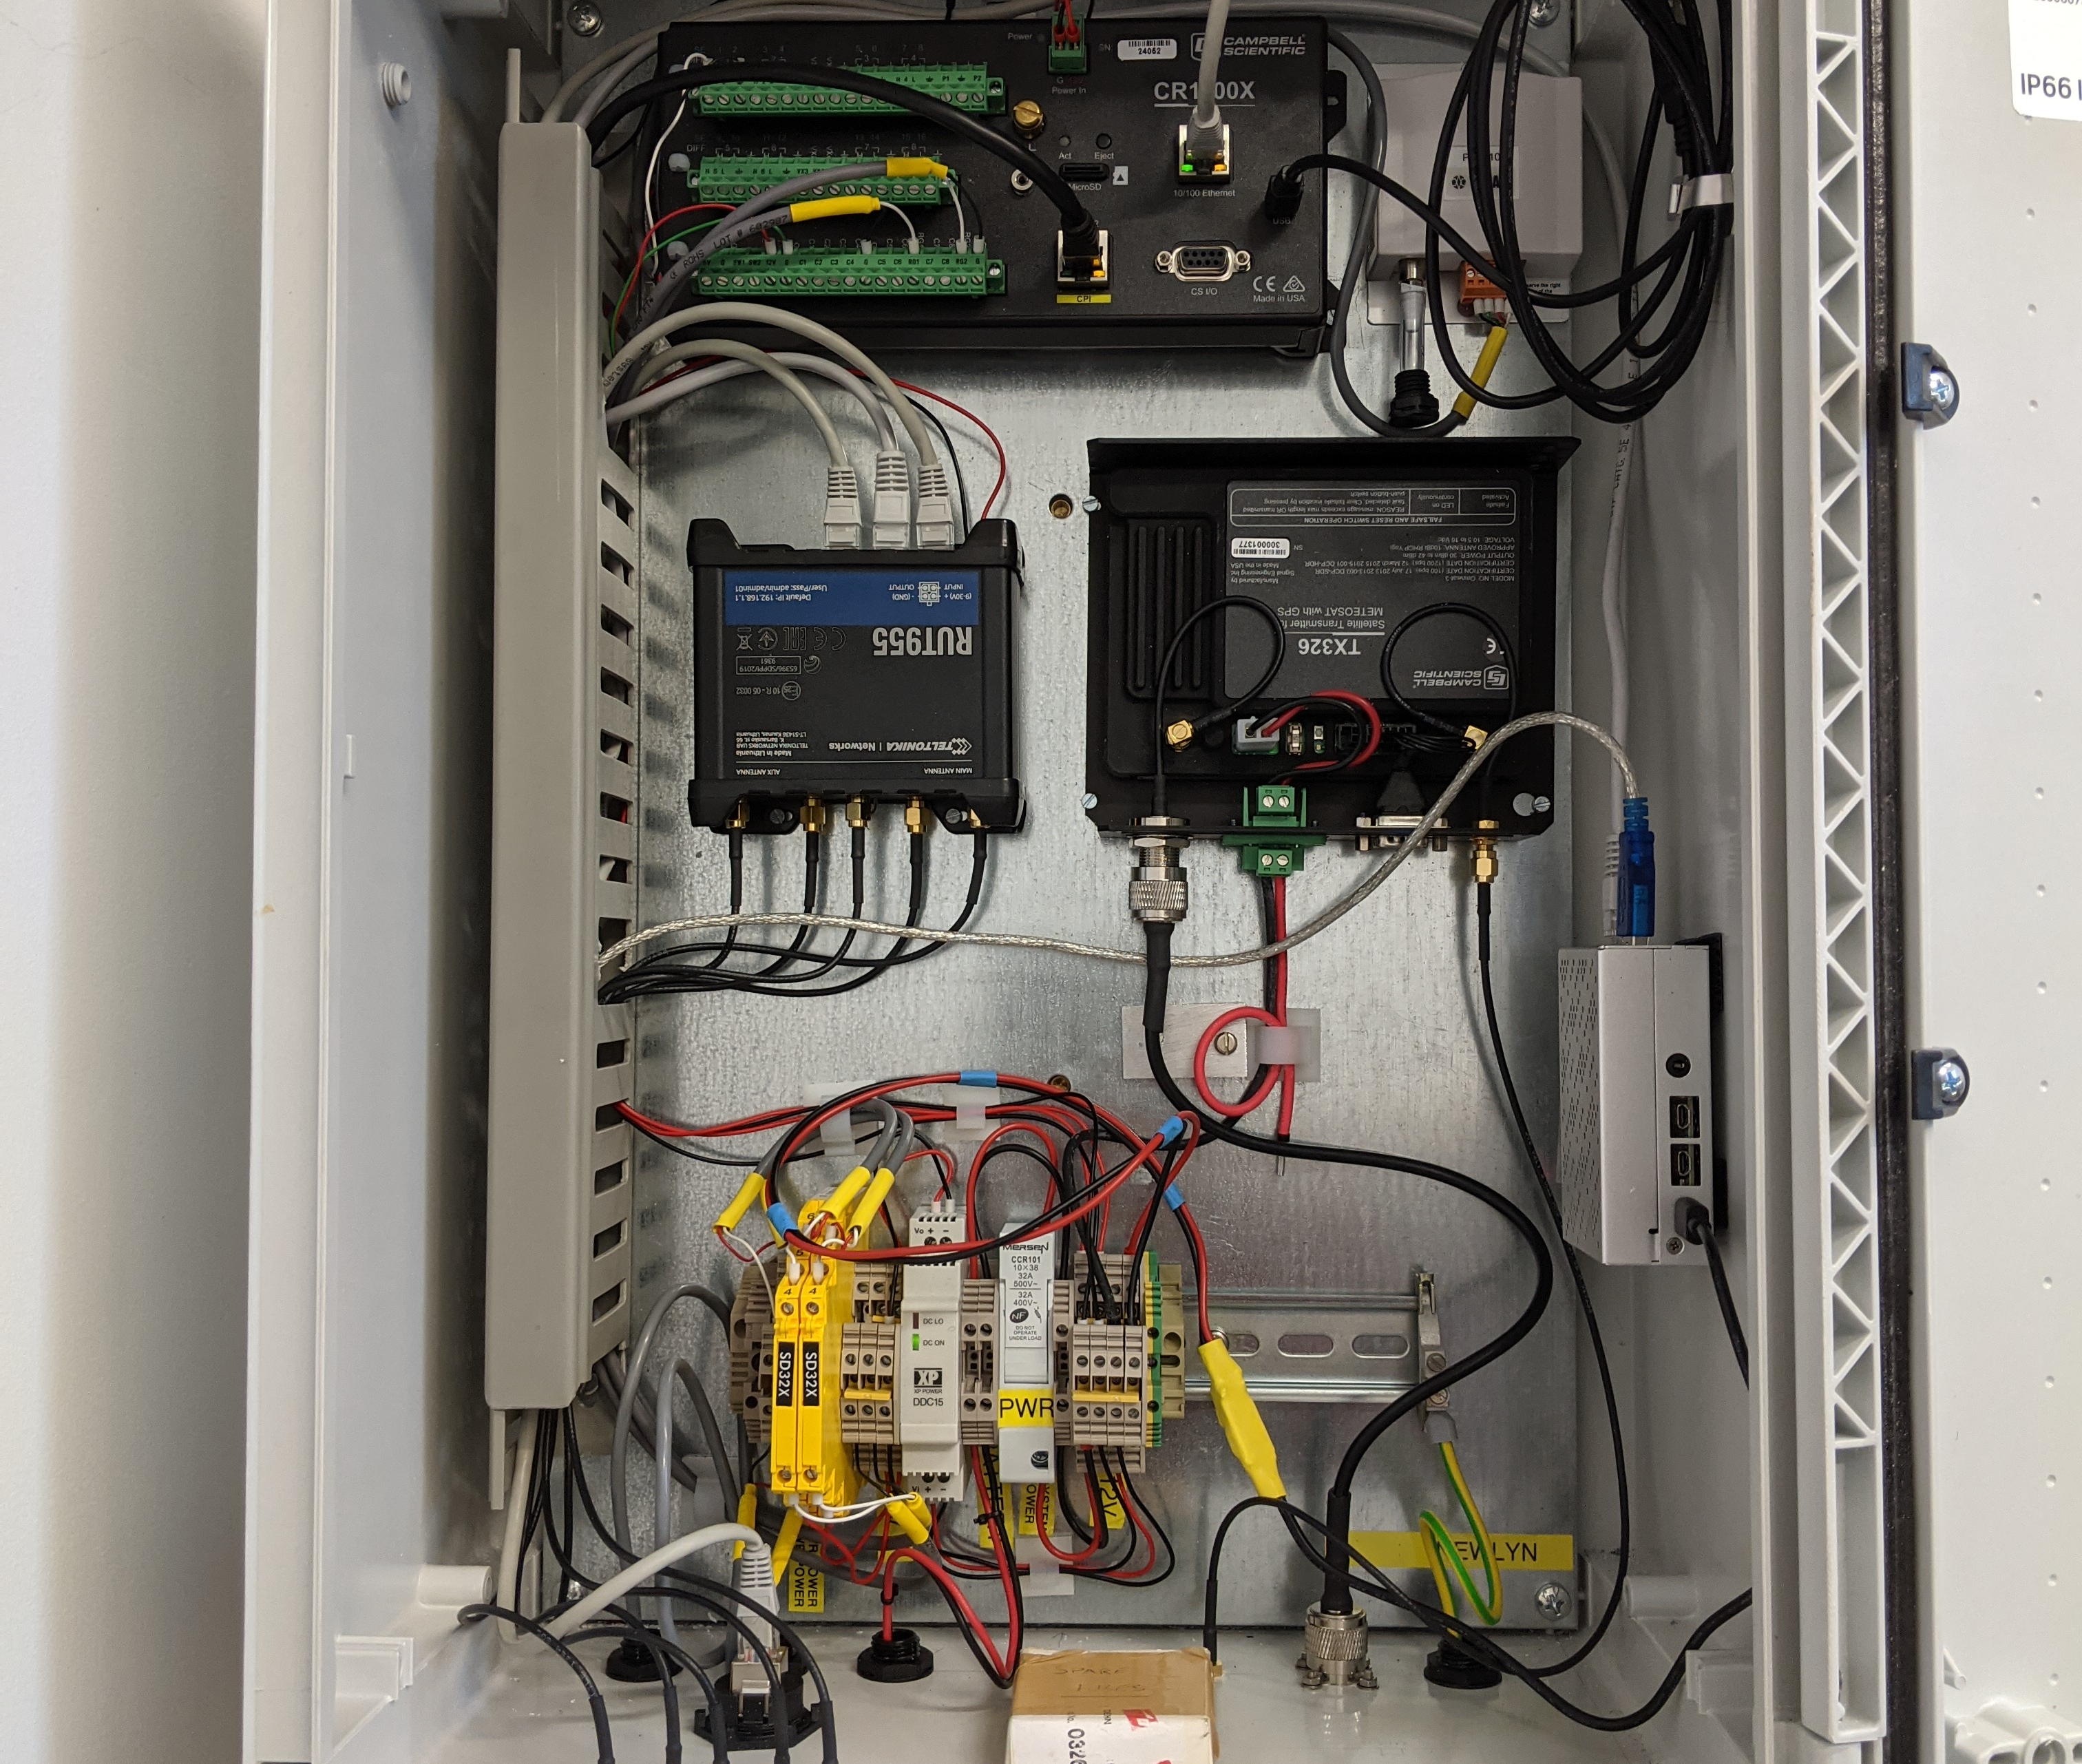
Elements of a tide gauge
Sensors to measure the sea level.
Pressure, radar, acoustic, bubbler, float
Method of storing the measurements.
Electronic data logger, chart recorder.
Communications system to send the results for analysis and long-term storage.
Telecoms, mobile, satellite.
Method of powering the tide gauge.
Batteries, mains power or renewable energy.

Slide 6
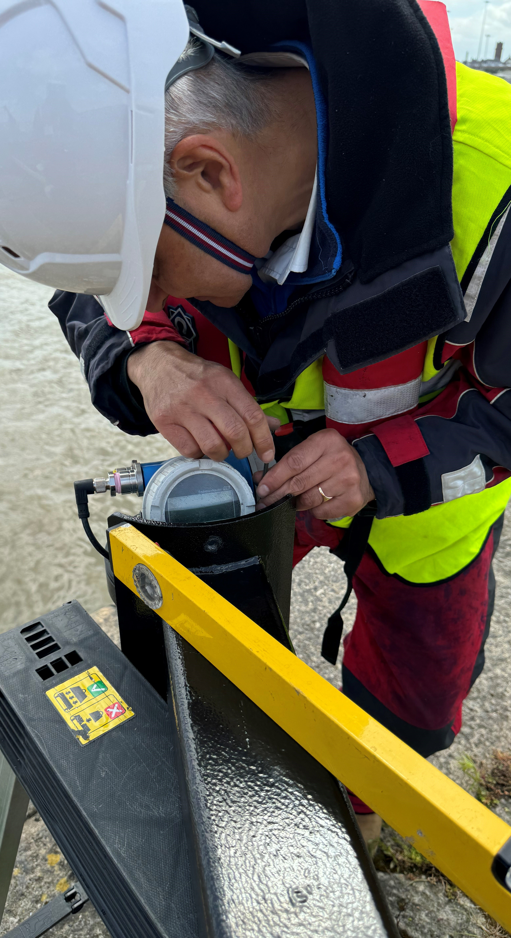
Tide gauge maintenance

Slide 7
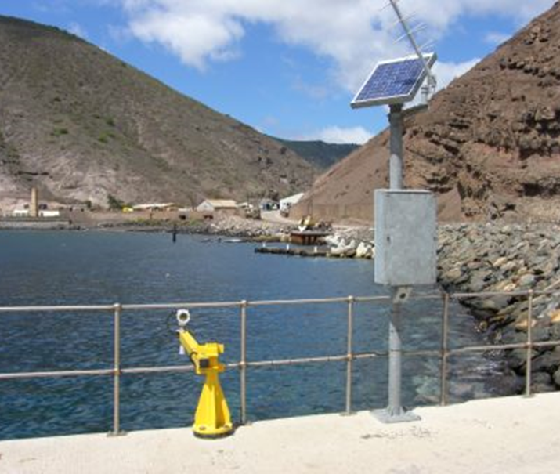
What does tide gauge maintenance involve?
Inspections visits should be undertaken regularly to examine components for external signs of wear, especially after an extreme event.
GOES & GPS antennae
Solar panel
Sensors
Cabling
Electronics

Slide 8
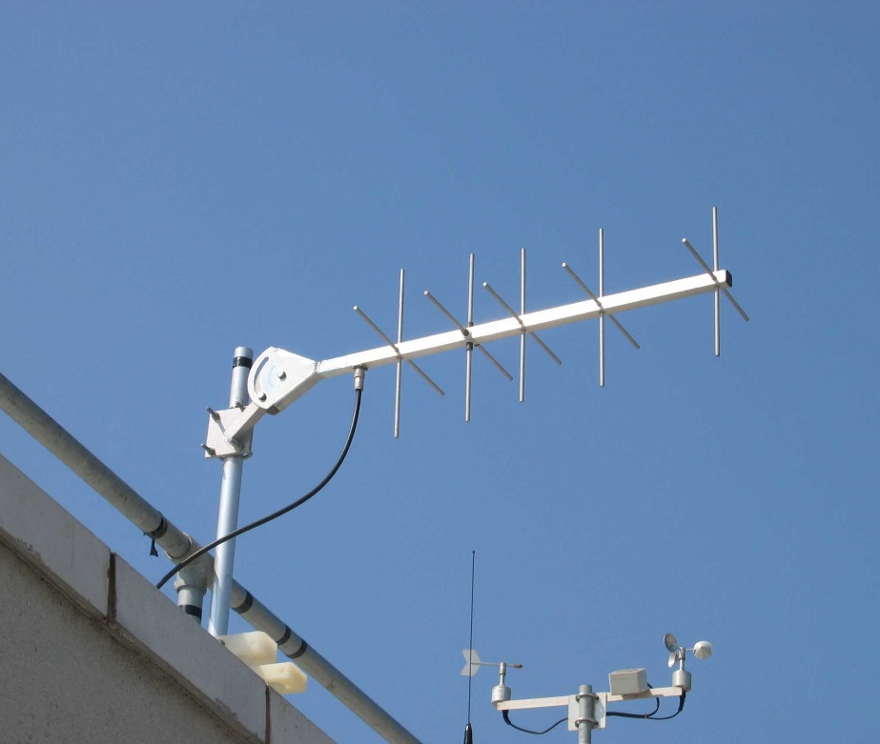
GOES and GPS antennae
Check for damage to the antennae and cabling.
Are the fixings secure? These can be loosened by storm damage or high winds.
Are the azimuth and elevation settings of the GOES antenna correct?
Inspect for perishing or nicks in the cable outer sheath.
Has water entered the antenna central core?

Slide 9
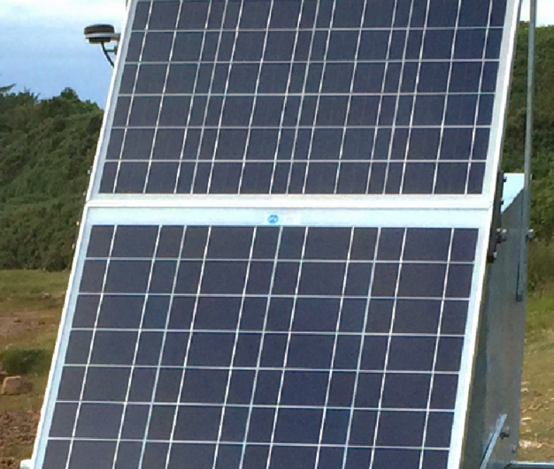
Solar panel
Is it securely attached?
Is the cabling in a good state of repair?
Regular cleaning will ensure a constant supply of power to the electronic components.
Only clean the panel if it is safe to do so.

Slide 10
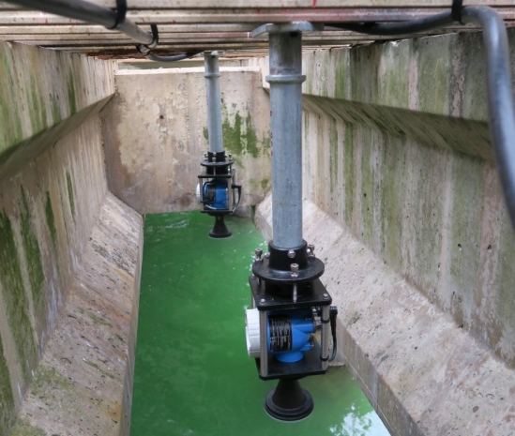
Radar sensors
If fitted with an LCD screen, this can be used to confirm normal operation.
Cables should be examined for signs of damage or wear.
On an annual basis the unit should be levelled to a known benchmark to ensure no movement has occurred.

Slide 11
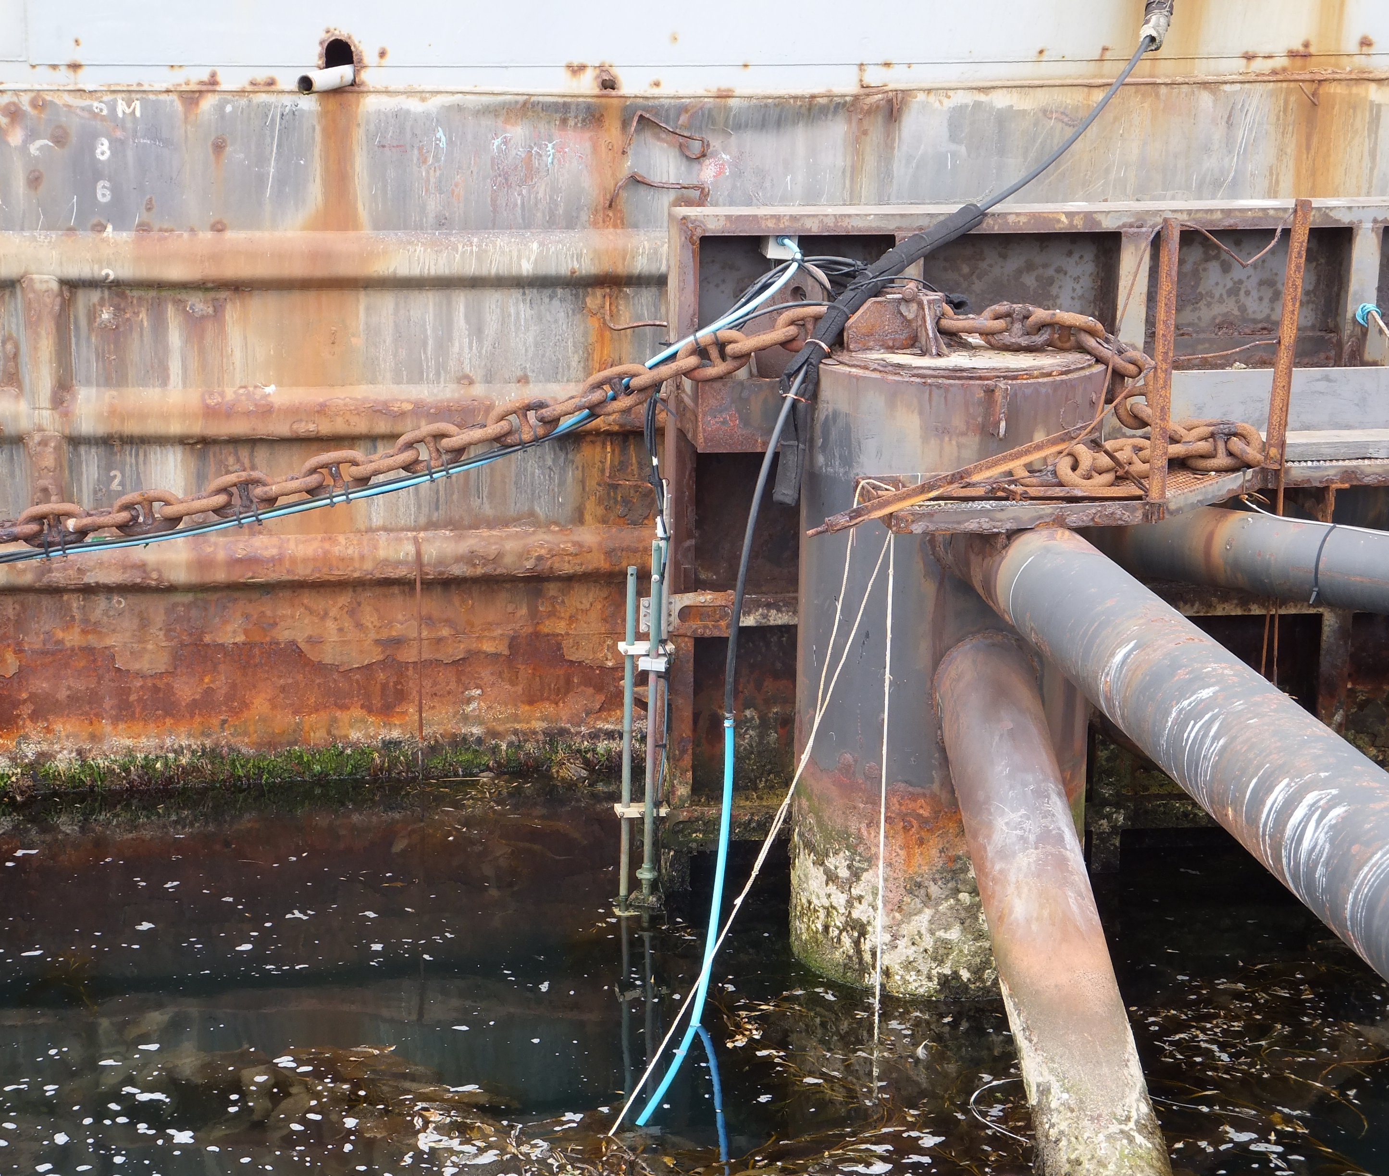
Pressure sensors
Sensors are underwater and therefore difficult to check!
Cables and mountings above the waterline should be inspected for signs of damage or wear.
Performance of these sensors can be monitored via IOC website.
Uploading tide gauge data to IOC website is recommended.

Slide 12
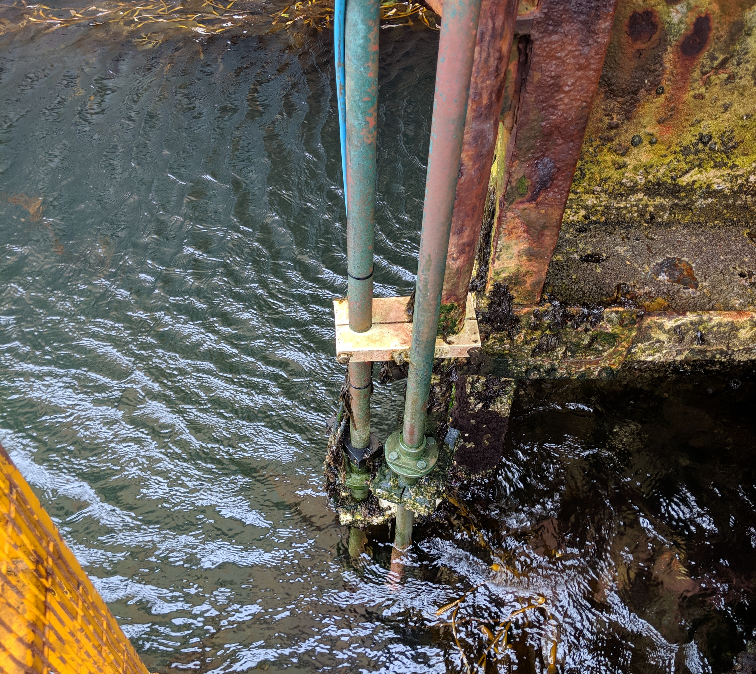
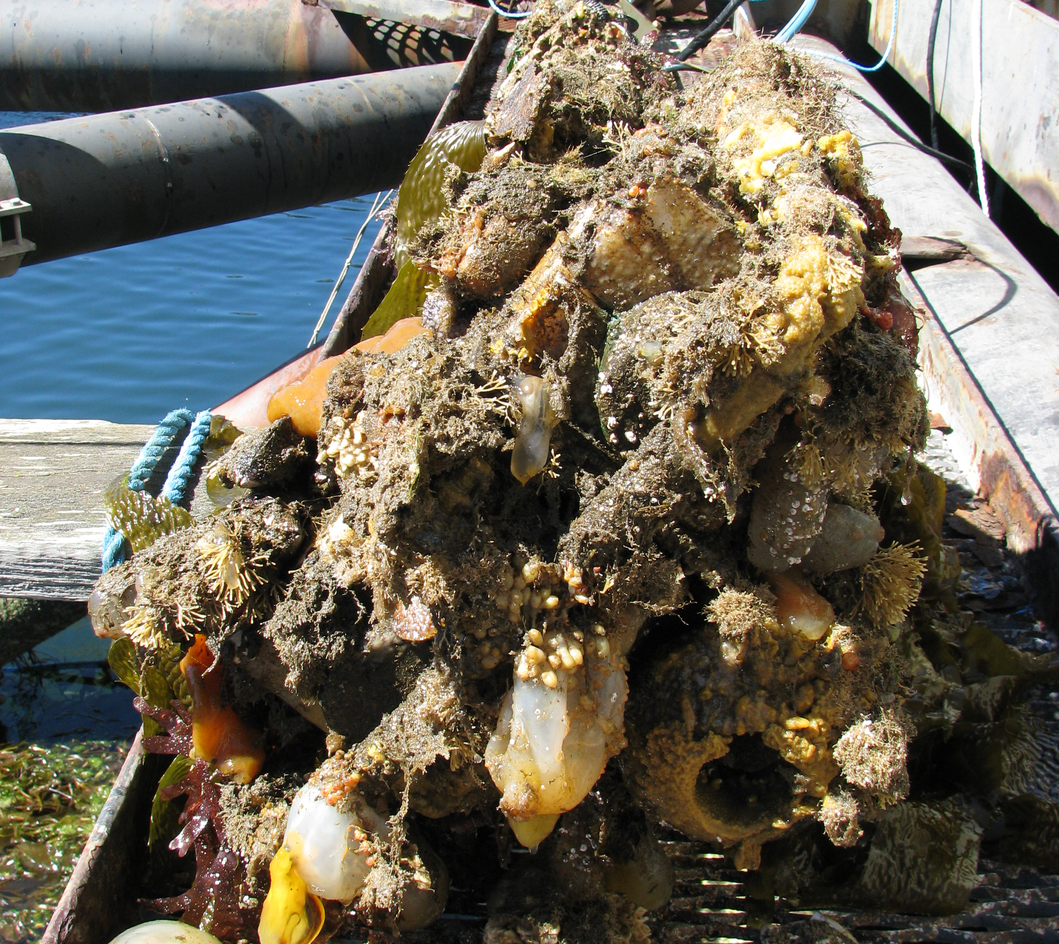
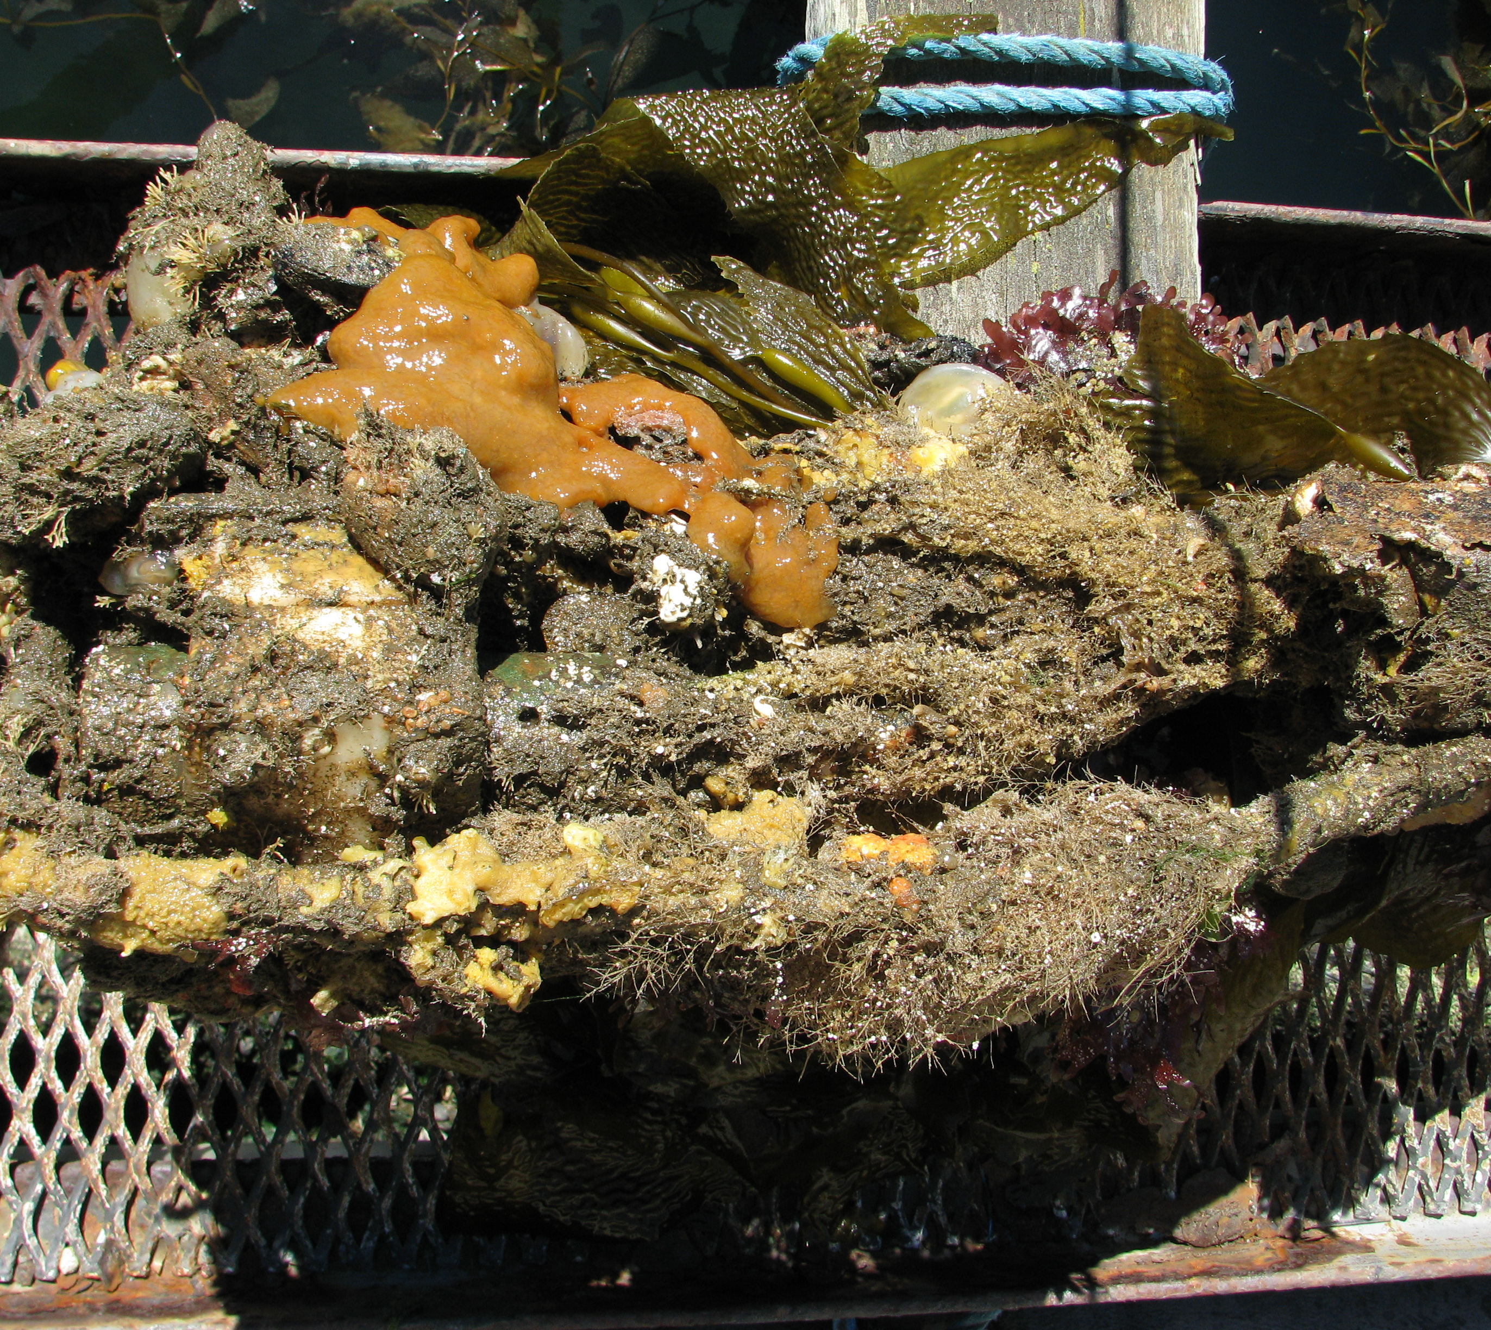
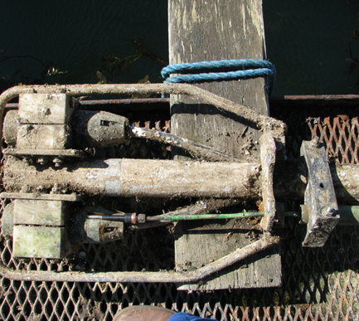
Pressure sensors
Sensors should be removed on an annual basis for inspection and cleaning.
It is important that when the sensors are refitted, they are returned to the same position.
This should be checked by levelling to a known benchmark.

Slide 13
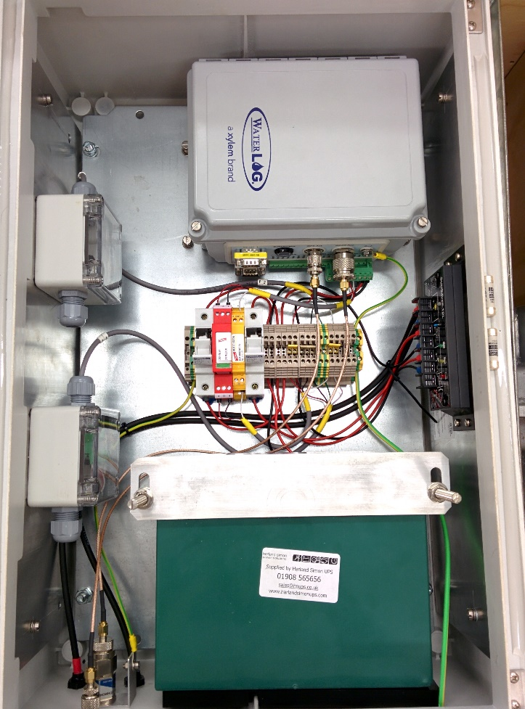
Electronics cabinet and datalogger
Generally, it requires very little maintenance.
Some dataloggers can store several years’ worth of data but it is good practice to download data on a 6 monthly basis.
If a lead crystal battery is used, it should last for ~3-5 years, but voltage should be checked.
Check for any water ingress to the cabinet and components.

Slide 14
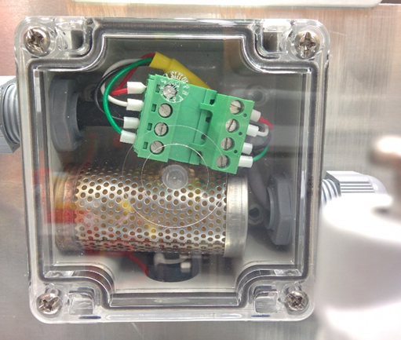
Electronics
Pressure-compensated sensors are vented to the atmosphere via a small plastic tube in the pressure sensor.
This exposes the internal workings of the pressure sensor to moist air, so a desiccant box is used to eliminate this.
Desiccant cartridges should be swapped every 6 months and the old ones placed in an oven for 3-4 hours on a medium heat to reactivate them. These should then be stored in sealed containers until required again.

Slide 15
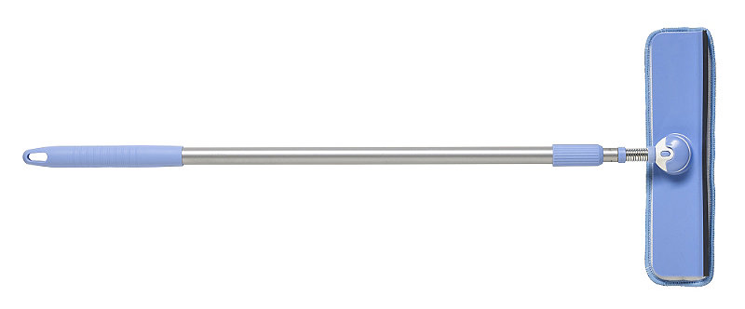
Tide board
Clean tide boards (if fitted).
A long-handled squeegee is ideal for this.
Take regular visual readings of the tide board and record these for comparison with data recorded by the logger.
A simple comparison of visual readings and recorded data can be made using MS Excel.

Slide 16
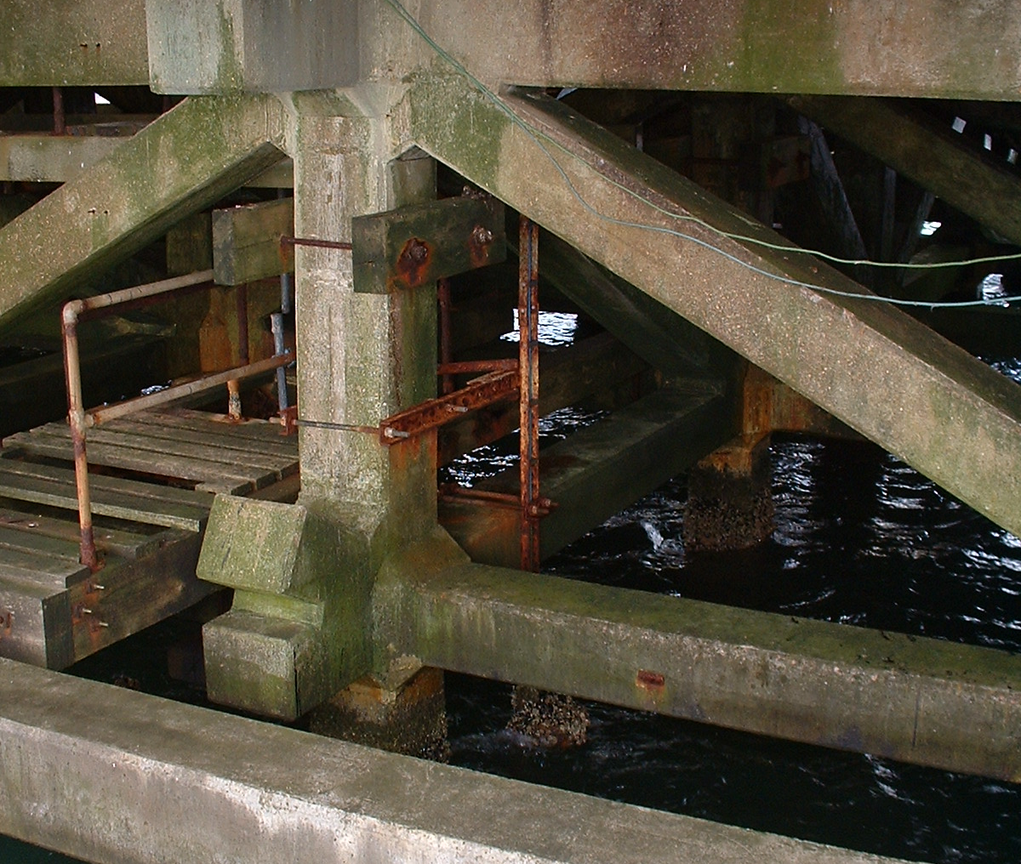
Steelwork and enclosures
Check the condition of the steelwork.
Is it badly corroded?
Are fasteners secure?
Look for signs of rodent activity?
Are there open points that could allow rodent access?
Seal up open access points if possible.

Slide 17
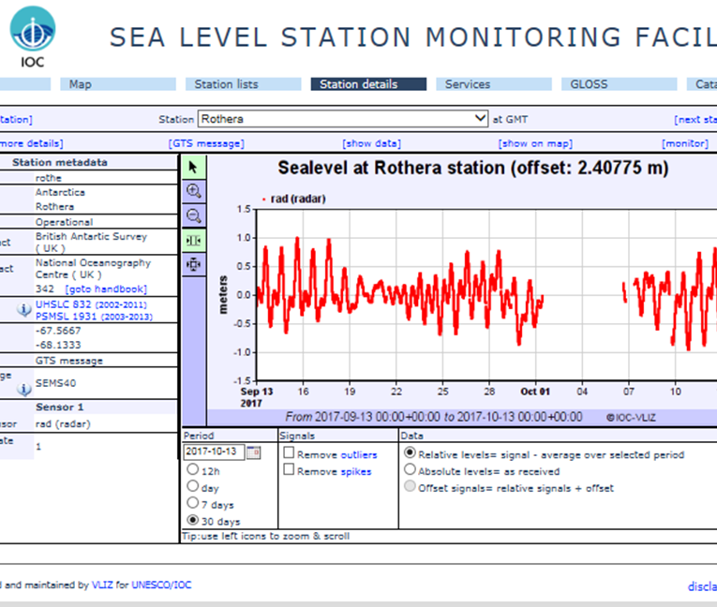
Daily checks
If data is uploaded to the IOC website, check it daily to monitor for gaps or anomalies and to check battery voltage, if uploaded.
Any issues arising can then be addressed quickly.
If data not sent to IOC, check local data flow is present.

Slide 18
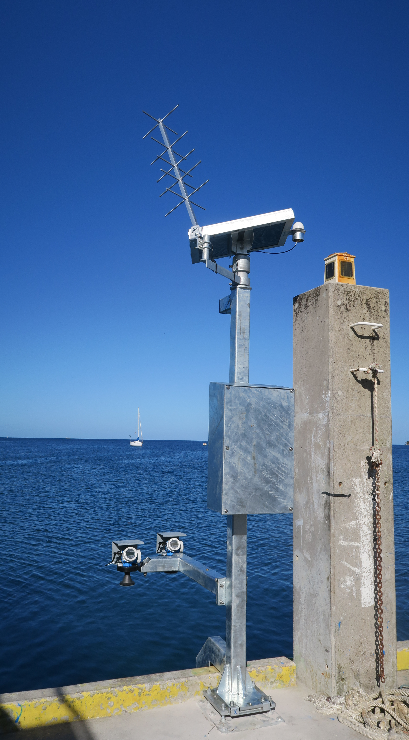
Installation of a tide gauge
Things to consider

Slide 19
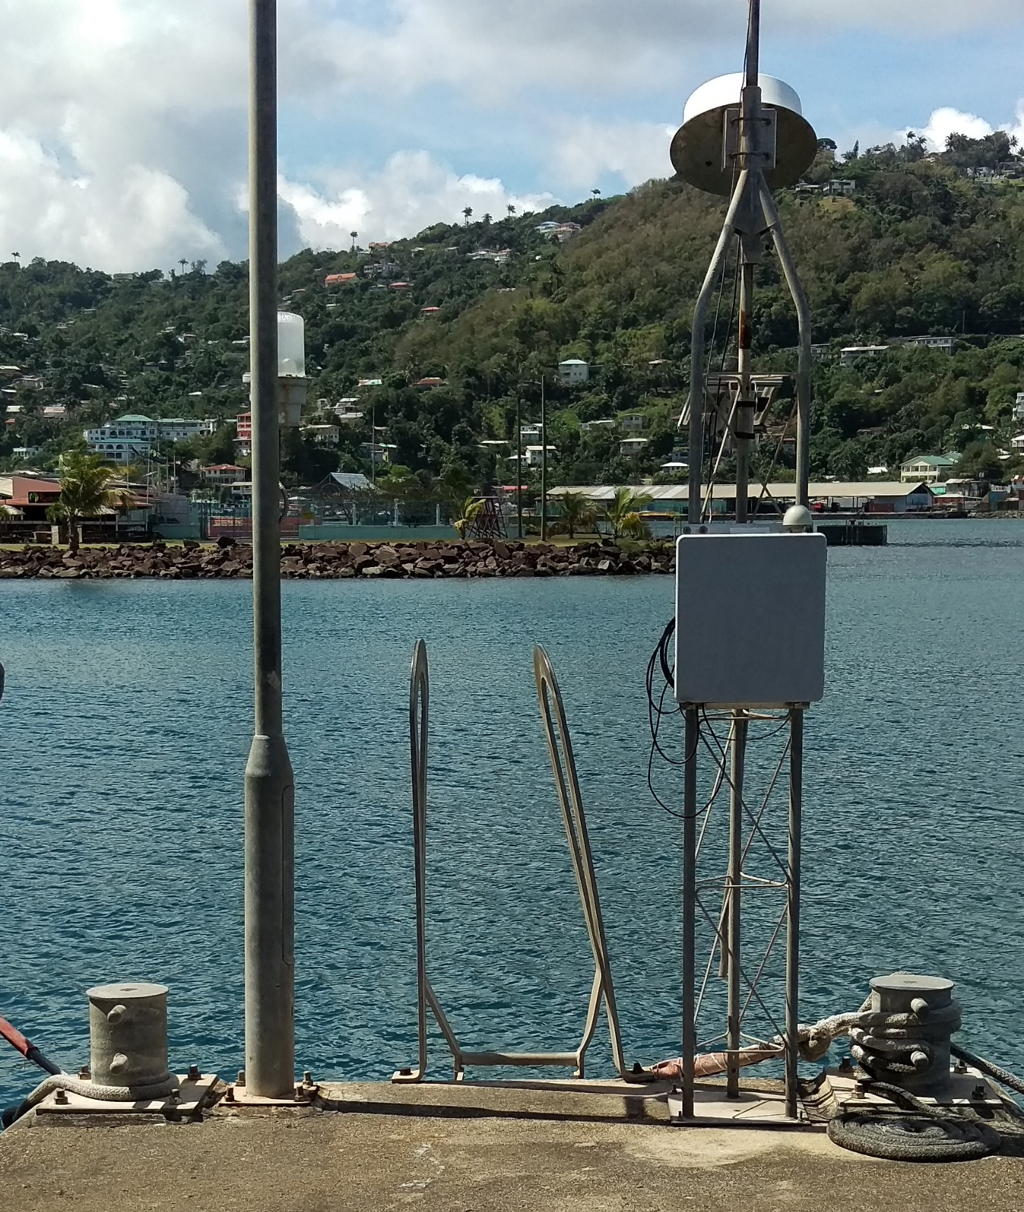
What makes a good location for a tide gauge?
An ideal location for a tide gauge is:
Away from risks of shipping and construction.
On flat, solid, stable ground.
Does not dry out at extreme low water.
Exposed to the open ocean (i.e. not up-river, in an estuary or behind sand banks or lagoons). Harbours are suitable as they are exposed to the ocean but also provide some protection from extreme conditions.

Slide 20
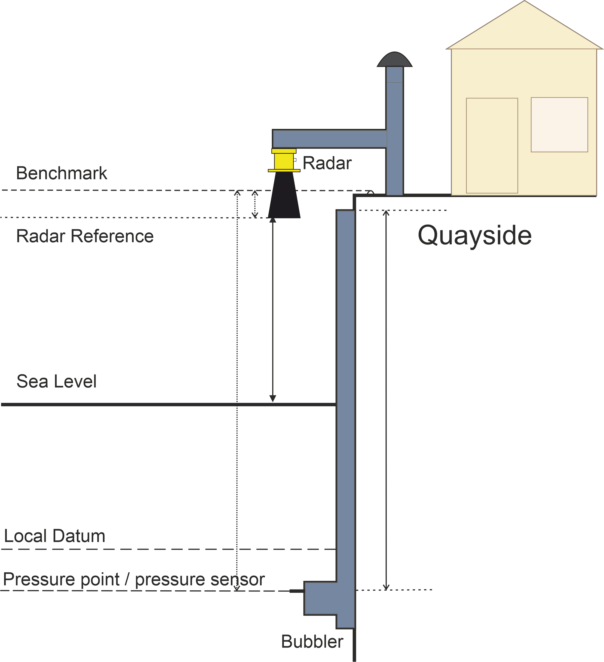
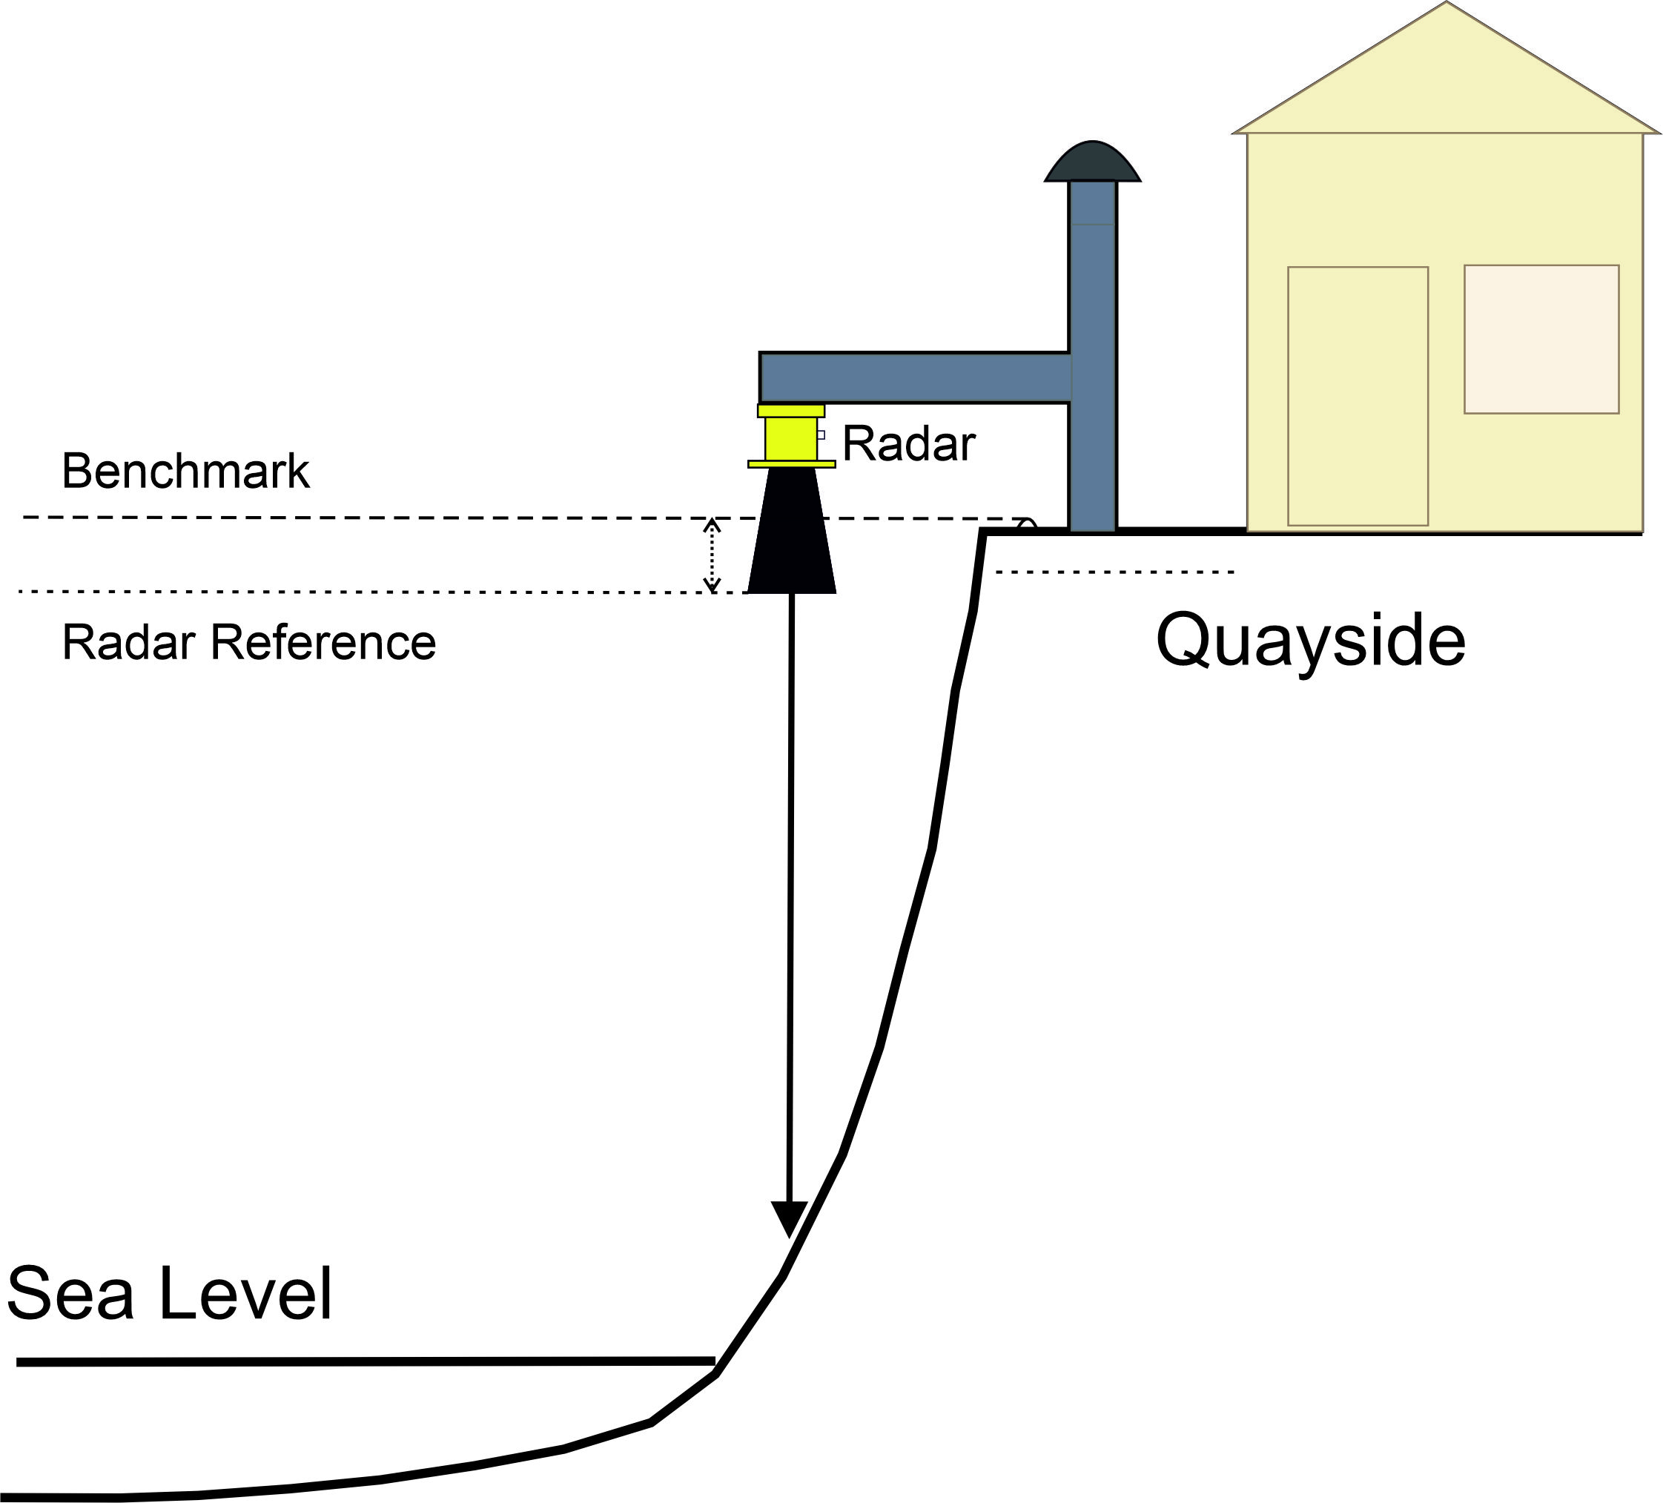
How topography influences tide gauge location
Site A
Site B

Slide 21
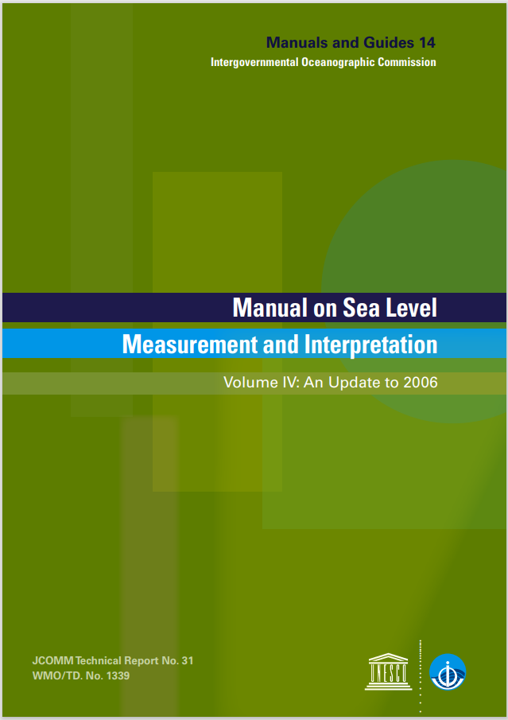
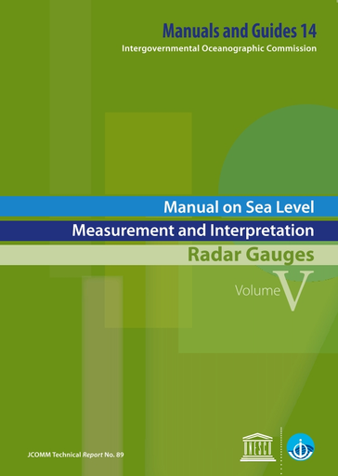
Ioc manuals on Sea level measurement and interpretation
Volume IV – general guidance on different technology types, suitability of locations etc
Volume V – specific to radar gauges (newer technology)
Available from www.unesco.org

Slide 22
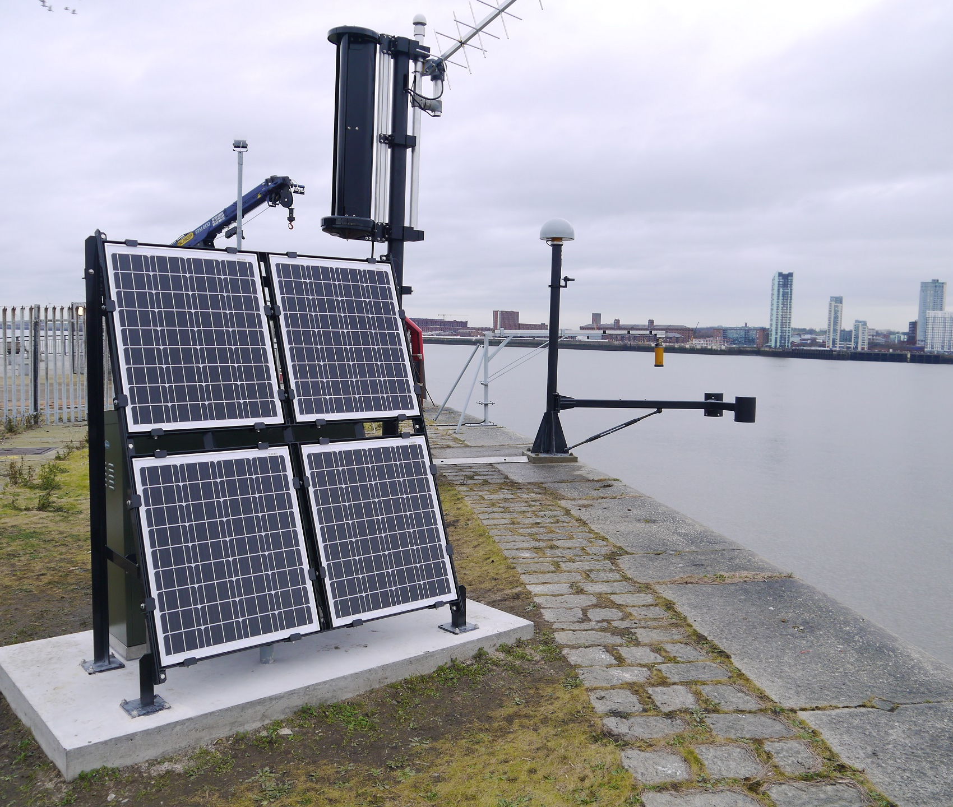
Installation Considerations
Dual sensors for redundancy (can combine 2 different technologies), plus a tide board for visual checks
Mains power or solar power? Ongoing costs and logistics of connecting to mains power supplies can be problematic
Telemetry options – dual methods are preferred in case one form fails. May be satellite-based (e.g. Meteosat. INMARSAT_BGAN), iridium-based, broadband etc. Cost may be a factor.
Data flows – to IOC Sea Level Station Monitoring Facility, University of Hawaii Sea Level Center, Permanent Service for Mean Sea Level and others

Slide 23

Gloss standard for sea level measurements
GLOSS sites require:
+/- 1 cm accuracy
At least 1 min averaged sampling
Levelling to local benchmarks
Continuous GNSS for vertical land motion (VLM)

Slide 24
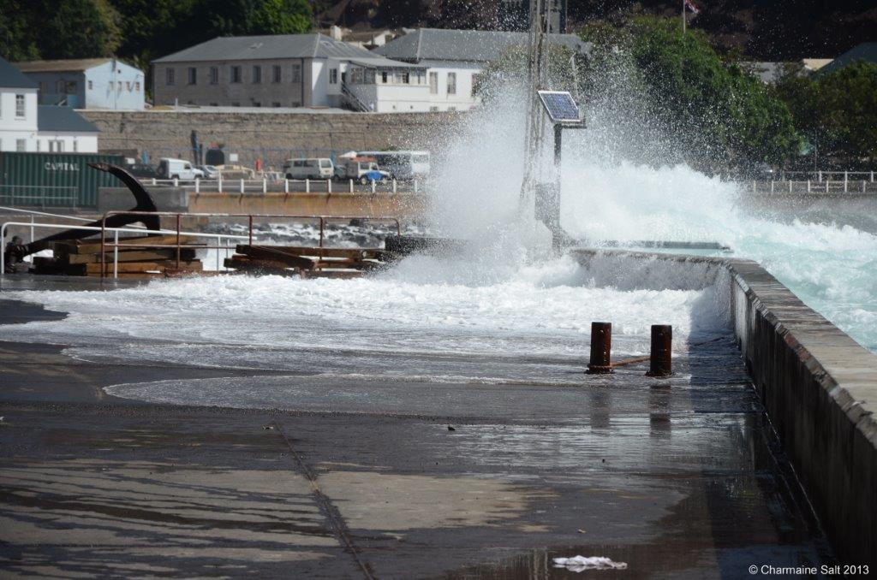
What to avoid with a tide gauge installation?
Locations that dry out at low spring tides
Locations near water/effluent outflow pipes
Sites with fast flowing water
Locations where vessels moor
Locations where wave overtopping occurs – depending upon the installation
Estuaries with strong freshwater influences

Slide 25
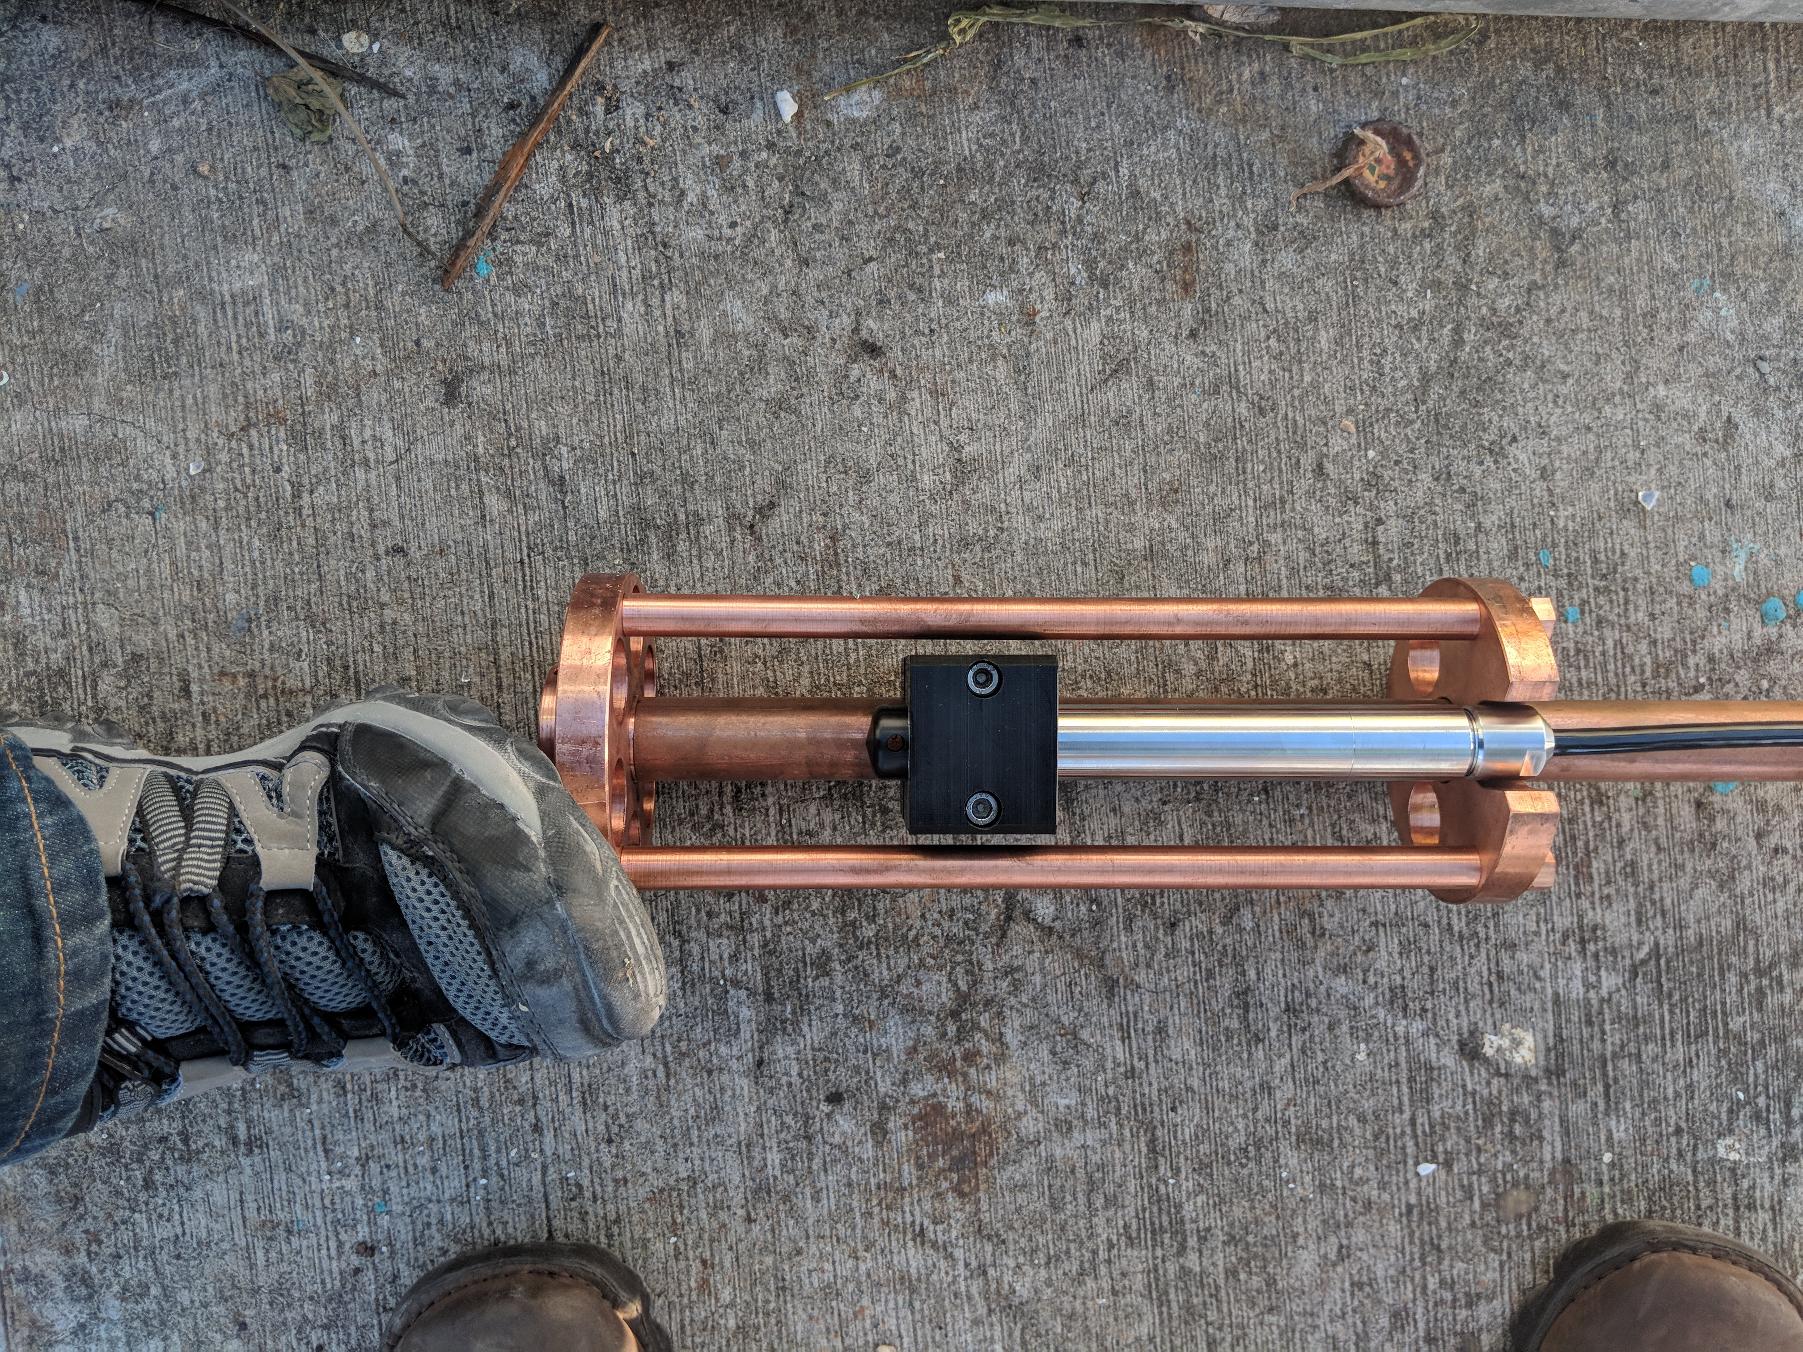
Sensor requirements – pressure sensors
Underwater pressure transducers
Measures the hydrostatic pressure of overlying water column, sea level value depends upon knowing the density of the water
Can’t be overtopped
Good for tsunami monitoring
Difficult to maintain
Corrosion & biofouling risk
May need large and costly supporting steelwork in areas of large tidal range

Slide 26
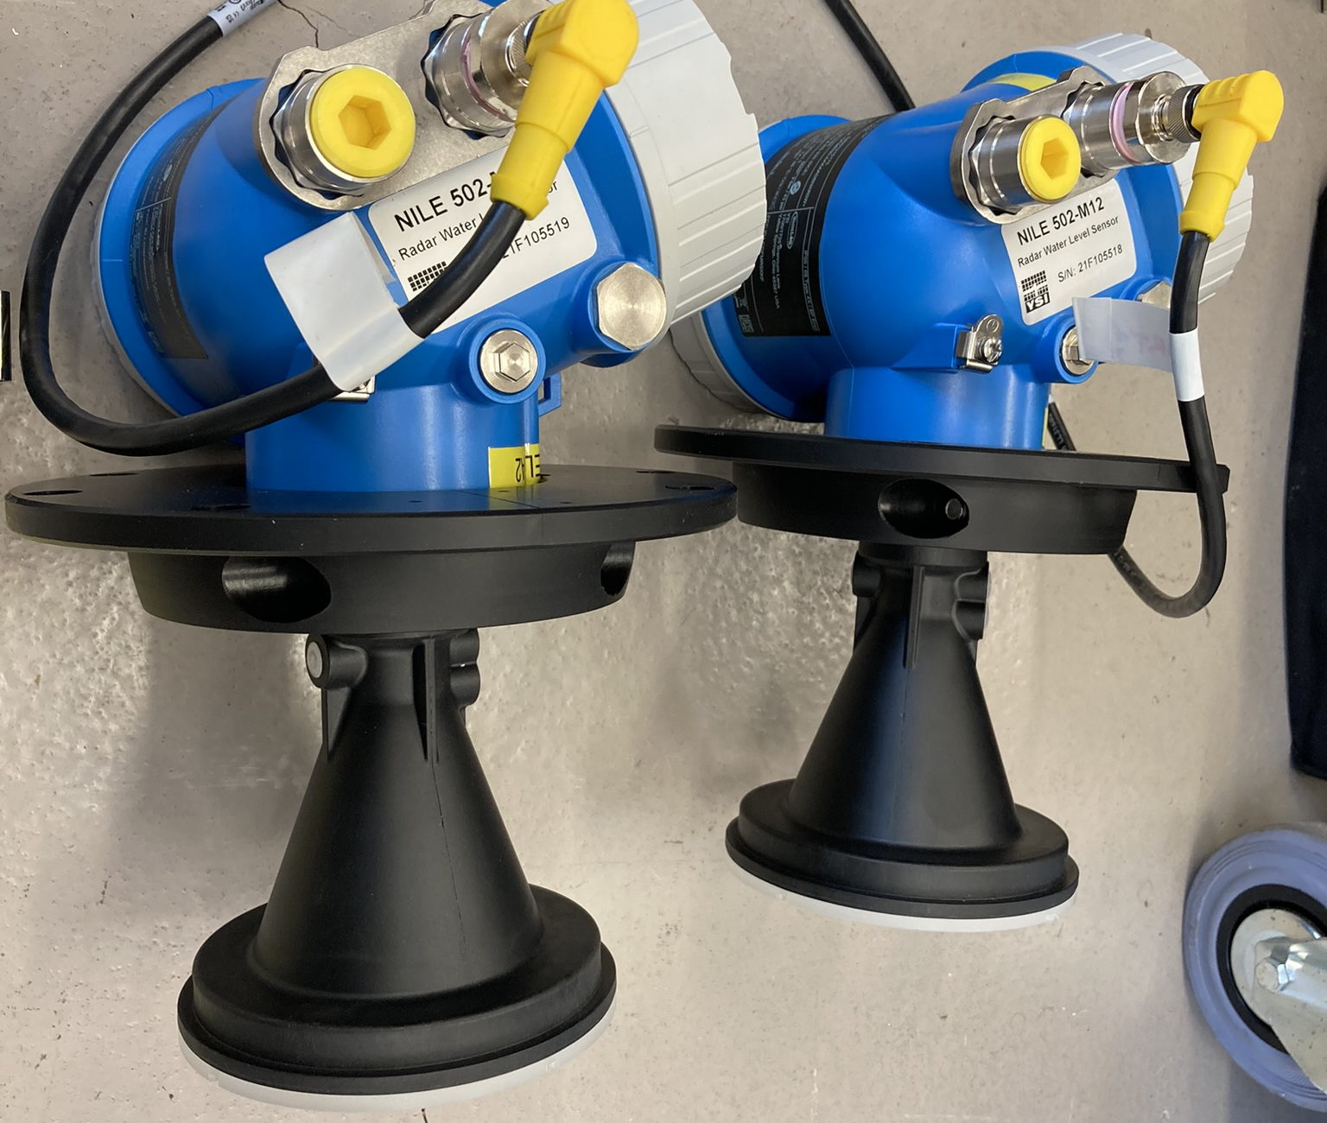
Sensor requirements – RADAR sensors
Measure the time of flight of radar pulses
Signal is inverted to give sea level height
Horn focuses the radar beam. Longer horns are suited to larger tidal range (so the footprint of the radar doesn’t capture surrounding objects at low water)
Relatively cheap
Easily installed and maintained (no need for divers or stilling wells etc.)
Can be damaged/overtopped so must be located away from shipping traffic
No obstructions between the radar sensor and the sea surface e.g. fenders, buoys

Slide 27
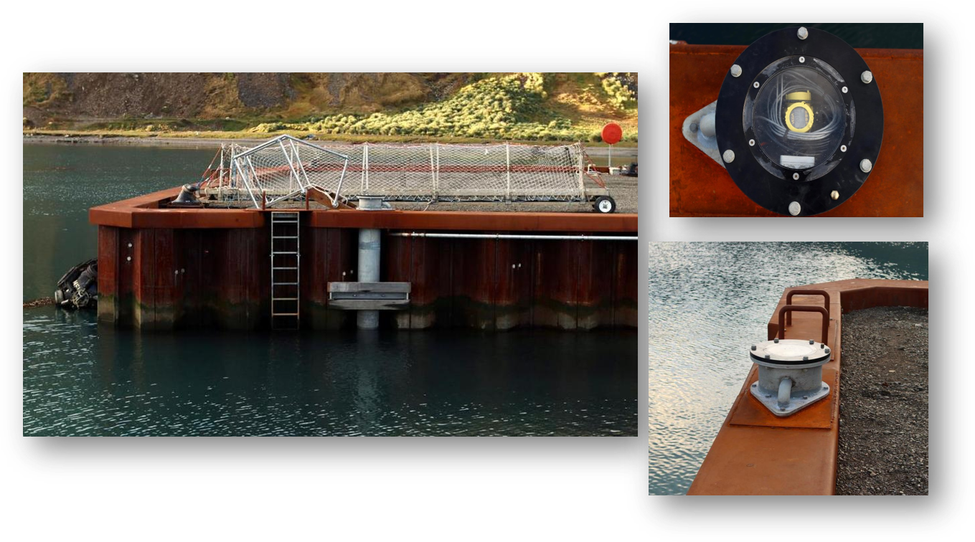
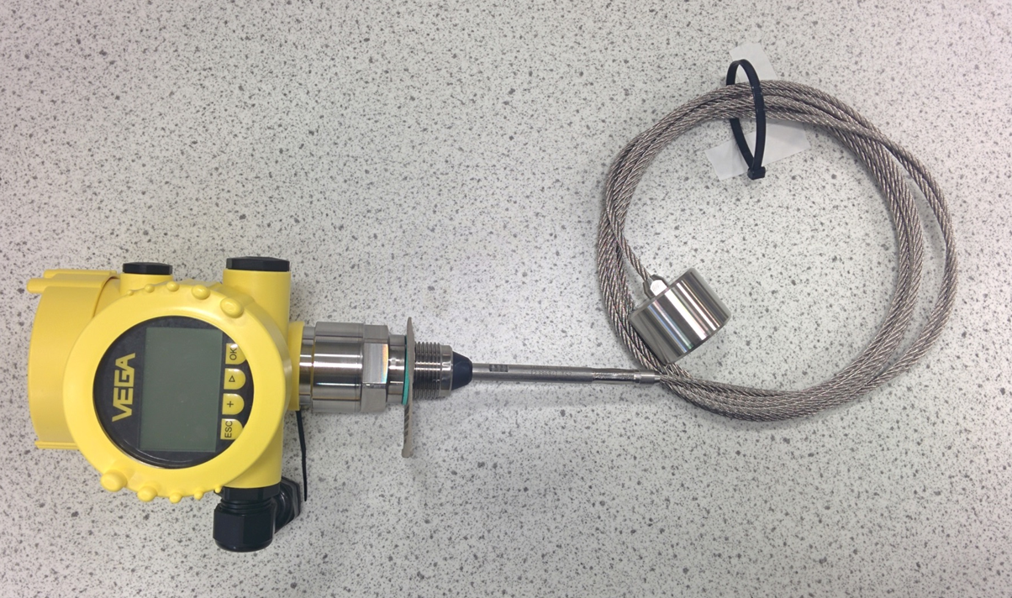
Sensor requirements – guided wave RADAR sensors
Guided wave radars can be installed within a stilling well
The flex guides the radar pulse down to the sea surface and avoids reflection off the walls of the stilling well
Tidal range is a consideration as very long stilling wells may be needed in areas of large tidal range

Slide 28
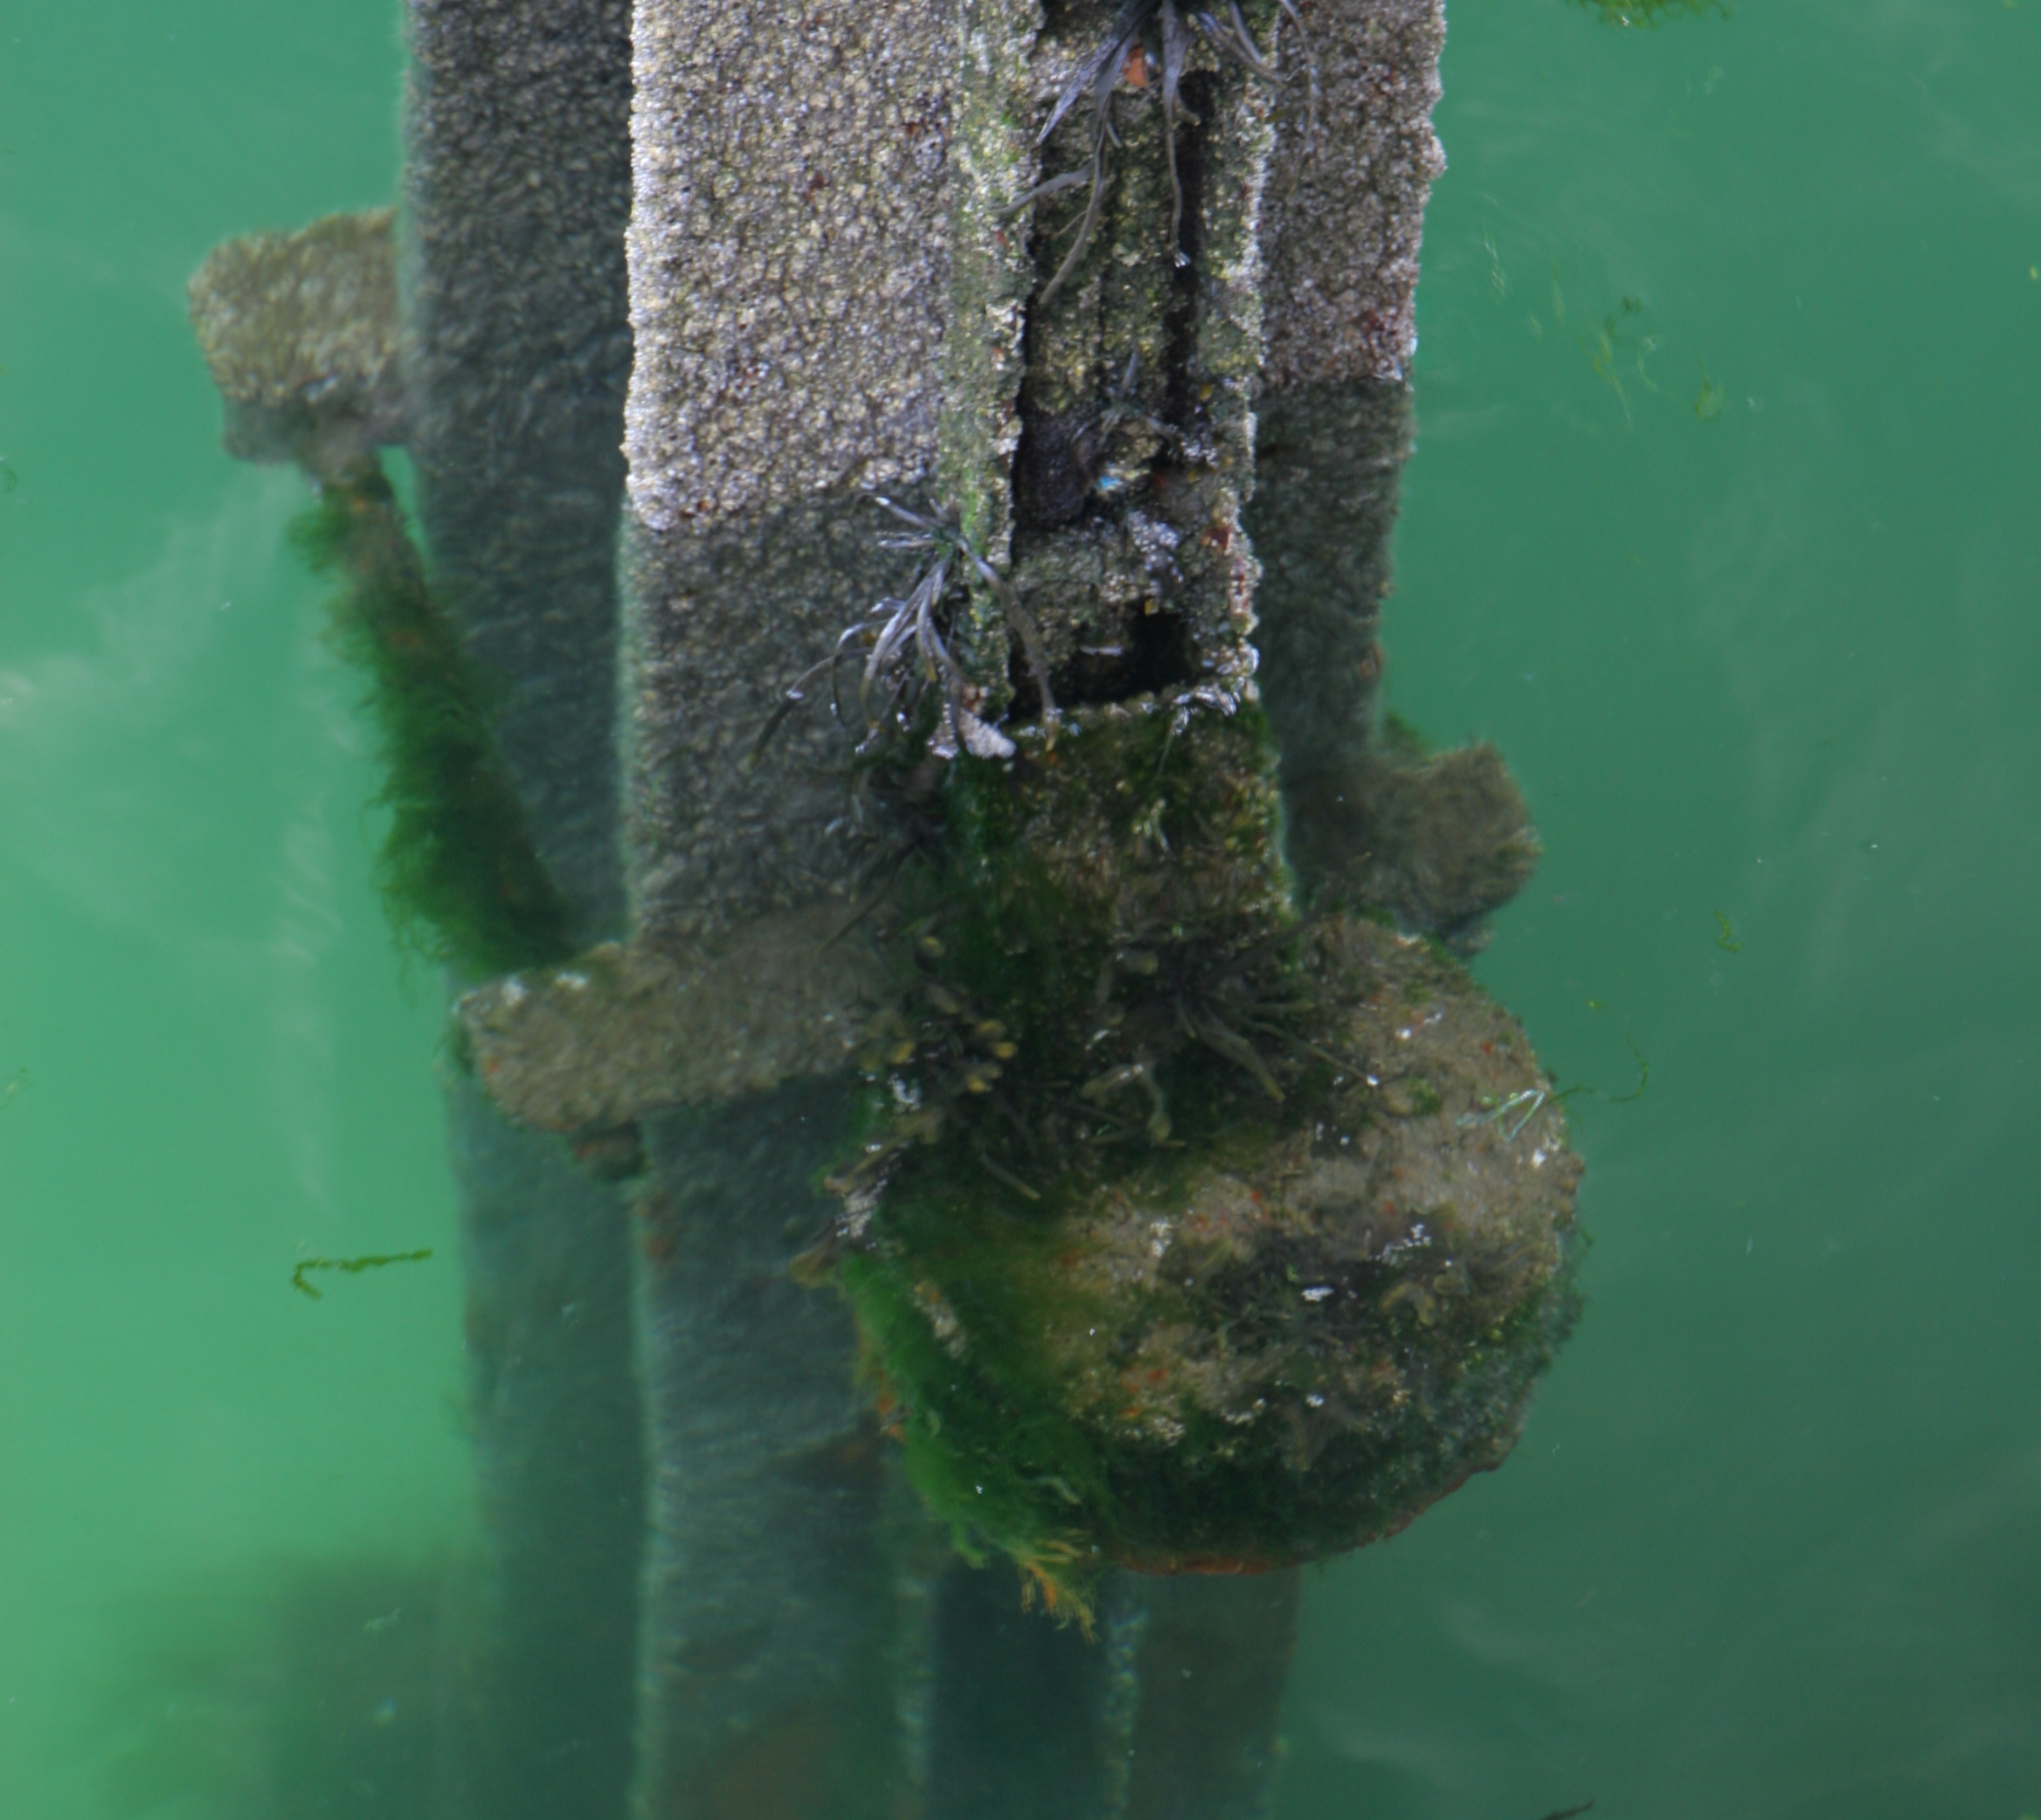
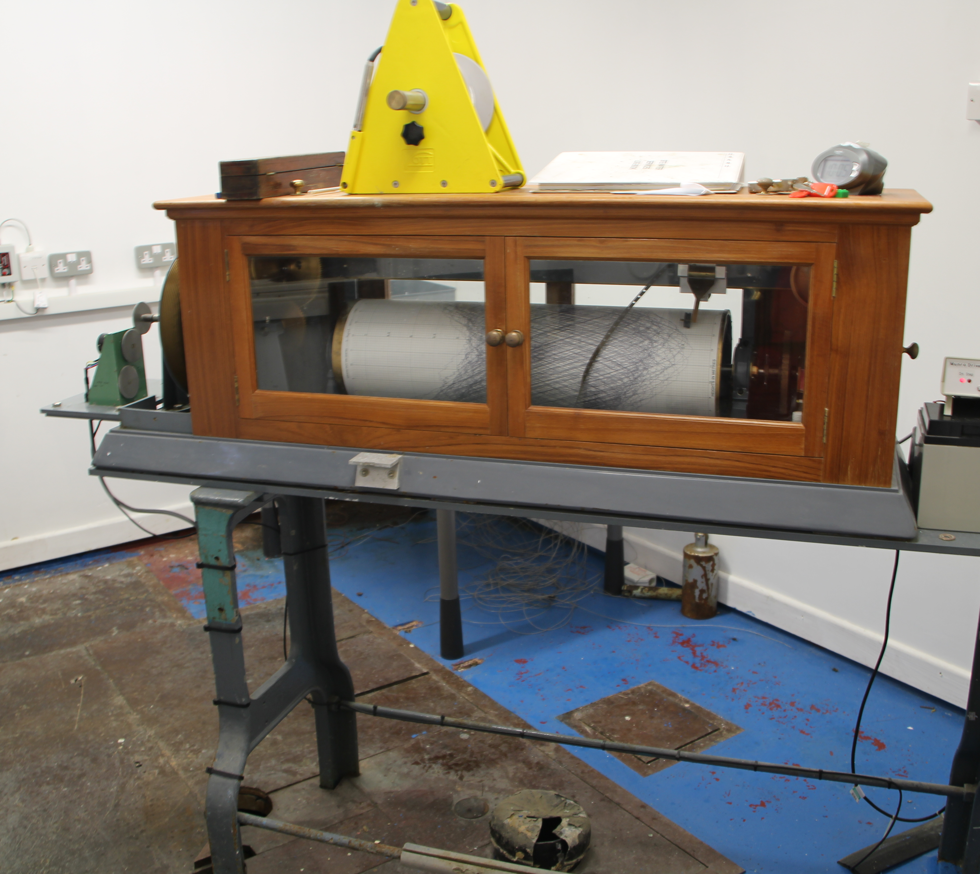
What sensors are best for a tide gauge?
Not all sensors are suitable for all locations.
Some sensor require expensive infrastructure to install – bubbler and direct pressure sensors.
Some sensors may not respond well in turbulent sea conditions – open water radars.
Stilling wells provide a calm sea surface but can also introduce a lag in the tide signal and become blocked.
The best sensors to use are those that will work well given the installation budget constraints.

Slide 29
Thank you

