Slide 1

4.5 NEAMWave 26 Exercise Preparation
Coordinated by Task Team on NEAMWave Exercise
co-chairs: Ceren Ozer Sozdinler
Marinos Charalampakis
ICG/NEAMTWS-XX
3-5 December 2025

Slide 2

@19th ICG/NEAMTWS
Decisions:
To organize the next NEAMWave exercise in March 2026 ⇨ 3 -24 March 2026
The exercise scenarios should be created through collaboration between TSPs and NTWCs ⇨ 3 NTWCs (CY, ES, RO) are collaborating with TSPs
One or more single or joint scenarios proposed to meet the specific needs of the MS ⇨ 3 joint scenarios / 2 single scenarios | 3 TSPs are participating in 2 scenarios
Encouraging the collaboration of CoastWAVE 2.0 activities
ICG/NEAMTWS-XX • 3-5 December 2025

Slide 3
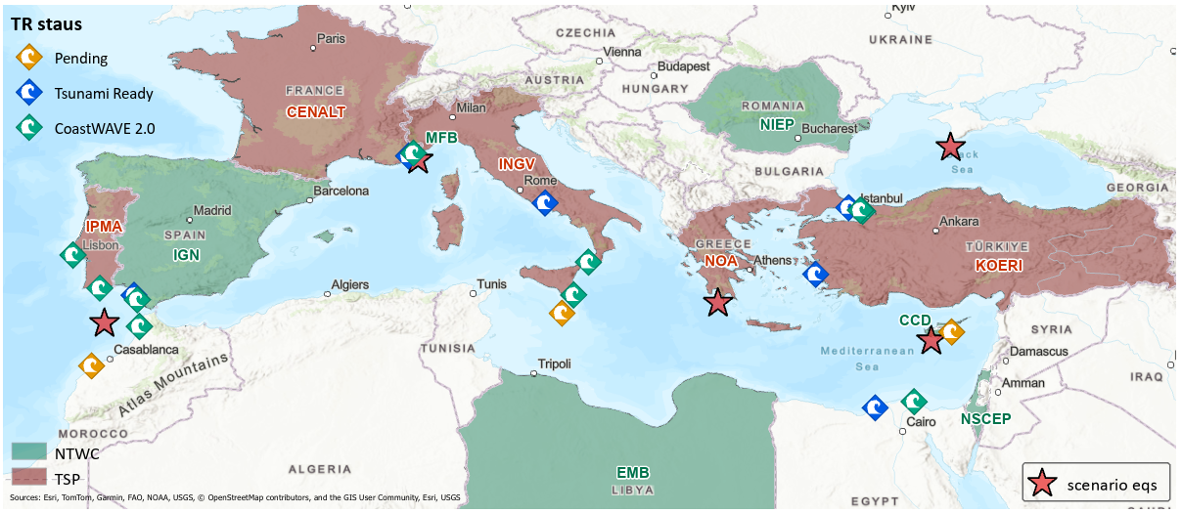
Scenarios
no | Date | Type | TSPs | NTWCs | Title | Epicenter (lat - lon) | Magnitude | Description | Potential affected MS
SN-01 | 03-Mar-26 | single | NOA | CD or GSD | Cyprian Arc | 34.55N - 32.65E | 7.5 | 1222 SW of Cyprus | Greece, Cyprus, Egypt, Libya, Malta, Italy
SN-02 | 11-Mar-26 | joint | INGV-NOA | EMB (LY) | Ionian Sea | 36.40N - 22.20E | 7.1 | 1867 Peloponnesus | Greece, Italy, Egypt, Malta
SN-03 | 12-Mar-26 | joint | CENALT-INGV | Monaco FB | Ligurian Sea | 43.42N - 7.50E | 6.9 | 1887 Ligurian Earthquake | Italy, France, Monaco
SN-04 | 13-Mar-26 | single | KOERI | NIEP | Black Sea | 44.04N - 33.60E | 7.5 | Black Sea | Turkiye, Romania, Bulgaria
SN-05 | 24-Mar-26 | joint | IPMA-CENALT | IGN | NE Atlantic Ocean | 35.41N -7.87W | 8.7 | Gulf of Cádiz | Portugal, Spain, Morocco

Slide 4
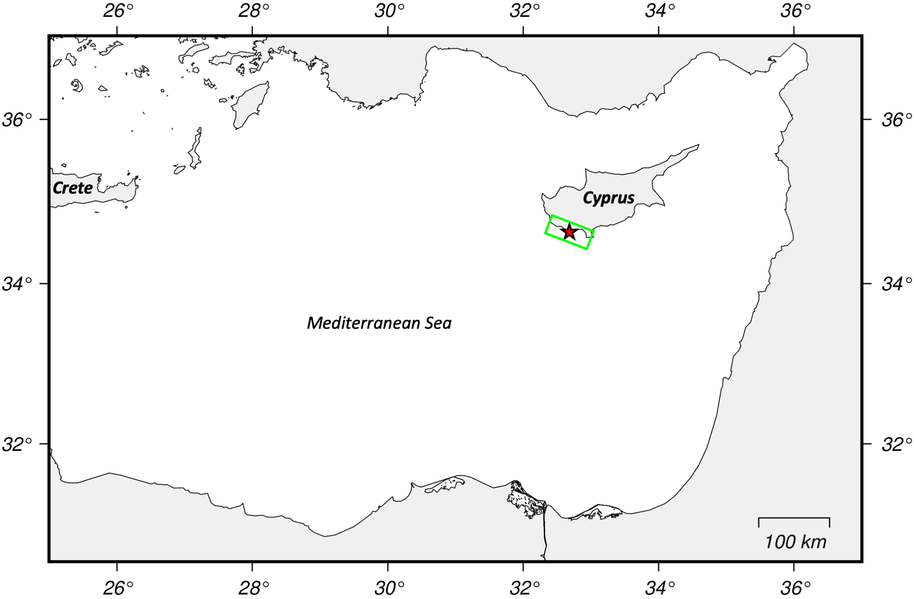
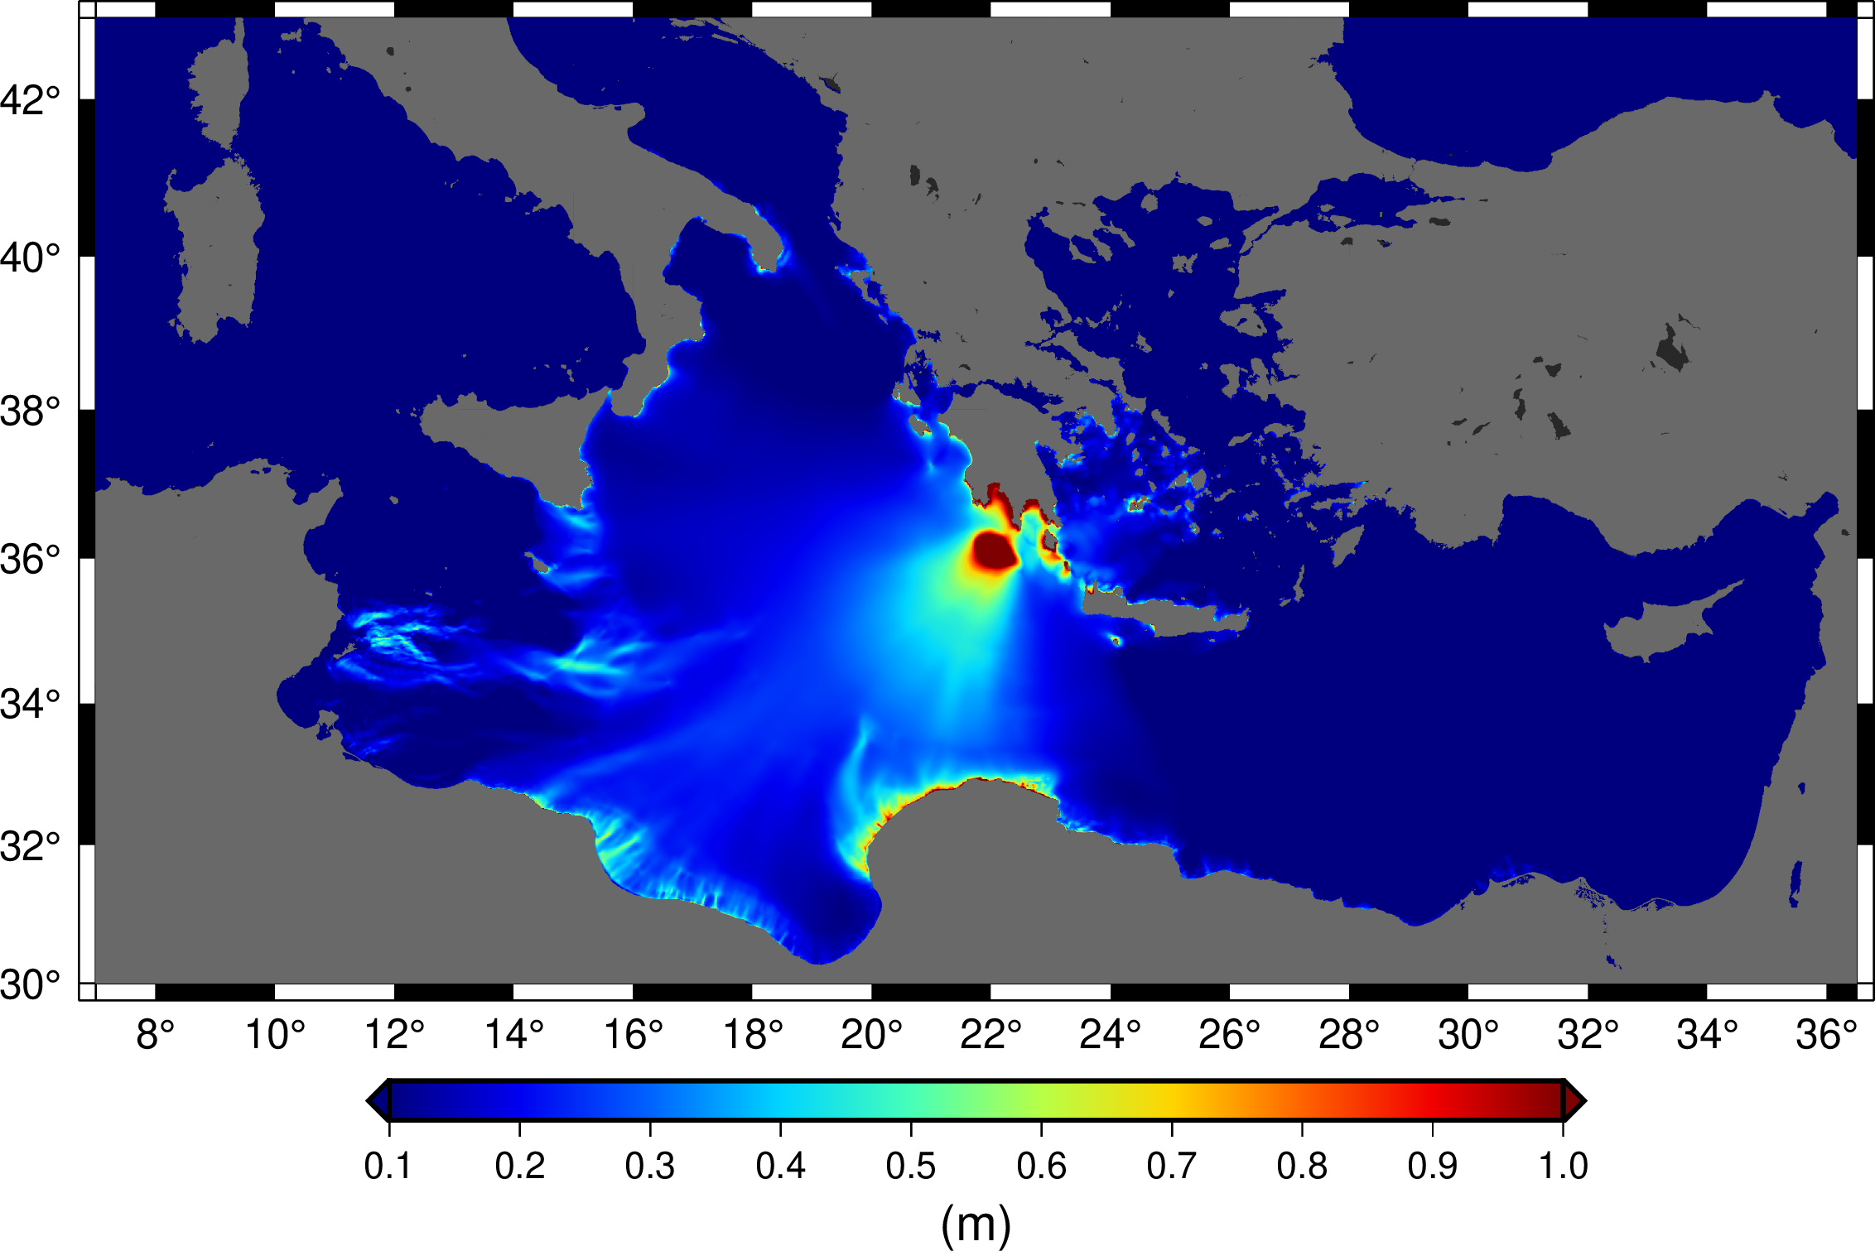
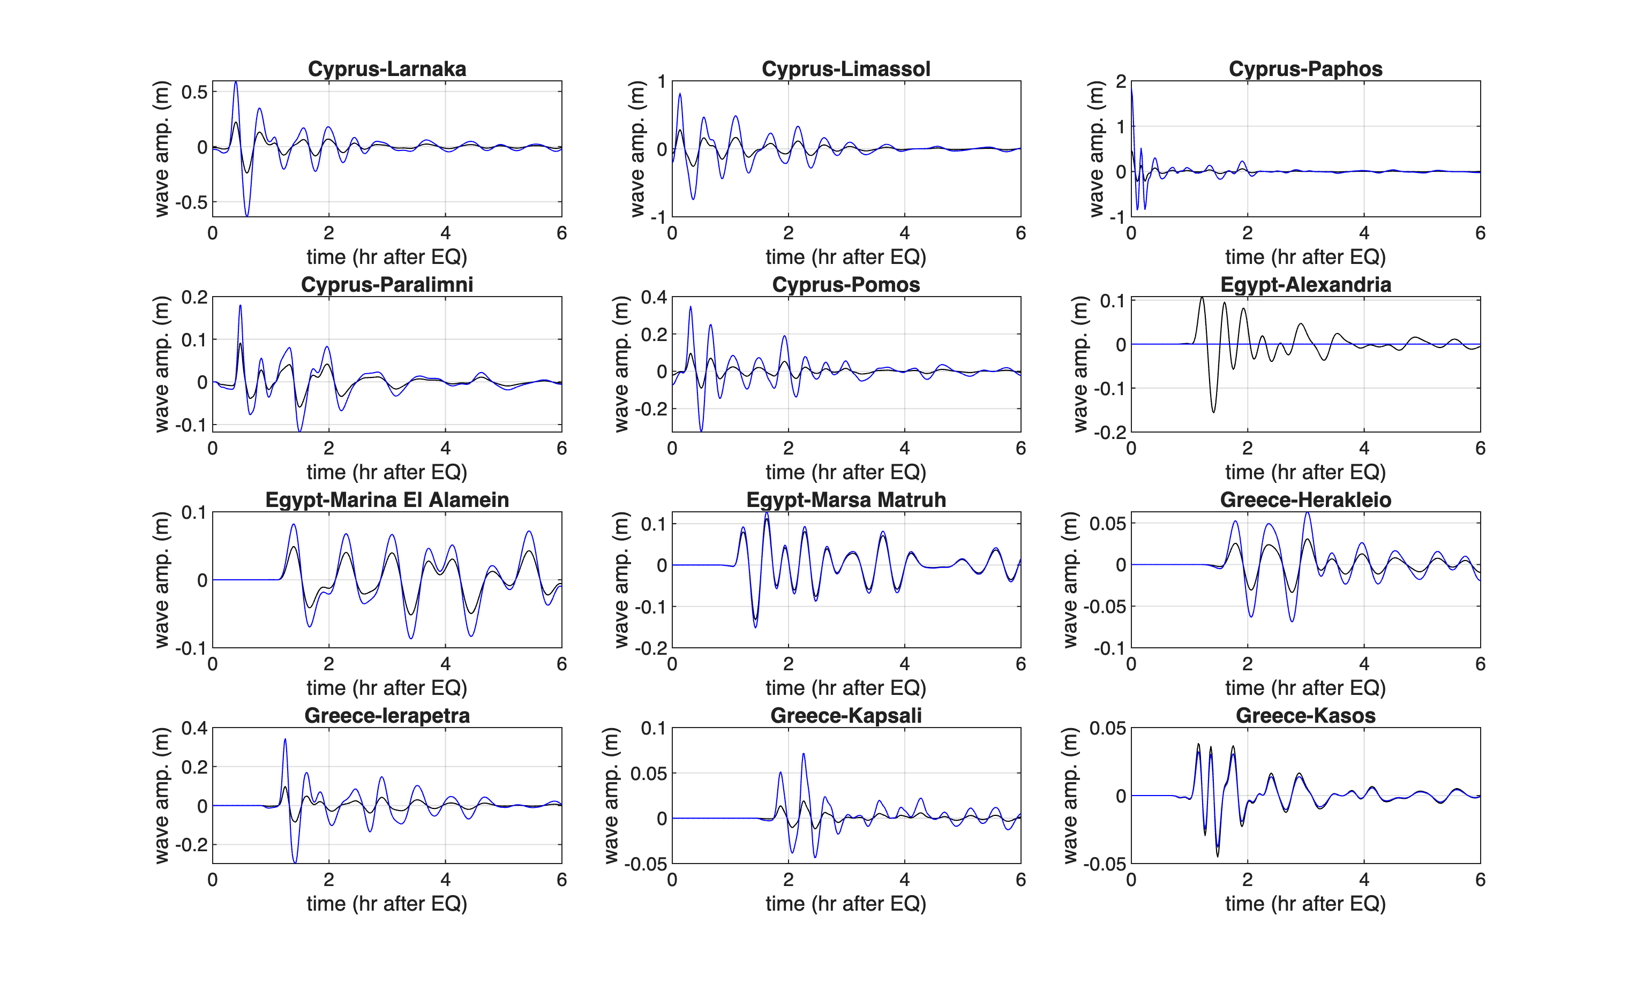
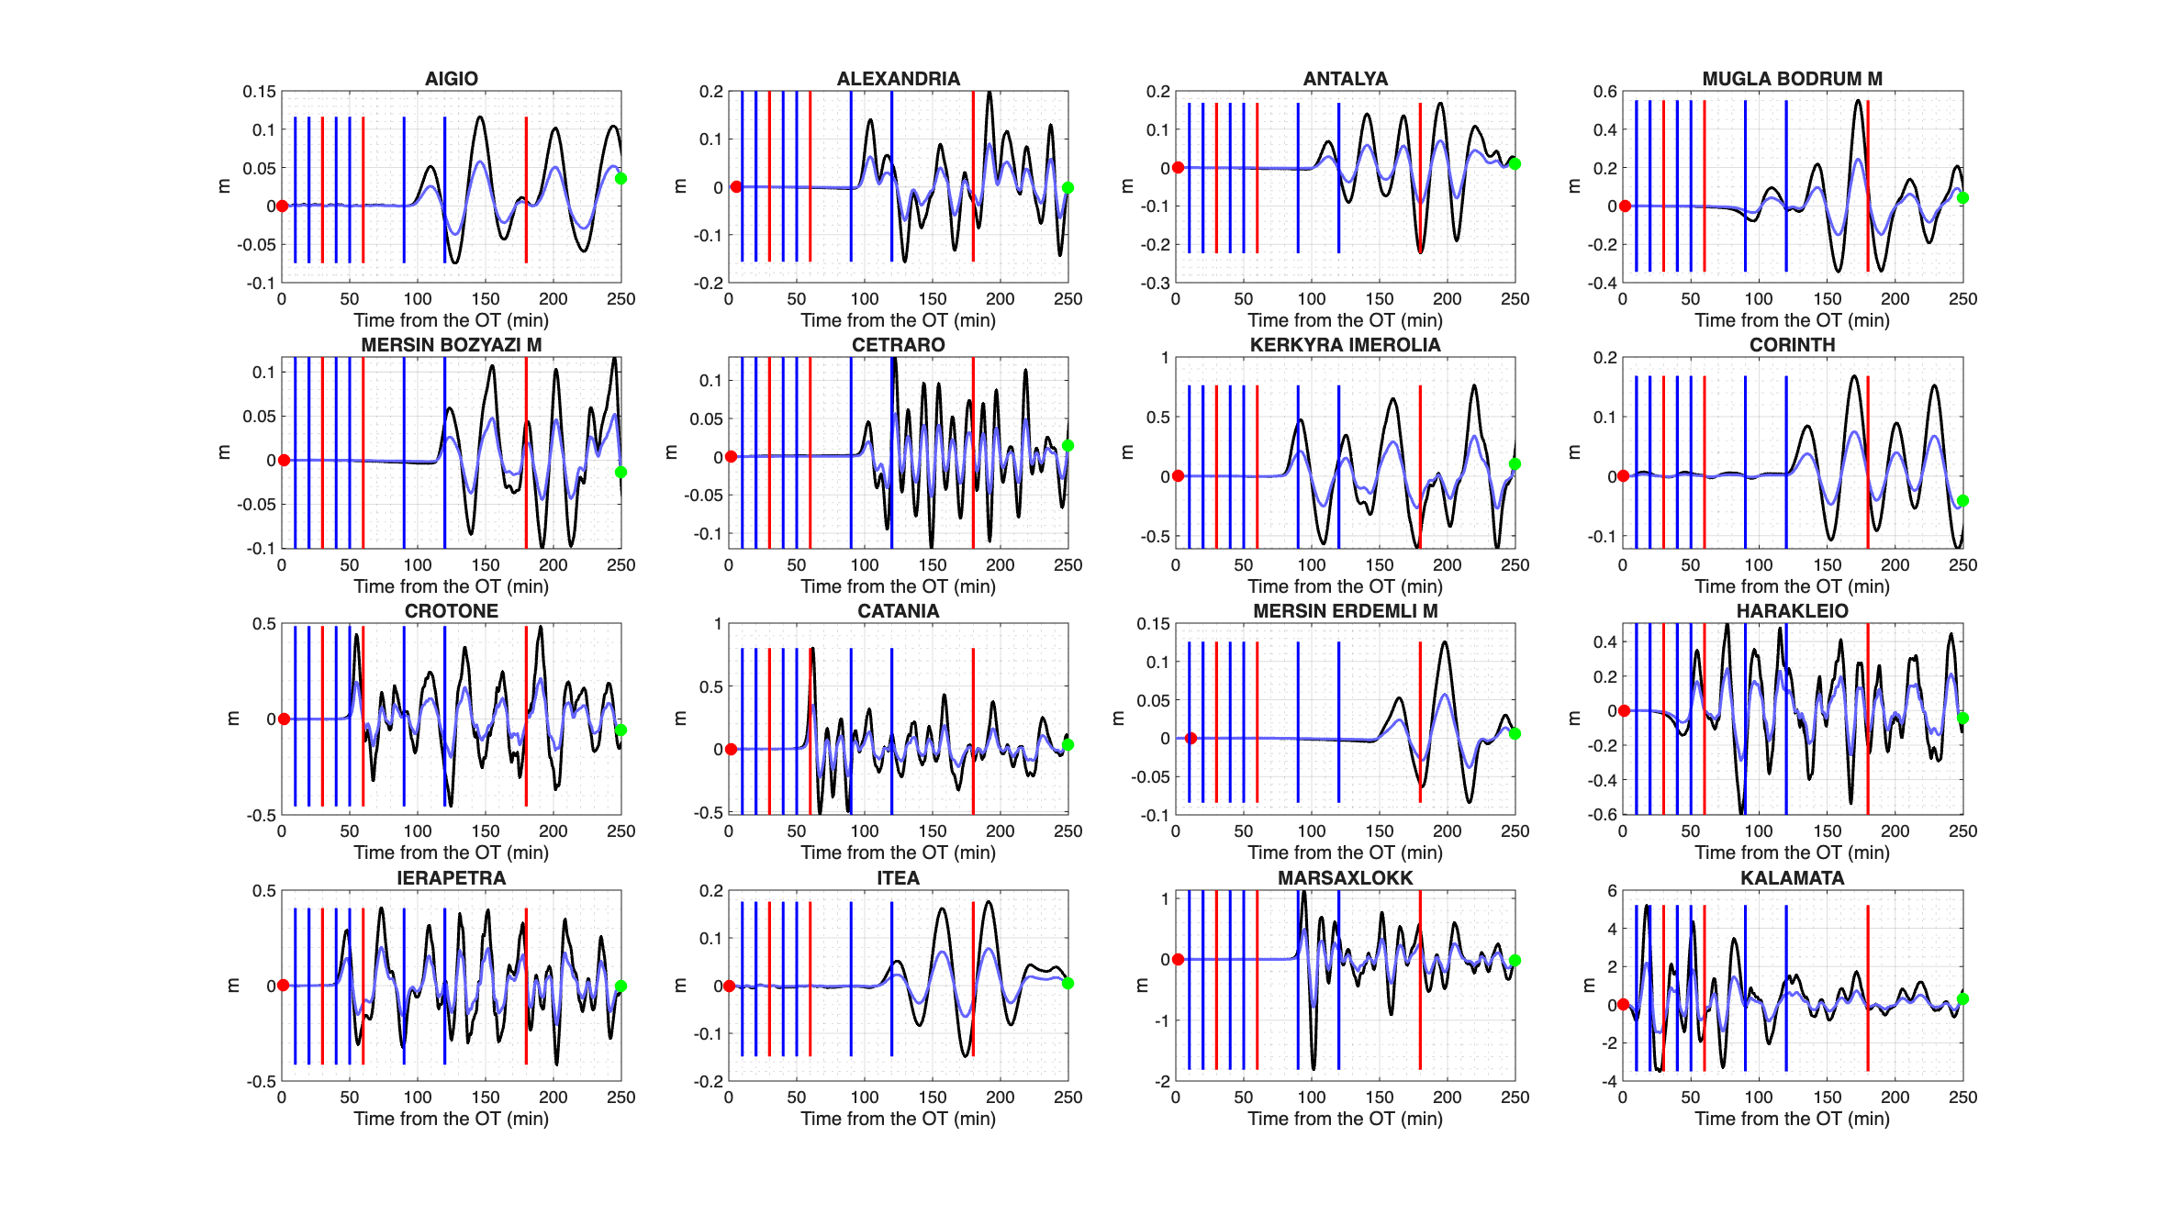
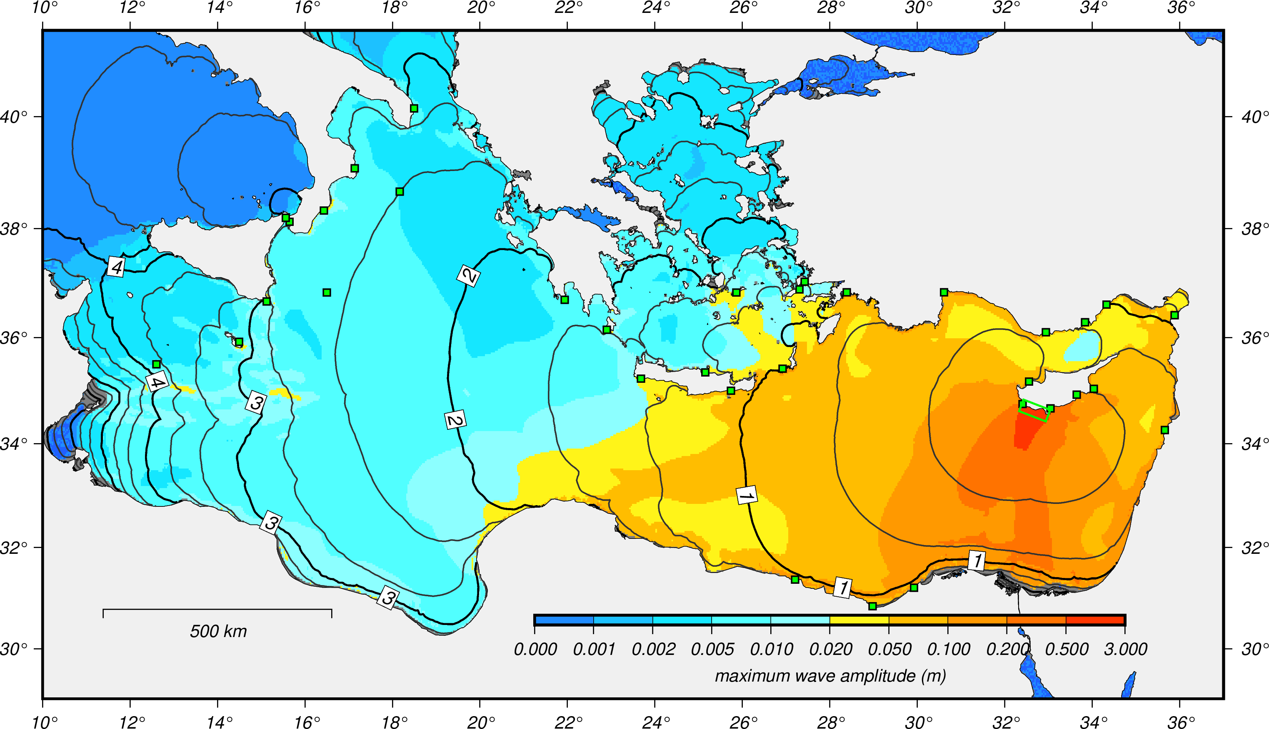
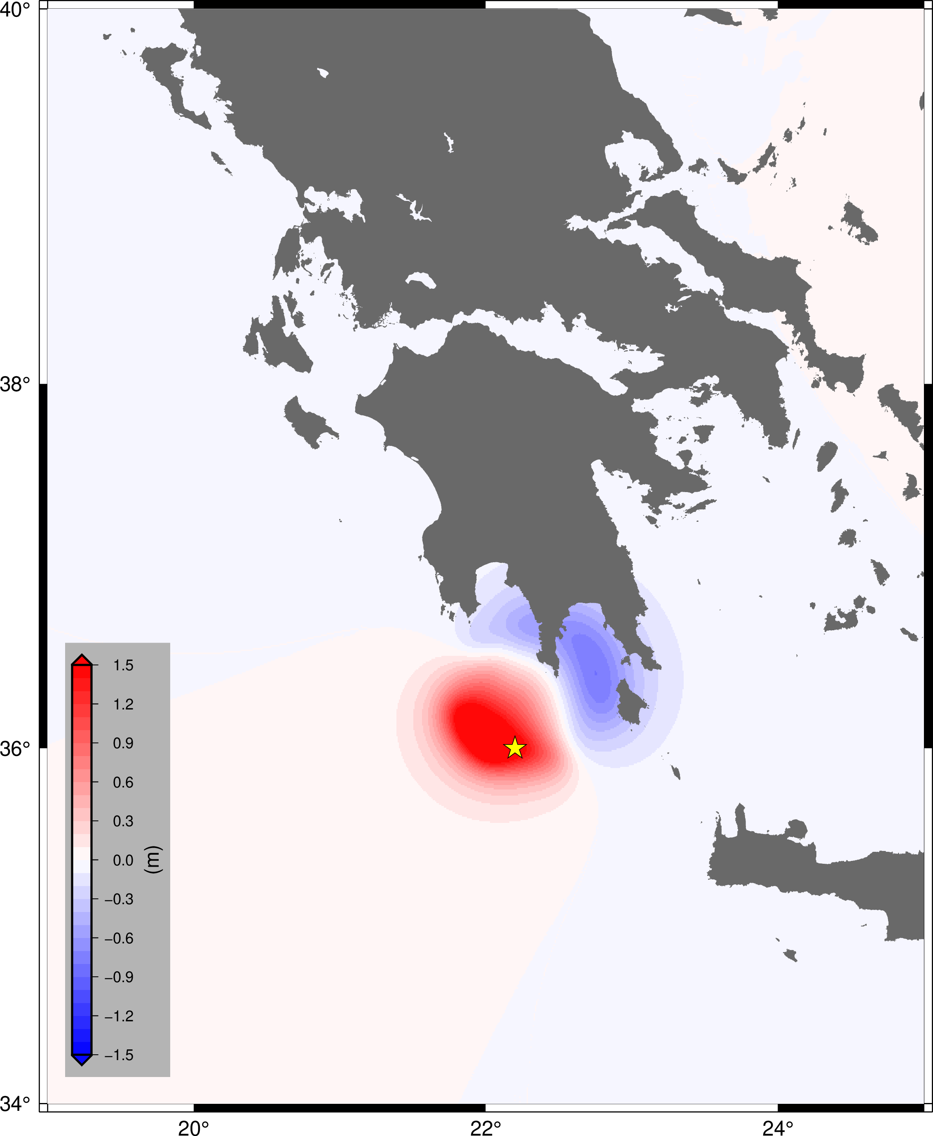
Scenarios
N O A
I N G V - N O A
ICG/NEAMTWS-XX • 3-5 December 2025

Slide 5
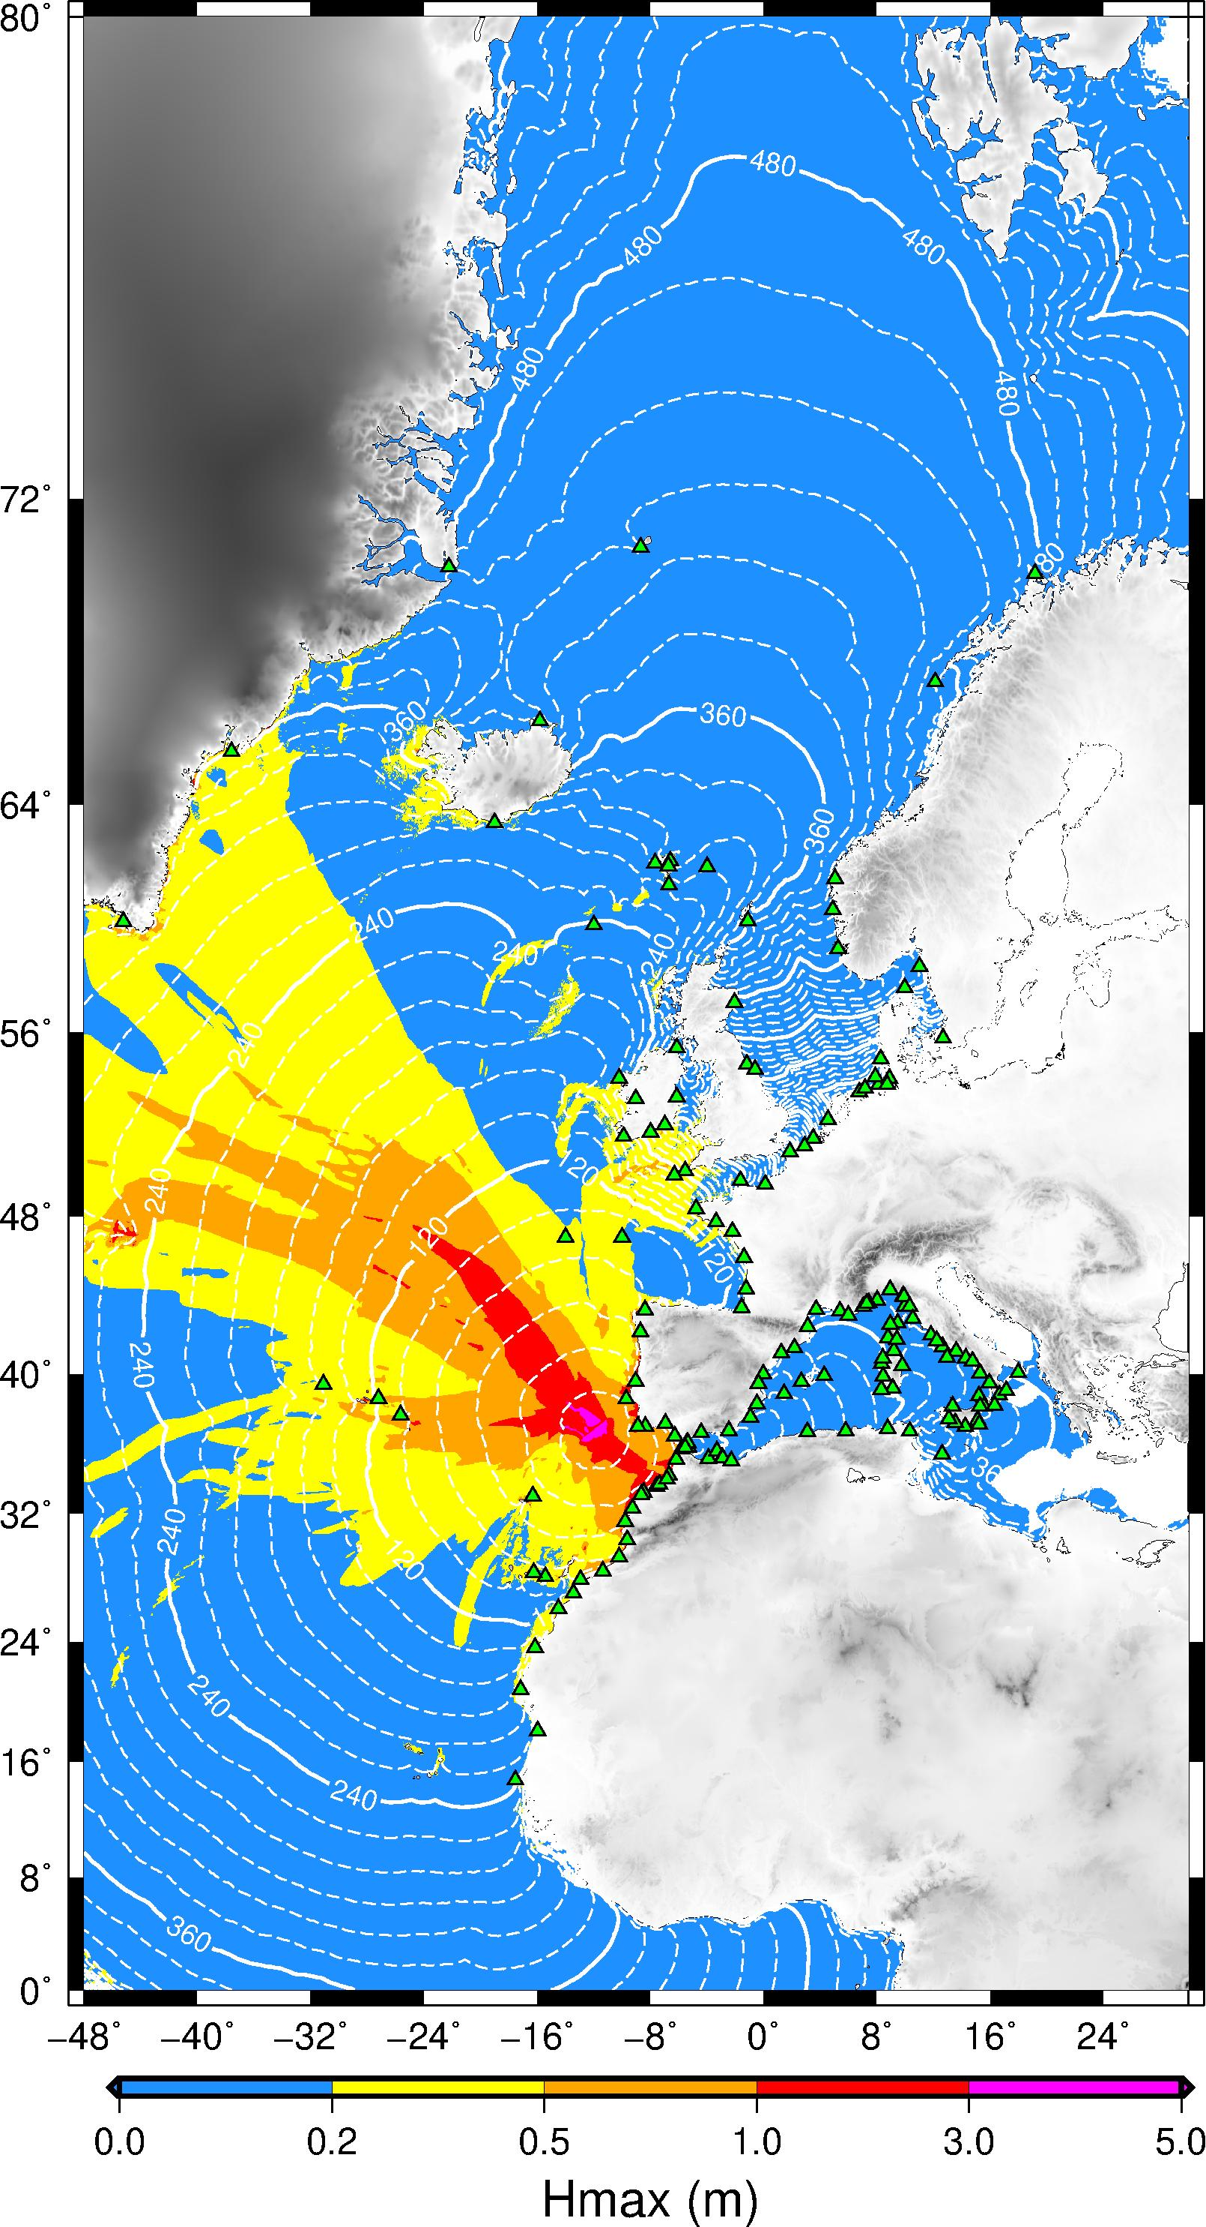
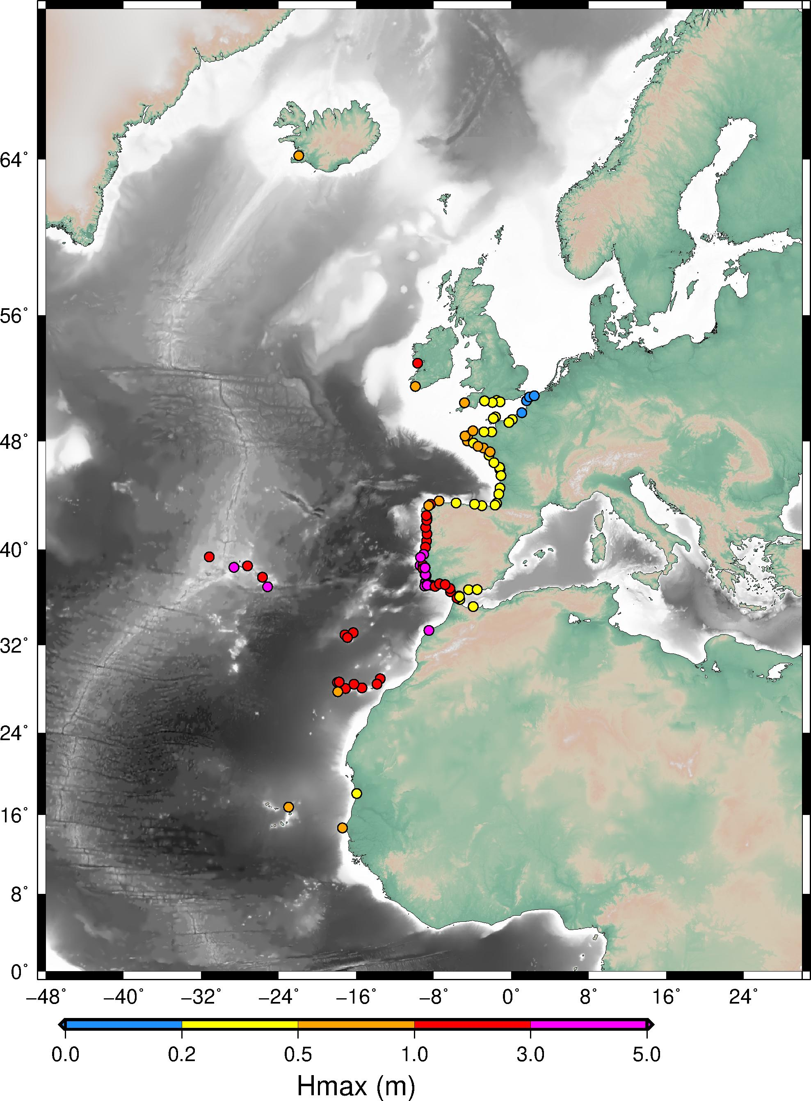
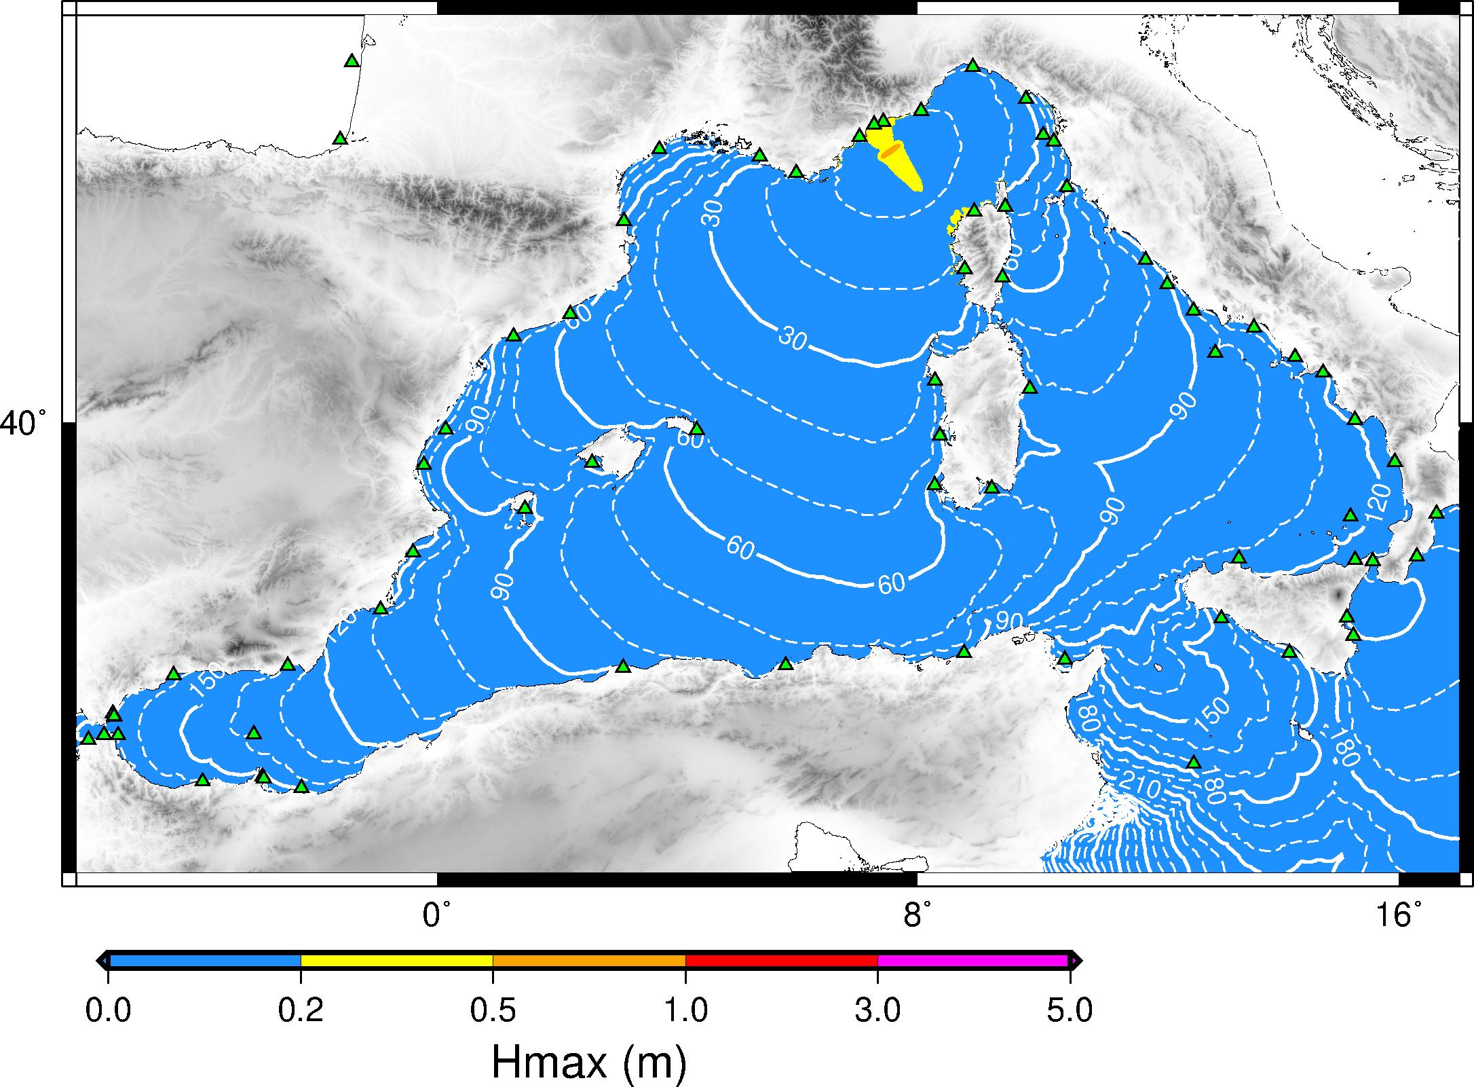
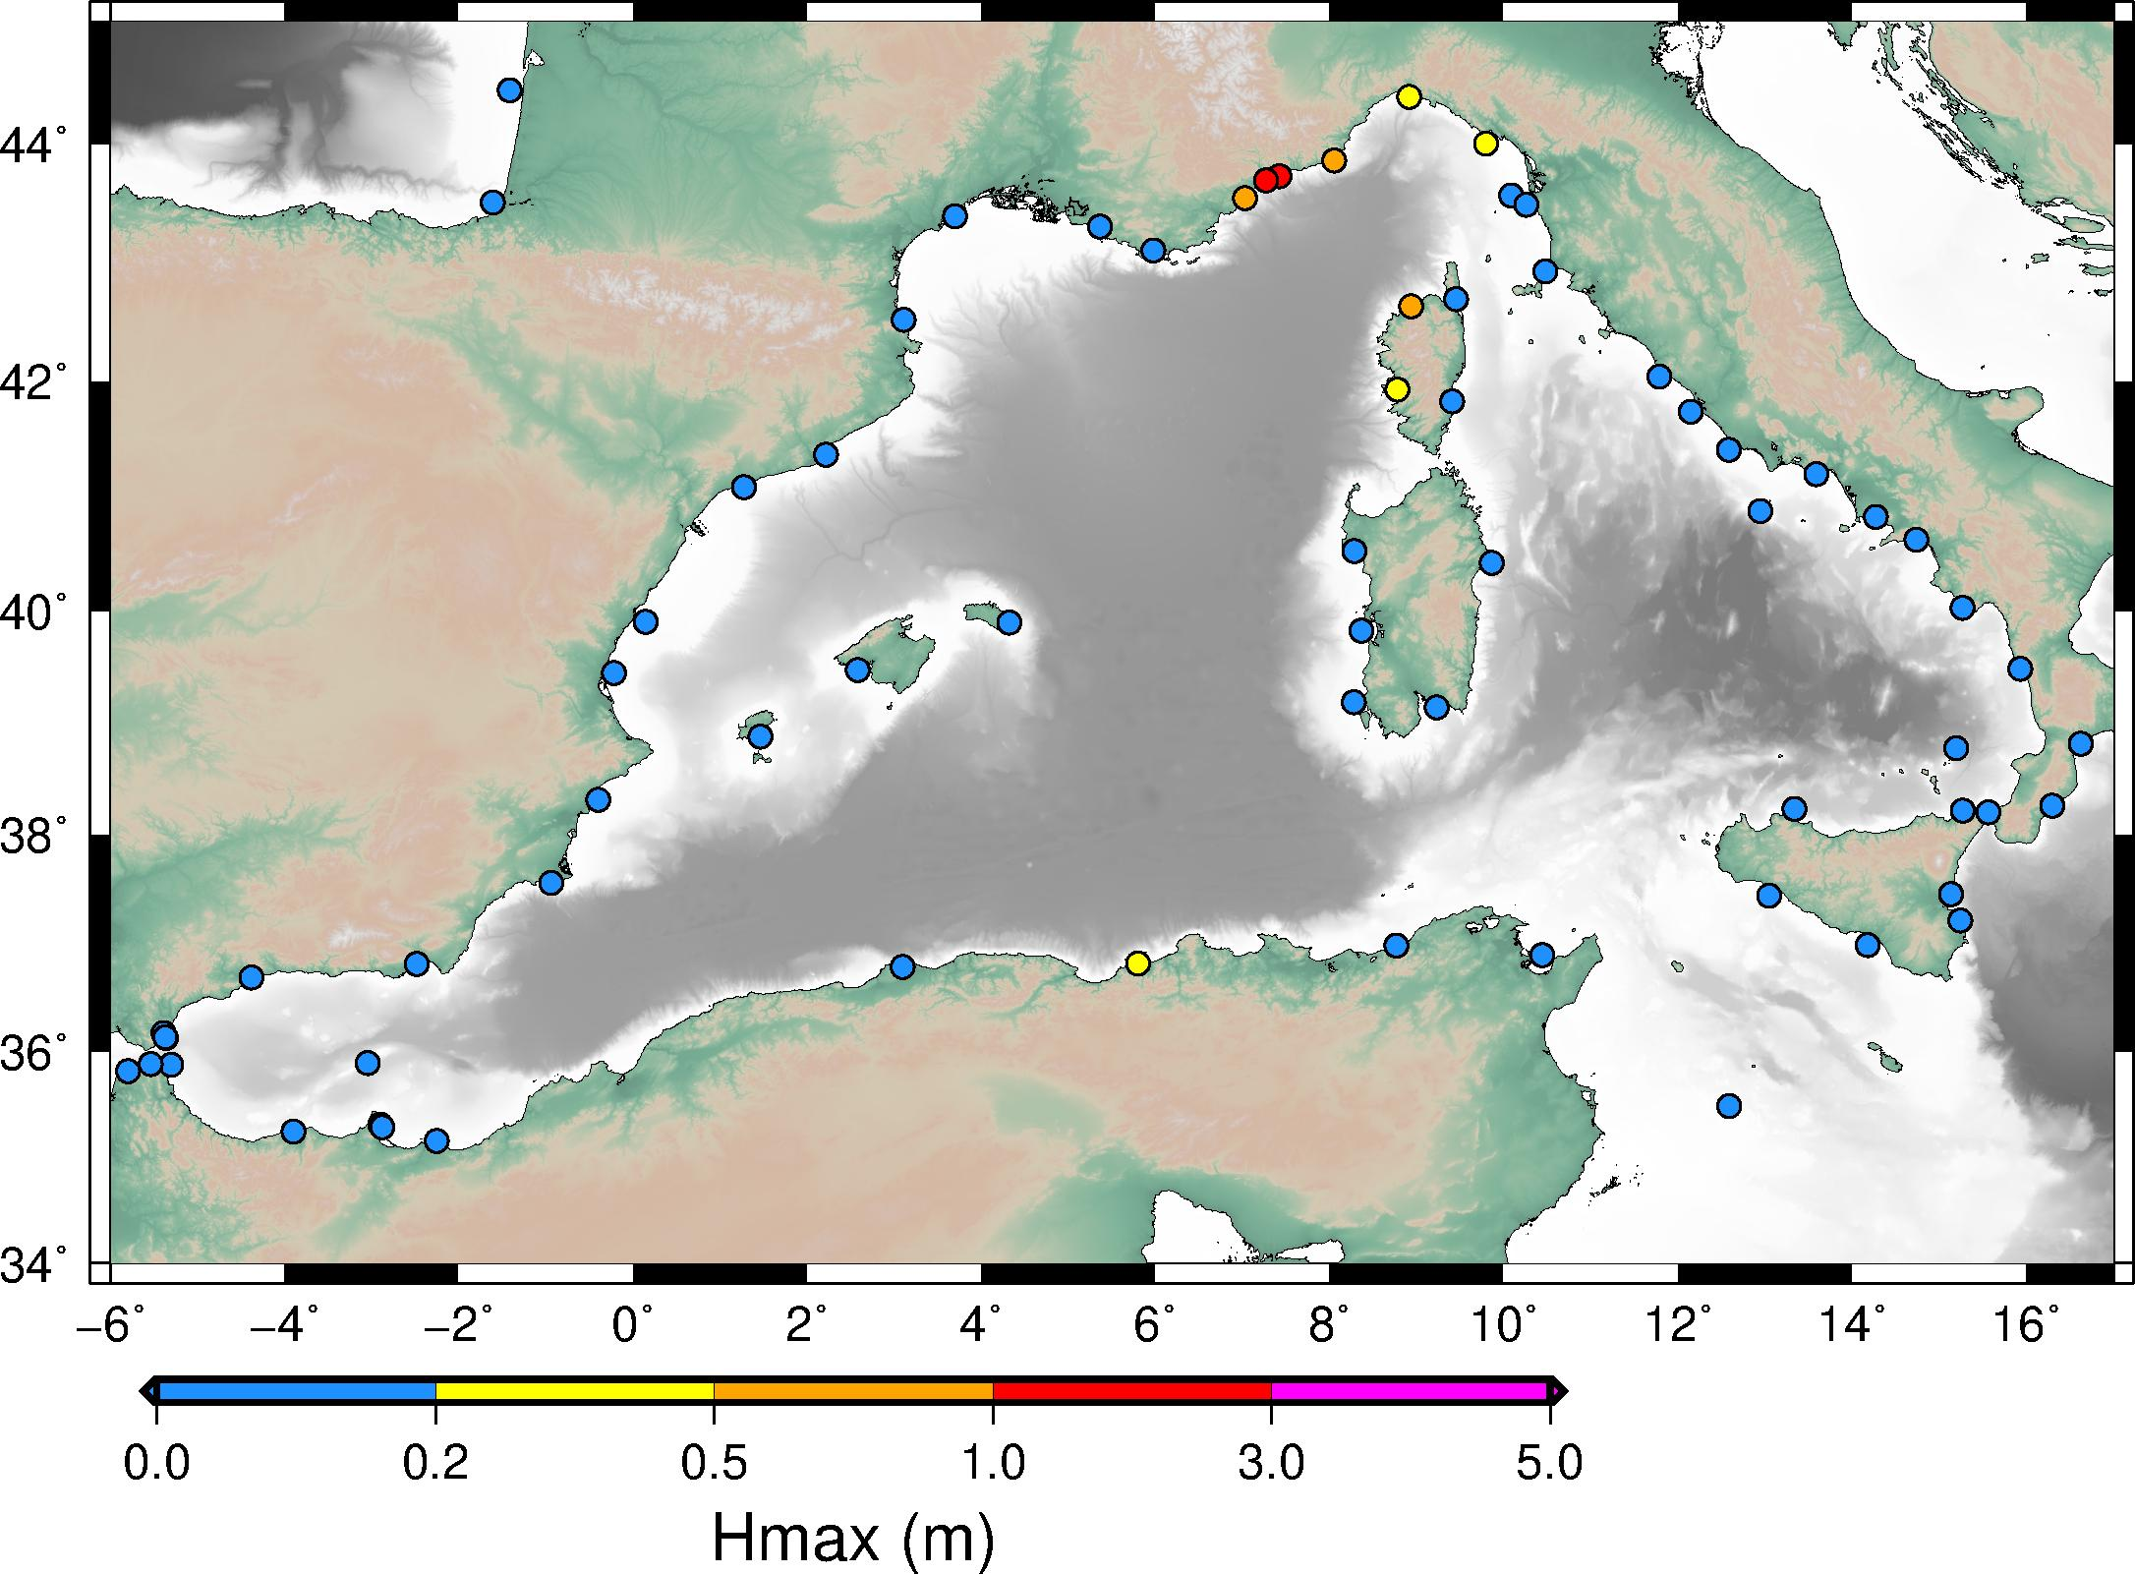
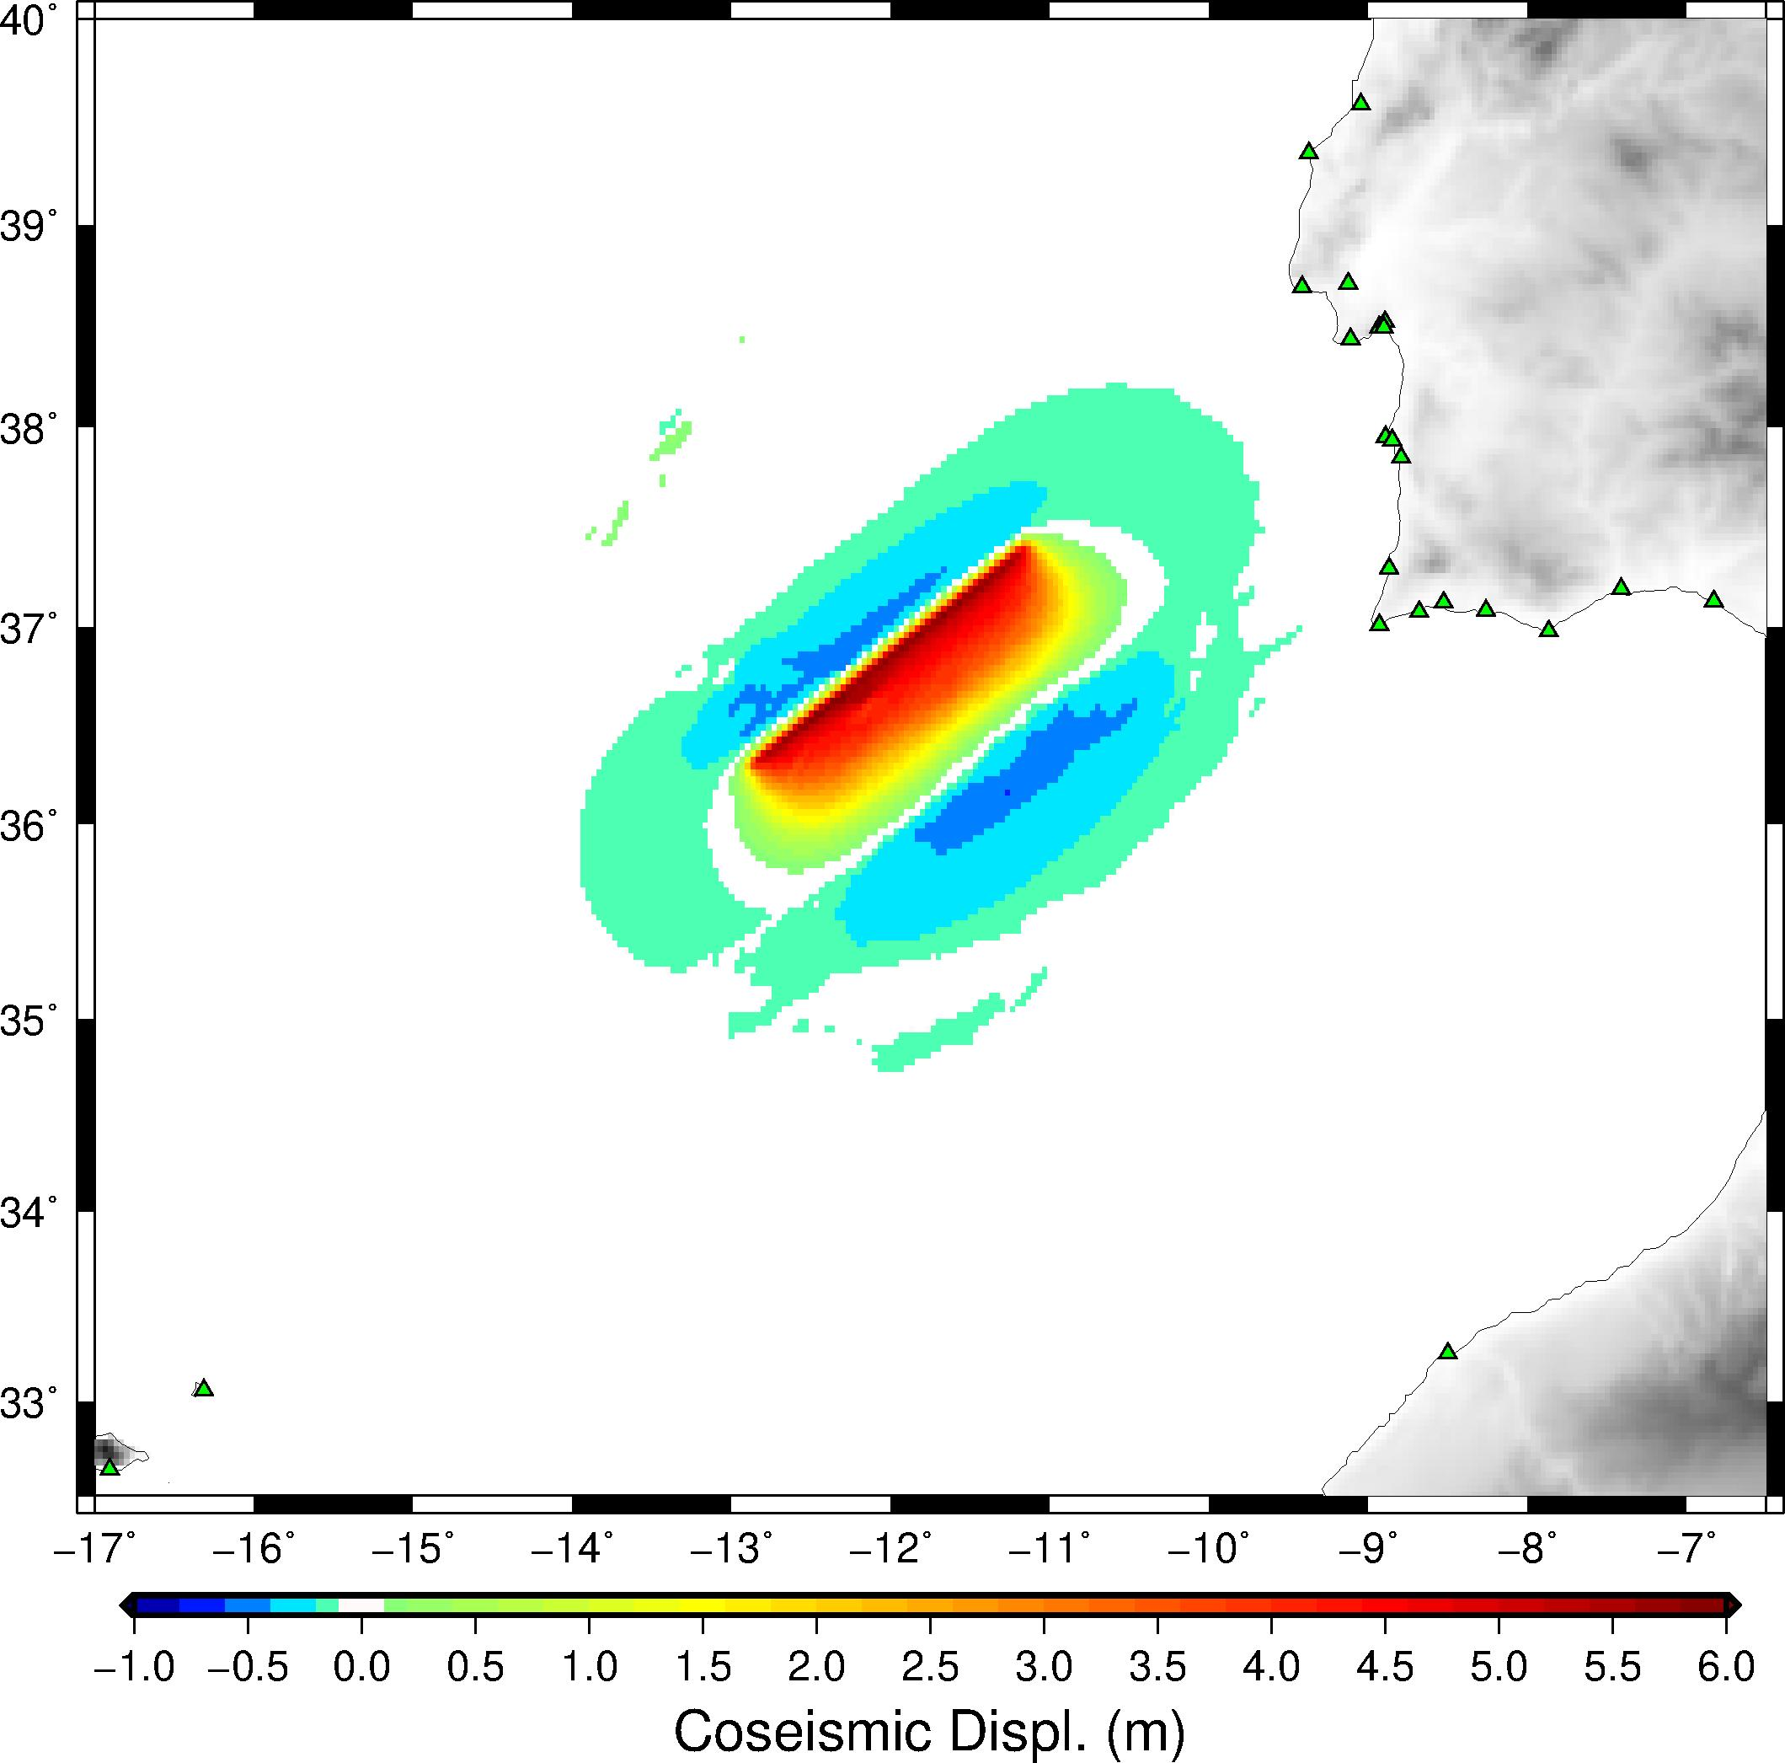
Scenarios
IPMA-CENALT
CENALT-INGV
ICG/NEAMTWS-XX • 3-5 December 2025

Slide 6
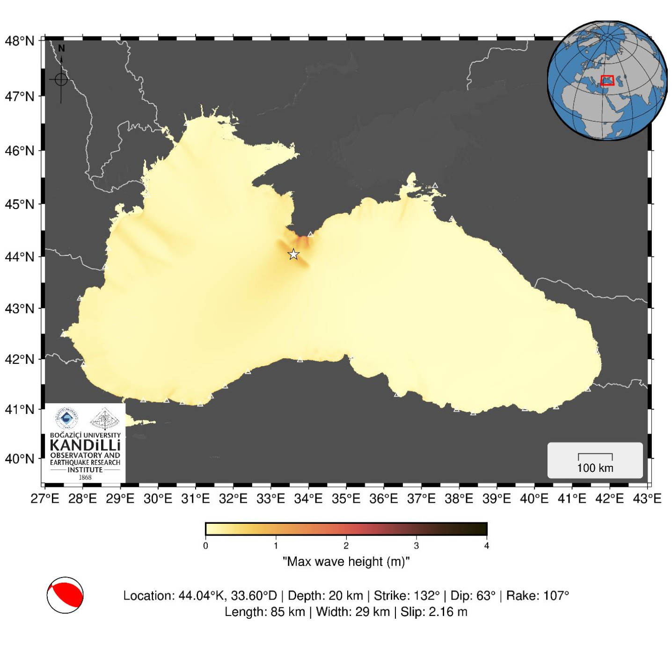
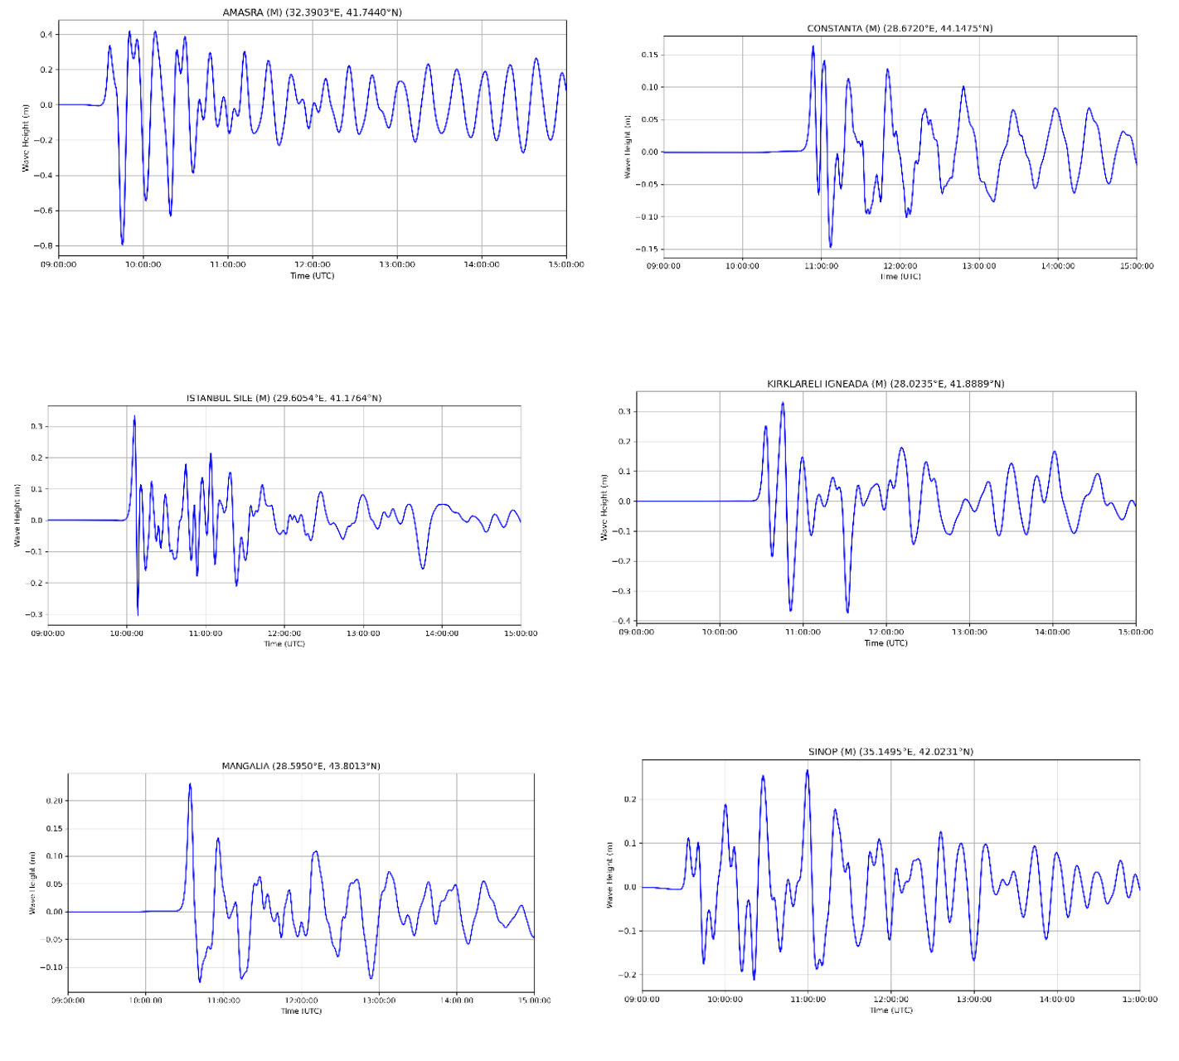
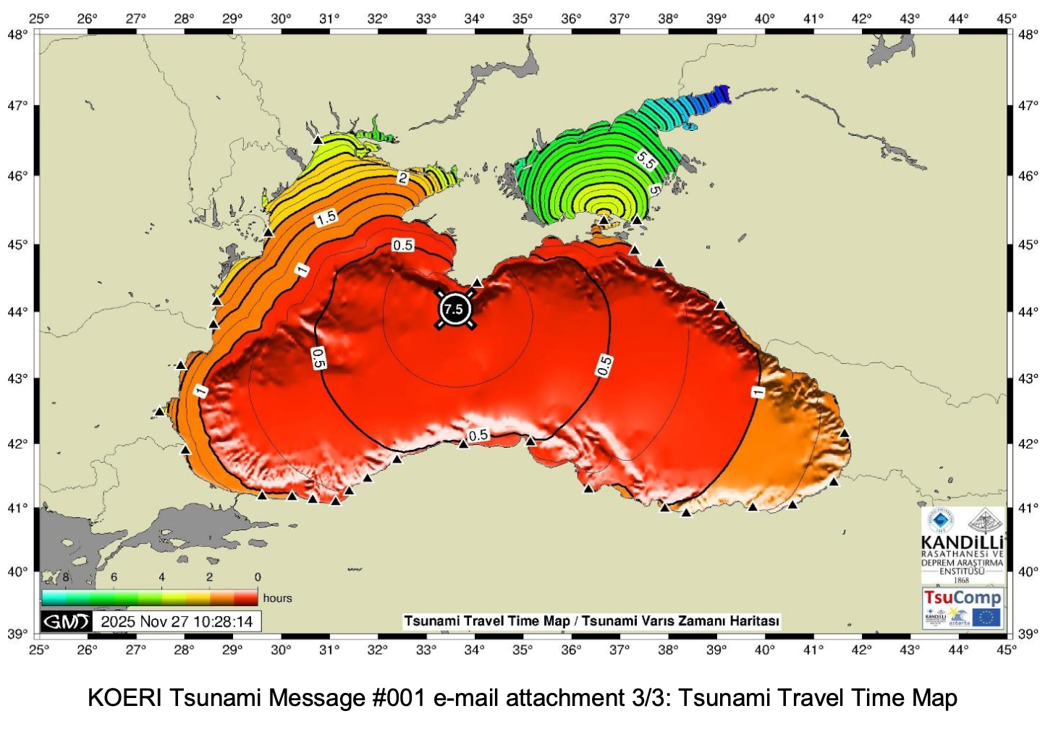
Scenarios
KOERI
ICG/NEAMTWS-XX • 3-5 December 2025

Slide 7

CoastWAVE
Meeting with CoastWAVE
ICG/NEAMTWS-XX • 3-5 December 2025

Slide 8


DEMONAX FSX
DEMONAX / DG-ECHO project
A Full Scale eXercise will be held between 20 - 23 April 2026, in Cyprus.
The earthquake’s epicenter will be in the south-west of Cyprus (offshore), generating also a subsequent tsunami event (injects in Larnaka).
The exercise will examine the response procedures of the essential services involved and based on the scenario; Cyprus will request assistance from the EU Civil Protection Mechanism (ERCC).
Cyprus Civil Defense (COO & NTWC) – NOA partner.
Synergy between NEAMWave26 and DEMONAX:
Table-top exercise one month before the FSX in April
ICG/NEAMTWS-XX • 3-5 December 2025

Slide 9
Roadmap
Actions:
IOC Circular Letter
Exercise manual
Registration | Very importantly, Member States registered as recipients of a Tsunami Service Provider do not need to subscribe separately to the exercise through the online form, as they will receive the exercise messages as part of the full service provided by the TSPs.
one page with two buttons:
“official authorities” for TNC/TWFP/NTWC/CPA (national level).
“open registration” for any other authority at the national or local level and even the public. This form will request contact details and affiliation. TSPs will not disseminate messages to them.
Arranging meeting with ERCC
ICG/NEAMTWS-XX • 3-5 December 2025

Slide 10
Important dates
Pre-Exercise
NEAMWave Exercise Brief (Arabic, French and Spanish) available online
Mid-January 2026 -> Exercise Manual available online
Deadline for providing updates regarding TNC, TWFP, NTWC & TWFP to the ICG/NEAMTWS Secretariat
End-January 2026 -> Deadline for online subscription/registration
Early February 2026 -> Informative Workshop on NEAMWave26
Exercise  3 – 24 March 2026
Post-Exercise
Mid-April 2026 -> Evaluation questionnaires by all participants available online
Mid-May 2026 -> TSPs Evaluation report
ICG/NEAMTWS-XX • 3-5 December 2025

Slide 11
Thank you!
co-chairs: Ceren Ozer Sozdinler
& Marinos Charalampakis
ICG/NEAMTWS-XX • 3-5 December 2025

Slide 12
NEAMWave 26
Exercise Final Evaluation Report:
It should be simplified in a way to be easier to prepare and more user-friendly to read.
TSP Final Evaluation Reports:
There is no interaction between providers and recipients, thus reports are not describing the whole picture. They should be limited to a couple of pages with certain bullet-point content, including summary of exercise performance, suggestions and recommendations, in the following concept: objectives, success criteria, best practices, lessons learnt and actions for the future.
Subscription Mechanism:
It should be only for providing “new” contact details “explicitly” for the exercise, if needed, and for registering new participants (other than the subscribers). Minimum information should be requested. We should find a way to also register “public” participants.
Evaluation forms:
Statistics and assessment of the participation in the exercise will be made only by the evaluation forms and not by the subscription forms.
ICG/NEAMTWS-XX • 3-5 December 2025

