Slide 1
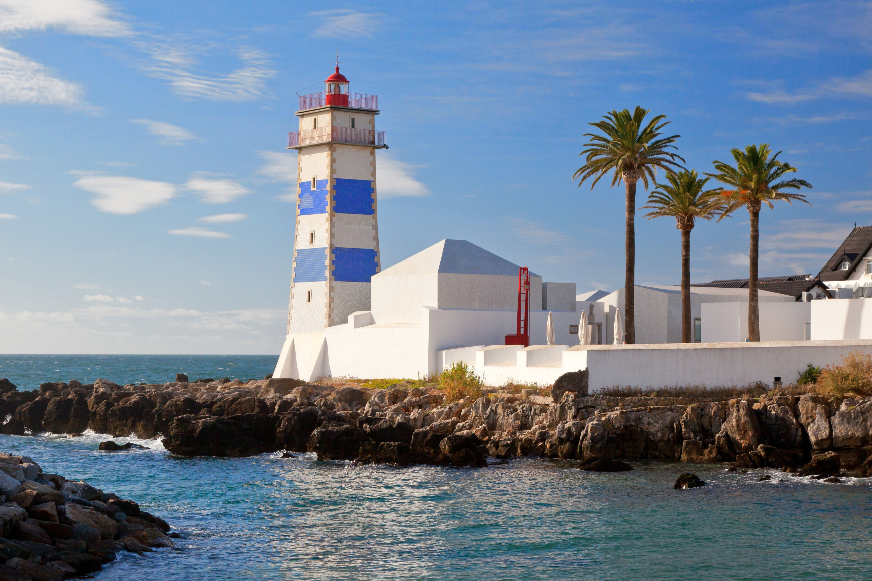




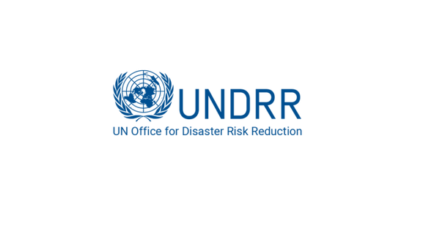


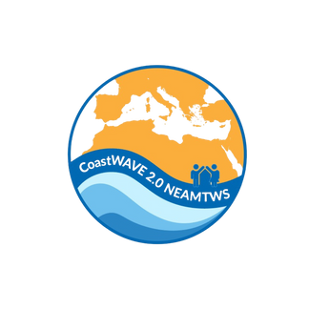

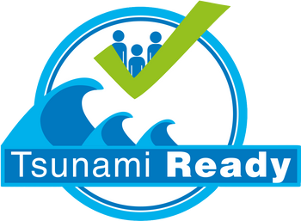
DG ECHO CoastWAVE 2.0 National to Local Level SOP Workshop
27 October-20 October
Cascais, Portugal
Roles and Responsibilities of Emergency Management Agencies (EMA)
Derya Itir VENNIN
CoastWAVE 2.0 Project Coordinator, UNESCO-IOC
Notes:
We’ll focus on strengthening our national tsunami warning and emergency response system, following international best practices set out in MG 76 by UNESCO–IOC.The emphasis will be on the roles and responsibilities of National Tsunami Warning Centres and how to develop effective Standard Operating Procedures, or SOPs, that connect seamlessly with national emergency response frameworks.

Slide 2
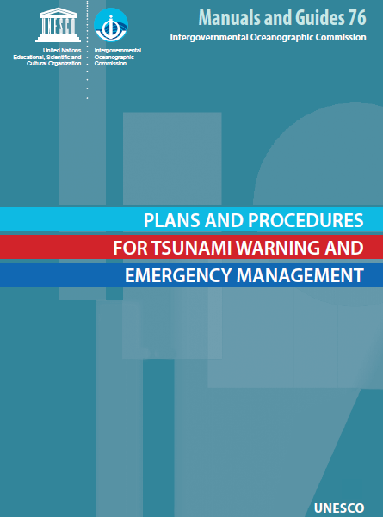
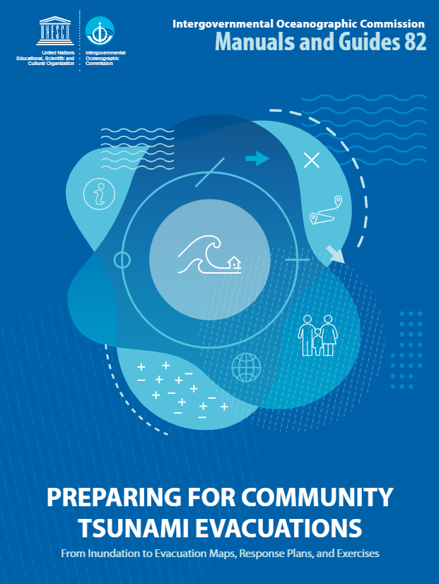
REFERENCES:
IOC Manuals and Guides No. 76, UNESCO-IOC
IOC Manuals and Guides No. 82, UNESCO-IOC

Slide 3
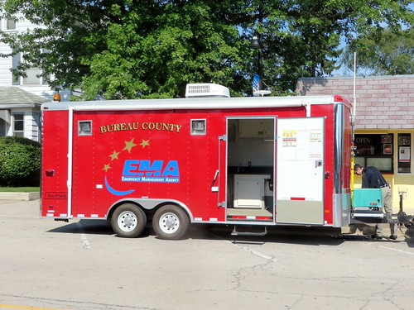
The EMA in the End-to-End System
EMA: Organization and management of resources and responsibilities for addressing all aspects of emergencies: in preparedness, response, and initial recovery steps.
EMA links technical tsunami warning and public response
Acts on information from the National Tsunami Warning Centre (NTWC)
Coordinates national and local emergency actions
Ensures rapid, clear communication to agencies and communities
This Photo by Unknown Author is licensed under CC BY-NC
Notes:
In the end-to-end tsunami warning system described in MG 76, four main stakeholders must act together:
Tsunami Service Providers (TSPs),
National Tsunami Warning Centres (NTWCs),
Emergency Management Agencies (EMAs), and
The public.
The EMA is the bridge between technical warning agencies and the people. It receives the warnings, interprets them for local impact, and ensures that appropriate protective actions are taken quickly including evacuation and public information.

Slide 4

Roles and Responsibilities of EMA under Tsunami Emergency Response
To receive official tsunami warning and cancellation messages from the NTWC.
To conduct further threat assessments and decide appropriate action.
To communicate the warnings, with instructions, via public alerting systems and the media.
To activate appropriate emergency response measures, including deciding and managing evacuations.
To communicate the “All Clear” when the threat is over.
Support public education (with other stakeholders)
Notes:
In this presentation we will talk about preparation of National EMA tsunami emergency response plans and SOPs.
It covers the role of EMAs during the events and also their role in development and maintaining of the tsunami response cabaibility.
The EMA is responsible for public safety and the welfare of the community in the event of an emergenct.
It mush establish and maintain preparedness for the tsunami response throught hazard risk assement and TER plans and accompanying SOPS.
It must immediately interpret the warnings issued and decide if all or some communiities are impacted and decide on the appropriate response actions.
It must dissemintate warnings instcutions and other safey information to agencies, local emas threatened communities at threat and to the media in accoriance with the NTWC and TER.
Presentation the hazard info to emegerny managers and puvlisc in an udnersatnsable manner.
Preparing the public for all hazards through awareness and education programmes, It should translate the science in an understandable wat to ordinary citizens.
Ensuring public alerting systems and precosuders are in place to provide timely and effective information to the public and the media

Slide 5

EMA Responsibilities Across Phases
Before an event
Hazard and risk assessments
Develop TER Plans and SOPs
Maintain public alert systems
Lead education and awareness
During an event
Receive and verify NTWC warnings
Activate EOCs and emergency procedures
Coordinate evacuations and resources
After an event
Oversee rescue, relief, and recovery
Conduct after-action reviews
Update plans and SOPs
Notes:
EMAs operate across all phases of disaster management. Before an event, they prepare communities and build systems. During an event, they lead the response, coordinate evacuations, and manage resources. Afterward, they support recovery and apply lessons learned to improve future plans and SOPs.

Slide 6
Tsunami Emergency Response (TER) Plan of EMA
Provides framework for national tsunami response
Defines hazard zones, responsibilities, and procedures
Includes:
Evacuation arrangements
Communication and alerting strategy
Agency roles and coordination
Notes:
It defines how tsunami response will be managed nationally and locally — who does what, where, and how.

Slide 7

EMA Standard Operating Procedures (SOPs)
Translate TER Plan into operational actions
Define who, what, when, where, and how
Key components:
Warning receipt and verification
Decision flowcharts for action
Evacuation and alert protocols
Media communication procedures
Coordination with NTWC and local agencies
Notes:
SOPs are the engine of the EMA’s response capability. They operationalize the TER Plan by describing exactly how each action is carried out.
They should include clear decision trees, checklists, and templates to minimize confusion during high-pressure events.

Slide 8
Communication and Coordination
Maintain 24/7 communication links with NTWC and responders
Use multi-channel alert systems: Sirens, SMS, radio, TV, social media
Employ pre-scripted messages for consistency
Coordinate with media to avoid misinformation
Include special needs and vulnerable groups
Notes:
MG 76 places huge emphasis on communication. EMAs must ensure messages reach everyone — through multiple channels — and are consistent and easy to understand.
Pre-approved message templates save time, while collaboration with media and accessibility for all populations ensures no one is left behind.

Slide 9
Stakeholder Collaboration
EMA leads, but collaborates with:
Local governments and emergency services
NTWC and scientific institutions
NGOs, utilities, education, and tourism sectors
Media and community groups
Establish a core stakeholder group for tsunami preparedness
Notes:
EMAs must engage stakeholders who understand local context — from schools to tourism operators — to ensure inclusive and effective evacuation planning and awareness.

Slide 10
EMA Operational Phases
Warning Phase : Receive and verify NTWC alerts
Public Alert Phase: Disseminate warnings through multiple channels
Evacuation Phase: Coordinate evacuation, traffic, and sheltering
Notes:
It gives EMAs a logical sequence of decisions and actions that can be mapped into flowcharts or checklists.

Slide 11
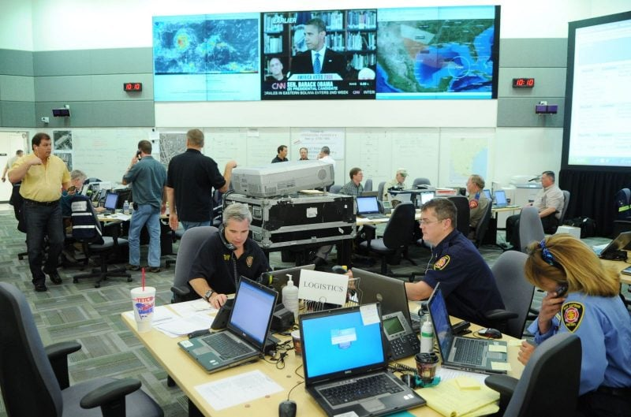
Emergency Operations Centers (EOCs)
Serve as command and coordination hubs
Link national, regional, and local levels
Manage situational updates and decisions
Deploy resources and logistics
Centralize coordination across agencies
This Photo by Unknown Author is licensed under CC BY-ND
Notes:
During a tsunami event, the EOC becomes the heart of the EMA’s operations. It coordinates the response between agencies, manages information flow, and ensures all actions are consistent and prioritized.
The strength of an EOC lies in its ability to make timely, informed decisions.

Slide 12
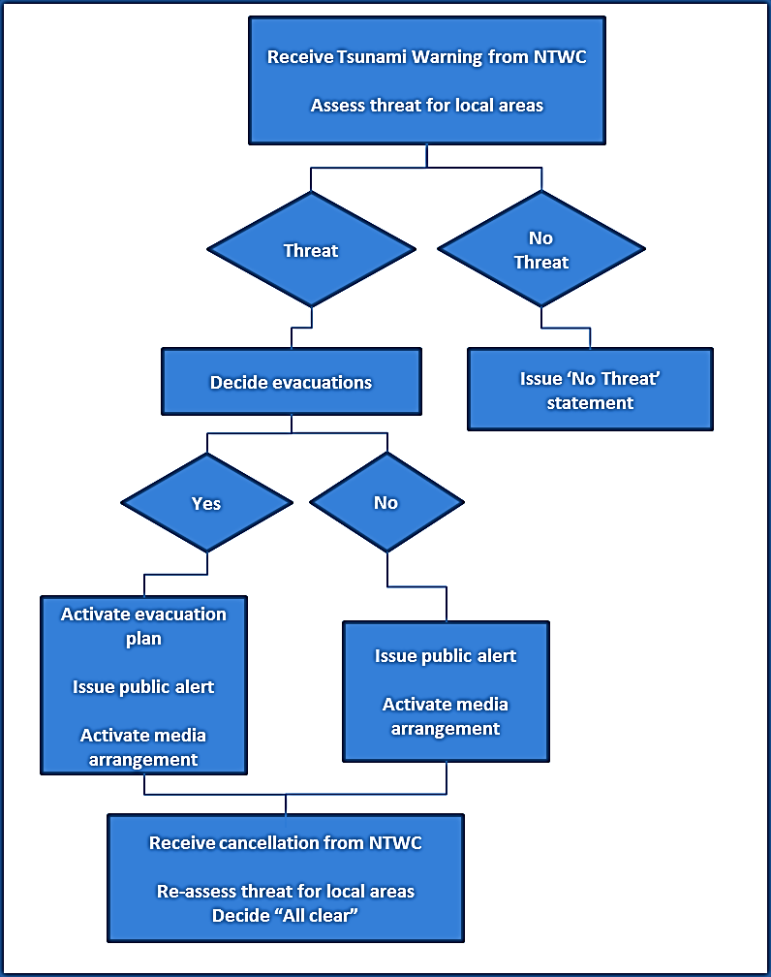
EMA Response Flow:
Receive tsunami warning from NTWC
Verify and determine level of threat
Activate EOC and mobilize agencies
Disseminate alerts to public and authorities
Coordinate evacuation and emergency support
Monitor and issue updates
Declare “All Clear” and initiate recovery
Notes:
The NTWC and EMA must operate as a single system. Harmonized SOPs ensure that as soon as a warning is issued, the EMA acts — and the public gets consistent messages.
Regular joint exercises and communication tests are the best way to ensure this alignment works when it matters most.

Slide 13

Exercising and Continuous Learning
Conduct regular tsunami drills and simulations
Engage all stakeholders and communities
Use post-exercise reviews to update SOPs
Conduct regular tsunami drills and exercises for both testing and public education purposes
Educate coastal communities on natural warning signs
Maintain evacuation routes and signage
Partner with schools and community groups
Promote household evacuation planning
This Photo by Unknown Author is licensed under CC BY-NC
Notes:
MG 82 expands on exercising: it’s not just for professionals but for communities.
Every exercise is a public awareness event — an opportunity to reinforce readiness and adjust SOPs based on lessons learned.

Slide 14
Key Takeaways
EMAs turn technical warnings into public action
Lead and coordinate all tsunami emergency operations
Ensure fast, accurate public communication
Maintain and test SOPs regularly
Build long-term awareness and resilience
Notes:
The EMA’s responsibility doesn’t stop at response — it extends to building long-term preparedness.
Public awareness and regular drills are vital. The more familiar communities are with warning signs and evacuation routes, the faster and safer they’ll react when a tsunami occurs.

