Slide 1


NEAMWave26
A Tsunami Warning and Communication Exercise
for the North-eastern Atlantic, the Mediterranean,
and Connected Seas Region
March 2026
3-24 March
Presented by Denis Chang Seng
Coordinated / co-prepared by Task Team on Tsunami Exercise ICG/NEAMTWS
co-chairs: Ceren Ozer Sozdinler (Turkiye)
Marinos Charalampakis (Greece)
and Denis Chang Seng (ICG/NEAMTWS Technical Secretary)

Slide 2
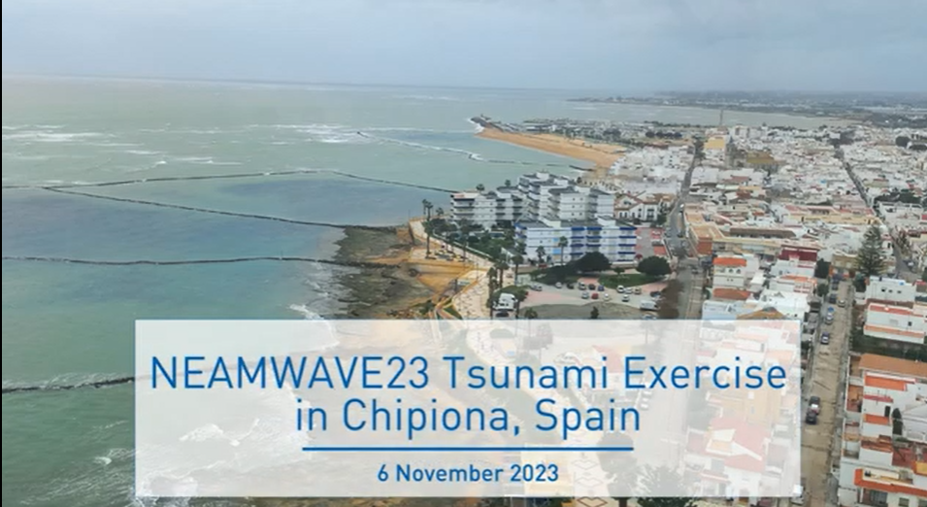
NEAMWave Exercise
To date five NEAMWave exercises have been conducted in 2012, 2014, 2017, 2021 and 2023.
NEAMWave26 will be conducted from 3 - 24 March 2026, featuring five distinct scenarios.
These multiple scenarios will provide Member States with greater flexibility to participate, allowing them to choose the type and number of scenarios that best suit their needs.

Slide 3
Objectives for NEAMWave 26 :
Validate and evaluate the Tsunami Service Provider (TSP) dissemination process of issuing Tsunami Messages in the NEAM region, also utilizing communication technologies, like SMS;
Validate and evaluate the procedures for countries to receive the Tsunami Messages issued by the TSP through their National Tsunami Warning Centres (NTWC), or the country Tsunami Warning Focal Points (TWFP) or the country Tsunami National Contacts (TNC);
Test the dissemination of the tsunami messages to the relevant agencies that are responsible for emergency response (CPA);
Assess the organizational decision-making process about public warnings and evacuations thus raising awareness of launching and contributing to the development of a national policy to tackle the tsunami risk.
Identify best practices (to be shared), criticalities (to be addressed by the programme in the future activities) and room for improvements in the entire process (including the procedures already tested between TSPs and TWFPs/NTWCs and also the heterogeneous panorama of national capacities to handle tsunami risk);
Test procedures for international assistance between the European Commission and participating Member States;

Slide 4
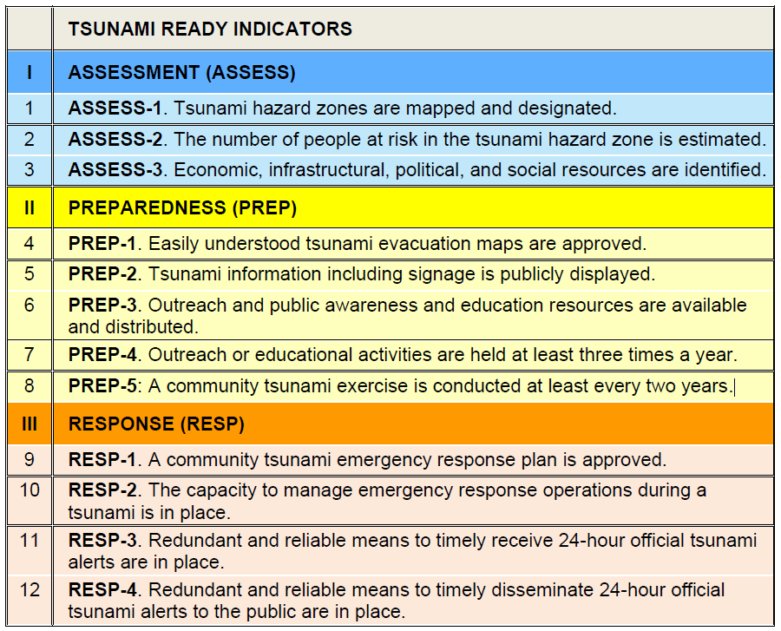
Objectives for NEAMWave 26(Con’t)
One of the key objective is the involvement of Member States that participate in the CoastWAVE 2.0 project, as well as existing recognized Tsunami Ready communities.
By participating in Phase B, which involves conducting a local exercise using the NEAMWave26 scenario project countries can fulfill TRR indicator 8
The exercise will test the efficiency and the abilities of communities to respond and test their systems in a complex and realistic situation.

Slide 5
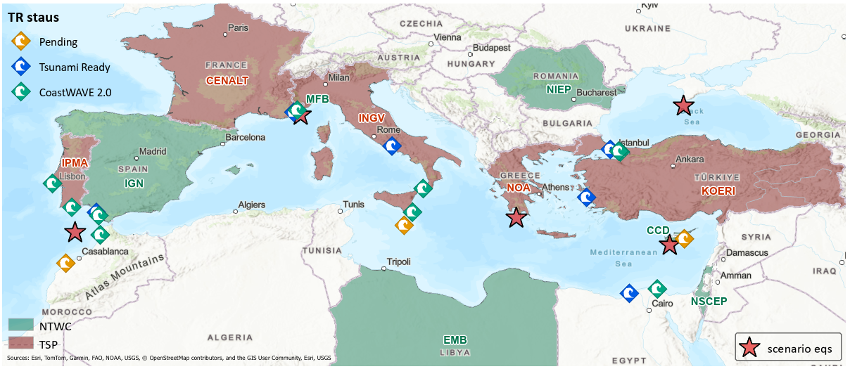
NEAMWave26
no | Date | Type | TSPs | NTWCs | Title | Epicenter (lat - lon) | Magnitude | Description | Potential affected MS
SN-01 | 03-Mar-26 | single | NOA | CD or GSD | Cyprian Arc | 34.55N - 32.65E | 7.5 | 1222 SW of Cyprus | Greece, Cyprus, Egypt, Libya, Malta, Italy
SN-02 | 11-Mar-26 | joint | INGV-NOA | EMB (LY) | Ionian Sea | 36.40N - 22.20E | 7.1 | 1867 Peloponnesus | Greece, Italy, Egypt, Malta
SN-03 | 12-Mar-26 | joint | CENALT-INGV | Monaco FB | Ligurian Sea | 43.42N - 7.50E | 6.9 | 1887 Ligurian Earthquake | Italy, France, Monaco
SN-04 | 13-Mar-26 | single | KOERI | NIEP | Black Sea | 44.04N - 33.60E | 7.5 | Black Sea | Turkiye
SN-05 | 24-Mar-26 | joint | IPMA-CENALT | IGN | NE Atlantic Ocean | 35.41N -7.87W | 8.7 | Gulf of Cádiz | Portugal, Spain, Morocco

Slide 6
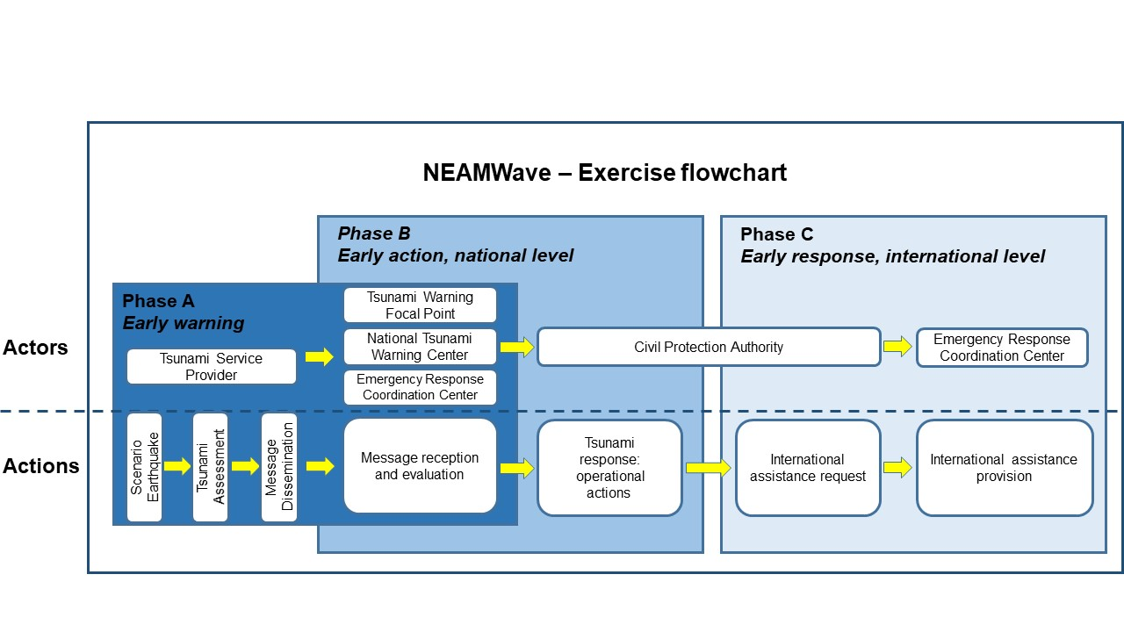
NEAMWave Flow Chart

Slide 7
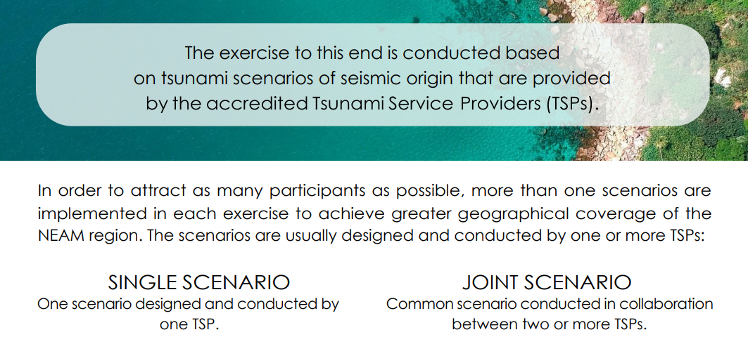

Slide 8
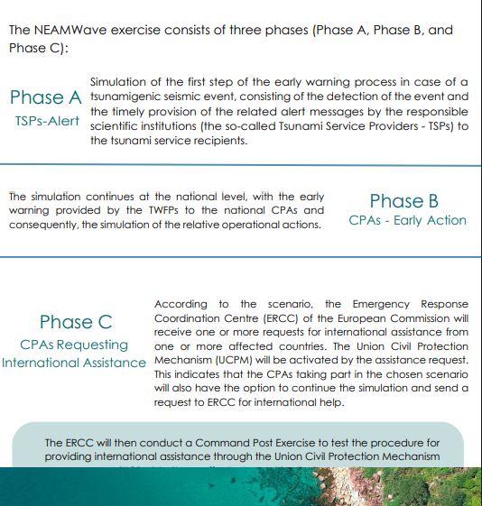

Slide 9
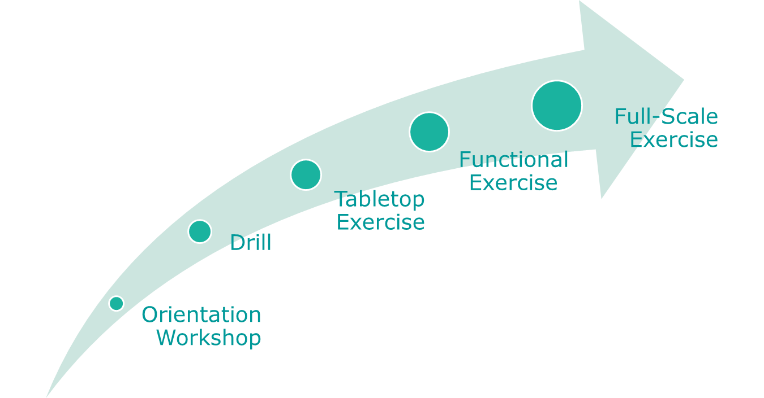
Focusing on Phase B…
- Phase B is designed to test and evaluate interdependent groups of functions among various agencies;
- Organizations will test their internal/external communications using real time simulation tsunami bulletins;
- Phase B exercises command and control activities at locations such as emergency command centers, command posts,…

Slide 10
Simulation of a Request for International Assistance

Slide 11
Phase B & C: Tsunami Alert Message Reception
Emergency management activities performed at national level
International assistance request and provision
Phase B
Phase C
Through the Union Civil Protection Mechanism and the Emergency Response and Coordination Centre (ERCC) of the European Commission.
Member States are encouraged to participate in Phace C of the exercise

Slide 12
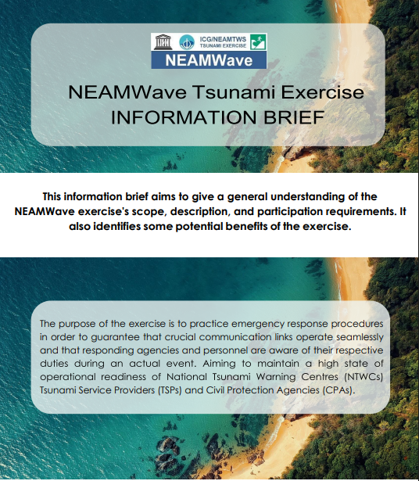
Exercise Documents and Subscription
A NEAMWave Exercise Brief was prepared in 2023 to encourage participation, especially Civil Protection Agencies and other entities who are not yet familiar with the exercise. Arabic, French and Spanish versions of the brief will be available online.
The full NEAMWave26 Exercise Manual will be available online by Mid-January 2026 as part of the NEAMTWS Guiding Documents and Forms available online.
The Exercise Manual describes in detail the scope and the objectives of NEAMWave26, the exercise phases, the exercise scenarios, the description of roles, the conduct and the evaluation of NEAMWave26, as well as any media arrangements.
The Exercise Manual has been simplified consisting of two separate documents:
Manual including general instructions of NEAMWave tsunami exercise, and
Supplements including specific information for NEAMWave26, i.e., Exercise scenarios, concepts on the composition of Tsunami Messages, exercise team members contact information, etc.

Slide 13
Participating in NEAMWave26
Member States wishing to participate in NEAMWave26 exercise have to fill online exercise subscription form.
Registration to the exercise to be completed no later than end of January 2026.
An Information Workshop on NEAMWave26 will be organized in the early February 2026 organized by ICG/NEAMTWS Technical Secretariat and TT on Exercise.

Slide 14
Activities to be Performed
Establishment of the National Contact of the Exercise
Establishment of the Exercise Team, at national and local (community) level
Appointment of roles: Coordinator - Director – Evaluators – Observers - Other
Set aim of the exercise and objectives
Participants in the exercise
Exercise scenario
Design of different activities that will be performed to fulfill the aim
Design the evaluation process

Slide 15
A Summary of Important Dates (Tentative)
Before Exercise
NEAMWave Exercise Brief (Arabic, French and Spanish) available online.
Mid-January 2026:
Exercise Manual available online
Deadline for providing updates regarding National Contact (TNC), Tsunami Warning Focal Point (TWFP), National Tsunami Warning Centre (NTWC) and Tsunami Warning Focal Points (TWFPs) to the ICG/NEAMTWS Secretariat through official channels (e.g., UNESCO Permanent Delegation).
End- January 2026: Deadline for online subscription/registration
Early-February 2026: Information Workshop on NEAMWave26. Workshop link

Slide 16
A Summary of Important Dates (Tentative)
Post Exercise
Mid-April 2026: Evaluation questionnaires by all participants available online
Mid- May 2026: TSPs detailed Evaluation report submission

Slide 17
Types of Phase B Exercises
Orientation Workshop:
This type of exercise can be conducted through a workshop.
It is used to familiarise the players with the activity.
There is no time-frame element; the orientation workshop could be performed after the exercise, making use of the NEAMWave26 material (i.e. Exercise manual, exercise scenarios) to conduct the workshop planned at national level.
This kind of exercise would provide an opportunity to raise awareness among the National Emergency Operations Centre(s) and response officials regarding the NEAMTWS programme
An example of an orientation exercise would be setting up a welfare centre to take in tsunami evacuees, and briefing to the staff about how the centre is organized.

Slide 18
Types of Phase B Exercises
Drill:
Staff physically handle specific equipment or perform a specific procedure or single operation.
A drill usually focuses on a single organization, facility or agency such as a national emergency operation centre, a hotel, a school or a village.
The exercise usually has a time-frame element and is used to test procedures.
A drill is a subset of a full-scale exercise.
In NEAMWave26, Phase A will be conducted as a drill exercise; the ability to send multiple consecutive tsunami messages by the TSPs will be tested.
An example of a drill exercise would be activating an Emergency Operations Centre (EOC), testing the relative procedures and all the communications technologies foreseen for the activation of those procedures (i.e. Email, telephone, radios) in a tsunami exercise.

Slide 19
Types of Phase B Exercises
Table-top Exercise:
May also be referred to as a ‘‘discussion exercise’’, or ‘‘DISCEX’’.
Participants face with a situation or problem that they are required to discuss and they formulate the appropriate response or solution.
An exercise controller or moderator introduces a simulated scenario (prewritten exercise) to participants and, as the exercise advances (in time), exercise problems and activities are further introduced.
This type of exercise is used to practice problem-solving and coordination of services with or without time pressures.
There is no deployment or actual use of equipment or resources.
An example of a table top exercise may cover the participants discussing their response to a tsunami threat to a particular area, where the only input are tsunami messages from the TSPs.

Slide 20
Types of Phase B Exercises
Functional Exercise:
May also be referred to as an ‘‘operational’’ or a ‘‘tactical’’ exercise.
It takes place in an operational environment and requires participants to actually perform the functions of their roles.
Participants interact within a simulated environment through an exercise control group which provides prewritten actions and respond to questions and tasks developing out of the exercise.
Functional exercises normally involve multi-agency participation (real or simulated) and can focus on one or more geographical areas.
Commonly, they involve the testing of standard operating procedures (SOP) and internal/external communications between organizations.
It lacks only the people "on the ground" to create a full-scale exercise
- An example would be a multi-agency response to a potentially devastating tsunami, where evacuation of a coastal community is required. Messages and actions are provided by exercise control group and are handled by the participants in the way described in appropriate plans and procedures.

Slide 21
Types of Phase B Exercises
Full-scale Exercise:
- May also be referred to as a “practical’’ or ‘‘field’’ exercise.
- It includes the movement or deployment of people and resources to provide a physical response ‘‘on the ground’’ to a simulated situation.
- It can be ‘‘ground’’ focused only or may include the higher-level response structures. It can be simple (single agency) or complex (multi agency, multi-levels of government from national to local).
- Typically used to test all aspects of a country's warning and emergency management systems and processes; they are practical, using actual centres and communications methods.
- Full-scale exercises are the largest, most costly, most time-consuming and most complex to plan, conduct and evaluate.
- An example: a post-impact tsunami response with volunteers representing 'victims' and the emergency services using real rescue equipment at the scene. Multi-agency response to the event is played. Actual field mobilization and deployment of response personnel are also involved.

Slide 22
Thank you for your attention!

