Slide 1
Tsunami Warning Dissemination and Public Alerts Responsibilities to Decision-Makers, Media, and the Public
Denis Chang Seng, PhD Programme Specialist
Technical Secretary (ICG-NEAMTWS & TOWS Task Team on Disaster Management and Preparedness
ODTP Focal Point
CoastWAVE Project Responsible Officer
Tsunami Resilience Section
UNESCO IOC

Slide 2
Setting the Stage
Tsunamis are challenging to warn for—travel times can be minutes to hours.
Most tsunamis are triggered by earthquakes, landslides, or volcanic eruptions.
Even with advances since 2004, detection and dissemination remain weak in many areas.

Slide 3
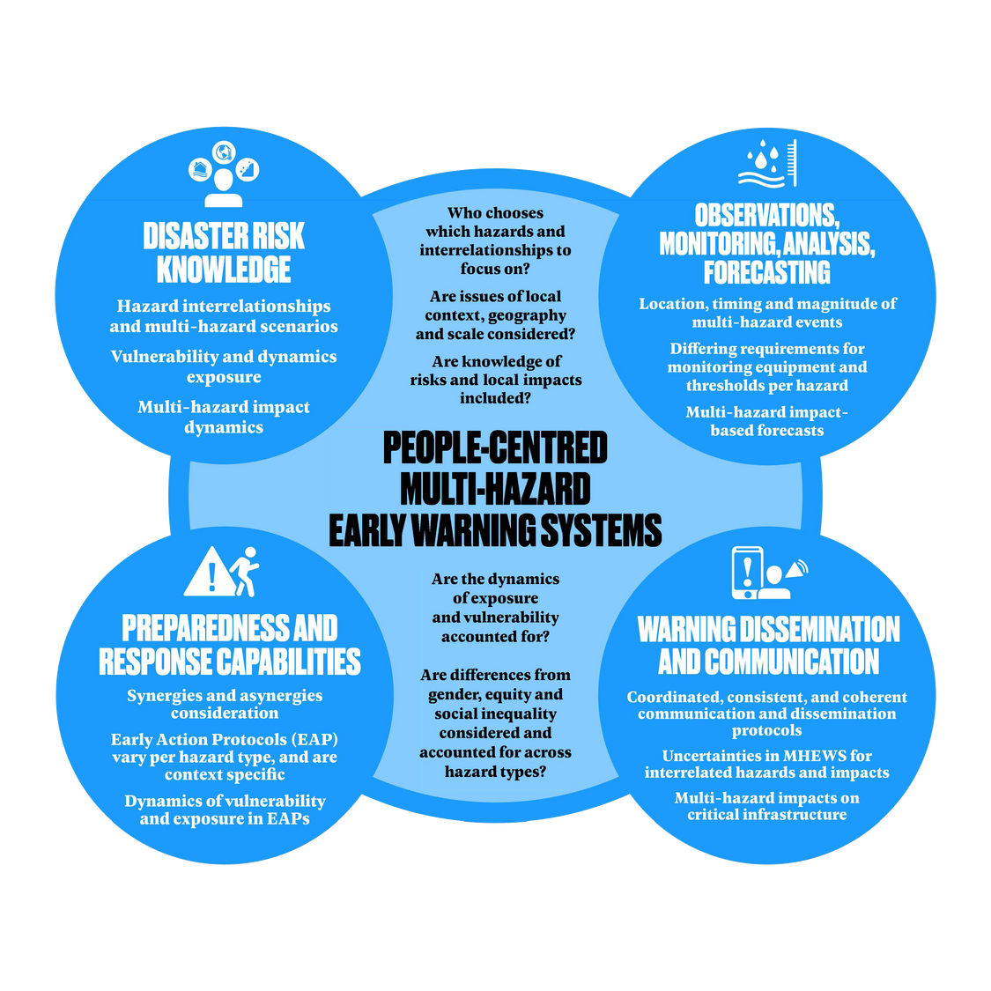
People-Centred Warning Approach
Goal: Enable individuals and communities to act quickly and appropriately.
Requires deep understanding of community needs and capacities.
Tsunami Early Warning Systems (TEWS) must link risk knowledge, monitoring, dissemination, and response.

Slide 4
Responsibilities Along the Warning Chain
National Tsunami Warning Centres (NTWCs): Detect and issue alerts.
Disaster Risk Management Institutions: Coordinate preparedness and response.
Media: Relay official alerts and maintain credibility.
Communities: Act promptly on received warnings.

Slide 5
Dissemination and Communication Architecture
Requires 24/7 coordinated systems and Standard Operating Procedures (SOPs).
Warning chains often too complex or slow for near-field tsunamis.
Effective dissemination demands clear authority and streamlined protocols (SOPs)

Slide 6
For Disaster Management Agencies /EMA/ Local Authorities/ Decision Making
Key information to communicate to them from NTWC
The alert message from NTWC: - alert level, affected zones (coastlines, hazard-zones, evacuation zones) and expected time of arrival or duration of threat.
Recommended actions: What should local authorities / disaster-management agencies do upon the alert (e.g., activate EOC, issue local evacuation order, mobilise shelters, close beaches, port/harbour actions).
Update/cancellation/all-clear: Local agencies must receive and forward information when the hazard has passed or changed and manage return to normal.

Slide 7
Summary for Media
Media must be integrated into the warning chain.
Require timely, accurate Official Warning Messages.
Know how to interpret and convey them.
Trained and equipped to act swiftly.
Follow coordinated procedures to avoid confusion.

Slide 8
For the Public / Communities at Risk
Key information to communicate to the public
What is happening?
Where to go / safe zones / evacuation routes? What not to do? Public advice content: Local agencies often tailor public-facing advice: “Go to high ground now”, “Stay off beaches”, “Listen to radio/TV”, etc.
Natural warning signs: Where relevant, communities should be informed of natural signs, however should not be curious to go down the coast to confirm?
When safe to return?
What resources are available / where to get information?
Reinforced preparedness: The public should be aware ahead of time?

Slide 9
Cross-cutting / Additional Notes
Alert levels & definitions: It is critical all actors (NTWCs, DRM agencies, media, public) use consistent alert terminology (Info/Watch/Advisory/Warning) to avoid confusion.
Redundancy & 24/7 operations: Systems (for reception and dissemination) must operate 24/7 and via multiple redundant channels.
Timeliness & accuracy: The efficacy of a tsunami warning system depends on fast detection, rapid dissemination and correct interpretation. Imperfect information is better than delayed perfect information — the guidance emphasises that for near-field tsunamis time is very limited.
Uncertainty communication: Warnings include uncertainty (e.g., “probable”, “possible”) — Decision-makers, media and public must understand what they can and cannot know. While not always spelled out in the sections I could access, the general principles of hazard warning apply

Slide 10
Role of Media and Communication Channels
Broadcast Media: Essential link for radio, TV, and online alerts.
Social Media: Powerful but prone to misinformation.
Building partnerships with broadcasters enhances reliability and counters rumours.
Joint training, exercises, and technical collaboration strengthen cooperation.

Slide 11
Technologies for Dissemination
Leverage existing multi-hazard frameworks.
Common Alert Protocol (CAP): Enables multi-channel warning from a single input.
Mobile alerts (Cell Broadcast, SMS) increasingly vital.
Sirens: Useful but prone to false alarms—must be redundant and locally adapted.

Slide 12
Community Preparedness and Public Response
Communities must recognize natural warning signs and know evacuation routes.
Warnings should include simple, actionable guidance.
Local authorities play a critical role in evacuation decisions.
Regular end-to-end exercises (e.g., UNESCO/IOC Tsunami Ready) build readiness.

Slide 13
Key Challenges and Opportunities
Institutional coordination gaps hinder timely dissemination.
Integration into MHEWS can strengthen resilience.
Public trust is the foundation of effective warnings.

Slide 14
Concluding Remarks
A warning system is only as strong as its weakest link.
Focus must remain on people, not just technology.
Timely, clear, and actionable messages save lives.
Strengthen partnerships across science, policy, media, and communities.

