Slide 1
Earthquake Monitoring and Tsunami Early Warning system in Viet Nam
(National Progress report)
Earthquake Information and Tsunami Warning Center
Institute of Earth Sciences, Vietnam Academy of Science and Technology (IES – VAST)

Slide 2
BASIC INFORMATION
PTWS NATIONAL TSUNAMI WARNING CENTER (NTWC)
NTWC Agency Name:
Earthquake Information and Tsunami Warning Center, Institute of Earth Sciences,
Vietnam Academy of Science and Technology
Email address: : dongdatsongthan@ies.vast.vn
Postal Address: A8-18 Hoang Quoc Viet, Hanoi, Viet Nam
NTWC Officer in Charge (person):
Name: Dr. Nguyen Xuan Anh
Position: Director
Telephone Number: (0084-4) 37564380
Email address: : nxanh@ies.vast.vn
Postal Address: A8-18 Hoang Quoc Viet, Hanoi, Viet Nam

Slide 3
WARNING SYSTEM
Phone, Fax
TV
Radio
Government Offices
Related Agencies
Regional seismic network
Seismic data processing centre
National and local seismic networks
Earthquake information
M ≥ 3,5
Earthquake information and tsunami warning centre
Tsunami scenarios
Alert system
Phone, Fax
TV
Radio
Government Offices
Related Agencies
Tsunami
Early warning
Sea level stations

Slide 4
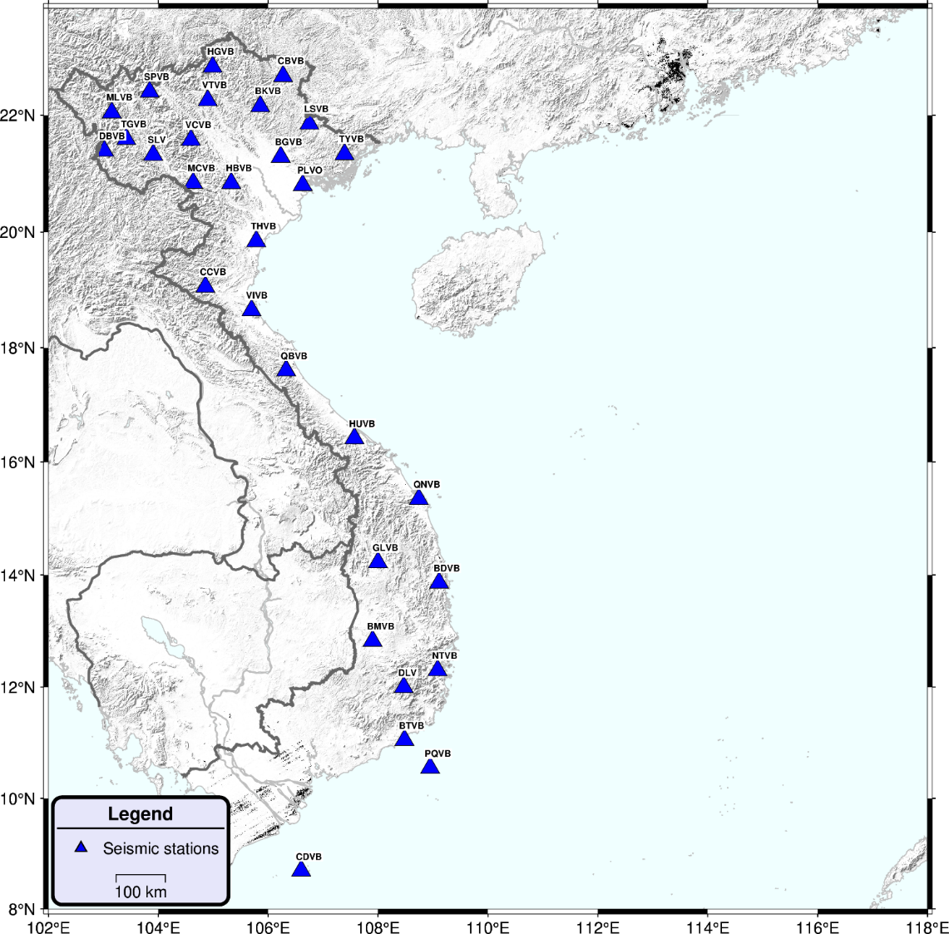
NATIONAL SEISMIC NETWORK
The IES is currently operating a National Seismic Network, which consists of 31 broadband seismometers.

Slide 5
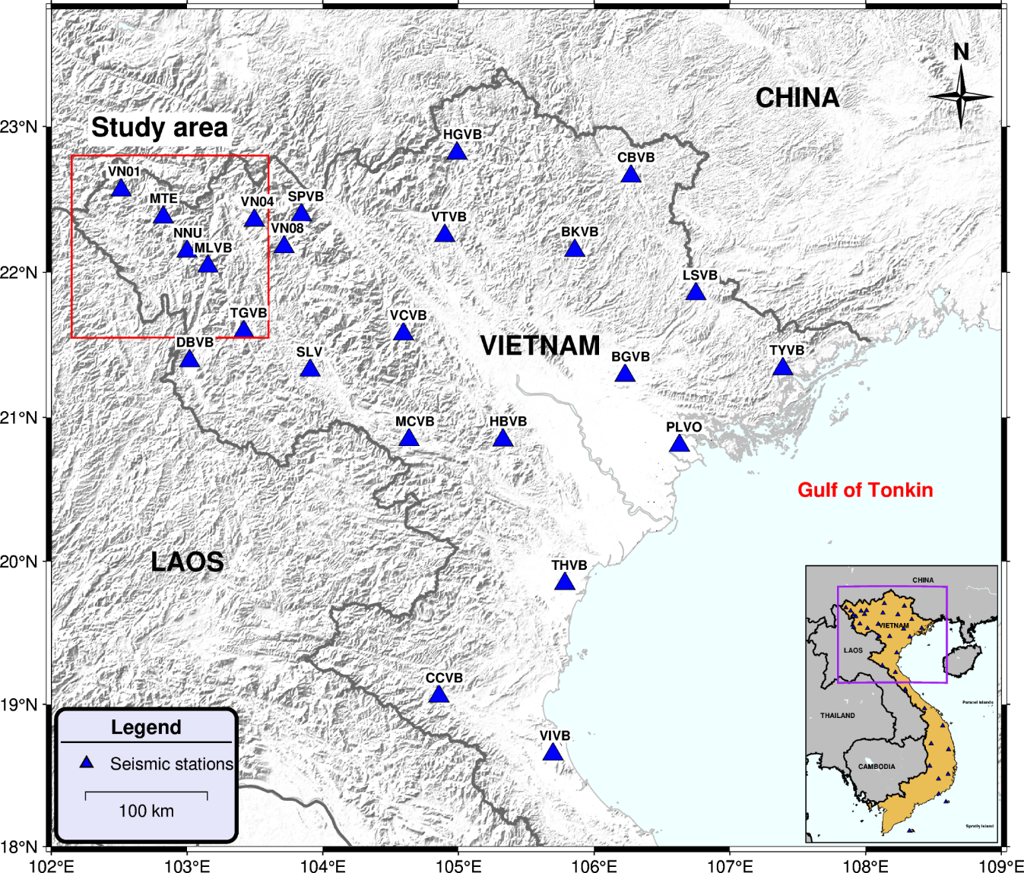
LOCAL SEISMIC NETWORK
About 50 broadband seismic stations for monitoring induced earthquake activities

Slide 6
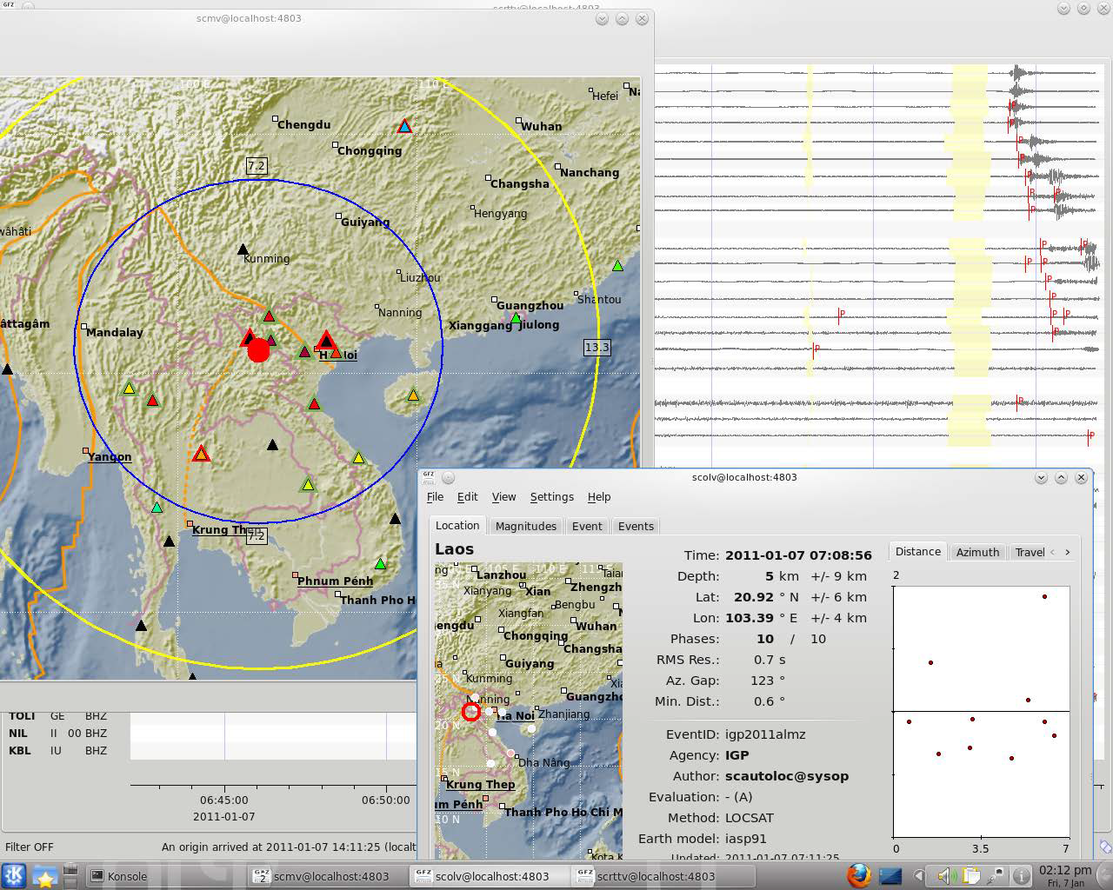
WARNING SYSTEM
DATA PROCESSING
SeisComp
Earthworm
SeisAn
Notes:
The earthquakes occurred in the territory of Vietnam and its sea areas can be timely detected and the information on the earthquake and tsunami threats is widely disseminated throughout the country

Slide 7
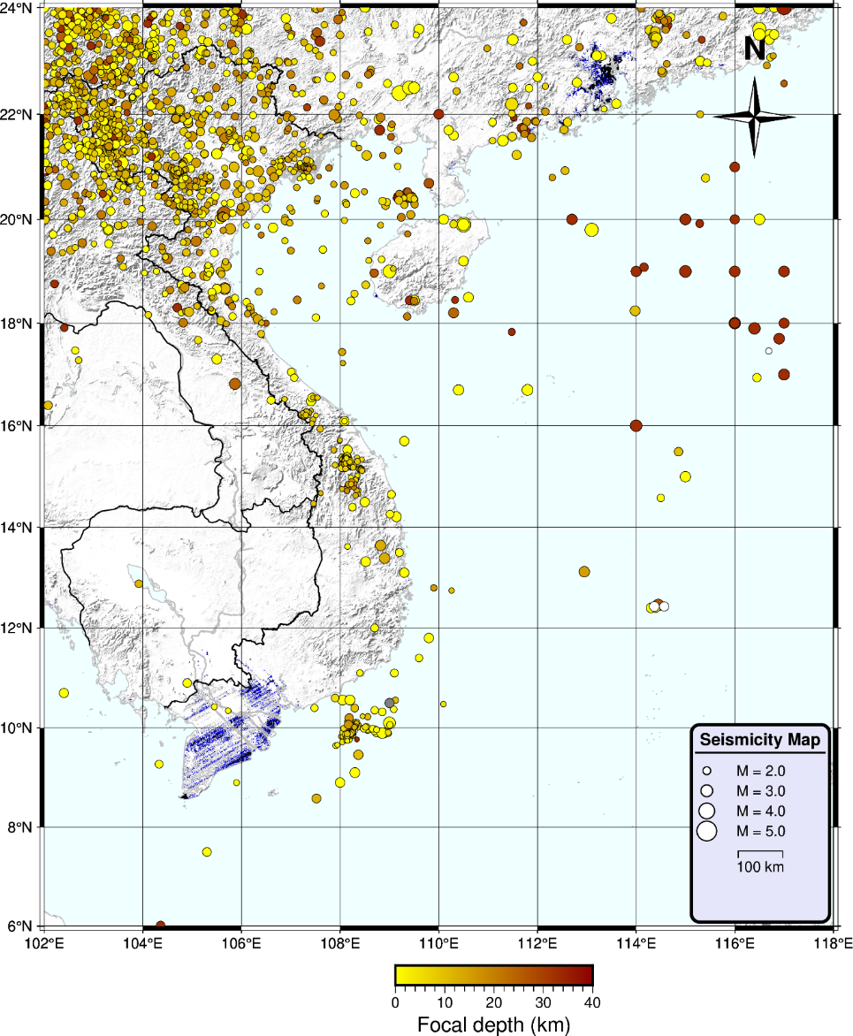
SEIMICITY IN VIETNAM
Đien Bien 1935 (M=6.7)
Tuan Giao 1983 (M=6.7)
Induced earthquakes (M = 5.0, Kon Tum)
Volcanic earthquake 1923 (M=6.1)

Slide 8
NATIONAL SEA LEVEL NETWORK
The National Hydro-Meteorological Service of Vietnam (NHMS), is operating a national hydro-meteorological network, which consists of 22 stations.

Slide 9
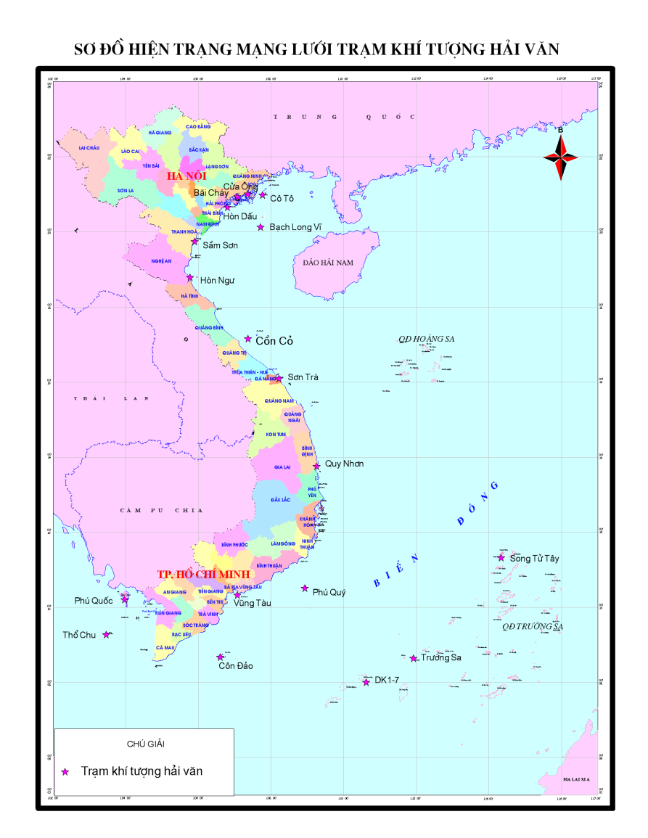
NATIONAL SEA LEVEL NETWORK
Distribution of the hydro-meteorological stations of Vietnam. The network includes 7 coastal, 13 island and 02 floating (on drilling rigs) stations .

Slide 10
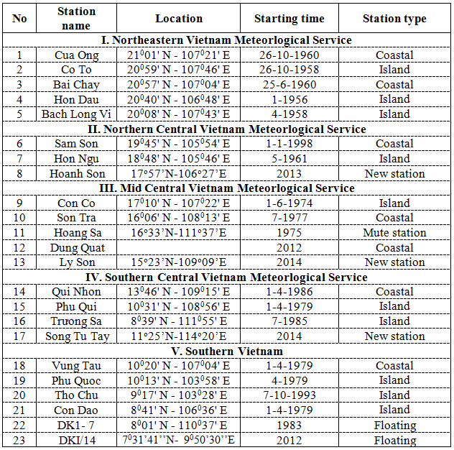
NATIONAL SEA LEVEL NETWORK

Slide 11
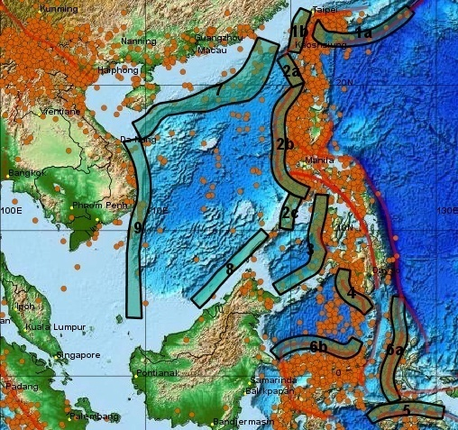
WARNING SYSTEM
TSUNAMI SOURCES ZONES
09 tsunami source zones are capable of affecting the Vietnamese coast.
1a. Riukiu-Taiwan;1b. West Taiwan; 2a. North Manila Trench; 2b. Central Manila Trench; 2c. South Manila Trench; 3. The Sulu Sea; 4. The Selebes Sea; 5. The South Banda Sea; 6a. The North Banda Sea 1; 6b. The North Banda Sea 2; 7. North of the East Vietnam Sea; 8. Northwest Borneo-Palawan; 9. The 109 meridian.

Slide 12
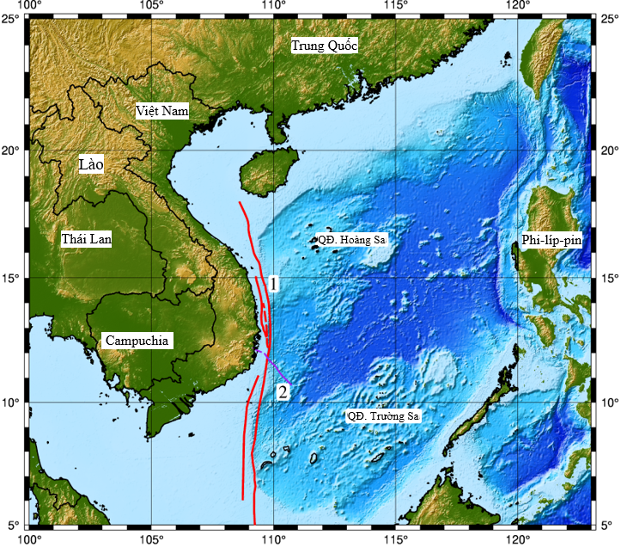
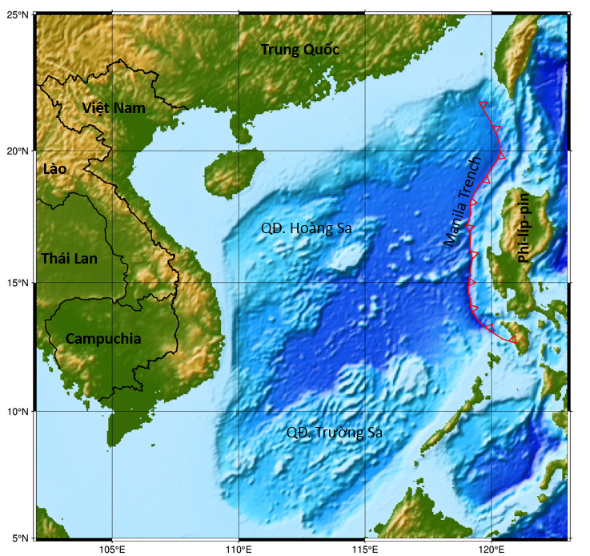
TSUNAMI SOURCES ZONES
The109⁰ meridian fault
Manila Trench

Slide 13
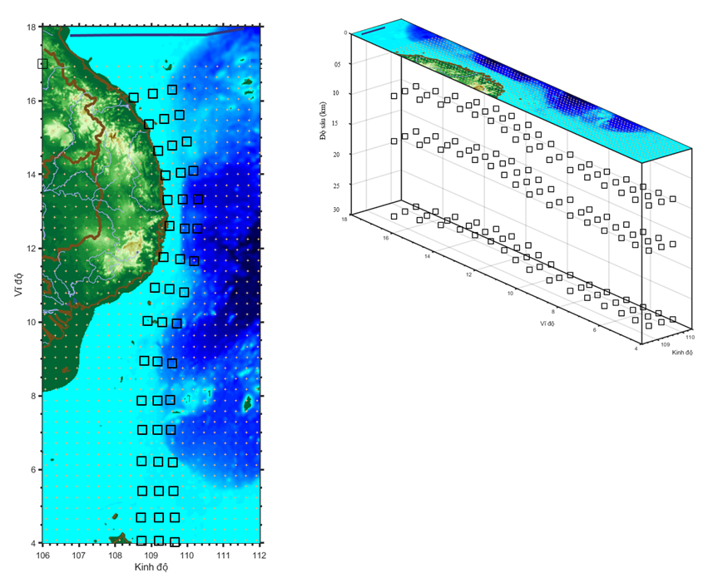
TSUNAMI SCENARIOS
- Magnitude: 6.5 to 8.0 with an increment of 0.5.
Changing the epicenter (Longitude, Latitude).
Depth (h): 10-15-25 km.
Total 336 tsunami scenarios have been developed in the109⁰ meridian source.

Slide 14
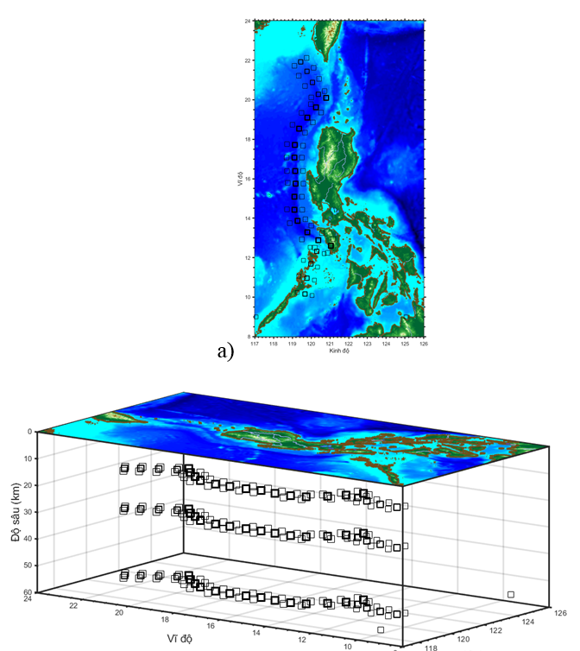
TSUNAMI SCENARIOS
- Magnitude: 6.5 to 9.3 with an increment of 0.5.
Changing the epicenter (Longitude, Latitude).
Depth (h): 10-15-25 km.
- Total 666 tsunamis scenarios have been developed in the Manila Trench source

Slide 15
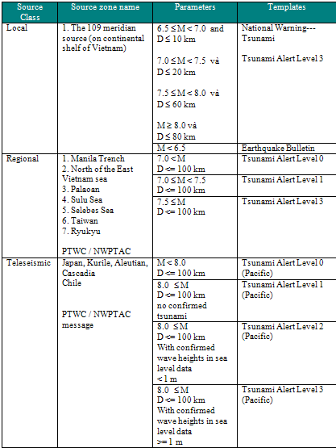
TSUNAMI SOP
The threshold of criteria for declaring a potential tsunami emergency is defined depending on the source zone’s location and magnitude of tsunami generating earthquake.

Slide 16
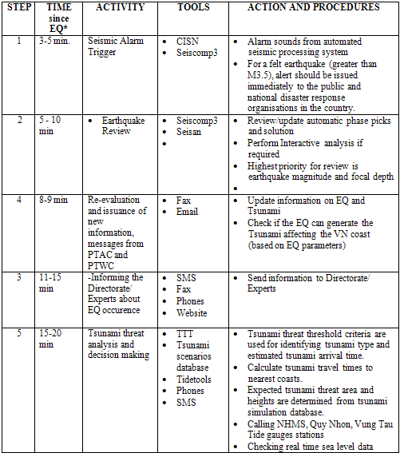
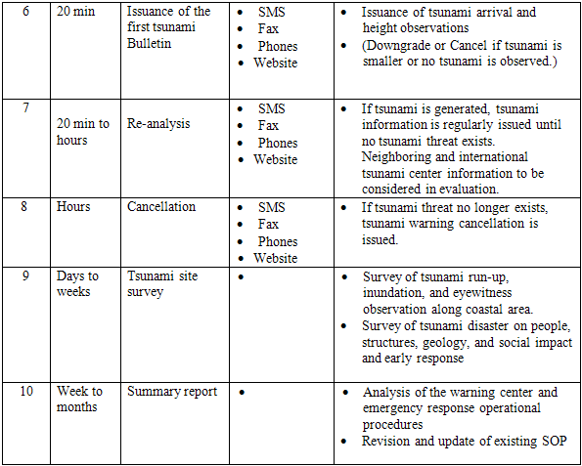
WARNING SYSTEM
TIMELINE FOR A DISTANCE TSUNAMI

Slide 17
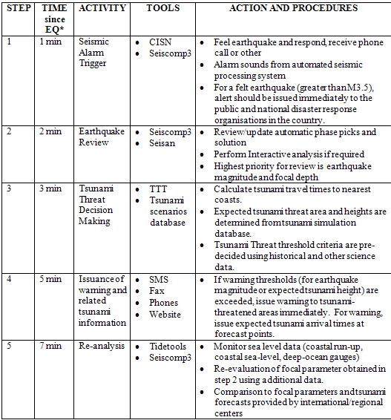
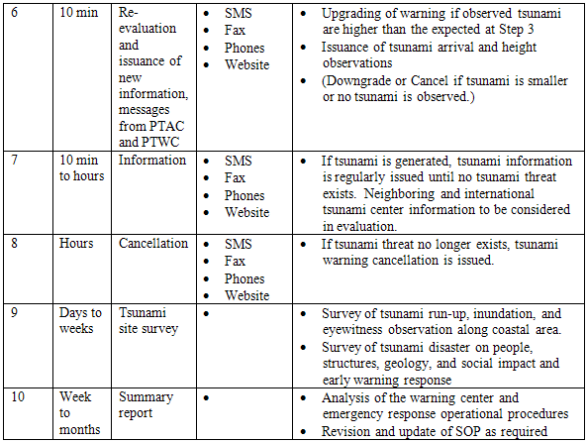
WARNING SYSTEM
TIMELINE FOR A NEAR-FIELD TSUNAMI

Slide 18
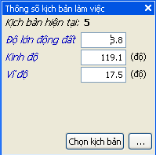
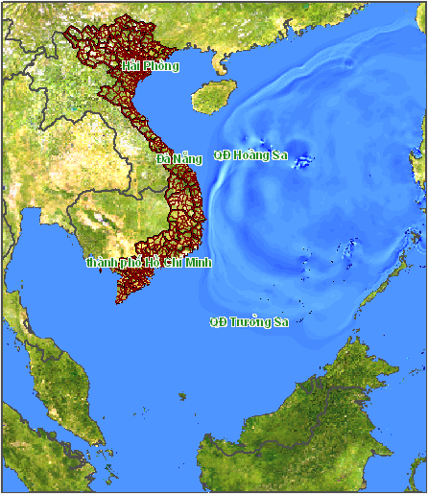
WARNING SYSTEM
TSUNAMI SCENARIO DATABASE

Slide 19
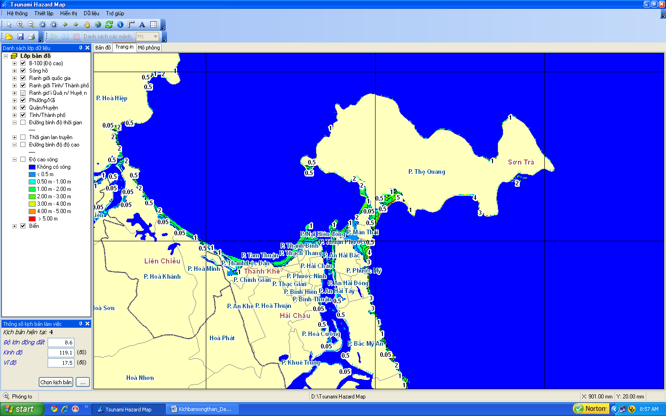
WARNING SYSTEM
TSUNAMI SCENARIO DATABASE

Slide 20
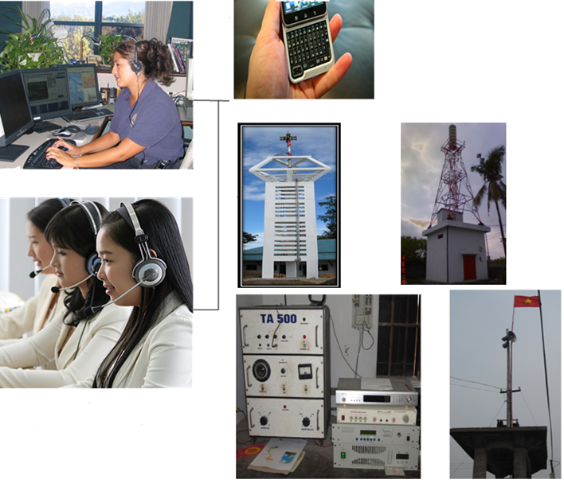
TSUNAMI WARNING DISSEMINATION
Tsunami information is disseminated through multiple communication channels, including fax, email, Viber, and Zalo.

Slide 21
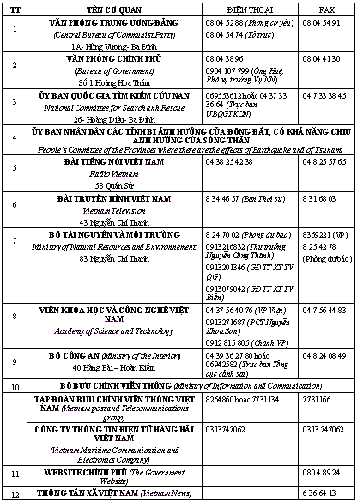
TSUNAMI WARNING DISSEMINATION
Tsunami information is disseminated to multiple governmental disaster-response entities; however, priority transmission is directed to:
the Disaster Management Office (DMO);
the National Committee for Search and Rescue and the People’s Committees of Vietnam’s coastal provinces; and
National and local media organizations.

Slide 22
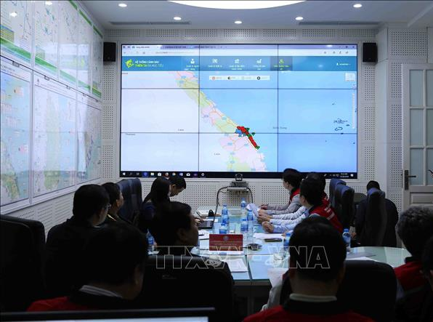
TSUNAMI RESPONSE
A Drill on tsunami response was conducted in Da Nang city, Central Vietnam

Slide 23
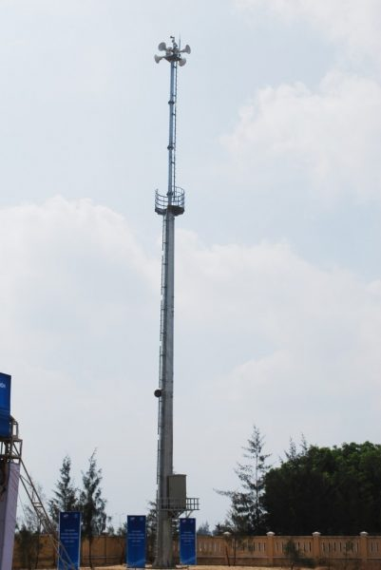
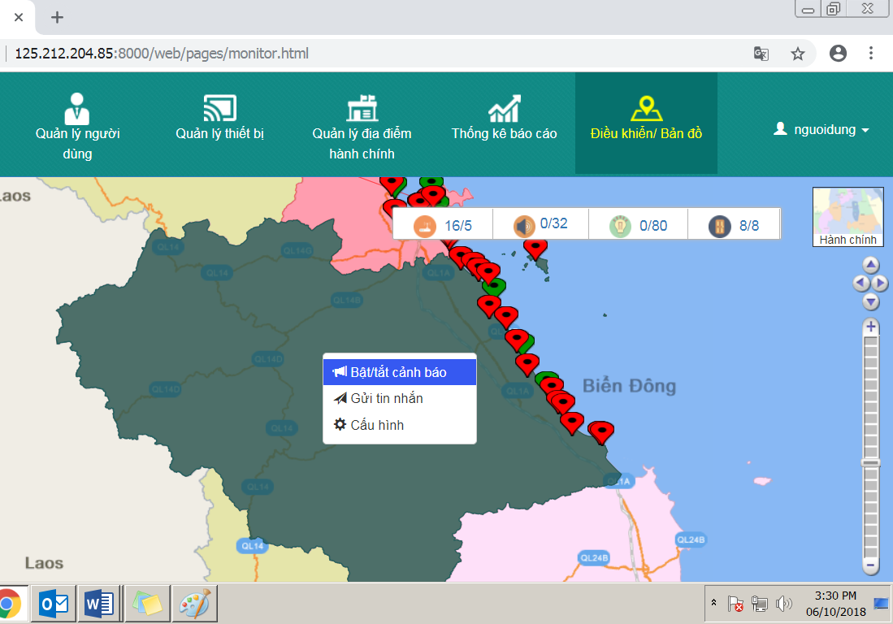
TSUNAMI RESPONSE
- 30 sirens in Đa Nang
- 21 sirens Quang Nam

Slide 24
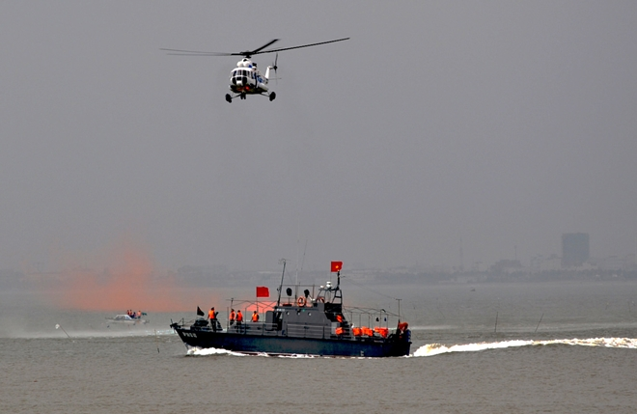
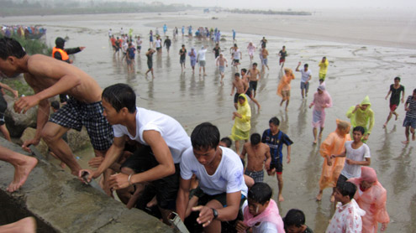
TSUNAMI RESPONSE
A Drill on tsunami response was conducted in Da Nang and Quang Nam provinces, central Vietnam

Slide 25
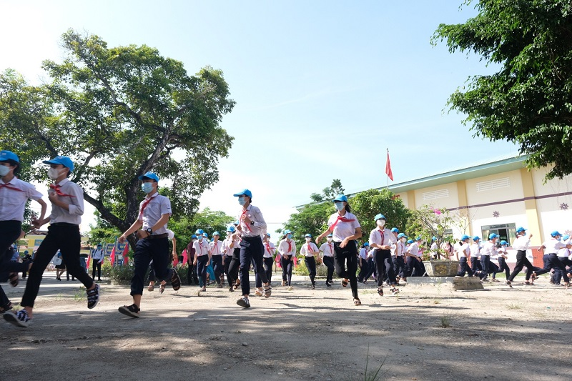
TSUNAMI RESPONSE
A Drill on tsunami response was conducted in Da Nang and Quang Nam provinces, central Vietnam

Slide 26
Future plans
Enhance the national seismic monitoring capacity through the deployment of additional broadband seismometers and the modernization of existing network infrastructure.
Refine and expand the national tsunami scenario database to improve the accuracy and reliability of early-warning and forecasting systems.
Conduct quantitative tsunami hazard assessments for major harbors and other high-exposure coastal zones in Vietnam.

Slide 27
THANK YOU !

