Slide 1
Local Tsunami SOPs
LARACHE - MOROCCO

Slide 2
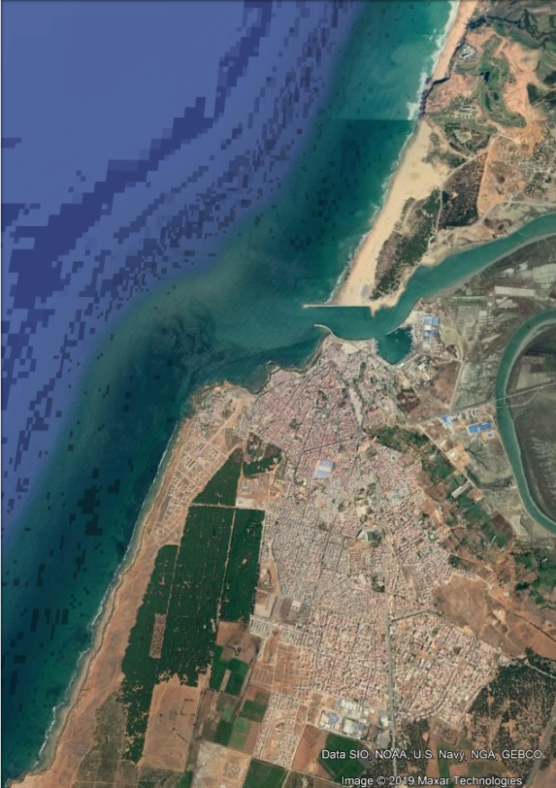
Larache is a city in northwestern Morocco. It is on the Moroccan coast, where the Loukos River meets the Atlantic Ocean. Many civilisations and cultures have influenced the history of Larache, starting in the ancient city of Lixus during the 12th century BCE. Between the period of being a strategic Berber town and then a Phoenician trading centre to Morocco's independence era around the 1950s, Larache was a nexus for many cultures.
Its population in 2024 was 510,211.
Larache has also a fishing harbor, the fishing industry provides work for 8000 persons.

Slide 3
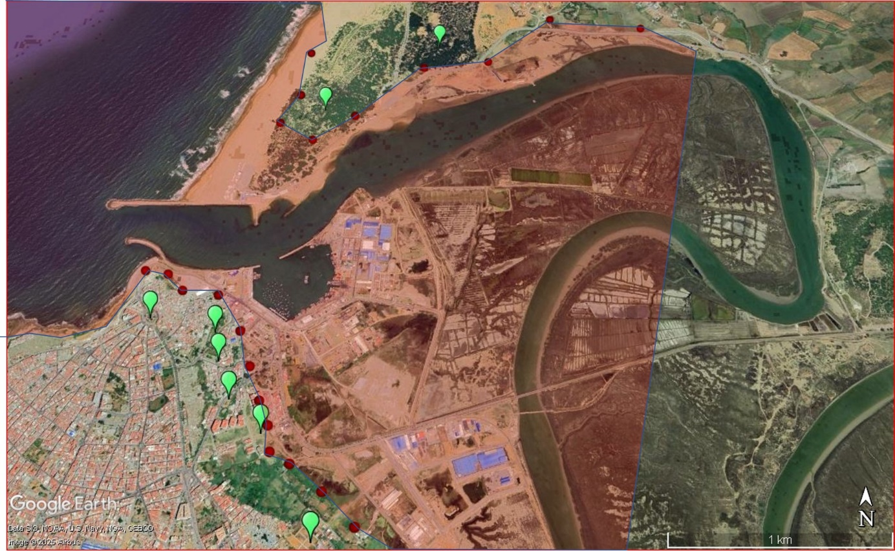
Assembly Areas in the Event of a Tsunami in Larache city (green point). Inundation zones and vulnerable areas (in red)

Slide 4

LARACHE LOCAL LEVEL WARNING CHAIN
NATIONAL
METEOROLOGICAL
AGENCY
Public
Local technical offices Volunteers
Local hospitals
Red crescent
NGO’s
Marine rescue agency
Police
Gendarmerie
Province authority
Local civil Protection
MINISTRY OF INTERIOR
CIVIL
PROTECTION
Media
CNRST
National
Local
Local

Slide 5
Existing Local SOPs
Coordination with provincial/national disaster management agencies
Regional emergency management center (Under construction)
Coordination Structure within Municipality
Local Focal point in natural risks
Evacuation procedures (local governorate)
Response Operations (local governorate)

Slide 6
Challenges
Implementation of a regional emergency management center covering the north west part of Morocco.
Coordination with national/regional agencies
Evacuation Procedures:
1 - Activation
2 - Evacuation Routes and Safe Zones (New areas)
3 - Population Evacuation (Old city)
4 - Evacuation Timing (Periodic evacuation drills)

Slide 7
Planned SOP updates
Dissemination channels:
Sirens in coastal towns.
SMS via telecom operators (IAM, Orange, Inwi).
National TV and Radio (RTM, Medi1, 2M).
Mosque loudspeakers where coordinated by authorities.
Social media.
Messages must be in Arabic, French, and Tamazight where applicable.
Make use of resistant buildings as tsunami shelters.

Slide 8
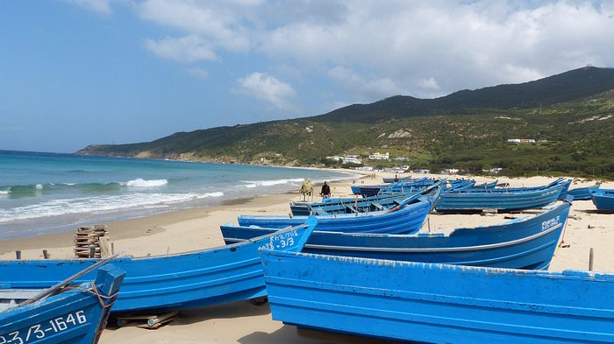
STAY SAFE - THANK YOU

