Slide 1










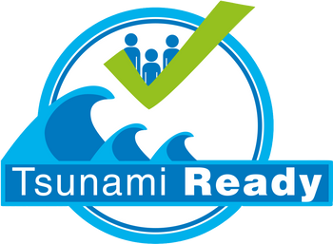
DG ECHO CoastWAVE 2.0 National to Local Level SOP Workshop
27 October-20 October
Cascais, Portugal
3. Effective End to End TWS

Slide 2
Tsunami Warning System (TWS- content, end to end TWS and supporting documents)
Tsunami Warning
  TSP, NTWC roles and responsibilities
  NTWC SOP and its development
Tsunami Emergency Response
  EMA and its role and responsibilities
  EMA SOPs and their developments
OUTLINE

Slide 3
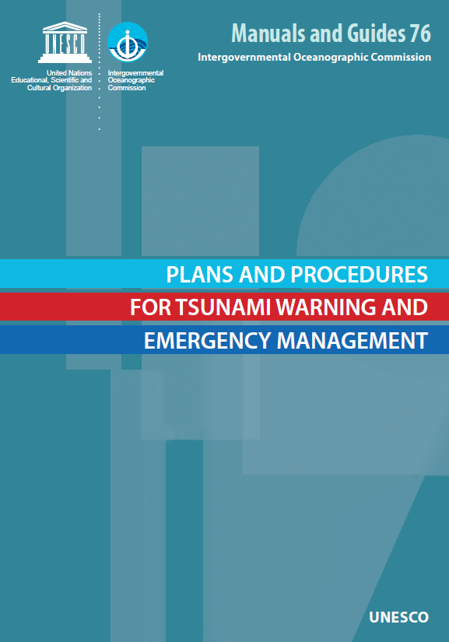
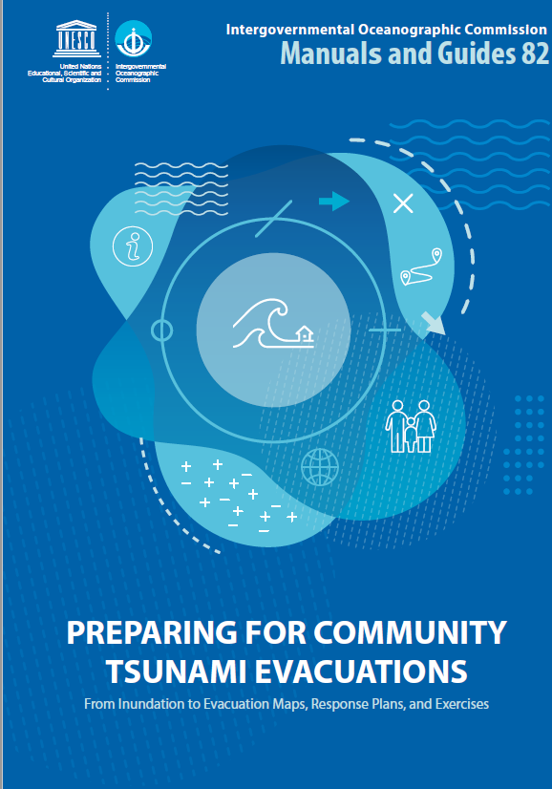

Manuals and guidelines of the workshop:
MG 76, MG 82 and MG 58
MATERIALS
Notes:
This manual provides guidance to NTWCs and EMAs and local EMAs on the development of SOPs for end to end tsunami warning systems.

Slide 4
End to End Tsunami Warning
System
What is ETWS?
The four components of ETWS
Stakeholders of ETWS
  TSP
  NTWC
Development of SOPs

Slide 5
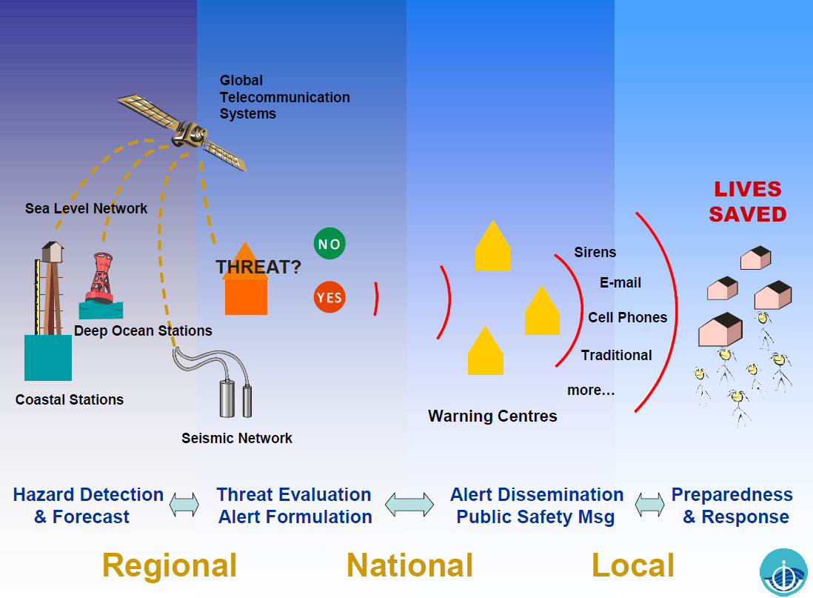
What is ETWS?
Notes:
Tsunami warning system is the chain of the events, to prepare coastal communities to respond appropriately and in a timely manner . At the operational level, SOPS are the foundations of an effective and reliable warning system. SOPs are particularly essential for tsunami warnings given the requirement for rapid effective response.
ETWS: the series of chronological events related to tsunami risk knowledge, monitoring and warning, communication dissemination and response to protect lives and property.

Slide 6
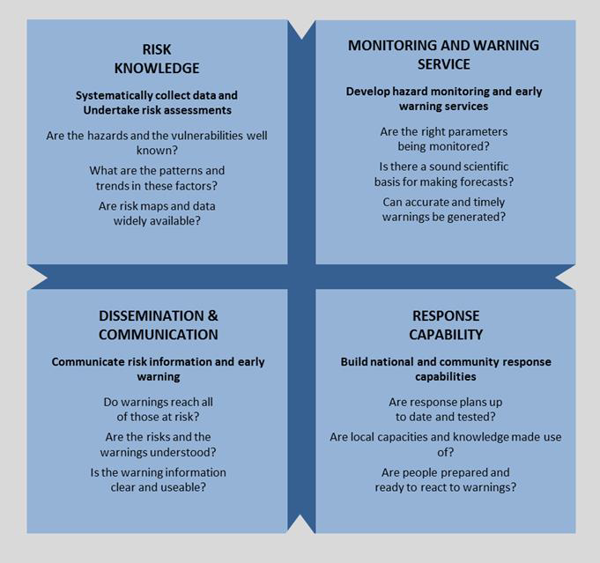
The Four
Components
of ETWS
Source: MG76

Slide 7
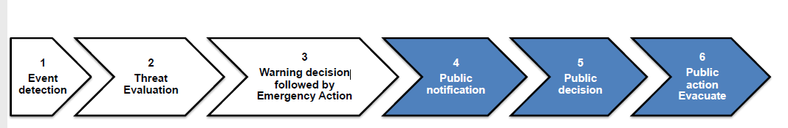
TSP
NTWC
EMA
The public
Principal Stakeholders of ETWS
TSP and NTWC
EMA
Smooth coordination between stakeholders is essential.
Notes:
This system involves several stakeholders who work together in a coordinated way with a good understanding of each other’s roles, responsibilities, actions, during an event.
This graph illustrates the six consecutive steps involved in an end-to-end warning and response process chain during a tsunami event; the objective is to support effective public action with timely, authoritative and quality information and arrangements. A TWS will be judged on its capacity to save lives and minimize damage and losses

Slide 8
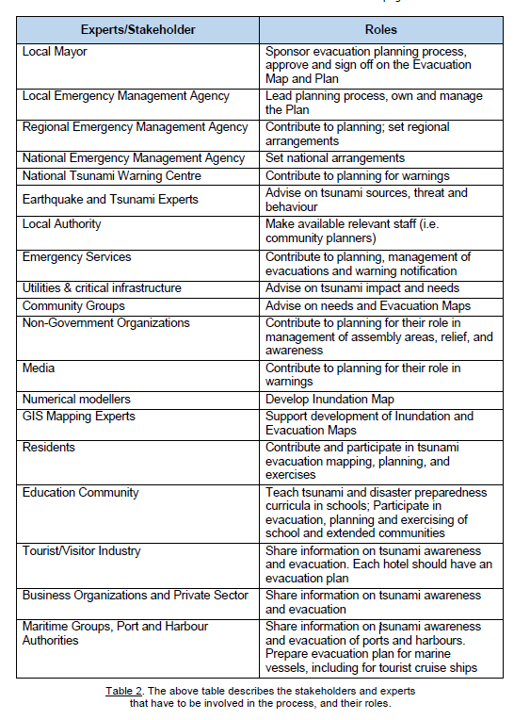
Stakeholders of ETWS

Slide 9
Stakeholder Coordination is Essential
TWFP
Warning
Center
TSUNAMI
COORDINATION COMMITTEE
  Hazard & Risk Assessment
  Warning Coordination
  Preparedness & Mitigation
Science
Institutions
Emergency Management
Agencies
Civil Society & NGOs
Community organizations
(social, gender, cultural, age,
language, religious …)
Trade, business organizations
Disaster response & relief
Government Agencies:
Planning & Development
Transportation
Health & Education
Coastal Management
Social Services
Other:
Media
Utilities
Tourism
International
Agencies
Figure 2.5 Participants in a Tsunami Coordinating Committee (Source: ITIC)
Source: MG76
Notes:
If the proper stakeholders are not identified and they don’t work together as a tsunami coordination committee, the public will not receive a timely warning; the End-to-End system will have failed to deliver the message to the last mile (i.e., people on coastlines).
Awareness and preparedness efforts will help sustain agreed-upon efforts by stakeholders. Finally, it provides a line of communication and a way to establish goals and objectives to reduce the impact of tsunamis.

Slide 10
Principal Stakeholders of ETWS
TSP
NTWC
EMA
The public
Notes:
This system involves a number of stakeholders who work together in a coordinated way with a good understanding of each other’s roles, responsibilities, actions, during an event,

Slide 11

TSUNAMI SERVICE
PROVIDERS

Slide 12
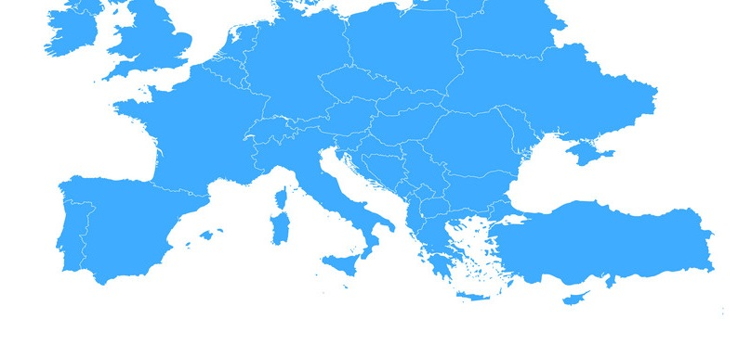
Tsunami Warning Principal Stakeholder
TSUNAMI SERVICE PROVIDERS (TSP)
5 in NEAM:
CENtre d’Alerte aux Tsunamis (CENALT)
Kandilli Observatory and Earthquake Research Institute (KOERI)
National Observatory of Athens (NOA)
Centro di Allerta Tsunami (CAT-INGV)
Instituto Português do Mar e da Atmosfera (IPMA)
CENALT
CAT-INGV
NOA
KOERI
IPMA
Tsunami Service Provider. Centre that monitors seismic and sea level activity and issues timely tsunami threat information within an ICG framework to National Tsunami Warning Centres/Tsunami Warning Focal Points and other TSPs operating within an ocean basin. The NTWCs/TWFPs may use these products to develop and issue tsunami warning for their countries. TSPs may also issue Public messages for an ocean basin and act as National Tsunami Warning Centres providing tsunami warnings for their own countries. Intergovernmental Oceanographic Commission. Fourth Edition. Tsunami Glossary, 2019. Paris, UNESCO. IOC Technical Series, 85. (English, French, Spanish, Arabic, Chinese) (IOC/2008/TS/85 rev.4)
A center with the capability to detect and assess tsunami threats over a large region, and to disseminate their threat assessment to other Member States

Slide 13
Tsunami Warning Principal Stakeholder-
TSP-roles & responsibilities
Event Response Operations
regional Monitoring & Detection (24/7) of seismic and seal level activity
provide timely initial earthquake information
determine more specific threat info
provide timely tsunami forecast
monitor tsunami propagation
serve as an NTWC for the country in which it resides
serve as a backup center to other TSPs
Notes:
Center, that monitors seismic sea level activity and issues tsunami threat information within ICG frameworks and other TSPs in the region.

Slide 14
Tsunami Warning Principal Stakeholder-
TSP-roles & responsibilities
In non-emergency/routine cases:
document and regularly review and update SOP
ρegularly test and carry out exercises
perform calibration and validation of forecasting tools and models.
review and update observations from seismic and sea level data streams.
Notes:
Which are essential in building preparedness and coordination internally and with the NTWCs
document and regularly review and update SOP, after the events
ρegularly test and carry out exercises , to determine and report system performance including communication channels to NTWCs, decision support tools etc.

Slide 15
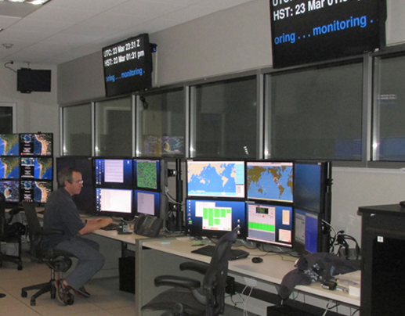
NATIONAL TSUNAMI
WARNING CENTERS

Slide 16
Tsunami Warning-Principal Stakeholder:
NTWC-roles & responsibilities
Event Response Operations:
operates on 24/7 basis to receive EQ and tsunami information from TSPs, and eventually operates its own detecting, processing and forecasting tools/systems
evaluates the threat to coastal communities and issues warnings about threats or cancellations to EMAs and other stakeholder agencies.
Must respond quickly, be as accurate as possible and be reliable to be effective
Notes:
NTWC is an authority officially designated by the country to monitor and issue tsunami warnings and other related statements within their country.
It provides the information to national emergency officials and may also provide it directly to other agencies, the media, and the public.
To receive, directly or indirectly through the designated country national tsunami warning focal point, earthquake and tsunami information from the TSPs of its choice and optionally to independently monitor seismicity and tsunamis in real time.

Slide 17
Principal NTWC event response steps and flowchart on receipt of EQ data
1. Detect and analyze large earthquake
2. Assess tsunami threat based on pre-determined criteria
3. Issue initial tsunami warning message
4. Receive and/or carry out further seismic analysis and receive/calculate tsunami forecast
5. Detect and analyze sea level data for tsunamis
6. Re-assess tsunami threat
7. Issue supplementary warning message
8. Repeat steps 4-7 until “No dangerous tsunami waves coming ashore”
9. Issue tsunami warning cancellation message

Slide 18
Tsunami Warning:
Principal Stakeholder: NTWC
NTWC during non-event or routine operations
Routine and daily office operations and watch duty staffing
Data quality control, equipment/instrument repair, and maintenance
Data and warning communications
Staff training and exercising
Contingency planning or backup in case the primary tools become inoperable
Education and training of stakeholders.
Tsunami event response operations and non-event operations are described in Operations Manual of NTWC!

Slide 19
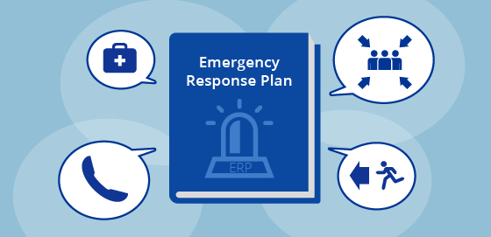
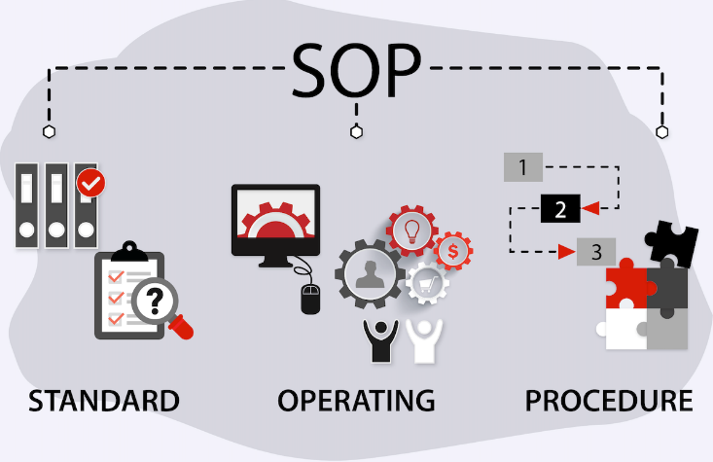
SUPPORTING DOCUMENTS OF ETWS
National Tsunami Warning and
Emergency Response Plan:
HIGH LEVEL DOCUMENT
describe the collective system components
and assign responsibilities and actions
Standard Operatiing Procedures Plan:
Each system component and responsibility requires an SOP
Notes:
National Tsunami Warning and Emergency Response Plan does not include procedures. It is a higher-level document that describes the system and its components and that assigns roles and responsibilities. In turn each Com. ensures a common understanding among all those with responsibilities under the TWS and form the basis for enhancements and changes of the TWS.
ponent and responsibility will require detailed SOPs as separate yet synchronized documents
Activities and actions to be covered by SOPs range from the receipt of data, its processing and analysis, decision-making, warning communication, public alerting, and evacuations

Slide 20
NTERP
The warning concept (thresholds, threat levels, danger zones as applicable)
The types of advisories/warnings (including describing when each type will be used, and how the information is to be used by recipients)
Key stakeholder addresses
Notes:
National Tsunami Warning and Emergency Response Plan does not include procedures. It is a higher-level document that describes the system and its components and that assigns roles and responsibilities. In turn each. It ensures a common understanding among all those with responsibilities under the TWS and form the basis for enhancements and changes of the TWS.
In turn each component and responsibility will require detailed SOPs as separate yet synchronized documents.
Activities and actions to be covered by SOPs range from the receipt of data, its processing and analysis, decision-making, warning communication, public alerting, and evacuations

Slide 21
EMA Roles & Responsibilities
The core responsibilities of the EMA in a tsunami warning are:
To receive official tsunami warning and cancellation messages from the NTWC.
To conduct further threat assessments and decide appropriate action.
To communicate the warnings, with instructions, via public alerting systems and the media.
To activate appropriate emergency response measures, including deciding and managing evacuations.
To communicate the “All Clear” when the threat is over.

Slide 22
EMA SOP development
During tsunami events the EMA must immediately interpret the warnings issued by the NTWC to decide if all or some of the
communities are impacted and decide on the appropriate response action.

Slide 23
EMA SOP development
“ A description and procedure on agreed steps by institutions used in coordinating who, what, when, where and how for tsunami early warning and response”
SOPs describe how the operational activities that are covered in the TER plans are to be performed. Specific SOPs must therefore be created for each individual TER plan. They must be teach and tested to ensure that response staff are familiar with them, and they must be exercised to identify gaps or improvements that are to be made.
SOPs should be sufficiently detailed so that mistakes or omissions in the execution of operational activities are avoided, and so that the activities are executed in a consistent way.
Useful support tools in this regard include flow charts, criteria tables, timelines and checklists

Slide 24
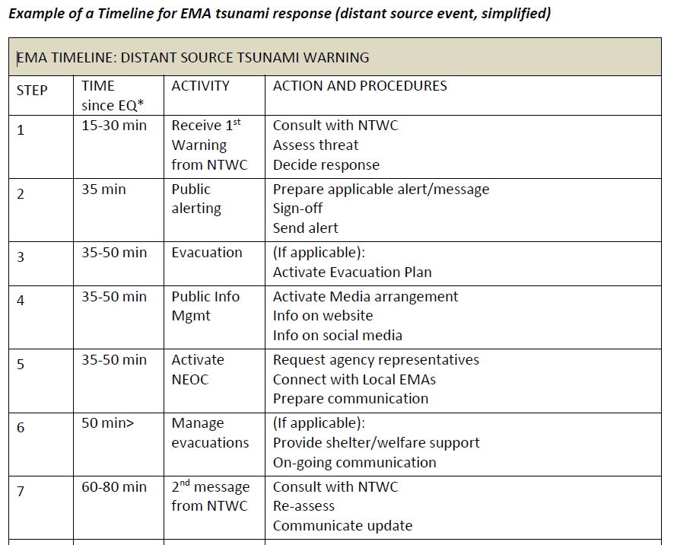
SOP Tools - timelines

Slide 25
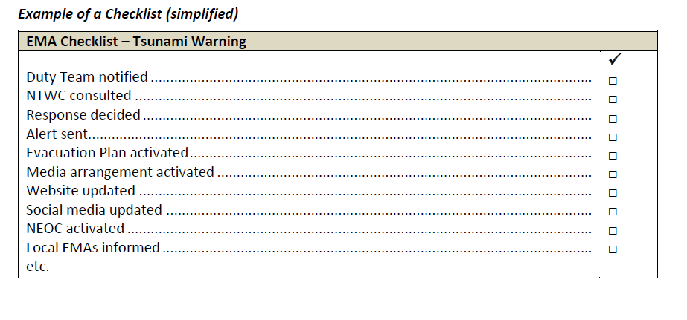
SOP Tools - checklists

