Slide 1
5.a. {Insert Country} Report
from National Workshop
Name(s)
Organisation(s)
Email(s)
Pre-IOWAVE25 Workshop on Standard Operating Procedures for NTWCs and DMOs
Hybrid – August 2025

Slide 2
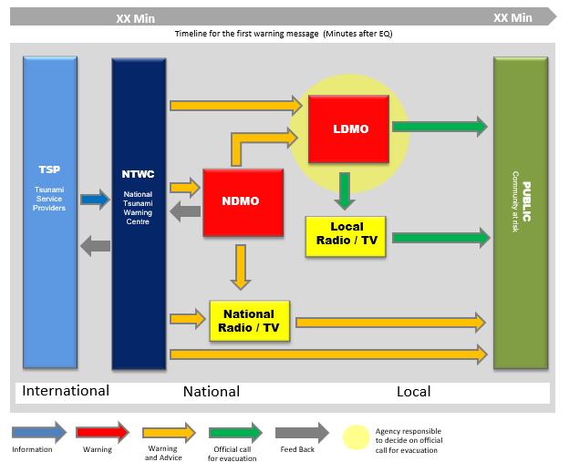
National Tsunami Warning Chain Status Update
Insert your country’s national tsunami warning chain (example provided).
Comment on any updates.

Slide 3
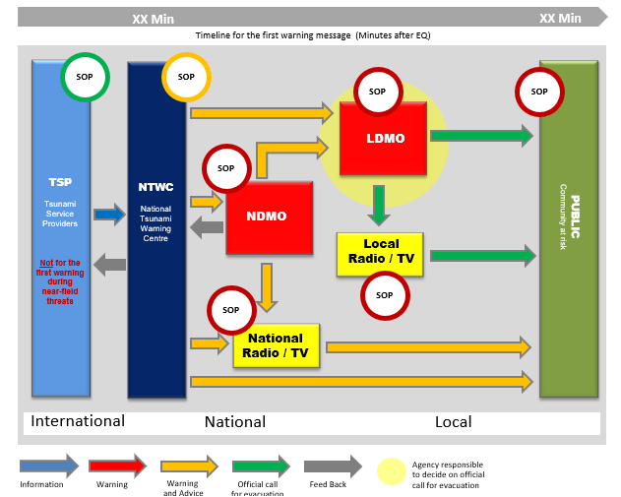
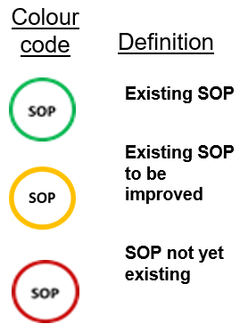
Standard Operating Procedure Status Report
Indicate your country’s SOPs status with regards to the tsunami warning chain (example provided).
Comment on any updates.

Slide 4
Issues for follow-up and future work
…
…
…

Slide 5
Exercise IOWave25 Plans
Modify as appropriate.
Scenarios: 1) Sunda Trench (Thursday 25 September 2025); 2) Makran Trench (Wednesday 15 October 2025); 3) Fani Maore Volcano (Saturday 25 October 2025); 4) Sumatra Trench (Wednesday 5 November 2025)
Exercise types: Full-scale exercise, Functional exercise, Tabletop exercise, Drill, Orientation exercise
Key players: NTWC, NDMO, P/LDMO, emergency response agencies, media, communities, etc.
Evacuation: Names of communities evacuating and approximate number of people (if known)

Slide 6
World Tsunami Awareness Day 2025 Plans
Modify as appropriate.
Activity Plan
Link WTAD and IOWave25
etc

