Slide 1
8.2 TARGET DATE AND VENUE FOR ICG/CARIBE-EWS XX
ICG/CARIBE-EWS XVIII
online
5-7 & 9 May 2025

Slide 2
Decisions and Recommendations of ICG/CARIBE-EWS XVII
Acknowledging the UNESCO recommendation reported by the Secretariat to the ICG on May 8, 2024, to hold statutory meetings and recurring conferences in-person only every second time, and online every other, in order to reduce UNESCO’s carbon footprint to meet its set target of reducing its emissions by 31 per cent by 2030, in line with the goals of the Paris Agreement,
Decides to consider conducting its future sessions from 2026 onwards in-person only every second year, and online every other,

Slide 3
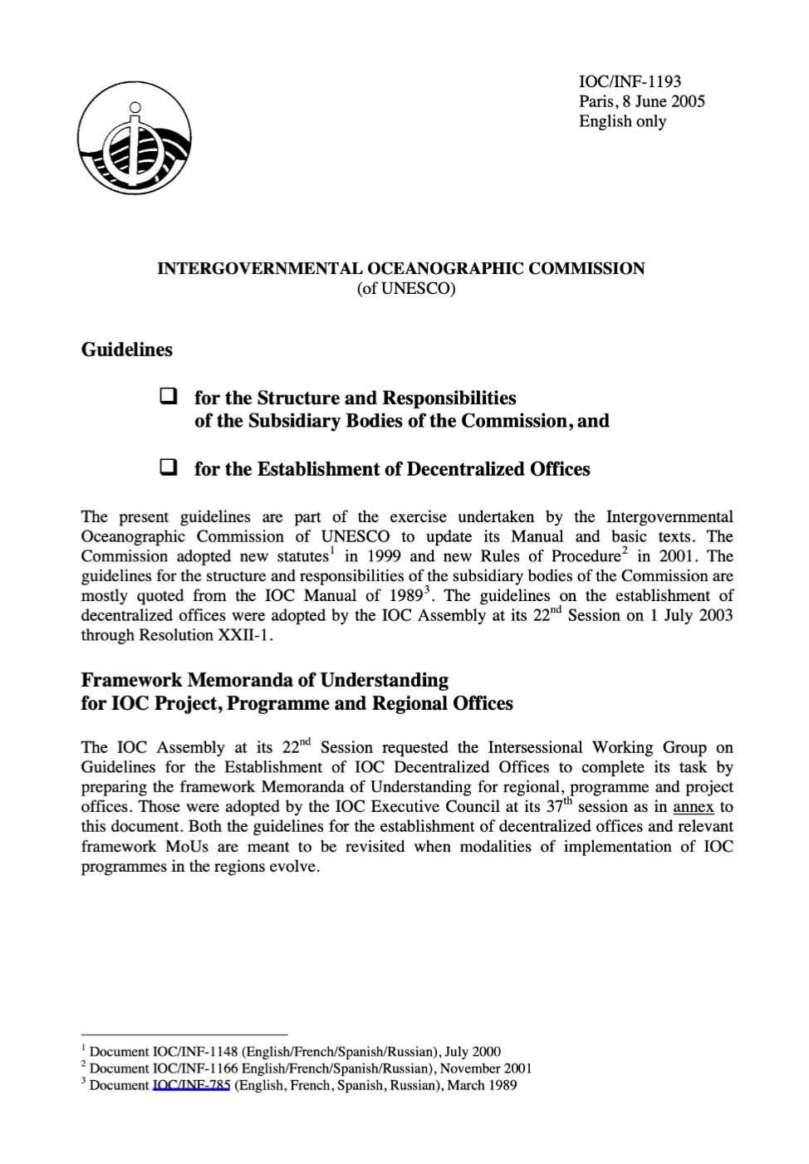
UNESCO-IOC guidance dated 8 June 2005 regarding
Frequency of Sessions
The frequency of sessions of Primary and Secondary Subsidiary Bodies depends on several factors, particularly:
(i) the developmental stage of the activity with which the body is concerned it usually being desirable to have relatively more frequent meetings in the early stages;
(ii) the disposition (in terms of funding, scheduling, etc.) of Member States vis-à-vis a given, activity;
(iii) the Secretariat workload and meeting schedule;
(iv) the desired relationship between the work of the subsidiary body and sessions of the Governing Bodies and/or Primary Subsidiary Bodies.
Nevertheless, in general, Sub-Commissions, Scientific and /or Technical Committees and Regional Committees should meet at least once every two years, the actual frequency being related to the state of development and the requirements of the particular programme or as determined by the Assembly or the Executive Council.

