Slide 1
3.2 ICG/CARIBE-EWS Secretariat Report
ICG/CARIBE-EWS XVIII
online
5-7 & 9 May 2025
Öcal Necmioğlu
Technical Secretary of ICG/CARIBE-EWS
Tsunami Resilience Section

Slide 2
Secretariat support to the ICG/CARIBE-EWS
during the intersessional period (I)
Continued to support both IOC ICG/PTWS and IOC ICG/CARIBE-EWS and their TSPs through the continuous update of TNCs/NTWCs/TWFPs, Working Groups and Task Teams contact databases in direct contact with the Member States
Organized an Expert Meeting on Seismic Sources in the Northwest Caribbean and on Non-Seismic Sources of Tsunamis for the Caribbean and Adjacent Regions in Heredia, Costa Rica, 2-6 December 2024 in close collaboration with WG-1 and SINAMOT. The draft report of the Expert Meeting is expected to be published by 2025/Q3
Provided active support to CARIBE WAVE 24 (CL-2979 on CARIBEWAVE24 and TS-187 CARIBEWAVE24 Participant Handbook).
Assisted the implementation of the TRRP.
3 Additional IOC-Technical Series were issued during 2024
TS-178 (EXERCISE CARIBE WAVE 23 - Summary Report)
TS-194 (CARIBE WAVE - General Guidelines)
TS-195 (CARIBEWAVE25 - Participant Handbook).

Slide 3

Secretariat support to the ICG/CARIBE-EWS
during the intersessional period (I)
In response to the M7.6 earthquake and Tsunami Threat Messages issued by the PTWC, a Post-Event Assessment “Hot-Wash” Webinar was organized on 12 February 2025, in which more than 100 Member State Representatives from 25 ICG/CARIBE-EWS Member States/Territories (Antigua and Barbuda, Barbados, Belize, Brazil, British Virgin Islands, Cayman Islands, Colombia, Costa Rica, Cuba, Curacao, Dominican Republic, Guatemala, Guyana, Haiti, Honduras, Jamaica, Martinique, Mexico, Nicaragua, Panama, Puerto Rico, Trinidad and Tobago, UK, USA, Venezuela) participated.
The report of the CARIBE WAVE 24 Exercise was published as TS-187 in 2025/01. CARIBE WAVE 25 webinars were hosted by the Secretariat (21-23 January 2025 and 25-27 February 2025, followed by an Exercise Hotwash on 1 April 2025.
Work is in progress for organizing a CARIBE-EWS Training on Sea-Level Station and Tide-Gauge Data Analysis (Venue TBD, 2025 November) and CARIBE-EWS Digital Elevation Models for Tsunami Inundation Modelling (Venue TBD, 2025/Q4).
CL-3006 on the Cessation of fax transmissions of tsunami information products by Tsunami Service Providers by 31 March 2025 was issued on 27 September 2024.

Slide 4
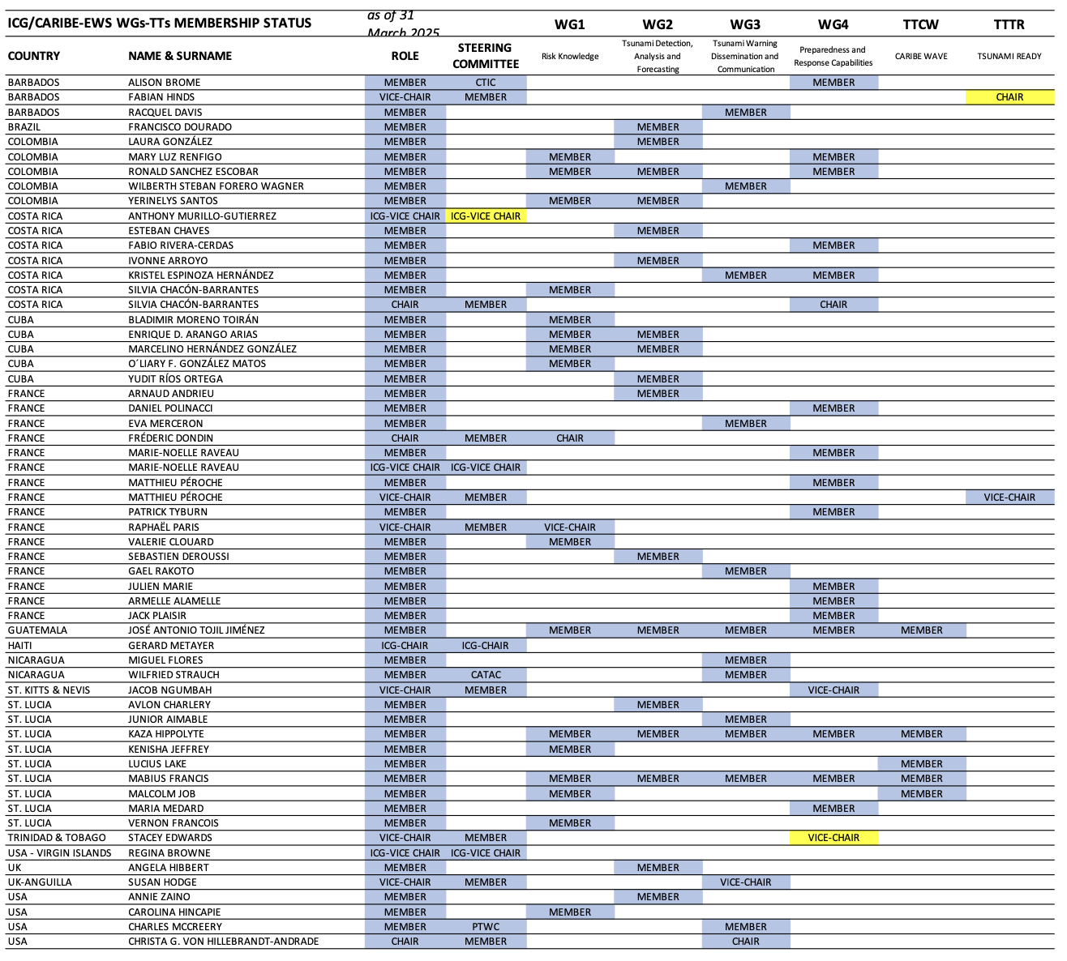
ICG/CARIBE-EWS WGs/TTs Membership Status
Member States were invited on 9 October 2023 through CL-2965 to nominate experts to the ICG/CARIBE-EWS Working Groups and Task Team.
As of 31 March 2025, there are 76 experts from 17 Member States/Territories, with the following distribution:
BARBADOS 3
BRAZIL 1
COLOMBIA 5
COSTA RICA 6
CUBA 5
FRANCE 14
GUATEMALA 1
HAITI 1
NICARAGUA 2
ST. LUCIA 9
TRINIDAD AND TOBAGO 1
UK 1
UK-ANGUILLA 1
USA 12
USA–PUERTO RICO 7
US VIRGIN ISLANDS 5
VENEZUELA 2
Delegations are invited to inform the Technical Secretary in case of any updates to the ICG/CARIBE-EWS Working Groups and Task Team Membership status.
Registration to OceanExpert is essential!

Slide 5
Status of CARIBE-EWS Action Monitor
Completed / Failed-Delayed / In Progress / Not Started / Canceled
Maintained by the Secretariat as a tool to monitor the execution of the Decisions and Recommendations of the ICG/CARIBE-EWS and relevant Ocean Decade Tsunami Program Research and Development Implementation Plan (ODTP-RDIP) milestones,
Updated at ICG/CARIBE-EWS Sessions and Steering Committee Meetings.
File available under ICG/CARIBE-EWS XVIII Documentation.

Slide 6
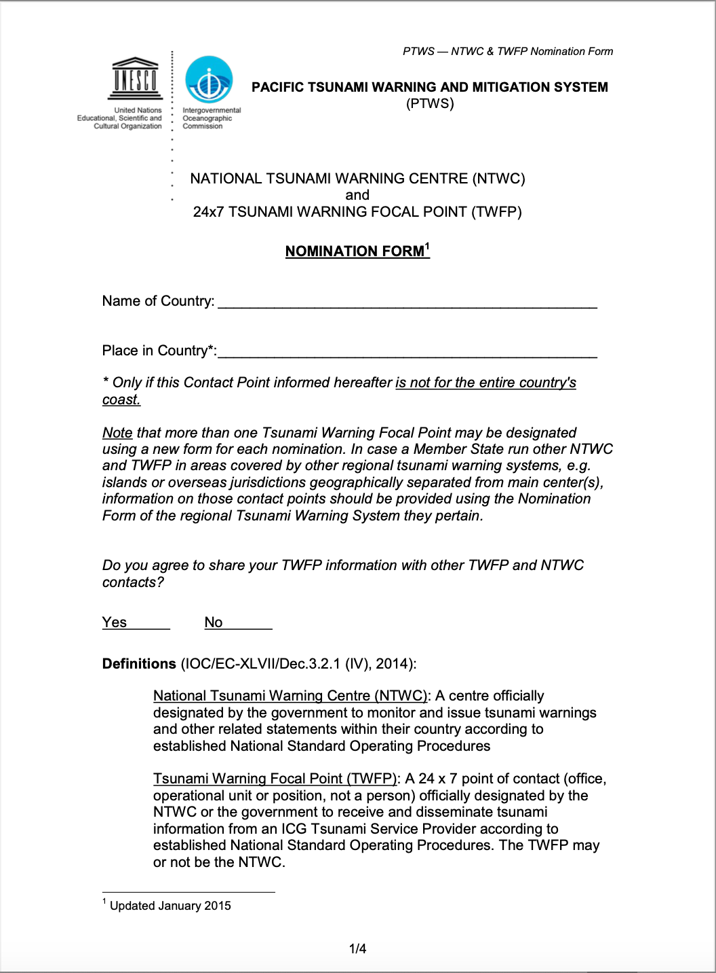
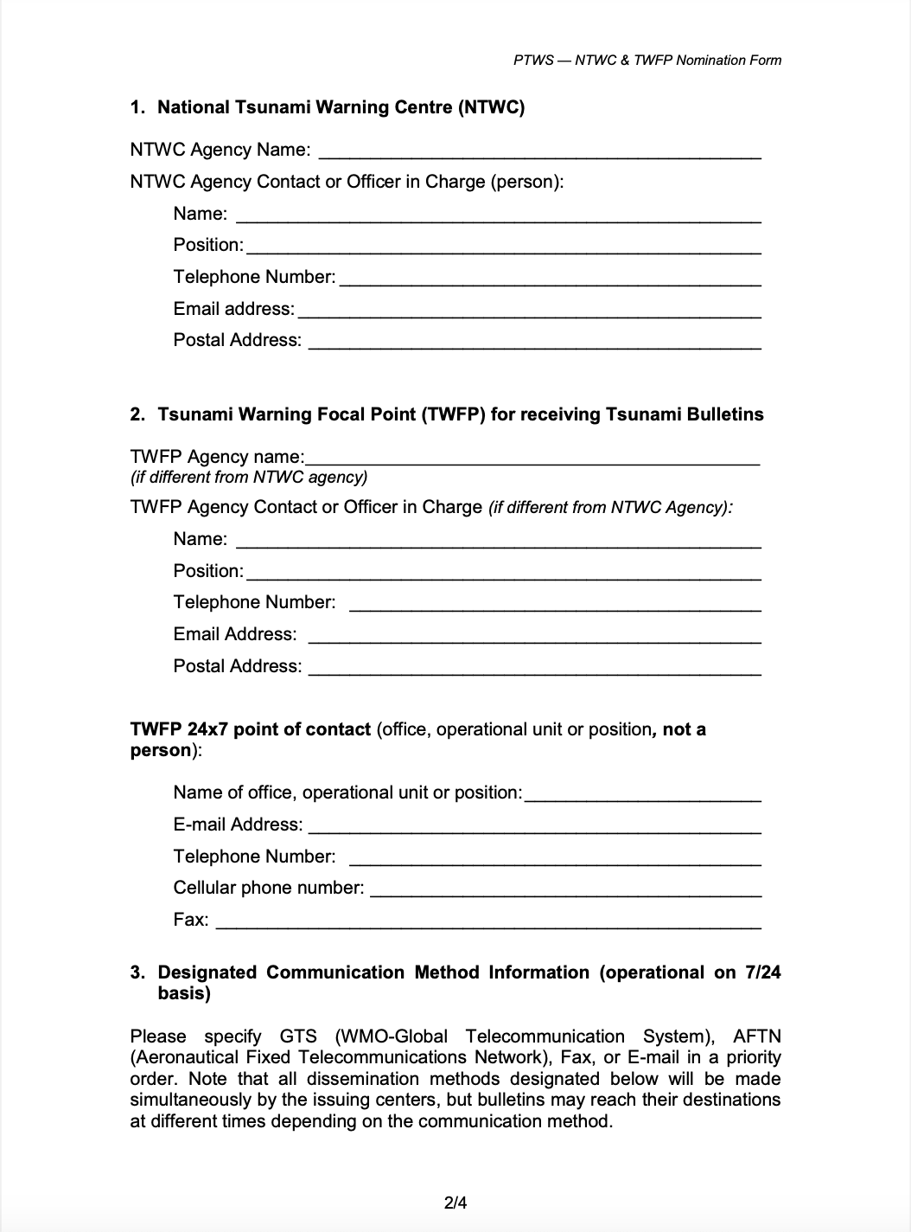
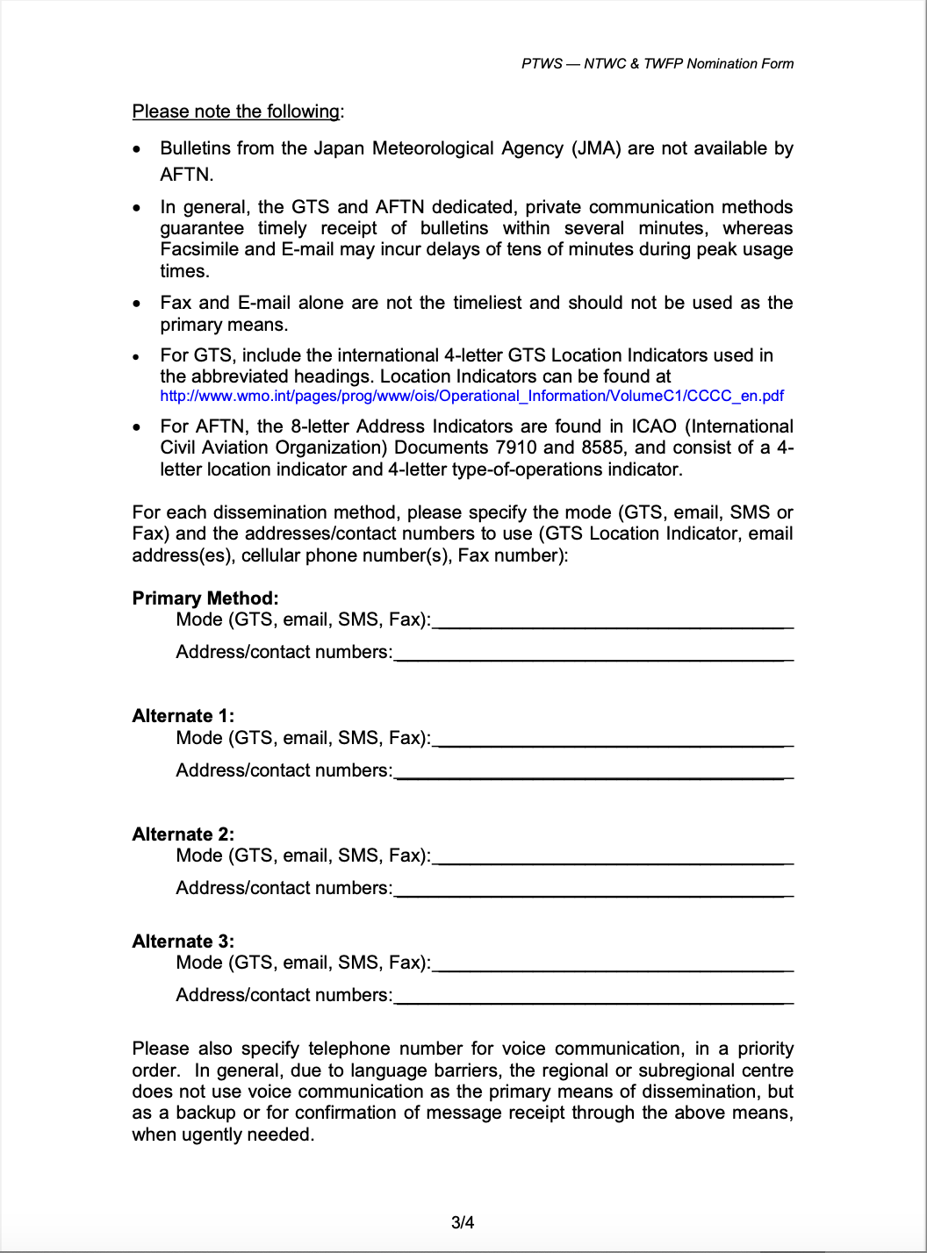
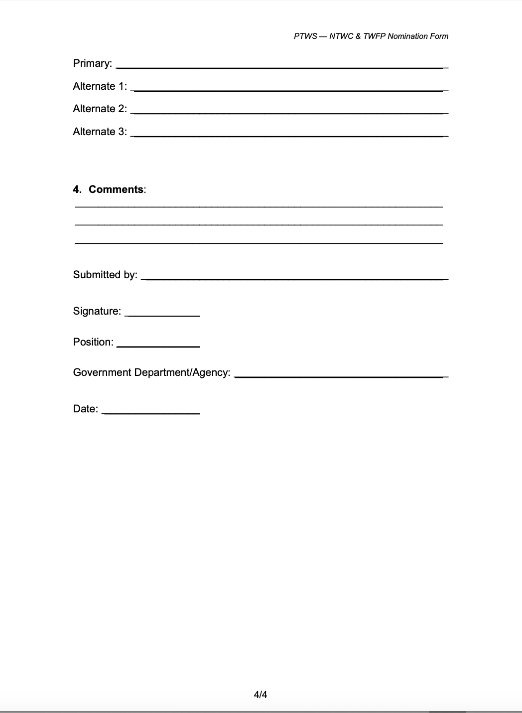
TNC/TWFP/NTWC Contact List
TOWS-WG-XVIII Recommendations
Currently, the collection of the TNC/TWFP/NTWC data is “in theory” governed through CL-2563, issued in 2015.

Slide 7
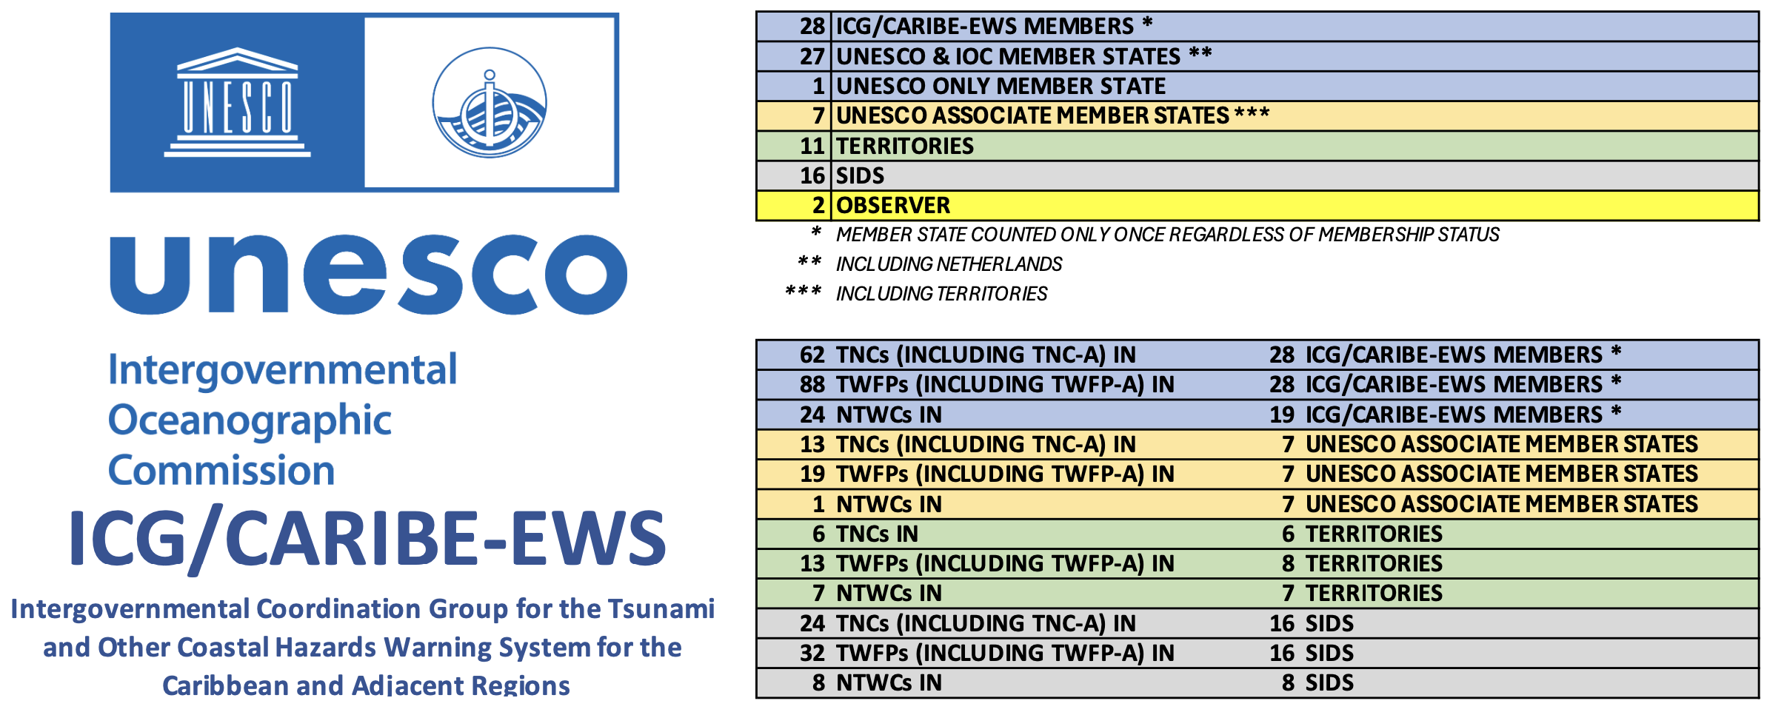
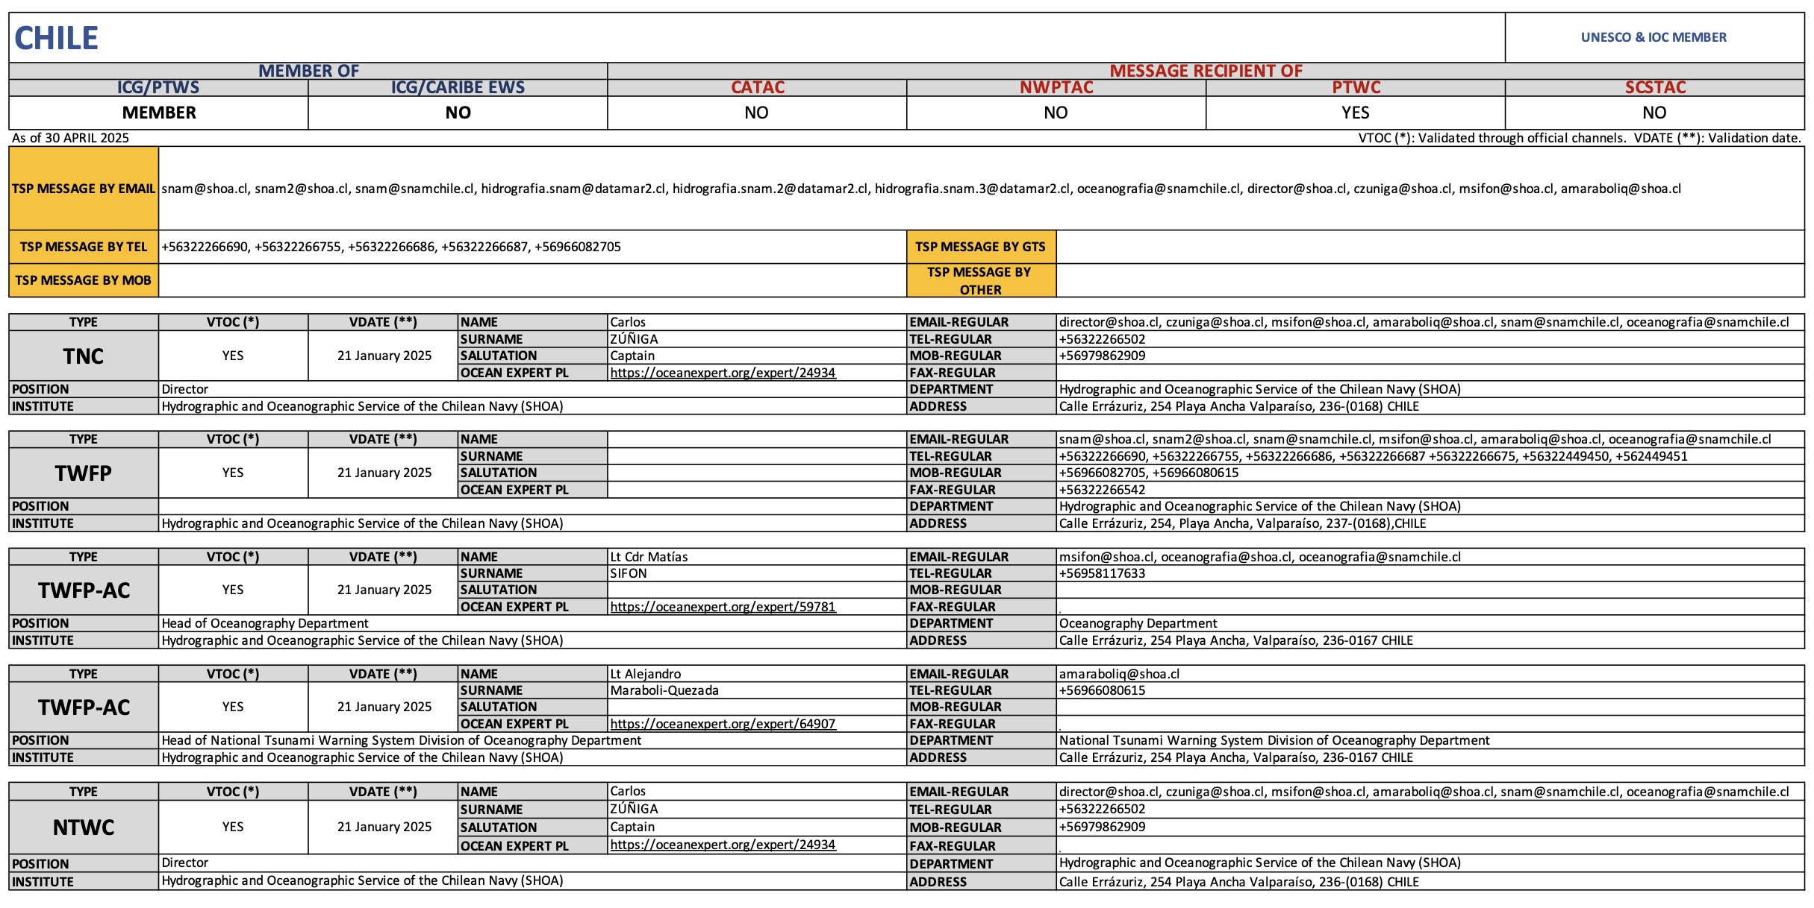
TNC/TWFP/NTWC Contact List
TOWS-WG-XVIII Recommendations
TOWS-WG-XVIII
The Group recommended the IOC Assembly at its 33rd session in 2025 to request the IOC Secretariat to prepare a standard and improved methodology of collecting TNC/TWFP/NTWC contact information, in close collaboration with the TT-TWO and TT-DMP and present its work at the next Joint TT-DMP and TT-TWO Meeting.

