Slide 1

The Intergovernmental Coordination Group for the Tsunami and Other Coastal Hazards Warning System for the Caribbean and Adjacent Regions (ICG/CARIBE-EWS)
XVIII Session
May 5-7 and 9, 2025
4.3 WG3: Tsunami Warning Dissemination and Communication Progress Report and Recommendations
Christa von Hillebrandt, Chair
Susan Hodge, Vice Chair

Slide 2
Terms of Reference
Purpose: To examine current and developing capacities and advise the ICG about the definition and composition of early warnings and tsunami products and the methods and best practices for effective end-to-end dissemination and communication.
Tasks:
- Explore and document the dissemination capabilities and existing alert guidance in the countries of the region.
- Identify the difficulties and challenges existing in the region that hinder the impact of “end to end” dissemination and communication of early warnings.
- Establish strategies for the development and implementation of methods and technologies to strengthen the interaction with the media and dissemination of early warnings within the countries of the region.
- Evaluate communication tests and tsunami exercises, in order to identify weaknesses and make recommendations to help strengthen these delivery systems
- Create communication protocol and standardized information identifying the minimum acceptable levels for communication and dissemination of tsunami early warning in all countries for approval by the ICG.
- Provide feedback to the Tsunami Service Providers on its products and communication procedures.
- Serve as a reviewing and approving body for proposed changes to TSP products for the CARIBE-EWS, or determine if proposed changes warrant going to the ICG for review and approval.
- Present a progress report based on the Key Performance Indicators related to the UN ODTP.
- Promote the sharing of experience and expertise, and capacity building essential to effective tsunami warning dissemination and communication.
#TSUNAMIREADY

Slide 3
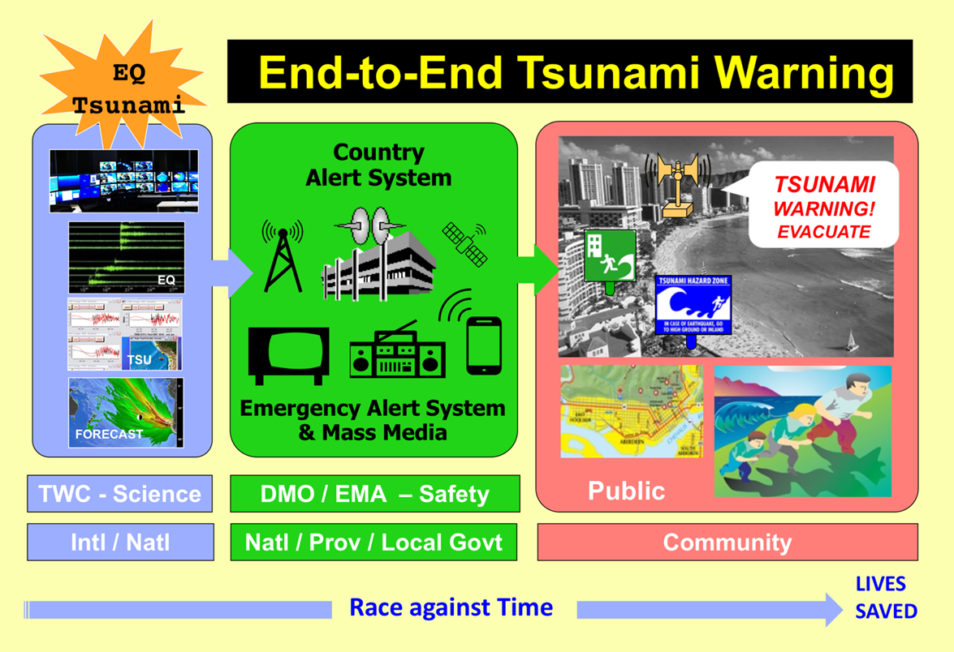
The Focus Area of WG 3

Slide 4
Membership
20 members, 18 regular (including TSP’s PTWC and CATAC), 2 Ex Officio (ICG Chair and ICG Technical Secretary)
CARIBE-EWS Member States in WG 3
Barbados, Colombia, Costa Rica, France, Guatemala, Nicaragua (CATAC), Saint Lucia, UK (Anguilla), USA (PR, USVI, PTWC),
CARIBE-EWS Observers in WG 3
PRSN

Slide 5
Activities
Status on Implementation of Recommendations from ICG CARIBE EWS XVII:
Finalize and submit the Inventory document including the results of the CARIBE WAVE 24 exercise. DONE (ICG XVIII document)
Further recommends the UNESCO-IOC Tsunami Resilience Section to promote and make available the final document to ICG/CARIBE-EWS Member States and other stakeholders. DONE (Email Sent by Chair to MS in December 2024)
Use the Inventory and EW4ALL initiatives to document the dissemination capabilities, existing alert guidance and capacity enhancement needs in each of the Member States of the ICG/CARIBE-EWS DONE (ICG XVIII document)
Review and revise Technical, Logistical and Administrative Requirements of a Regional Tsunami Service Provider for CARIBE-EWS and present at its XVIII session at the latest. DONE sent to CARIBE EWS Steering Group.

Slide 6
Activities
Other Activities 20024-2025
The working group had four virtual meetings during the intersessional 2024-2025 period.
Reviewed and suggested changes to PTWC updated User’s Guide for CARIBE EWS
Received updates from CATAC on its Users Guide, shared among members the April 4, 2025 version
Shared with WG 3 the Global Service Definition Document
Received updates from CATAC on Earthquake Early Warning (EEW), and potential applications for tsunami warning and communication
Supported the planning, conduct and evaluation of the CARIBE WAVE 2025

Slide 7
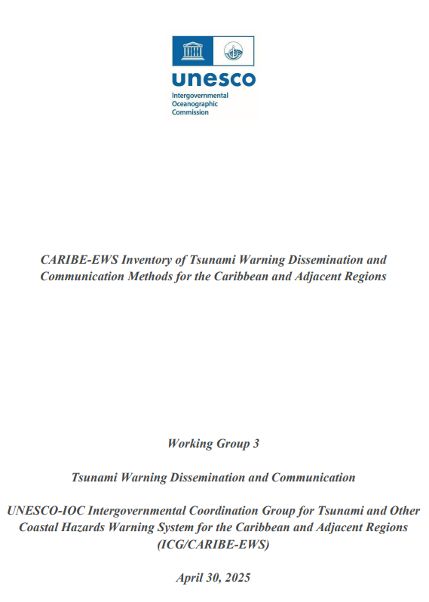
Working Group 3 with support of ITIC-CAR
Inventory of > 30 methods available for the reception of TSP products and dissemination and reception of tsunami warnings and other related products.
Overview of the methods and mechanisms used at different level and agencies from TSP’s through national authorities down to the private sector, media and communities and local governments.
Challenges of redundant and robust methods.
Systems for people with disabilities.
Basis for inventory within MS and to identify Capacity Development activities
#TSUNAMIREADY

Slide 8
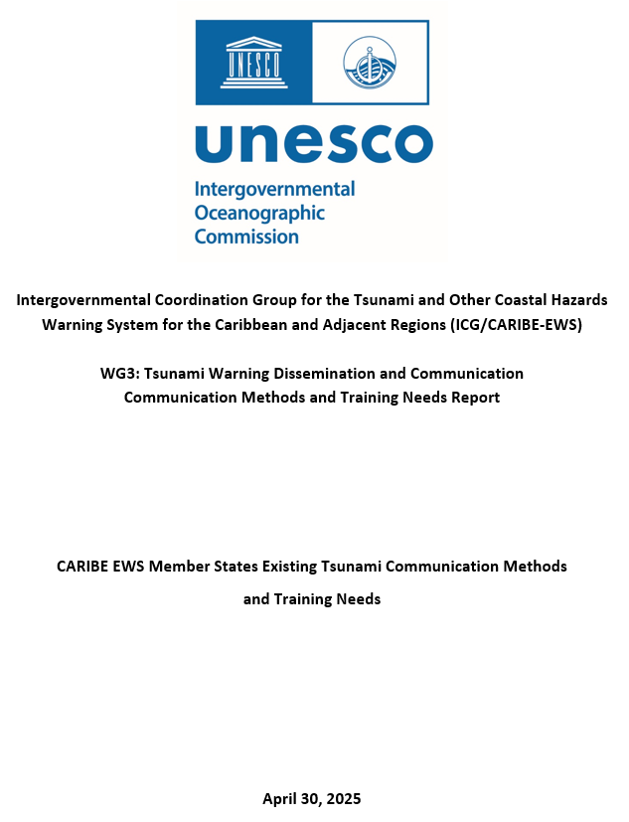
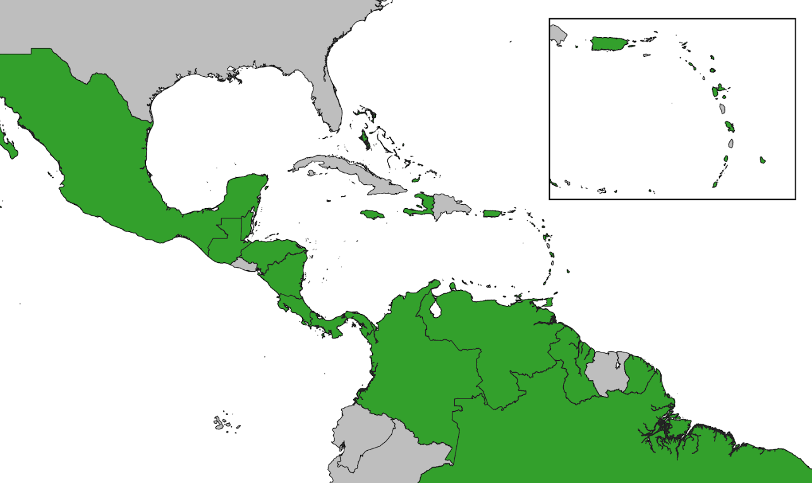
Inventory of Tsunami Warning Dissemination and Communication Methods for the Caribbean and Adjacent Regions
33 responses from 48 Member States and Territories (69%)

Slide 9
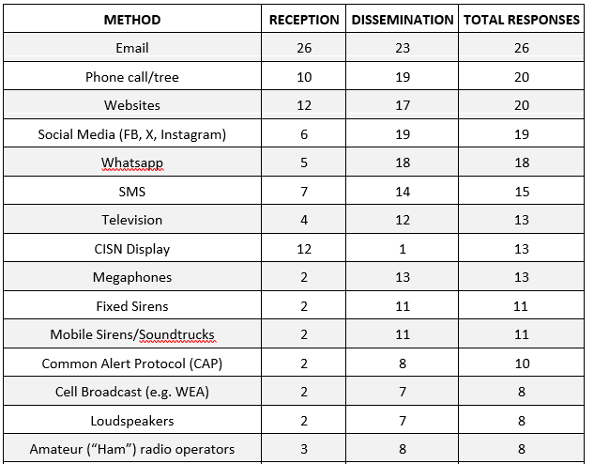
Inventory of Tsunami Warning Dissemination and Communication Methods for the Caribbean and Adjacent Regions
Most Used

Slide 10
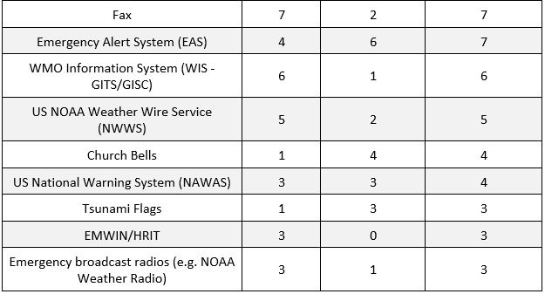
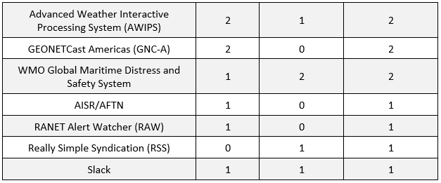
Inventory of Tsunami Warning Dissemination and Communication Methods for the Caribbean and Adjacent Regions
Least Used

Slide 11
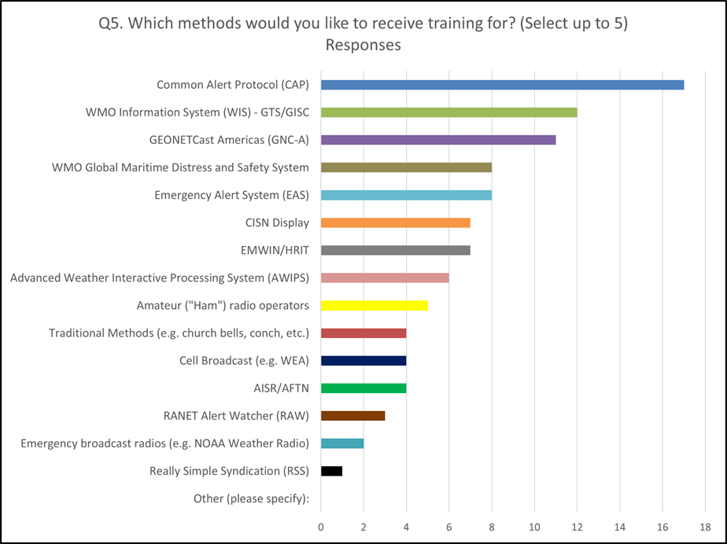
Training Priorities

Slide 12
Recommendations for ICG/CARIBE EWS XVIII
Recognizes the actions of the Working Group 3 towards the advancement of tsunami warning dissemination and communication.
Welcomes the representatives of WMO and UNDRR in the Working Group 3 as well as other new members nominated by the Member States.
Noting the lack of participation of some of the Working Group members,
Requests Tsunami National Contacts to encourage active participation of all its members and communicate to the Secretariat changes in designations.

Slide 13
Cont. (Inventory)
Noting the advances in the implementation plan for the Ocean Decade Tsunami Programme and its recommended actions for advancing Tsunami Warning, Dissemination and Communication,
Additionally noting the findings and recommendations of the UN Early Warnings for All Initiative (EW4ALL),
Acknowledging the updates to the CARIBE EWS Inventory of Tsunami Warning Dissemination and Communication Methods for the Caribbean and Adjacent Regions.
Recommends the Working Group 3 to work with UNESCO/IOC Tsunami Resilience Section to post and share the report and findings as a living document.

Slide 14
Cont. (Training)
Acknowledging the WG 3 report on the survey conducted among Member States on communication methods used and training required,
Noting that some of the training priorities can best be done locally (telecoms) and others regionally (online or in person),
Further Noting TOWS recommendation and the results of the CARIBE EWS survey for the need of Common Alerting Protocol (CAP) training and the efforts underway through EW4ALL,
Requests UNESCO/IOC Tsunami Resilience Sector to enhance coordination, including training, with UNDRR, International Telecommunications Union and WMO on CAP.
Recommends WG3 to develop a training strategy for tsunami warning dissemination and communication taking into consideration international, regional and national resources and activities.

Slide 15
Cont (PTWC Users Guide, EEW)
Noting the updates to the PTWC Users Guide for the CARIBE EWS, and the integration of the 2006 PTWC Communications Plan for the CARBE EWS,
Recommends the adoption of the 2025 PTWC Users Guide for the CARIBE EWS,
Further recommends the implementation of the new products by PTWC following notification to Member States with three months in advance.
Noting further advances by CATAC in Earthquake Early Warning, and potential applications for Tsunami warning and communication,
Recommends CATAC to continue to share, explore and integrate EQEW applications into its tsunami services and products for its TWFP and NTWCs.

Slide 16
Cont. (GSDD, Supplement)
Acknowledging that the Global Service Definition Document updated and approved by TOWS in 2025 is based on agreed concepts and guidelines and describes global tsunami warning services that are provided by regional tsunami warning systems operating in different ocean basins as a global system of systems and coordinated by the Intergovernmental Oceanographic Commission,
Noting that there are some items of the CARIBE EWS Tsunami Service Provider that are not included or are inconsistent with the Global Service Definition Document,
Further noting the duplications between the TOWS Global Service Definition Document and the CARIBE EWS Technical, Logistical and Administrative Requirements of a Regional Tsunami Service Provider for CARIBE-EWS.
Recommends the ICG CARIBE EWS Steering Group to prepare a CARIBE EWS supplement to the GSDD.
Further recommends that both the GSDD and the CARIBE EWS supplement guide the operations of the CARIBE EWS Tsunami Service Providers.

Slide 17
Cont. (SOPs)
Noting the task of the WG 3 to create a communication protocol and standardized information identifying the minimum acceptable levels for communication and dissemination of tsunami early warning in all countries for approval by the ICG,
Requests the Working Group 3 to review existing national and local SOPs and provide a report for the ICG XIX.
Appreciates the support that the International Tsunami Information Centre Caribbean Office has provided to Working Group 3 with as the contributions of other stakeholders;

Slide 18
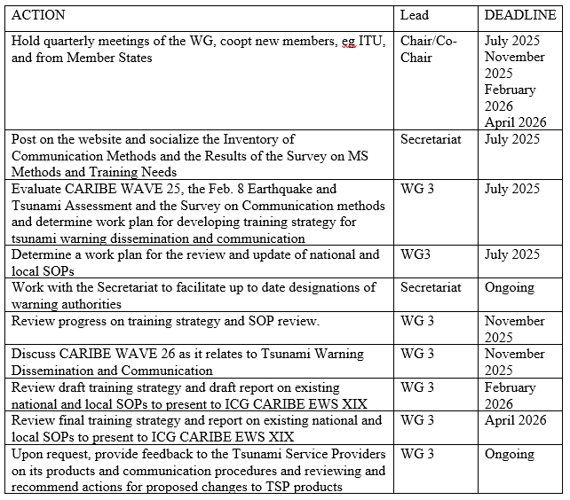
Internal Work Plan/Key Proposed Activities

Slide 19
Thank You!
#TSUNAMIREADY

