Slide 1

The Intergovernmental Coordination Group for the Tsunami and Other Coastal Hazards Warning System for the Caribbean and Adjacent Regions (ICG/CARIBE-EWS)
XVIII Session
May 5-7 and 9, 2025
4.2 WG2: Working Group 2: Tsunami Detection, Analysis and Forecasting
Progress Report and Recommendations

Slide 2
Tasks of the Group: General
Support the operations of a fully interoperable regional tsunami warning system.
Support and integrate the work of the subgroups.
Present a progress report based on the Key Performance Indicators related to the UN ODTP.
Establish strategies to enhance the warning system by including the detection, analysis and forecasting of other coastal hazards.
Promote the sharing of experience and expertise, and capacity building essential to effective tsunami source characterization, detection and forecasting.

Slide 3
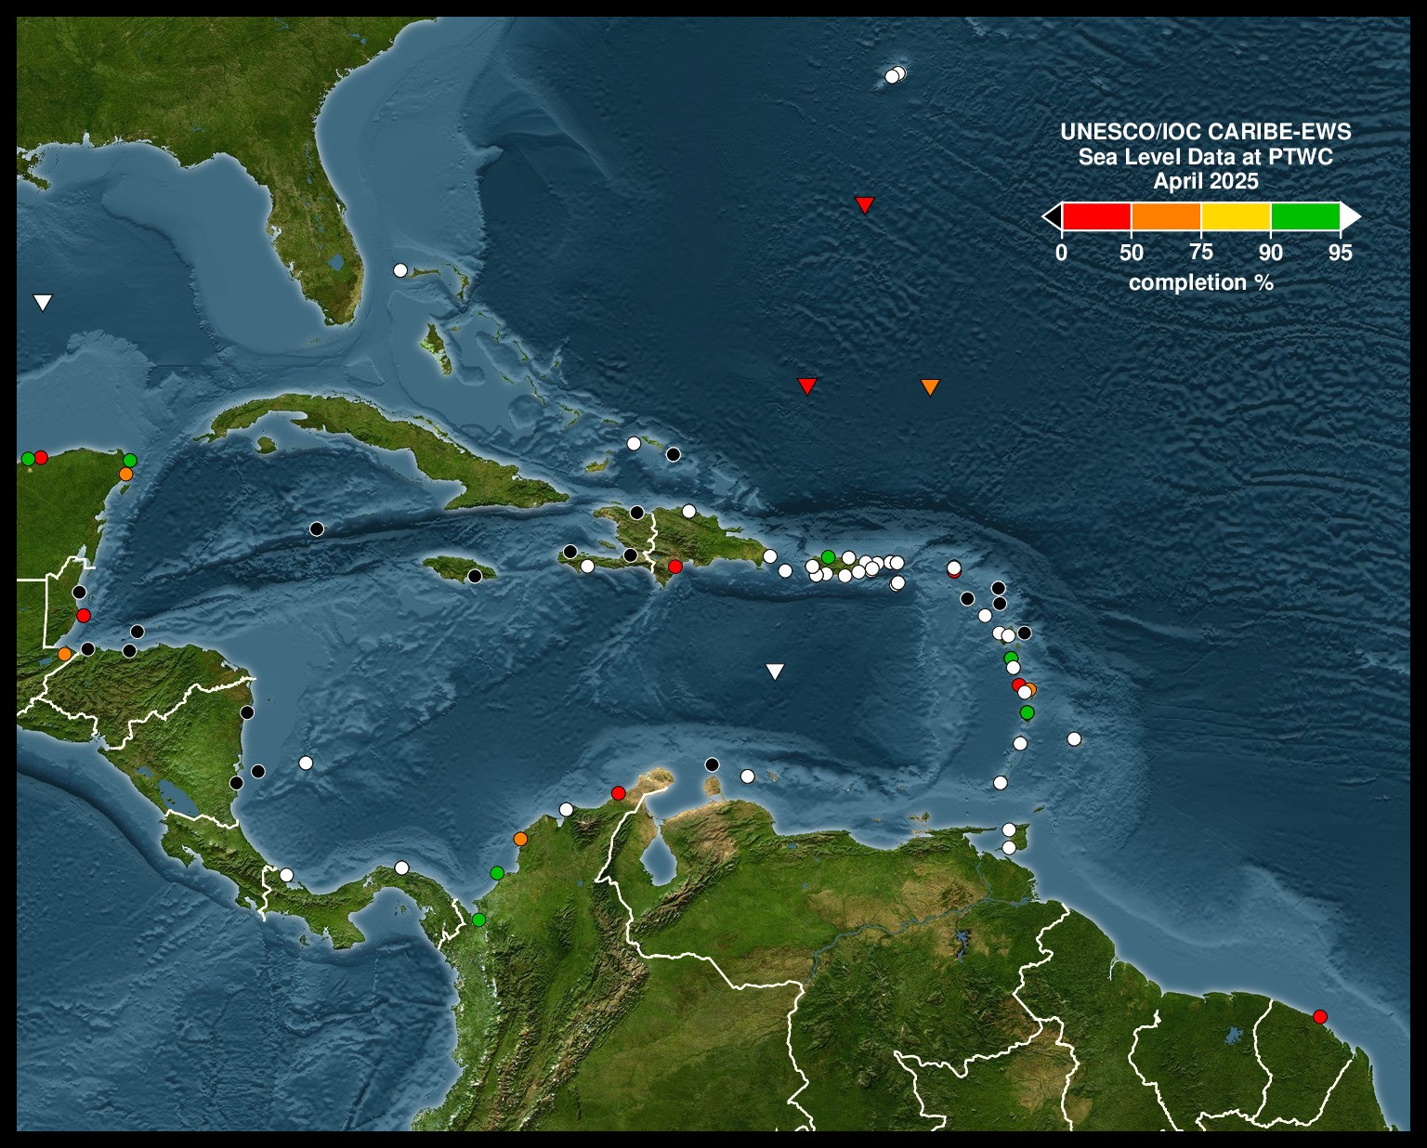
Current Sea Level Status: April 2025
Note Gaps in coverage especially in NW Caribe
Impacts response to events like Feb 8, 2025.
Highlights need for sea level station maintanence and capacity building in the region

Slide 4
Sea Level Training
Originally planned to be held summer of 2025 in Puerto Rico
Currently re-tooling to be held in an alternate location in the Fall of 2025
Organizing Committee has been meeting regularly.
Expect more information soon

Slide 5
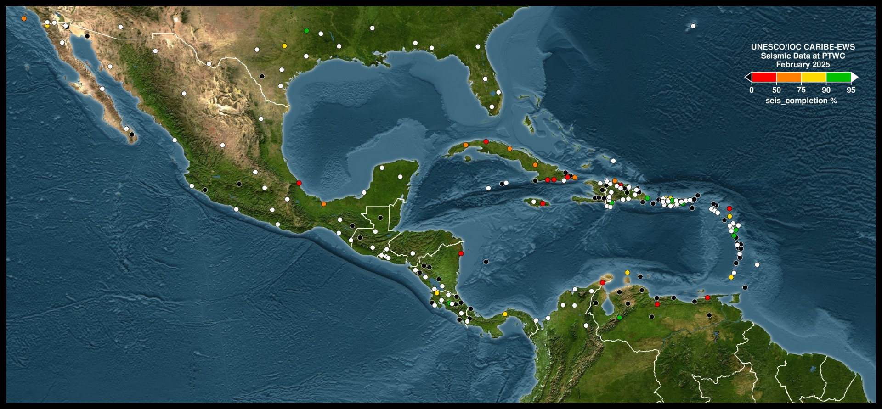
Seismic Station Status: March 2025

Slide 6
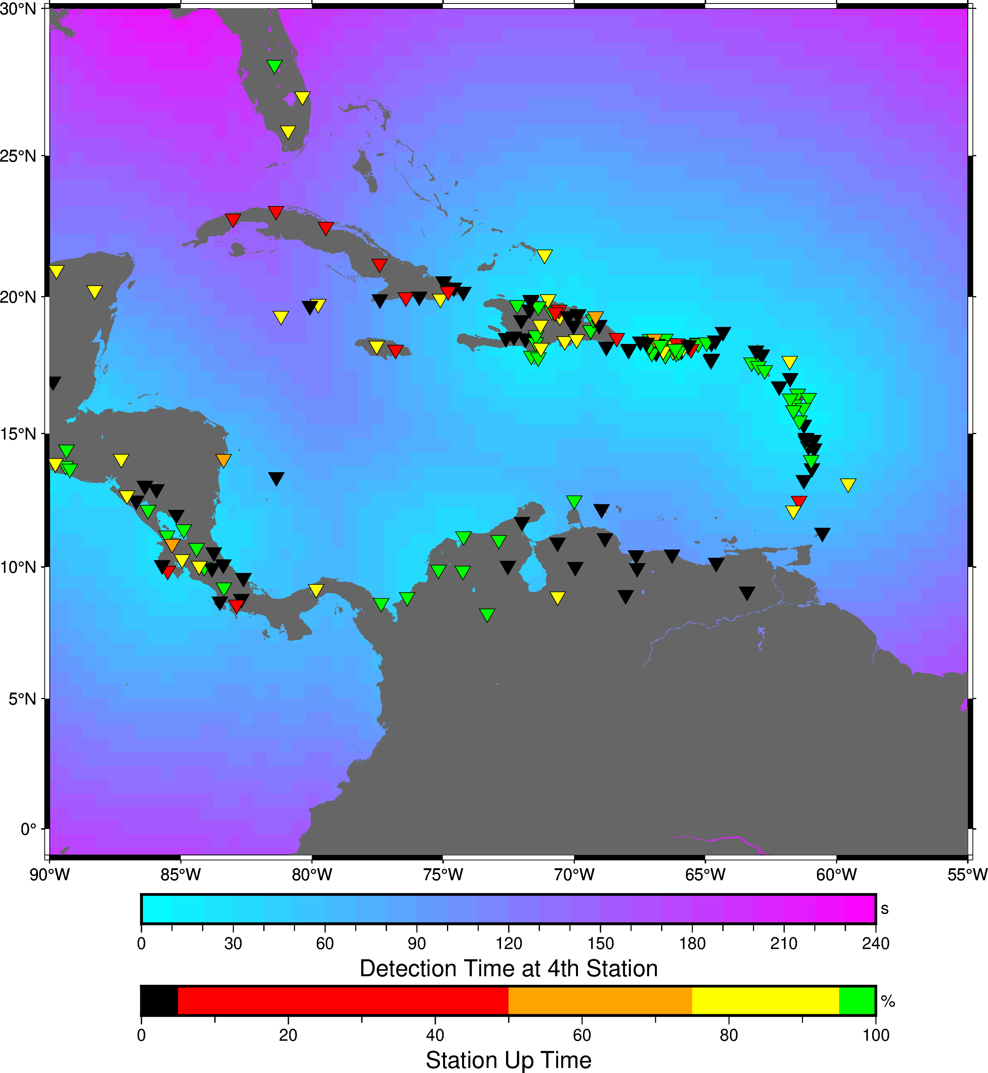
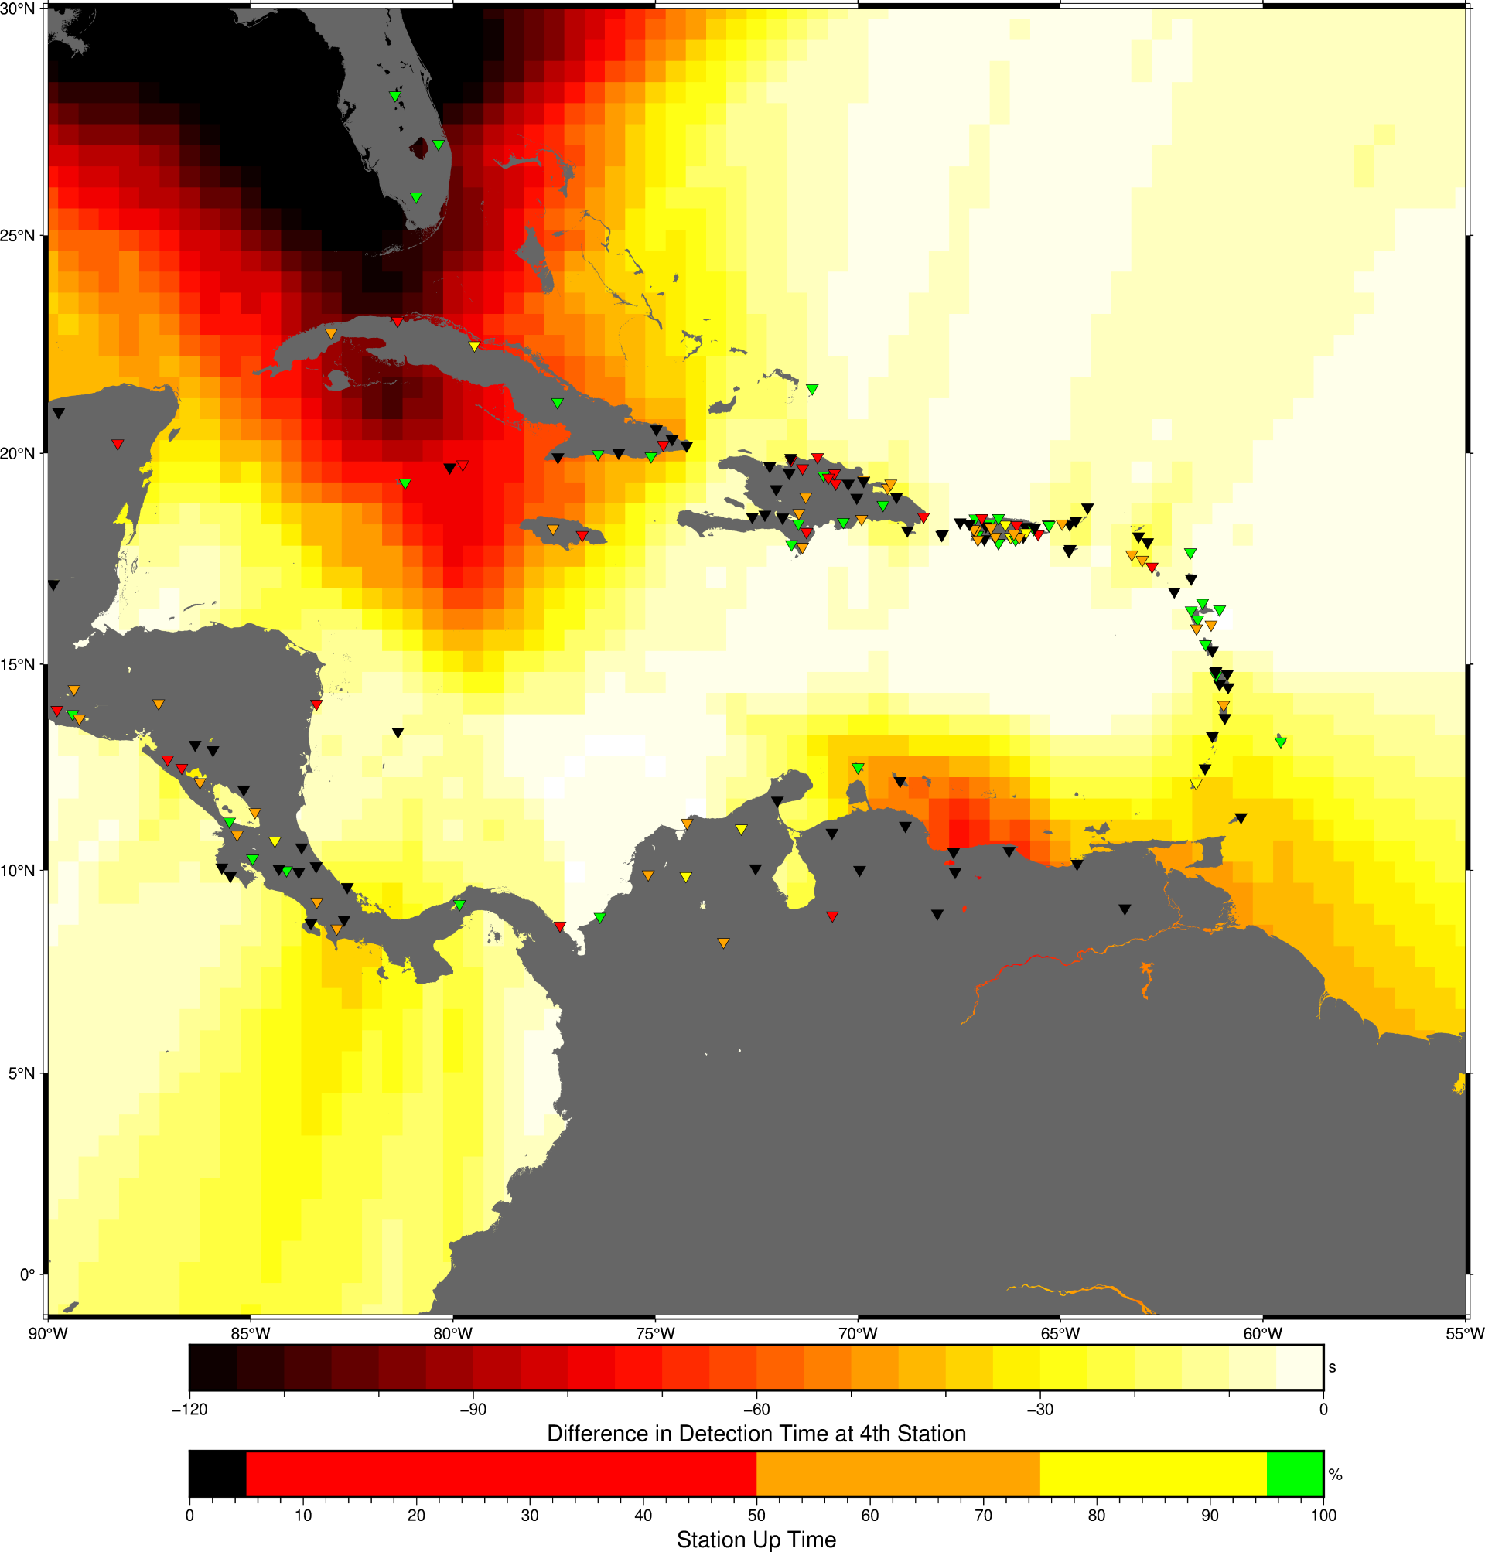
Example of Detection Time Maps: Seismic

Slide 7
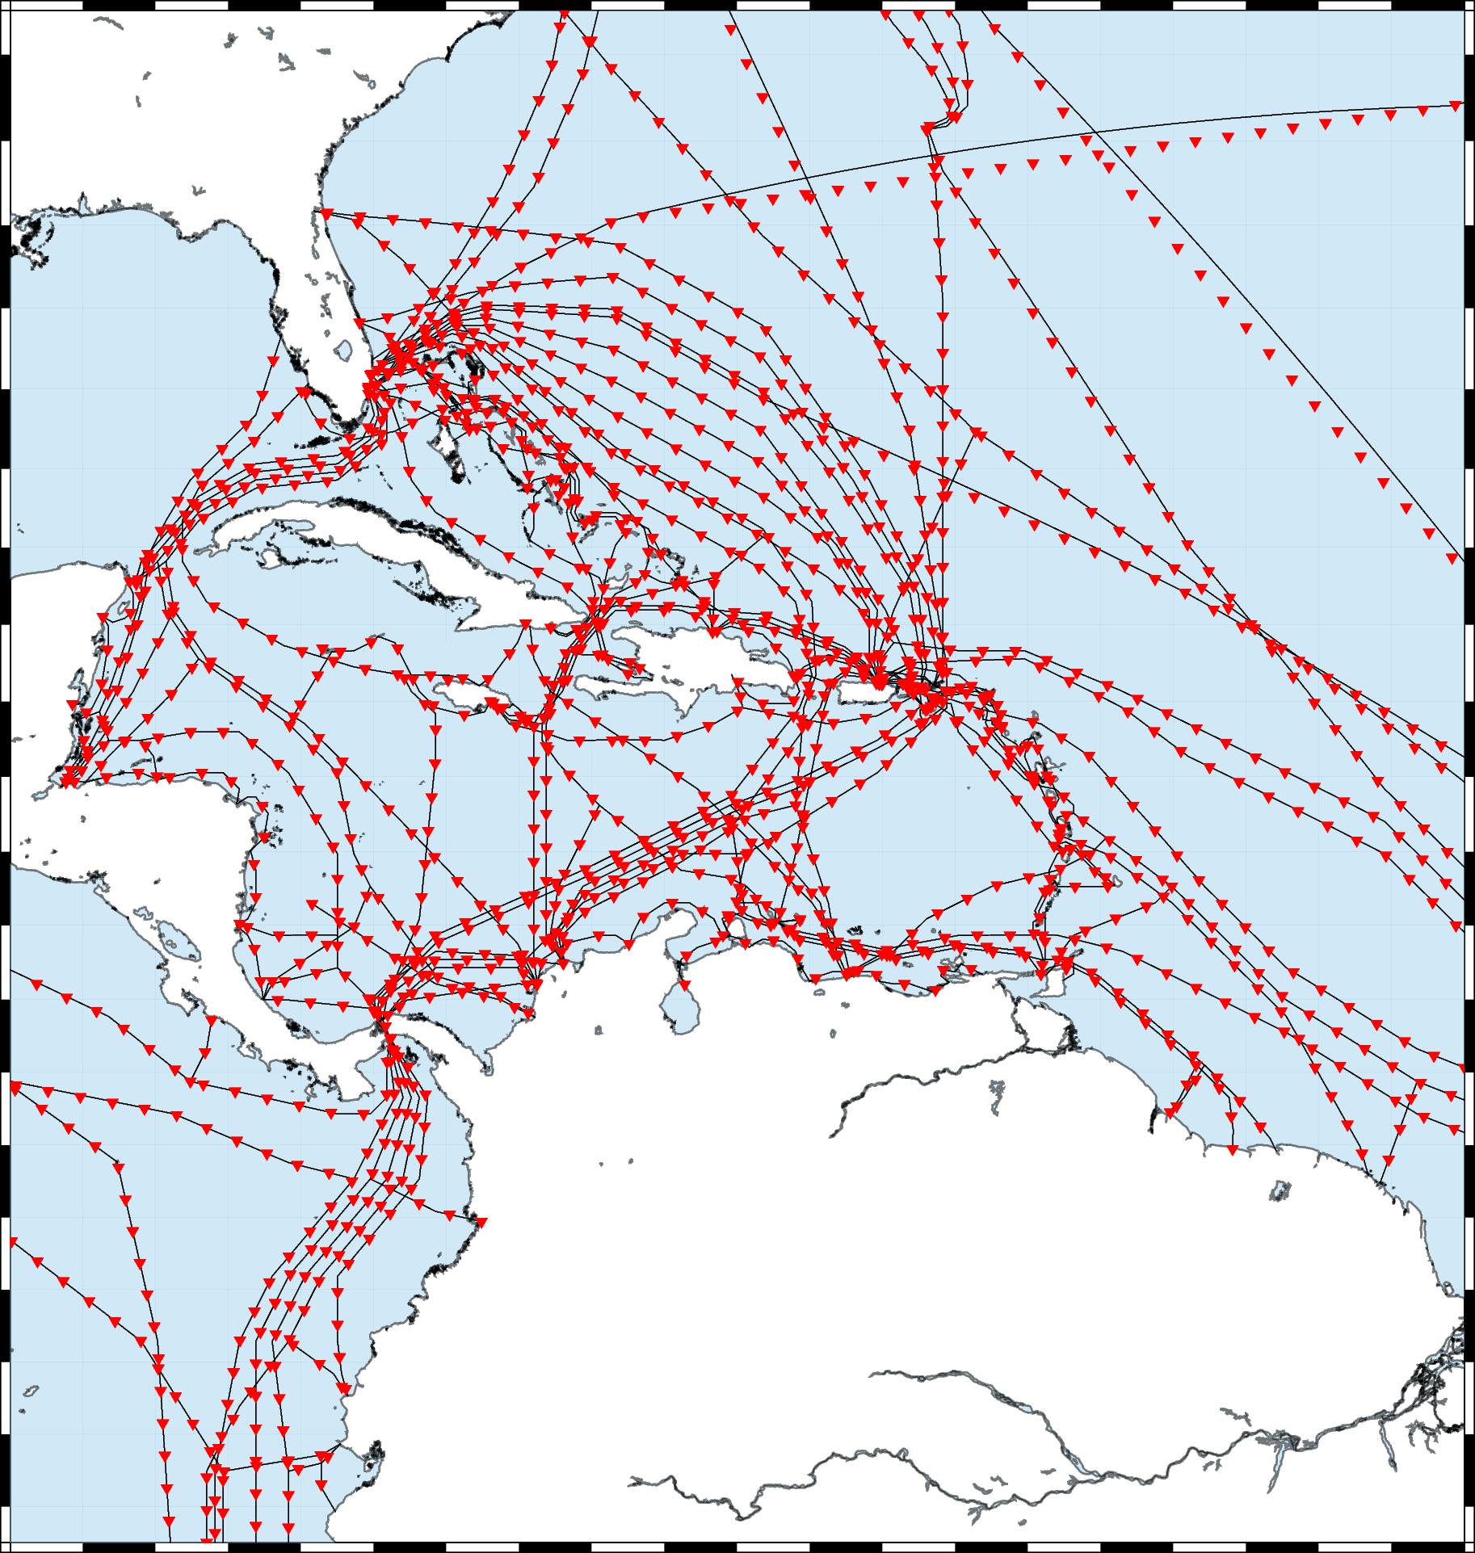
Smart Cables
Conduct a study to demonstrate improvement in tsunami early warning times with two to four variations on SMART Cable designs -Code written to determine improvements in detection time for seismic sources - To Do: EV create a GitHub to share code - Run more test scenarios for optimization

Slide 8
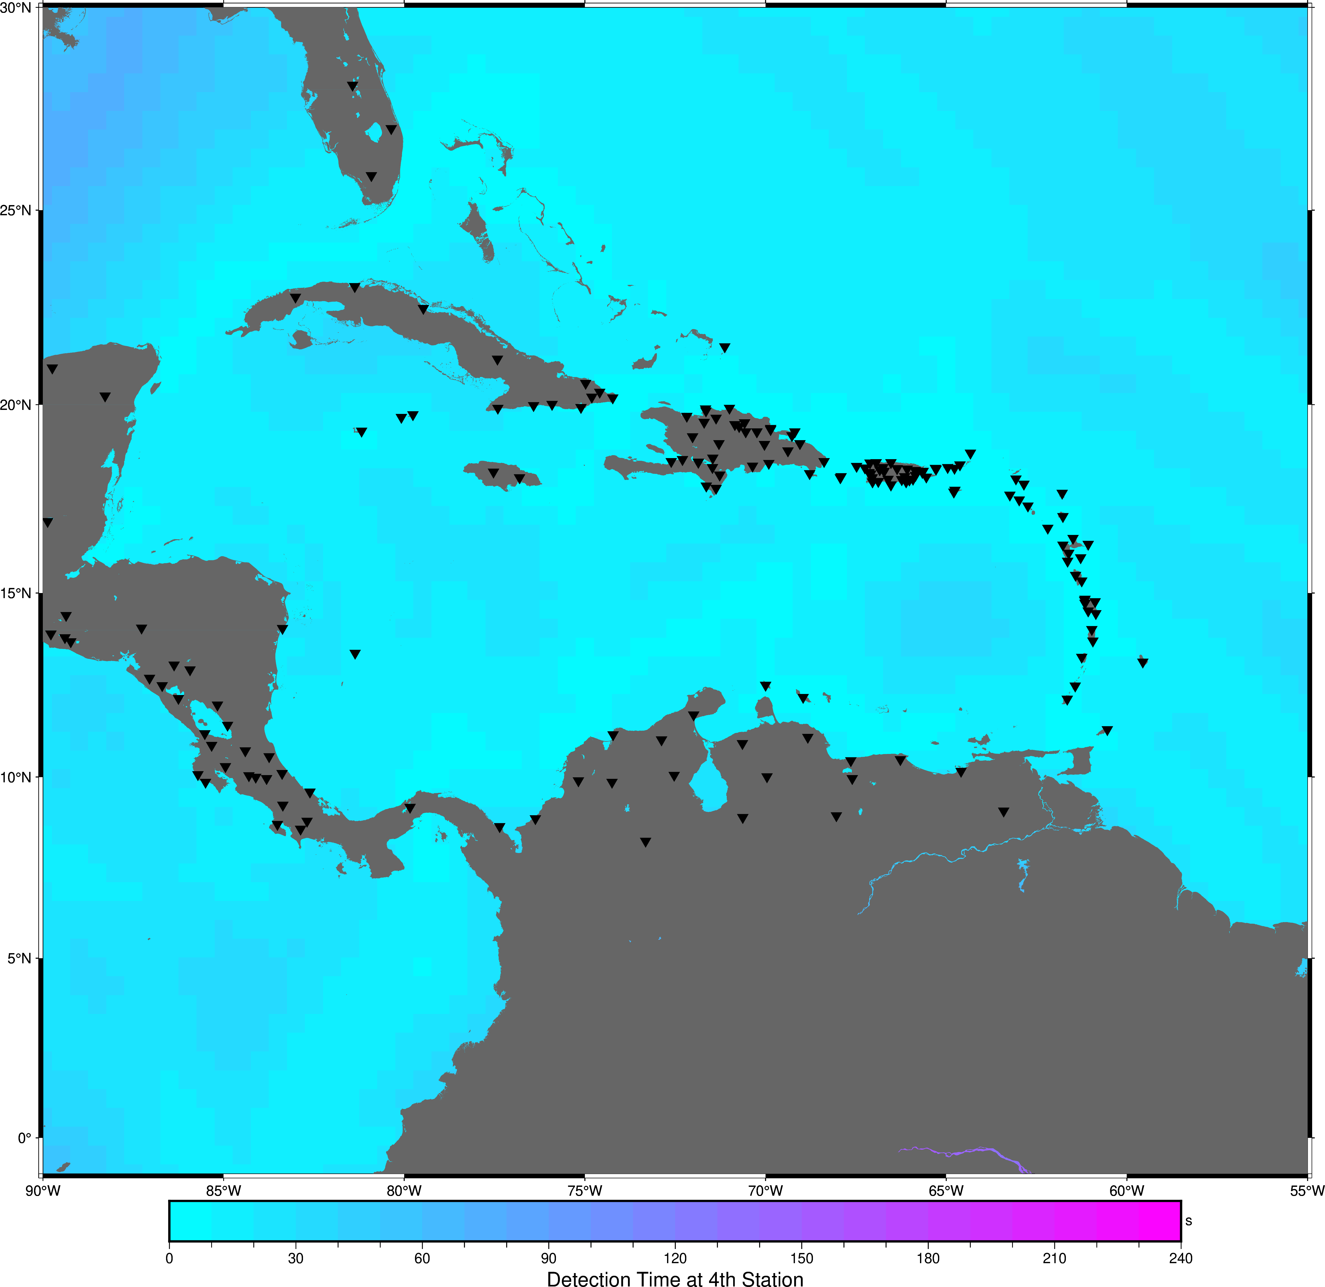
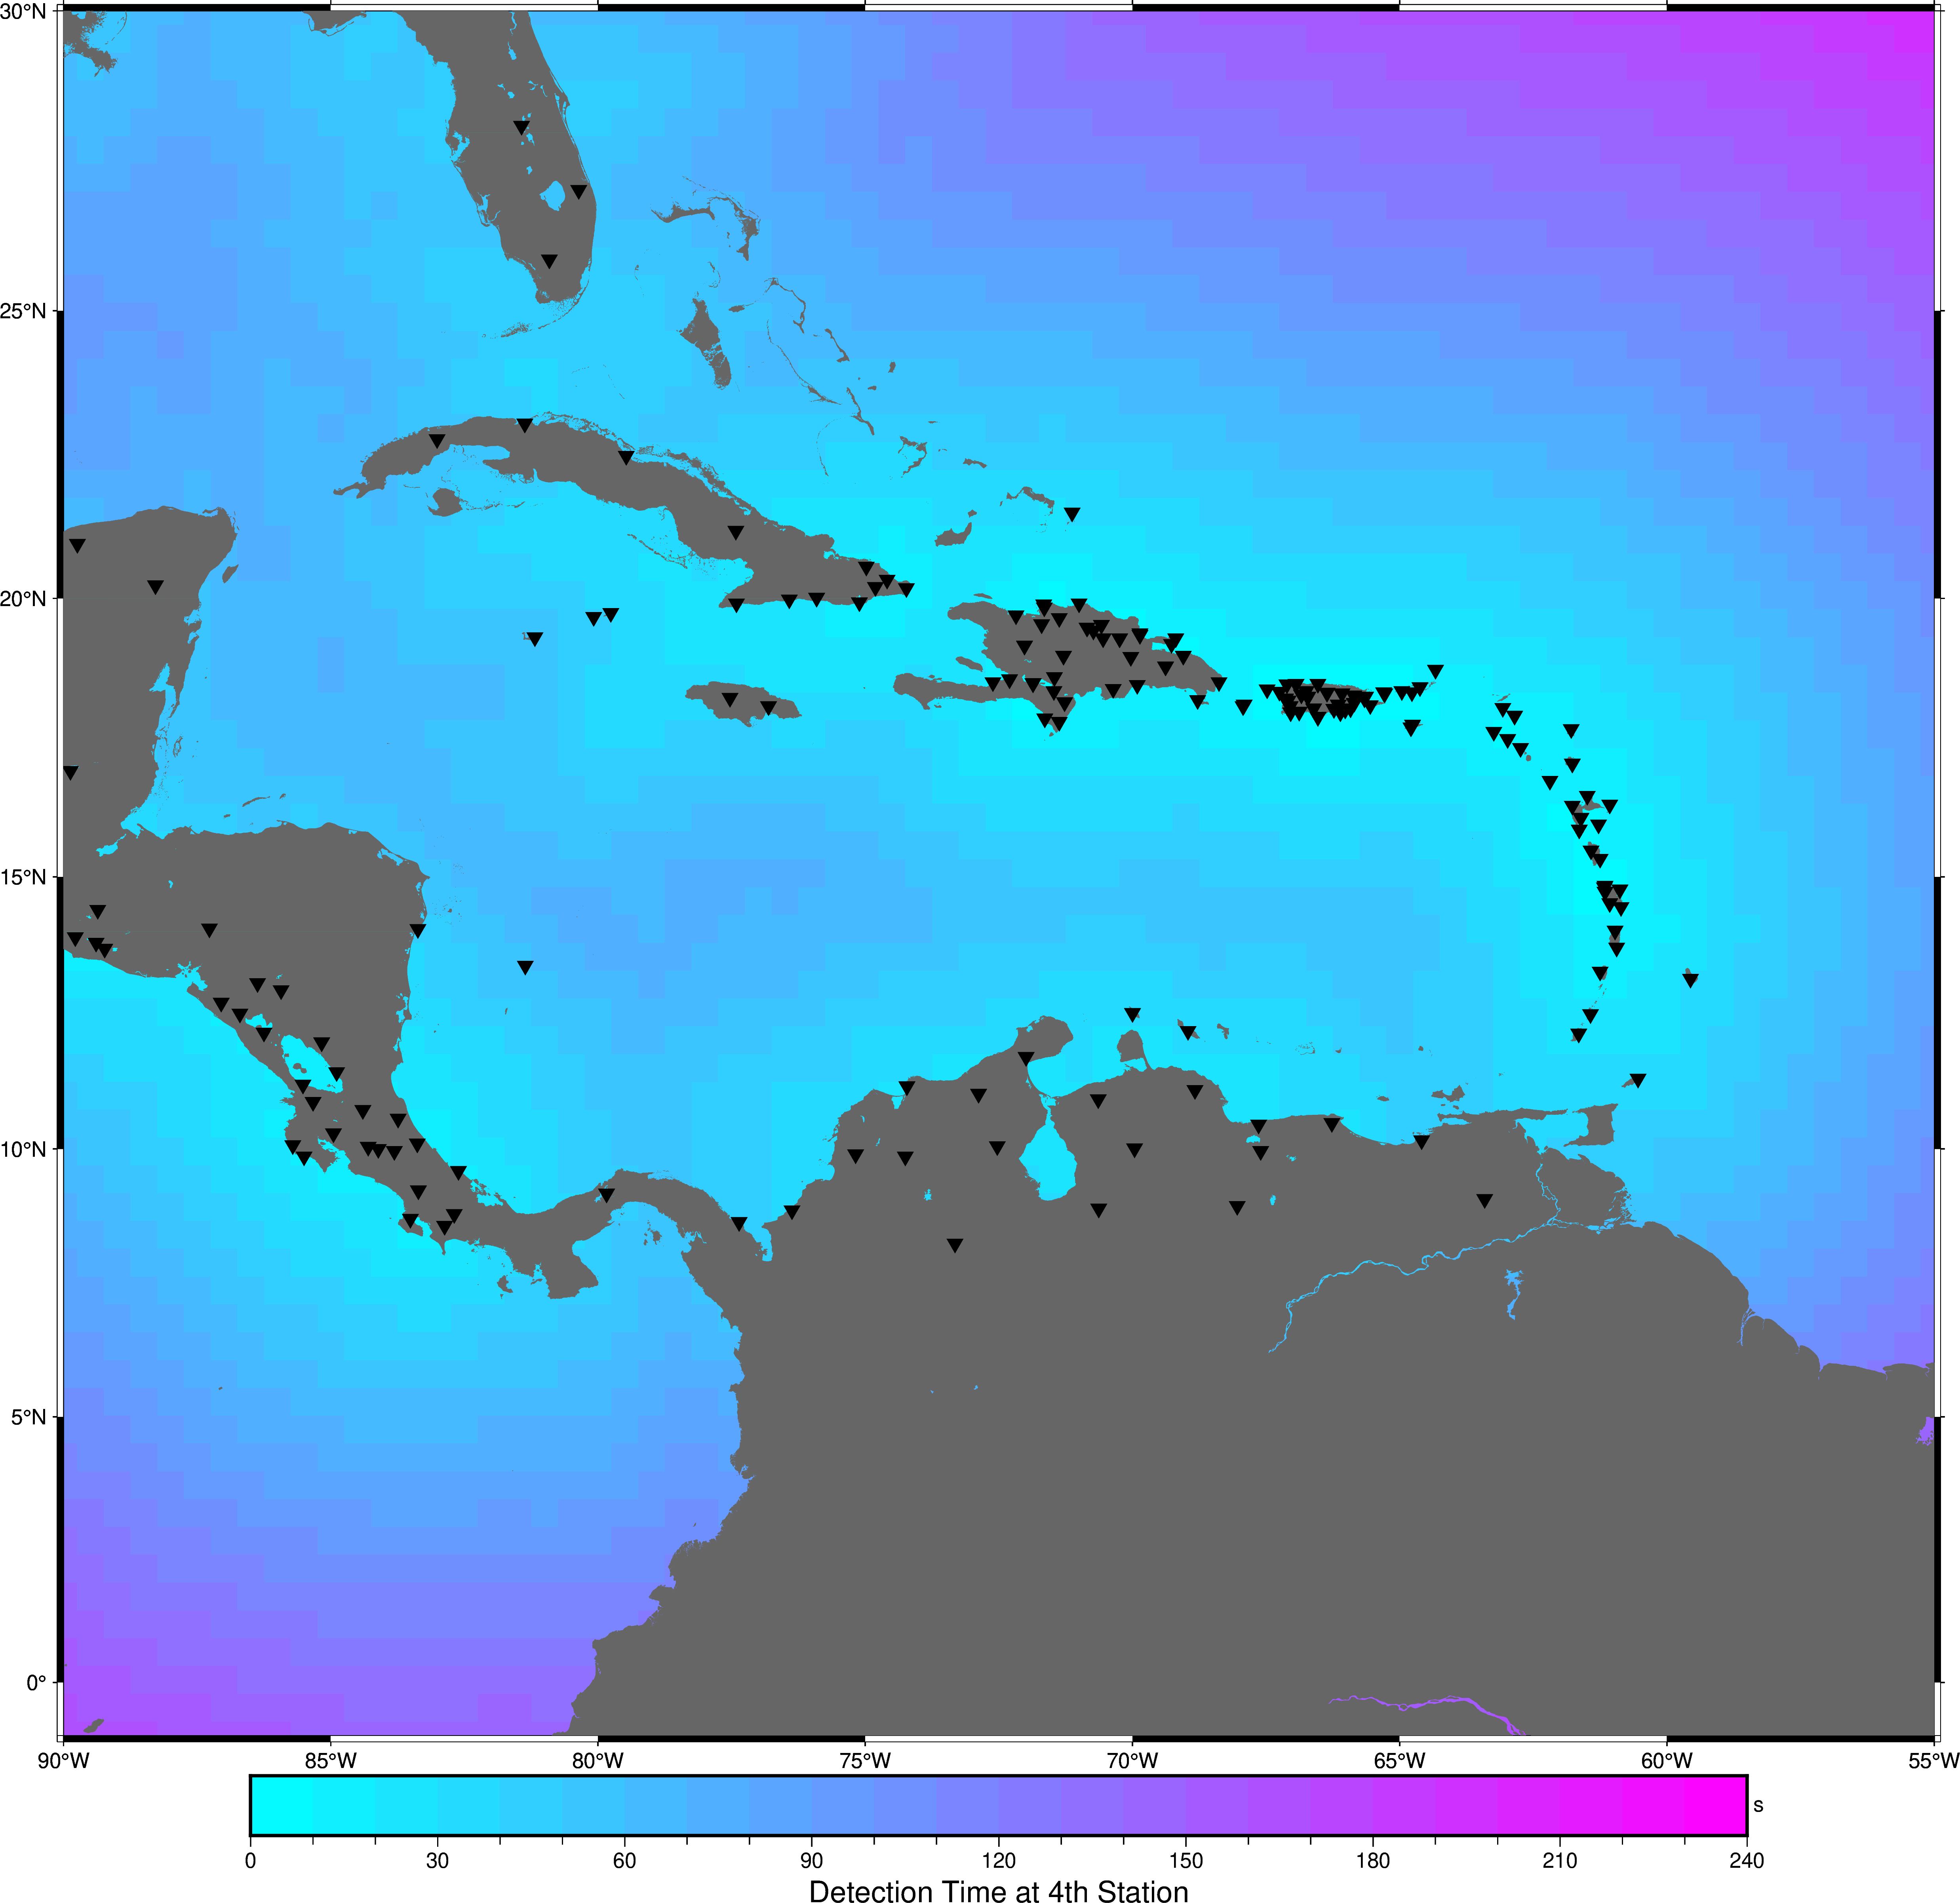
Smart Cables
If All Cables Were Smart
All Seismic: Best Case Current

Slide 9
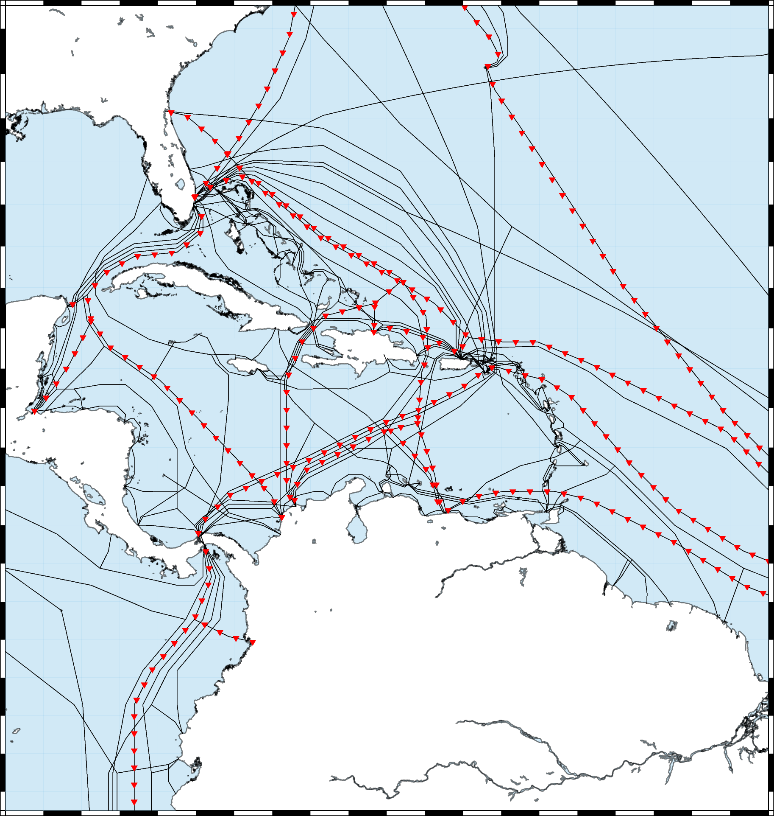
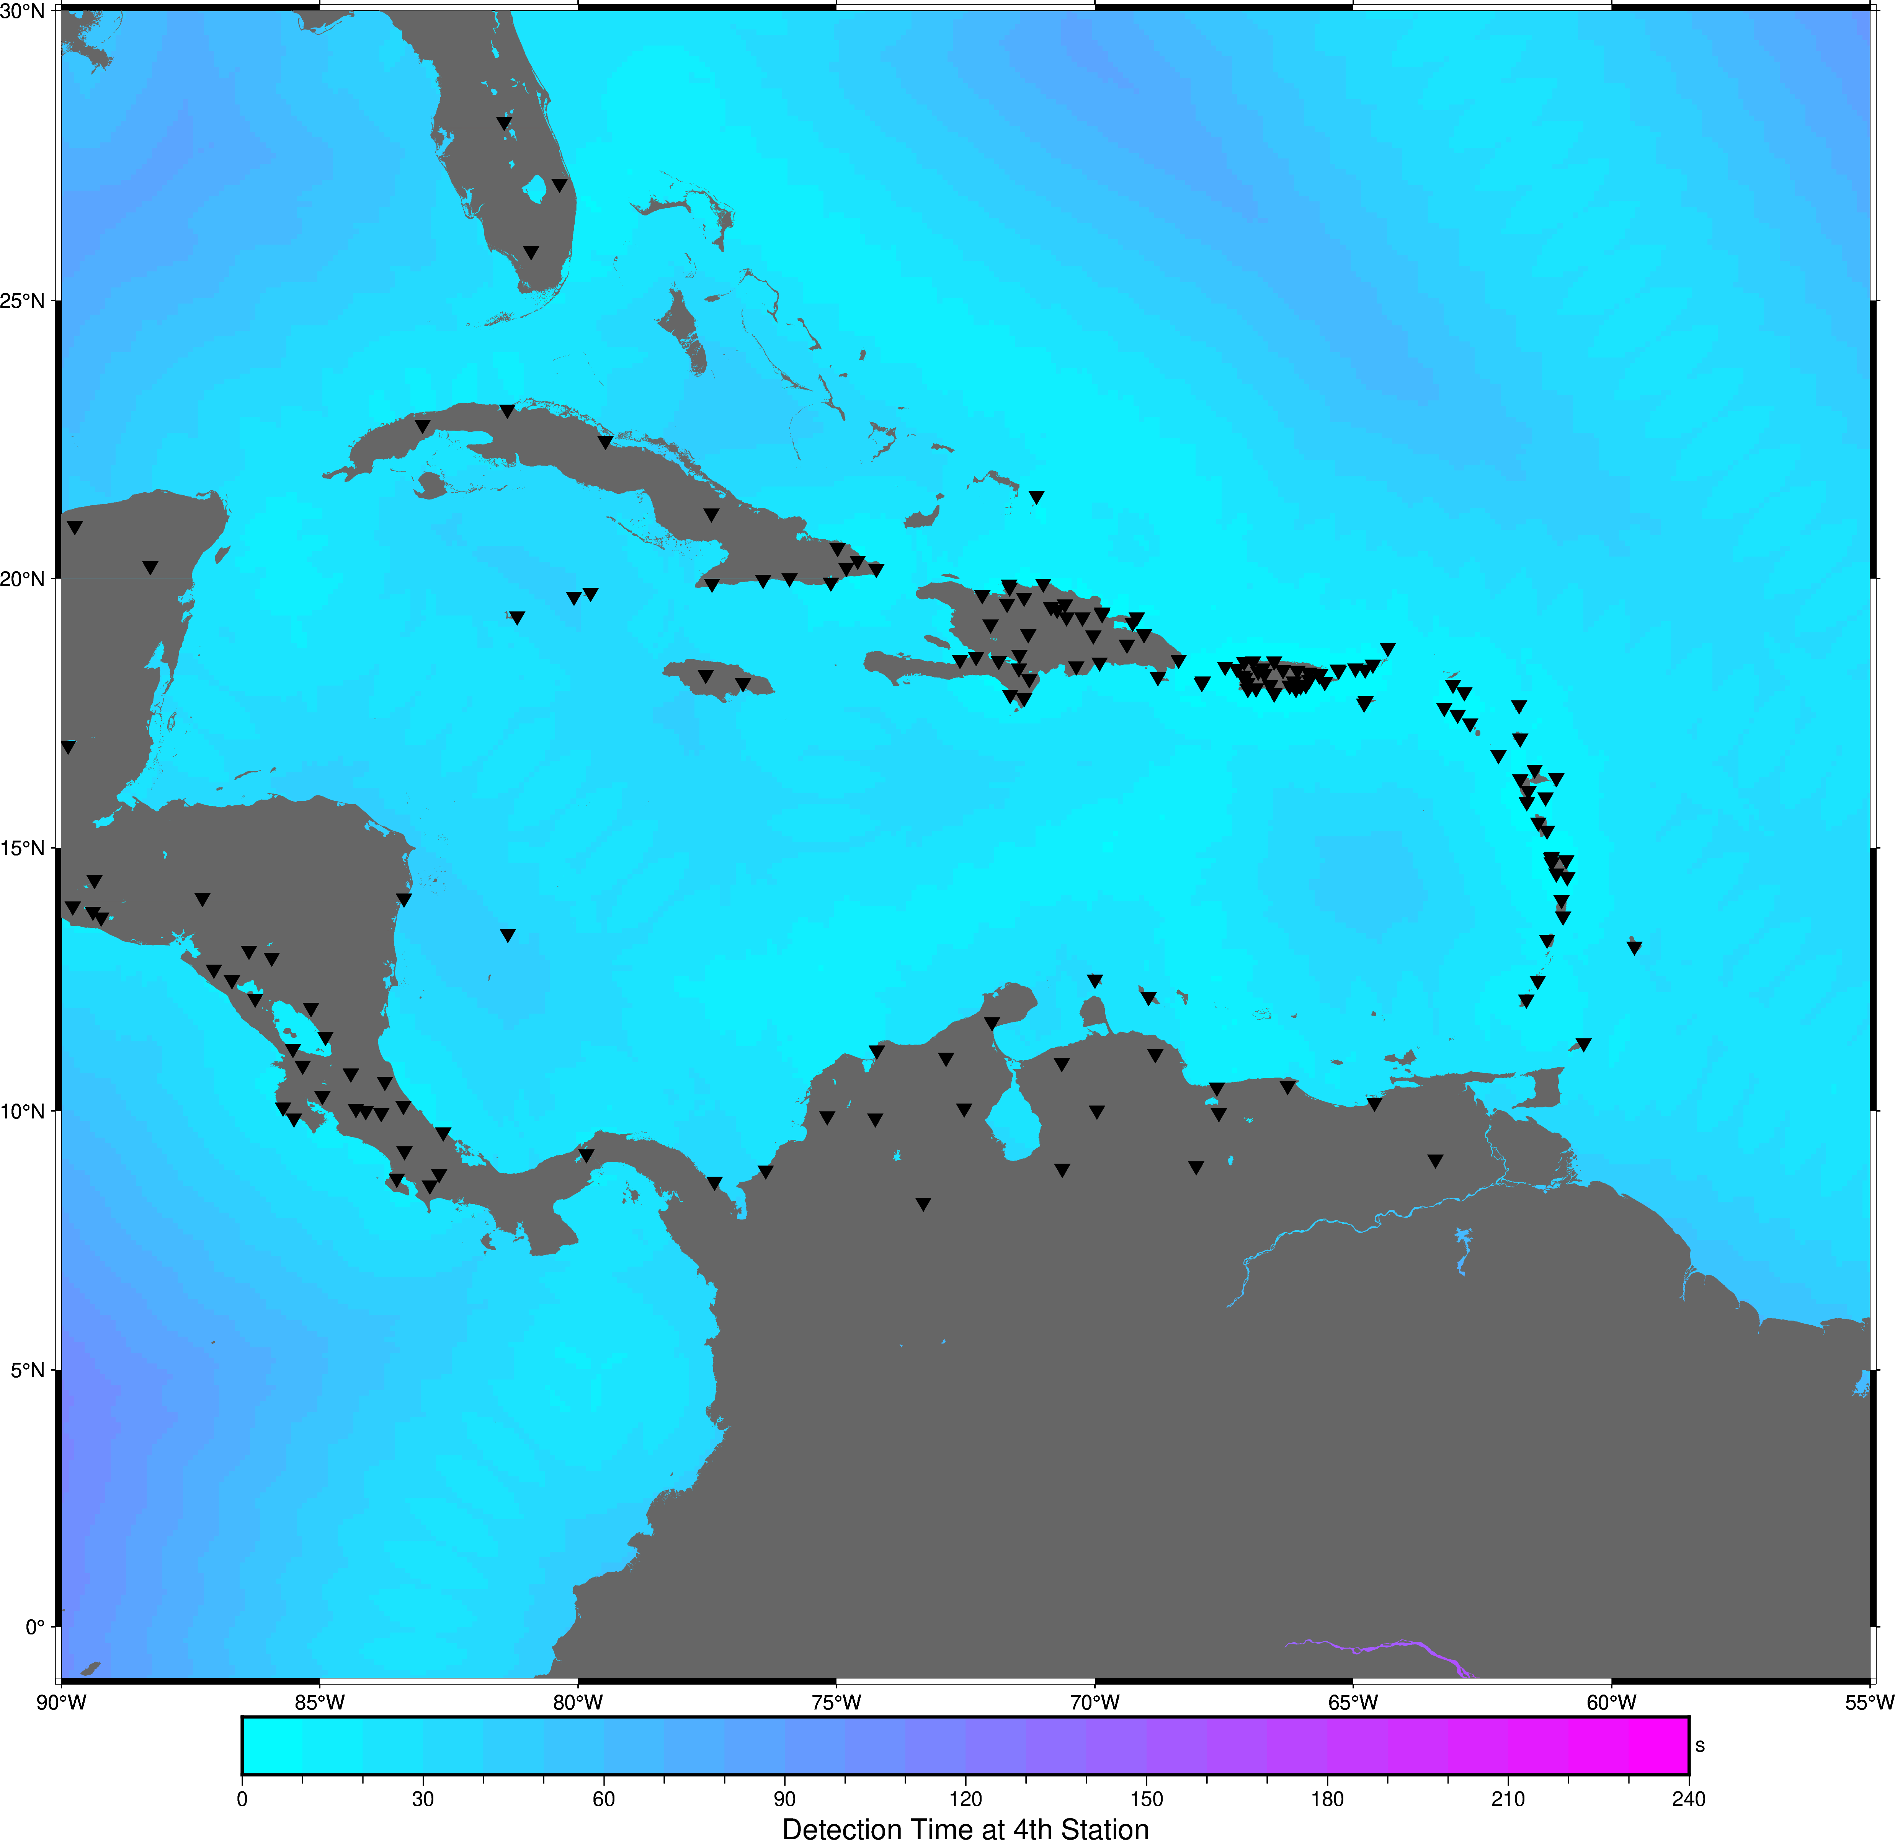
An Example with Less Cables

Slide 10
Smart Cables
Code can be use to test or show return on investment for any planned deployed.
Code developed for seismic only; Expansion to include direct wave observations needed (possibly a multi-ICG project)
Code is based on Obspy and plotted with PyGMT, it is open source removing potential paywall barriers
Keep an eye out for a webinar in the future regarding Smart Cables

Slide 11
Draft Recommendations for ICG/CARIBE EWS XV
Notes and appreciates the member States role of network operators in the region for the installation, maintenance, and data transmission from seismic, sea level and GNSS stations in the region
Appreciates the NOAA ITIC-CAR, PTWC, and Earthscope for improving the automated processing and continued reporting on the status of seismic and sea level stations;

Slide 12
Draft Recommendations for ICG/CARIBE EWS XV
Notes that a high percentage of the stations in the CARIBE-EWS sea level network are currently non-operational and therefore can delay the proper assessment of tsunami events and the issuance of timely and accurate tsunami alerts;
Urges Member States and operators of sea level stations contributing to CARIBE EWS to maintain their sea-level stations in an operational status and regularly review and update the status of its stations, in the IOC Sea Level Monitoring Facility, and inform ITIC-CAR and Secretariat on plans for repair;

Slide 13
Draft Recommendations for ICG/CARIBE EWS XV
Recognizing and Appreciating the success of the Spanish language sea level training in Costa Rica and;
Appreciating the efforts of the NOAA, IHO, NOC, and the secretariat to secure support for an English sea level training and;
Appreciating the efforts of English sea level training organizing committee and regional partners in initial planning of such a training
Recommends that WG2 continue to organize an English language sea level station workshop with the support of NOAA and the secretariat.

Slide 14
Draft Recommendations for ICG/CARIBE EWS XV
Notes the development of a tool to assess impact of seismic outages in the region;
Recommends the development of a similar tool to assess the impact of sea level station outages.
Appreciates the work of the UN Ocean Decade on smart cables and efforts to quantify the impact of smart cables on regional detection of tsunamigenic events;
Recommends the formation of a task team to specifically address the implementation of such technology in the Caribe-EWS and formalize relationships between the Caribe-EWS and the ITU/WMO/UNESCO-IOC Joint Task Force (JTF) on SMART Cables.
Further Encourages Member States to incorporate SMART capability into new subsea telecom cable projects.

Slide 15
Draft Recommendations for ICG/CARIBE EWS XV

