Slide 1


3.11 Tsunami Ready Recognition Programme
Christa G. von Hillebrandt-Andrade, Manager, NOAA/NWS ITIC-CAR
Dr. Matthieu Peroche (Co-chair, ICG/CARIBE EWS Tsunami Ready Task Team) and Dr. Marion Le Texier, LAGAM Geography and Planning Laboratory, University Paul-Valéry Montpellier
Grace Lemoine, Intern, NOAA/NWS, ITIC-CAR, - Lead Support for Implementation of Tsunami Ready Evaluation Survey
Alison Brome, Programme Officer, UNESCO.IOC-CTIC
Fabian Hinds, Research Officer, CZMU, Barbados, Co-Chair ICG/CARIBE EWS Tsunami Ready Task Team
Dr. Ocal Necmioglu, UNESCO/IOC ICG/CARIBE EWS Technical Secretary
INTERGOVERNMENTAL OCEANOGRAPHIC COMMISSION of UNESCO
Eighteenth Session ICG/CARIBE-EWS XVIII
May 5-7 and 9, 2025

Slide 2
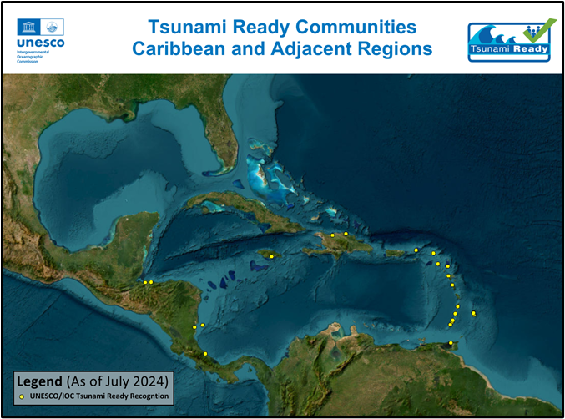

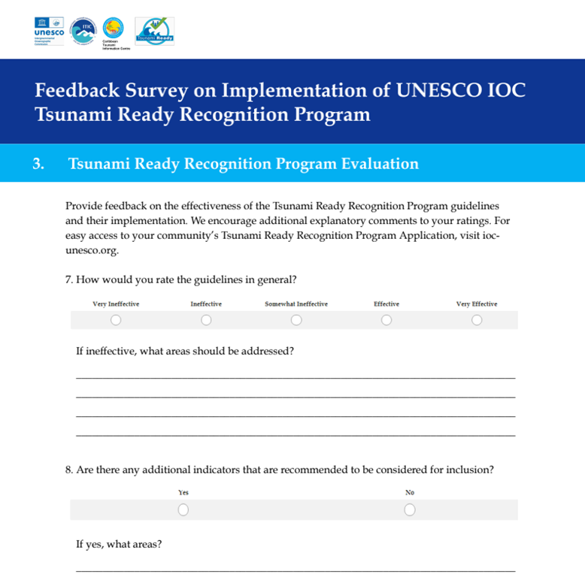
Presentation Outline
Pilot Feedback Survey on the Implementation of Tsunami Ready in ICG/CARIBE-EWS
Tsunami Ready Communities for CARIBE EWS
Tsunami Risk Ranking at the Community Level in the Caribbean Basin - First Result
Challenges and Considerations
Recommendations

Slide 3
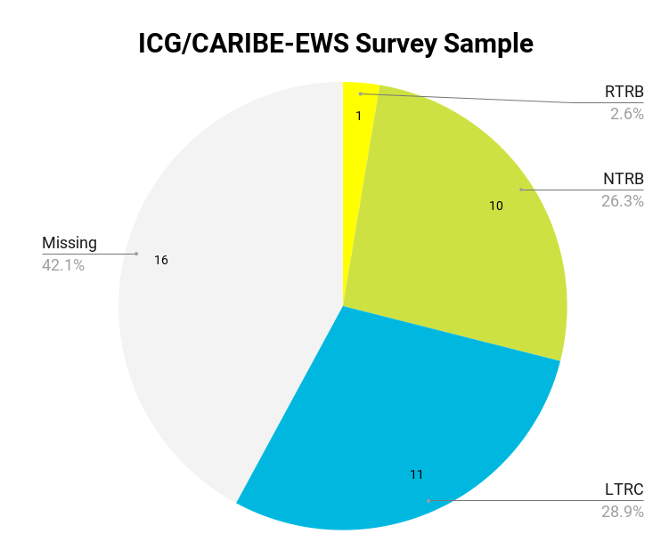
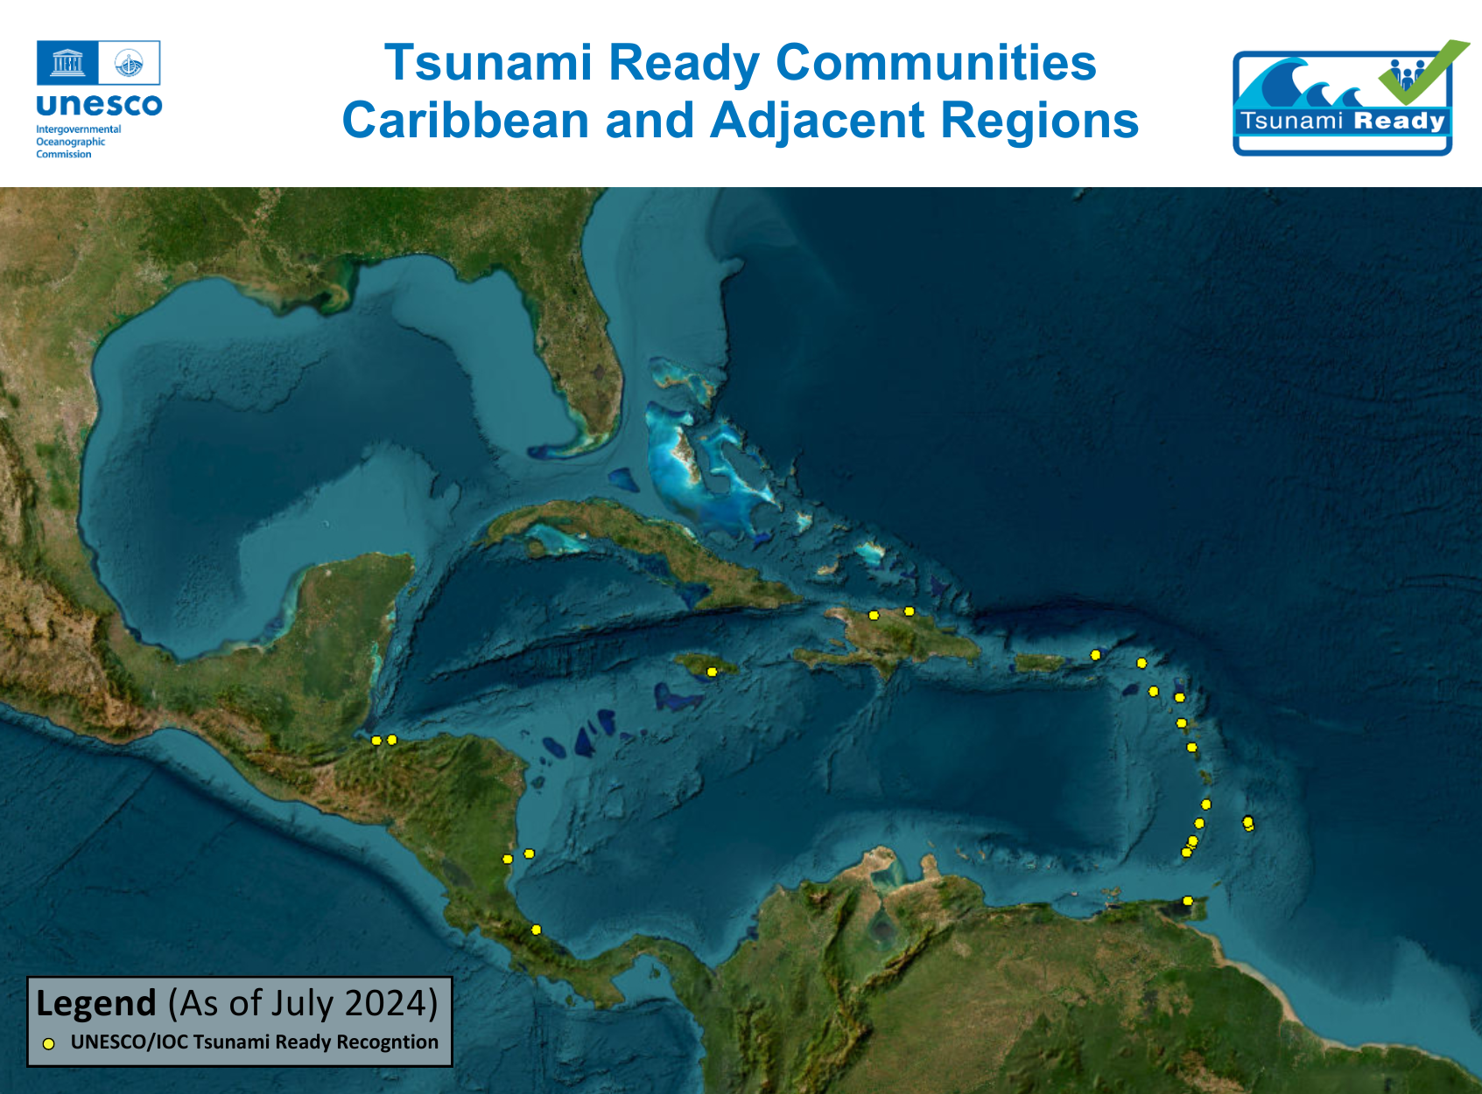
Pilot Feedback Survey on the Implementation of Tsunami Ready in ICG/CARIBE-EWS
Benchmark the current effectiveness of the recognition program
Provide insight into the program’s strengths and deficiencies
Promote and improve the program collectively
OBJECTIVES
Full report is available at
https://oceanexpert.org/event/4626#documents
Notes:
The pilot encountered several difficulties that hindered its overall return, such as contacting eligible respondents, confirming email delivery, and obtaining the intended number of responses. Furthermore, the survey was limited in eliciting comprehensive feedback about the effectiveness of the program due to issues such as respondent involvement in implementation, variations in response detail, time since community recognition, and survey design errors.

Slide 4
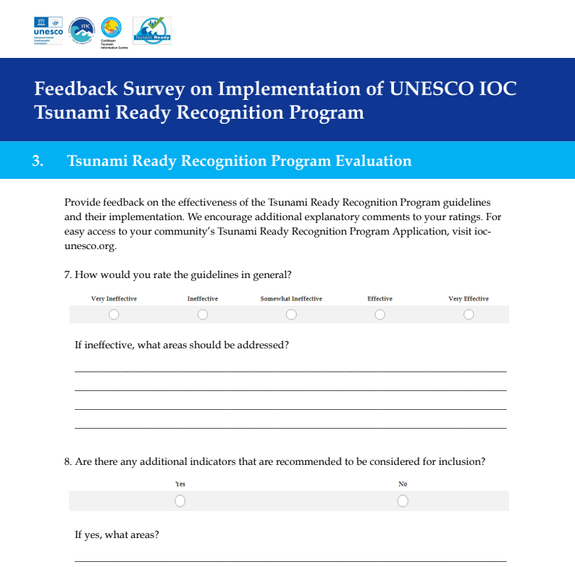
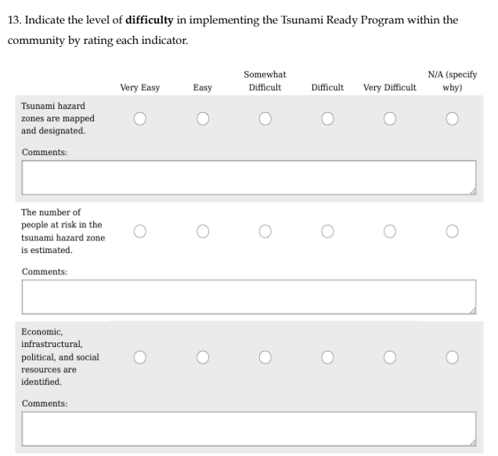

Slide 5
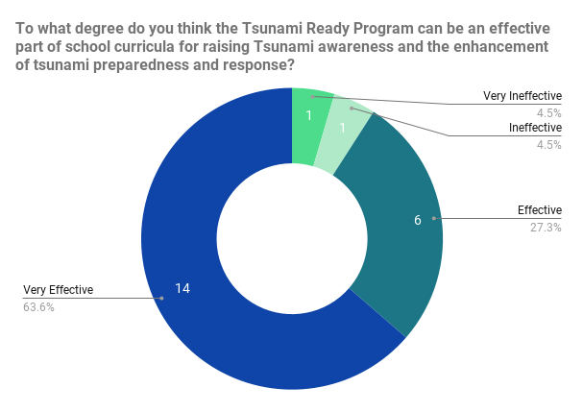
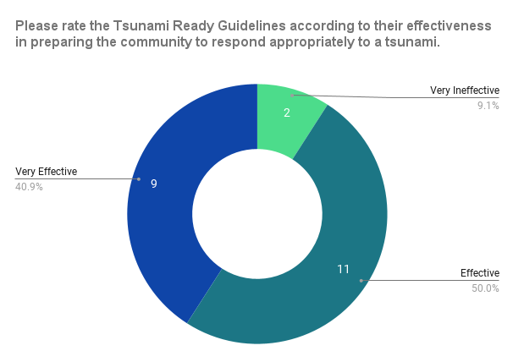
Feedback on Program Effectiveness
Tsunami Education
Tsunami Response Preparedness
Consensus: Very Effective
Consensus: Effective

Slide 6
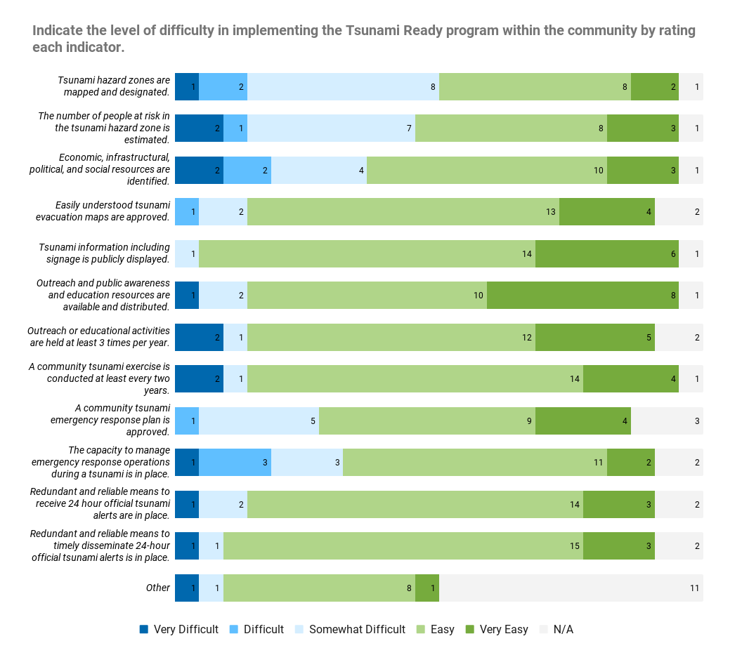
Feedback on Implementation Difficulty
Most Difficult Indicator: “Tsunami hazards are mapped and designated.”
Easiest Indicator:
“Tsunami information including signage is publicly displayed.”
Note: These ratings inherently embody a subjective nature due to their contextual variability.

Slide 7
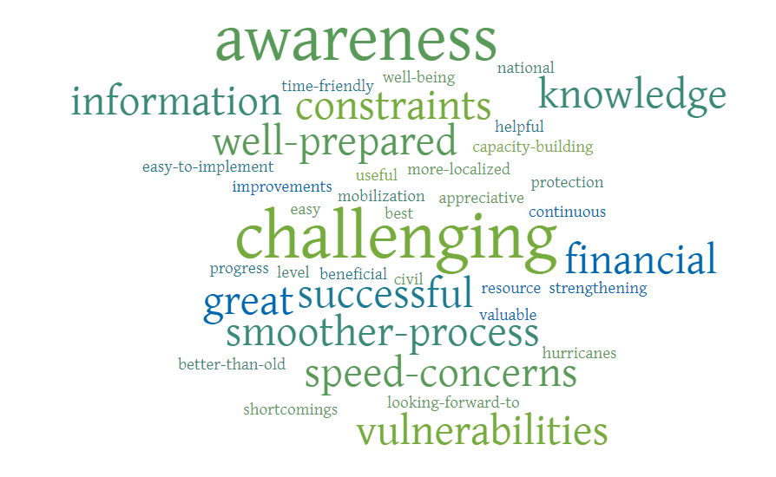
General Comments

Slide 8

Summary
Tsunami Ready has been successful in bolstering community preparedness and response with its strong culture of outreach, education, and capacity building.
Additional support is still needed to address gaps in data collection, communication, funding, and resource mobilization issues.
It is important to ensure that Tsunami Ready remains efficient and effective in its requirements through efforts like the pilot survey.

Slide 9
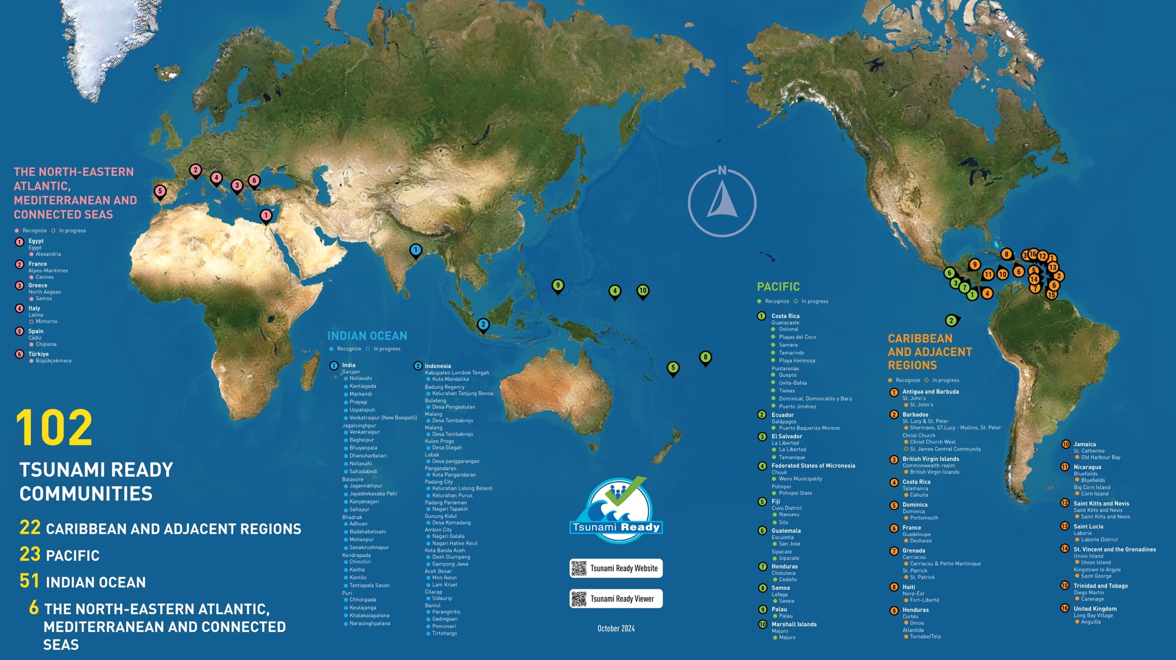

Global Implementation Status
ITIC & CTIC Support - Facilitate TRRP in Caribbean
Map, Nov 2024 (IOTIC)
100 (Feb 2025, IOC TSR)
TSUNAMI READY
COMMUNITIES
23 CARIBBEAN AND ADJ REGIONS
48 INDIAN OCEAN
6 NORTH-EASTERN ATLANTIC,
MEDITERRANEAN AND
CONNECTED SEAS
23 PACIFIC OCEAN
100
TSUNAMI READY
COMMUNITIES
23 CARIBBEAN AND ADJ REGIONS
48 INDIAN OCEAN
6 NORTH-EASTERN ATLANTIC,
MEDITERRANEAN AND
CONNECTED SEAS
23 PACIFIC OCEAN

Slide 10
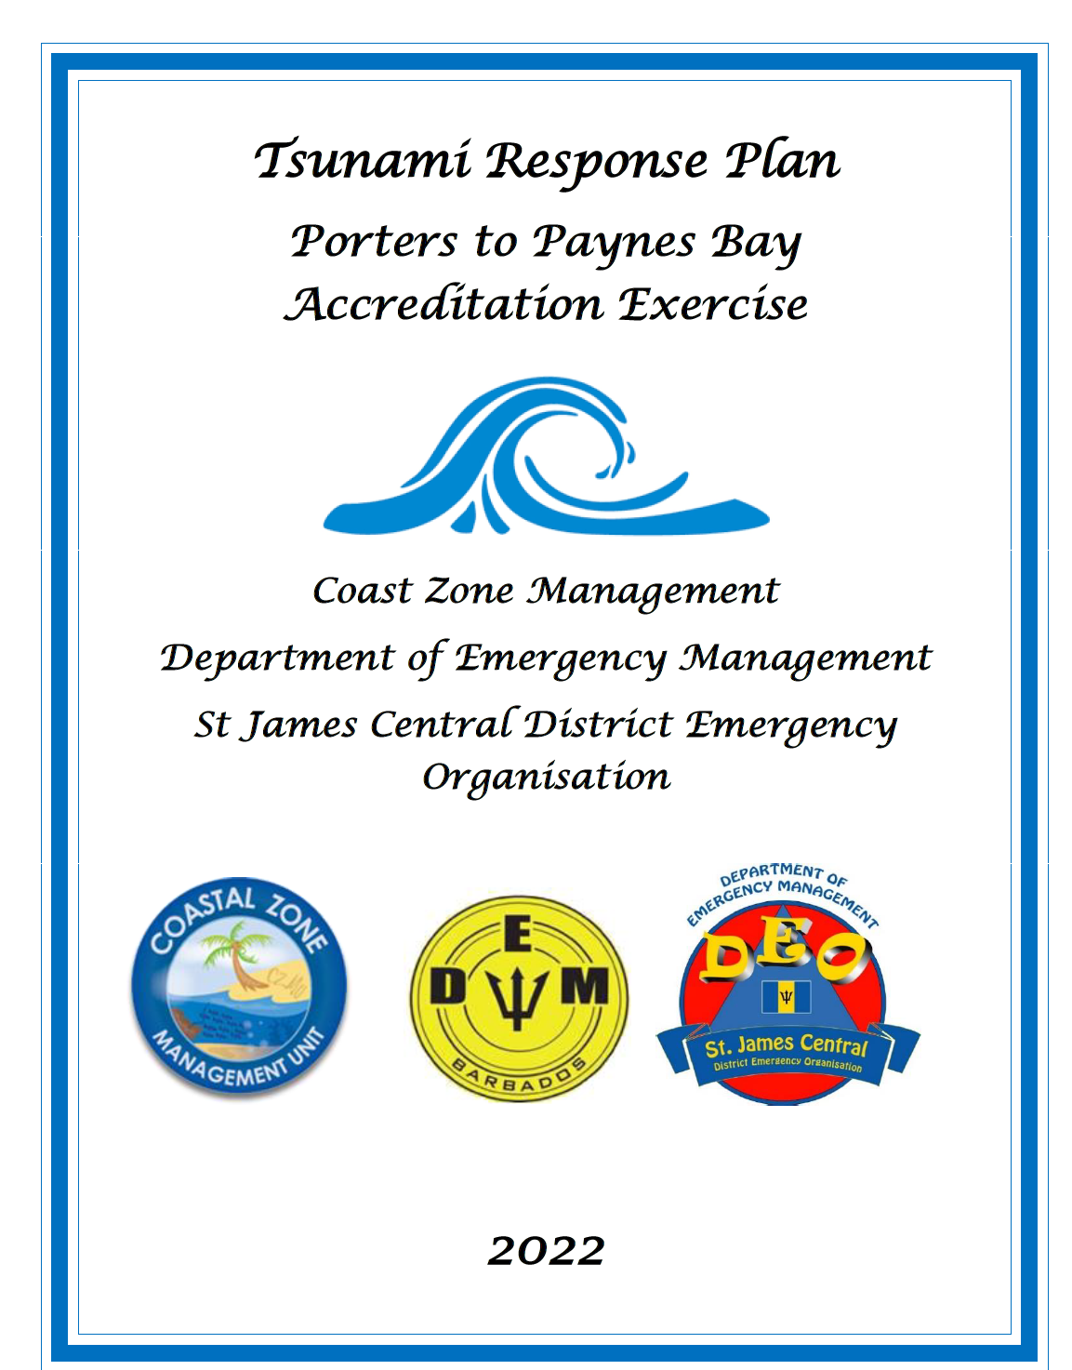
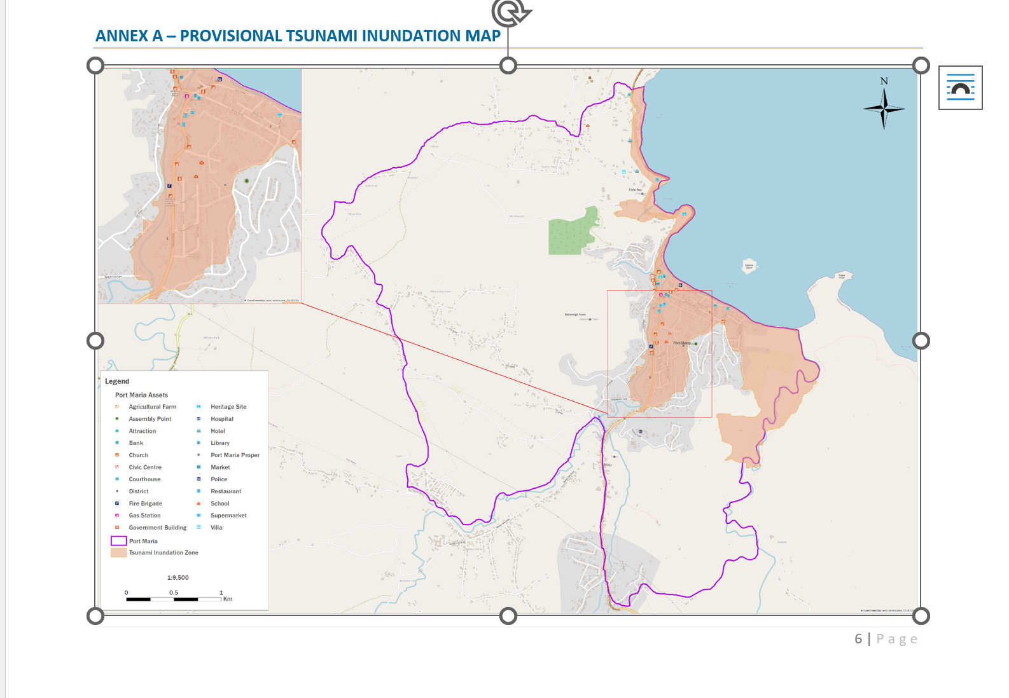
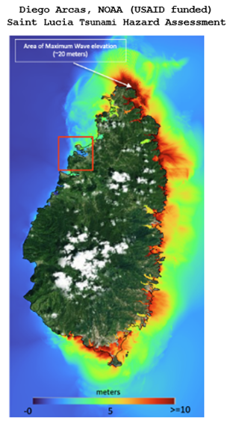
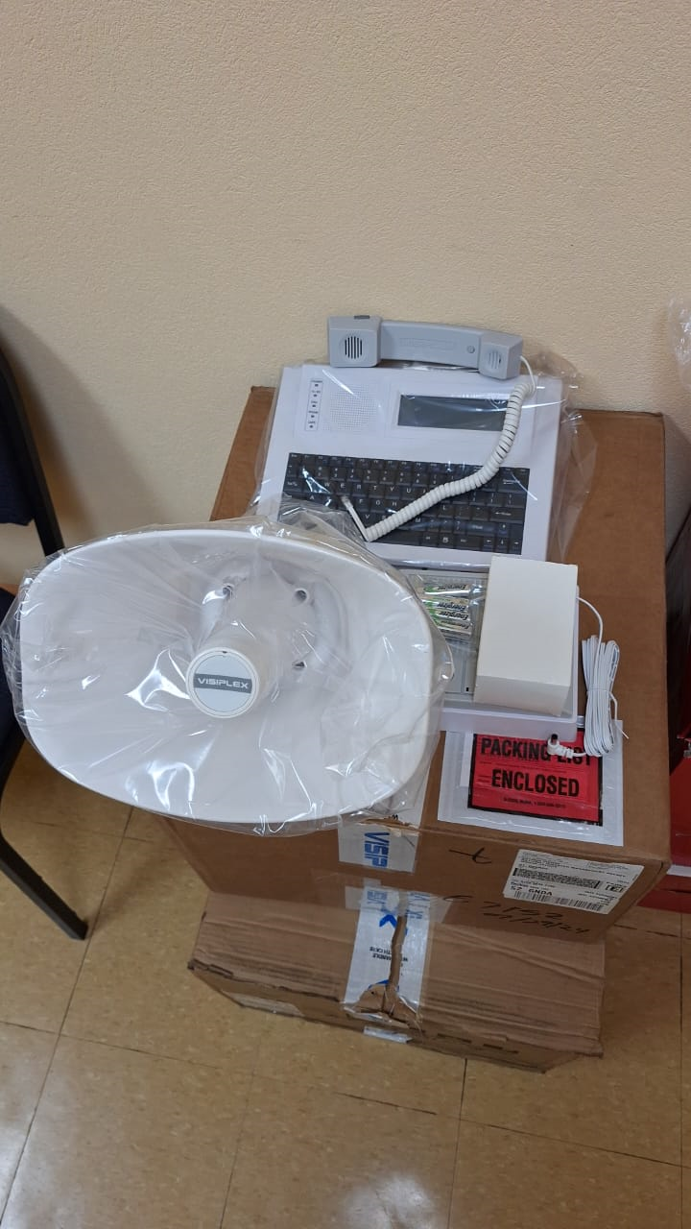
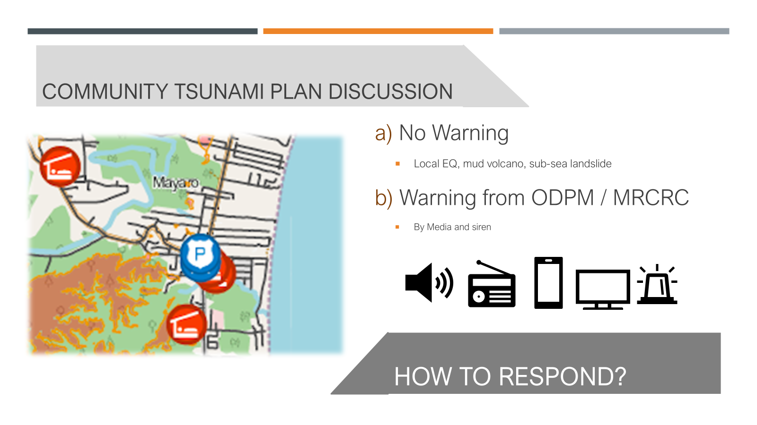
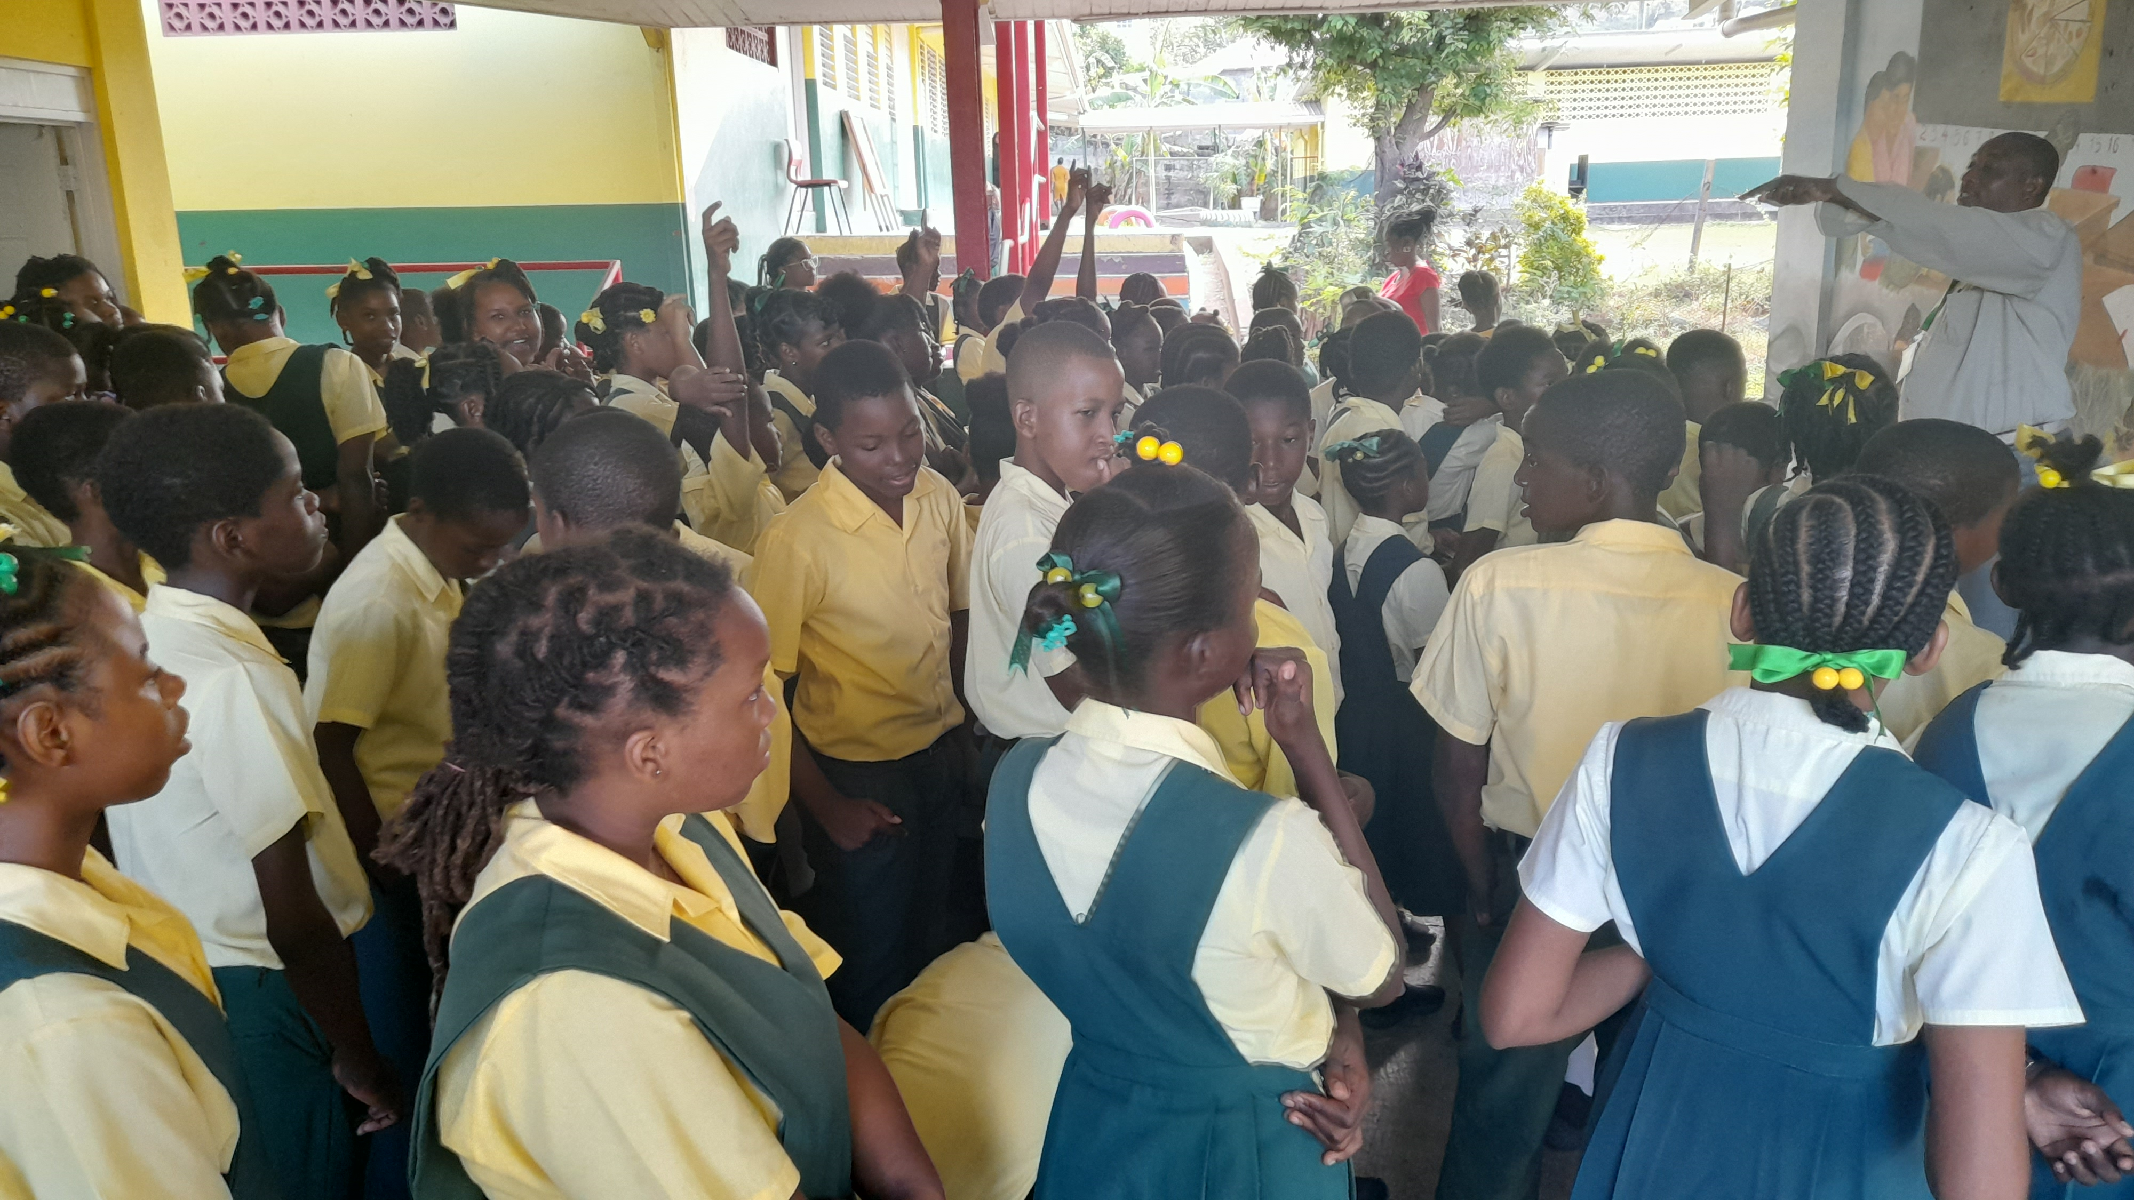
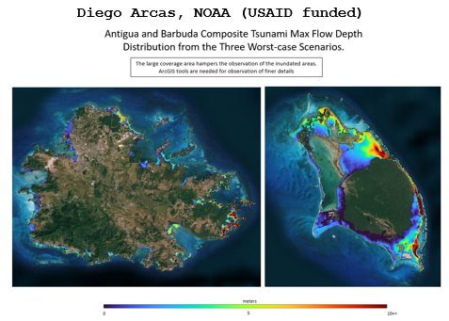
Tsunami Ready Nominations:
St. George’s, Grenada (CTIC): Testing of EOP and inter-agency coordination for installation of billboards advanced but challenged by technical resource constraints & identification of landowners
NORAD Project communities in (TBC), Barbados, Port Maria, Jamaica: and Mayaro, Trinidad and Tobago (CTIC): Tsunami Ready facilitator in conjunction with ITIC-CAR and IOC on pause, alternative options under development
Puerto Plata and Sabana Grande de Palenque, Dominican Republic (IOC Sec & CTIC): internal consultations on-going
Barbuda, Antigua and Barbuda (ITIC-CAR) national hazard assessment completed (USAID funded)
Belize City, Belize (ITIC-CAR): virtual training and review of status
Saint Lucia (ITIC-CAR): national hazard assessment completed (USAID funded)

Slide 11

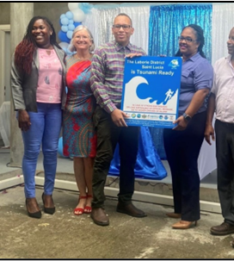
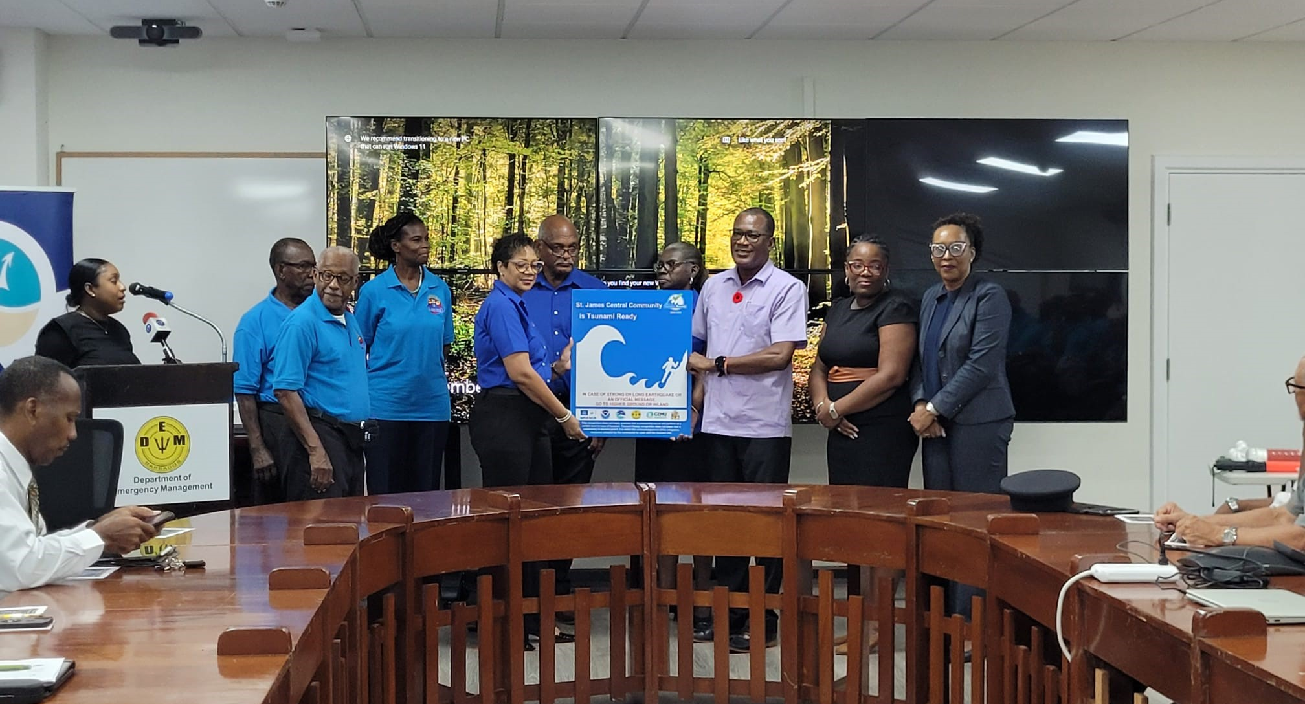
Tsunami Ready Certifications:
St. James Central, Barbados nationally-led, supported by UNESCO/IOC & CTIC Tsunami Ready Ceremony 05 November 2024
Portsmouth, Dominica (ITIC-CAR, USAID supported) Tsunami Ready Ceremony 26 September 2024
Laborie, St. Lucia (ITIC-CAR, USAID supported) Tsunami Ready Ceremony 24 September 2024

Slide 12
Tsunami Ready Renewals
Tsunami Ready Renewals:
Sherman’s to Mullins, Barbados - strategic discussions advanced with CTIC, PAE support
St. John’s City, Antigua and Barbuda initial discussions convened by CTIC & ITIC-CAR
St. Patricks & Petite Martinique and Carriacou, Grenada discussions advanced by CTIC, constrained by significant devastation due to Hurricane Beryl, July 2024
Union Island, St. Vincent and the Grenadines discussions advanced by CTIC, constrained by significant devastation due to Hurricane Beryl, July 2024
Carenage, Trinidad and Tobago initial discussions convened by CTIC
Fort Liberte, Haiti, discussions initiated by CTIC, challenged by current national considerations
Corn Islands & Bluefields, Nicaragua no action taken
Anguilla: (UK, ITIC CAR supported), Training and Tsunami Hazard Assessment (USAID funded), pending Evacuation Map and Signage
Tela/Tornabe and Omoa, Honduras – Status review (USAID funded), Virtual Training and Coordination Meetings led by ITIC-CAR

Slide 13


Objective
TSUNAMI RISK RANKING AT THE COMMUNITY LEVEL IN THE CARIBBEAN BASIN STUDY - FIRST RESULT
Estimate the theoretical resident population requiring evacuation in each community across the Caribbean, based on the results of tsunami wave amplitudes simulations.
Methodological protocol applicable to the entire Caribbean basin and further replicable at the global scale

Slide 14

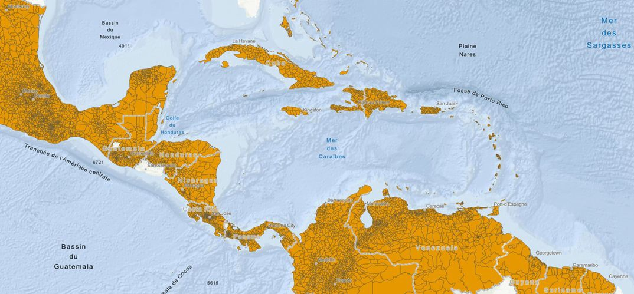

Communities delineation
Data from OpenStreetMap (shared territorial ontology on a global scale), downloaded in 2024
Administrative level from 2 to 8 (equivalent to French municipalities)
Eligibility rule: hosting an evacuation zone
Study area - 41 small states or territories bordering the Caribbean Sea (7 694 territorial boundaries), excluding the United States and Brazil.
Data source:
OpenStreetMap

Slide 15
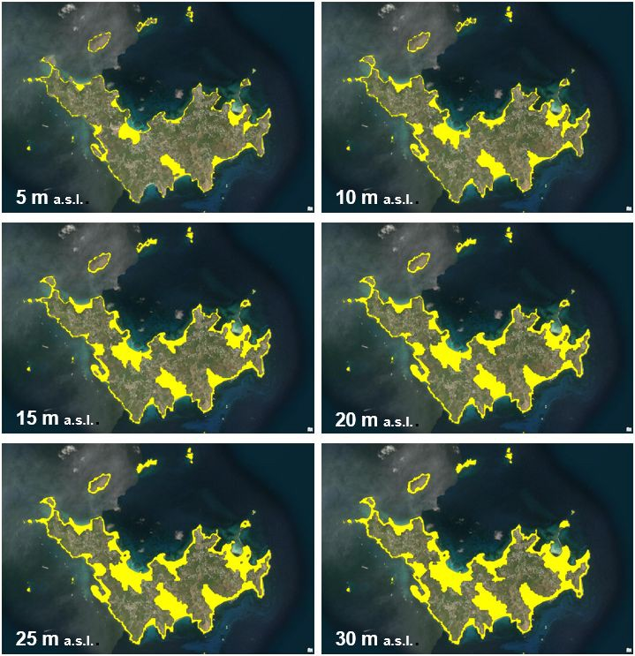

Evacuation zones delineation
An evacuation zone is deﬁned by a maximum distance from coastlines (3KM) AND the presence of areas located between 0, 5, 10, 15, 20, 25 and 30 meters a.s.l
Elevation grids - GLO-30 Data Advantages
Copernicus Digital Elevation Model (DEM)
Global coverage at a resolution of 30 metres
Absolute vertical accuracy: < 4m (90% linear error). Relative Vertical Accuracy: < 2m for slopes below or equal 20%;
Derived from multiple sources, including TanDEM-X, providing reliable data
4

Slide 16
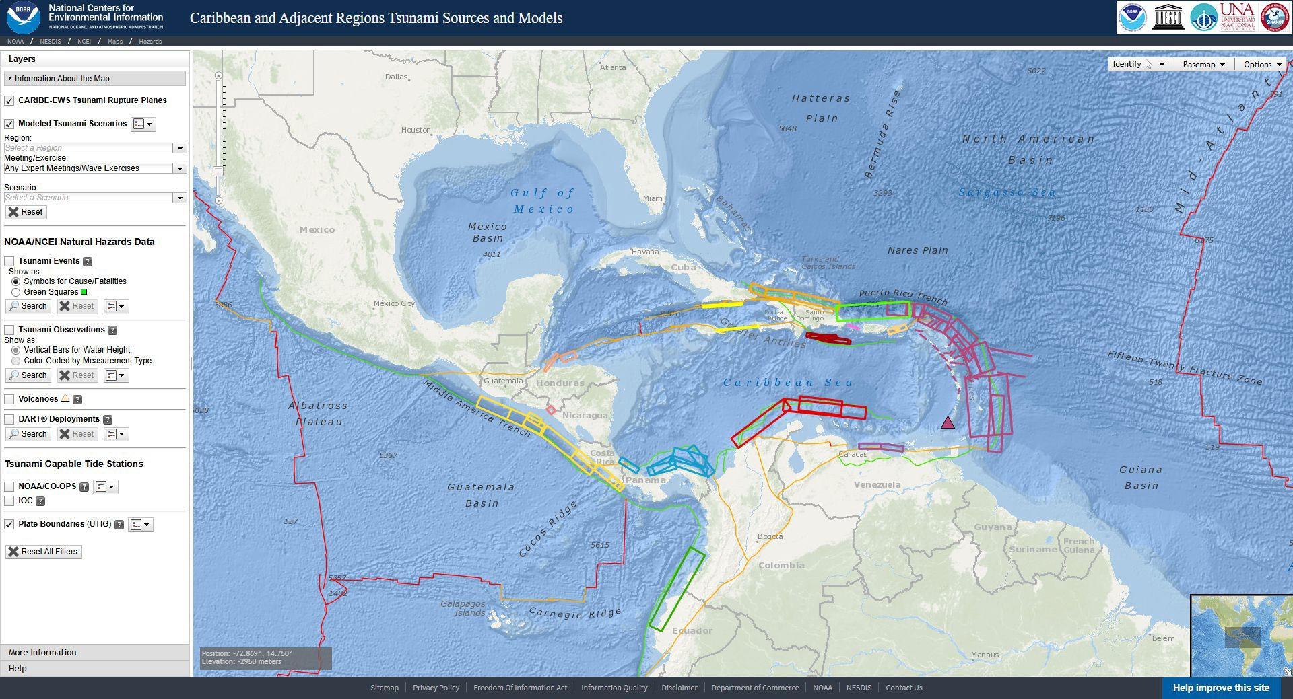
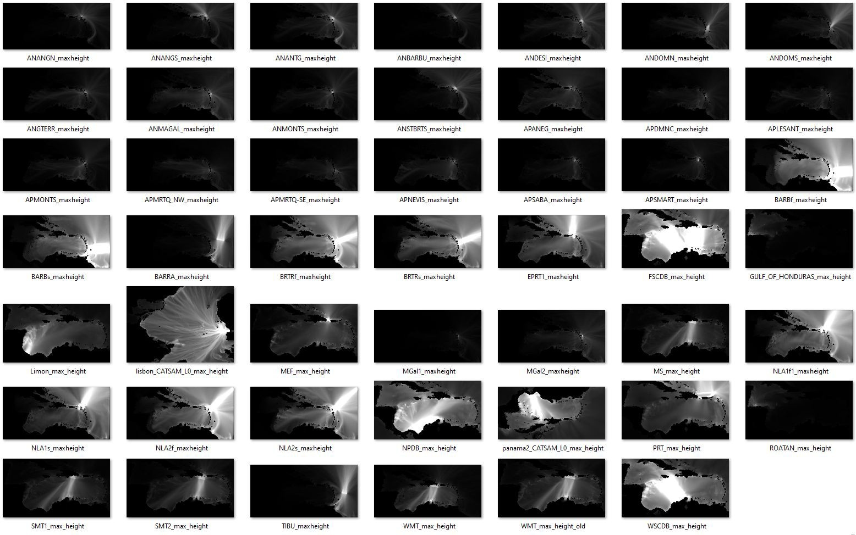
Tsunami Hazard Exposure
Tsunami hazard exposure is deﬁned by the maximum wave amplitude at the coast (to the nearest communities by euclidean distance)
Amplitude grid
with a spatial
resolution between 900m and 1800m
CATSAM (Caribbean and Adjacent Regions Tsunamis Sources and Models)
Scenarios based on historical events and/or tectonic and geodetic data
48 scenarios were used (based on expert meeting reports)
https://www.ncei.noaa. gov/maps/CATSAM/

Slide 17
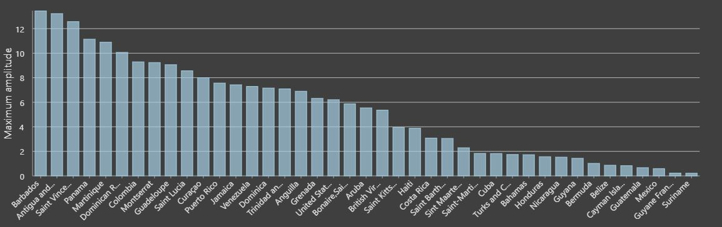
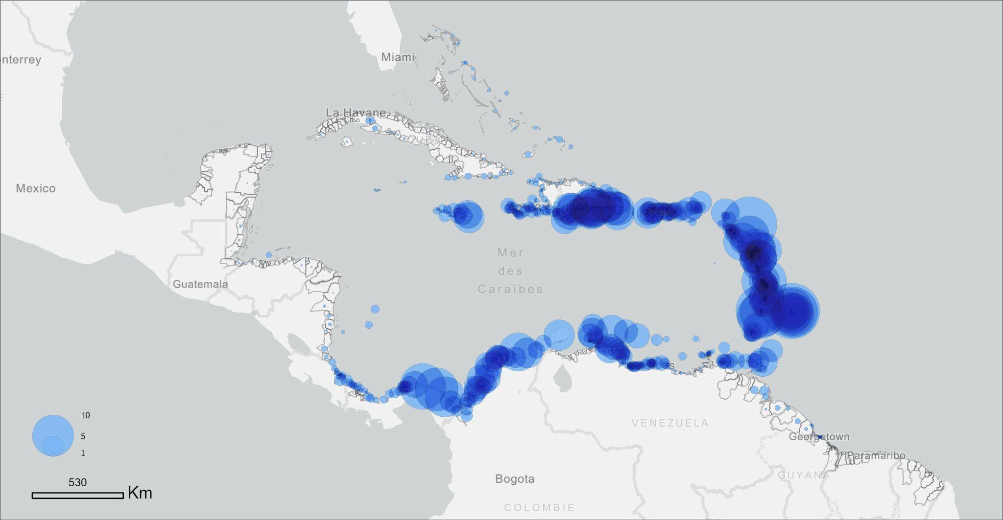
Tsunami Hazard Exposure
Maximum amplitude per community, all scenarios combined
Maximum amplitude by country, all scenarios
combined

Slide 18
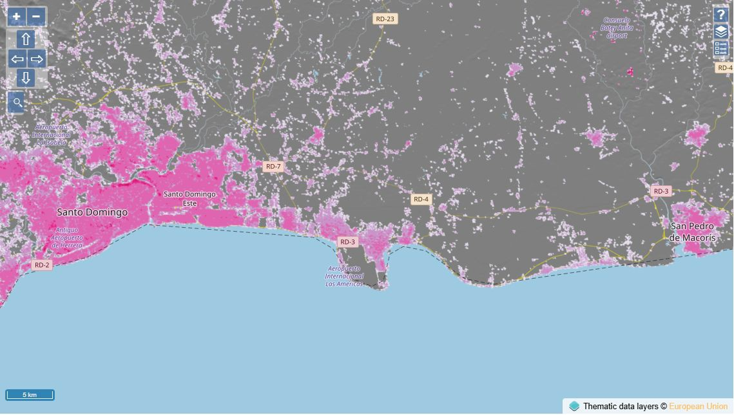
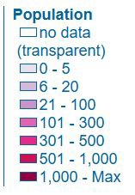


Evacuation needs estimation
Evacuation needs are deﬁned by the size of the population living in the evacuation zones.
Population grids
Copernicus Global Human Settlement Layer (GHSL)
Residential population in 2020 expressed as the number of people per cell
Data derived from the raw global census data harmonized by CIESIN for the Gridded Population of the World, version 4.11 (GPWv4.11)
Spatial resolution: 100 m

Slide 19
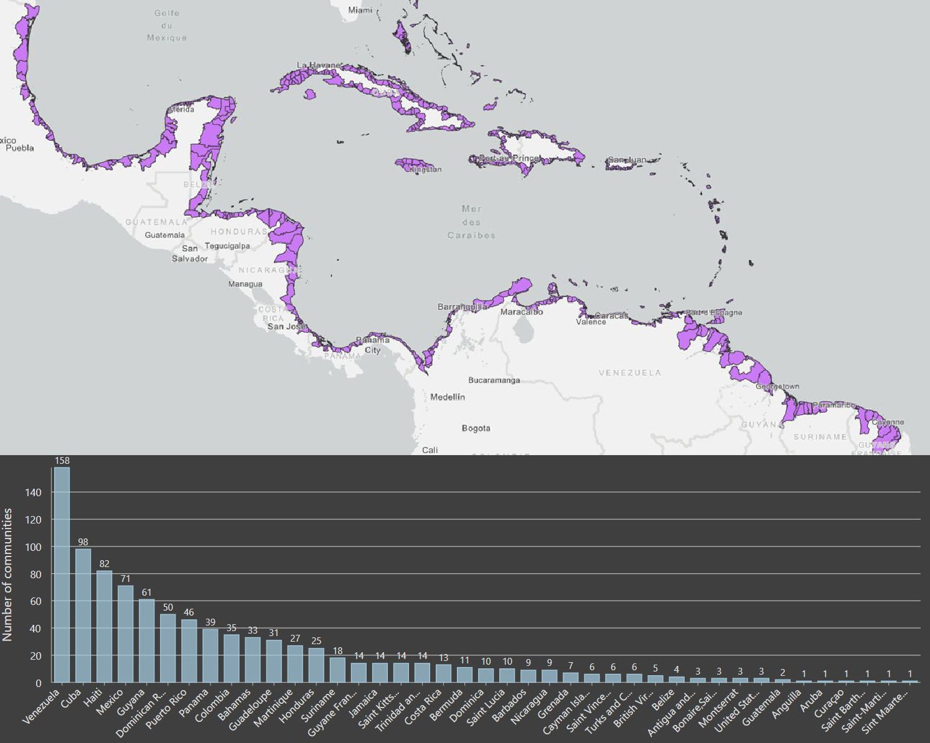
RESULT 1: eligible communities
A total of 945 communities are included in the evacuation zone at an altitude up to 30 meters
35 of these are without direct access to the sea (still need to be checked manually)

Slide 20
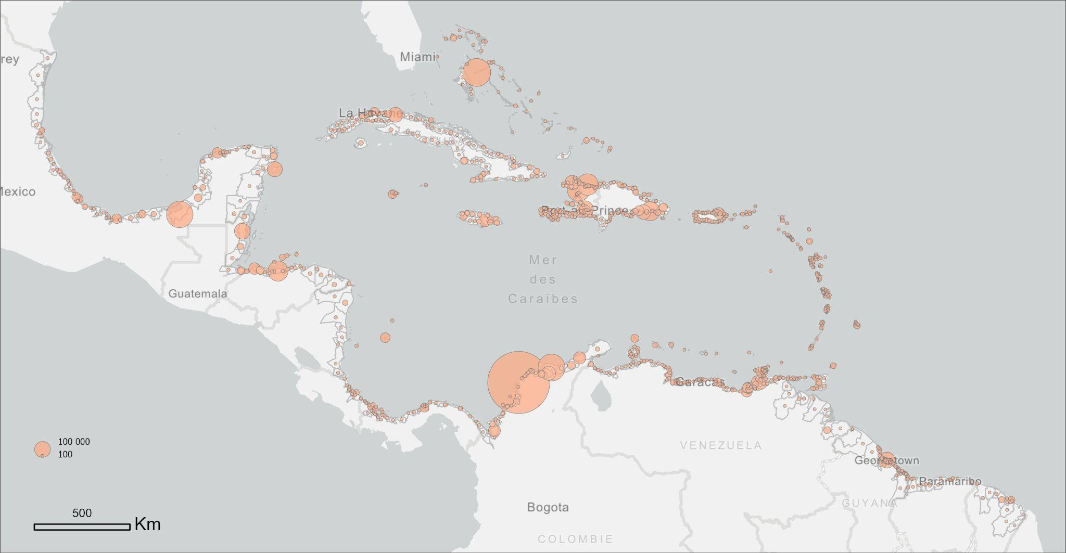
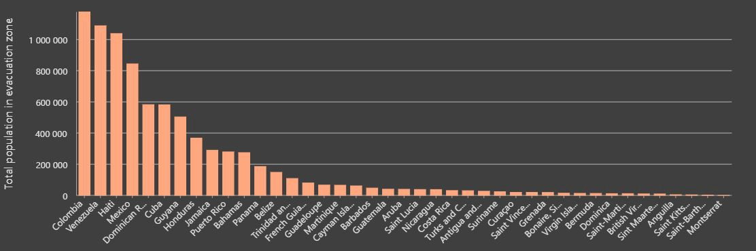
RESULT 2: population living in an evacuation zone
Nearly 47,030,000 people were detected as living in coastal communities.
It was estimated that more than 8,00,000 people would live in an evacuation zone.

Slide 21
NEXT STEPS
Evacuation zones
Methodology uses standardized zones based on CATSAM simulations.
→ National authorities remain responsible for official evacuation thresholds and procedures.
Scientific dissemination
Results will be submitted to a peer-reviewed journal.
→ Ensures validation, transparency, and wider academic impact.
Interactive dashboard
A web-based platform is under development.
→ To explore indicators from community to national scale.

Slide 22
Recommendations
Notes the Report on Pilot Feedback Survey on the Implementation of the UNESCO-IOC Tsunami Ready Recognition Programme in ICG/CARIBE-EWS and first results on Tsunami Risk Ranking at the Community Level in the Caribbean Basin
Further Notes the survey revealed critical insights into the challenges and successes faced by communities,
Additionally notes the difficulties in contacting eligible respondents and eliciting comprehensive feedback,
Recommends to evaluate the feasibility and desirability of establishing a national Tsunami Ready contact.
Suggests that an improved survey be implemented immediately upon a community’s recognition as Tsunami Ready
Further suggests that annual reporting mechanism for all recognized communities be established that would provide an opportunity to give ongoing feedback, enabling continuous improvement and adaptation of the guidelines and help maintain involvement with the recognized communities.
Notes the challenge with the US-funded Tsunami Ready Facilitator for CTIC and recommends for the IOC Secretariat and CTIC to prioritise completion of the related outstanding Tsunami Ready projects by ICG/CARIBE EWS XVIII
Welcomes finalization of the study on Tsunami Risk Ranking at the Community Leve; in the Caribbean Basin
Appeals to Member States and donors to provide funding for the continued implementation of the Tsunami Ready Programme in the Caribbean and Adjacent Regions

Slide 23
Recommendations
Notes the need for a digital tool to support ongoing implementation and monitoring of the UNESCO-IOC Tsunami Ready Programme,
Recommends the development of a shared monitoring platform at the level of the Caribbean Basin, and potentially at the global level, to allow for the structured submission of supporting documents, tracking of community progress, and management of recognition renewal
Notes that certain indicators within the Tsunami Ready Guidelines are currently interpreted and applied differently across Member States and territories,
Encourages the initiation of discussions to clarify such indicators, with particular attention to the number and layout of tsunami evacuation signs and routes, to ensure consistent implementation and assessment,
Further encourages the standardization of evacuation signage, and stresses the importance of achieving visual and operational coherence, at a minimum within each Member State or territory, to support clarity of communication and public understanding in emergency situations,
Proposes the creation and regular maintenance of a directory of national Tsunami Ready committee members, including institutional affiliations, roles, and contact information, to strengthen inter-country coordination and improve collaboration with the Task Team Tsunami Ready.

Slide 24

Discussion
gracelemoine@gwu.edu
Christa.vonH@noaa.gov
matthieu.peroche@univ-montp3.fr
marion.le-texier@univ-montp3.fr
Fabian.Hinds@barbados.gov.bb
a.brome@unesco.org
a.necmioglu@unesco.org

