Slide 1
IOC Sub-Commission for the Caribbean and Adjacent Regions (IOCARIBE)
Report to
ICG/CARIBE-EWS XVIII
Dr Lorna V Inniss
Regional Coordinator & Head of Office

Slide 2
Outline
General report of the IGM XVIII
Specific decisions of relevance to the ICG
Summary of Recommendations

Slide 3
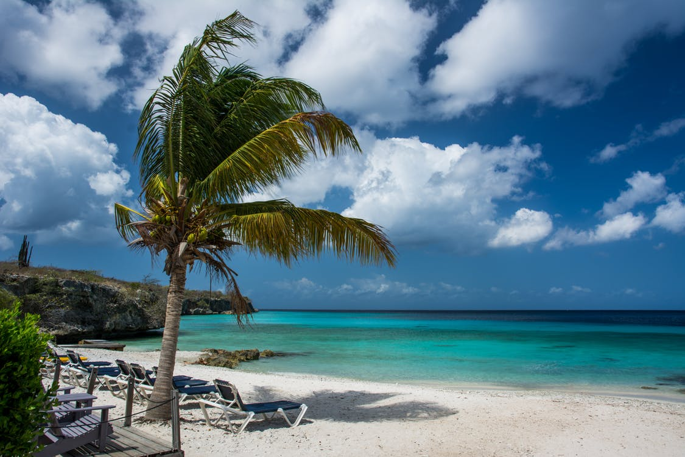
Report of the IGM XVIII
Hybrid meeting held in Brasilia, Brazil, 22-25 April, 2025
Technical Science Meeting “A Warming Ocean”
Climate-biodiversity-pollution Science/policy nexus

Slide 4
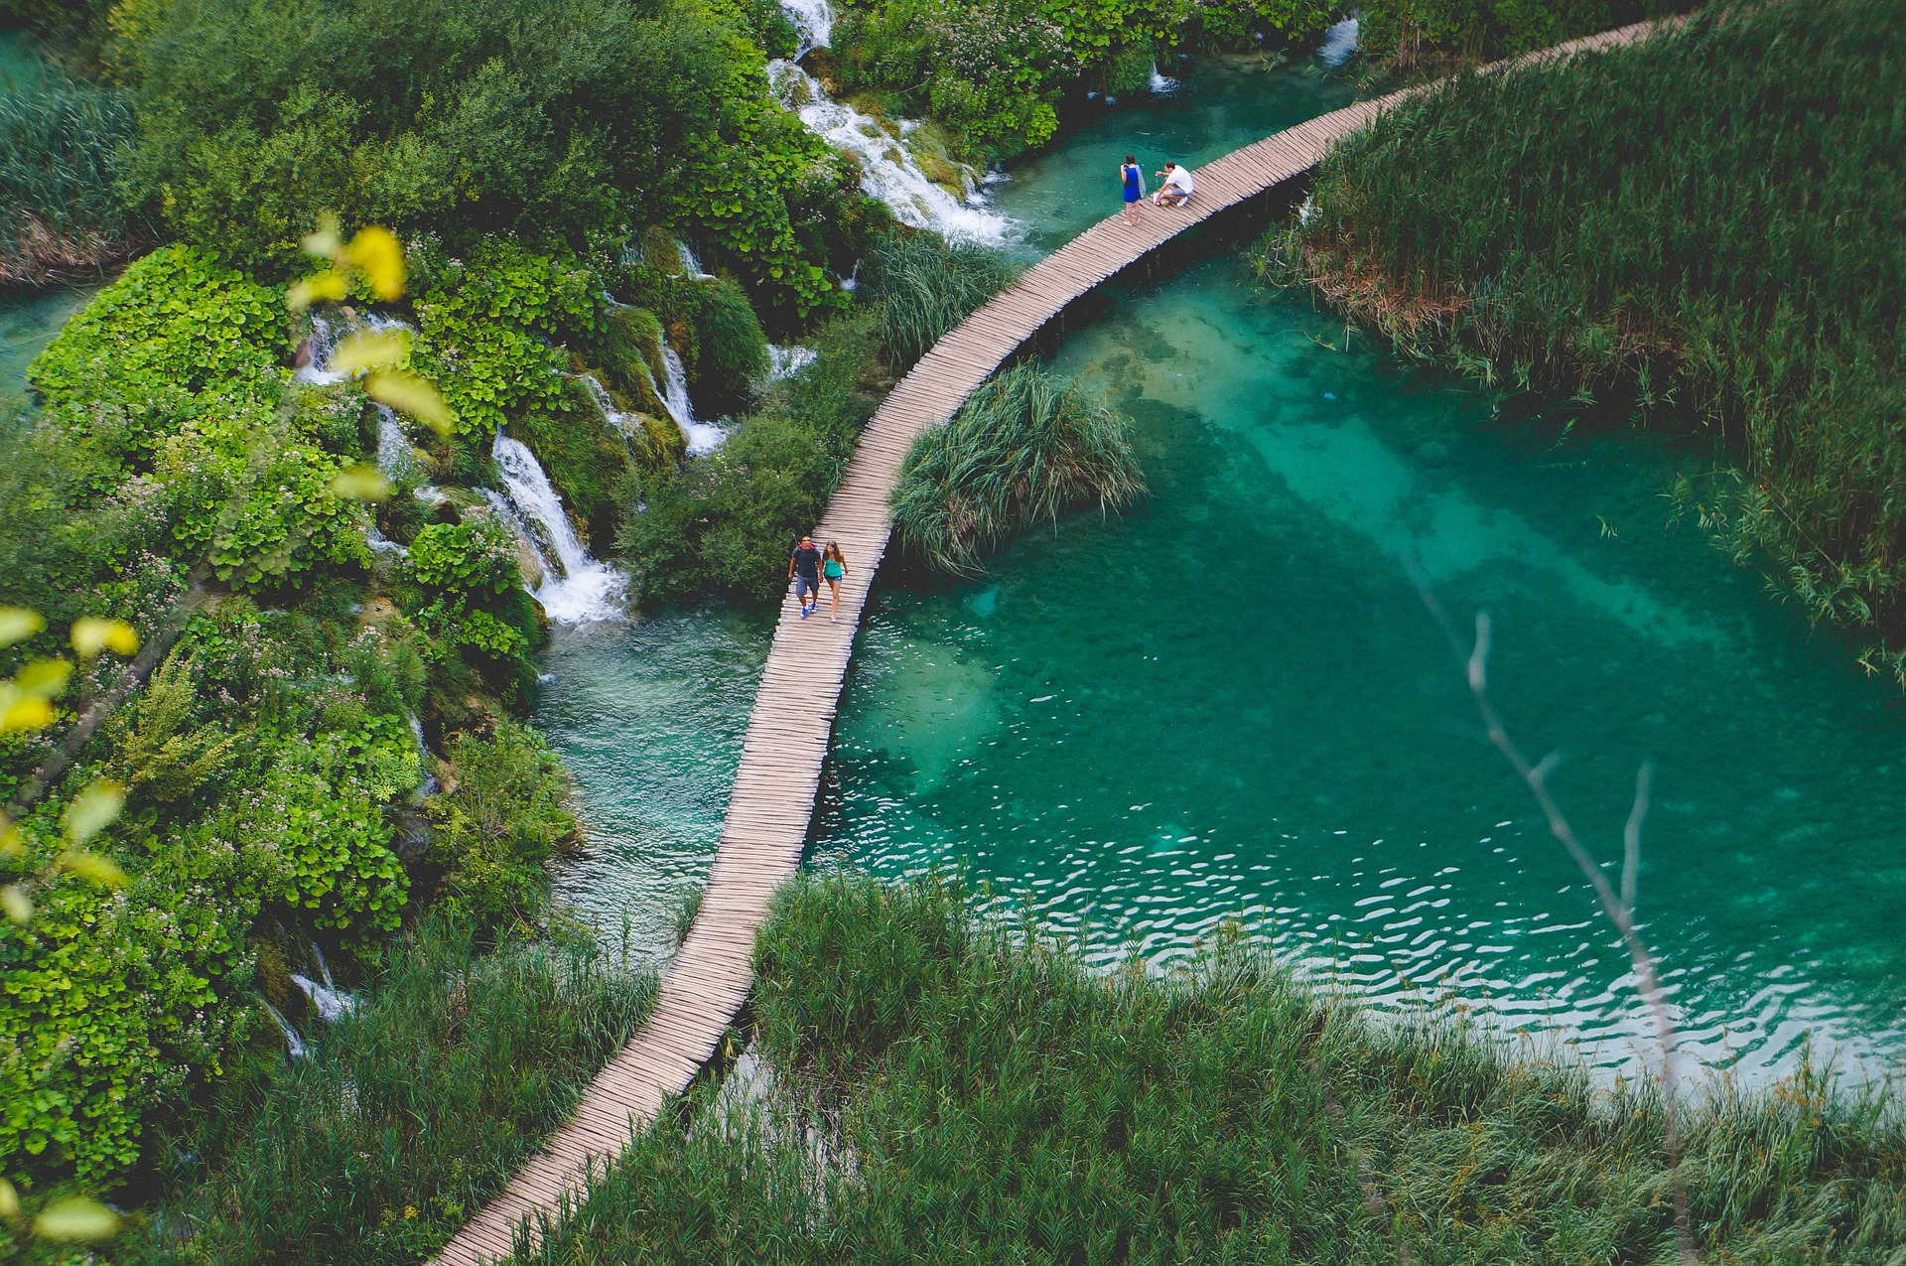
Governance
IOCARIBE Medium-Term Strategic Science Plan
Capacity development working group
IOCARIBE GOOS working Group
Ocean Literacy Task Team

Slide 5
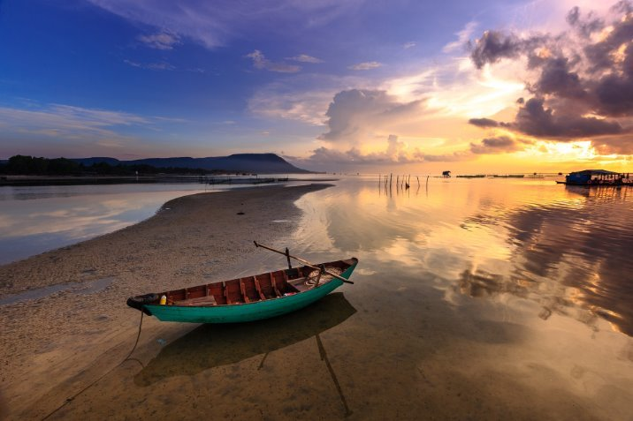
GOOS/iCHEWS Proposal
Align regional threats under a Multi-Hazard Framework
EW4ALL
Links to Met & DRR Community
Strengthen links to ICG

Slide 6
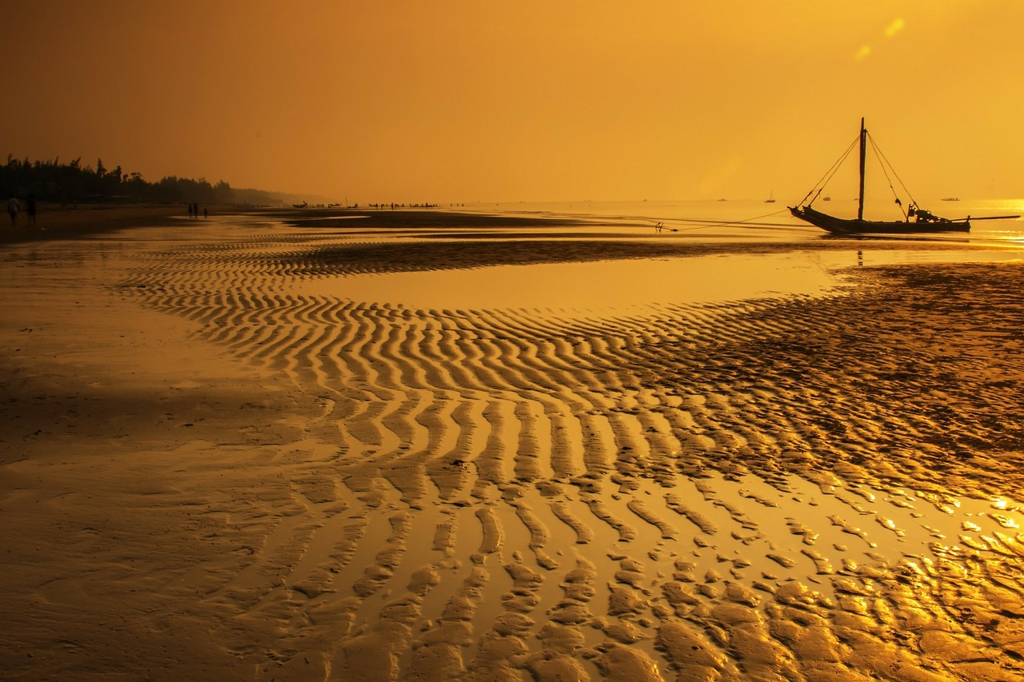
Data, Information, Knowledge & Tools
MS Needs and Gaps
Assess, prioritize, and address the data, information, and knowledge needs
IODE to support IOCARIBE in the establishment of new OBIS, OIH, ODIS nodes

Slide 7
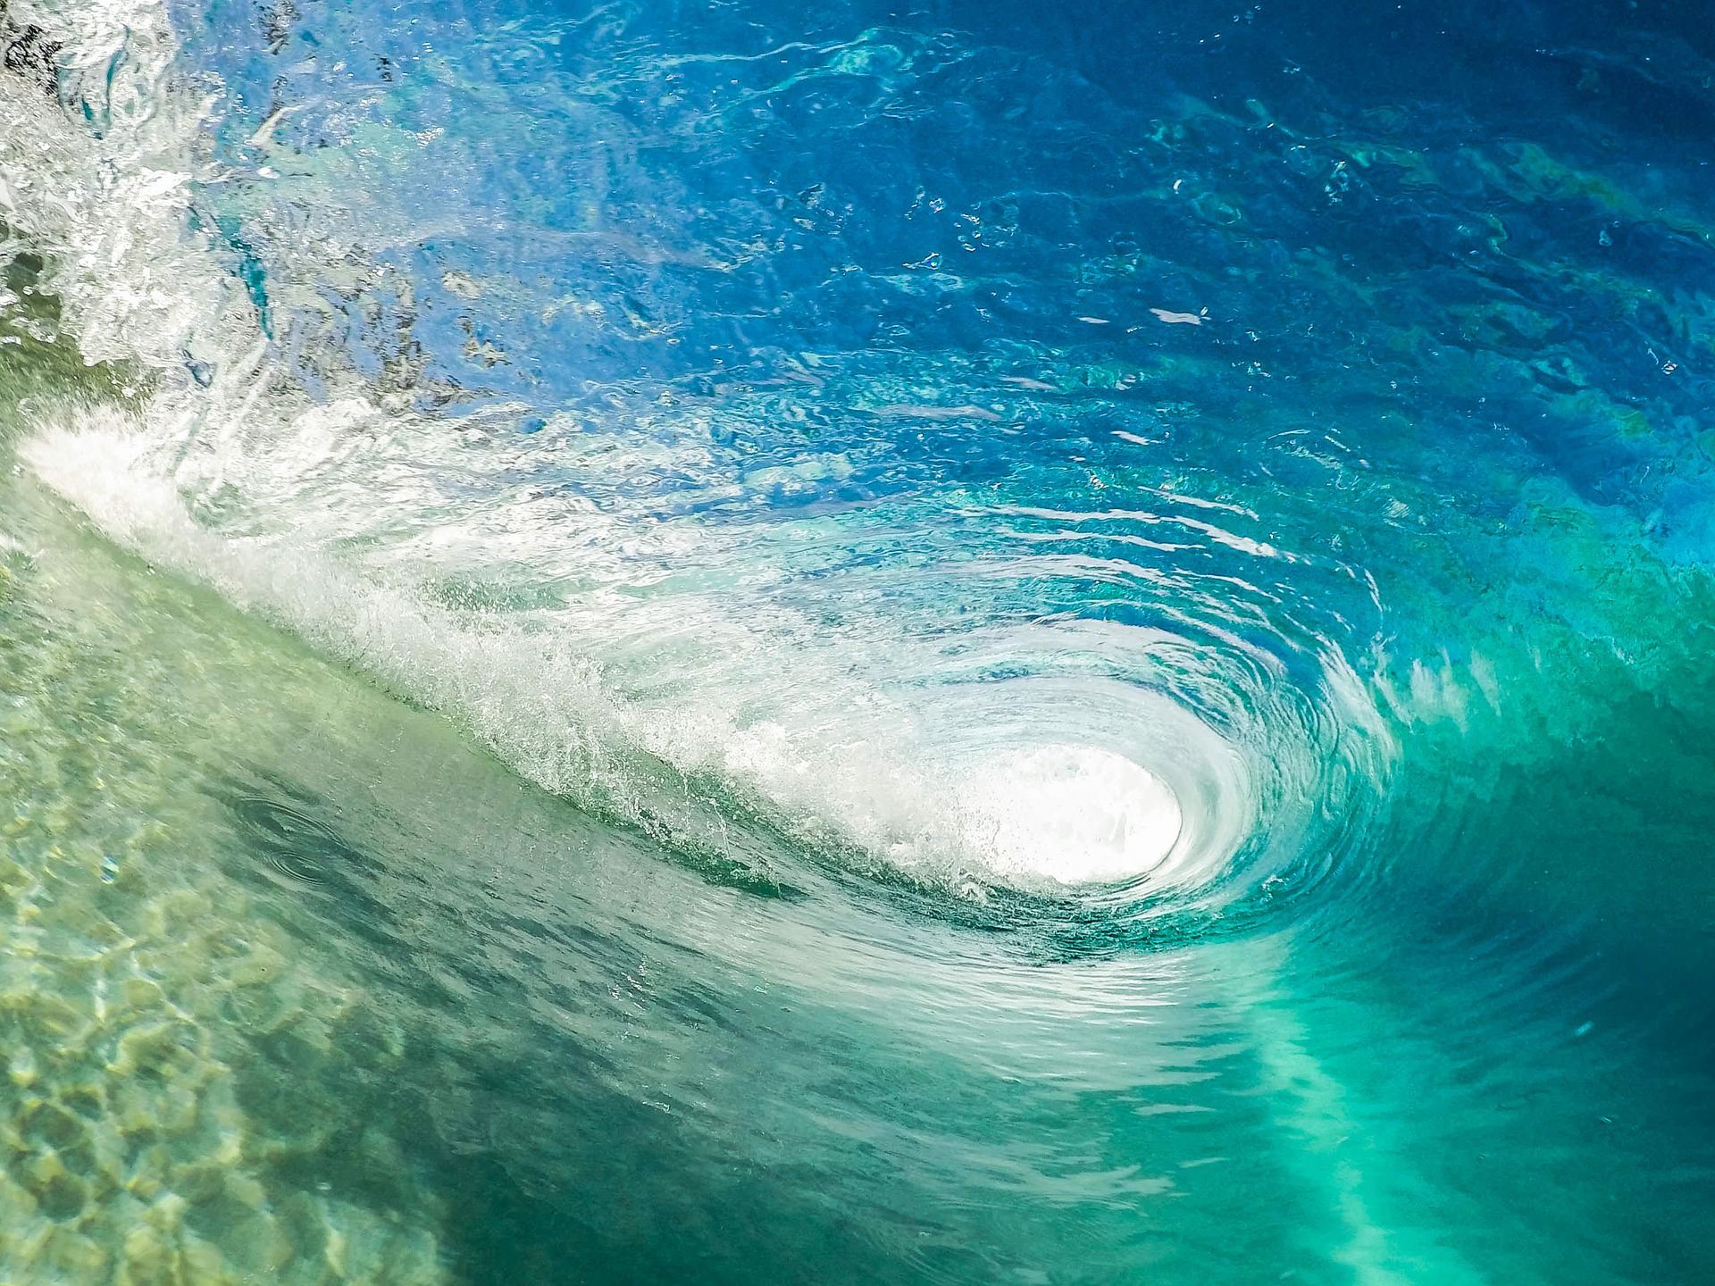
No. | Title
1 | United Nations Decade of Ocean Science for Sustainable Development
2 | Ocean Literacy
3 | Capacity Development
4 | IOCARIBE-GOOS
5 | Blue Carbon
6 | Regional Ocean Coordination Mechanism
7 | Marine Spatial Planning
8 | UNDP/GEF/UNOPS PROCARIBE+ Project
9 | Ocean Data and Information
10 | Sargassum Working Group
11 | Ocean Acidification
12 | National Contacts
13 | Harmful Algal Blooms
14 | All-Atlantic Ocean Research and Innovation Alliance

Slide 8
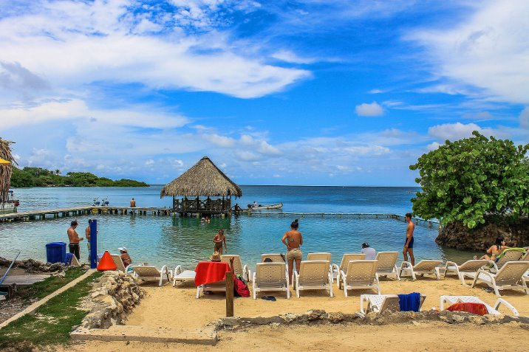
Recommendations to the ICG
Sharing reports of ICG Technical Working Groups
Membership of ICG or TIC/Secretariat to the IOCARIBE-GOOS Working Group
A representative to join the planning and drafting of the proposal to the Adaptation Fund
Agreement on where the multi-hazard focus should be
EWALL
DRR Community
Meteorology Community
Steering Committee for the Program

Slide 9
Recommendations II
Membership of/Contributions to the
IOCARIBE GOOS Working Group – Building and implementing the CoastPredict Program
Capacity development Working Group – Building on preparedness and readiness
Ocean Literacy Task Team – from the TICs

Slide 10
L.inniss@unesco.org

