Slide 1

4.3. Report of the Caribbean Tsunami Information Centre (CTIC)
ICG/CARIBE EWS XVIII (Online)
05 May 2025
Alison Brome (Programme Officer, CTIC)

Slide 2
Presentation Outline
Status on CTIC activities May 2024 – April 2025
CTIC Considerations & Challenges
Recommendations

Slide 3
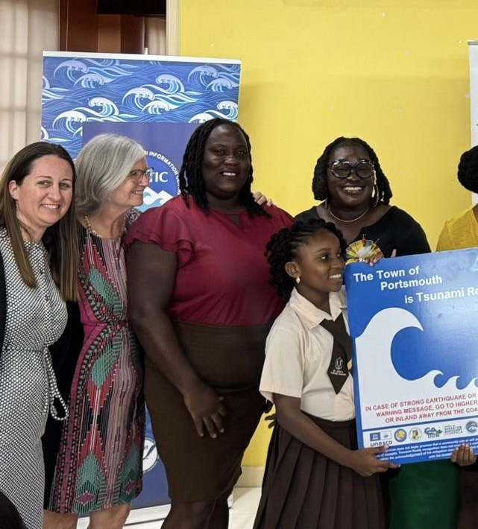
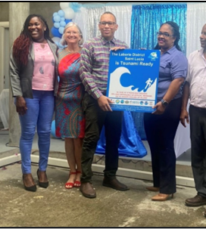
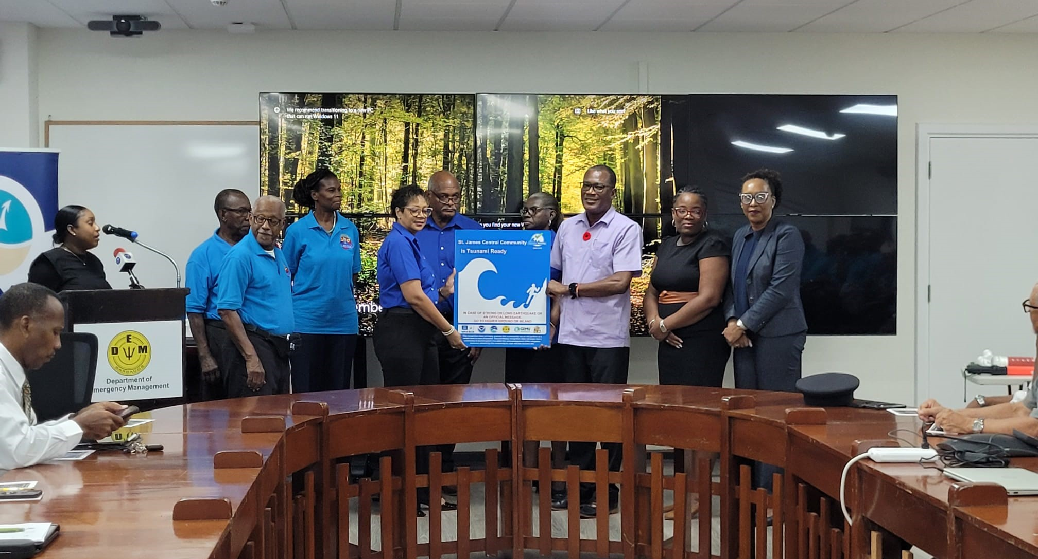
Status on Tsunami Ready Nominations:
Support to TRRP Communities:
St. George’s, Grenada: Testing of EOP advanced, inter-agency coordination for installation of billboards advanced but challenged by technical resource constraints & identification of landowners
NORAD Project communities in Barbados, Jamaica and Trinidad and Tobago: Tsunami Ready facilitator in conjunction with ITIC-CAR and IOC on pause, alternative options under development
Puerto Plata and Sabana Grande de Palenque, Dominican Republic internal consultations on-going
St. James Central, Barbados supported the administration and Tsunami Ready Ceremony WTAD 2024
ITIC-CAR: Tsunami Ready Ceremonies in Portsmouth, Dominica and Laborie, St. Lucia
ITIC-CAR: identification of new communities in Dominica and Saint Lucia

Slide 4
Tsunami Ready Renewals, Tsunami Ready Summit, Tsunami Ready Evaluation
Tsunami Ready Renewals:
Sherman’s to Mullins, Barbados - advanced strategic discussions & PAE support
St. John’s City, Antigua and Barbuda initial discussions convened
St. Patricks & Petite Martinique and Carriacou, Grenada discussions advanced, constrained by significant devastation due to Hurricane Beryl, July 2024
Union Island, St. Vincent and the Grenadines discussions advanced, constrained by significant devastation due to Hurricane Beryl, July 2024
Carenage, Trinidad and Tobago initial discussions convened
Fort Liberte, Haiti, discussions initiated, challenged by current national considerations
Corn Islands & Bluefields, Nicaragua no action taken
Anguilla, and Tela/Tornabe and Omoa, Honduras - select support to on-going ITIC-CAR TR Projects
Tsunami Ready Summit: advanced, to be reported in separate ICG/CARIBE EWS XVIII agenda item
Tsunami Ready Evaluation Survey: advanced, to be reported in separate ICG/CARIBE EWS XVIII agenda item

Slide 5
Status on CTIC activities May 2024 – April 2025
CARIBE WAVE 2025: supported Exercise planning, webinars and registration in conjunction with the CARIBE WAVE Task Team, ITIC-CAR & IOC
Joint training on Manuals and Guides 86 and CARIBE WAVE Task Team meeting – CTIC, ITIC-CAR & IOC funding advanced planning in consultation with national authorities in Antigua and Barbuda - Logistical challenges, staffing constraints and pause on co-funding. Alternative approach TBD
CTIC Brochure and CTIC Flyer:
Revision of English & Spanish versions completed by February 2025 with ITIC-CAR & IOC, WG4, WID and other partners
1st batch printing completed, soft copy available for distribution
Arrangements for hard copy distribution to Barbados and select RSS Member States on-going (Antigua and Barbuda, Dominica, Grenada, St. Kitts and Nevis, St. Lucia, St. Vincent and the Grenadines), Guyana pending flight scheduling
Efforts for distribution to other CARIBE EWS under consideration including collaboration with CDEMA
Engagement on options for French versions to be advanced Qs 2-3 2025
CTIC Website – full integration into IOC management structure on-going, with IOC Intern support, more concentration in Qs 2-3 2025

Slide 6
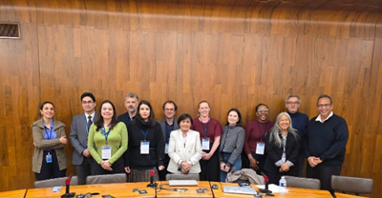
Status on CTIC activities May 2024 – April 2025
EW4All Regional Mechanism participated in the 1st meeting 20 September 2024 with IOCARIBE & engaged UNDRR including 13th CCDM Conference 04-06, December 2024
Collaboration with World Institute on Disability to advance discussions on integration of considerations for people living with disabilities in CARIBE EWS activities and programmes
2nd Global Tsunami Symposium, Nov 2024 : printing and presentations. Mission not possible due to financial and logistical constraints
Meetings of TOWS TTDMP, Joint TOWS TTDMP & TTTWO, TOWS XVIII 20 -25 February 2025:
Reviewed and supported regional autonomy to amend post-event assessment survey
No. of Member States and communities joining the UNESCO-IOC TRRP
Instructed TT-DMP to prepare a guideline for inclusive Standard Operating Procedures (SOP) building on the development of inclusive SOP and inclusive warning tools for disabled children in Indonesia and the Caribbean
Prioritize regional Tsunami Ready workshops or summits in 2025 and conduct further workshops or summits before 2030

Slide 7
Status on CTIC activities May 2024 – April 2025
IOC- UNESCO TICS Meeting 26 Feb 2025:
Advanced automation of TRRP, led by IOC
New TRRP Toolkit approved, IOC M&G 74 to be updated
CARIBE WAVE participation – recommended MS reporting to take precedence
Draft procedures for renewal to be developed
OTGA courses to be imbedded in regional training activities e.g. prerequisites
Bridging Japanese and UNESCO-IOC expertise on Geohazard Early Warning Systems to support Pacific and Caribbean SIDS” Project, Grenada – commences Q3 2025, 3 years, stocktaking & geohazards multi-hazard EWS complementary project in Pacific
CTIC Staff Recruitment:
Drafted TOR and procured Consultant to support TR with IOC & ITIC-CAR through USAID-BHA funding. Process on pause
Drafting of alternate TOR for staff recruitment initiated
CTIC MOU with Government of Barbados: signed 29 May 2024 for 5 years
UNESCO-CDEMA MOU: signed 14 December 2024 in Barbados
HOSTING OF ICG/CARIBE EWS XIX, 2026 in Barbados, strong support to IOC and national efforts through several meetings, supporting draft Cabinet Paper

Slide 8
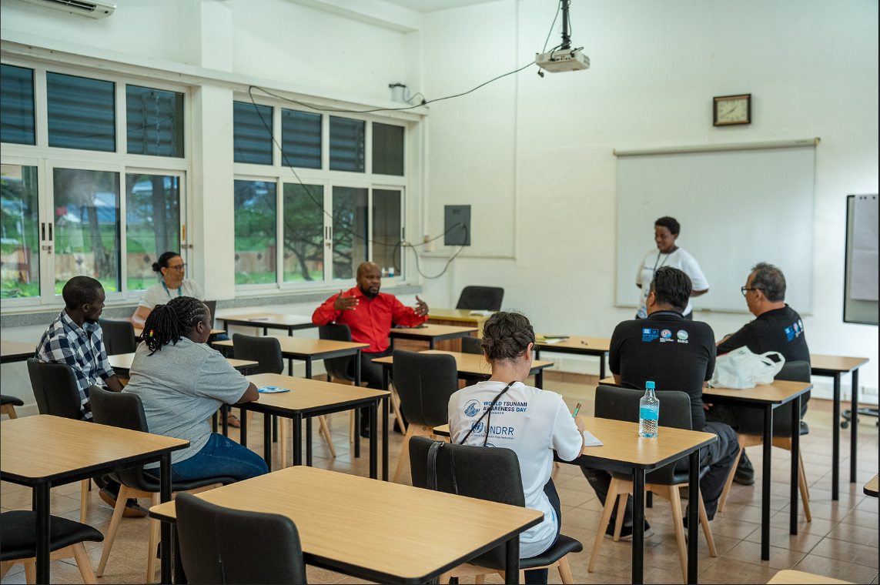
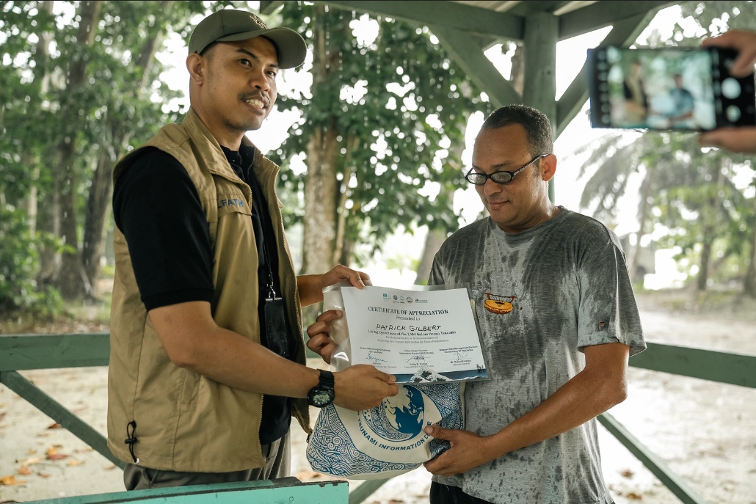
2025 Partnership Proposals with UNESCO IOC
World Tsunami Awareness Day 2025 Theme Co-development
Tsunami Ready Programme + Get to High Ground Campaign
Making Cities Resilient Program

Slide 9
Post Event Assessment Survey – 08 Feb 2025 M7.6 Western Caribbean Earthquake
A major earthquake = 7.6 Mw occurred north of Honduras 08 February 2025, 23:23:14 UTC, depth of 33 km/20 miles.
Small tsunami (max 4cm) observed at Isla de Mujeres (Mexico)
Most likely associated with the Swam Island Transform fault, Similar to the 2018 event in the same region
PTWC = 5 Threat Messages for non-US CARIBE, 4 Tsunami Advisory Messages for US-CARIBE & BVI
CATAC = 1 message to Central American MS
12 February 2025 the IOC-UNESCO TSR convened online post-event assessment meeting /“hotwash” - ICG/CARIBE EWS Member State TNCs/TWFPs/NTWCs, ICG/CARIBE-EWS Steering Committee/Working Groups/Task Team Members, representatives of regional partners and other stakeholders
12 Member States completed survey – Colombia, Costa Rica, Dominican Republic, Guatemala, Haiti, Honduras, Kingdom of the Netherlands (Aruba, Bonaire, Curacao, Saba), Mexico, United Kingdom (British Virgin Islands) United Kingdom (Cayman Islands), Puerto Rico (United States of America), United States Virgin Islands) (United States of America)
Tsunami Observation: Isla de Mujeres, Mexico

Slide 10
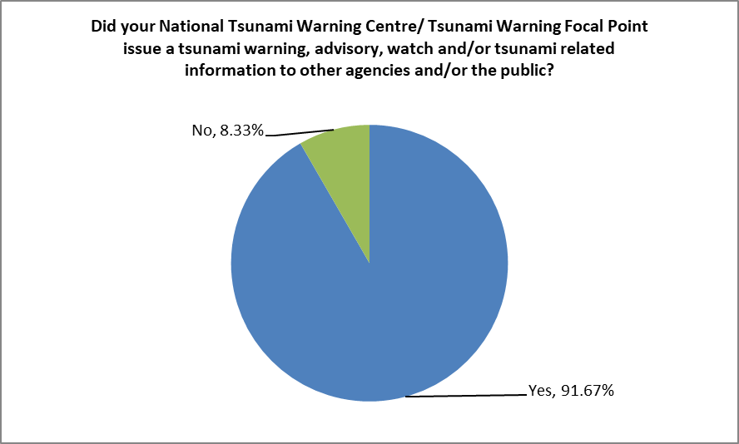
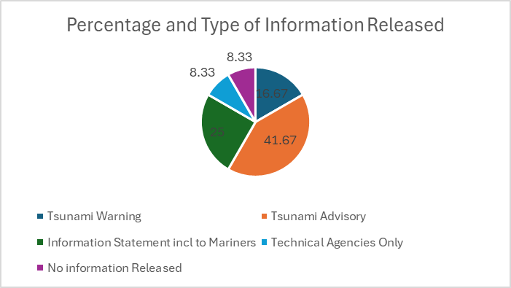
Post Event Assessment Survey – 08 Feb 2025 M7.6 Western Caribbean Earthquake – Key Metrics
Time UTC | OT + from PTWC issuance | Source | Comments
08 February 2025
23:23:15 | 0 | Earthquake
23:24:48 | 00:01:33 | First Alarm
23:27:50 | 00:04:35 |  | Observatory Message issued with the preliminary earthquake parameters M 8.0, depth 33km/20 miles
23:29 | 00:06:07 | PTWC Non-US Caribbean Threat #1
All 3 Central American respondent MS confirmed access to CATAC message. Costa Rica and Guatemala by email, Honduras via CATAC website
CATAC experienced computer challenges which hampered dissemination of later messages
CATAC made phone calls and WhatsApp messages but challenges due to contact info.
Time UTC | OT + from CATAC issuance | Source | Comments
08 February 2025
23:23:15 | 0 | Earthquake
23:25:25 | 00:02:10 | Preliminary Automatic Earthquake Information

Slide 11
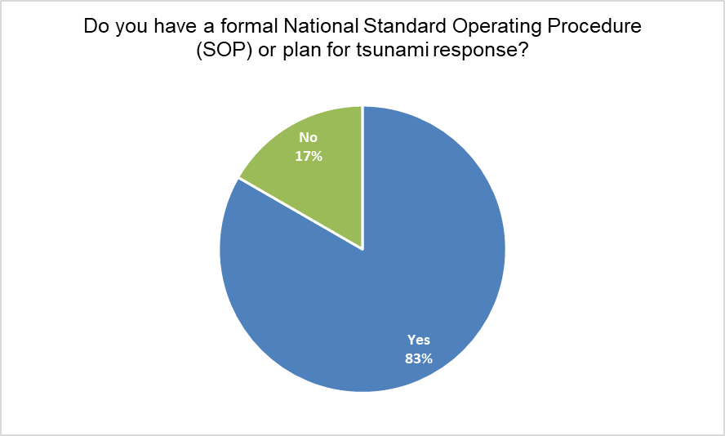
Post Event Assessment Survey – 08 Feb 2025 M7.6 Western Caribbean Earthquake – Key Metrics
Honduras was the only MS to evacuate
Tsunami inundation maps for the TRRP communities of Omoa, Cortés, Tornabé, Tela, Atlántida were available
Populations did not self-evacuate

Slide 12
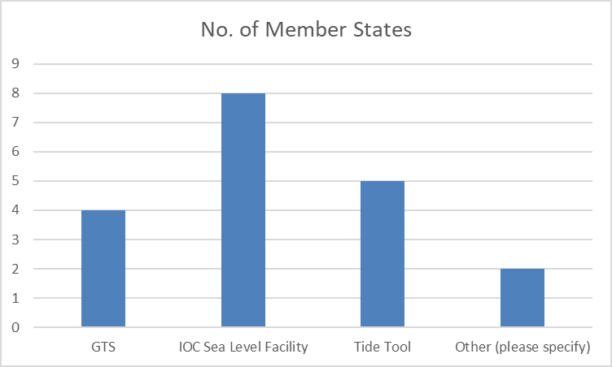
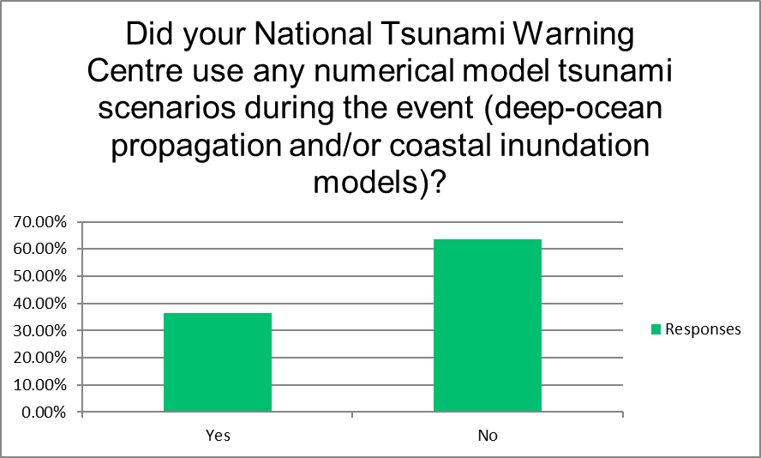
Post Event Assessment Survey – 08 Feb 2025 M7.6 Western Caribbean Earthquake – Key Metrics

Slide 13
Considerations and Challenges from Post-Assessment Surveys
08 February 2025
Challenges experienced in creating Survey Monkey version, provided challenges and time constraints in manual transfer and analysis
Low level of sea-level data hindered PTWC analysis and issuance of cancellation message
CATAC experienced computer challenges, only issued 1 automatic message re: seismic event
Predominate reliance on email for receipt of messages from TSP
A large proportion of MS possess SOPs
Use of social media predominate public alerting – verification, CARIBE WAVE etc.
Deactivated telephones, internet down, response times in communicating with some agencies and public
14 August 2021 (Haiti)
Similar trends in predominance of emails for receipt of TSP messages
Low availability of sea-level data
MS requested support in sea-level training, SOP training, inundation modelling, risk assessment

Slide 14
Considerations & Challenges
CTIC Resource (financial and human) Constraints - impacting performance and service levels to Member States and partners and sustainability in respect to implementation of TR projects and mobilizing interests, development of public awareness and education materials, evaluations
CTIC Governance and Collective Ownership requires enhancement to support improvement on performance and service levels to Member States and partners and foster sustainability

Slide 15
ICG/CARIBE EWS XVIII Recommendations
Recommends convening a dedicated session of the CARIBE-EWS Steering Committee to strategically review the staffing resources needed to ensure adequate capacity at the CTIC to effectively execute and implement the programmatic and project activities to support the ICG/CARIBE-EWS and EW4All frameworks.
Urges ICG/CARIBE EWS Member States to make contributions to the IOC Special Account and provide human resources under various arrangements including long and short term internships to support the work of the CTIC.
Recommends that CTIC continues to work with the IOC Secretariat, CARIBE EWS Member States and partners to develop a strategic plan to guide the resource mobilization and staffing efforts of the CTIC

Slide 16
ICG/CARIBE EWS XVIII Recommendations
Encourages Member States to observe WTAD 2025 within the concept of Tsunami Ready Programme + Get to High Ground Campaign, Making Cities Resilient Program and to share their activities with CTIC
Notes the planning advanced for the joint training on Manuals and Guides 86 and CARIBE WAVE Task Team by the CTIC and ITIC-CAR in coordination with Working Group 4 and CARIBE WAVE Task Team and the logistical and administrative challenges faced. Recommends that alternative options be pursued to convene this training prior to ICG/CARIBE EWS XVIII
Notes the challenge with the US-funded TR Facilitator and recommends for the IOC Secretariat and CTIC to complete outstanding TRRP projects by ICG/CARIBE EWS XVIII
Appeals to Member States and donors to provide funding for the implementation of the Tsunami Ready Programme in the Caribbean and Adjacent Regions

Slide 17






Thanks for your attention
a.brome@unesco.org

