Slide 1


Towards A Safe Ocean: Tsunami Ready Recognition Programme Progress in the Caribbean and Adjacent Regions
Grace Lemoine, NOAA/NWS Lapenta Scholar at International Tsunami Information Center- Caribbean
B.A. International Affairs and Geography at George Washington University
Mentor: Christa G. von Hillebrandt-Andrade
Advisors: Fabian Hinds, Öcal Necmioğlu, and Alison Brome
INTERGOVERNMENTAL OCEANOGRAPHIC COMMISSION of UNESCO
Eighteenth Session ICG/CARIBE-EWS XVIII
May 5-7 and 9, 2025
Agenda Item 3.11

Slide 2
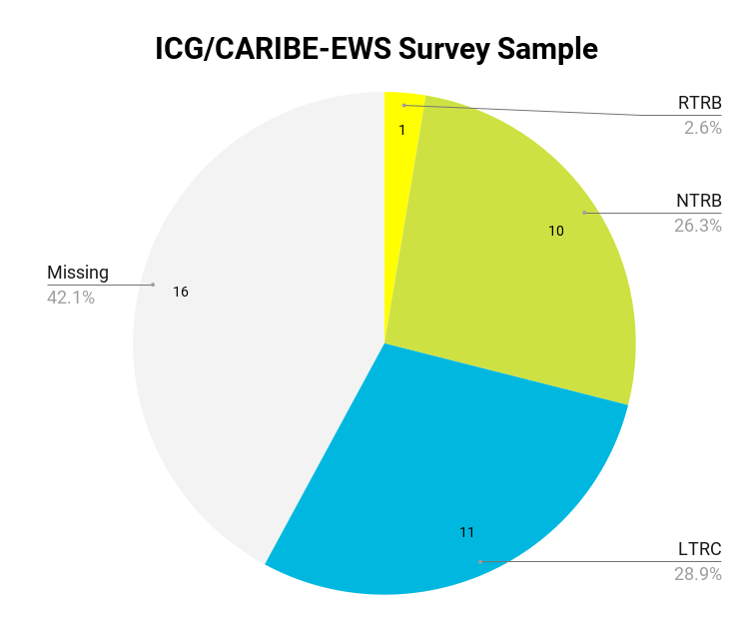
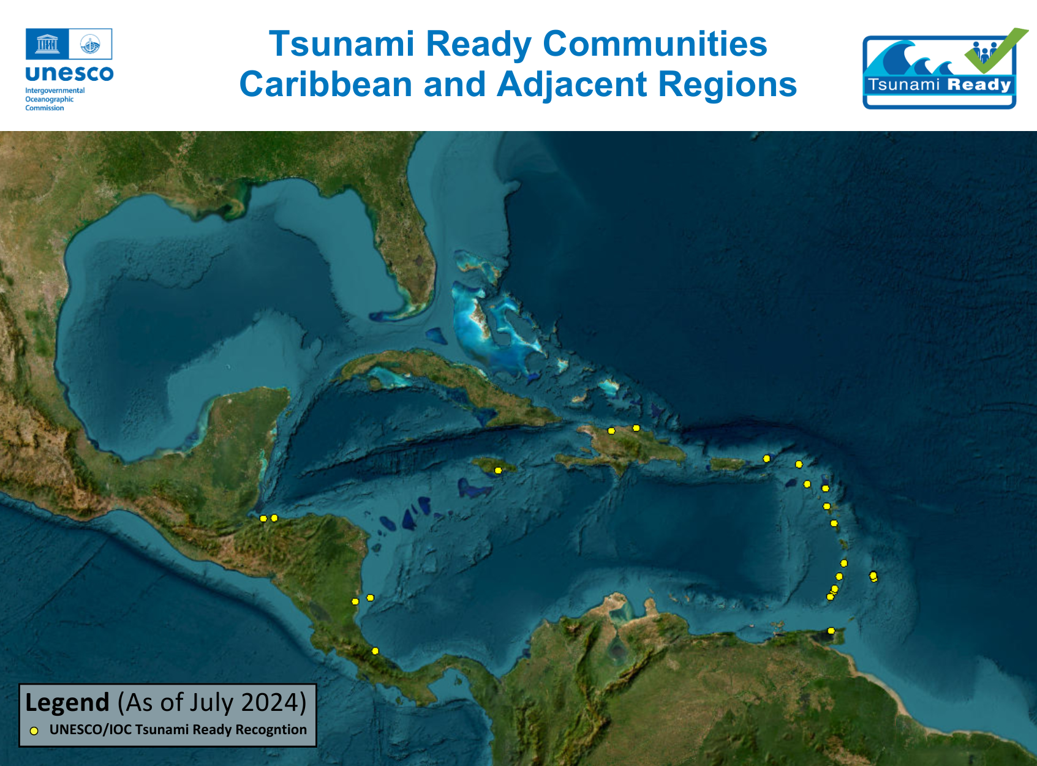
Pilot Feedback Survey on the Implementation of Tsunami Ready in ICG/CARIBE-EWS
Benchmark the current effectiveness of the recognition program
Provide insight into the program’s strengths and deficiencies
Promote and improve the program collectively
OBJECTIVES
Full report is available at
https://oceanexpert.org/event/4626#documents
Notes:
The pilot encountered several difficulties that hindered its overall return, such as contacting eligible respondents, confirming email delivery, and obtaining the intended number of responses. Furthermore, the survey was limited in eliciting comprehensive feedback about the effectiveness of the program due to issues such as respondent involvement in implementation, variations in response detail, time since community recognition, and survey design errors.

Slide 3
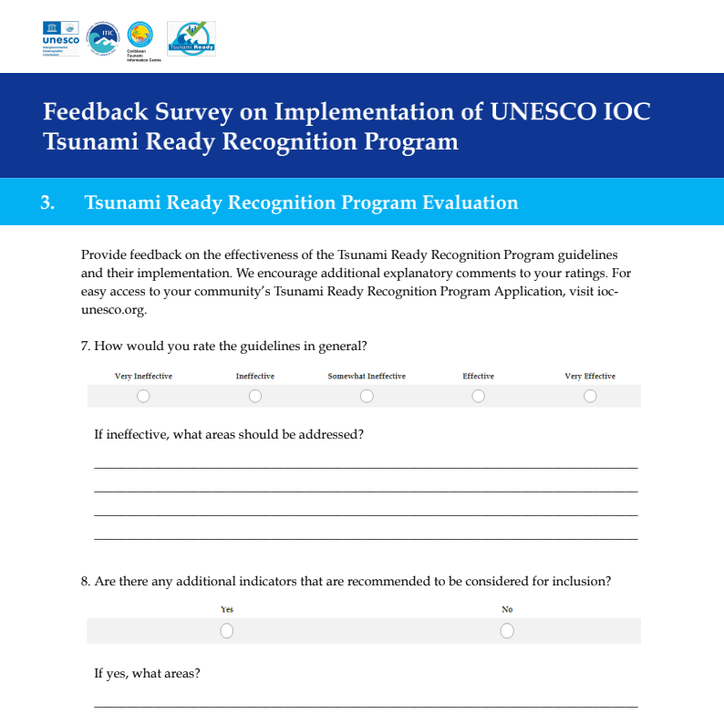
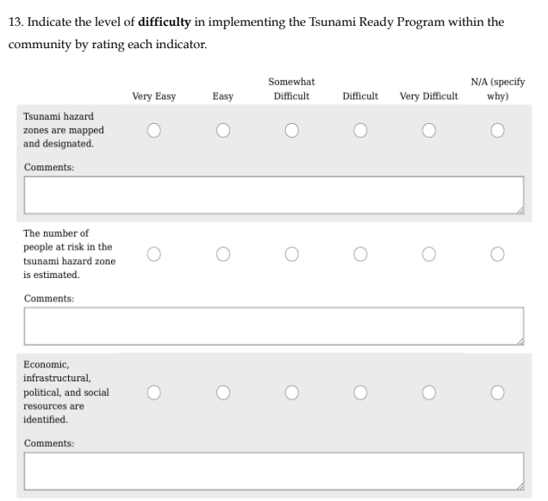

Slide 4
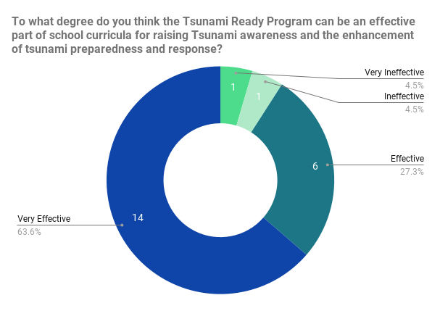
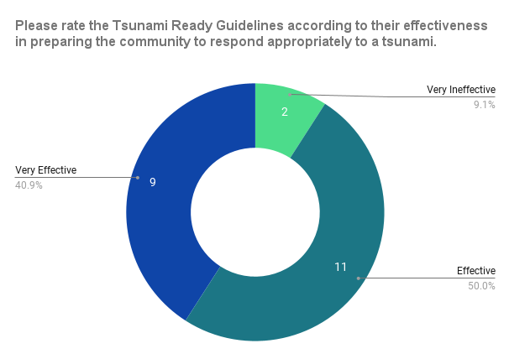
Feedback on Program Effectiveness
Tsunami Education
Tsunami Response Preparedness
Consensus: Very Effective
Consensus: Effective

Slide 5
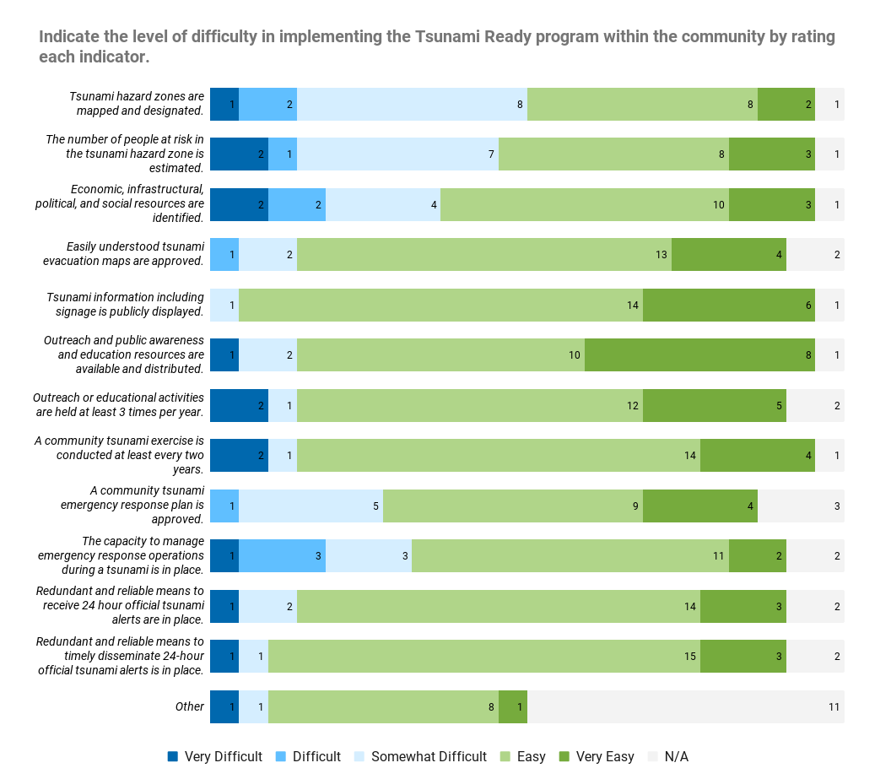
Feedback on Implementation Difficulty
Most Difficult Indicator: “Tsunami hazards are mapped and designated.”
Easiest Indicator:
“Tsunami information including signage is publicly displayed.”
Note: These ratings inherently embody a subjective nature due to their contextual variability.

Slide 6
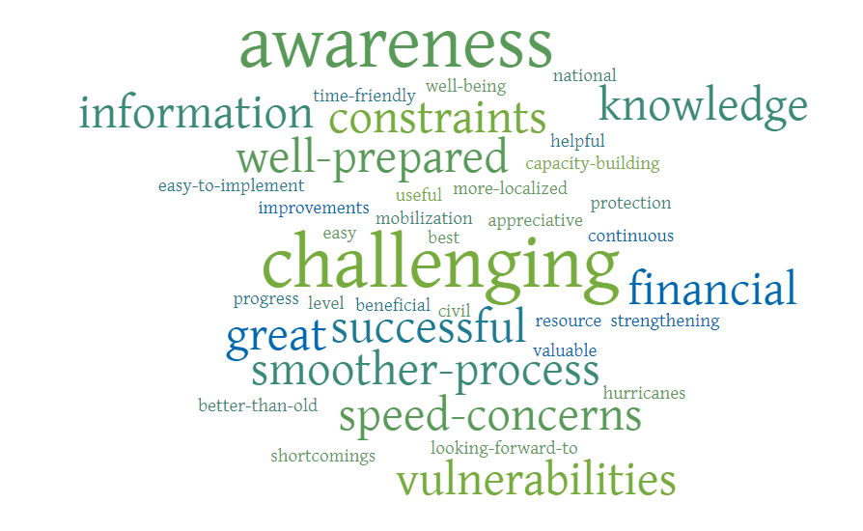
General Comments

Slide 7

Summary
Tsunami Ready has been successful in bolstering community preparedness and response with its strong culture of outreach, education, and capacity building.
Additional support is still needed to address gaps in data collection, communication, funding, and resource mobilization issues.
It is important to ensure that Tsunami Ready remains efficient and effective in its requirements through efforts like the pilot survey.

Slide 8
Recommendations
Notes the Report on Pilot Feedback Survey on the Implementation of the UNESCO-IOC Tsunami Ready Recognition Programme in ICG/CARIBE-EWS
Noting the survey revealed critical insights into the challenges and successes faced by communities,
Further Noting the difficulties in contacting eligible respondents and eliciting comprehensive feedback,
Recommends to evaluate the feasibility and desirability of establishing a national Tsunami Ready contact.
Suggests that an improved survey be implemented immediately upon a community’s recognition as Tsunami Ready
Further suggests that annual reporting mechanism for all recognized communities be established that would provide an opportunity to give ongoing feedback, enabling continuous improvement and adaptation of the guidelines and help maintain involvement with the recognized communities.

Slide 9
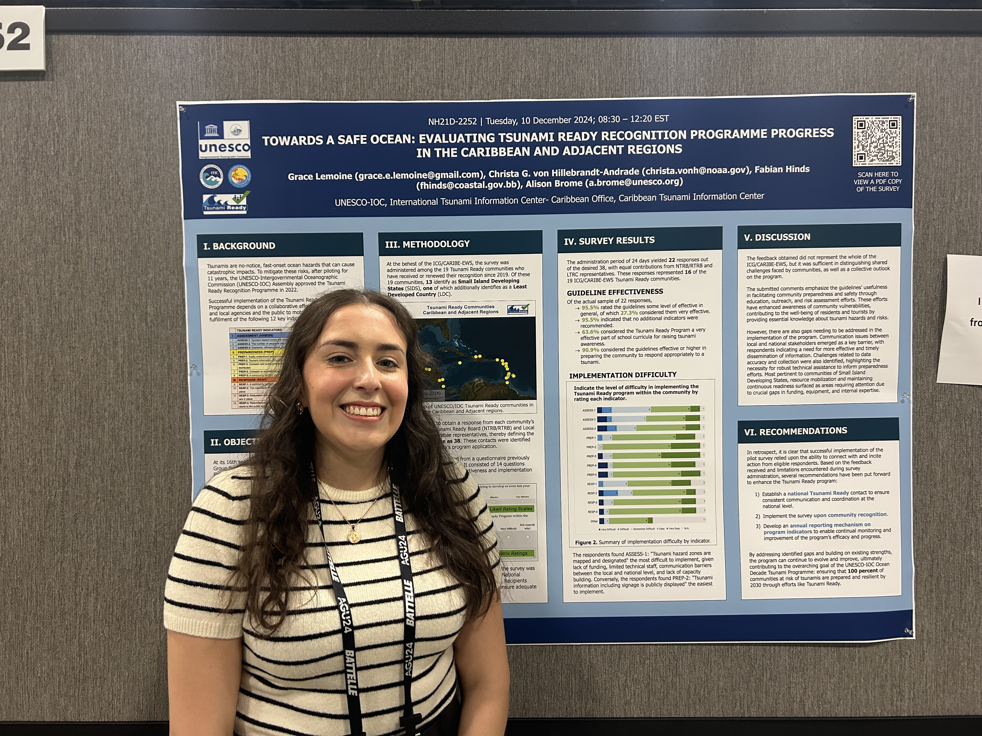
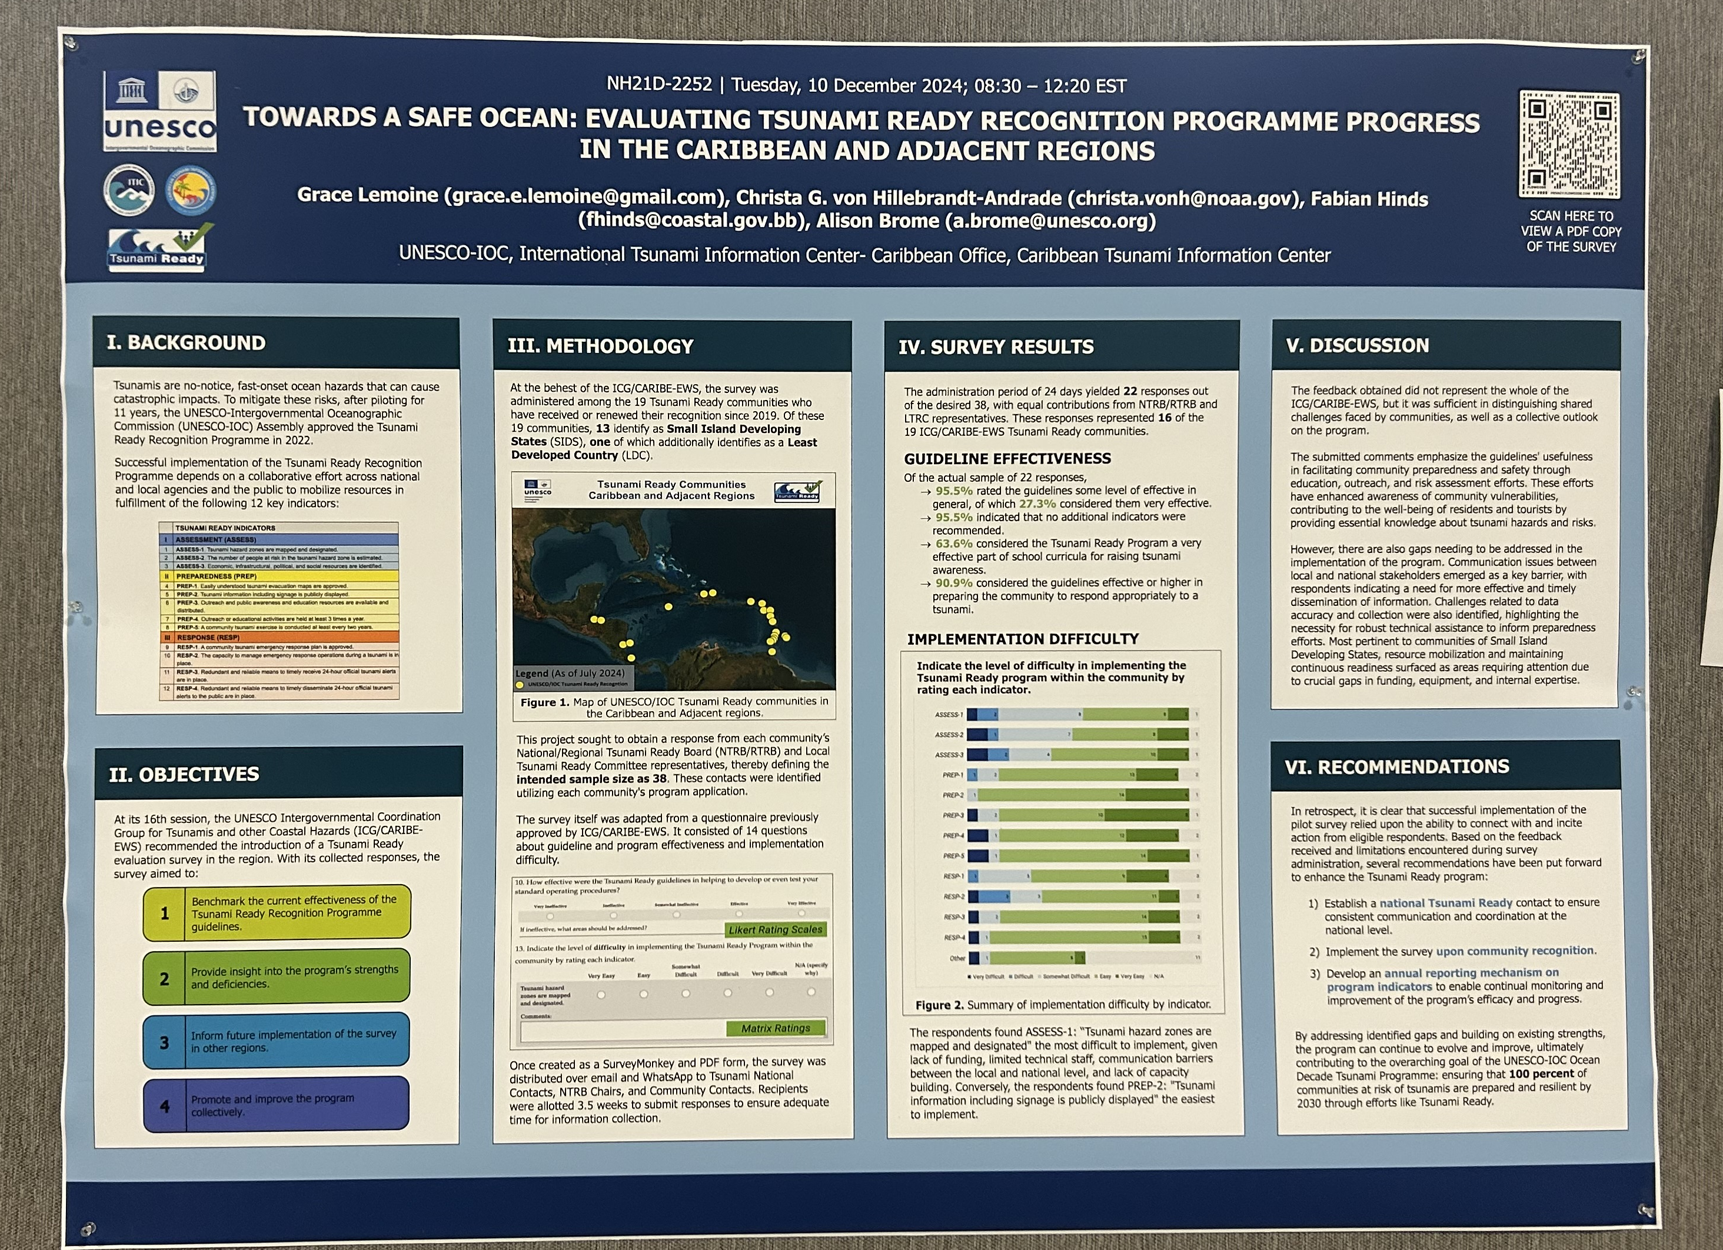


Summary
Ms. Grace Lemoine presented results of the Survey at the American Geophysical Union Meeting in December 2024
Grace Lemoine
gracelemoine@gwu.edu
Page 8

