Slide 1
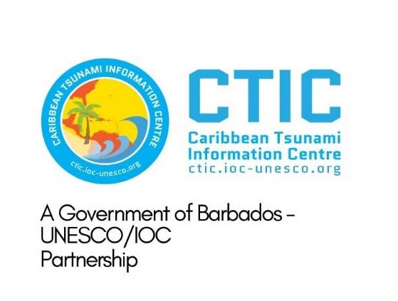





ICG/CARIBE-EWS XVIII
3.10 CARIBE WAVE 2025
Summary
Antonio Aguilar
CARIBE WAVE Vice Chair, FUNVISIS, Venezuela
Gisela Báez-Sánchez
CARIBE WAVE Vice Chair, Puerto Rico Seismic Network, USA
Supported by:
Christa G. von Hillebrandt-Andrade
Manager, ITIC Caribbean Office
ICG CARIBE EWS WG III Chair
Kimberly Maisonet Gonzalez
Student Contractor
ITIC Caribbean Office
May 2, 2024

Slide 2
Objectives
Summary of CARIBE WAVE 25
Survey results
Hotwash and recommendations

Slide 3
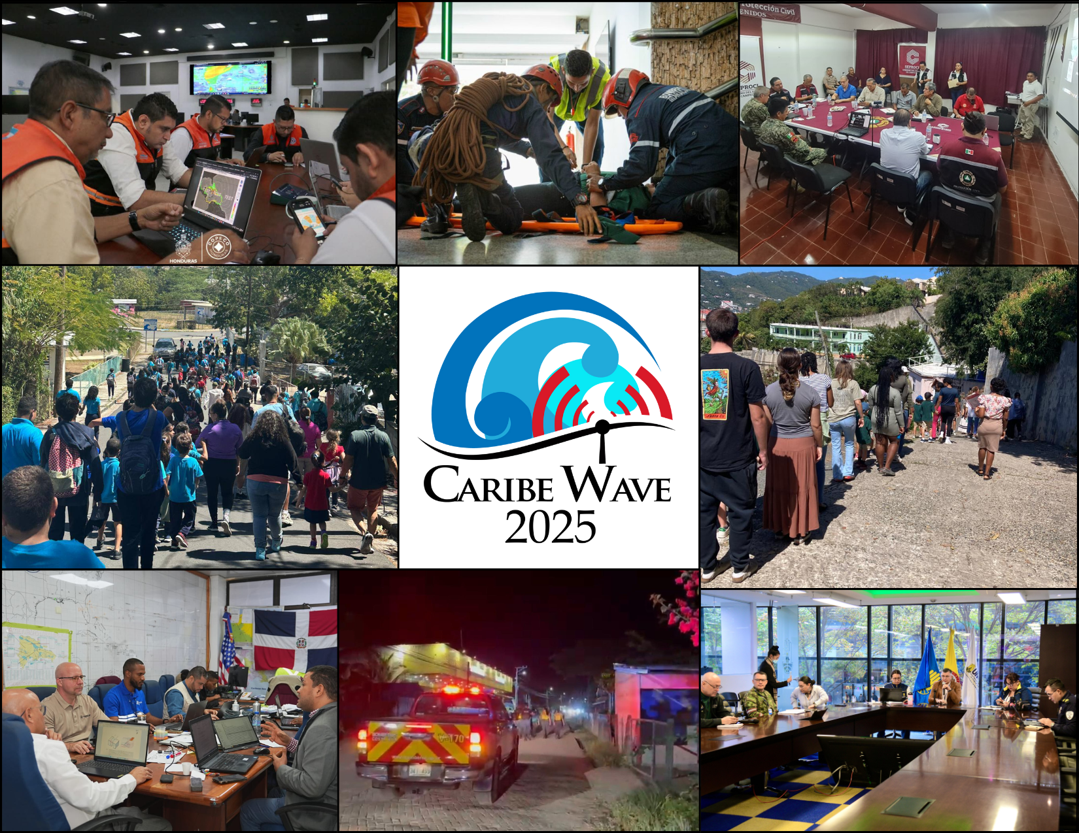
CARIBE WAVE 2025
CARIBE WAVE 25 was held on March 20, 2025.
Member States and Territories chose from the two scenarios (Jamaica and Portugal) and decided if any additional activity would be carried out.
In the Caribbean and Adjacent Regions, 45 Member States and Territories participated with a total of over 510,360 people engaged (94% participation of MS and territories).
b
From left to right, top to bottom, is Honduras, Venezuela, Mexico, Puerto Rico, British Virgin Islands, Dominican Republic, Costa Rica, and Colombia.
a
#CARIBEWAVE #TSUNAMIREADY

Slide 4
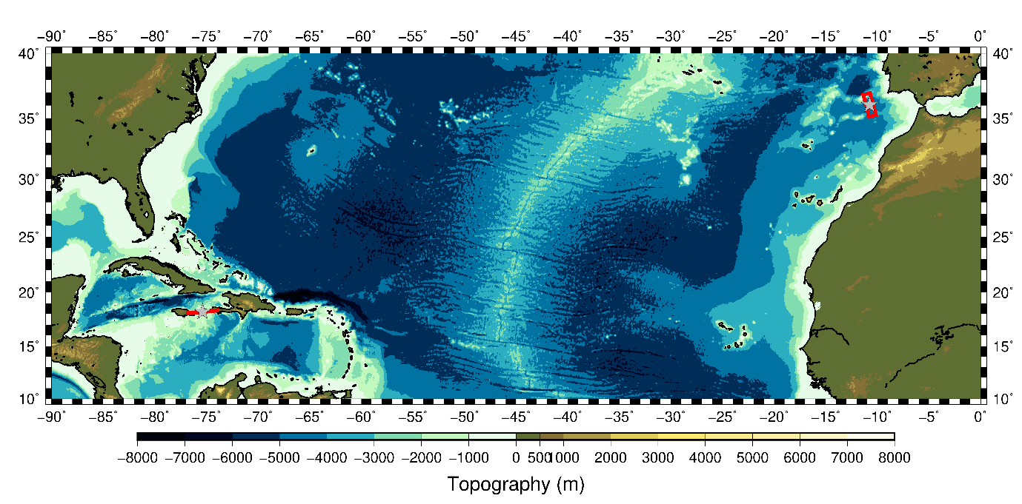
CARIBE WAVE 25
Earthquake and Tsunami Scenarios
Portugal
Jamaica
Scenario | Origin Time | Mw | Epicenter
Jamaica | 15:00:00 UTC 20 March 2025 | 8.0 | 18.203ºN, 75.376ºW
Portugal |  | 8.6 | 36.0ºN, 10.7ºW

Slide 5
Timeline
ACTION | DUE DATE
Handbook Draft Circulated among ICG CARIBE-EWS CARIBE WAVE 25 Task Team | November 2024
Deadline for Comments | November 2024
Circular Letter Issued by IOC to MS | December 2024
Exercise Handbook Available Online | December 2024
First Webinar CW | 21 January 2025 – English 22 January 2025 – Spanish 23 January 2025 – French
Second Webinar CW | 25 February 2025 – English 26 February 2025 – Spanish 27 February 2025 – French
Countries Indicate Selected Scenario (extended) | 13 March 2025
Exercise | 20 March 2025
Hot-Wash | 1 April 2025
Exercise Evaluation Due (extended) | 23 April 2025
Draft CARIBE WAVE 25 Report (extended) | 30 April 2025

Slide 6
Goals / Metrics
Goals | 2016 Results | 2017 Results | 2018 Results | 2019 Results | 2020 Results | 2021 Results | 2022 Results | 2023 Results | 2024 Results | 2025 Metrics | 2025 Results
TWFP receive the dummy message | 84% | 95% | 100% | 89% | 97% | 97% | 91% | 97% | 100% | 100% | 100%
Participation of Member States of the ICG/CARIBE-EWS with designated focal warning point | 100% | 100% | 97% | 100% | 92% | 98% | 100% | 94% | 96% | 100% | 93%
Community involvement (including agencies beyond TWFP) | 73% | 82% | 77% | 66% | 38% | 56% | 43% | 41% | 76% | 95% | 81%
Number of participants* | 332,812 | 679,985 | 643,403 | 793,353 | 4,622 | 333,518 | 413,281 | 422,913 | 470,423 | +10% | 510,360
Countries who participate submit exercise questionnaire | 100% | 100% | 91% | 82% | 92% | 95% | 100% | 93% | 80% | 100% | 93%
Members State and Territories are satisfied with exercise |  |  |  | 82% | 76% | 96% | 88% | 97% | 100% | 100% | 86%
*As reported by Member States and Territories in survey

Slide 7
Participation
*Number taken from TsunamiZone.org for cases where countries did not report number of participants in the survey.
Country |  | Participants according to Member States | Participants according to Tsunami Zone
Antigua and Barbuda |  | 7,000 | 5
Aruba |  | 27,000 | 27,890
Bahamas |  | 0* | 0
Barbados |  | 400 | 502
Belize |  | 3 | 8
Brazil |  | 9 | 10
Colombia |  | 162 | 882
Costa Rica |  | 25 | 86
Cuba |  | 300 | 2
Curacao |  | 144* | 144
Dominica |  | 4* | 4
Dominican Republic |  | 1,132 | 1,132
France |  | 107,328 | 107,328
Grenada |  | 8,893* | 8,893
Guatemala |  | 25 | 63
Guyana |  | 10 | 10
Haiti |  | 522 | 522
Honduras |  | 400 | 203
Jamaica |  | 1,289 | 1,289
Mexico |  | 850 | 1,073
Country |  | Participants according to Member States | Participants according to Tsunami Zone
Netherlands (Bonaire, Saba, Sint Eustatius, other) |  | 39 | 39
Nicaragua |  | 440 | 440
Panama |  | 6 | 1,028
Saint Kitts and Nevis |  | 7,202* | 7,202
Saint Lucia |  | 1,403* | 1,403
Saint Vincent and the Grenadines |  | 25 | 100
Sint Maarten |  | 22 | 12
Suriname |  | 0* | 0
Trinidad and Tobago |  | 294* | 294
United Kingdom | Anguilla | 45 | 45
 | Bermuda | 326 | 326
 | British Virgin Islands | 6,855 | 5,115
 | Cayman Islands | 11,501 | 11,501
 | Montserrat | 0* | 0
 | Turks and Caicos | 375* | 375
United States | Puerto Rico | 172,141 | 172,141
 | US Virgin Island | 18,144 | 18,144
Venezuela |  | 136,046 | 130,902
TOTAL |  | 510,360 | 499,113

Slide 8
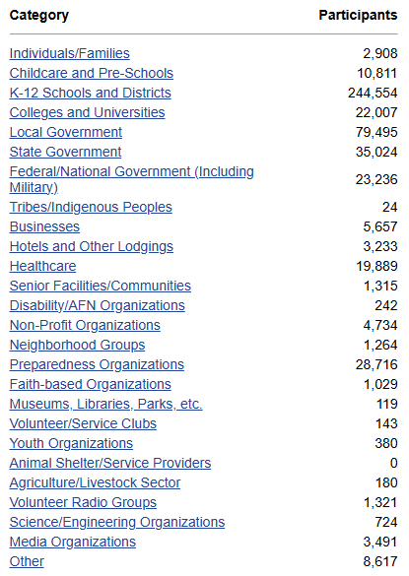
TsunamiZone Participation Categories

Slide 9
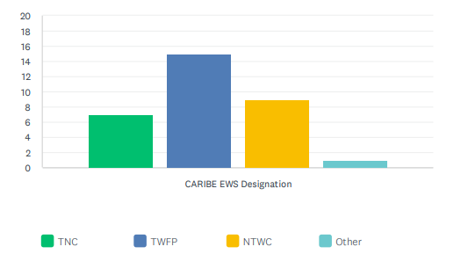
Evaluation Form
The questionnaire contained 40 questions for participating countries to provide feedback on the exercise.
Original deadline was Deadline was April 4, then extended until April 23.
Responses from 91% of participating MS and territories (32 surveys total): Antigua and Barbuda, Aruba Barbados, Belize, Brazil, Colombia, Costa Rica, Cuba, Dominica, Dominican Republic, France (Guadeloupe, Martinique, Saint Martin, St. Barthelemy), Grenada, Guatemala, Guyana, Haiti, Honduras, Jamaica, Mexico, Netherlands (Bonaire, Saba, Sint Eustatius), Nicaragua, Panama, Saint Kitts and Nevis, Saint Vincent and the Grenadines, Sint Maarten, Trinidad and Tobago, United Kingdom (Anguilla, Bermuda, British Virgin Islands, Cayman Islands), United States (Puerto Rico, U.S. Virgin Islands), and Venezuela).

Slide 10
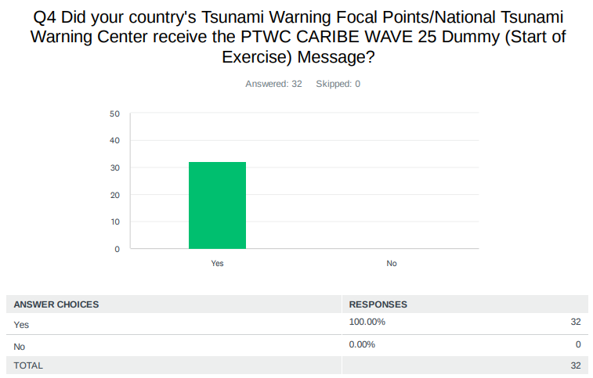
Evaluation Form – Dummy Message
The PTWC issued the “dummy” (start of exercise) message on March 20, 2025, at 1500 UTC and disseminated over all its standard broadcast channels.

Slide 11
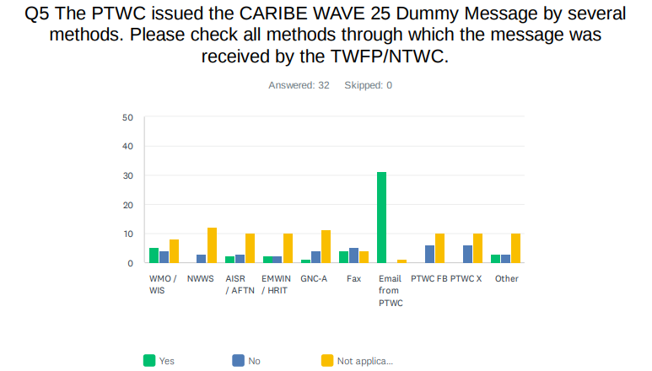
Evaluation Form – Dummy Message
As in past years, the most common method to receive the Dummy message was the Email. Fax saw a decrease in use for this exercise.

Slide 12
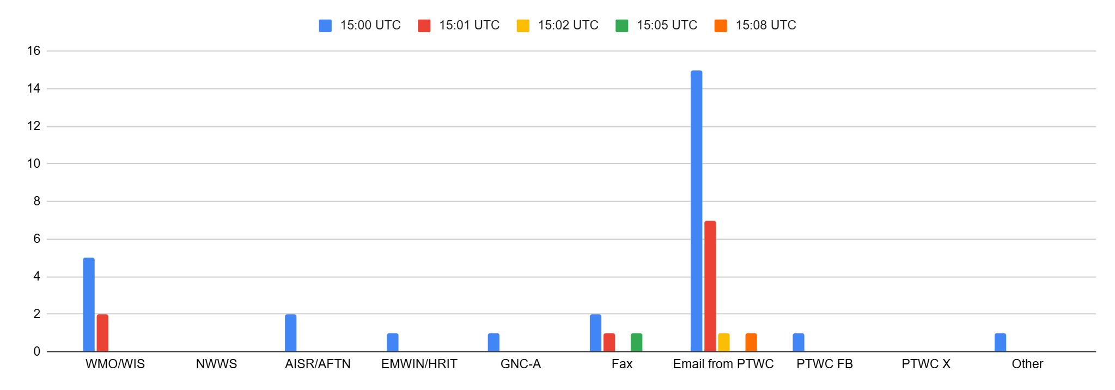
Evaluation Form – Dummy Message
The time at which the PTWC message was received by the TWFP/NTWC in the different systems.
The majority stated that they received the dummy message aat 1500 UTC with few reported delays.
It is crucial to seek other communication systems to avoid messages delays.

Slide 13
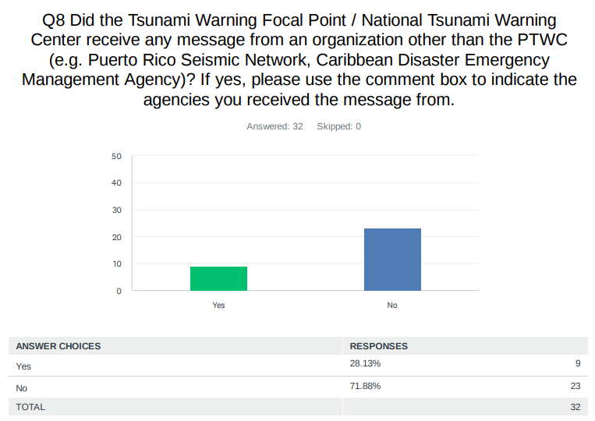
Evaluation Form - Dummy Message
Costa Rica: CATAC
Dominican Republic: Puerto Rico Seismic Network.
Guatemala: We received a message from the "Central American Tsunami Advisory Center (CATAC)"
Honduras: Yes, we received exercise start messages from the Central America Tsunami Advisory Center (CATAC)
Panama: from CATAC - Central America Tsunami Advice Centre
St. Kitts and Nevis: We only receive messages from the PTWC.
UK - British Virgin Islands: The Puerto Rico Seismic Network called the TWFP and TNC
USA - Puerto Rico: PREMB and NWS-SJ received messages from PRSN.
USA - US Virgin Islands: Puerto Rico Seismic Network
Venezuela: The Venezuelan Seismological Service sent notice

Slide 14
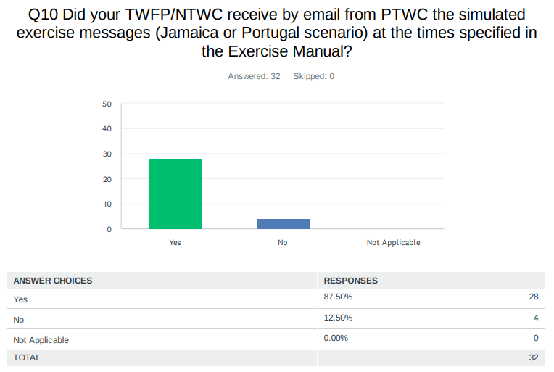
Evaluation Form - Threat Messages
Colombia: Message 1 was received at 15:08 UTC, message 3 was received at 16:02 UTC
Dominican Republic: No, we only receive the simulate for Portugal exercise
France: The French NTWC correctly and timely received the emails. The French TWFP did not received the emails timely: they arrived two days after the exercise (they were blocked in mta6.iscinternational.com server before delivery the 22nd of March.
Guyana: However, I must note that the messages were not sent to Guyana. I had to inform Christa von Hillebrandt-Andrade, ITIC-CAR Manager (christa.vonh@noaa.gov) about this issue and then she forwarded the messages to us. After 1600 UTC we began to receive the messages via email from PTWC
UK - Cayman Islands: Time difference of 1-2 minutes from times listed in exercise manual

Slide 15
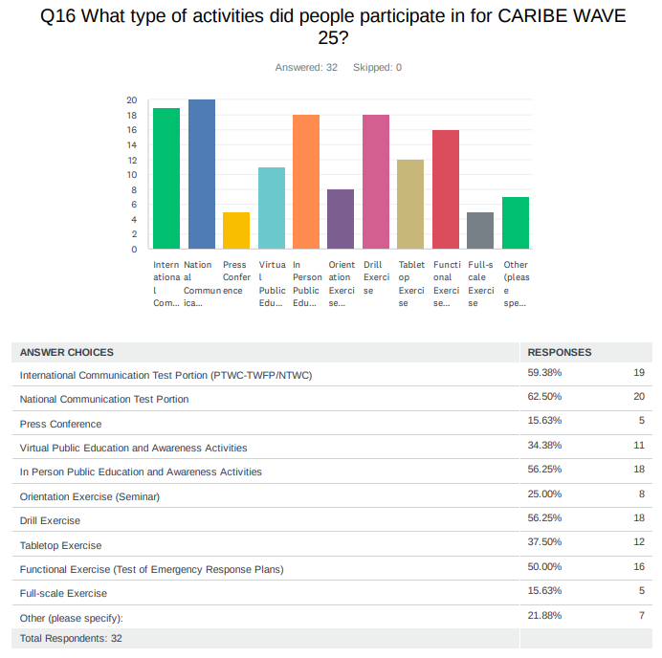
Evaluation Form – Type of Participation

Slide 16
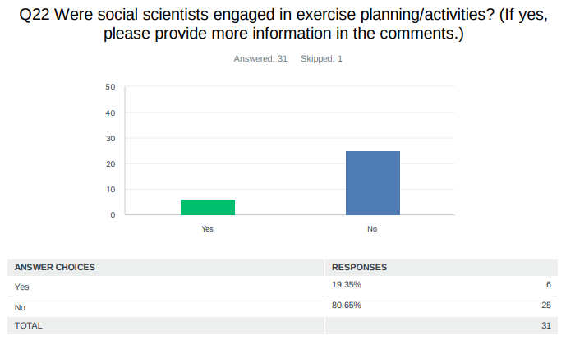
Evaluation Form – Social Scientists Engagement
Dominican Republic: Lic. Ramon Delanoy director of the National Center of Seismology of the UASD, a representative of the National Geological Service.
Costa Rica: Evaluation
Jamaica: Officers of the Social Development Commission were involved in selected targeted communities
Venezuela: since the domain exercised by natural and basic sciences on the problem of disasters in the Latin American subcontinent is almost total. The study of seismic and climatological patterns, terrestrial dynamics, etc., places a notorious emphasis on prediction problems and on the adaptation of structures to the physical parameters of natural events that threaten society. But society does not appear in the formula, neither as an object of study, nor as an object of action and change in terms of its patterns of behavior and incidence in the realization of disaster situations. We have two social scientists who have participated as observers in the exercise and have made important reflections that indicate the importance of incorporating the social issue into the Caribe Wave exercise. Researchers gave workshops and seminars on the Caribe Wave 24 exercise, material for Civil Protection and Disaster Management was sent locally and regionally

Slide 17
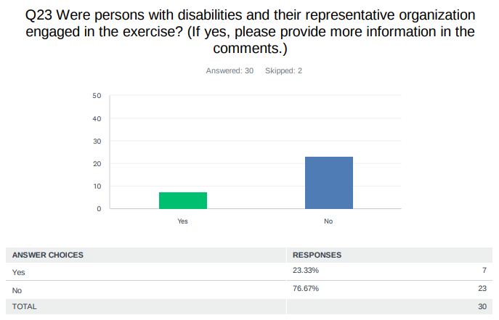
Evaluation Form – People with Disability
Antigua and Barbuda: The Care Project was part of the exercise as a disability center for young children.
Barbados: Patients from the St. Lucy District Hospital were evacuated. More information can be acquired from the Department of Emergency Management.
France: Probably among all the participants, but not specifically targeted
Jamaica: Jamaica Council for Persons with Disabilities participated on March 20 in the Functional Exercise and the Communications test at the National Level. Other entities were engaged but did not participate in the functional but were incorporated into the communication tests
Mexico: We do not know for sure, but probably yes.
St. Kitts and Nevis: They were tested in a previous exercise.
UK - British Virgin Islands: The school registered for participation
UK - Cayman Islands: One of the schools HMCI attended as observers was Lighthouse School which is a school for students with special needs. Some preparation practices were altered for their needs.
Venezuela: People with visual impairments gave workshops on the Caribe Wave exercise

Slide 18
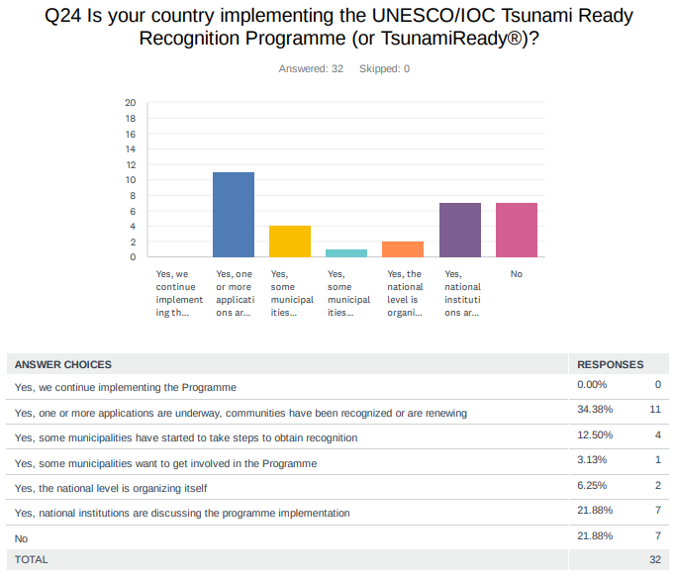
Evaluation Form – Tsunami Ready
The results for the status of the implementation of the UNESCO/IOC Tsunami Ready Recognition Programme indicated that 81% are already implementing the program, while 71% interest for those who have not yet implemented it with 244 as total number of target communities to be recognized as Tsunami Ready.

Slide 19
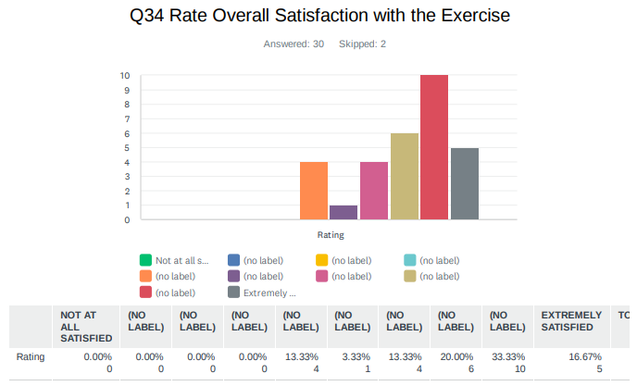
Evaluation Form – Exercise Satisfaction
Dominican Republic: The exercise was well organized, the handbook was clear and specific
Trinidad and Tobago: We need to have a more efficient method other than calling the NTWC on the phone for confirming receipt when we pass on the tsunami messages. Solutions like MissionMode would be a more efficient way to communicate emergency advisories but we lack the funding for such software.
Venezuela: It was very good, because we had to think about a regional tsunami, and educate our new authorities and new staff.

Slide 20
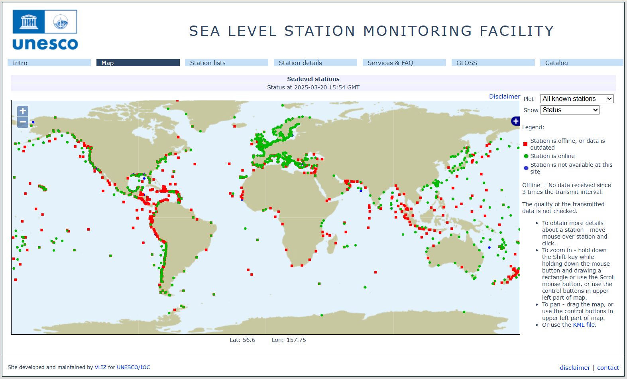
Status of Sea Level Stations during the exercise
Western Muertos Trough scenario
Northern Panama scenario
The PTWC provided simulated forecasted maximum wave heights for 165 CARIBE EWS stations in the simulated bulletins.
Only about 64% of these sea level stations were online on the IOC Sea Level facility during the exercise period.

Slide 21
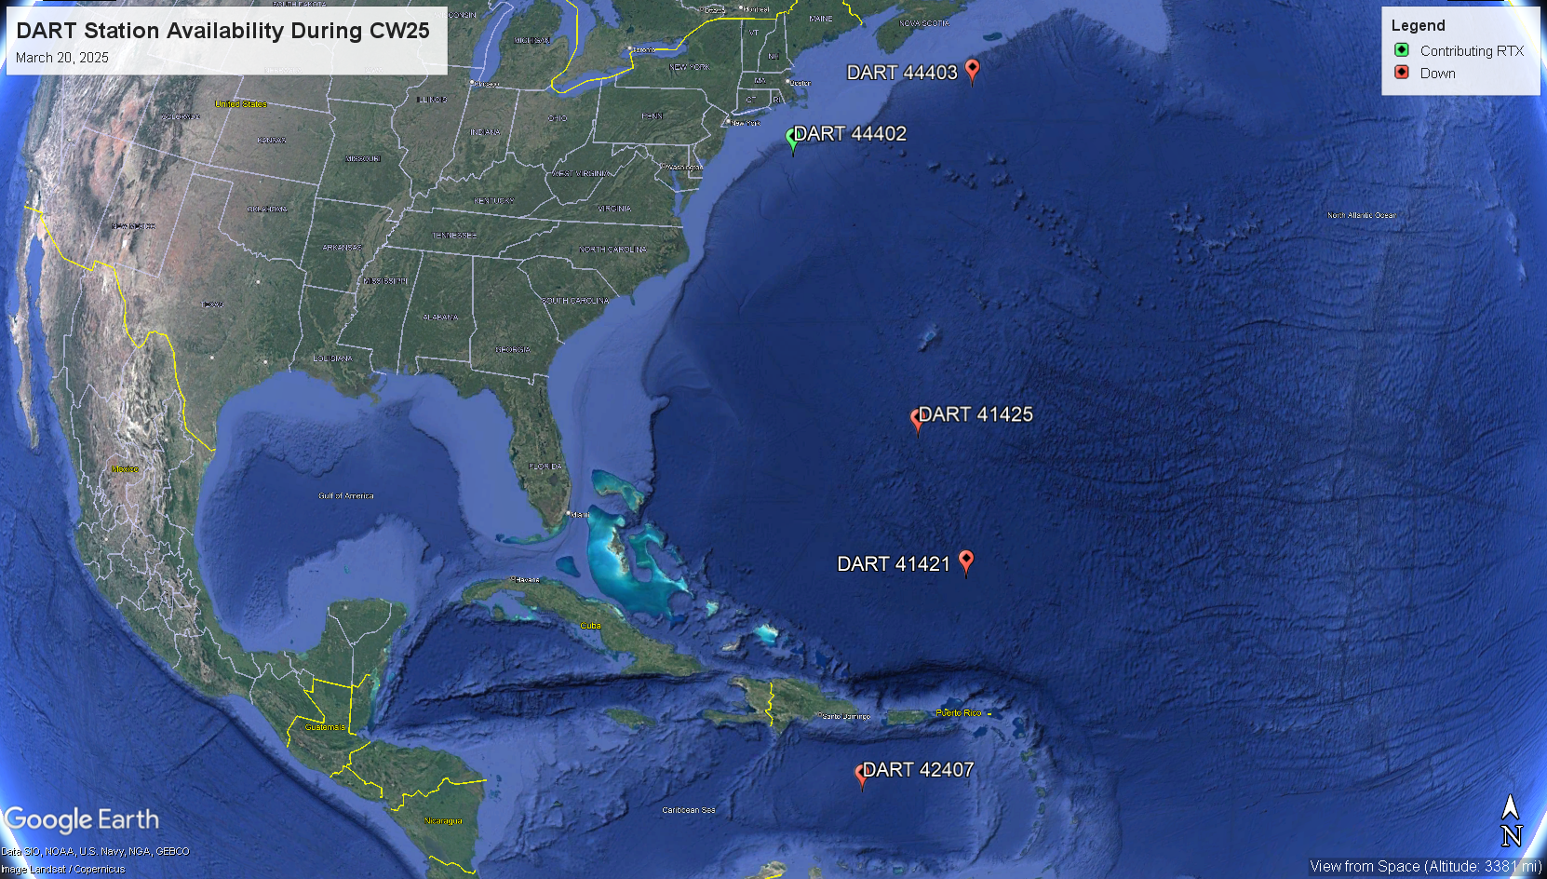
Status of DART’s
1 DART station was streaming data in the Caribbean and Atlantic through the National Buoy Center during the day of the exercise.

Slide 22
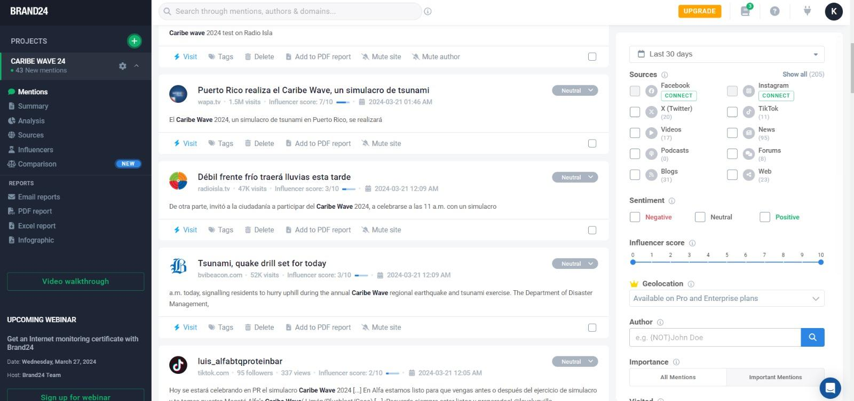
Media Arrangements
There were difficulties obtaining exact metrics with the hashtag tracker Brand24 due to changes in Instagram and Facebook's terms and conditions.
However, it was noted that there was less social media presence than previous exercises, but the presence was still relatively large.
The CARIBE WAVE 24 Media Report includes an overview of different countries’ publications on their exercises.

Slide 23
CARIBE WAVE 25 Task Team
Person | Phone # | Email
Antonio Aguilar CARIBE WAVE Vice Chair, FUNVISIS, Venezuela | +58 4168009876 | antoniodesastres@gmail.com
Gisela Báez-Sánchez CARIBE WAVE Vice Chair, Puerto Rico Seismic Network, USA | 1-787-833-8433 | gisela.baez1@upr.edu
Gerard Metayer, CARIBE EWS Chair, Service Maritime et de Navigation Haiti | 509-48 93 7805 | gerard_metayer@yahoo.fr
Frederic Dondin Chair WG 1 Risk Knowledge | 1868 6624659 | fredericdondin@gmail.com
Elizabeth Vanacore, PRSN Chair WG 2 Tsunami Detection, Analysis and Forecasting | 1-787-833-8433 | elizabeth.vanacore@upr.edu
Christa von Hillebrandt-Andrade; Chair WG 3 Tsunami Warning Dissemination and Communication, Deputy Director/ITIC-CAR | 1-787-249-8307 | christa.vonh@noaa.gov
Silvia Chacón-Barrantes Chair WG 4 Preparedness, Readiness and Resilience | 506-830-96690 | silviach@una.ac.cr
Alberto López; Ivan Wong; Matt Hornbach ; Richard D Koehler Scientific Experts – Jamaica Scenario | 1-787-833-8433 | alberto.lopez3@upr.edu ; wong@lettisci.com mhornback@smu.edu ; rkoehler@unr.edu
Maria Ana Viana Baptista Scientific Expert – Portugal Scenario |  | mavbaptista@gmail.com
Elizabeth Riley Director CDEMA | 246-434-4880 | elizabeth.riley@cdema.org
Claudia Herrera Melgar Executive Secretary CEPREDENAC | 502-2390-0200 | iajche@cepredenac.org memendez@cepredenac.org
Lt. Colonel Daniel Polinacci Chief EMIZ Antilles | 596-596-393-937 | daniel.polinacci@martinique.pref.gouv.fr
Charles McCreery, PTWC | 1-808-689-8207 | charles.mccreery@noaa.gov
Wilfried Strauch CATAC |  | wilfried.strauch@yahoo.com
David Wald, USGS; Kristin Marano Scientific Experts – Earthquake Impact Products | 1-303-273-8441 303-273-8602 | wald@usgs.gov kmarano@usgs.gov
Ocal Necmioglu Technical Secretary CARIBE EWS | 33-1-45683980 | o.necmioglu@unesco.org
Alison Brome Director CTIC | 246-243-7626 | a.brome@unesco.org
Matthieu Pèroche Chair of Tsunami Ready Task Team |  | mathieu.peroche@gmail.com

Slide 24
Hot-Wash
After the exercise, the CARIBE WAVE 25 Task Team organized a post-exercise “hot-wash” webinar to permit Member States and Territories discuss and provide feedback on the exercise in an open forum on April 1, 2025.
Some of the feedback was on the successful reception of the messages. It was stated that the February 8 event may have motivated greater participation in the exercise; it was also helpful for training authorities to separate the general guidelines and the 2025 handbook.
Future CARIBE WAVE exercise scenarios were discussed during the webinar with preference for nonseismic (possibly volcanic) scenarios. It is suggested to use Kick ‘em Jenny submarine volcano, as well as an earthquake scenario.

Slide 25
Decision and Recommendations:
The Intergovernmental Coordination Group for the Tsunami and Other Coastal Hazards Warning System for the Caribbean and Adjacent Regions (ICG/CARIBE-EWS),
Notes the CARIBE WAVE 25 draft final, media, supplement reports and presentation,
Further notes the successful conduct of the CARIBE WAVE 25 Exercise with the participation of 93% of the Member States and half a million participants,
Additionally notes with satisfaction that the new CARIBE WAVE website hosted by UNESCO-IOC and that the handbook was divided in two: General Guidelines and the CW 25 Participants Handbook highlighting the scenarios, timeline and simulated products.
Congratulates all the Member States who promoted, participated, and provided feedback on the CARIBE WAVE 25 exercise.

Slide 26
Recommendation ICG/CARIBE-EWS-XVII._ (CONT)
Notes 91% of the Member States provided the feedback which is essential for assessing the functionality including warning, response and preparedness capabilities of CARIBE EWS and future actions,
Urges Member States to complete survey evaluations in a timely manner,
Acknowledges again the good collaboration between the CARIBE WAVE Task Team, CTIC and ITIC-CAR in planning, promoting, executing, and evaluating the annual CARIBE WAVE Exercises.
Appreciates the International Tsunami Information Centre Caribbean Office (ITIC-CAR) for their support in generating the handbooks, reports and overall coordination and the Pacific Tsunami Warning Center (PTWC) and the Central America Tsunami Advisory Center (CATAC) for providing and disseminating dummy message and simulated products for the CARIBE WAVE 25,
Further appreciates the United States Geological Survey (USGS) for their continued support in generating simulated ShakeMap and PAGER products for the Jamaica scenario of CARIBE WAVE 25,

Slide 27
Resources available at caribewave.org
Manual and Guides 86: Multi-Annual Community Tsunami Exercise Programme Guidelines for the Tsunami and Other Coastal Hazards Warning System for the Caribbean and Adjacent Regions.
PTWC Enhanced Products and Staging for the Caribbean and Pacific, English
IOC Manuals “How to plan, conduct and evaluate tsunami exercises” and “Module on Tsunami Exercise” are useful resources.
CARIBE WAVE 2011 - 2025 Handbook
CARIBE WAVE 2011 - 2024 Final Reports
PTWC Communications Plan and Users Guide for the Caribbean

Slide 28
Questions, Comments
Thank You!
christa.vonh@noaa.gov

