Slide 1
Tsunami Hazard Assessments
Tiered standards:
Gold, Silver, Bronze

Slide 2
PTHA/M: Tiered Hazard Assessments / Models
"Tiered" recommendations on hazard assessments:
inundation mapping should not rely on stochastic assessment - we need ideas for cheaper engineering soln’s: tiered best-practice ideas gold, silver, bronze standards
Recommendation:
Gathering info on model resolution, isobath depth, tools available
Catalogue the sources used in each: Circum-Pacific Source Model
Possible Tsunami Source workshop to include PTHA
Requested an agenda item for April ICG meeting

Slide 3
PTHA/M use case for TsunamiReady (and others)
From the catalog of tsunami sources database
Provide tools to allow easy comparison of impact of a source on a given coastline to aid in choosing a return period/probability
Provides open-ocean/deep-water wave amplitudes offshore
Allow for varying needs from member states:
No high resolution DEM …. or no hydrodynamic modeling support:
Extend PTHA wave amplitudes by extrapolation to the coast
Some high-resolution DEM:
Provide MCE for a given probability to allow modeling
High-res DEM and full hydrodynamic modeling resources:
Full multi-source inundation probabilistic modeling assessment

Slide 4
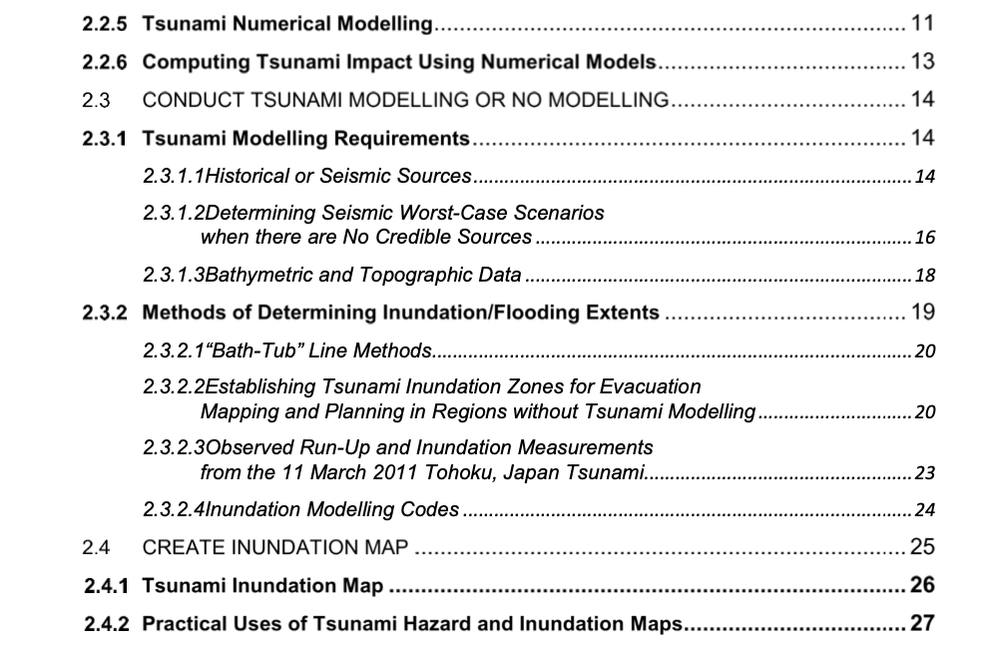
Tier 3: Bronze (poor bathymetry, no modeling)
Previous recommendations included a simple algorithm that involved a runup value and an inundation distance.
Common choices were 30-meters / 1.5 km
Inundation area is chosen as 1.5 km from the coast unless an altitude of 30-meters is attained sooner
Pros: relies only on reasonable topography
Cons: arbitrary values, no accounting for source
Alternate: use known sources, extrapolate offshore values to the coastline
Build on guidance from IOC MG 82
Preparing for Community Tsunami Evacuations: from inundation to evacuation maps, response plans and exercises, Supplement 1: Programme Modules and Specialized Documents. Paris, UNESCO, 2020

Slide 5
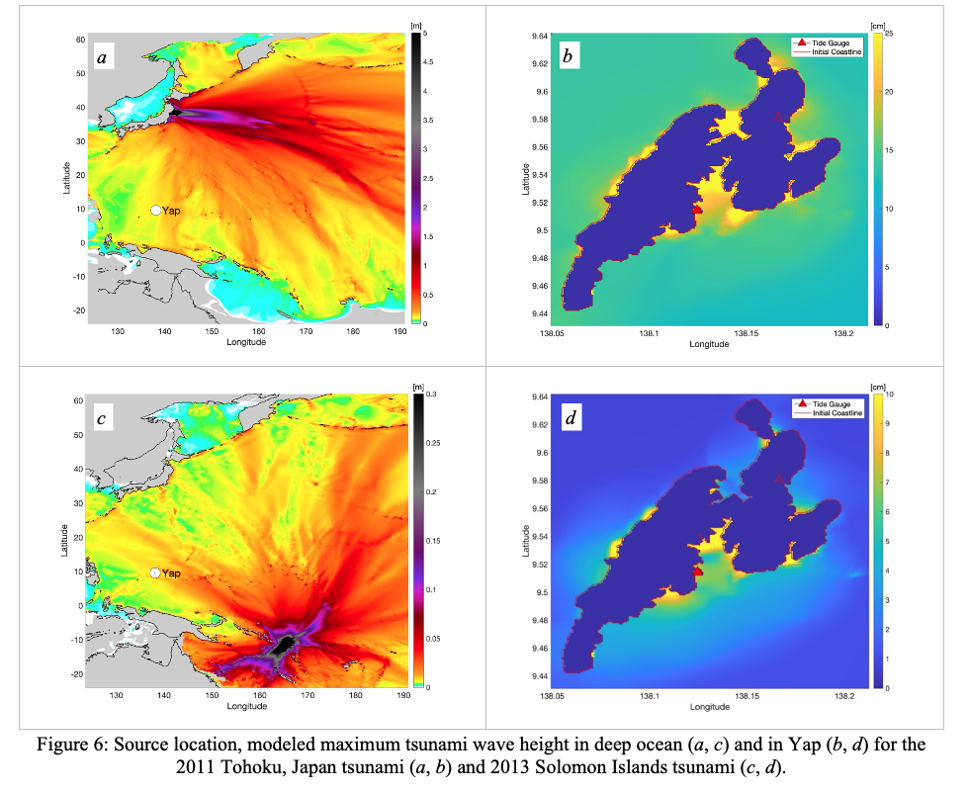
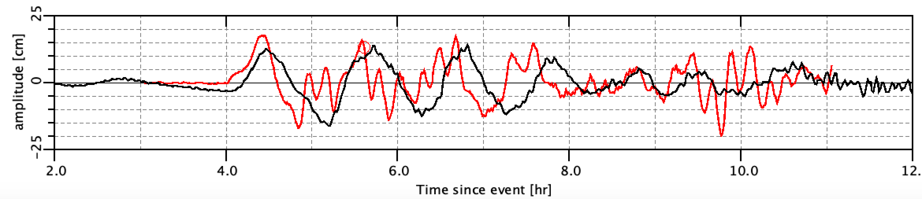
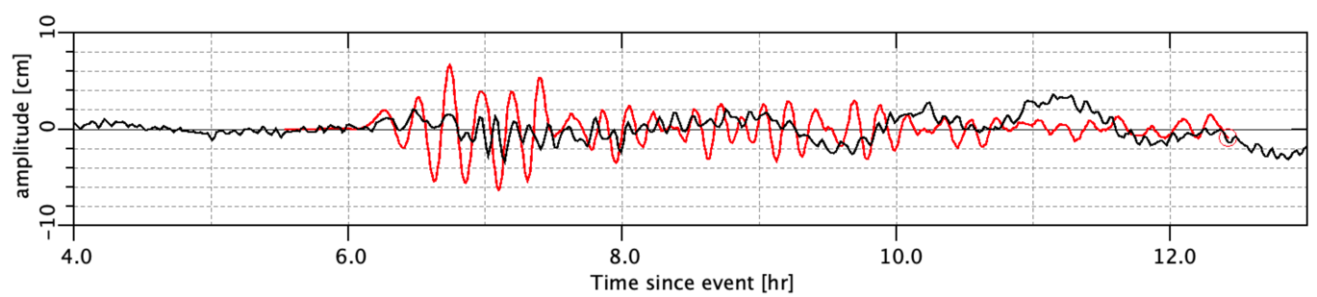
Use case: Yap (FSM)
Tohoku, 2011
Solomon Islands, 2013
From Natalia Sannikova, UW CICOES

Slide 6
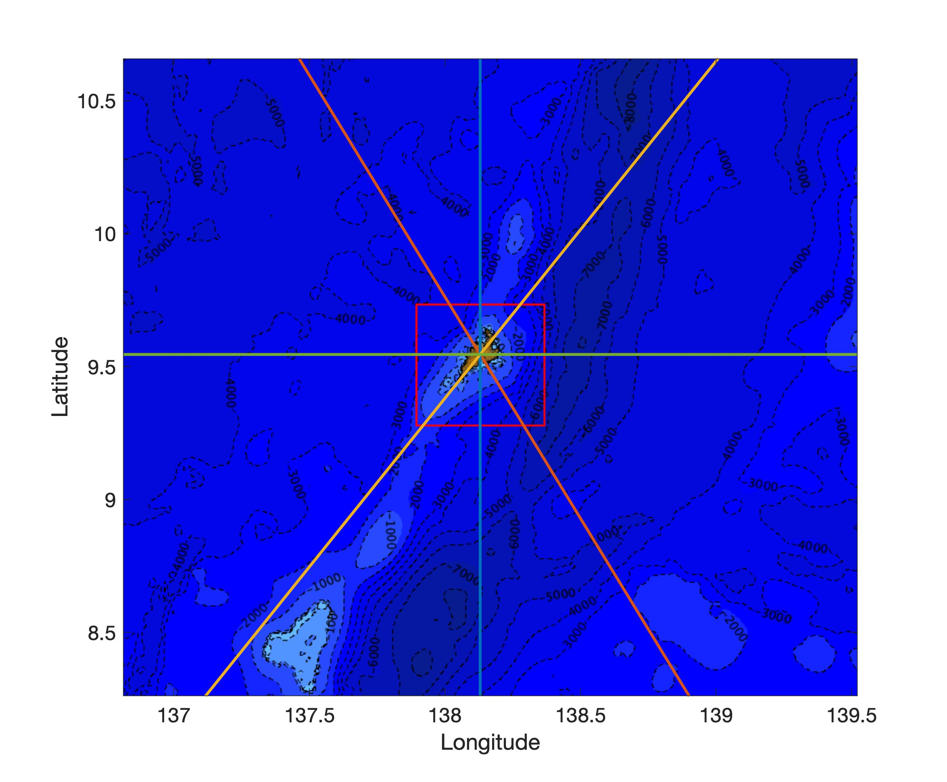
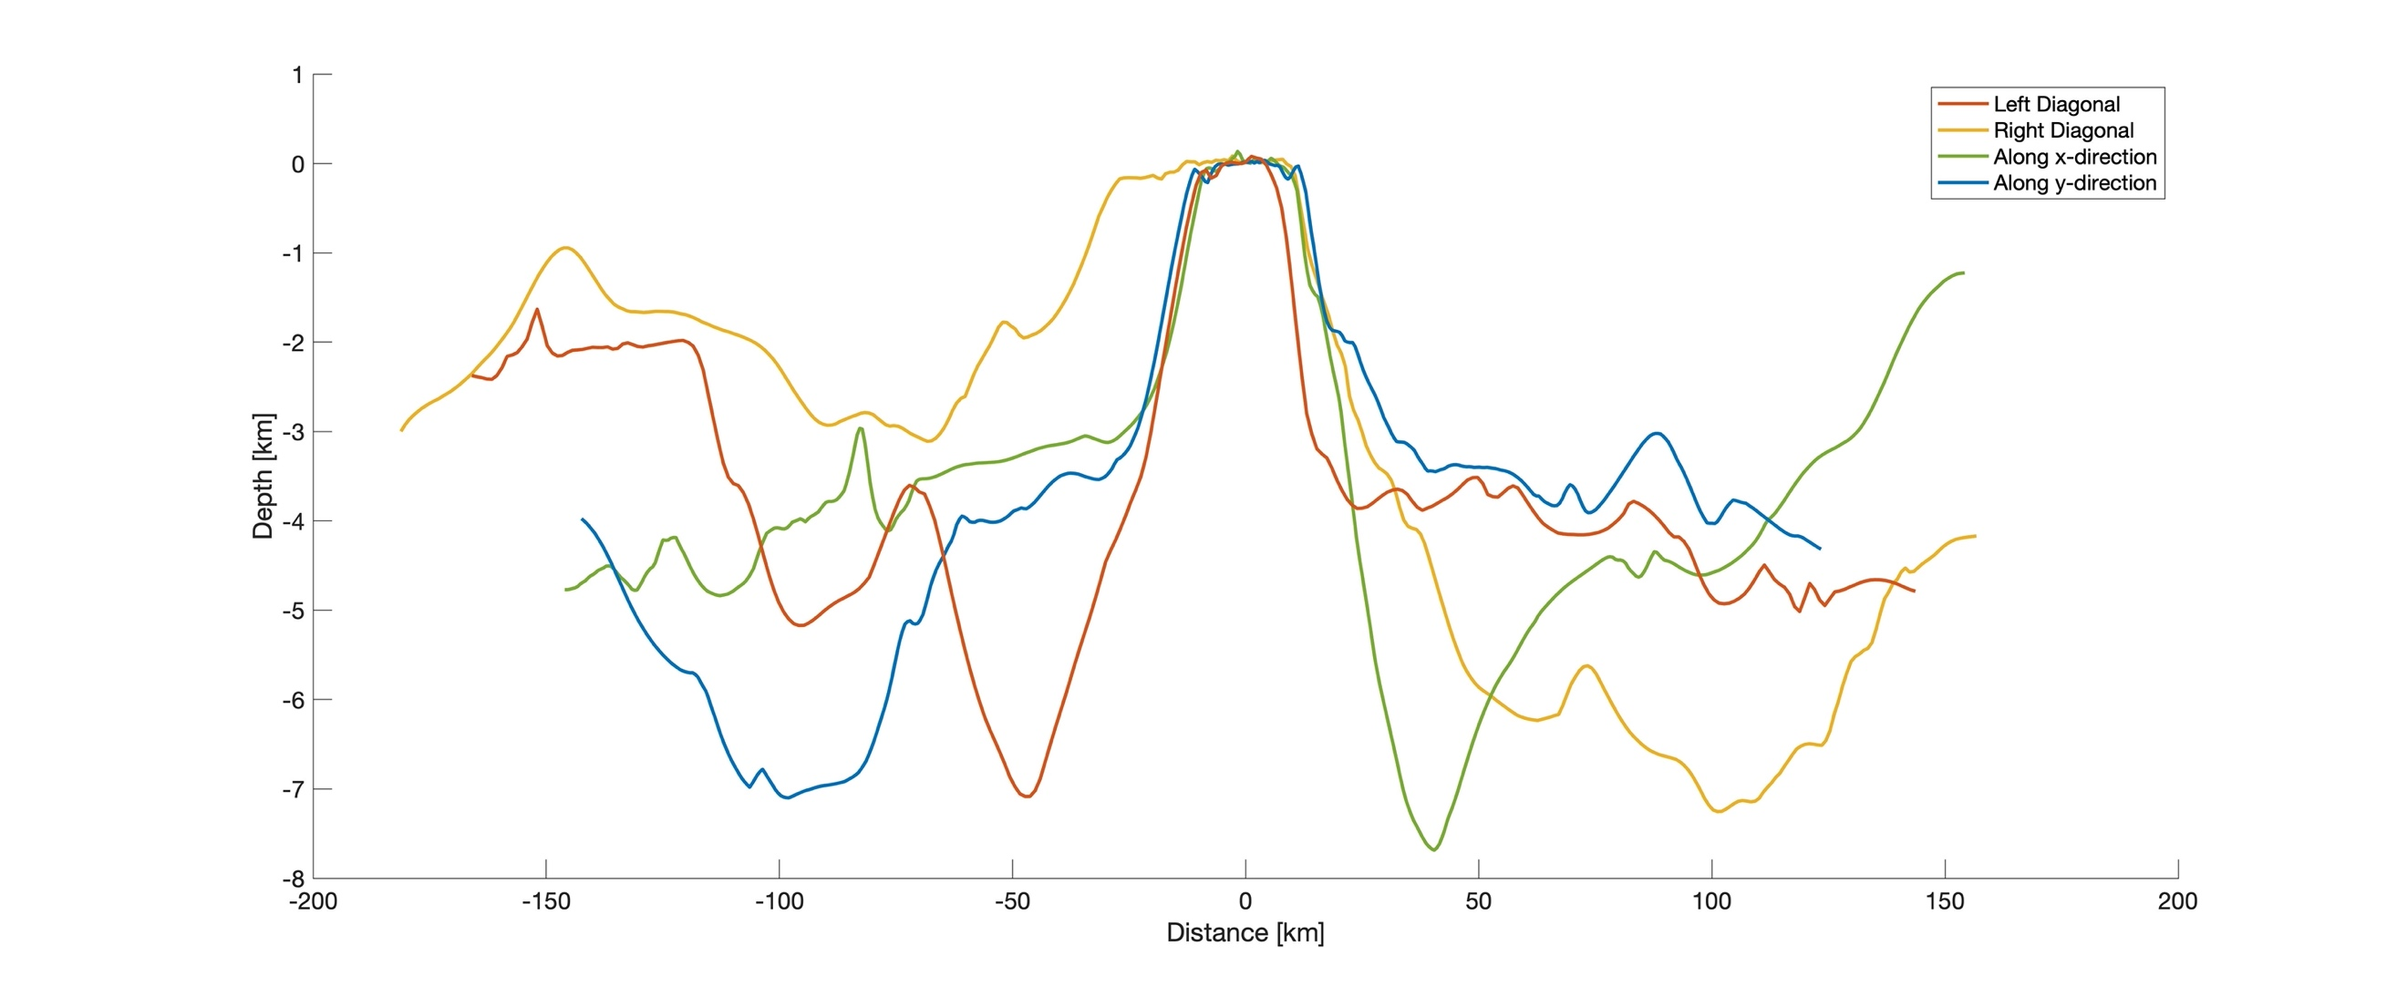
Extrapolation techniques
Green’s Law
Løvholt amplification
(scaling dependant on wave period and bathy profile)

Slide 7
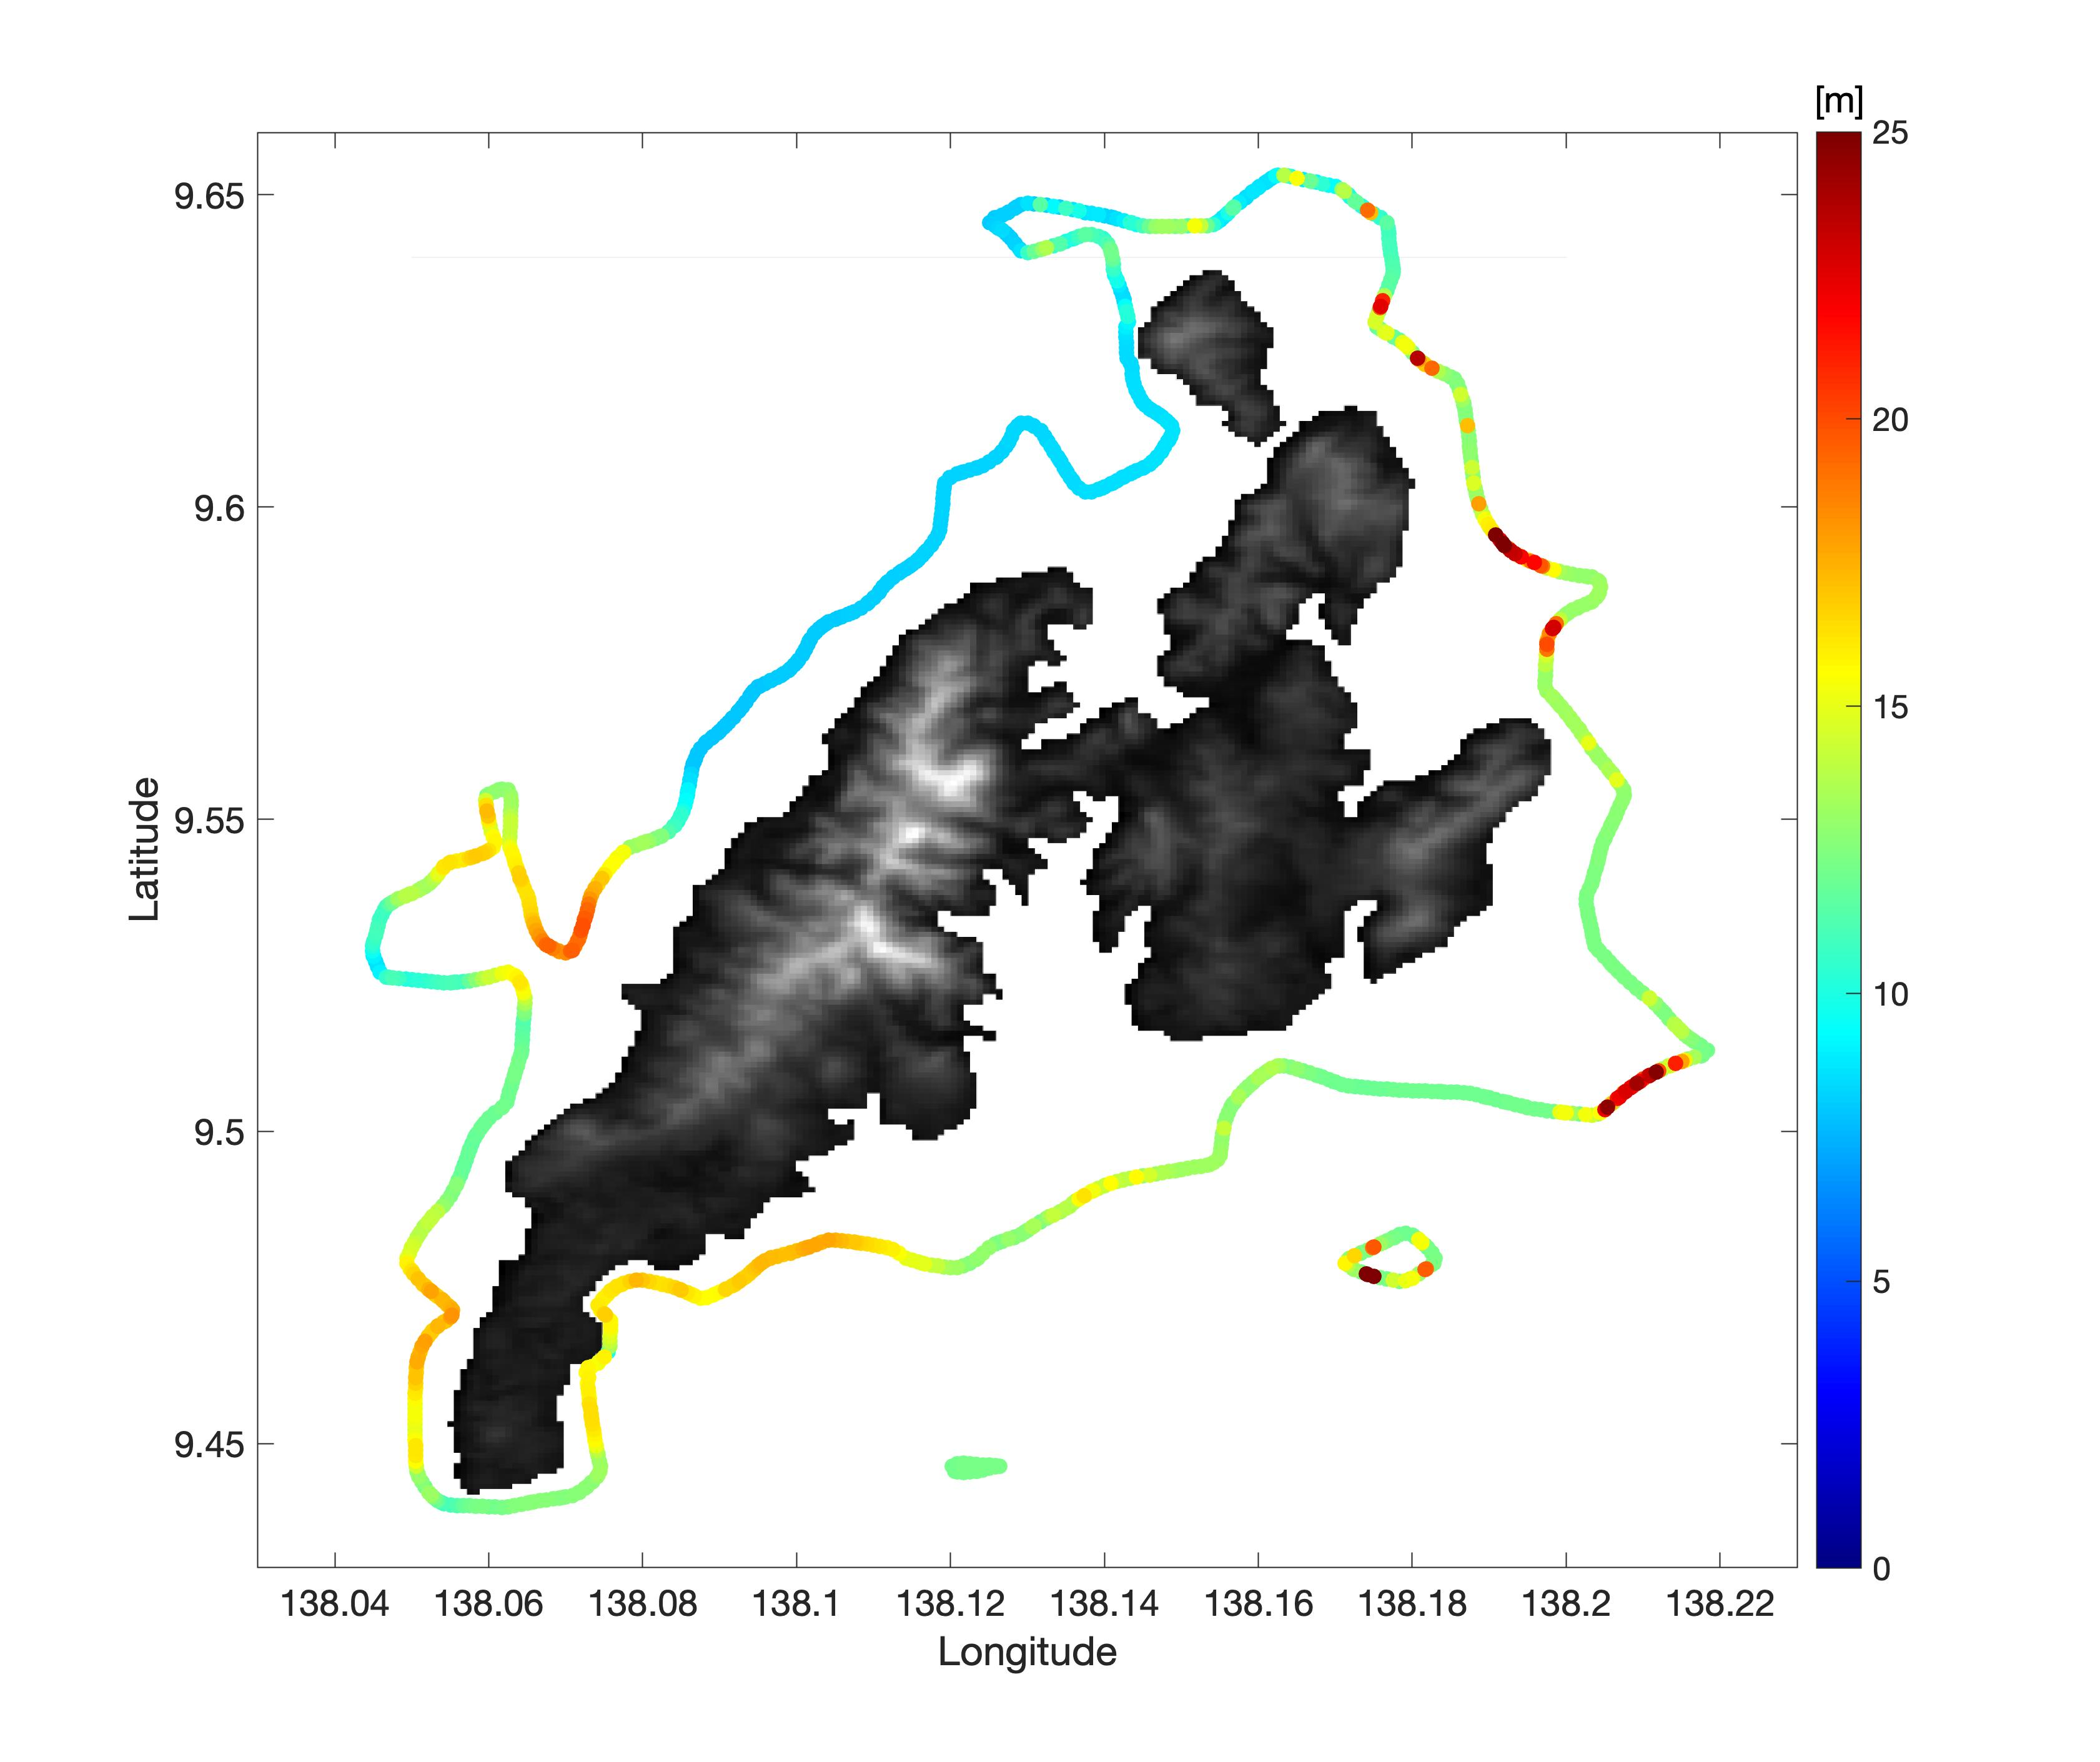
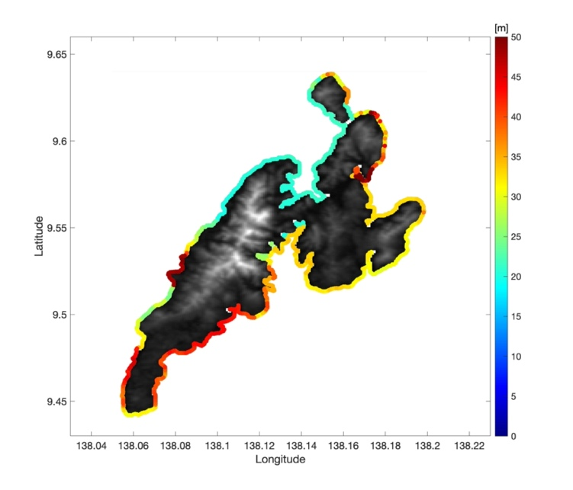
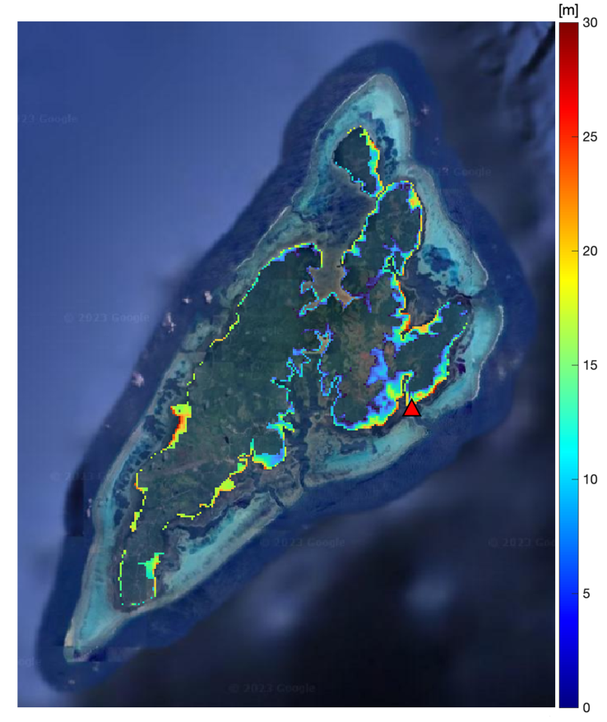
Offshore values to inundation

Slide 8
Recommendations
Request WG1 to explore best practices for a tiered approach to Tsunami Hazard Assessment and provide recommendations to PTWS WG3 and its Task Team on Tsunami Ready for achieving the Tsunami Ready Recognition Programme Hazard Assessment indicator.

