Slide 1
WG2 Task Team on Integrated Sensor Networks Co-Chairs:
Adrienne Moseley
Tim Melbourne
WG2 TT FOO
7 April, 2023
Beijing, China
Presentation given by Bill Fry, WG2 Chair

Slide 2
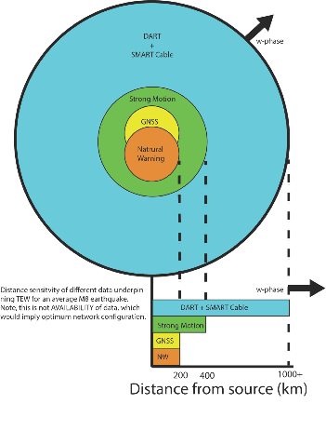
Task Team Terms of Reference
This expert Task Team will establish and document a methodology to test the sensitivity of the PTWS sensing networks, integrating new and emerging techniques and technologies by: 1. Developing a methodology for gap and sensitivity analysis that combines multiple sensing technologies for tsunami detection and characterisation. 2. Integrating emerging techniques and sensor technologies (e.g. better use of tide gauges; GNSS technology and processing; sensors on telecom cables) with the existing sensing network to meet tsunami warning service requirements. 3. Where possible, include cost-benefit analysis of the potential technologies being considered.

Slide 3
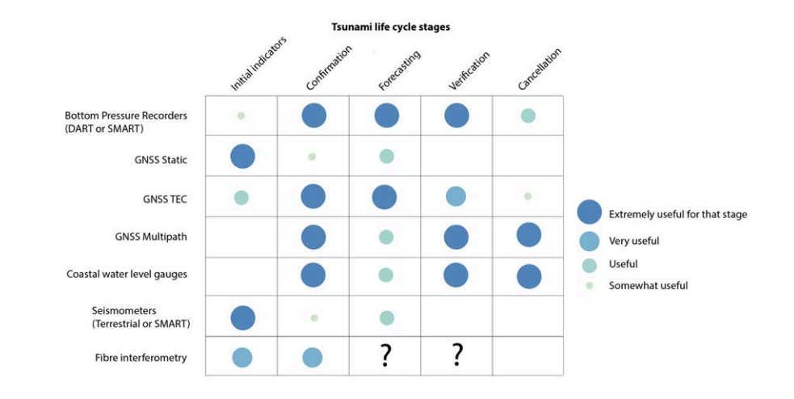
Justification for multi-data/multi-sensor approaches

Slide 4
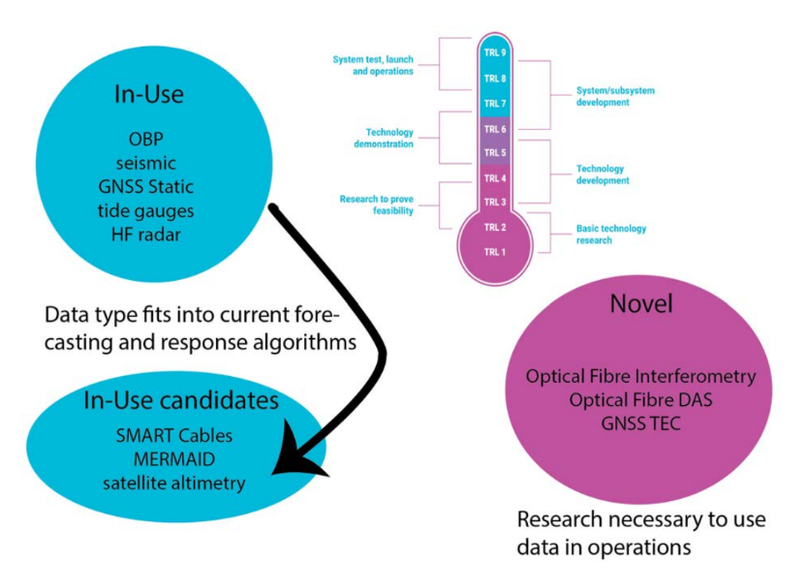
Data maturity
Can our existing systems ingest data type with little or no modification?
In-Use:
TRL 7-9
Novel:
TRL 1-6
We consider both classes of data in our gap analysis.

Slide 5
Gap analysis with existing sensors and technologies

Slide 6
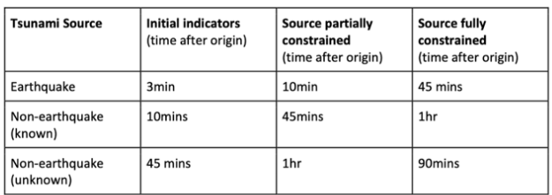
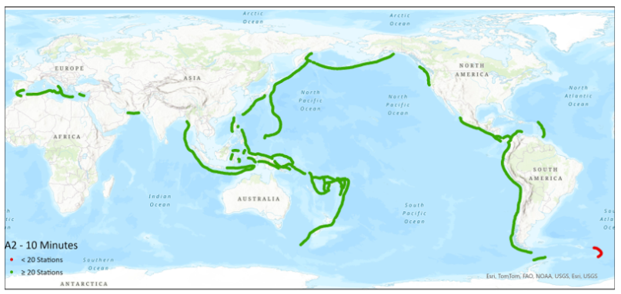
Progress against ODTP with "in-use" and available data:
10-minute amplitude forecast
Moseley (Australia)

Slide 7
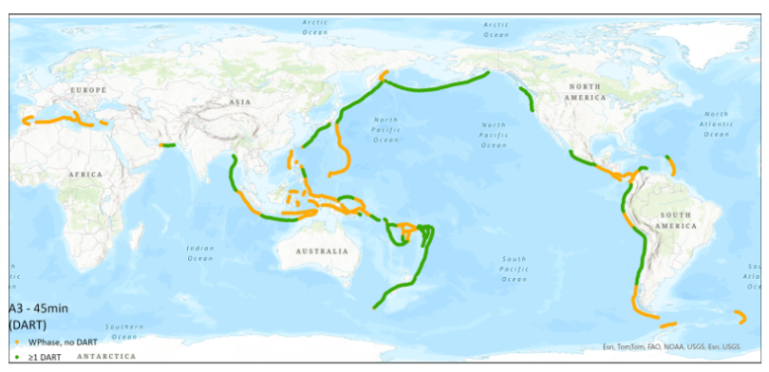
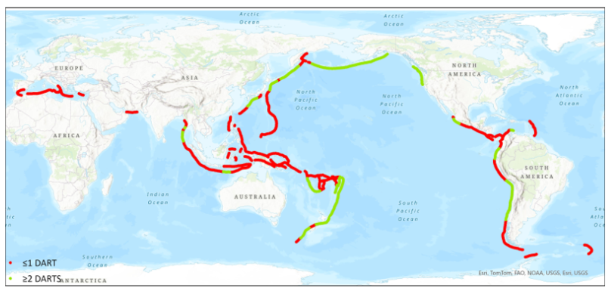
Progress against ODTP targets with "in-use" and available data:
EQ and non-EQ fully constrained
Hybrid methods
Direct observation methods
Moseley (Australia)

Slide 8
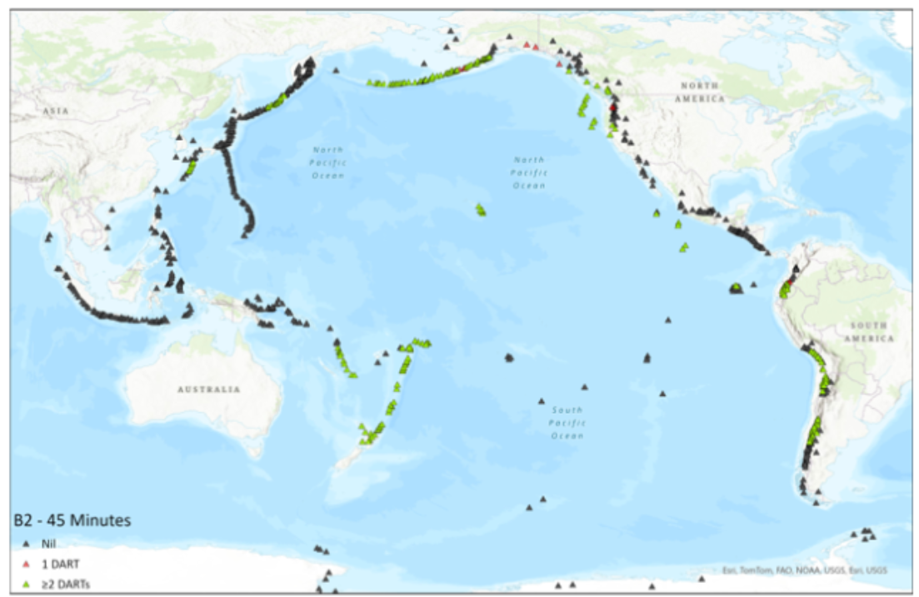
Volcano tsunami forecasting with "in-use" and available data:
2 ocean observations
Moseley (Australia)

Slide 9
Adding risk to the analysis

Slide 10
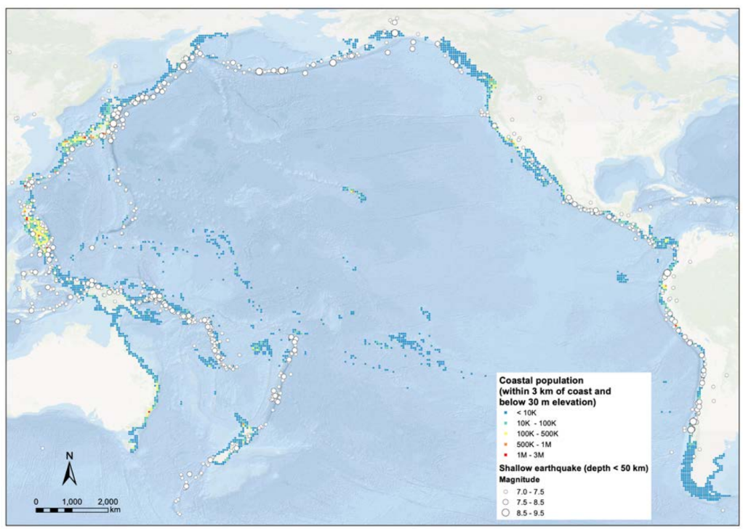
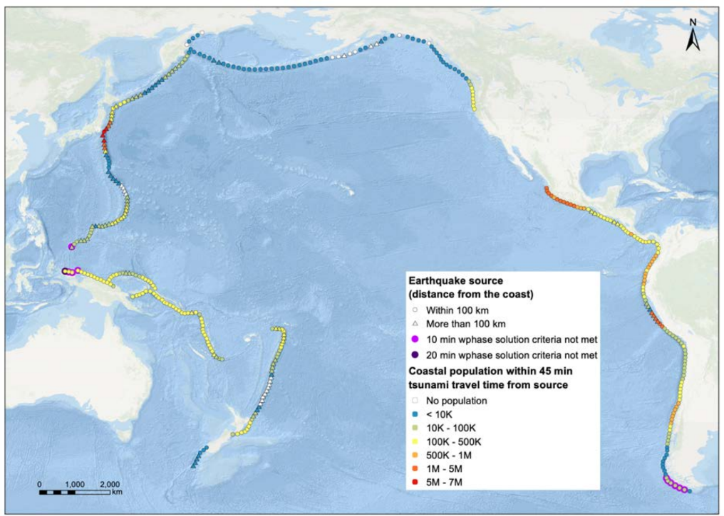
Exposure for risk-based gap identification
Tsunami zone population
Local-source exposure

Slide 11
Adding novel data and emergent forecasting methods

Slide 12
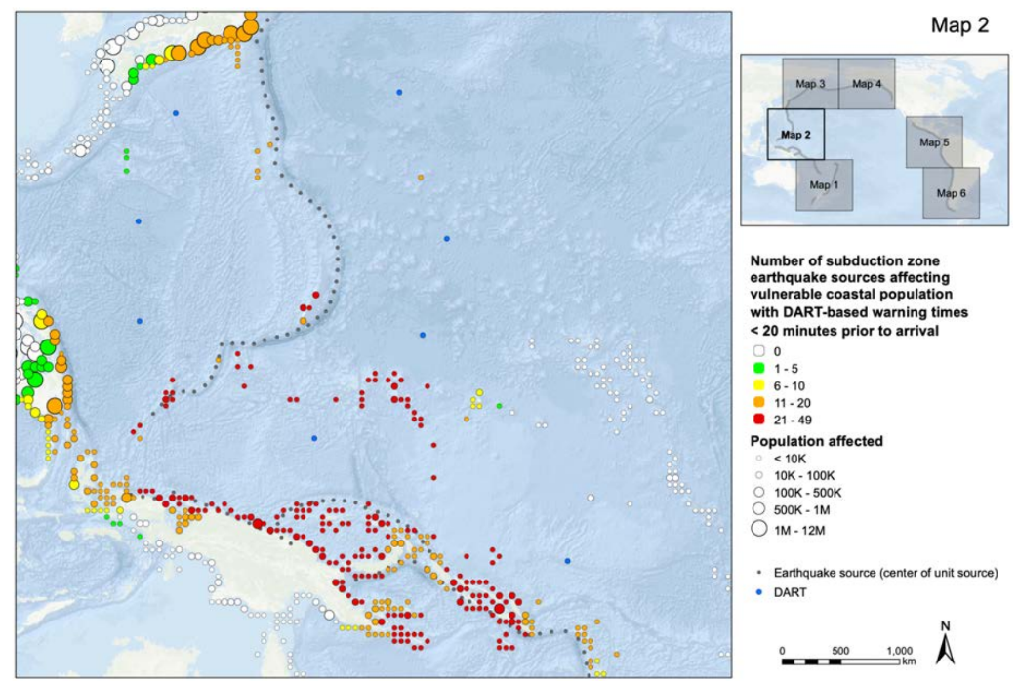
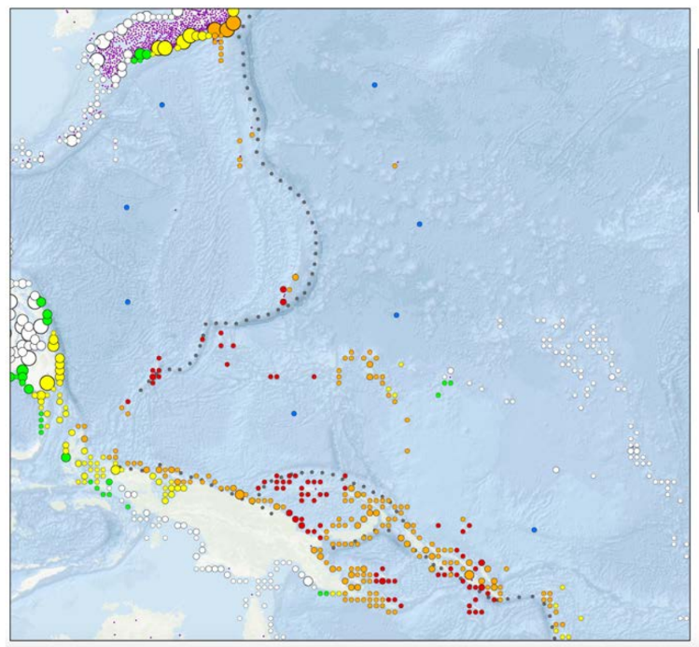
FOO improvement with BPR (DART or SMART) and GNSS TEC
TEW With 2 BPR
GNSS TEC + 1 BPR

Slide 13
Summary
Gap analysis: PTWS has the current data networks to deliver some, but not most, of the UNDP targets.
Emerging technolgies: Emergent data technologies (e.g. GNSS TEC, SMART) may deliver more of the UNDP targets, but many remain to be considered (e.g. hydroacoustic) and forecasting from direct ocean observations must be advanced.
Risk-based anlaysis: We have created a framework to map network gaps to affected coastal populations within the context of pre-impact warning times.

Slide 14
Recommendations
WG2 currently has 11 recommendations, 6 of which directly involve TTISN. These are contained in the WG2 report and can be viewed prior to the adoption of decisions and recommendations session 9 on Friday.

Slide 15
Thank you very much for your continued efforts to support tsunami DRR!

