Slide 1
Tsunami Service Provider Report
Pacific Tsunami Warning Center
Charles McCreery, Director
NOAA Pacific Tsunami Warning Center
charles.mccreery@noaa.gov
Notes:
Thank you and good afternoon everyone. I am going to present a brief summary of the status, activities and plans of the Pacific Tsunami Warning Center since the last meeting of the ICG in 2023 in Tonga.

Slide 2
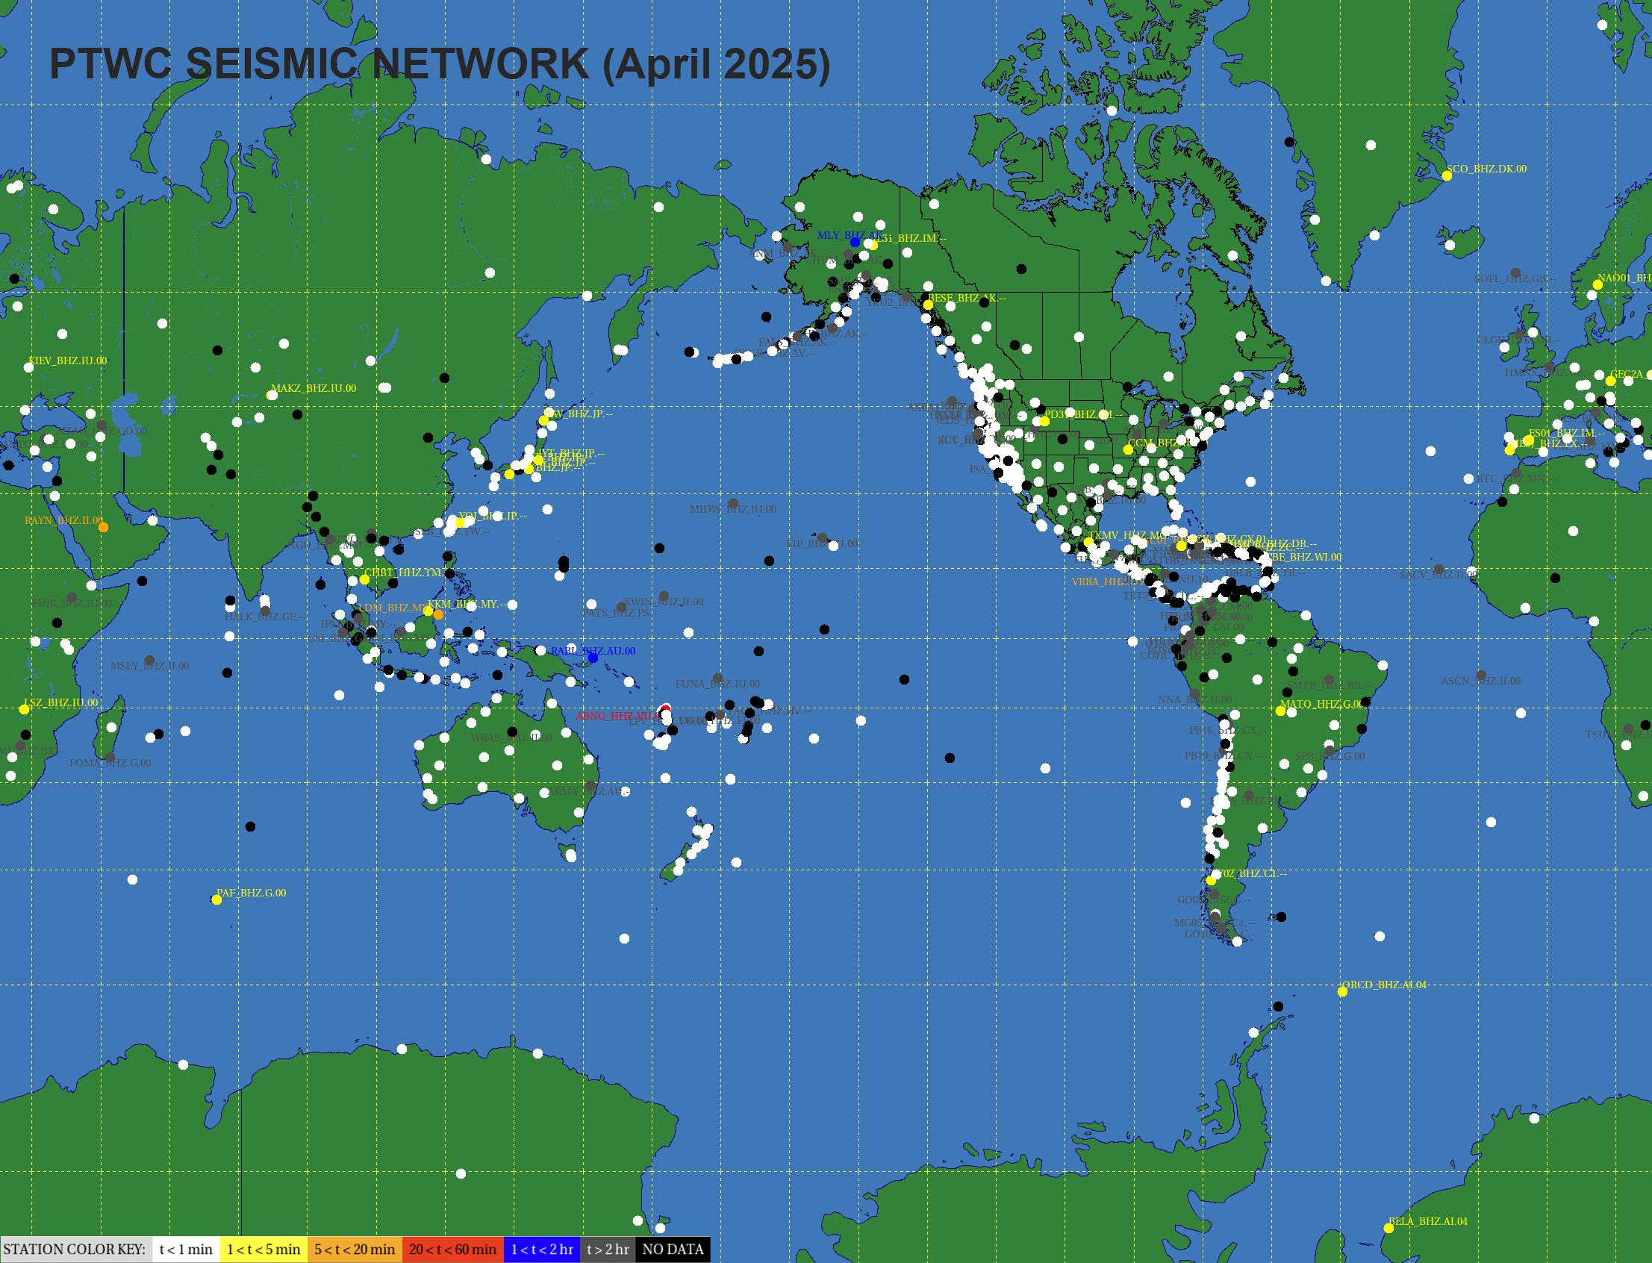
Seismic Network Used by PTWC – 4/3/25
Snapshot on 6/5/22
White Dots are Active
Each dot is a seismic station. At the time of this snapshot, PTWC was receiving digital seismic waveform data from all the white-colored stations within a minute. No data was being received from black-colored stations.
Notes:
This map shows the seismic stations from many networks across the globe that provide their data to PTWC in real time for tsunami warning. And it shows the status of those data streams from just a few days ago. White dots indicate that data was received within the last minute, while black dots indicate the data stream has been down for a long time. It is typical that at any time data from a number of stations are not coming in due to station or network outages. But we have enough data that this does not usually affect performance. There are also regions where there simply are not many stations, and in those areas it can take more time for earthquake detections and analysis. Yesterday Adrian presented a lot of maps showing the varied capabilities of the existing seismic networks as well as those for sea level and GNSS.

Slide 3
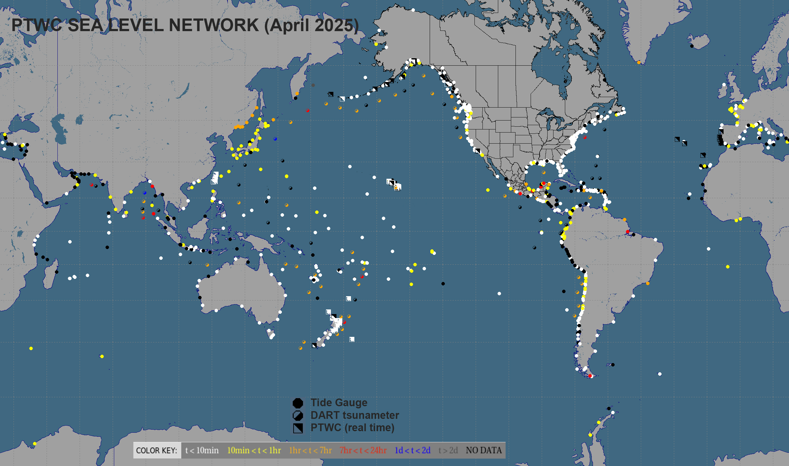
Pacific Sea-Level Gauges – 4/3/25
Snapshot on 6/5/22
White Dots are Active
Small dots are coastal sea-level stations. Larger dots are deep-ocean tsunameters (DARTs). At the time of this snapshot, the white and green coastal stations and the orange DART gauges were sending timely data. Black stations were not functioning.
Notes:
This is a similar plot for the coastal and deep-ocean sea-level stations also showing their status as of a few days ago. White and yellow coastal gauge dots indicate working data streams, but black and the other colors indicate delayed or no data. Orange deep-ocean gauges are okay, since they only transmit every four hours when not in trigger mode. But guite a few of them are black and in need of service.

Slide 4
Planned 2025 DART Services
Current outages in red
Caribbean / Atlantic
March: 42407 (done)
April: 41421, 41420, 41425
Pacific
April: 43412, 43413, 32411, 32413, 44403, 44402
June: 46416, 46415, 46409, 46414, 46408, 46413
July: 21416, 21419, 21418, 21413, 21420, 52404, 52403
August: 52401, 52406, 51425
October: 51407, 46407, 46404
Notes:
This is the servicing schedule for the U.S, deep-ocean gauges, or DARTs. Work is going on now in the Atlantic and Caribbean and one gauge has already been repaired. Maintenance will begin in the Pacific in April. Gauge numbers shown in red are those that are currently down.

Slide 5
PTWC Message Events since Sep 2023
42 PTWS Tsunami Information Statements
10 PTWS Tsunami Threat Message Sequences
Earthquake |  |  | Messages
Date – Time (UTC) | Location | Mw | 1st Elapsed | Total
12/02/2023 14:37:06 | MINDANAO, PHILIPPINES | 7.6 | 07:22 | 3
12/07/2023 12:56:30 | VANUATU | 7.1 | 08:24 | 2
01/01/2024 07:10:10 | NEAR THE WEST COAST OF HONSHU, JAPAN | 7.5 | 11:46 | 5
04/02/2024 23:58:00 | TAIWAN | 7.4 | 11:16 | 4
08/08/2024 07:42:55 | KYUSHU JAPAN | 7.1 | 11:37 | 3
08/17/2024 19:10:27 | OFF THE EAST COAST OF KAMCHATKA, RUSSIA | 7.0 | 07:36 | 3
12/05/2024 18:44:24 | NEAR THE COAST OF NORTHERN CALIFORNIA | 7.0 | 08:56 | 2
12/17/2024 01:47:23 | VANUATU | 7.3 | 06:05 | 3
03/30/2025 12:18:47 | TONGA | 7.0 | 10:31 | 3
04/04/2025 20:04:38 | NEW BRITAIN REGION OF PAPUA NEW GUINEA | 6.9 | 05:22 | 4

Slide 6
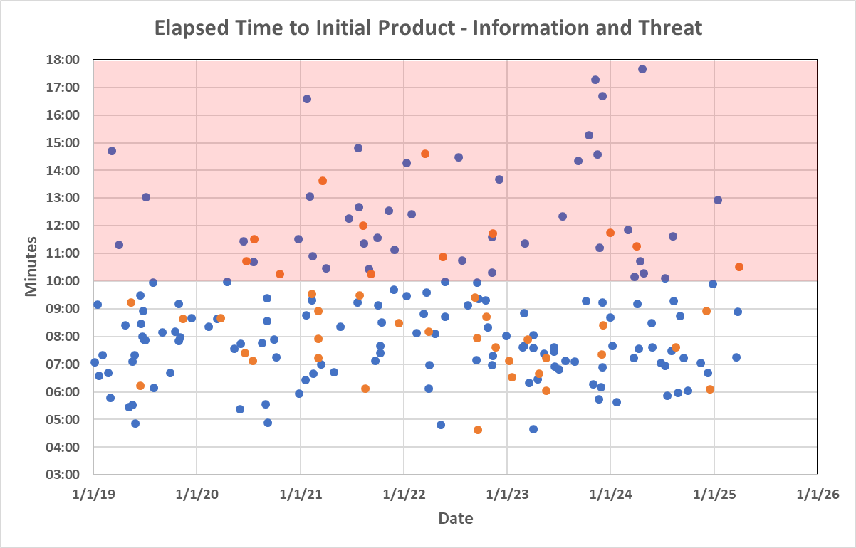
Key Performance Indicator – Elapsed Time
Blue dots are Information Statements, Red dots are Threat Messages.

Slide 7
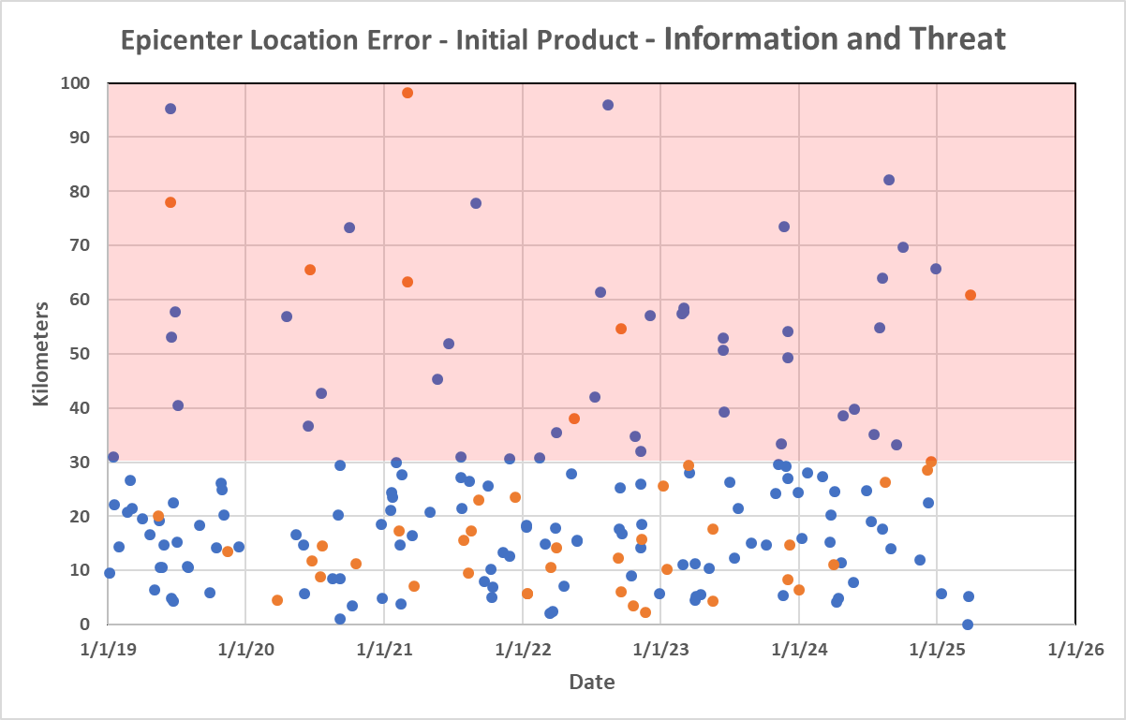
Key Performance Indicator – EQ Location
Blue dots are Information Statements, Red dots are Threat Messages.
PTWC real-time parameters compared with USGS parameters published later

Slide 8
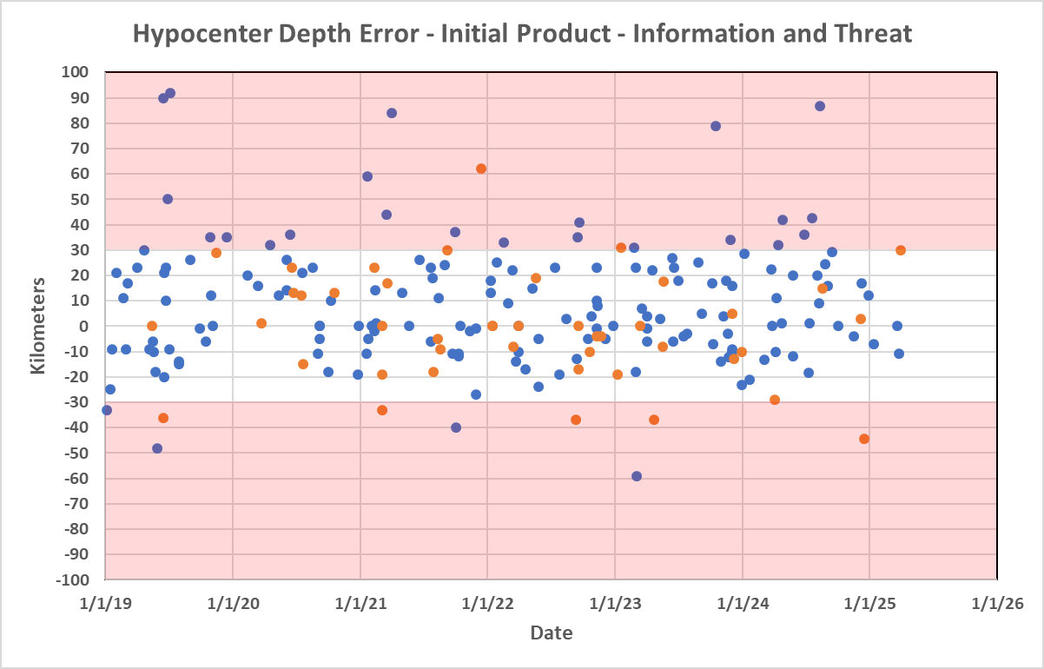
Key Performance Indicator – EQ Depth
Blue dots are Information Statements, Red dots are Threat Messages.
PTWC real-time parameters compared with USGS parameters published later

Slide 9
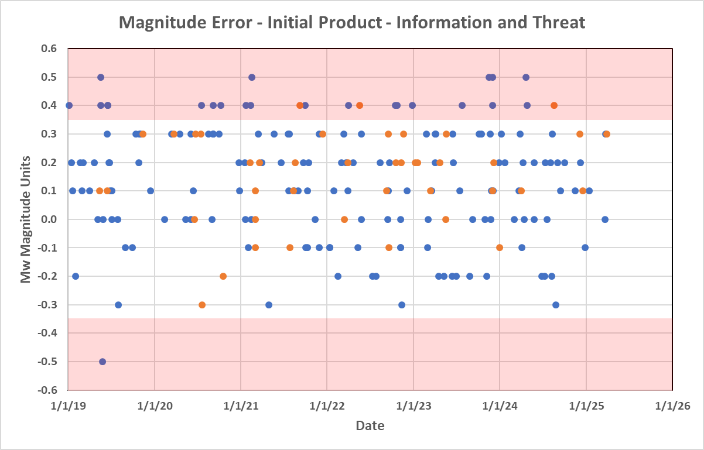
Key Performance Indicator – Mw
Blue dots are Information Statements, Red dots are Threat Messages.
PTWC real-time parameters compared with USGS parameters published later

Slide 10
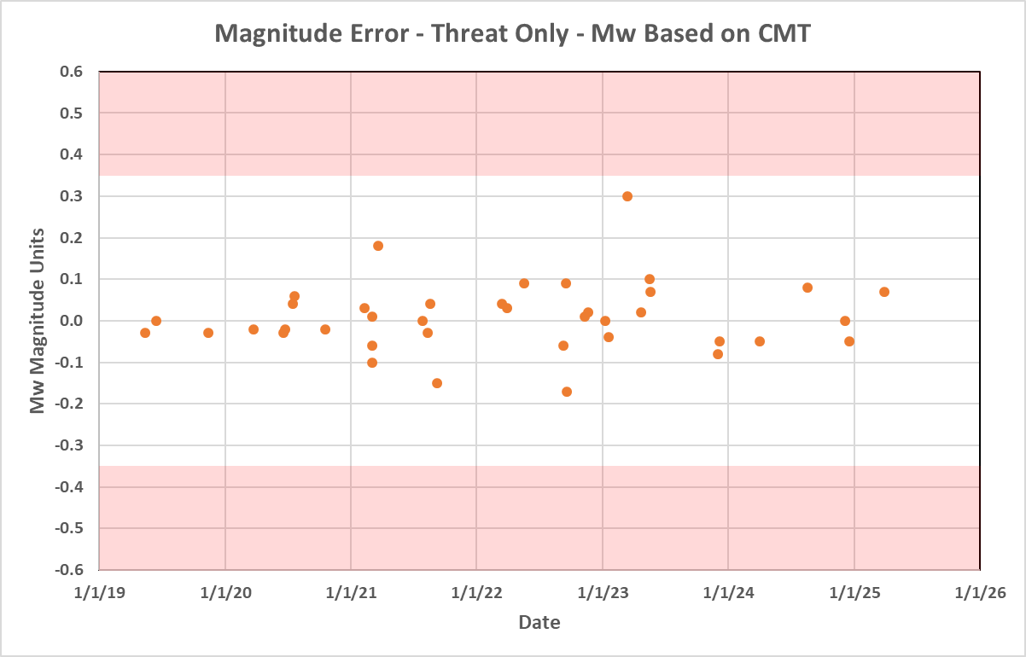
Key Performance Indicator – Mw from WCMT
PTWC real-time parameters compared with USGS parameters published later

Slide 11
Review of Proposed Text Product Changes
Briefed and agreed upon in ICG/PTWS-XXX
In initial threat messages, prior to having a quantitative forecast, alphabetize the list of countries and territories with a possible tsunami threat.
Organize the list of expected times of arrival (ETA) of the first tsunami wave by country or territory.
Organize the list of observed tsunami wave maximum amplitudes by country or territory.
Include an indicator for the type of measurement made on each gauge.
Except
Remove the forecast category label “less than 0.3 meters” and replace it with the label “no threat”.

Slide 12
Lowest Forecast Category - Current
TSUNAMI THREAT FORECAST
-----------------------
* TSUNAMI WAVES REACHING MORE THAN 3 METERS ABOVE THE TIDE
LEVEL ARE POSSIBLE ALONG SOME COASTS OF
MEXICO.
* TSUNAMI WAVES REACHING 0.3 TO 1 METERS ABOVE THE TIDE LEVEL
ARE POSSIBLE FOR SOME COASTS OF
AMERICAN SAMOA... ANTARCTICA... COOK ISLANDS... ECUADOR...
EL SALVADOR... FIJI... FRENCH POLYNESIA... GUATEMALA...
KIRIBATI... NEW ZEALAND... SAMOA... TOKELAU... TUVALU...
VANUATU... AND WALLIS AND FUTUNA.
* TSUNAMI WAVES ARE FORECAST TO BE LESS THAN 0.3 METERS ABOVE
THE TIDE LEVEL FOR THE COASTS OF
AUSTRALIA... CHILE... CHINA... CHUUK... COLOMBIA... COSTA
RICA... GUAM... HAWAII... HONDURAS... HOWLAND AND BAKER...
INDONESIA... JAPAN... JARVIS ISLAND... JOHNSTON ATOLL...
KERMADEC ISLANDS... KOSRAE... MALAYSIA... MARSHALL
ISLANDS... MIDWAY ISLAND... NAURU... NEW CALEDONIA...

Slide 13
Lowest Forecast Category – Option 1
TSUNAMI THREAT FORECAST
-----------------------
* TSUNAMI WAVES REACHING MORE THAN 3 METERS ABOVE THE TIDE
LEVEL ARE POSSIBLE ALONG SOME COASTS OF
MEXICO.
* TSUNAMI WAVES REACHING 0.3 TO 1 METERS ABOVE THE TIDE LEVEL
ARE POSSIBLE FOR SOME COASTS OF
AMERICAN SAMOA... ANTARCTICA... COOK ISLANDS... ECUADOR...
EL SALVADOR... FIJI... FRENCH POLYNESIA... GUATEMALA...
KIRIBATI... NEW ZEALAND... SAMOA... TOKELAU... TUVALU...
VANUATU... AND WALLIS AND FUTUNA.
* TSUNAMI WAVES ARE FORECAST TO BE NO THREAT FOR THE COASTS OF
AUSTRALIA... CHILE... CHINA... CHUUK... COLOMBIA... COSTA
RICA... GUAM... HAWAII... HONDURAS... HOWLAND AND BAKER...
INDONESIA... JAPAN... JARVIS ISLAND... JOHNSTON ATOLL...
KERMADEC ISLANDS... KOSRAE... MALAYSIA... MARSHALL
ISLANDS... MIDWAY ISLAND... NAURU... NEW CALEDONIA...

Slide 14
Lowest Forecast Category – Option 2
TSUNAMI THREAT FORECAST
-----------------------
* TSUNAMI WAVES REACHING MORE THAN 3 METERS ABOVE THE TIDE
LEVEL ARE POSSIBLE ALONG SOME COASTS OF
MEXICO.
* TSUNAMI WAVES REACHING 0.3 TO 1 METERS ABOVE THE TIDE LEVEL
ARE POSSIBLE FOR SOME COASTS OF
AMERICAN SAMOA... ANTARCTICA... COOK ISLANDS... ECUADOR...
EL SALVADOR... FIJI... FRENCH POLYNESIA... GUATEMALA...
KIRIBATI... NEW ZEALAND... SAMOA... TOKELAU... TUVALU...
VANUATU... AND WALLIS AND FUTUNA.
* TSUNAMI WAVES ARE FORECAST TO BE LESS THAN 0.3 METERS ABOVE
THE TIDE LEVEL FOR THE COASTS OF
AUSTRALIA... CHILE... CHINA... CHUUK... COLOMBIA... COSTA
RICA... GUAM... HAWAII... HONDURAS... HOWLAND AND BAKER...
INDONESIA... JAPAN... JARVIS ISLAND... JOHNSTON ATOLL...
KERMADEC ISLANDS... KOSRAE... MALAYSIA... MARSHALL
ISLANDS... MIDWAY ISLAND... NAURU... NEW CALEDONIA...
DELETE THIS SECTION

Slide 15
Proposed – Reinforce that Products are for the PTWS
Issue: There can be confusion with authoritative NTWC alerts when PTWC’s international products have conflicting advice.
Example: For example, PTWC text products may say the threat has now passed, but the national authority may still have an alert in effect.
One Solution: Add language to key statements in PTWC text products emphasizing that they only apply to PTWS coasts covered by PTWC.
  Existing:
  Based on all available data... the tsunami threat from this earthquake has now passed.
  Proposed:
  Based on all available data... the tsunami threat from this earthquake has now passed FOR ALL PTWS COASTS COVERED IN THIS INTERNATIONAL PRODUCT with advice only.

Slide 16
PTWC Product Changes Implementation
Previously approved changes,
as well as whatever is agreed upon by the ICG regarding the
  less than 0.3 meter forecast category, and
  proposed text changes to emphasize that key statements only apply to PTWS coasts and are advice only
will be implemented following notification to Member States in a circular letter issued at least three months in advance.

Slide 17
Other Activities
Reorganization of PTWC, ITIC, and USNTWC under the US National Weather Service’s National Center for Environmental Prediction for a single chain of command, more coordinated and efficient operations
Common tsunami detection and analysis system for PTWC and USNTWC for consistency and enterprise maintenance
Common message creation and dissemination software for PTWC and USNTWC for near seamless backup and enterprise maintenance
Complete re-invention of the tsunami.gov website to provide a more intuitive and effective user experience and broader and more easily updated content
Development of Maritime Products (covered later under agenda #4.7)

Slide 18
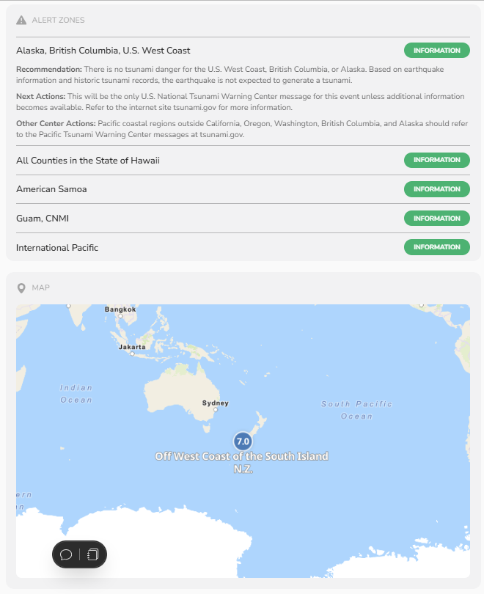
New tsunami.gov website (under development)

Slide 19
Thank You
Charles McCreery, Chair
NOAA Pacific Tsunami Warning Center
charles.mccreery@noaa.gov

