Slide 1
Landslide tsunamis and surrogate models
Dimitra Salmanidou
Advanced Research Computing Centre (ARC)
Risk and Disaster Reduction Department (RDR)
d.salmanidou.12@ucl.ac.uk

Slide 2
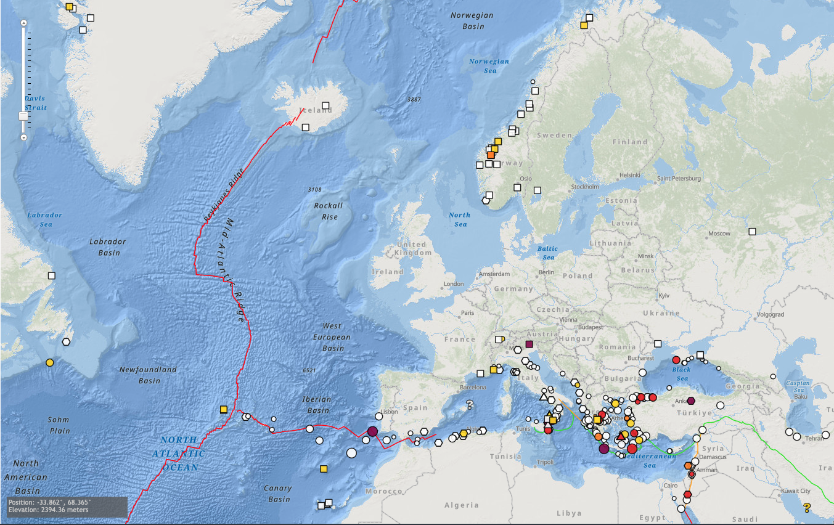
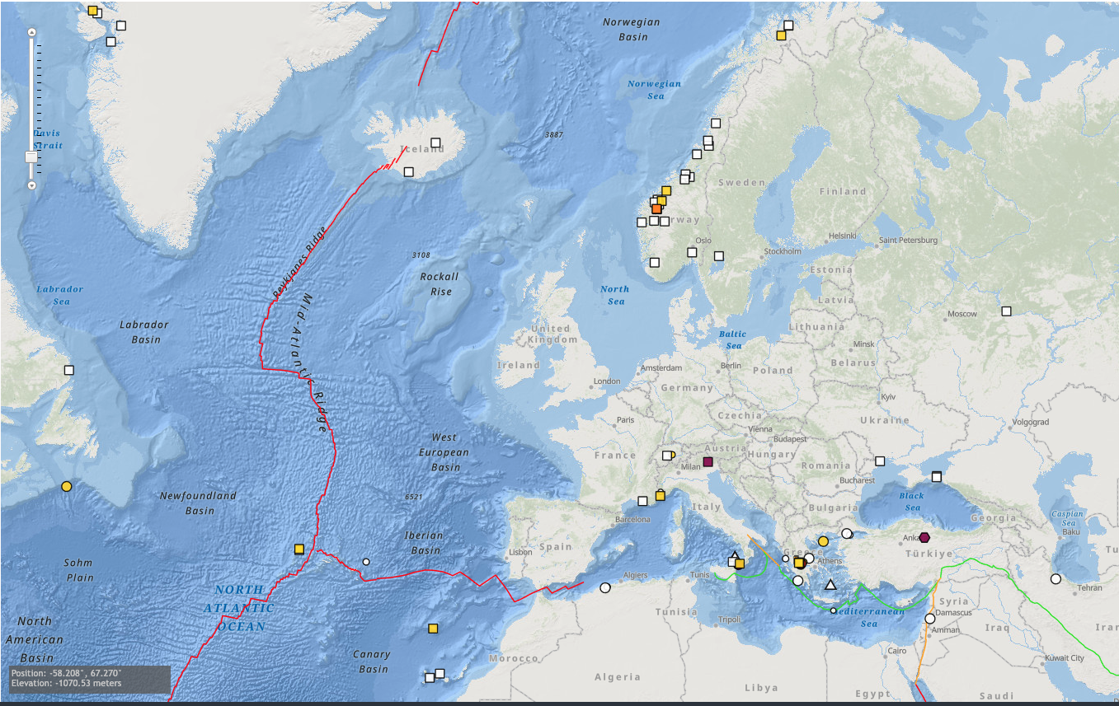
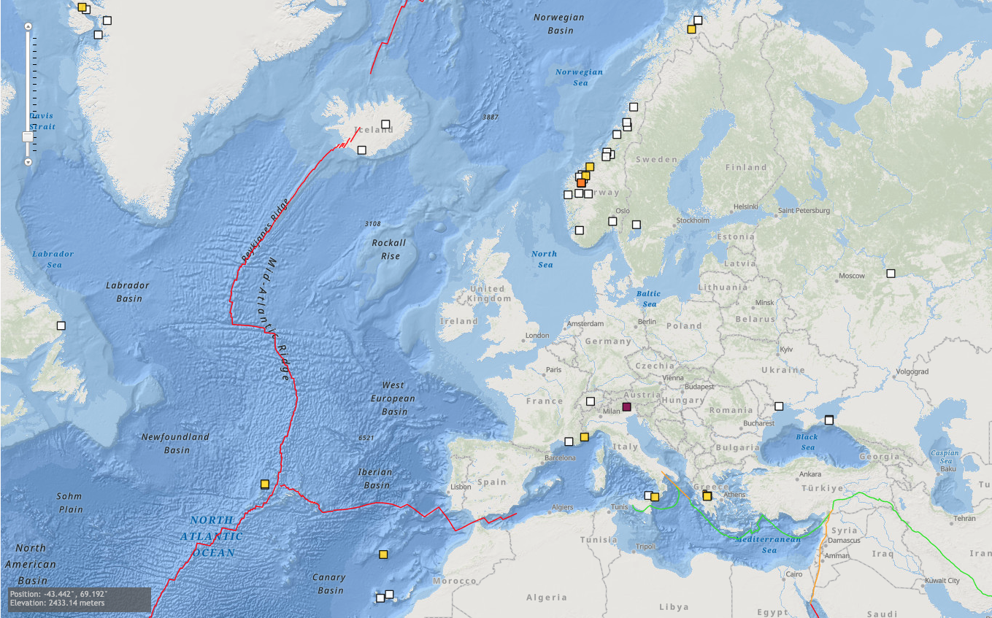
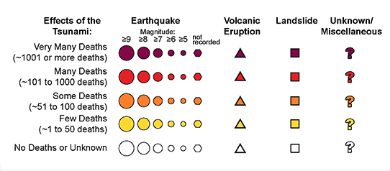
Historical Tsunami Events
Probable tsunamis in N. Atlantic and the Mediterranean
www.ncei.noaa.gov
Notes:
National Centers for Environmental Information
1930 Mar 04, Runup >5 m. Madeira 20 casualties

Slide 3
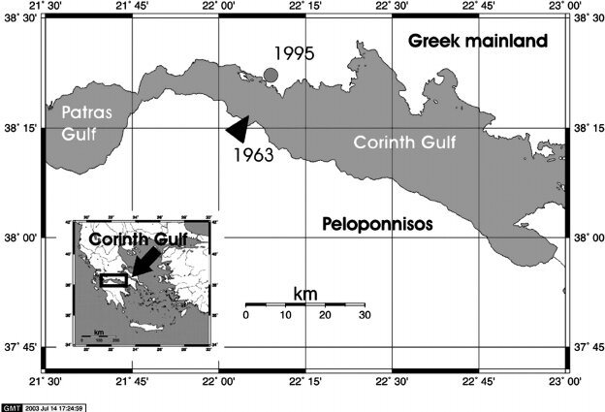
Corinth Gulf, Greece
07 February 1963
3 - 6 m high tsunami
2 causalties and 12 injured
Slump mass: 57,000 m³
Local Earthquakes and heavy rainfall
01 January 1996 - 2m asl
Papadopoulos et al., 2007

Slide 4
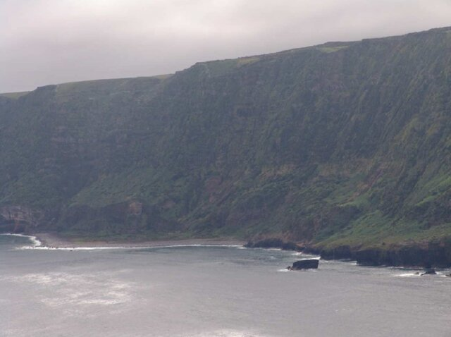
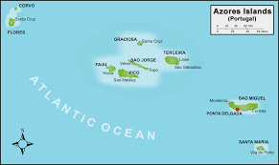
Flores Island, Azores
9 July 1847
NW coast of Flores Island
10 casualties in Flores and Corvo islands hundreds of wounded
Deadliest tsunami in the Azores archipelago
Cabral 2020

Slide 5
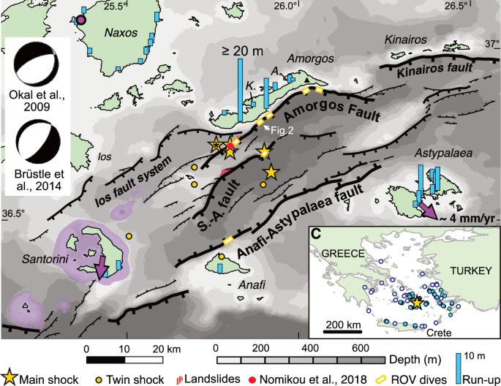
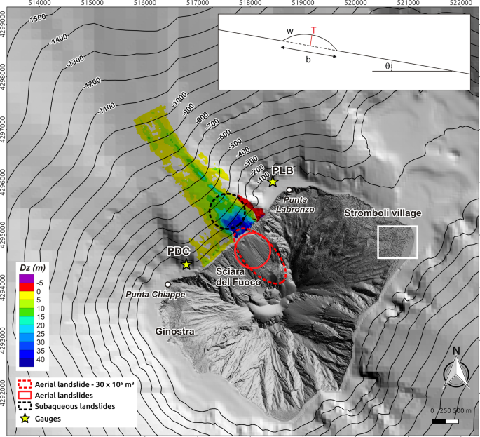
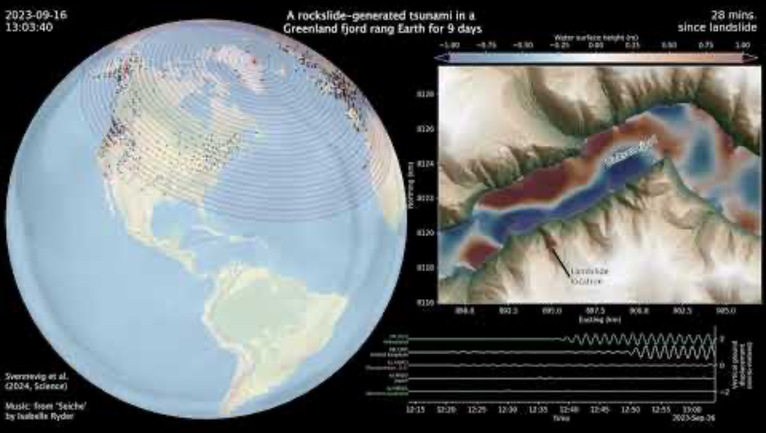
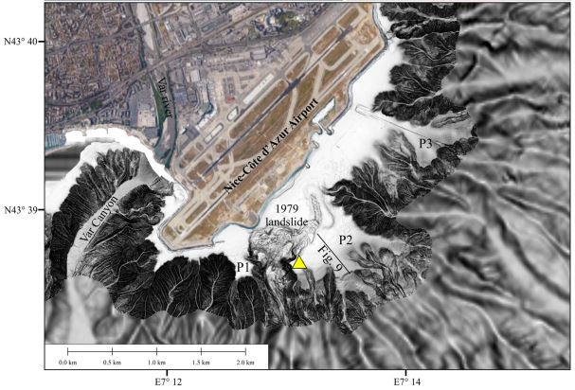
Landslide tsunamis - more complex than EQ tsunamis? Generation mechanisms
Sources:
Leclerc et al., 2024
Courboulex et al., 2020
Fournaciai et al., 2019
Svennevig et al., 2024
Notes:
16 October 1979 Nice airport
9 July 1956 Amorgos
30 December 2002 Stromboli
16 September 2023 Greenland

Slide 6
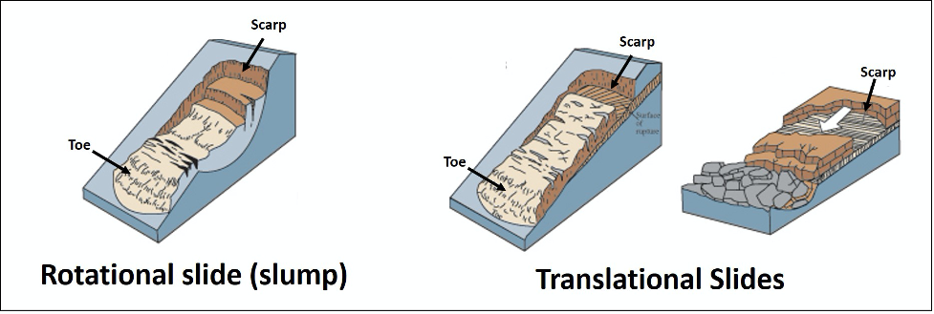
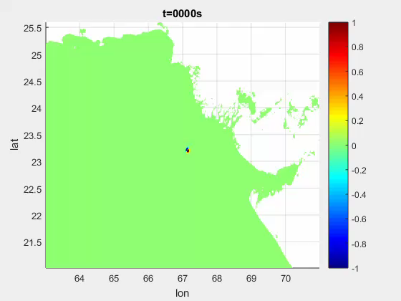
Landslide tsunamis more complex than EQ tsunamis? Challenge 1 - Modelling perspective
Complexity in modelling
Subaerial vs submarine failure
Submarine mode of failure: slump vs slides
Rheology
Frequency dispersion
Large computational costs
Salmanidou et al., 2021
Notes:
Depth and volume
wave breaking

Slide 7
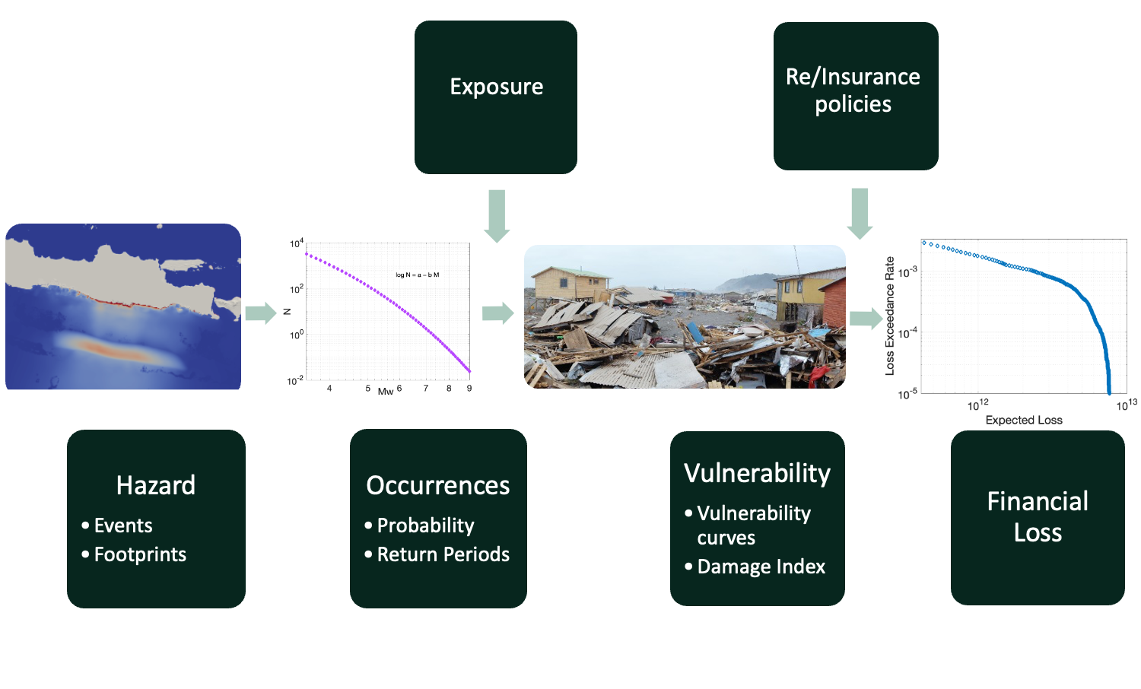
Landslide tsunamis more complex than EQ tsunamis? Challenge 2 – where and when?
Near field locations - increased regional impact
Return periods challenge PTHA & PTRA

Slide 8
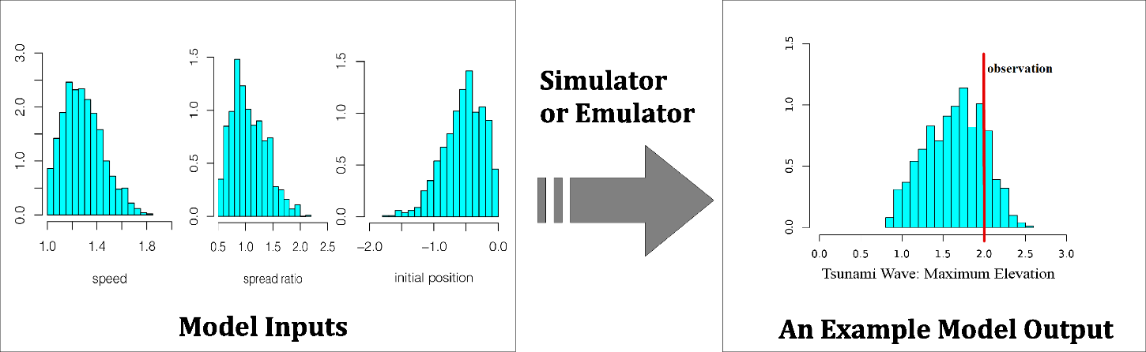
Can surrogate models capture the uncertainty?
Advantages
Represent well the deterministic response
Fast, they run almost instantaneously
Allow exploration of thousands of scenarios for uncertainty quantification
Disadvantages
Limited extrapolation
Restricted by the accuracy in numerical models and data

Slide 9
Building a surrogate model
Experiment Set-up
Model runs
(Training data)
Surrogate model training
Surrogate validation
Surrogate Model predictions
Add Samples if needed
Experimental Design
  Critical input parameters
  Parameter ranges
  Set prediction variables
  Sampling runs for training
Surrogate Training
  Runs of the deterministic model
  Regression and correlation models
Validation
Prediction
Notes:
lab experiments, model runs, literature
Complex! Case specific, lack of data

Slide 10
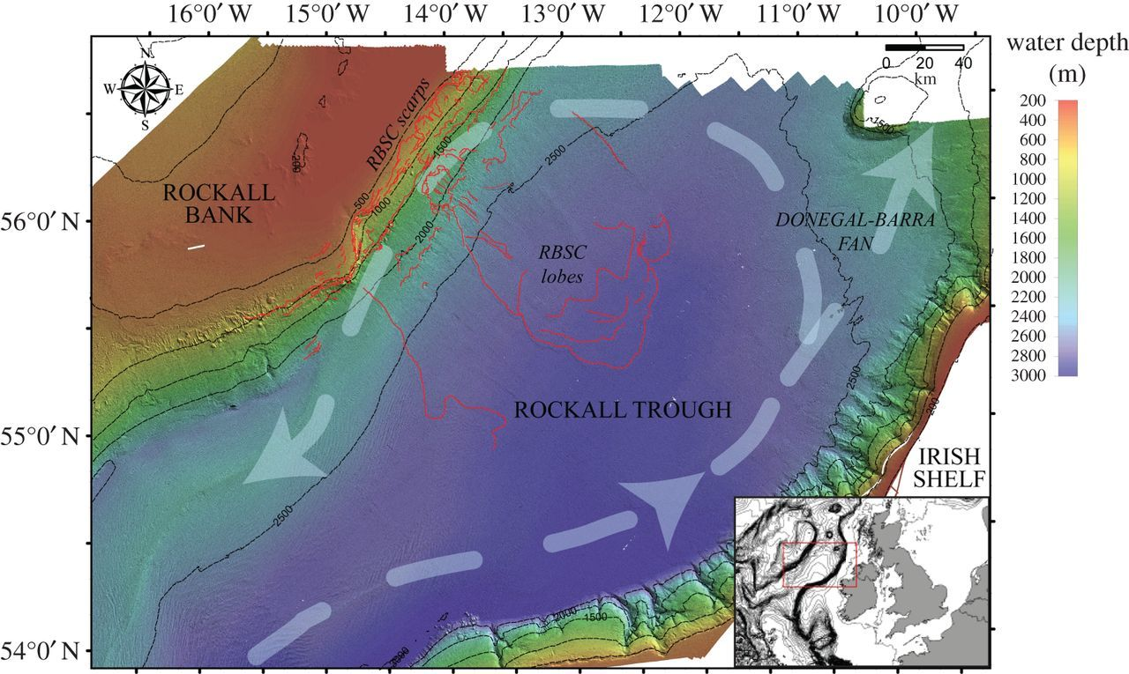
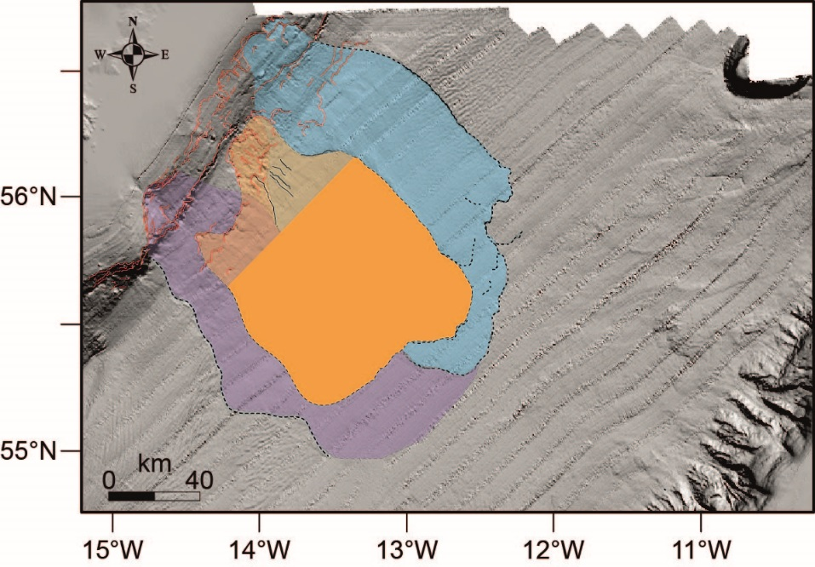
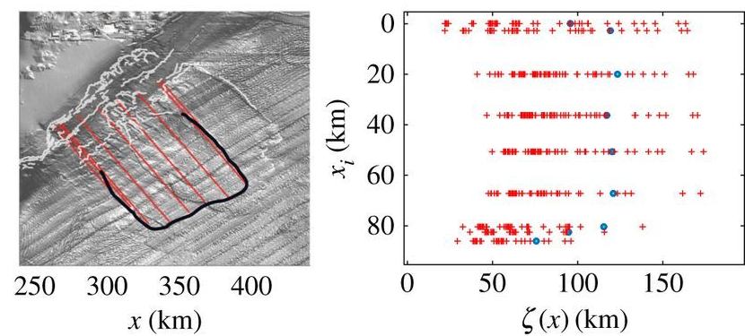
RBSC - Salmanidou et al. 2017
Bayesian inversion & surrogate modelling
Tsunamigenic potential of past event
Maximum tsunami amplitude
100 landslide & tsunami simulations

Slide 11
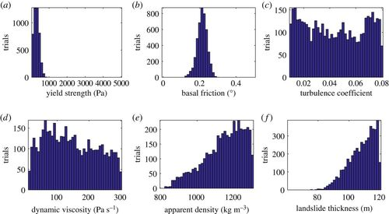
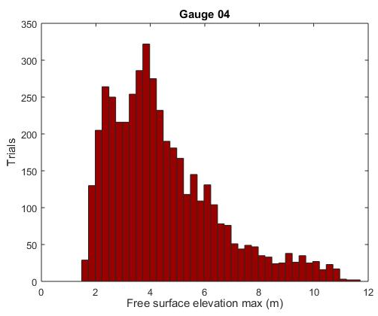
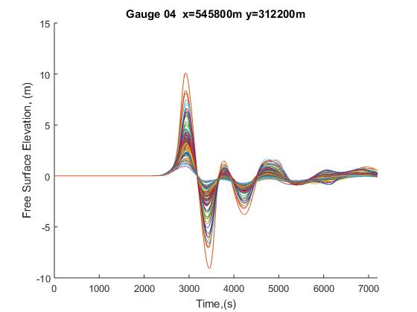
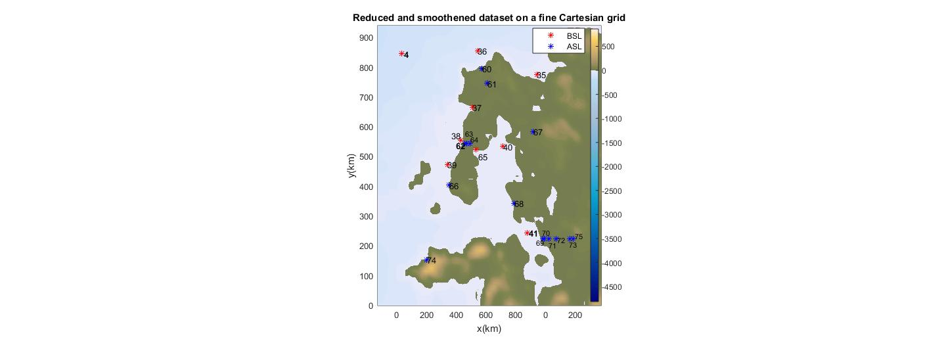
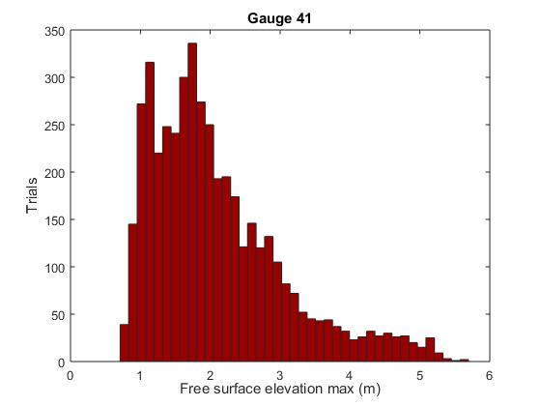
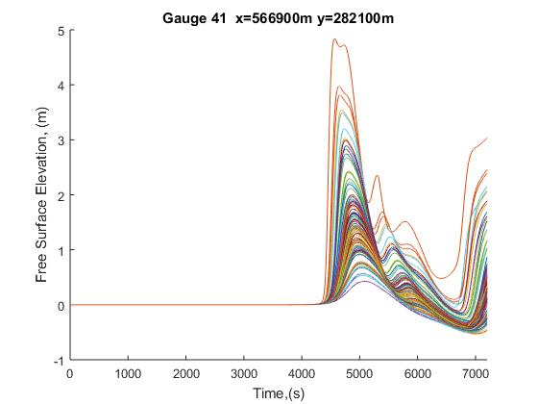
RBSC
4,500 predictions
~ 1” per gauge

Slide 12
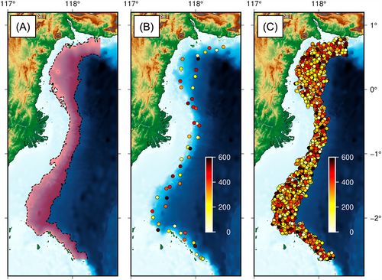
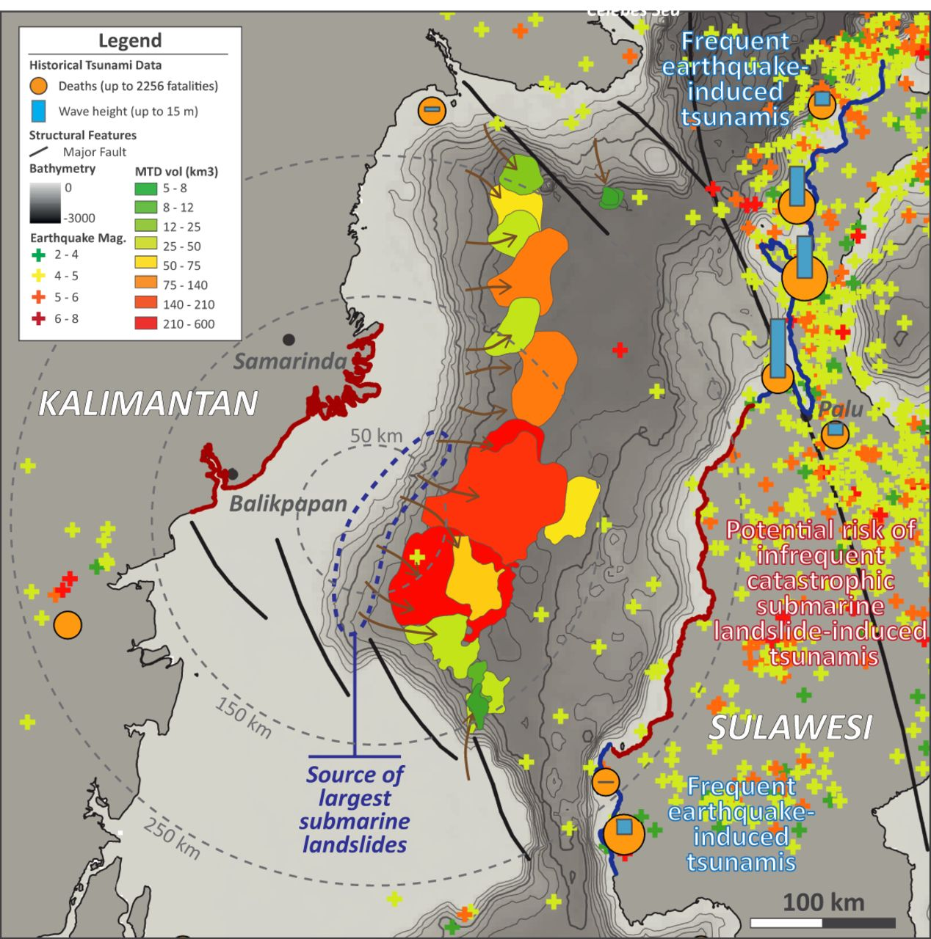
Makassar Strait – Dignan et al. 2023
Brackenridge et al., 2020

Slide 13
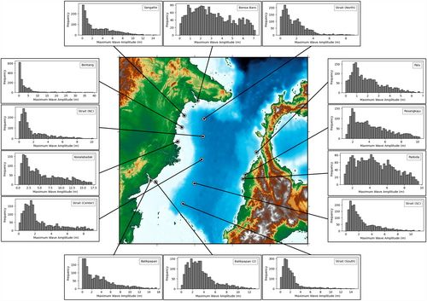
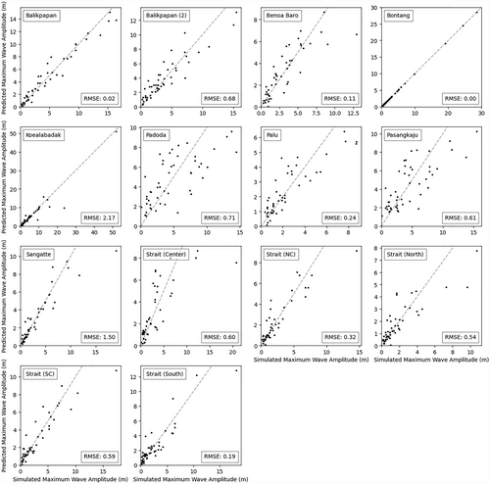
Makassar Strait

Slide 14
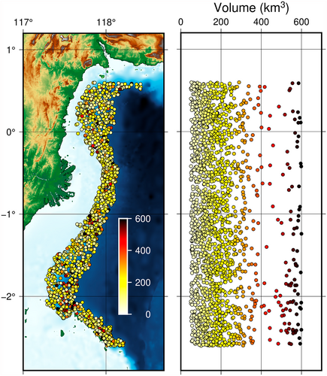
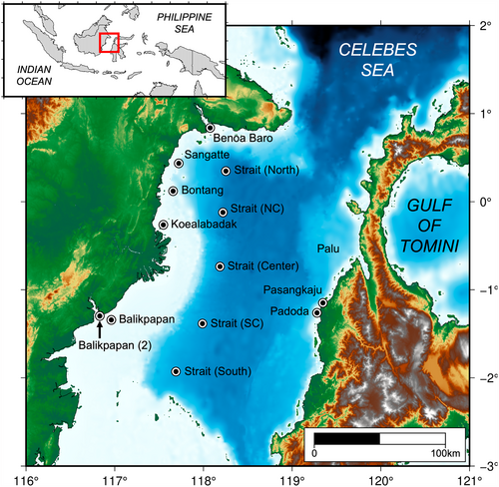
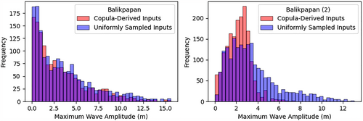
Makassar Strait
- 2,000 probabilistic scenarios
- Copula-derived samples

Slide 15
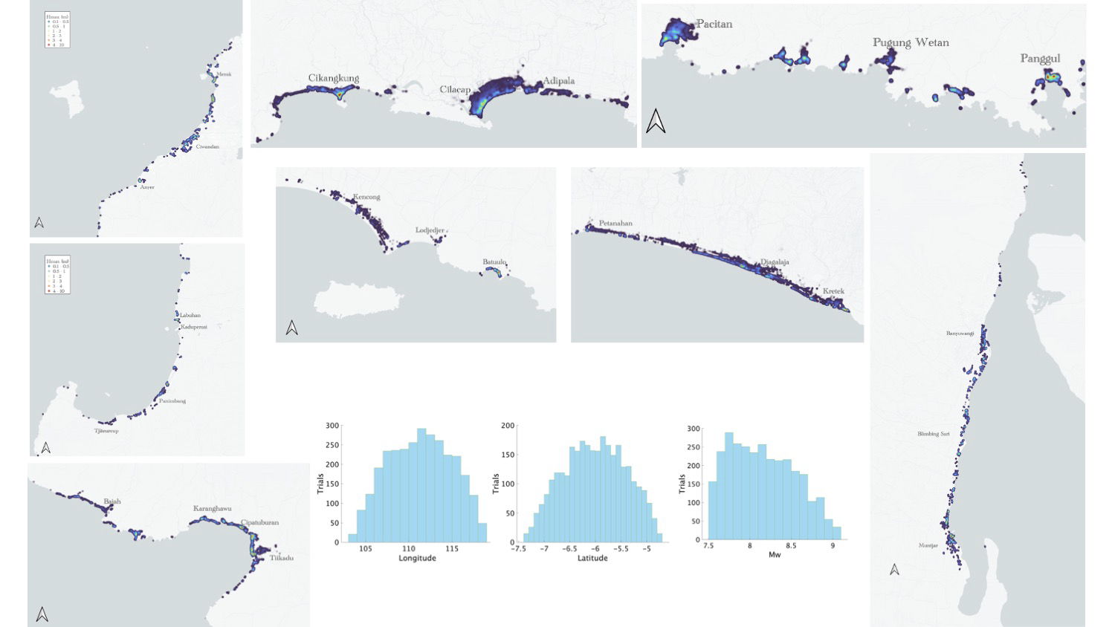
Exposure-driven assessment
- 95% of tsunami inundation depths
- 1,300 predictions with the use of 1.4 million surrogate locations

Slide 16
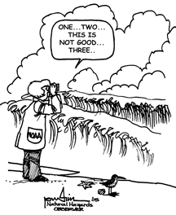
Thank you!

