Slide 1
Tsunami Ready Coalition
Draft Implementation Plan
Dr. Laura Kong, TRC Chair
Director, ITIC
David Coetzee, UNOD TP SC
IOC Tsunami Resilience Section
TOWS WG, 24-25 February 2025
Paris, France

Slide 2
Tsunami Ready Coalition (TRC, 2022)
IOC Decision EC-55/3.5.1 (June 2022) Warning and Mitigation Systems of Ocean Hazards. Part IV: Working Group on Tsunamis and Other Hazards related to Sea Level Warning and Mitigation Systems (TOWS-WG)
Approves the establishment of the UNESCO/IOC Tsunami Ready Recognition Programme (TRRP) as described in the working document “Tsunami Ready Programme – Proposal for endorsement by IOC” dated 21 February 2022;
Approves also
(ii) the Terms of Reference for the Tsunami Ready Coalition, as included under Annex 2 to this decision;
Annex 1. Revised Terms of Reference of the Working Group on Tsunamis and Other Hazards Related to Sea-Level Warning and Mitigation Systems (TOWS-WG)
The membership of the TOWS-WG will be constituted by:
a) The Chairpersons of the four ICG-TWSs, the Scientific Committee of the UN Ocean Decade Tsunami programme, the special Tsunami Ready Coalition, and representatives of the GOOS Steering Committee and IODE,
b) …

Slide 3
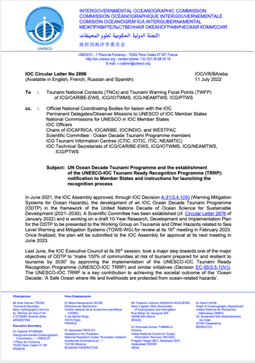
Annex 2. TRC Terms of Reference (2022)
Goal: Contribute to increasing the number of Tsunami Ready recognized communities as part of the UN Ocean Decade
Objectives:
The goal should be achieved through the following objectives:
Raise the profile of Tsunami Ready in collaboration with critical stakeholders across the UN system, interested regional organizations, national disaster management agencies and the public,
Increase funding resources for the implementation of Tsunami Ready,
Advise the TOWS-WG, TTDMP, and TTTWO on the implementation of Tsunami Ready, including on measures related to:
flexibility with regards to accomplishing the indicators to allow for circumstances where formal bureaucratic frameworks/requirements may pose barriers,
consideration of unique regional and/or local circumstances,
recognition of similar standards already in place in some countries
TRRP, IOC CL 2896 (July 2022)

Slide 4
Annex 2. Terms of Reference – Membership (2022)
Membership could include, as appropriate, representatives from international, regional and national organizations, such as:
(up to 139 MS)
National:
AID National Agencies/Organizations
Emergency Management Agencies/EDMAs
French Inter- Ministerial for the Antilles Estate Major Zone (EMIZA)
IOC & Tsunami National Contacts (TNCs) & Tsunami Ready Focal Points (TRFPs)
National Commissions for UNESCO
National Youth organisations, and
relevant Members of the UN Ocean Decade Alliance with a focus on commitments towards Tsunami Ready actions;
(8+)
International:
IFRC
International Association of Emergency Managers (IEAM)
International Council for the Exploration of the Sea (ICES)
Relevant ICG Working Groups and Task Teams
Save the Children
Tsunami Information Centres
UNDP
UNDRR
(12+)
Regional:
Arab League Educational, Cultural and Scientific Organization (ALESCO)
ASEAN
Caribbean Disaster Emergency Management Agency (CDEMA)
CARIDIMA Youth Platform for DRM in the Caribbean.
Coordination Center for Disaster Prevention in Central America and the Dominican
Republic (CEPREDENAC)
Directorate-General for the European Civil Protection and Humanitarian Ais Operations of the EC (DG-ECHO-EC)
Islamic World Educational, Scientific and Cultural Organization (ICESCO) (Headquarters in Rabat, Morocco).
Joint Research Centre of the European Commission (JRC-EC)
Pacific Community (SPC)
U-INSPIRE Alliance (Asia and Pacific Alliance of Youth and Young Professionals in Science, Engineering, Technology, and Innovation for Disaster Risk Reduction and Resilience)
UNESCAP

Slide 5
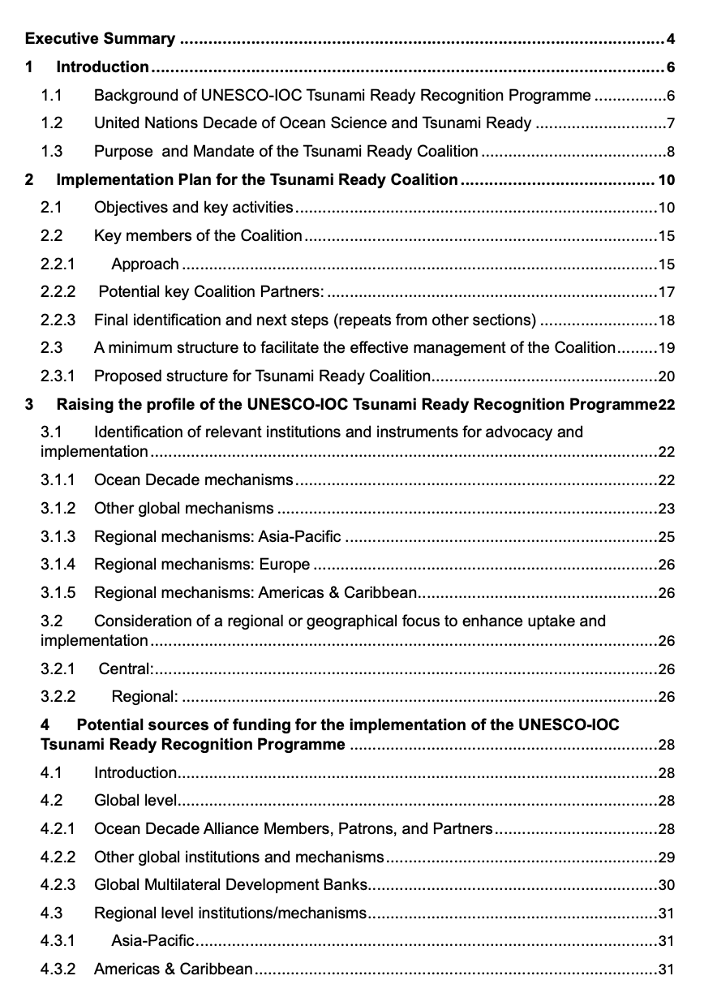
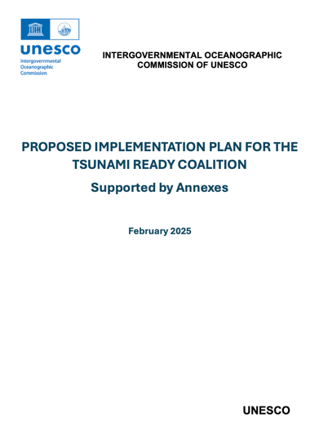
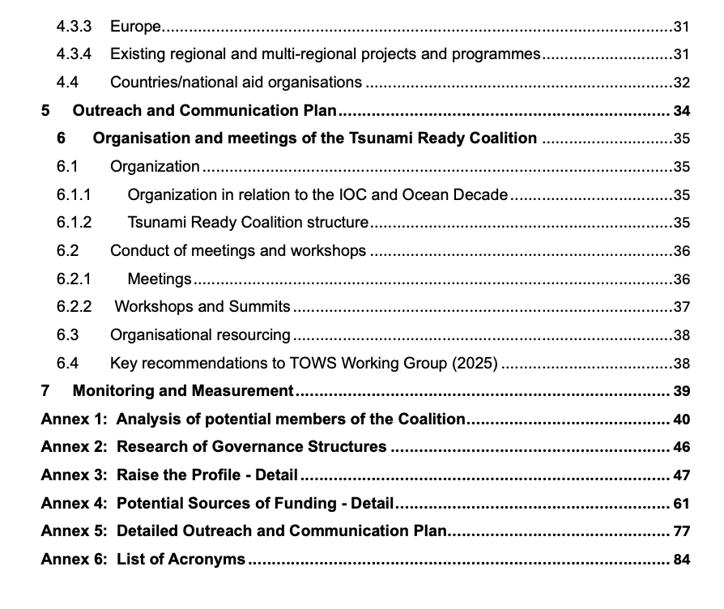
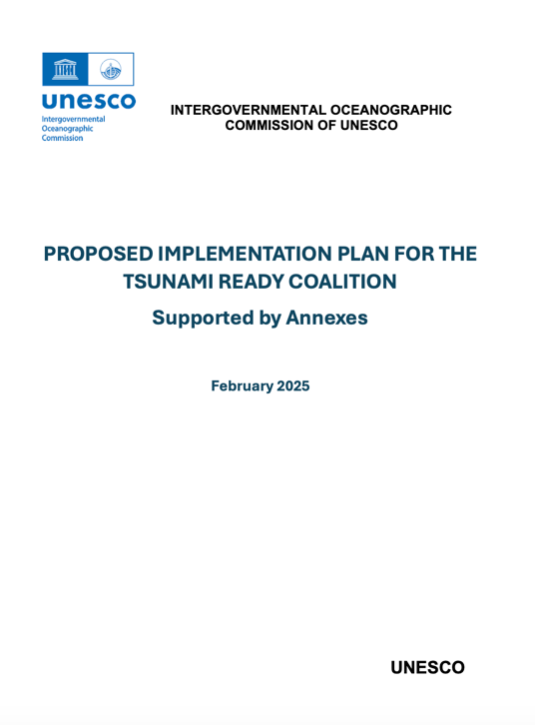
To meet TRC Goals, Implementation Plan created (2024)
ODTP Scientific Committee & TOWS Task Teams provided input to improve Plan (Jan-Feb 2025)
TRC Chair seeks approval of Plan by TOWS WG, including the
Coalition Mandate and Terms of Reference
Coalition governance structure
Key Coalition Partners

Slide 6
High-level ToR, Purpose and Mandate p. 5-6
1.3.1 Further clarification for high-level ToR (interpreted to include the following):
Considering progress, providing strategic advice on the implementation and sustainability of the TRRP (“how to”)
Creating opportunities for the global promotion of the TRRP.
Identifying, mobilizing, and coordinating ideas, solutions, initiatives, and resources in all its manifestations to support the implementation of, and the sustainability of the TRRP (“people, $$”)
Strengthening existing or creating new partnerships between organisations and across nations to advance the TRRP
1.3.2 Purpose and benefit:
The Coalition, through its Steering Group of Partners and Ambassadors (or similar namesake), is intended to serve as the catalyst and leadership for the TRRP towards achieving the 100% goal of at-risk communities around the world tsunami resilient.
1.3.3 Mandate (IOC Decision A-31/3.4.1), TOWS WG XV, OCTP Implementation Plan (IOC TS 18) - proposed
The Tsunami Ready Coalition is a collaboration between global, regional, and national stakeholders to advance and sustain the UNESCO-IOC Tsunami Ready Recognition Programme (TRRP), with a specific view on the UN Ocean Decade Tsunami Programme aim of 100% of communities at risk of tsunami are prepared for and resilient to tsunamis by 2030. The Coalition will establish a network of critical stakeholders that will advocate for and facilitate support towards the implementationa nd sustaining of Tsunami Ready through targeted promotion, resource mobilization, networking, influence, and advice. Reporting to the TOWS-WG, the Coalition will have a diverse, yet relatively small, membership by invitation of the UNESCO-IOC. Membership is primarily at the institutional level.

Slide 7
Implementation Plan - Objectives
Objective 1: Raise profile of TRRP in collaboration with critical stakeholders
Focus: Short-term (2 years) – 1st priority objective
As goal “100% of communities at risk of tsunami prepared for and resilient to tsunamis by 2030 through implementation of the UNESCO-IOC TRRP and other initiatives. Prominent profile needed to support participation and funding.
Objective 2: Increase funding resources for implementation of TRRP
Focus: Medium-term (5 years); On-going
Given TRRP will be on-going beyond 2030, and UNESCO-IOC recognition renewed every 4 years, sustainable funding will be required on an on-going basis. Ideally, funding arrangements should therefore allow for at least one re-validation.
Objective 3: Advocate for the conduct Tsunami Ready Indicator Workshops in the Regions
Focus: Medium-term (5 years); On-going
Via regional workshops, focus on targeted Indicators/topics in accordance with needs, sharing of practical experience and best practice from within the regions, and mayavoid language barriers. ICGs, and specifically TICs, to play key role
Objective 4: Organize an effective Tsunami Ready Coalition.
Focus: On-going. Endorsed Coalition Implementation Plan, appointment of co-Chair. Advising TOWS-WG on implementation of TR including (among others): TRRP progress, resources, and opportunities, unique regional and/or local circumstances.

Slide 8
Objectives and Activities p. 11-13
Objective 1: Raise profile of TRRP in collaboration with critical stakeholders
Focus: Short-term (2 years)
# | Raising the Profile: Sub-Objectives
1.1 | Advocate for TRRP in the UN system
1.2 | Advocate for TRRP in regional organisations
1.3 | Advocate for TRRP among other stakeholders (i.e. NGOs, Industry)
1.4 | Advocate for TRRP in countries (i.e. mainstream, Aid Organisations)
1.5 | Advocate for TRRP equivalency approaches
1.6 | Raise the Public profile
1.7 | Support countries with the TRRP process

Slide 9
Objective 1 - Activities p. 12-13
Activity # | Sub-Obj # | Activity | Who | When / by when
1 | 1.1 - 1.4 | Utilise 2nd UNESCO-IOC Global Tsu Symposium Nov 2024 (Banda Aceh) to promote TRRP | Coalition Chair | Nov 2024
2 | 1.1 - 1.4 | Finalise the list of targeted stakeholders to compose the Coalition from: - The list of potential stakeholders identified by the TOWS TTDMP in 2021, - The stakeholder analysis in this Draft Implementation Plan, and - Expressions of Interest received | TOWS TTDMP | Feb 2025
3 | 1.1 - 1.3 | Endorse list of targeted stakeholders and request letters of invitation from IOC Executive Secretary. Letter to include Coalition mandate & ToR | TOWS-WG | April 2025
4 | 1.4 | Request letter from IOC Executive Secretary to IOC Member States to promote the TRRP and invite participation/implementation | TOWS-WG (Drafting- TTDMP) | April 2025
5 | 1.2; 1.4 | Invite respective ICGs to support promotion of TRRP among their member states | TOWS-WG | April 2025
6 | 1.5 | Letter to UNDRR under Activity # 3 above, to also request inclusion of a TRRP focus in World Tsunami Awareness Day in 2025, and every subsequent year up to 2030 | TOWS-WG (Drafting- TTDMP) | April 2025
7 | 1.1 - 1.4 | Confirm make-up of Coalition via letter from IOC Executive Secretary. Information posted TRRP website. Decade Coordination Unit (IOC) advised | TRS | May 2025
8 | 1.1 - 1.6 | Identify key international and regional meetings & conferences to target | TTDMP, Coalition SG | 2025-2028
9 | 1.1 - 1.6 | ‘Lobby’ for inclusion in targeted meeting & conference agendas of non-Coalition members | TTDMP; Coalition SG | 2025-2028
10 | 1.7 | Hold regional Tsunami Ready Workshops to promote TTRP and determine needs (see Objective 3 below). | TICs | 2025
11 | 1.5 | Monitor and review progress on, and advise in establishing TRRP equivalencies | TTDMP; Coalition SG | 2025

Slide 10
Obj 1. Raise the profile of TRRP – Relevant Institutions for Advocacy and Implementation - p. 22-27
Mechanisms | Activity {Engagement Point}
Ocean Decade | Barcelona Statement {Decade Coordination Unit, DCU} Ocean Decade Coordination Unit (DCU); Decade Collaborative Centres (DCCs); Decade Coordination Offices (DCOs) {DCU} Ocean Decade Projects and Programmes: CoastWAVE 2.0 Project {NEAMTWS} CoastPredict Programme {CoastPredict Secretariat} Integrated Multiple Coastal Hazard Early Warning System and Services for the Tropical Americas and Caribbean (iCHEWS TAC) {IOCARIBE}
Other Global | Early Warnings for All {IFRC, UNDRR, WMO} International Federation of Red Cross and Red Crescent Societies (IFRC) {Programme and Operations Division} International Union of Geodesy and Geophysics (IUGG) {IUGG Joint Tsunami Commission}, The Ocean & Climate Village {UNESCO-IOC} UN Office for Disaster Risk Reduction (UNDRR) {Intergovernmental Processes, Inter-agency Cooperation and Partnerships Branch; UNDRR Stakeholder Engagement Mechanism (UNDRR-SEM). (The latter may advise more than one engagement point)}. World Bank Group {See Chapter 3 World Bank’s International Development Association (IDA)}. World Meteorological Organization (WMO) {Services Department}
Meetings 2025 | First Ocean Decade International Coastal Cities Conference, 26-27 February 2025 in Qingdao, China: {Decade Coordination Centre, China} 8th Session of the Global Platform for Disaster Risk Reduction (GP2025), 2-6 June 2025 in Geneva, Switzerland {UNDRR} UN Ocean Conference, 9-13 June 2025 in Nice, France {UN Department of Economic and Social Affairs} 3rd UN Ocean Decade Conference, 2027 {Decade Coordination Unit}
Regional – Asia-Pacific | ASEAN {ASEAN Committee on Disaster Management (ACDM)} APEC {Asia-Pacific Economic Cooperation, Emergency Preparedness Working Group} ESCAP {Chapter 3 (Potential Sources of Funding) for detail for ESCAP Trust Fund for Tsunami, Disaster, and Climate Preparedness}, Pacific Community (SPC) {Partnerships, Integration, and Resource Mobilisation Division; Geoscience, Energy and Maritime (GEM) Division}, UNDP {See Ch 3 (Potential Sources of Funding) for detail in UNDP Strategic Plan 2022-2025, as well as Tsunami Project}
Regional – Europe | European Union {ECHO (for DIPECHO)}
Regional – Americas, Caribbean | Coordination Centre for the Prevention of Natural Disasters in Central America and the Dominican Republic (CEPREDENAC) {Executive Secretary}, Caribbean Disaster Emergency Management Agency (CDEMA) {CDEMA Coordinating Unit}

Slide 11
Objective 2 - Activities p. 13-14
Objective 2: Increase funding resources for implementation of TRRP
Focus: Medium-term (5 years), On-going
# | Increasing Funding Resources: Sub-Objectives
2.1 | Determine targeted funding sources
2.2 | Approach/encourage targeted funding sources
Activity # (cont) | Sub-Obj # | Activity | Who | When / by when
12 | 2.1 | Test the desktop research output and approaches in the Draft TRRP Implementation Plan through expert consultation | TTDMP; TOWS-WG; Coalition SG | 2025
13 | 2.1; 2.2 | Identify and catalyse existing projects and programmes for engagement and inclusion of TR elements. | TICs | 2025
14 | 2.1; 2.2 | Identify and catalyse new funding sources and in-kind support mechanisms | Coalition SG | 2025, On-going
15 | 2.2 | Implement/action other identified approaches (from Activity # 12) | Tbd | 2025
16 | 2.2 | Invite potential funding institutions to regional Tsunami Ready Workshops (see Objective 3) | TICs | 2025

Slide 12
Objective 3 - Activities p. 14
Objective 3: Advocate for the conduct Tsunami Ready Workshops in Regions
Focus: Medium-term (5 years), On-going
# | Regional Tsunami Ready Indicators Workshops
3.1 | Support the implementation of TRRP in the regions through targeted workshops
Activity # (cont) | Sub-Obj # | Activity | Who | When / by when
17 | 3.1 | Determine the geographic target areas or sub-regions for regional workshops | ICGs | 2025
18 | 3.1 | Establish resources to conduct regional workshops | ICGs | 2025
19 | 3.1 | Coordinate regional workshops | TICs | On-going

Slide 13
Objective 4 - Activities p. 15
Objective 4: Organize an effective Tsunami Ready Coalition
Focus: On-going
# | Effective Organization: Sub-Objectives
4.1 | Endorsement of the Coalition Implementation Plan by the TOWS-WG
4.2 | Appointment of Co-chair
4.3 | Opportunities for fruitful participation are created
4.4 | Reports to TOWS-WG result in outcomes
Activity # (cont) | Sub-Obj # | Activity | Who | When / by when
20 | 4.1 | Present the Plan to SC-ODTP for comment, TTDMP for validation, & TOWS-WG for endorsement | Coalition Chair | Jan, Feb 2025
21 | 4.2 | Identify, recommend, and appoint a Coalition Co-chair | Coalition Chair; TOWS-WG; Executive Council | 2025
7 | 1.1 - 1.4 | Confirm the make-up of the Coalition via letter from IOC Executive Secretary. IOC approval of TRC Implementation Plan, Co-chairs, Steering Group (SG). Information posted to TRRP website. Decade Coordination Unit (IOC) advised. | Coalition Chair; TSR; IOC Assembly | On-going
22a | 4.3 | 1st meeting of Tsunami Ready Coalition Steering Group | Coalition SG | Qtr 3 2025
22 | 4.3 | Hold meetings, workshops/summits as covered in Objective 3 (above) and in Ch 5 | Coalition Chair, SG; TSR | On-going
23 | 4.4 | Reports to TOWS-WG include recommendations aimed at enhancing the Coalition and TRRP | Coalition Chair | Annually
24 | 4.4 | Reports to TOWS-WG include considerations w/regard to achieving the ODTP’s goal by 2030, incl alternative tsunami ready programmes, pathways, and metrics | Coalition Chair | Annually

Slide 14
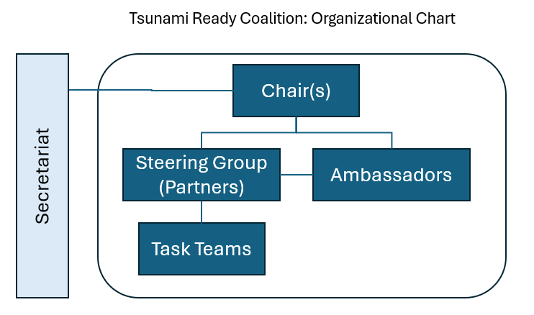
Effective TRC – Governance, Organization
p. 35-39
Chair and Co-chair
Steering Group (SG)
Partners – members of Steering Group
Steering Group - meets 2X year (at least 1 in-person, schedule alongside TOWS-WG and/or coincide with global conferences)
Meeting Agenda (notional)
TRRP implementation status (per region)
Countries requiring support
Common implementation barriers (discussion with view on solutions)
Promotion opportunities
Future meetings and workshops (how can Partners assist)
Reporting to TOWS-WG
Ambassadors (primarily implementational focus, participation in Steering Group meetings by invitation in advisory or observer role)
Task Teams (as required)
Secretariat (TSR)

Slide 15
Chairs, Steering Group p. 20
Considered IODE Ocean Best Practices, GOOS, CoastPredict Programme
Basic, relatively small structure to facilitate its management and coordination
1. Co-chairs: 1 appointed (Dr Laura Kong, ITIC). Propose 2nd appointed from Partners
2. Steering Group: Comprised of Key Partners
Up to 15 stakeholders + 4 TICs as ex-Officio
 | Steering Group Terms of Reference
1 | Steer the TRRP to achieve the aim of making 100% of communities at risk of tsunami prepared for and resilient to tsunamis by 2030.
2 | Keep an overall view on the implementation of the TTRP
3 | Identify and channel synergies and opportunities among Steering Group Partners to advance TRRP objectives.
4 | Negotiate the mobilizing of resources to advance the TRRP objectives.
5 | Invite and draw on other relevant stakeholders, such as the Decade Coordination Unit (DCU), Decade Collaborative Centres (DCCs), Decade Coordination Offices (DCOs) to support relevant discussions.
6 | Create enduring partnerships to support sustaining Tsunami Ready globally
7 | Develop strategic advice and reporting to the TOWS-WG.

Slide 16
3. Partners p. 16-20
Steering Group composed of “Partners”
To be efficient, target institutions with best ability or potential to support implementation:
For broad and diverse representation, recruit Strategic / Operational Partners (institutions)
Level | Implementation Role
Global | for mobilizing international support though promotion / funding, over next 5 yrs
Regional | for strengthening regional coordination and collaboration around TRRP.
National | for building bilateral and national momentum for implementation of TRRP.
Focus | Implementation Role
Strategic | aims at reinforcing existing or establishing new partnerships from an influence and decisions perspective
Regional | aims at exploring creative ways of leveraging on global and regional programmes, projects, and events.

Slide 17
Ambassadors, Task Teams, Secretariat p. 21
“Ambassadors” (or similar name) complement Coalition
May not have policy mandate or capacity to offer substantive support but keen to collaborate through sharing of experience and serving as examples of implementing best practices
 | Ambassadors Terms of Reference
1 | Act as TRRP representatives in their organizations or countries
2 | Raise awareness through advocating for TRRP in their areas of influence.
3 | Share expertise with aspiring countries/communities.
4 | Share TRRP best practice among Ambassadors.
5 | Advise the Coalition Steering Group about TRRP implementation.
6 | Participate in special task teams identified by the Steering Group as required.
5. Task Teams
Task Teams, reporting to Steering Group may be established to support Work Plan
6. Secretariat
Secretarial and logistical support by UNESCO-IOC Tsunami Resilience Section (TSR)

Slide 18
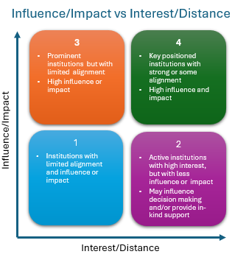
Analysis of Potential Partners, Ambassadors
Implementation Plan, Annex 1 p. 40-45
Annex 2 (original) identified 8+ intl, 12+ regional, 139+ natl candidates for TRC membership.
Important not to leave any relevant stakeholder behind, but the more participants involved, the more complex its coordination and management. Thus, Annex 2 list may be too broad – listed institutions had not been analysed for potential.
Partners reviewed for potential funding & promotional support, and to assure TRRP & relevant TR Indicators recognised in their Programmes
Global: multilateral development aid organisations and programmes.
Regional: regional development/aid organisations and programmes
National: AID agencies and/or NDMO from each region, specifically with view on bilateral and national support.

Slide 19
Governance: Partners, Ambassadors – potential p. 17-18
Type
Global Partners | IFRC, Islamic Development Bank, UNDRR (WTAD; EW4All), UNDP (Tsunami Project), WMO (Weather Ready; EW4All), World Bank Group (IDA; GFDRR)
Regional Partners | High value regional institutions that are also involved in sub-regional programmes Asian Development Bank (Pacific Disaster Resilience Programme; Strengthening Cooperation on Disaster Risk Management within the Association of Southeast Asian Nations), Caribbean Development Bank, CEPREDENAC, ESCAP (Trust Fund for Tsunami, Disaster and Climate Preparedness), APEC (Asia-Pacific Economic Cooperation, Emergency Preparedness Working Group). EU Civil Protection and Humanitarian Aid Operations department – DG-ECHO (DIPECHO Programme; CoastWAVE), 4 x ICG-TICs (as key regional TRRP coordinators and representing the 4 ICGs), SPC (DCRP)
National Partners | High value national institutions that also support programmes on bilateral/international level Germany (GIZ – funded EWS in Indonesia; climate change initiatives in Pacific Island countries) Norway (Norad – strong engagement with the Decade), Japan (JICA; MEXT - funding UNDP Tsunami Project; CATAC), Switzerland (Agency for Development and Cooperation - funded Tsunami Capacity Assessment Validation Workshop for Indian and Pacific Oceans), USA (funded TRRP in Pacific Island countries)
Ambassadors | Government institutions that are implementing TRRP; best practice exemplars; may support via regional advice Note: For some countries, regional/provincial government institutions active in Tsunami Ready space may also serve as Ambassadors with endorsement of relevant national institution. For instance, the Odisha State Disaster Management Authority (OSDMA) in India Barbados , Costa Rica, Fiji, India, Indonesia

Slide 20
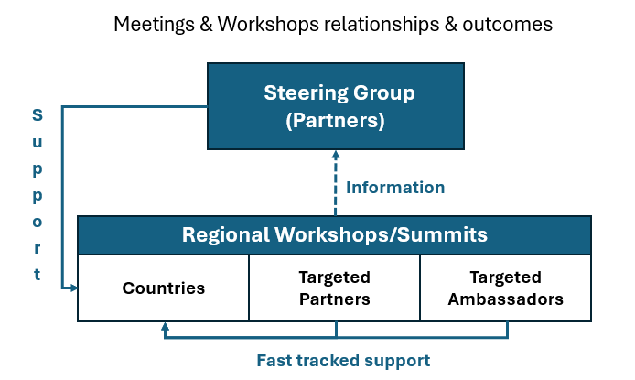
Objective 3: Advocate for the conduct Tsunami Ready Workshops TRC Regional, Sub-regional Workshops
p. 37
Workshop/summit feedback/comments feed back to Steering Group
After 2025 workshops, at least one summit to should be organized to follow up before 2030.
TICs expected to play lead role in coordinating
Regional / sub-regional workshops/summits should
Encourage countries in regions to adopt or extend TRRP implementation
Identify barriers and solutions to TRRP implementation
Solicit resources to support country TRRP implementation
Share experience regarding TRRP implementation
Discuss equivalency pathways to achieving Tsunami Ready communities where appropriate.

Slide 21
5. Communication and Outreach – Annex 5 p. 77-84
To maintain engagement of Tsunami Ready Coalition Partners and Ambassadors.
Document approach for connecting with other important stakeholders and audiences in international fora to register and to sustain prominence of Tsunami Ready, and the aim of 100% communities at risk are prepared and resilient to tsunamis by 2030.
Format consistent with communications practice
Covers:
Background and environmental factors,
An analysis of stakeholders and audiences,
An outreach and communication approach,
Consistent messages,
An Outreach and Communication Action Plan, and
Monitoring/measurement.

Slide 22
7. Monitoring and Measurement p. 39
Monitor implementation progress, and measure effectiveness of TRC through Performance Indicators (established by TRC SG, TTDMP).
Positive Progress and effectiveness indicated by increases each year
Report annually to TOWS WG – TRRP actions/outcomes compiled by TRC and TTDMP, supported by ICGs and TSR
TR Performance Indicators may include :
# countries implementing Tsunami Ready every year.
# communities implementing Tsunami Ready every year.
% of each country that is Tsunami Ready
# countries with TRRP Programmes
# countries that have allocated funds for TRRP
# countries in which the TRRP is embedded in policies and structures (e.g., TRRP included in national DRR strategy documents, example is Costa Rica (CNE) and Colombia (SECDRR))
TR Coalition indicators may include:
# and status of institutions participating in the Coalition
# and outcomes of Coalition engagements
# and amount of resources available from diverse sources for implementing the TRRP

Slide 23
TOWS WG Recommendation (2025)
Notes that TOWS-WG-XVI (2023) requested the Tsunami Ready Coalition Chair to propose a governing structure for the Tsunami Ready Coalition and that TOWS WG approval is essential for advancing the work of the Tsunami Ready Coalition
Also notes that the Tsunami Ready Coalition Implementation Plan was reviewed by the Ocean Decade Scientific Committee (16-17 January 2025), by the TOWS-WG Joint Task Teams on TWO and DMO (20-22 February 2025), and is included as part of the Coalition Chair’s report to TOWS-WG-XVIII)
Having considered the Tsunami Ready Coalition Implementation Plan,
Approves the Implementation Plan, including:
The Coalition mandate and terms of reference,
The Coalition structure, and
The identified key Coalition Partners.
Notes that the Plan will remain a dynamic document to allow for updates to the Plan, with updates reflected in the Coalition’s annual reports to the TOWS-WG
Requests the Secretariat to finalize in consultation with the Tsunami Ready Coalition Chair the Coalition Partners, 'Ambassadors' or similar namesake, and Coalition Co-Chair.
Recommends the IOC Executive Secretary to extend invitations to the proposed Coalition Partners and Ambassadors or similar namesake, and a Coalition Co-chair.
Requests ICGs to prioritize regional Tsunami Ready workshops or summits in 2025 and conduct further workshops or summits before 2030.
Notes resource and capacity constraints that will stymie progress of the TRC Coalition Implementation Plan, requests the IOC Executive Secretary to urgently address.

Slide 24
Tsunami Ready Coalition
Draft Implementation Plan
Dr. Laura Kong, TRC Chair
Director, ITIC
David Coetzee, UNOD TP SC
IOC Tsunami Resilience Section
TOWS WG, 24-25 February 2025
Paris, France

