Slide 1

REPORT OF THE 2ND IOC UNESCO SCIENCE SYMPOSIUM ON ADVANCES IN TSUNAMI WARNING TO ENHANCE COMMUNITY RESPONSES
11-14 November 2024, Banda Aceh - Indonesia
Chair :
Dr. Harkunti Pertiwi Rahayu (UNESCO IOC-TOWS WG-TTDMP / Chair WG1 IOTWMS )
Vice Chair :
Yuji Nishimae (UNESCO IOC-TOWS WG-TTTWO / Chair of ICG PTWS)
Ms. Suci Dewi Anugrah (BMKG /Chair WG3 IOTWMS)
IOC of UNESCO Eighteenth Meeting of the Working Group on Tsunamis and Other Hazards related to Sea Level Warning and Mitigation Systems (TOWS-WG-XVIII), Paris 23-24 February 2025

Slide 2
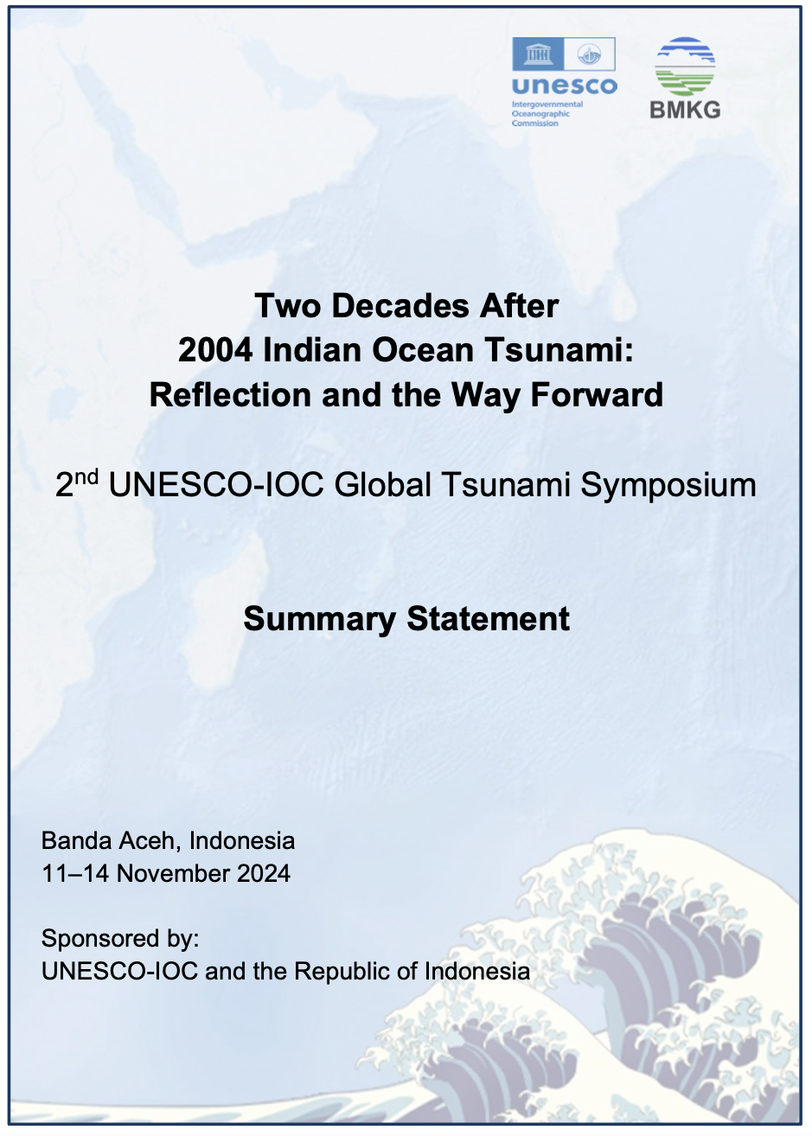
Two Decades After 2004 Indian Ocean Tsunami: Reflection and the Way Forward

Slide 3
Banda Aceh Statements:
Global Tsunami Warning and Mitigation: Building Sustainability for the Next Decade through Transformation and Innovation.
UNESCO and its Partners Call on States and Civil Society to Drastically Step Up their Investments and Efforts to Achieve 100% of Tsunami Ready Communities across the world by 2030

Slide 4
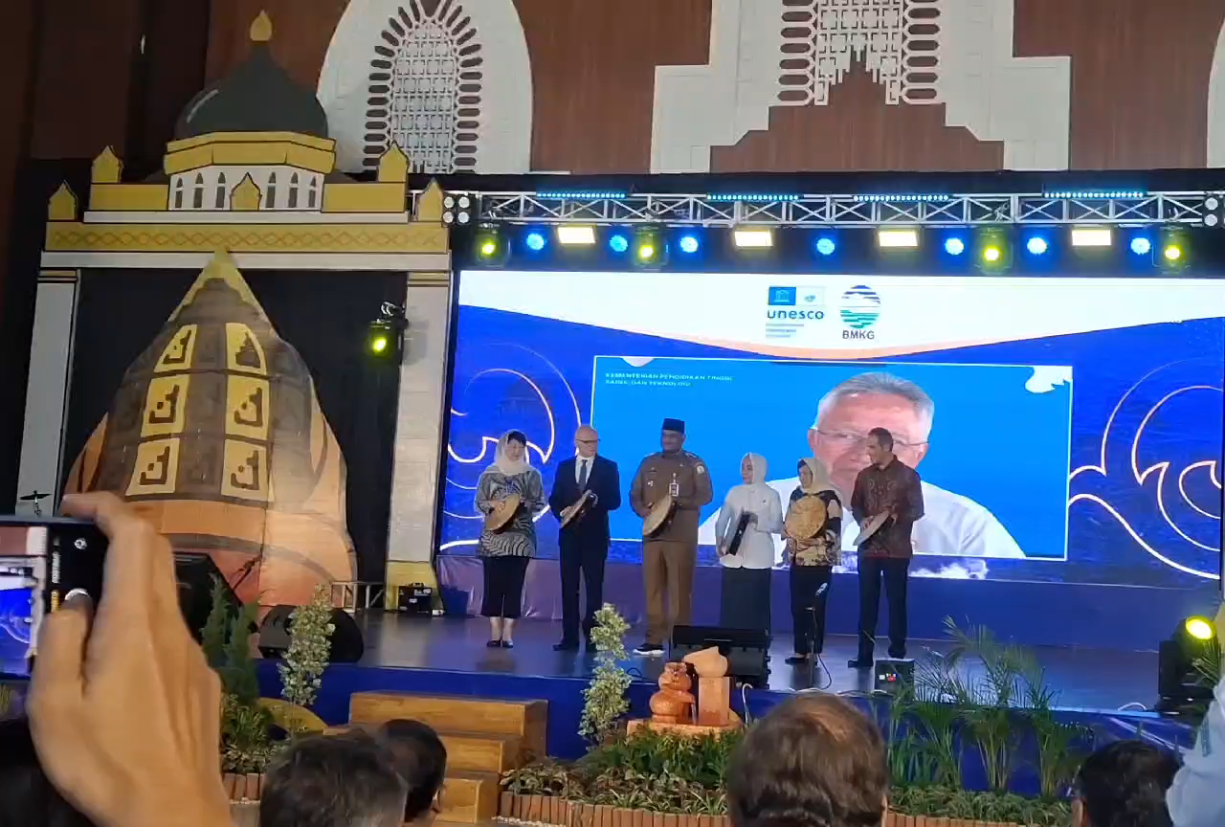
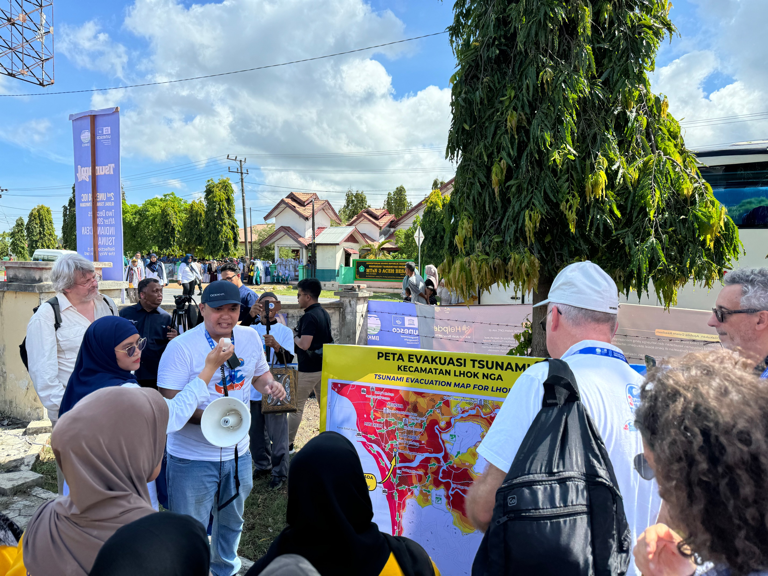

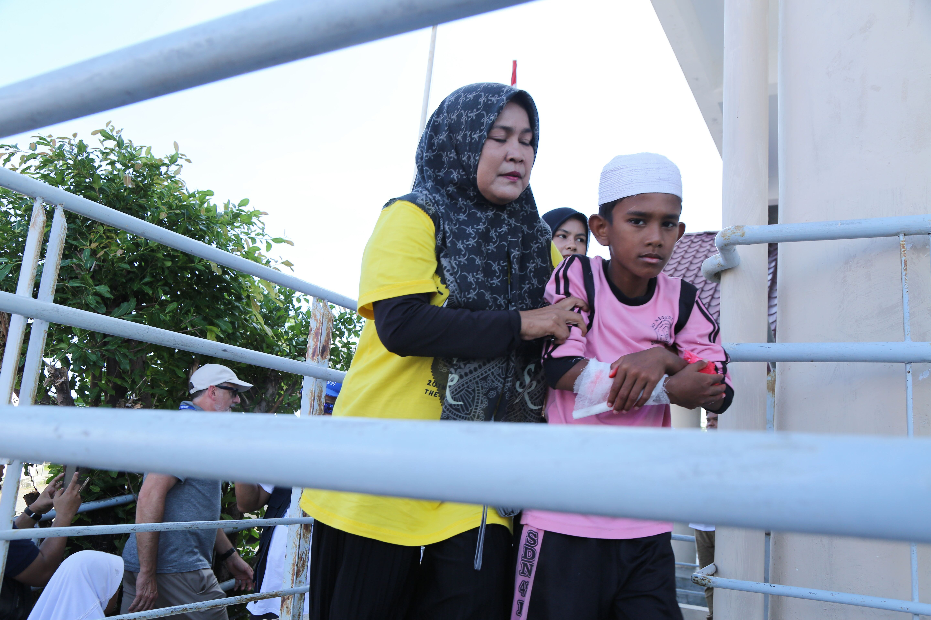
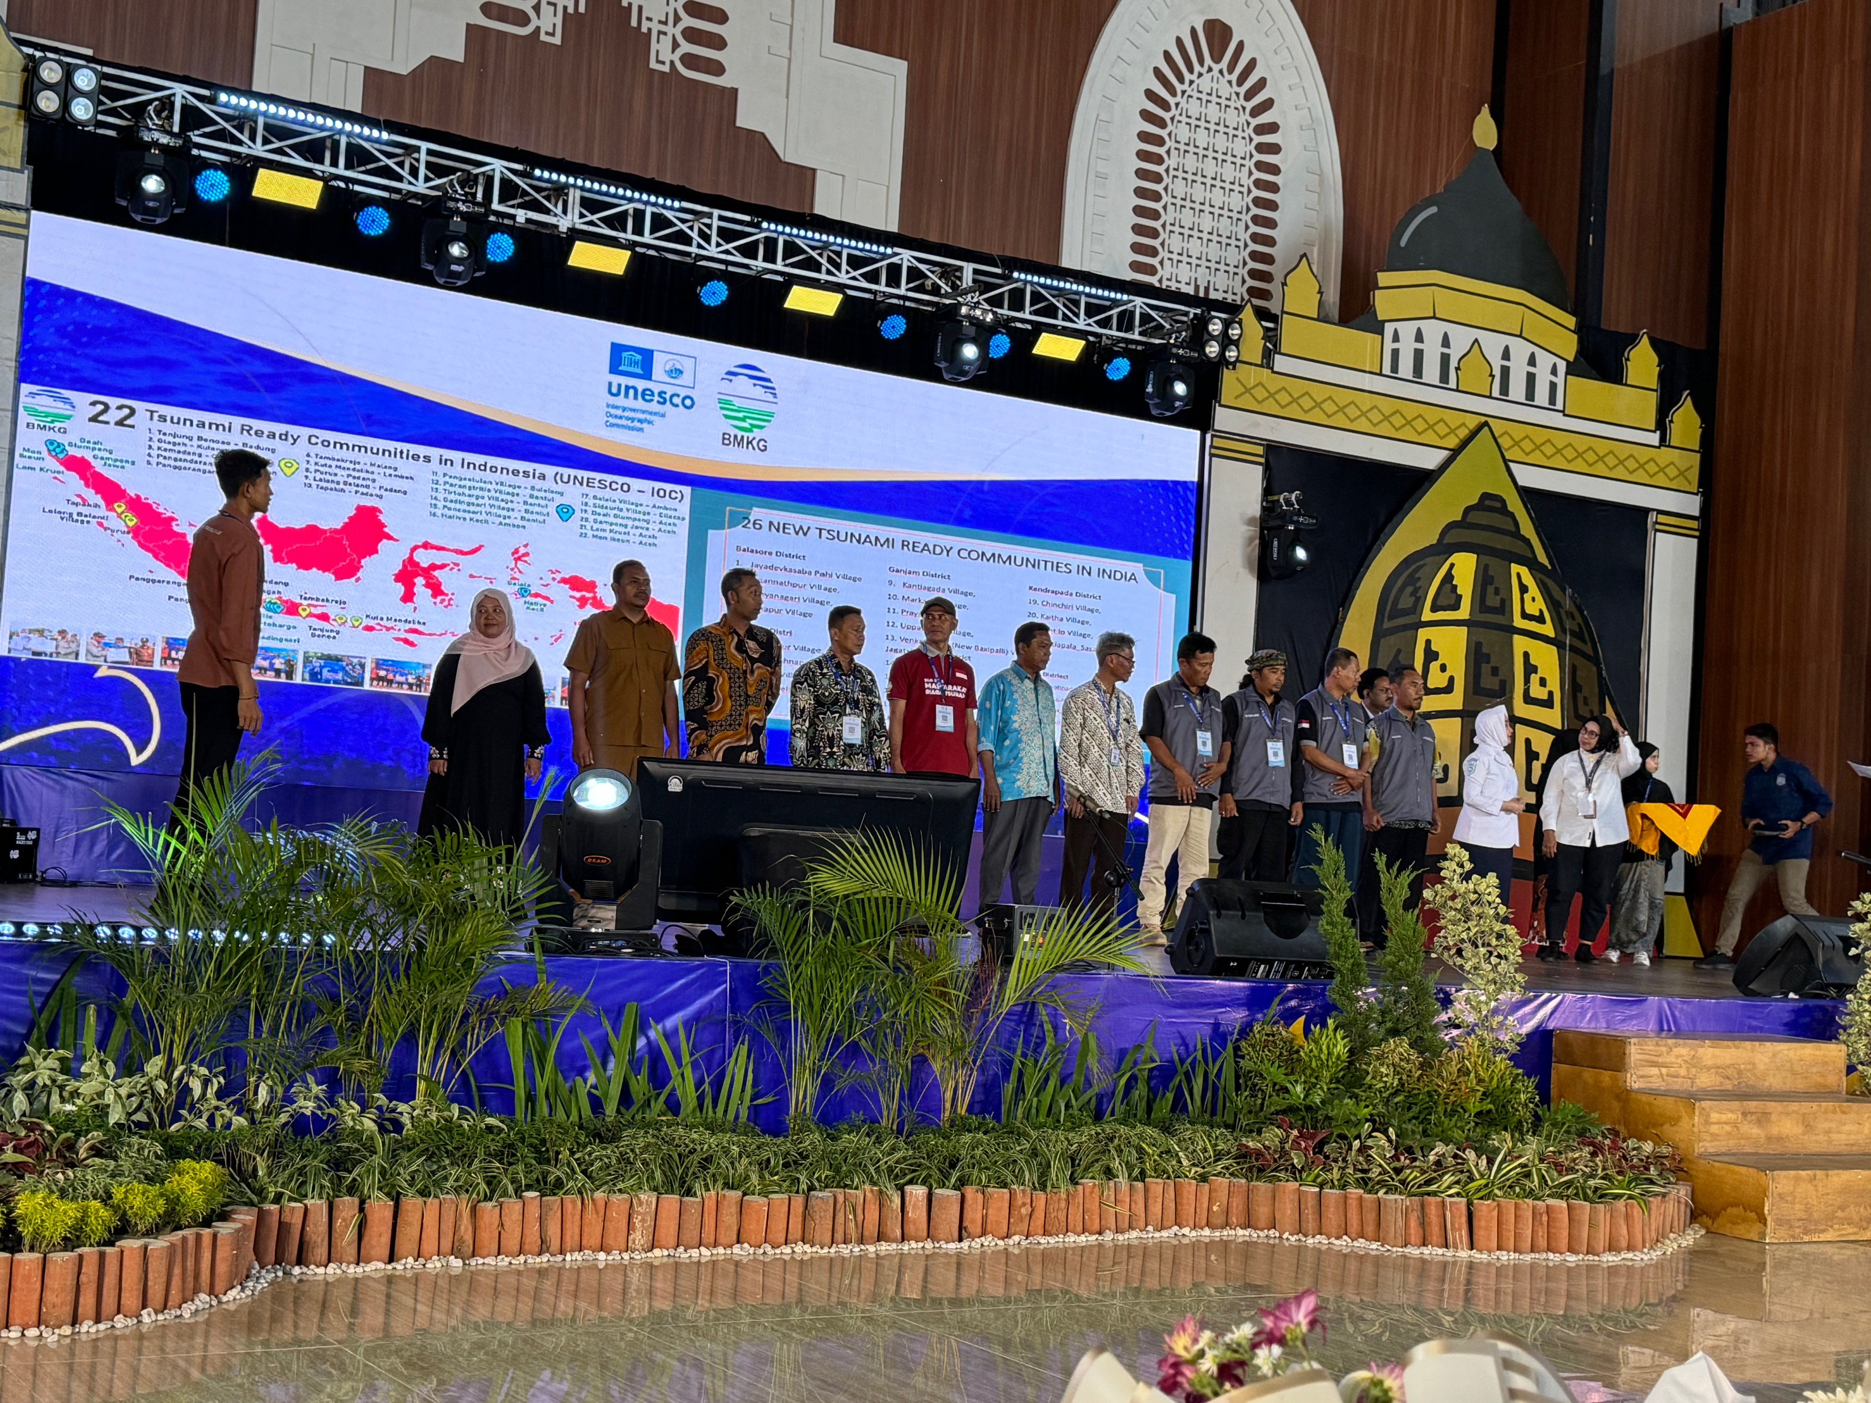
Four Days Symposium
8 Plenary Sessions
1 Day Field trip to the affected 2004 tsunami and TR Ready Locations
Attended by:
  702 participants (offline) from 37 countries
  170 participants (online)
  1,200 viewers of YouTube
Opening
TR Communities Simulation
New TR Communities Recognition

Slide 5
Objectives of Global Tsunami Symposium
To commemorate two decades after 2004 Indian Ocean Tsunami
To reflect what has been achieved in two decades
To identify gaps, challenges and priorities for tsunami early warning and mitigation
To identify synergy with global challenges and coherence with global commitments
To gather global tsunami community

Slide 6
Session 1
Review of the Tsunami Warning and Mitigation Systems over the past 2 decades
Chair: Dr. Idwan Suhardi & Dr. Jorn Lauterjung
Rapporteur: Ms. Nora Gale
10 Speakers : Prof Jan Sopaheluwakan, Prof. Shinishi Kuriyama, Mr Rick Bailey, Dr. Yuichi Ono, Dr. Chip McCreery, Dr. Pattabi (IOTWMS), Mr. Yuji Nishimae (PTWS), Dr. Gerard Metayer (CARIBE-EWS), Dr. Alessandro Amato (NEAMTWS),
Gaps (technological)
Lack of adequate sea level data for tsunami detection and also monitoring infrastructure for early warning of non-seismic tsunamis (i.e., volcano, landslide, meteo-tsunami).
Limited coverage in the availability of high- resolution shallow water bathymetry that is needed for more accurate tsunami forecasts, inundation modelling, and evacuation planning.
Constraints in the extensive real-time sharing of freely available tsunami detection and forecasting data in order to improve timeliness and accuracy of tsunami forecasts.
Current Status:
Regional Intergovernmental Coordination Groups are established in the Pacific Ocean (ICG/PTWS), Indian Ocean (ICG/IOTWMS), North-Eastern Atlantic, Mediterranean and connected seas (ICG/NEAMTWS), and Caribbean and adjacent regions (ICG/CARIBE-EWS).
Regional Tsunami Service Providers monitor round the clock and issue timely tsunami threat information and forecasts based on seismic and sea-level data, which is made available to National Tsunami Warning Centres.
Recognition of the equal importance of social and societal aspects, in addition to the technical-instrumental based tsunami forecast to achieve effective tsunami early warning.
Regular ocean-wide tsunami exercises are organised to test the functionality of the end-to- end warning systems.
The UNESCO-IOC Tsunami Ready Recognition Programme is being implemented.
Future Priorities
Monitoring and forecasting for non-seismic tsunamis. Integration of emerging technologies (i.e., GNSS, cable-based deep-ocean sensors, Deep Learning) into the existing monitoring systems.
Increased accuracy and shorter dissemination times for tsunami threat information.
Mainstreaming of the UNESCO-IOC Tsunami Ready Recognition Programme (or similar initiative) as a national priority and requirement implemented for all coastal communities at risk from tsunamis.

Slide 7
Session 2
Tsunami generated by non-seismic and complex sources
Chair: Mr. Bernardo Aliaga
Rapporteur: Srinivasa Kumar Tummala & Denis Chang Seng
5 Speakers : Francois Schindele and Dr. Raphael Paris, Dr Aditya R. Gusman and Prof. Yuichiro Tanioka, Dr. Laura Kong
Gaps (technological)
While several efforts are underway to develop warning protocols for tsunamis generated by non-seismic sources, such capabilities in the current regional tsunami warning systems are limited to a very few volcanoes.
Observing, modelling, evaluating and early warning for non-seismic tsunamis, which often arise from volcanic eruptions or landslides, require distinct approaches, emphasizing the complexity and challenges they present.
Volcanic- and landslide-induced tsunamis have diverse generation mechanisms, unlike seismic tsunamis, complicating prediction and requiring specialized and dense monitoring and modeling.
Forecasting?
Current Status:
The 2018 Anak Krakatau and 2022 Hunga Tonga (HTHH) volcanic eruptions exposed critical gaps in existing tsunami warning systems, which was primarily designed for seismic activity.
The ‘Monitoring and Warning for Tsunamis generated by Volcanoes’ UNESCO-IOC publication is a useful reference on tsunamigenic volcanoes that could trigger tsunamis, the numerical modeling of volcanic tsunamis, and the monitoring and warning, and preparedness for these events.
Recent developments in monitoring and warning for tsunamis generated by non-seismic and complex sources include the automatic sea level anomaly detection algorithm (Indonesia), Stromboli Volcanic Tsunami Warning System (Italy), and ocean-air coupling analysis to detect volcanic induced tsunamis (Japan, New Zealand).
Future Priorities
Integrated standard operating procedures for operational warning of tsunamis generated by non-seismic sources including linkages and coordination with both volcanic and tsunami monitoring agencies.
Development of optimal observing networks numerical modelling, and scenario databases of non-seismic tsunamis to aid in hazard assessment and early warning capabilities.
Strong international collaboration and global integration of multi-hazard warning systems is necessary for comprehensive tsunami risk management.

Slide 8
Session 3
Tsunami Hazard and Risk Assessment
Gaps (technological)
Multi-hazards, coastal vulnerability, and inclusion of tsunamis generated by non-seismic and complex sources are not included in the majority of tsunami risk and/or hazard assessments.
Local-level hazard and risk assessment and smaller impact scenarios (in addition to the largest impact scenarios) are needed to better inform communities.
Reaching every individual and sector with the appropriate, useful, and timely information will always be a challenge.
The catalogue of tsunami sources is limited and needs to extend further back in time, such as to the last Holocene period.
There are few guidelines for tsunami risk and hazard assessments available leading to uncertainty on best practices.
Chair: Dr. Srinivasa Kumar Tummala
Rapporteur: Mr. Rick Bailey
8 Speakers :
Current Status:
Considerable progress on evaluating seismic generated tsunami hazards has been made through initiatives such as the Global Tsunami Model, Impact-based Forecast Facility (e.g. TsunamiCast, real-time tsunami inundation forecasting and damage estimation), probabilistic tsunami forecasts and hazard assessments, and paleo-tsunami studies.
Community awareness of ocean basins tsunami hazards has increased since 2004 through tsunami hazard assessments with regional scale assessments identifying communities at-risk (e.g., North-West Indian Ocean and Caribbean).
Most casualties result from local or regional tsunamis, making awareness and community preparedness critical. Many examples exist and the best are people-centred, inclusive and customized to meet the needs of each audience. Instilling preparedness will have its greatest long-lasting impact through formal education with teachers teaching disaster preparedness from early grades.
Preliminary efforts in estimating the location and quantity of coastal communities that could be impacted by tsunamis has informed the UNESCO-IOC Tsunami Ready Recognition Programme and other similar initiatives
Future Priorities
Extension of hazard and risk assessment to include tsunamis generated by non-seismic and complex sources (e.g., volcanoes, landslides, meteotsunami, splay faulting, etc.) is needed to enhance tsunami generation models.
More high-resolution near-shore bathymetry and topography data should be acquired and made freely available for tsunami propagation and inundation models underpinning hazard and risk assessments.
Paleo-tsunami studies to better inform tsunami hazard assessments should be undertaken along at-risk coastlines with preserved sedimentary deposits (i.e., North-West Indian Ocean).
Preparedness needs to strive to address all individuals, the public and private sector, educational institutions, NGOs, and consider race and cultural, religious, and language diversity, and socioeconomic and demographic, geographical and migration status.
Continued emphasis on early education as a fundational priority to sustain awareness and preparedness over generations, especially as tsunamis are infrequent and no-notice events..

Slide 9
Session 4
Tsunami Detection, Warning, Dissemination, and Response (1)
Chair: Prof. Nanang Puspito and Dr. Charles McCreery
Rapporteur: Ms. Ocal Necmioglu
8 Speakers :
Gaps (technological)
Forecasting for tsunamis generated by non-seismic and near-source events remains a challenge.
Determining accurate earthquake magnitudes immediately after the event remains challenging with magnitude estimates for large events generally increasing over time and initial assessments an underestimate.
Ensuring tsunami warning and response is all inclusive is a necessary challenge to protect the lives of vulnerable communities.
Current Status:
Since 2004 substantial improvements have been made to detect and warn for tsunamis generated by earthquakes, which account for 70% of the global tsunamigenic events.
Enhancements in real-time seismic and sea-level monitoring networks, propagation models, and the provision of information through national tsunami warning chains have improved tsunami information to coastal communities.
Events such as the 2004 Indian Ocean tsunami, 2011 Tohoku tsunami, 2018 Palu tsunami, 2018 Anak Krakatau tsunami, 2020 Aegean Sea tsunami, and 2022 HTHH tsunami have provided insights and lessons learned thus enhancing future tsunami responses and best practices.
Establishment of National Tsunami Warning Centers and warning chains to reach communities at risk has dramatically increased since 2004.
Future Priorities
Develop tsunami warning systems capable of issuing actionable and timely warnings from all sources to 100% of coasts at risk.
Tsunami early warning systems should be people-centred and inclusive of all genders, children, elderly and people with disabilities.
Maximize and extend existing tsunami monitoring technologies and identify emerging technologies for tsunami propagation modelling and forecasting.
Design and install optimal global tsunami monitoring networks capable of identifying Detecting?

Slide 10
Session 5
“Achieving 100% Communities at Risk to be Prepared and Resilient to Tsunami by 2030”
Chair: Prof. Faisal Fathani and Mr. David Coetzee
Rapporteur: Ms. Nora Gale
10 Speakers :
Gaps (technological)
While there is progress in the implementation of the TRRP, the momentum is relatively slow and/or not equal across all regions and sub-regions. Capacity and funding gaps are particularly prevalent in SIDS.
A significantly greater global implementation rate is required to achieve the ODTP aim of 100% communities at risk are prepared and resilient to tsunamis by 2030.
To achieve the above aim, the collective support of the international community is required, including leveraging existing global and regional programmes and projects, and in successfully engaging new partners with resources.
The Tsunami Ready Coalition has not yet been formed.
Current States
The TRRP is now well established, and the number of recognised Tsunami Ready communities is growing. Implementation has reflected the countries’ desire to implement TRRP and their access to resources. There continue to be challenges in country capacities and funding resources.
Experience with regards to the implementation of TRRP is being gained within all the ocean basins
The Tsunami Ready Coalition has been mandated by the IOC and is anticipated to contribute significantly to the global effort by supporting promotion, resource mobilization, networking, influence, and providing advice
WTAD is well established, with the UNDRR extending its awareness initiatives in 2024/25 to commemorate the 2004 Indian Ocean Tsunami.
Future Priorities
Scale up the implementation of TRRP through establishment of a comprehensive TTRP implementation plan for each region, including identification of benefits, gaps and needs.
Promote TTRP through relevant international and regional events and conferences.
Identify funding for the TRRP in the regions, and/or opportunities for leveraging existing funding and programmes to advance Tsunami Ready.
Establish an effective Tsunami Ready Coalition with the inclusion of traditional and non-traditional global and regional institutions to facilitate critical strategic and operational partnerships.

Slide 11
Session 6
Other Critical issues for building community resilience
Gaps (technological)
Existing tsunami education and preparedness efforts are often episodic and lack a structured, sustainable framework, while the inclusion of vulnerable groups, particularly women, in decision-making processes remains insufficient.
There is a significant need for designing critical infrastructure facilities to cater to specific functions during tsunamis, as well as for improved collaboration between infrastructure management and communities for effective preparedness.
There is a lack of effective frameworks to address the non-linear nature of systemic risks, alongside inadequate integration of technology resilience in emergency management systems, which may compromise detection and warning efforts during simultaneous hazard events.
Chair: Mr. Ardito M. Kodijat and Dr. Ocal Necmioglu;
Rapporteur: Dr. Laura Kong
10 Speakers :
Current States
Tsunami science incorporates social and human perspectives to enhance understanding and governance of tsunami risks, yet there remains a need for holistic approaches that adequately address community preparedness and disaster risk reduction.
Critical infrastructure, including airports, ports and harbours, schools, hospitals and hotels currently lack adequate tsunami-resistant design, necessitating enhancements beyond existing building codes to ensure safety and swift recovery during disasters.
Recent cascading and compound hazards have exposed significant challenges in society's ability to mitigate and prepare for systemic risks, highlighting a complex and interconnected risk landscape that complicates emergency response efforts.
Future Priorities
There is a critical need to promote transdisciplinary collaboration in tsunami early warning systems to grasp the social complexities, empower women in disaster risk reduction efforts, and leverage higher education resources to build resilient communities through continuous awareness and preparedness initiatives.
The goal is to promote implementation of tailored tsunami mitigation strategies for critical infrastructure facilities including conducting effective emergency drills, and implementing the UNESCO-IOC Tsunami Ready Recognition Programme for critical infrastructure
To enhance preparedness and governance in this complex risk landscape, there is a need for probabilistic analyses, scenario-building techniques, and a community-level approach to resilience that focuses on capacity building and clarifies roles within a multi-agency governance structure.

Slide 12
Session 7
Critical Contributions of TEWS to global initiatives:
Chair: Mr. Tony Elliott and Dr. Andi Eka Sakya
Rapporteur: Prof. Richard Haigh
7 Speakers :
Keys Takeaways (2)
An EW4All key priority, applicable for tsunamis, for enhancing risk knowledge is to improve impact-based forecasting and transmission of actionable warning messages. Several talks in earlier sections shared tools for evolving warnings to better meet customer needs, and for providing tools and global or regional community facilities for disaster risk reduction to ensure no one is left behind.
Overall, partnership and coordination will be central to aligning tsunami with the global initiatives. However, further work is required to identify and / or establish the most suitable platforms to achieve this, especially at the sub-national level.
Keys Takeaways (1)
There already is alignment and coherence across many global initiatives at the framework level. For example, EW4ALL was launched at COP 27, builds upon and synergises with existing initiatives. The UNESCO-IOC TRRP indicators mirror the EW4ALL pillars for tsunami.
The global initiatives are not hazard-specific but are inclusive of tsunami. However, the Ocean Decade also provides an opportunity for dedicated actions that address specific challenges associated with tsunami.
Coordination and partnership are crucial to achieving alignment in practice. It is also evident that the organisations leading EW4ALL pillars have many linkages and networks to facilitate building these partnerships. However, the specific mechanisms for coordination are less clear. The national roadmaps in EW4ALL are a way of facilitating coordination at the national level.
A recurring theme of the session was about the global initiatives and Early Warning being meaningful at the community / local level, such as risk knowledge and early warning technology and messaging. Tsunami Ready and MCR2030 are vehicles for achieving this.

Slide 13
Pre-event
Special Session -Tsunami sciences after, the 2004 Sumatra earthquake
Chair: Prof. Yuichiro Tanioka and Dr Arko Nurlambang
Rapporteur: Robby
Speakers :
Keys Takeaways (2)
To enhance accuracies of tsunami warning, immediate priority should be accorded to increase observational data (e.g., SMART cables), data assimilation and machine learning, as well as systematic collection of historical tsunami records, including small tsunamis.
Background and Rationale
Two pre-events were organised before the conference centred around:
scientific advancements made since the 2004 Sumatra earthquake, with a focus on forecasting techniques, technological innovations, and understanding complex tsunami sources,
importance of building community preparedness and sustaining advancements in early warning systems and infrastructure. These discussions brought together leading experts and stakeholders to address challenges, explore innovations, and outline priorities for future work in tsunami science and risk management.
Keys Takeaways (1)
Advances in DART observations, modelling, source characterisation, high-performance computing and digital twin technologies have improved real-time impact tsunami forecasts not only from far-field earthquakes, but also from complex tectonic regions such as the Banda and Molucca seas.
Tools such as LIDAR systems, ship tracking, integration of sea-level and atmospheric pressure data and source modelling have demonstrated promising capabilities for the assessment and forecasting of tsunamis from volcanic sources such as the HTHH & Anak Krakatau.

Slide 14
Side-Events:
Ignite Stage, Booth and Poster Exhibition
Date: 11 – 14 November 2024
Venue: Banda Aceh Convention Hall

Slide 15

Thank you …

