Slide 1

International Union of Geodesy and Geophysics (IUGG)
2025 update
TOWS WG, Agenda 2.2, Non-UN Bodies, 24 February 2025
prepared by
Maria Ana Baptista (Vice-Chair), Yuichiro Tanioka (Chair), Laura Kong (ITIC)

Slide 2
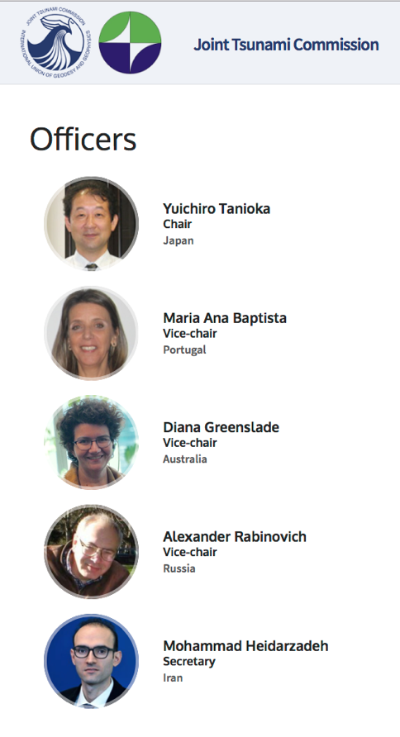
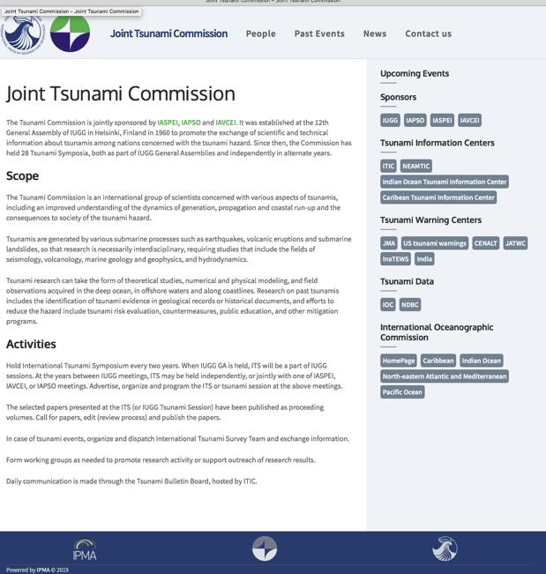
IUGG Joint Tsunami Commission
Associations: IAPSO (Oceans), IASPEI (Seismology), IAVCEI (Volcanology)
Est 12th General Assembly of IUGG, July 1960
Promote the exchange of scientific and technical information about tsunamis among nations concerned with the tsunami hazard
~70 members (Australia, Bulgaria, Canada, Chile, Costa Rica, Croatia, Estonia, France, Greece, India, Indonesia, Italy, Japan, NZ, Norway, Oman, Portugal, Turkiye, India, Russia, Singapore, UK, USA)
Business Meeting: 16 Jul 2023 Working Groups – enabled focused efforts
  Tsunami Terminology (review IOC TS 85, Tsunami Glossary) - Dr. William Power, NZ
  Science-based Tsunami Warning (TOWS Ad Hoc TT, TS 183 - TGV) - Dr. Laura Kong, USA
  Tsunami Magnitude – Dr. Vasily Titov, USA
  GNSS Data for Tsunami Warning - Dr. Tony Song, USA
  Meteotsunami (TOWS Ad Hoc TT) – Dr. Ivica Vilibić, Crotia
  Tsunami Data –Dr. Viacheslav ‘Slava’ Gusiakov, Russia
Elected 2019

Slide 3
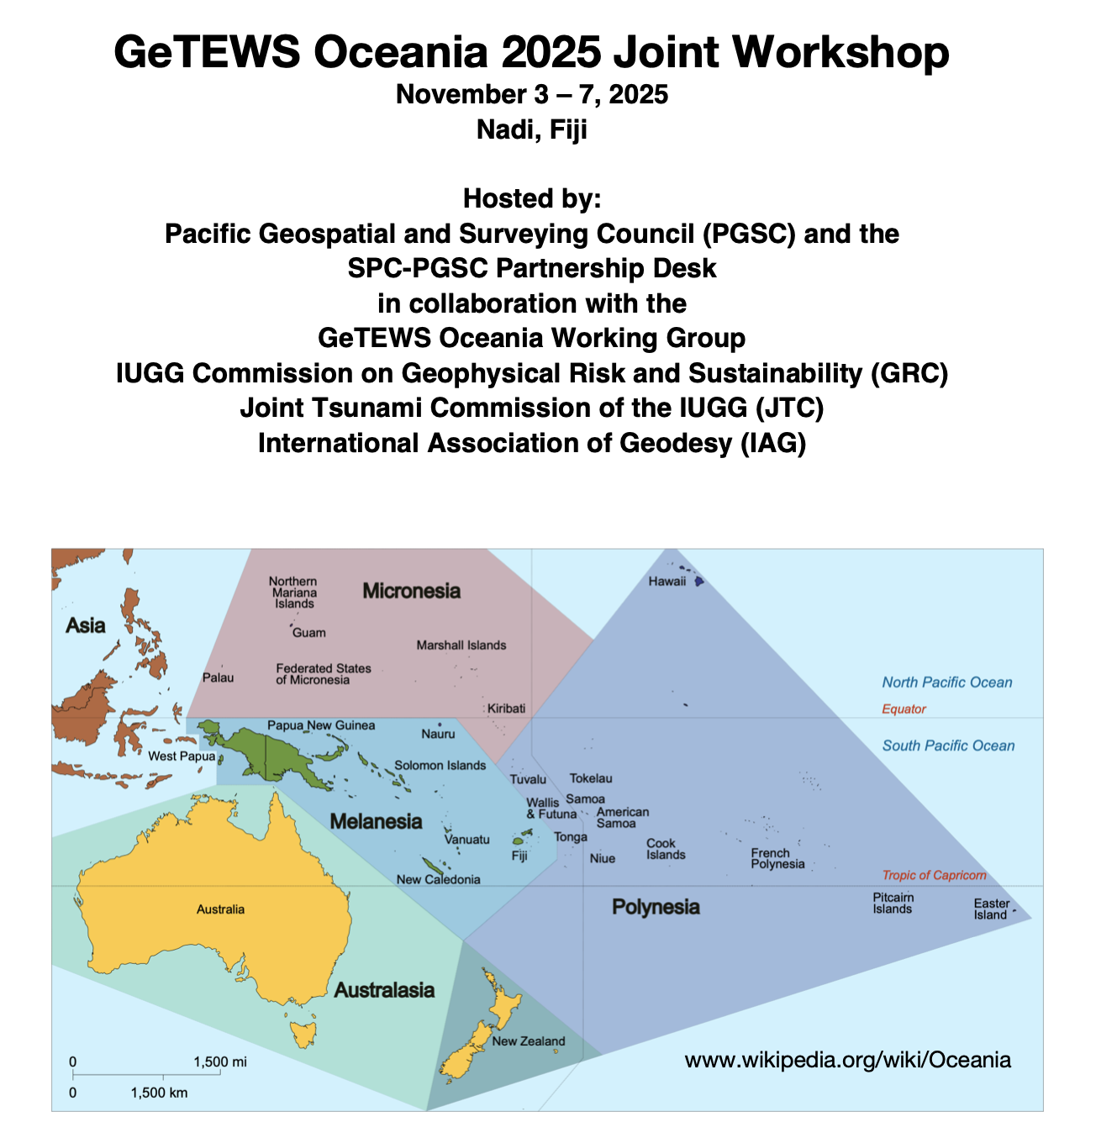
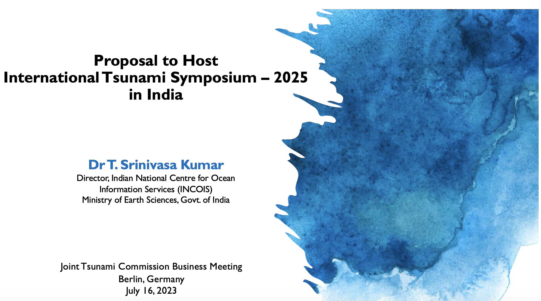
IUGG JTC – Meetings, Publication
JTC jointly organized meetings:
  The 2nd UNESCO-IOC Global Tsunami Symposium on “Two Decades After 2004 Indian Ocean Tsunami: Reflection and the Way Forward” held in Banda Aceh, Indonesia during 11-14 November 2024.
    The Special International Scientific Workshop on “Tsunami Sciences after the 2004 Sumatra Earthquake” as a pre-event of the UNESCO-IOC Symposium.
  Joint IOC JTC 60th Anniversary of the ICG/PTWS – Past and Future: Achievements and challenges, in China, April, 2025
  Joint GeTEWS Oceania 2025 Workshop in Fiji, in Nov. 2025
  2025 ITS meeting in Hyderabad, India in Nov. 2025.
JTC members actively participated in organization of numerous tsunami sessions in AGU, EGU, AOGS General Assemblies and other Intl conferences, such as The 3rd World Conference on Meteotsunamis (13-17 Oct 2025).
Special Volume: Tonga Volcanic Eruption 2022: Topical collection in Pure and Applied Geophysics (PAGEOPH), 5 out of 18 papers published online in 2024.

Slide 4
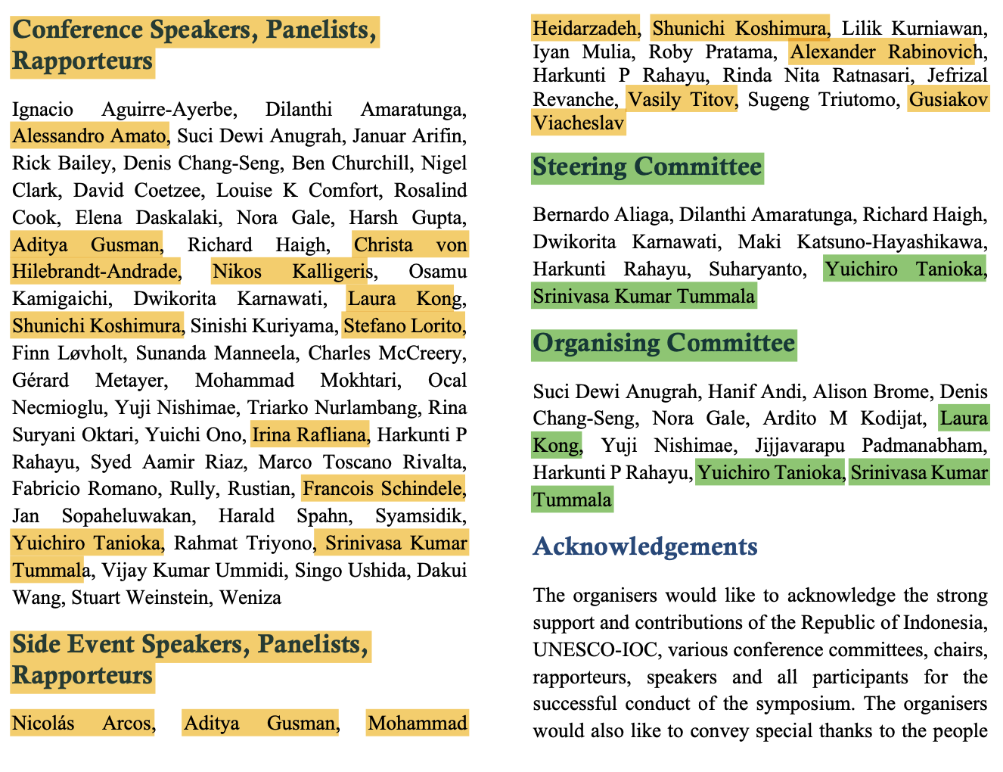
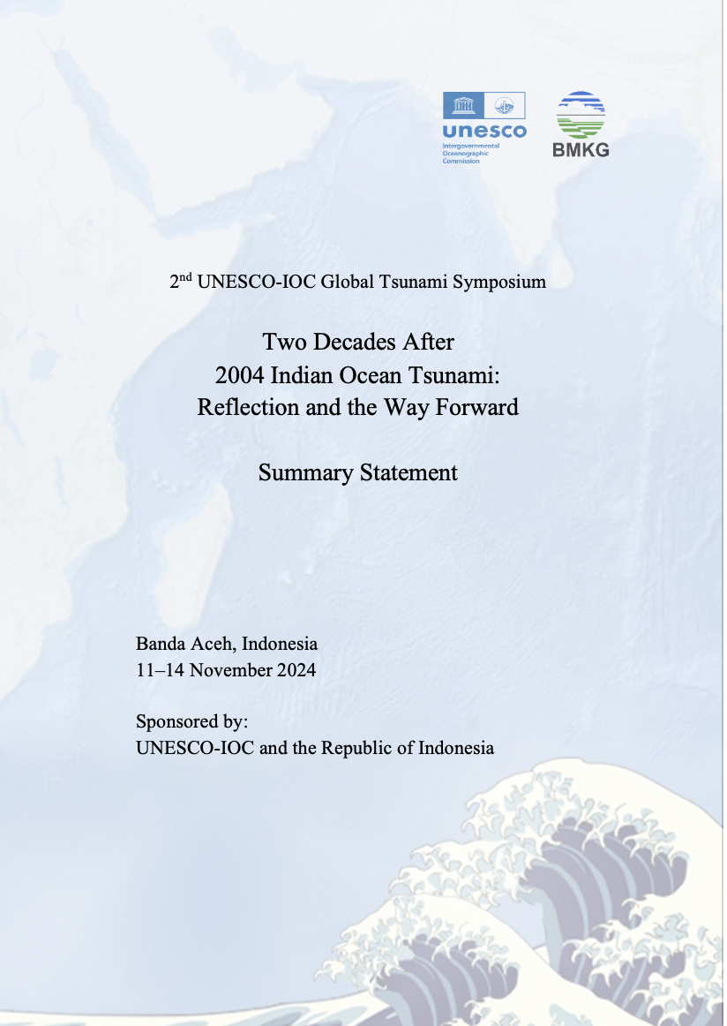
2nd Global Tsunami Symposium, Nov 2024
Steering Committee
Dr. Yuchiro Tanioka, IUGG-JTC Chair
Program Organizing Committee
Dr. Srinivasa Kumar Tummala (IOC)
Dr. Laura Kong (ITIC)
Posters
Maria Ana Baptista

Slide 5
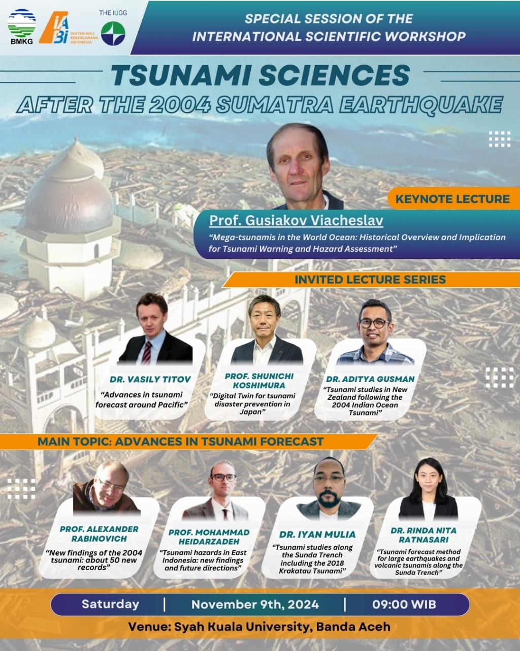
JTC IUGG Special Session - 9 Nov 2024, Banda Aceh
Tsunami Sciences after the 2004 Sumatra Earthquake
Speakers (remote *)
Dr. Yuchiro Tanioka
Dr. Mohammed Hierzdarzadeh *
Dr. Viacheslav ‘Slava’ Gusiakov
Dr. Aditya Guzman
Dr. Shunichi Koshimura
Dr. Alexander Rabinovich
Dr. Vasily Titov *

Slide 6
2025 International Tsunami Syposium (ITS)
ITS – every 2 years – tsunami research, incl on disaster prevention
ITS 2021 – Sendai, Japan
ITS 2023 – Bali, Indonesia
ITS 2025 will be in Hyderabad, India
At the JTC Business Meeting (July 2023), Dr Srinivasa Kumar Tummala (Director, Indian National Centre for Ocean Information Service, INCOIS), made a proposal to host ITS 2025 in Hyderabad, India. The JTC accepted India INCOIS’s proposal.
INCOIS provided update at 2025 ODTP-SC (Jan 2025)

Slide 7

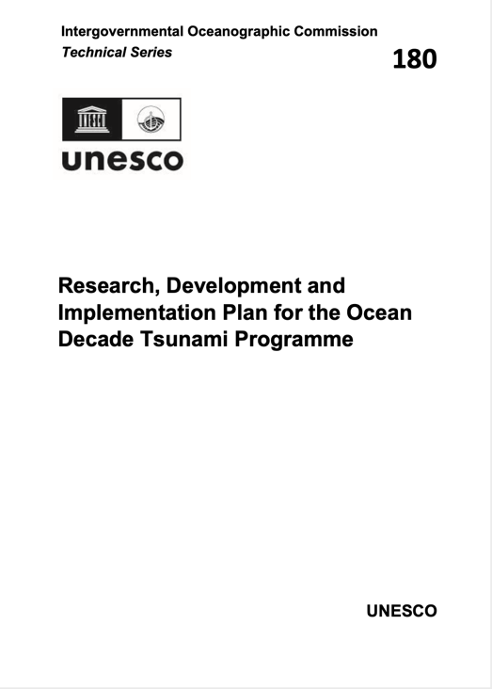
IOC support - Scientific Committee of ODTP
Meeting at UNESCO Headquarters in Paris. Altogether, 5 meetings. Last: 16-17 January 2025
IUGG JTC members part of UN Ocean Decade Tsunami Programme Scientific Committee (SC):
Dr. Alexander Rabinovich
Christa von Hillebrandt-Andrade
Dr. Helene Hebert
Dr. Maria Ana Baptista
Dr. Silvia Chacon (SC Chair a.i.)
Dr. Laura Kong (ad hoc as Tsunami Ready Coalition Chair)

Slide 8
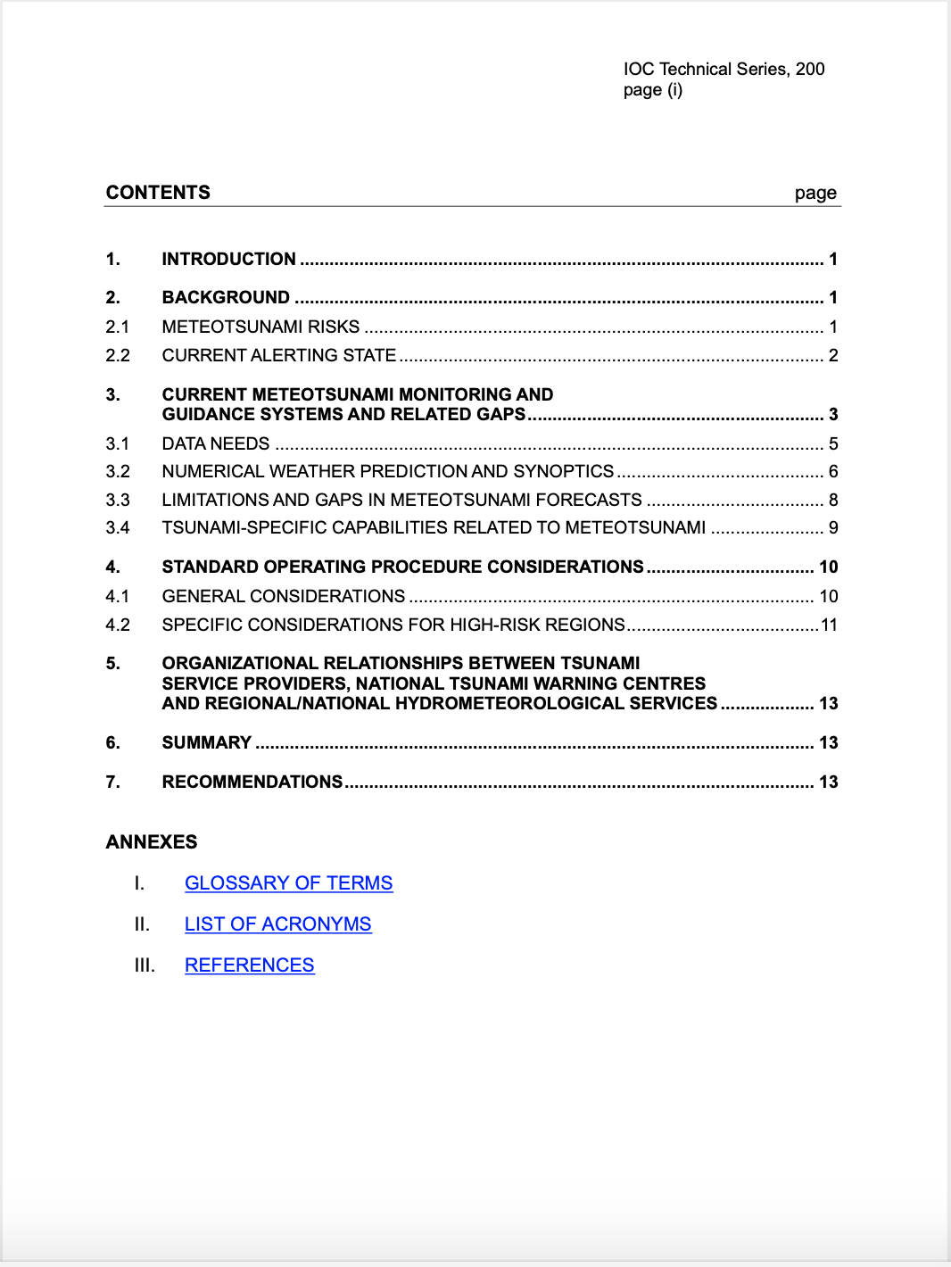
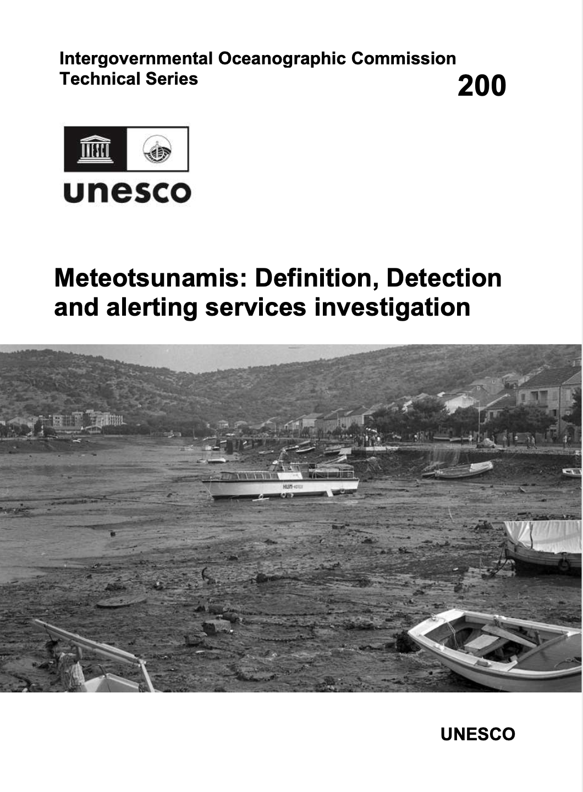
IOC support: Meteotsunamis
Participation in TOWS ad hoc TT : Ad hoc Team on Meteotsunamis: definition, detection and alerting services of the IOC of UNESCO (TS 200, 2025)
JTC members
Ivica Vilibić, JTC WG Chair for Meteotsunami
Mohammad Heidarzadeh
Emile Okal
Chari Pattiaratchi
Alexander Rabinovich
Jadranka Šepić
Vasily Titov

Slide 9

IOC support: Tsunami Glossary 2025
JTC Working Group on Terminology (member update next business meeting, 2025)
  William Power, Chair
  From 2021: Kelly Stroker, Alexander Rabinovich, Fumihiro Imamura, Lori Dengler, Diana Greenslade, Laura Kong
Beginning to review toward next update
2024 TOWS WG approved edits/updates (except for meteotsunami)
  Lamb waves, UNESCO/IOC Tsunami Ready Recognition Programme, Tsunamis generated by volcanoes.
2025 Tsunami Glossary currently being published (IOC TS 85, rev 2025) – English, French, Spanish, Arabic, Chinese
2025

Slide 10
IOC support - other activities
IOC Roger Revelle lecture, 2024 – Emile Okal
WMO Task Team on Long Waves under the Expert Team on Waves, Coastal Hazards, and Marine Emergency Response (ET-WCHMER) – Vasily Titov
WMO-IOC JCB – Srinivasa Kumar, co-chair 2023-24
UNESCO International Geoscience Programme (IGCP) Scientific Board (evaluate geohazards proposals) – Christa von Hillebrandt-Andrade
ITU-WMO-UNESCO IOC Joint Task Force for SMART Subsea cables – Science and Society co-chair – Laura Kong
Capacity Development
  IOC Group of Experts for Capacity Development – Laura Kong
    IOC OceanTeacher Global Academy (OTGA) Specialized Training Center for Tsunamis (TWC Min Competency course) - JTC WG on Science-based Tsunami Warning – ITIC and IOC TSR
      Ocean Decade Capacity Development Facility – Christa von Hillebarndt-Andrade, IOCARIBE rep
UN Ocean Decade committees, task force, WG – many involved

Slide 11
International Union of Geodesy and Geophysics (IUGG)
2025 update
TOWS Joint TT, Agenda 7, 20 February 2025
TOWS WG, Agenda 2.2, Non-UN Bodies, 24 February 2025
prepared by
Maria Ana Baptista (Vice-Chair), Yuichiro Tanioka (Chair), Laura Kong (ITIC)

